Slide 1
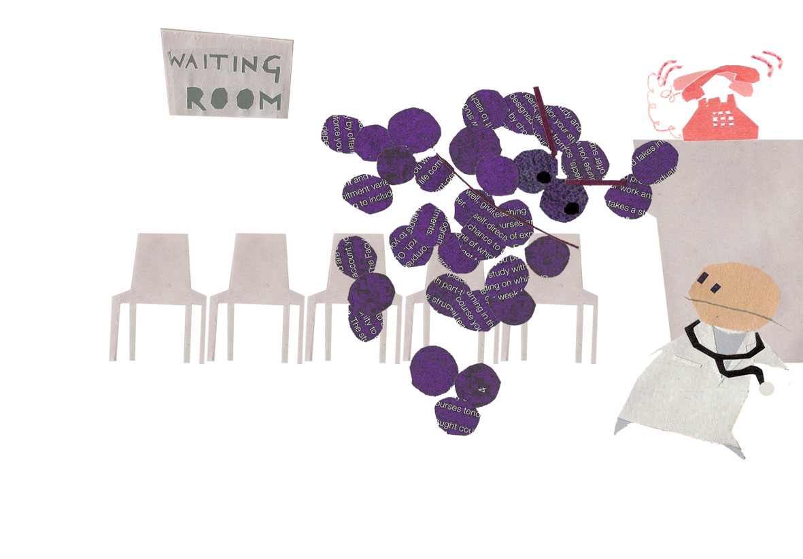
© Rachel Otter

Slide 2

ABC News. Jan 23, 2008.

Slide 3


CA-MRSA: here to stay
?
Jon Otter, PhD
King’s College London
Guy’s and St Thomas’ NHS Foundation Trust

Slide 4
Disclosures
I am employed part-time by Bioquell. I have received funding from the Royal Commission for the Exhibition of 1851, Pfizer and the Guy’s and St Thomas’ Charity.

Slide 5
Outline
The emergence of CA-MRSA
Definitions of CA-MRSA
Global molecular epidemiology
CA-MRSA in emergency medicine
CA-MRSA in the UK
What the future may hold

Slide 6
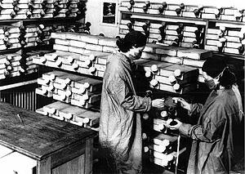
MRSA milestones
Penicillin introduced
(1941-2)
1940
1960
1970
1980
1990
2000

Slide 7
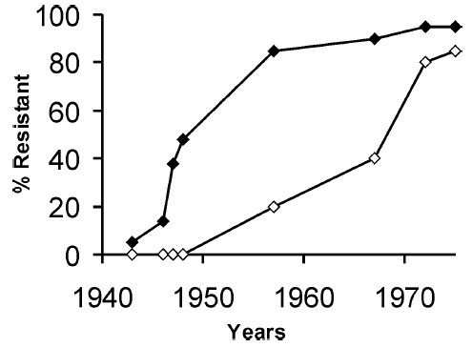
Penicillin-resistance in S. aureus
Hospital
Community
Adapted from Chambers HF. Emerg Infect Dis 2001;7:178-182.

Slide 8
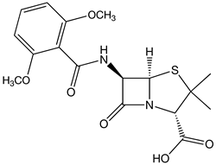
MRSA milestones
Penicillin introduced
(1941-2)
1940
1960
1970
1980
1990
2000
Methicillin introduced
(1960)
First MRSA isolate
(1961)

Slide 9
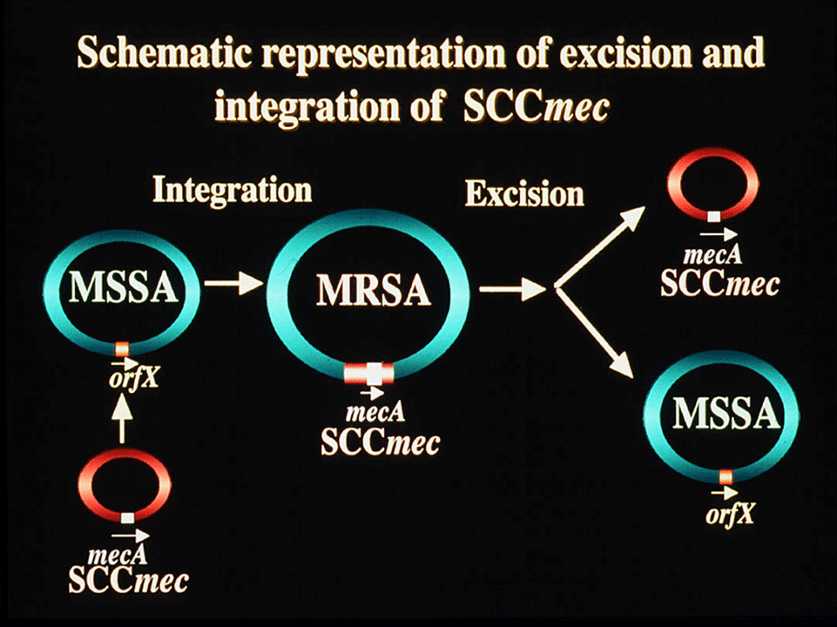
Methicillin-resistance in S. aureus
Source: www.staphylococcus.net

Slide 10
MRSA milestones
MRSA spreads globally
Penicillin introduced
(1941-2)
Outbreak in London
EMRSA-1
Outbreak in Denmark
1940
1960
1970
1980
1990
2000
Methicillin introduced
(1960)
First MRSA isolate
(1961)
First report of VRSA
(2002)

Slide 11
MRSA milestones
MRSA spreads globally
Penicillin introduced
(1941-2)
Outbreak in London
EMRSA-1
Outbreak in Denmark
Hospital
infections
1940
1960
1970
1980
1990
2000
Sports teams
MSMs
ERs
Prisons
Schools…
Methicillin introduced
(1960)
First MRSA isolate
(1961)
Drug users in Detroit
Aboriginal Australians
Children in the US

Slide 12

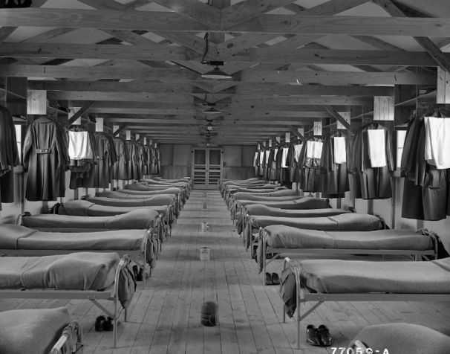
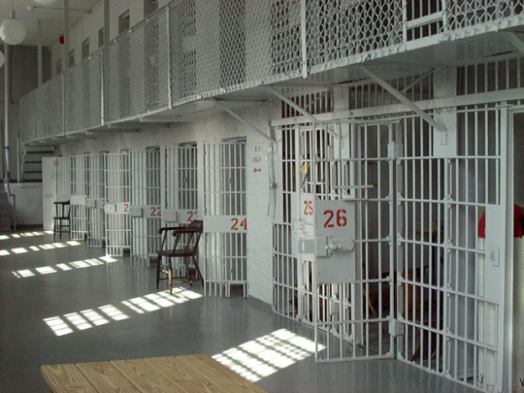

Community groups affected
CDC’s 5 Cs
Crowding
Contact
Compromised skin
Contaminated items and surfaces
Cleanliness
(Capsules)
Miller et al. Clin Infect Dis 2008;46:752-760.
Kazakova et al. New Engl J Med 2005;352:468-475.
Pan et al. Clin Infect Dis 2003;37:1384-1388.
Kallen et al. Infect Control Hosp Epidemiol 2000;21:223-226.

Slide 13
Déjà vu?
Hospital
Community
c. 20 yrs
Adapted from Chambers HF. Emerg Infect Dis 2001;7:178-182.

Slide 14
What is CA-MRSA?
CA-MRSA is...
an MRSA infection occurring in a community setting; or
an MRSA infection occurring in a person without previous hospital contact in a community setting; or
PVL-positive MRSA; or
genetically distinct from HA-MRSA and tends to affect people in community settings.

Slide 15
Classical features of CA-MRSA
Healthcare-associated MRSA (HA-MRSA)
Usually affect old, sick hospitalised patients
Typically multidrug-resistant
Almost never PVL-positive
A few successful strains dominate globally
Community-associated MRSA (CA-MRSA)
Tend to affect young, healthy patients in the community
Typically non-multi-resistant
Close association with PVL
Distinct and diverse genetic background vs. HA-MRSA

Slide 16
Emerging features of CA-MRSA
Clinical features
Can cause outbreaks and endemic infections in hospitals
MSSA disease spectrum in the community; MRSA disease spectrum in hospitals
Apparent association with non-nasal sites of colonisation
Microbiological features
Less frequent resistance to non-β-lactam antimicrobial classes, but resistance increasing
Genetic features
A few geographically distinct successful lineages becoming established

Slide 17

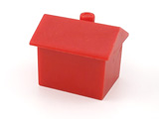
CA-MRSA as a cause of HCAI
There have always been a few “overflow” cases of MRSA causing infections and limited transmission in the community.
Rosenberg J. Lancet 1995;346:132-133.

Slide 18
CA-MRSA as a cause of HCAI
CA-MRSA began causing hospital outbreaks in the early 2000s, resulting in:
Infection in healthcare workers
A wider group of patients a risk (e.g. paediatrics)
Control challenges
Otter & French. Lancet Infect Dis 2006;6:753-755.
Otter & French. J Hosp Infect 2011 in press.
D’Agata et al. Clin Infect Dis 2009;48:274-284.
Niamh Whittome. Poster 68. IPS 2011.

Slide 19
CA-MRSA as a cause of HCAI
In some parts of the world, CA-MRSA strains have supplanted traditional HA-MRSA strains as the most common cause of HCAI
Popovich et al. Clin Infect Dis 2008;46:787-794.
Chini et al. Clin Microbiol Infect 2006;12:29-34.
Larsen et al. J Clin Microbiol 2009;47:73-78.
Benoit et al. Emerg Infect Dis 2008;14:1216-1223.

Slide 20
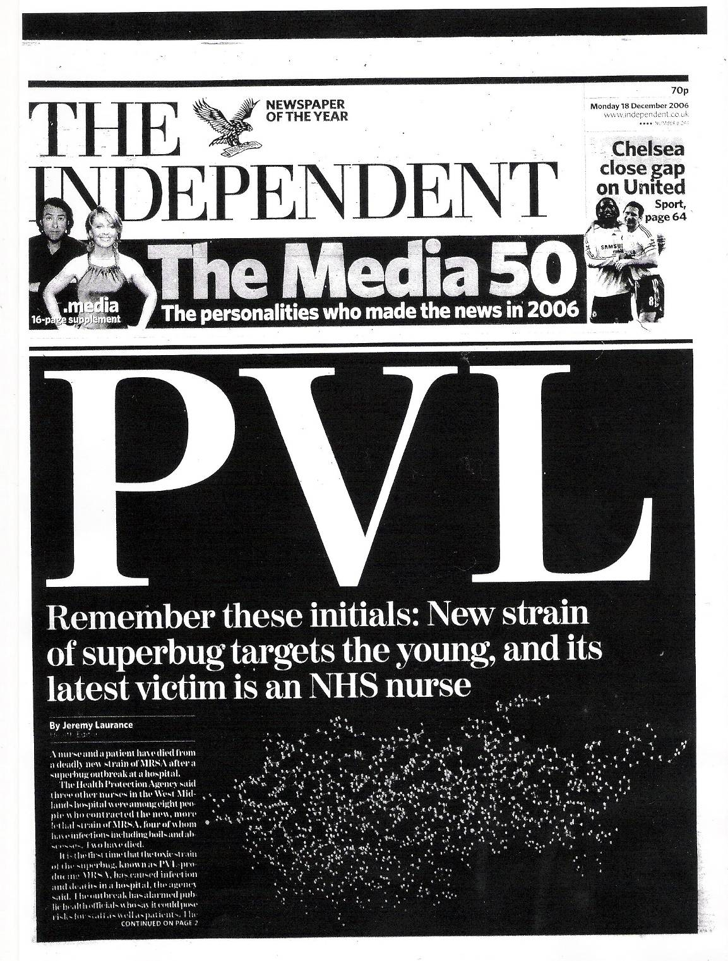
PVL has a strong epidemiological association with CA-MRSA
It is associated with increased virulence in animal models
However, not all successful CA-MRSA lineages are PVL+
Therefore, PVL is not the prime virulence factor
Independent Front Page, 18th December 2006, British Library Newspapers.

Slide 21
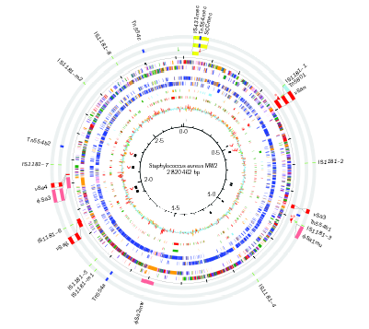
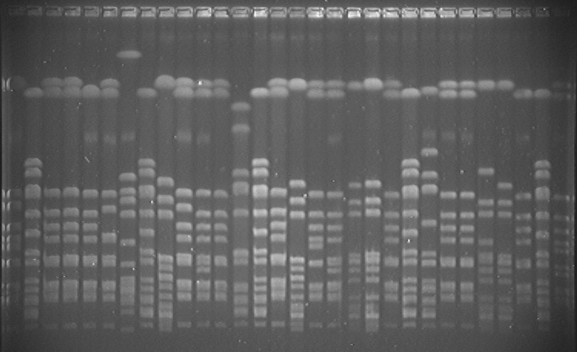
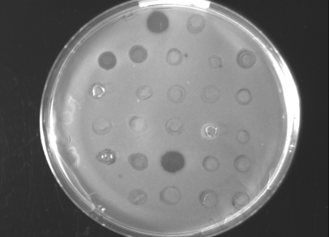
All MRSA is not equal!
Microarrays
PFGE
Antibiogram
REP-PCR
Typing methods
Phage typing
PCR-based
VNTR e.g. SIRU
Sequence-based
SCCmec
Whole genome
MLST
spa

Slide 22
The usual suspects
MLST CC | MLST-SCCmec | Name(s)
CC5 | ST5-II | New York/Japan USA100
 | ST5-I | EMRSA-3
 | ST5-IV | Paediatric USA800
CC8 | ST250-I | Archaic
 | ST8-IV | EMRSA-2 EMRSA-6 USA500
 | ST8-II | Irish-1
 | ST239-III | Brazilian/Portuguese EMRSA-1 AUS-2/3
 | ST247-I | Iberian
CC22 | ST22-IV | EMRSA-15
CC30 | ST36-II | EMRSA-16 USA200
CC45 | ST45-IV
 | ST45-II | USA600
Enright et al. Proc Natl Acad Sci USA 2002;99:7687-7692.

Slide 23

Global epidemiology of CA-MRSA
Canada
ST8-IV, PVL+ (USA 300)
ST1-IV, PVL+ (USA 400)
Europe
USA
ST80-IV, PVL+ (“European”)
ST398-V, PVL- (Pig-associated)
ST152-V, PVL+ (Balkan region)
Asia
ST8-IV, PVL+ (USA 300)
ST1-IV, PVL+ (USA 400)
ST59-VII, PVL+ (Taiwan)
ST30-IV, PVL+ (SWP)
ST72-IV, PVL- (Korea)
South America
Oceania
ST30-IV, PVL+ (SWP)
ST5-IV, PVL+ (Argentina)
ST1-IV, PVL- (WA-MRSA 1)
ST129-IV, PVL- (WA-MRSA 2)
ST93-IV, PVL+ (Queensland)
ST30-IV, PVL+ (SWP)
Otter & French. Lancet Infect Dis 2010;10:227-39.

Slide 24


vs.
Features of fluoroquinolone-susceptible MRSA in outpatients or identified during the first 72 hours of admission at hospitals in the UK and USA
 | USA | UK
Rate per 1000 patient days | 0.2 | 0.1
Specimen from ER / A&E | 51% | 27%
Abscess | 49% | 15%
PVL-positive | 95% | 32%
USA300 | 65% | 5%
ST1, PVL-negative | 0% | 38%
ST80, PVL-positive | 0% | 10%
Otter et al. Eur J Clin Microbiol Infect Dis 2009;28:835-839.

Slide 25


Slide 26
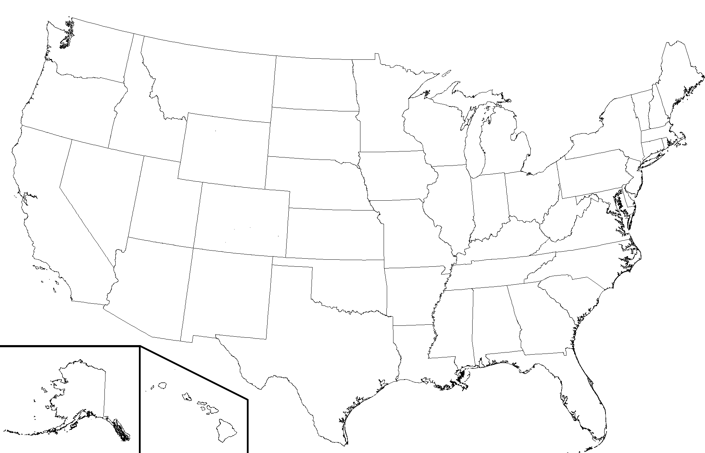
CA-MRSA in the USA
All SSTIs cultured for S. aureus in August ‘05
MRSA caused 59% of the SSTIs
  78% of the S. aureus were MRSA
97% of the MRSA was PVL-positive USA300
  74% were USA300-0114, a specific USA300 subtype
Moran et al. N Engl J Med 2006;355:666-674

Slide 27
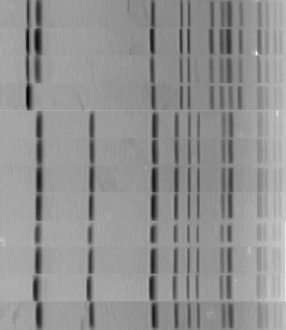
Typical PFGE gel
Non-outbreak MRSA
Outbreak MRSA
Otter et al. J Hosp Infect 2007;67:232-239.

Slide 28
CA-MRSA on the rise in the UK?
A PVL-negative ST1 clone has been known to be circulating among IDUs in the UK since 2003.^{1,2}
Several hospital outbreaks have been reported in the UK.^{3,4}
Studies indicate that the prevalence of CA-MRSA in the UK is increasing.^{5,6}
Kearns et al. J Infect 2004;49:49-50.
Cooke et al. Clin Microbiol Infect 2010;16:921-926.
David et al. J Hosp Infect 2006;64:244-250.
Orendi et al. J Hosp Infect 2010;75:258-264.
Otter & French. Clin Microbiol Infect 2008;14:670-676.
Schneider-Lindner et al. Emerg Infect Dis 2007;13:994-1000.

Slide 29
PVL producing S. aureus, 2005-2010
Number of PVL–SA isolates identified by the HPA's Staphylococcus Reference Unit
Health Protection Report. Volume 5, Number 7. 18 Feb 2011.

Slide 30
CA-MRSA at GSTT
Otter & French. Clin Microbiol Infect 2008;14:670-676.

Slide 31
CA-MRSA in A&E / GP isolates
Otter JA. Unpublished data.

Slide 32
CA-MRSA in A&E / GP isolates
Otter JA. Unpublished data.

Slide 33
CA-MRSA control challenges
Investigated all 55 cases of PVL-SA, Jul ‘08- Dec ‘10.
Visited the home of each patient.
Identified overseas travel as a risk factor.
Vanessa Morris. Poster 58. IPS 2011.
Notes:
Wider picture – hospitals, community and interface (hospital wards to hospital doors and beyond)
Different groups of patients
Virulence and pathogenicity
Transmission routes (animals, environmental reservoirs, non-nasal colonisation sites)
How will the ingress of CA-MRSA affect attempts to control HA-MRSA?
Prevalence in the UK; risk factors?

Slide 34
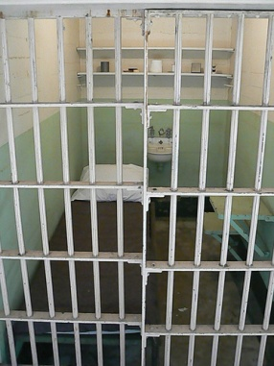
CA-MRSA control challenges
Pan et al. Clin Infect Dis 2003;37:1384-1388.
Notes:
Wider picture – hospitals, community and interface (hospital wards to hospital doors and beyond)
Different groups of patients
Virulence and pathogenicity
Transmission routes (animals, environmental reservoirs, non-nasal colonisation sites)
How will the ingress of CA-MRSA affect attempts to control HA-MRSA?
Prevalence in the UK; risk factors?

Slide 35
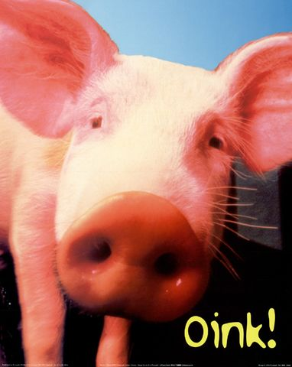

CA-MRSA control challenges
Wulf & Voss. Clin Microbiol Infect 2008;14:519-521.
Desai et al. Am J Infect Control 2011;39:219-225.

Slide 36
CA-MRSA control challenges
Bubeck et al. Nat Med 2007;13:1405-1406.

Slide 37
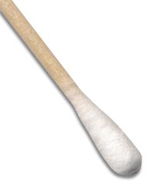
CA-MRSA control challenges
Miller & Diep. Clin Infect Dis 2008;46:752-760.

Slide 38

CA-MRSA control challenges

Slide 39
© Rachel Otter

Slide 40
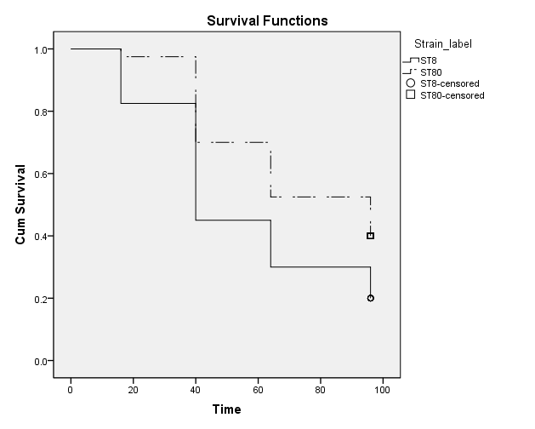
What gives CA-MRSA the edge?
Log rank test p=0.014

Slide 41
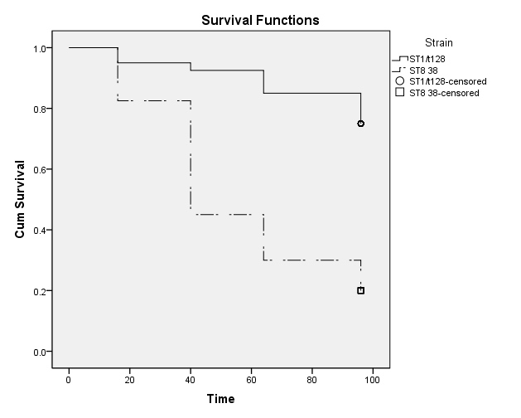
What gives CA-MRSA the edge?
Log rank test p<0.001

Slide 42
PSM production in CA-MRSA

Slide 43
Summary
CA-MRSA has reached epidemic proportions in the USA and in other parts of the world
HA-MRSA is declining but CA-MRSA is increasing in the UK
Further increases in CA-MRSA will challenge attempts to control HA-MRSA, and put a wider group of patients and staff at risk of MRSA infection

Slide 44
Acknowledgements
Professor Gary French (KCL / GSTT)
Dr Jonathan Edgeworth (KCL / GSTT)
Dahir Mohammed (GSTT)

Slide 45
© Rachel Otter

