Slide 1
Ebola decontamination
Managing risk and paranoia
27 Feb 2015
Jon Otter, PhD FRCPath
Scientific Director, Healthcare, Bioquell
Research Fellow, King’s College London
jonathan.otter@kcl.ac.uk
www.micro-blog.info
@jonotter

Slide 2

‘…the greatest medical crisis in the world is about to happen.’
Transmission routes (“it’s airborne”)
Role of quarantine
PPE
Lab safety
Image source: http://en.wikipedia.org/wiki/Outbreak_(film)

Slide 3
Ebola: challenges
Ebola
High mortality
Experimental treatment
Diagnosis
Community control
Politicalisation (airport screening & quarantine)
Repatriation of HCW
Hospital transmission (inc HCW)
Ftika & Maltezou. J Hosp Infect 2013;83:185-192.
Lee & Henderson. Curr Opin Infect Dis 2001;14:467-480.
Bausch et al. J Infect Dis 2007;196 Suppl 2:S142-147.

Slide 4
Ebola: outbreak in West Africa
Prior to current outbreak:
2,387 cases
Mortality 67%
Current outbreak:
23,729 cases. Mortality ~75%¹
Source: World Health Organisation & VDU blog, as of 25 Feb 2015.
1. Schieffelin et al. N Engl J Med 2014;371:2092-2100

Slide 5
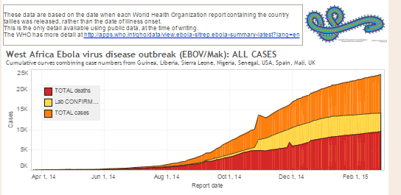
Ebola: outbreak in West Africa (not a happy epi curve)
Source: VDU blog.

Slide 6
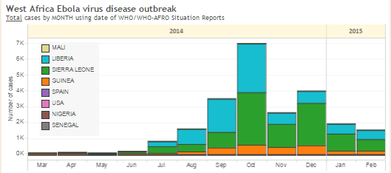
Ebola: outbreak in West Africa, by country
Source: VDU blog.

Slide 7
Ebola: healthcare worker risk
10:1
 | Infected | Died
Non-HCW | 2375 | 1318
HCW | 240 | 120
Source: World Health Organisation, 25 August 2014

Slide 8
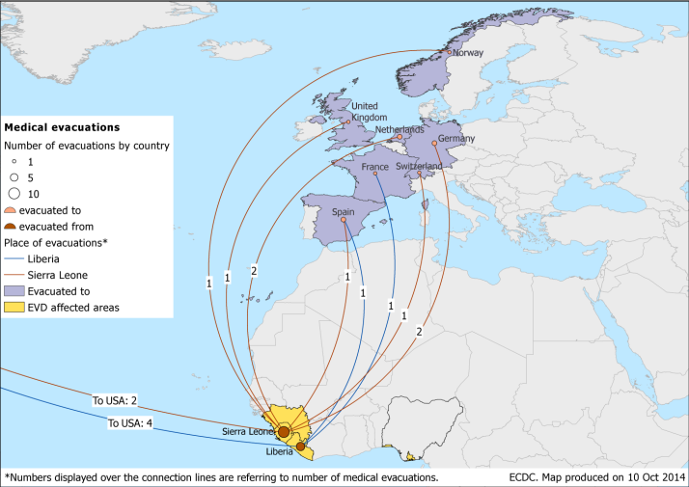
Repatriation of healthcare workers
Source: ECDC.

Slide 9
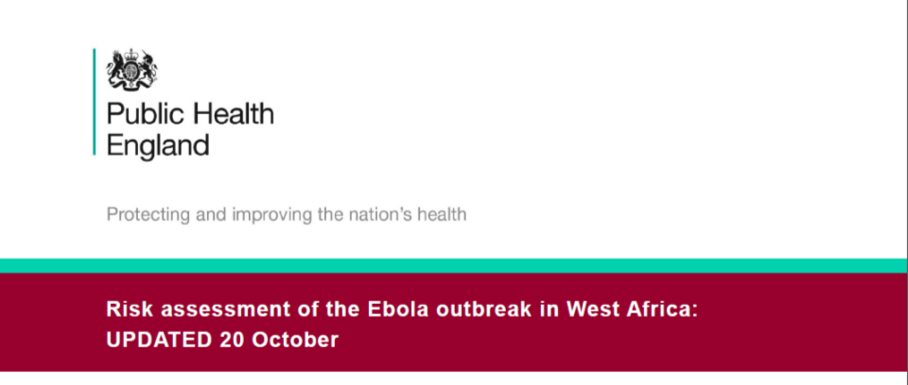
‘…it seems reasonable to expect a maximum of 3 cases over the next 3 months.’

Slide 10
Game changer: Ebola transmission US / Spain
6 Oct 2014: Madrid, Spain
12 & 15 Oct 2014: Dallas, Texas, USA
13 cases -> 3 secondary transmissions

Slide 11
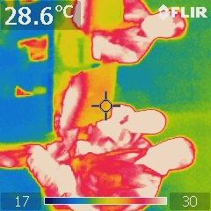
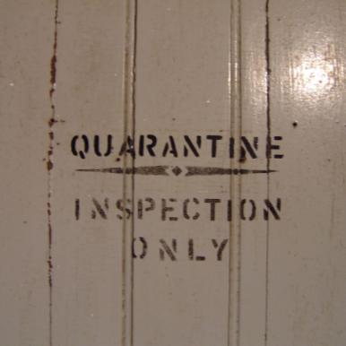
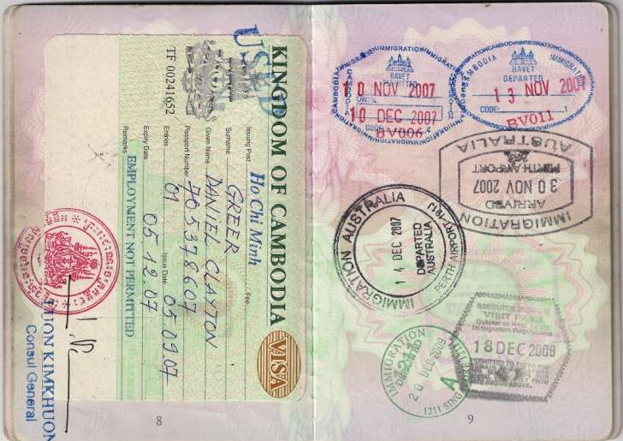
‘Politicisation’
Images: Temperature mapping, Quarantine and Passport.

Slide 12

‘Fearbola’
‘After my diagnosis, the media and politicians could have educated the public about Ebola. Instead, they spent hours retracing my steps through New York and debating whether Ebola can be transmitted through a bowling ball.’
Spencer C. New Engl J Med 2015 in press.

Slide 13
Ebola: transmission routes
Direct contact with blood or body fluids incl. droplet sprays (through broken skin or mucous membranes)^{1,2}
Indirect contact with contaminated environments¹⁻⁴
>
R₀ = 2
(Nishiura & Chowell)⁵
R₀ significantly higher in non-survivors (2.36) than in survivors (0.66).⁶
Ftika & Maltezou. J Hosp Infect 2013;83:185-192.
Lee & Henderson. Curr Opin Infect Dis 2001;14:467-480.
Bausch et al. J Infect Dis 2007;196 Suppl 2:S142-147.
Forrester et al. MMWR Morb Mortal Wkly Rep 2014;63:925-929.
Nishiura & Chowell. Euro Surveill 2014;19.
Yamin et al. Ann Intern Med 2014 in press.

Slide 14
Ebola: infection prevention and control
A number of public health agencies including the US CDC and UK Department of Health have issued guidelines for preventing and controlling EVD in hospitalised patients. Although there are some differences in the recommended strategies, the following principles are common:
Place suspected or confirmed EVD patients in single room isolation, ideally in a specialised containment facility.
PPE for direct and indirect patient contact: “no skin in the game” plus respiratory protection.
Record and monitor all HCW contact with EVD patients, especially those who have
unprotected contact.

Slide 15
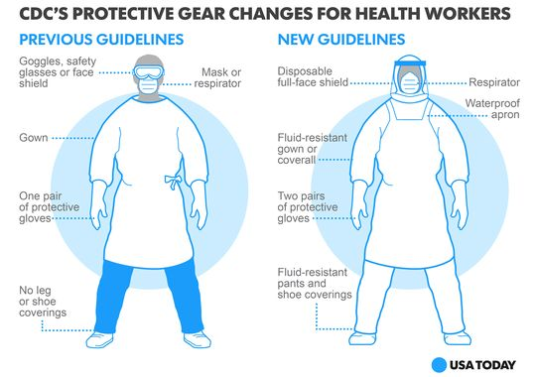
CDC tightens PPE recommendations
Source: USA Today.

Slide 16
Ebola: patient isolation
EVD patients should be transferred to a specialist containment facility where possible.
Otherwise, suspected and confirmed patients should be placed in single room isolation with an en suite or dedicate commode.
Bioquell Pod may be useful for pre-emptive isolation in emergency departments lacking single rooms, or for suspected Ebola patients where side rooms occupied by higher priority patients.

Slide 17
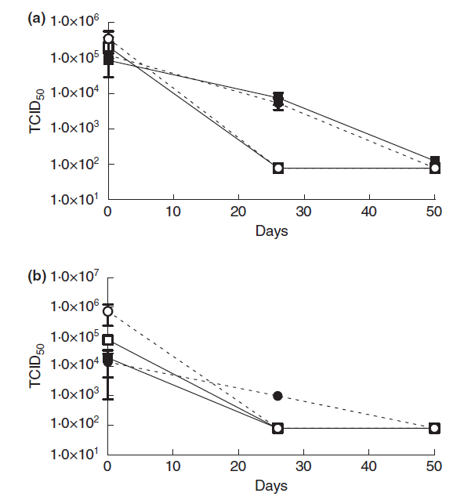
Ebola: surface contamination risk
Glass
Despite being an enveloped virus, Ebola can survive for days to weeks when dried onto surfaces.^{1,2}
Epidemiological data support the possibility of indirect Ebola acquisition through contact with contaminated environments.³⁻⁷
Therefore, careful attention should be given to cleaning and disinfection of hospital rooms.
Plastic
Figure: Survival of Zaire ebolavirus (ZEBOV) and Lake Victoria marburgvirus (MARV) dried onto different solid substrates over a 50-day period. The survival of ZEBOV (solid line) and MARV (dotted line) on different substrates when dried in tissue culture media (closed shapes) or guinea pig sera (open shapes) over 50 days was assessed by the TCID₅₀ microtitre plate assay. Samples were recovered from the surfaces, in triplicate, at various time points over a longer time period. (a) Survival on glass at 4°C, (b) Survival on plastic at 4°C. Each point shows the mean count (TCID₅₀ ml)1) from triplicate samples, plus the standard error.
Sagripanti et al. Arch Virol 2010;155:2035-2039.
Piercy et al. J Appl Microbiol 2010;109:1531-1539.
Ftika & Maltezou. J Hosp Infect 2013; 83: 185-192.
Bausch et al. J Infect Dis 2007; 196 Suppl 2: S142-147.
Francesconi et al. Emerg Infect Dis 2003; 9: 1430-1437.
Roels et al. J Infect Dis 1999; 179 Suppl 1: S92-97.
Forrester et al. MMWR Morb Mortal Wkly Rep 2014;63:925-929.

Slide 18
Surface survival: viruses with pandemic potential
Virus | Survival time
SARS-CoV | Days to weeks^{1,2}
MERS-CoV | More than 2 days³
Influenza | Hours to days^{1,4}
Ebola | Days to weeks* ⁵⁻⁶
* The study that reported survival times measured in weeks was performed at 4°C.⁶
Chan et al. Adv Virol 2011:734690.
Lai et al. Clin Infect Dis 2005;41:67-71.
van Doremalen et al. Euro Surveill 2013;18.
Dublineau et al. PLoS ONE 2011;6:e28043.
Sagripanti et al. Arch Virol 2010;155:2035-2039.
Piercy et al. J Appl Microbiol 2010;109:1531-1539.

Slide 19
Ebola: terminal disinfection of hospital rooms
 | CDC | UK DH
PPE for cleaners | As for HCW with direct patient contact | As for HCW with direct patient contact
Disinfectant | EPA registered disinfectant effective against non-enveloped virus | Standard methods where no blood contamination, 10,000ppm bleach where blood contamination evident
Fumigation | Not mentioned | Recommended
Source: US CDC and UK Department of Health

Slide 20
Fumigation via automated room disinfection
Ebola is an enveloped virus, so will be susceptible to a range of disinfectants in vitro, including alcohol, QAC, bleach and other disinfectants.¹
However, studies with other organisms have demonstrated that conventional methods consistently fail to eliminate contamination with pathogens that can survive on surfaces such as C. difficile, MRSA and norovirus.²
Hydrogen peroxide vapor (HPV) is effective in vitro for the inactivation of enveloped and non-enveloped viruses (see table below) and eliminates pathogens from hospital surfaces.^{3,4}
Formaldehyde and chlorine dioxide would also be effective, but it would be difficult to apply these safely and without material damage in hospitals.⁵
The lower level of efficacy in general and especially out of direct line of sight makes aerosolised hydrogen peroxide (AHP) and UV systems unsuitable for terminal decontamination following EVD cases.^{3,6}
Virus (strain) | Log₁₀ reduction in virus titer (TCID₅₀) ± (SD) after HPV Exposure
 | 25 mL* | 27 mL* | 33 mL*
TGEV | >5.05 (0.19) | >4.94 (0.19) | >5.28 (0.69)
Avian influenza virus (H9N9) | >4.08 (0.58) | >4.50 (0.25) | >4.83 (0.29)
Data from Goyal et al.⁴
Goyal et al. J Hosp Infect 2014;86:255-9.
Beswick et al. Applied Biosafety 2011;16:139-157.
Sagripanti & Lytle. Arch Virol 2011;156:489-494.
Ftika & Maltezou. J Hosp Infect 2013;83:185-192.
Otter et al. ICHE 2011;32:687-699.
Otter et al. J Hosp Infect 2013;83:1-13.

Slide 21
Protocol for Ebola decon using HPV
In terms of transmission risk:
PATIENT > CLINCAL WASTE > SURFACES > AIR
Clean and disinfect surfaces to remove blood spots.
Ebola is not an airborne pathogen, but may be transmitted via droplets. Thus, viable Ebola is highly unlikely to be in the air but a secondary (to blood spot) and much less likely risk is aerosolisation of surface contamination as it is disturbed during cleaning and disinfection or decontamination equipment manipulation.
Transmission of Ebola requires contact with mucous membranes (principally eyes and respiratory tract in this context).
Thus, PPE requirements for those tasked with cleaning and disinfection should be the same as for direct patient contact.
Inadequate PPE for cleaning and disinfection staff has been noted in field settings.¹
Forrester et al. MMWR Morb Mortal Wkly Rep 2014;63:925-929.

Slide 22










Ebola decontamination using Bioquell HPV
Click on each logo for further information.
Emory have published their protocols, including reference to Bioquell HPV.

Slide 23
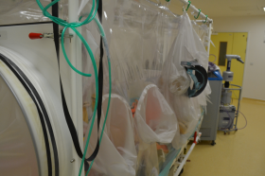
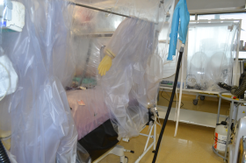
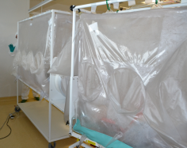
Ebola terminal decontamination: Royal Free
A British healthcare worker with EVD was repatriated from Sierra Leone to the High Level Isolation Unit (HLIU) in a transport isolator.
The patient isolators and the rooms housing them required decontamination.
Biological and chemical indicators situated throughout the isolators and rooms (n=25) to verify the process were inactivated.
The plastic half-suits in the patient isolator represented a particular challenge to decontamination, and were donned and doffed mid-cycle to maximise surface exposure.
The previous protocol involved formaldehyde and disposal of the isolators, which were reused following HPV.
Decontamination was completed over two days (would be possible to decon the patient isolators in a single day in necessary).
HPV allowed the isolators to be re-used and returned the HLIU to service more quickly than when using formaldehyde

Slide 24
Ebola terminal decontamination: Royal Free

Slide 25
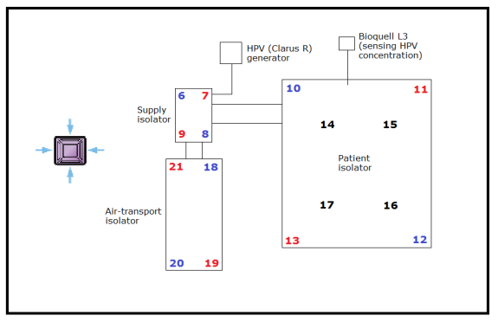
Ebola terminal decontamination: Royal Free
#14,15,16,17 were placed on the half-suits, inside the patient isolator.

Slide 26
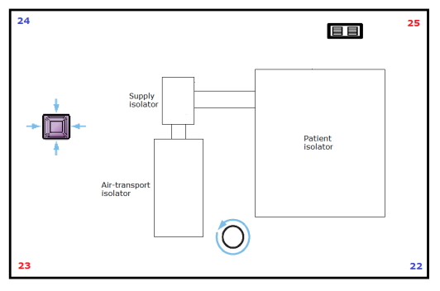
Ebola terminal decontamination: Royal Free

Slide 27
Ebola: summary
The current outbreak of EVD centred in West Africa is the largest ever reported.
Imported cases are likely to increase.
In-hospital transmission in Spain and the USA has pushed Ebola high on the agenda.
Guidelines recommend placing patients with suspected or confirmed EVD in single rooms, and the use of PPE including gloves, gowns, eye and respiratory protection.
Ebola virus can survive on dry surfaces for days, and HPV has been used worldwide for terminal decontamination following cases of EVD.

Slide 28
Other sources for information
WHO fact sheet
CDC Ebola pages
CDC recommendations for infection prevention and control
UK Department of Health / Health Protection Agency guidelines for management of viral haemorrhagic fever
Public Health England Ebola pages
Bioquell Ebola remediation pages
Virology Down Under blog (Dr Ian Mackay)
Controversies in HAI blog

Slide 29
Ebola decontamination
Managing risk and paranoia
27 Feb 2015
Jon Otter, PhD FRCPath
Scientific Director, Healthcare, Bioquell
Research Fellow, King’s College London
jonathan.otter@kcl.ac.uk
www.micro-blog.info
@jonotter

