Slide 1
Pervasive infection threats in acute healthcare, including Gram-negative bacteria
30/06/15
Jon Otter, PhD FRCPath
Imperial College Healthcare NHS Trust
Blog: www.ReflectionsIPC.com
Twitter: @jonotter
Email: jon.otter@imperial.nhs.uk

Slide 2
MRSA bacteraemia, England 2001-2013
4
5
6
Mandatory reporting, 2001
‘Gettting ahead of the curve’, 2002
‘Winning ways’, 2003
‘Towards cleaner hospitals’, 2004
‘Cleanyourhands’, 2004
Targets introduced, 2004
Cleanliness improvement, 2005
‘Going further faster’, 2006
Root cause analysis, 2006
Revised national guidelines, 2006
Deep clean, 2007
Screening elective admissions, 2008
Universal screening, 2010
8
9
10
3
7
1
2
11
12
13

Slide 3
C. difficile infection (CDI), England 2004-2013
CDI cases, 2004-2013
2
Mandatory reporting, 2004
Targets, 2007
Revised guidelines, 2009
1
3
Notes:
Trust apportioned = specimens from patients who have been in hospital for 3 days or more (MRSA) or 4 days or more (CDI)

Slide 4
E. coli and MSSA bacteraemia, England

Slide 5
Invasive MRSA (EARS-Net)

Slide 6

THE END OF ANTIBIOTICS IS NIGH

Slide 7




What’s the problem?
“CRE are nightmare bacteria.”
Dr Tom Frieden, CDC Director
“If we don't take action, then we may all be back in an almost 19th Century environment where infections kill us as a result of routine operations.”
Dame Sally Davies, Chief Medical Officer
“If we fail to act, we are looking at an almost unthinkable scenario where antibiotics no longer work and we are cast back into the dark ages of medicine where treatable infections and injuries will kill once again.”
David Cameron, Prime Minister, UK
“The rise of antibiotic-resistant bacteria, however, represents a serious threat to public health and the economy.”
Barack Obama, President USA

Slide 8
Rising threat from MDR-GNR
% of all HAI caused by GNRs.
% of ICU HAI caused by GNRs.
Non-fermenters | Acinetobacter baumannii Pseudomonas aeruginosa Stenotrophomonas maltophilia
Enterobacteriaceae | Klebsiella pneumoniae Escherichia coli Enterobacter cloacae
Hidron et al. Infect Control Hosp Epidemiol 2008;29:966-1011.
Peleg & Hooper. N Engl J Med 2010;362:1804-1813.

Slide 9

What’s the problem? Resistance

Slide 10
What’s the problem? Mortality
 | Enterobacteriaceae |  | Non fermenters
Organism | AmpC / ESBL | CPE | A. baumannii
Attributable mortality | Moderate | Massive (>50%) | Minimal
Shorr et al. Crit Care Med 2009;37:1463-1469.
Patel et al. Iinfect Control Hosp Epidemiol 2008;29:1099-1106.
Falagas et al. Emerg Infect Dis 2014;20:1170-1175.

Slide 11
What’s the problem? Global domination!
Rapid spread
Clonal expansion
GI carriage
Horizontal gene transfer

Slide 12
Invasive carbapenem-resistant K. pneumoniae
i.e. CRE (EARS-Net)

Slide 13
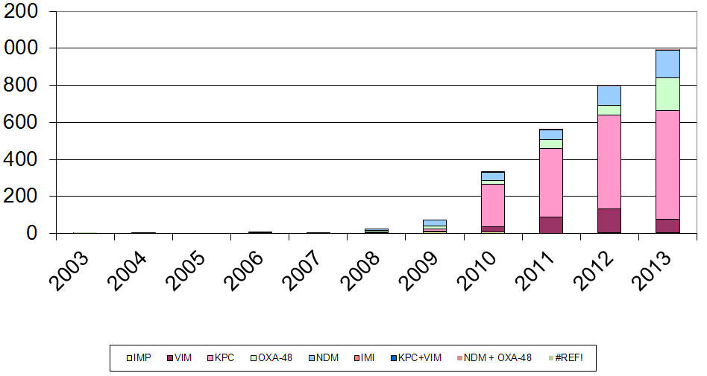
Emergence of CPE in the UK

Slide 14

Colistin resistance in Italy
Survey of 191 CRE from 21 labs across Italy.
43%
Colistin resistant K. pneumoniae.
Range = 10-80% for the 21 labs.
Monaco et al. 2014; Euro Surveill 2014;19:pii=20939.

Slide 15
CRE in the USA
National survey of Enterobacteriaceae in 2001 (n=2,631) and 2011 (n=6,573).
CDC NHSN / NNIS data. MMWR 2013;62:165-170.

Slide 16




CRE in the UK and US

Slide 17
Understanding the enemy
Pathogen | CRE¹ | MRSA | VRE | C. difficile
Resistance | +++ | + | + | +/-
Resistance genes | Multiple | Single | Single | n/a
Species | Multiple | Single | Single | Single
HA vs CA | HA & CA | HA | HA | HA
At-risk pts | All | Unwell | Unwell | Old
Decolonisation | No | Yes | No | No
Virulence | +++ | ++ | +/- | +
Environment | +/- | + | ++ | +++
Carbapenem-resistant Enterobacteriaceae.

Slide 18
MDR-GNR Toolbox
Hand hygiene
Contact precautions
Active screening
Antibiotic stewardship
Cleaning / disinfection
Cohorting staff / patients
Note flagging
HCW screening
Education
Env. screening
Decol.
Tacconelli et al. Clin Microbiol Infect 2014;20 Suppl 1:1-55.

Slide 19
Pervasive infection threats in acute healthcare, including Gram-negative bacteria
30/06/15
Jon Otter, PhD FRCPath
Imperial College Healthcare NHS Trust
Blog: www.ReflectionsIPC.com
Twitter: @jonotter
Email: jon.otter@imperial.nhs.uk

