Slide 1

Detecting CPE: time to throw away those agar plates?
Jon Otter, PhD FRCPath
Imperial College Hospitals NHS Trust
jon.otter@imperial.nhs.uk
@jonotter
Blog: www.ReflectionsIPC.com
You can download these slides from www.jonotter.net

Slide 2

THE END OF ANTIBIOTICS IS NIGH

Slide 3




What’s the problem?
“CPE are nightmare bacteria.”
Dr Tom Frieden, CDC Director
“If we don't take action, then we may all be back in an almost 19th Century environment where infections kill us as a result of routine operations.”
Dame Sally Davies, Chief Medical Officer
“If we fail to act, we are looking at an almost unthinkable scenario where antibiotics no longer work and we are cast back into the dark ages of medicine where treatable infections and injuries will kill once again.”
David Cameron, Prime Minister, UK
“The rise of antibiotic-resistant bacteria, however, represents a serious threat to public health and the economy.”
Barack Obama, President USA

Slide 4
Rising threat from MDR-GNR
% of all HAI caused by GNRs.
% of ICU HAI caused by GNRs.
Non-fermenters | Acinetobacter baumannii Pseudomonas aeruginosa Stenotrophomonas maltophilia
Enterobacteriaceae | Klebsiella pneumoniae Escherichia coli Enterobacter cloacae
CPO
CPE
Hidron et al. Infect Control Hosp Epidemiol 2008;29:966-1011.
Peleg & Hooper. N Engl J Med 2010;362:1804-1813.

Slide 5

Enterobacteriaceae vs. non-fermenters
Share | Differ
Gram stain reaction | Risk factors & at-risk population
Concerning AMR | Potential for epidemic spread
 | Infection profile & mortality
 | Prevalence
 | Colonisation site & duration
 | Transmission routes
 | Resistance profile & mechanisms
Notes:
You could (and probably should) dissect the epidemiology of:
K. pneumoniae vs. E. coli
A. baumannii vs. P. aeruginosa
ESBL vs. KPC producing K. pneumoniae

Slide 6

What’s the problem? Resistance
Courtesy of Pat Cattini

Slide 7
What’s the problem? Mortality
 | Enterobacteriaceae |  | Non fermenters
Organism | AmpC / ESBL | CPE | A. baumannii
Attributable mortality | Moderate | Massive (>50%) | Minimal
Shorr et al. Crit Care Med 2009;37:1463-1469.
Patel et al. Iinfect Control Hosp Epidemiol 2008;29:1099-1106.

Slide 8
What’s the problem? Rapid spread
Rapid spread
Clonal expansion
GI carriage
Horizontal gene transfer

Slide 9


Slide 10
Acronym minefield
CPC
CPE
MDR-GNR
CRO
MDR-GNB
ESBL
CPE
CRC
CPE
KPC
CRAB

Slide 11
Poll: would you be comfortable explaining the difference between ‘carbapenem-resistant Enterobacteriaceae (CPE)’ and ‘carbapenemase producing Enterobacteriaceae (CPE)’ to a colleague?
A) Yes
B) No

Slide 12
What are CPE?
Carbapenem-resistant Enterobacteriaceae (CPE) – Enterobacteriaceae that are resistant to carbapenems by any mechanism.
Carbapenemase-producing Enterobacteriaceae (CPE) – Enterobacteriaceae that are resistant to carbapenems by means of an acquired carbapenemase.
CPE
CPE

Slide 13
When CPE is not CPE
Wild-type
Carbapenemase
ESBL / AmpC + porin loss
or true carbapenemase ?
N
0.5 16
Carbapenem MIC
Courtesy of Dr Katie Hopkins, PHE.

Slide 14
Understanding the enemy
Pathogen | CPE¹ | CPAB² | MRSA | VRE | C. difficile
Resistance | +++ | +++ | + | + | +/-
Resistance genes | Multiple | Multiple | Single | Single | n/a
Species | Multiple | Single | Single | Single | Single
HA vs CA | HA & CA | HA (ICU) | HA | HA | HA
At-risk pts | All | ICU | Unwell | Unwell | Old
Virulence | +++ | +/- | ++ | +/- | +
Environment | +/- | +++ | + | ++ | +++
Carbapenemase-producing Enterobacteriaceae.
Carbapenemase-producing Acinetobacter baumannii.

Slide 15
Poll: How much CPE have you seen in your hospital?
A) None
B) One or two cases
C) One or two outbreaks
D) Regularly (not related to known outbreaks)

Slide 16
CPE in the USA
NHSN / NNIS data; MMWR 2013;62:165-170.

Slide 17
CPE in the USA
25 community hospitals in Southwestern USA
Thaden et al. Infect Control Hosp Epidemiol 2014;35:978-983.

Slide 18
CPE in LTACs, USA
Lin et al. Clin Infect Dis 2013;57:1246-1252.

Slide 19
Who’s carrying CPE?
Author | Year | Location | Setting | n patients | n carriers | % carriers
Adler¹ | 2015 | Israel | CPE carriage in post-acute hospitals, 2008 | 1147 | 184 | 16.0
– | – | – | CPE carriage in post-acute hospitals, 2013 | 1287 | 127 | 9.9
Mack | 2014 | London | ‘High-risk’ inpatients and admissions. | 2077 | 7 | 0.3
Rai² | 2014 | East Delhi, India | Outpatients | 242 | 24 | 9.9
Zhao³ | 2014 | Fujian, China | Stool samples from hospitalized patients | 303 | 20 | 6.6
Birgand⁴ | 2014 | Paris, France | Patients repatriated or recently hospitalized in a foreign country | 132 | 9 | 6.8
Kim⁵ | 2014 | Seoul, Korea | ICU admissions | 347 | 1 | 0.3
Girlich⁶ | 2014 | Morocco | Hospitalized patients | 77 | 10 | 13.0
Lin⁷ | 2013 | Chicago, USA | Long term acute care hospitals | 391 | 119 | 30.4
– | – | – | Short stay hospital ICU | 910 | 30 | 3.3
Villar⁸ | 2013 | Buenos Aires, Argentina | Non-hospitalized individuals | 164 | 8 | 4.9
Kothari⁹ | 2013 | New Delhi, India. | Healthy neonates | 75 | 1 | 1.3
Day¹⁰ | 2013 | Pakistan | Patients attending a military hospital | 175 | 32 | 18.3
Swaminathan¹¹ | 2013 | New York | All admissions to 7 units, including ICU, of 2 hospitals | 5676 | 306 | 5.4
Nüesch-Inderbinen¹² | 2013 | Zurich, Switzerland | Healthy community residents and outpatients | 605 | 0 | 0.0
Armand-Lefèvre¹³ | 2013 | Paris, France | ICU patients | 50 | 6 | 12.0
Wiener-Well¹⁴ | 2010 | Jerusalem, Israel | Hospitalized patients | 298 | 16 | 5.4
For refs see: http://reflectionsipc.com/2014/12/22/whos-harbouring-cre/

Slide 20
Invasive multidrug-resistant K. pneumoniae
EARS-Net

Slide 21

Colistin resistance in Italy
Survey of 191 CPE from 21 labs across Italy.
43%
Colistin resistant K. pneumoniae.
Range = 10-80% for the 21 labs.
Monaco et al. 2014; Euro Surveill 2014;19:pii=20939.

Slide 22

Emergence of CPE in the UK
PHE.

Slide 23




CPE in the UK and US

Slide 24
Evidence-free zone

Slide 25
Guidelines = Policy

Slide 26
CPE prevention & control
Hand hygiene
Contact precautions
Active screening
Antibiotic stewardship
Cleaning / disinfection
SDD?
Topical CHX?
Education?
Otter et al. Clin Microbiol Infect 2015 in press.

Slide 27
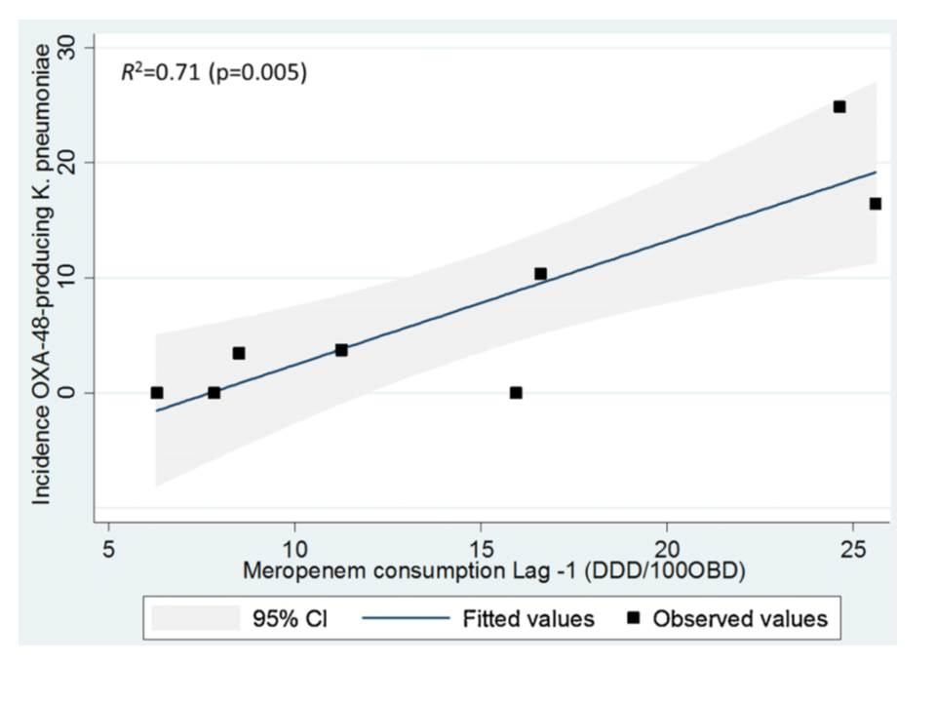
Can we forecast a CPE storm?
Could we find and implement an “alert” level of carbapenem use?
The authors claim a stewardship intervention brought the CPE outbreak under control – but also implemented ‘case isolation, screening of contacts, barrier nursing and other infection control interventions’.
Study focussed only on OXA-48 K. pneumoniae; what about other Enterobacteriaceae and non-fermenters.
What drives carbapenem resistance? The use of meropenem in the previous year plotted against the incidence rate of OXA-48-producing K. pneumoniae
Gharbi et al. Int J Antimicrob Agents 2015 in press.

Slide 28
Decolonisation using faecal microbiota transplantation (FMT)
82 year old colonised with CPE.
Carriage was delaying her admission to a nursing home.
Single dose of FMT decolonised her at 7 and 14 days.
Laiger et al. J Hosp Infect 2015 in press.
Buffie & Pamer. Nat Rev Microbiol 2013;13:790-801.

Slide 29
Who do I screen?
PHE CPE Toolkit screening triggers:
an inpatient in a hospital abroad, or
an inpatient in a UK hospital which has problems with spread of CPE (if known), or
a ‘previously’ positive case.
Also consider screening admissions to high-risk units such as ICU, and patients who live overseas.

Slide 30
You have positive case: now what?
‘Contact precautions’
Single room+glove/gown
Consider staff cohort
Contact tracing
Trigger for screening contacts or whole unit?
Flagging
Patient notes flagged
Receiving unit informed
Education
Staff
Patient / visitor
Cleaning / disinfection
Use bleach or H₂O₂ vapour at discharge
Decolonization?
‘Selective decontamination’ / chlorhexidine bathing?

Slide 31
How do I screen?
Rectal swab
Agar plate
NAAT
(PCR)
AST
MADLDI-TOF MS
WGS
NAAT
(PCR)
NAAT = nucleic acid amplification techniques
AST = antimicrobial susceptibility testing
MALDI-TOF = Matrix-assisted laser desorption /ionization – time of flight mass spectrometry
WGS = whole genome sequencing

Slide 32
Agar plates
MacConkey
Selective for all Gram-negative bacteria (including Enterobacteriaceae and non-fermenters)
Chromogenic Media
Selective for resistant Enterobacteriaceae only (ESBL or CPE options available); several options

Slide 33
Antimicrobial susceptibility testing (AST)
Quantitative
(MIC or breakpoint)
Agar or broth dilution (manual or autmoated), E-tests
Qualitative
(R/I/S)
Disc diffusion; supplemental tests for mechanisms (e.g. ESBL, CPE)

Slide 34
MALDI-TOF, WGS, NAAT (PCR & Arrays)
MALDI-TOF
Rapid and accurate speciation of bacteria from a colony; potential to detect resistance genes
WGS
Whole genome sequence; gold standard typing method; costs coming down; can detect abx resistance genes
PCR
PCR can be used to detect a single or multiple genes of interest from a pure colony
Array Chips
>100 PCRs on a single chip for simultaneous detection of a range of genes and markers

Slide 35
How do I screen?
Rectal swab
Agar plate
NAAT
(PCR)
AST
MADLDI-TOF MS
WGS
NAAT
(PCR)
NAAT = nucleic acid amplification techniques
AST = antimicrobial susceptibility testing
MALDI-TOF = Matrix-assisted laser desorption /ionization – time of flight mass spectrometry
WGS = whole genome sequencing

Slide 36
NAAT direct from clinical specimens
PCR
Rapid real-time PCR kits available to detect resistance genes direct from clinical specimens; point of care tests coming
Rapid sequencing kits
Kits available for rapid sequence-based simultaneous detection of common organisms and resistance genes

Slide 37
Poll: which method is used by your clinical laboratory to detect CPE?
A) Chromogenic agar plate
B) Non-chromogenic agar plate
C) Molecular method (e.g. PCR)
D) Other
E) Don’t know

Slide 38
CPE picture at ICHT
Mookerjee et al. IPS 2015.

Slide 39
Epidemic curve of the outbreak; total number of cases
Brannigan et al. FIS 2015.

Slide 40
Outbreak control measures
Improved screening and isolation
Laboratory and epidemiological investigations
Internal and external communications. Coordinating briefing and discussions with external stakeholders.
Input from other Trust’s addressing CRE
Hand hygiene and equipment focus, ward based monitors
Environmental cleaning and disinfection, attention to pillows and mattresses, HPV usage
External reviews and visits of clinical areas
Antimicrobial usage and stewardship
Expediting discharges

Slide 41
Outbreak control measures: Challenges
Improved screening and isolation, impact of typing delays
Laboratory and epidemiological investigations
Internal and external communications. Coordinating briefing and discussions with external stakeholders.
Input from other Trust’s addressing CRE
Hand hygiene and equipment focus, ward based monitors
Environmental cleaning and disinfection, attention to pillows and mattresses, HPV usage
External reviews and visits of clinical areas
Antimicrobial usage and stewardship
Expediting discharges

Slide 42
Universal admission screening in London
All patients within the first 72 hrs of admission (excluding paediatrics)
Rectal swab
Perineal swab
CRO cultured on MacConkey plus erta (reference method)
ESBL cultured on Chrome plate
CRE cultured on Chrome plate
CPO detected by PCR (Check Direct CPE*)
Each patient approached and verbal consent obtained; risk factor questionnaire completed. Target sample size: 4500.
* PCR+ samples repeated on Cepheid PCR.
The study was approved by the NHS Research Ethics Committee.

Slide 43
Results
4843 patients enrolled.
Rectal swabs collected from 4207 patients.
CPE cultured from 5 (0.1%) patients.
  All were positive by Cepheid, 4/5 positive by CheckDirect.
Samples from 2 patients were PCR+/culture negative by both PCR systems (Cepheid and CheckDirect).
  CPO identified in 7 (0.2%) patients.
Samples from a further 75 patients were culture negative, and PCR+ by CheckDirect but negative by Cepheid.
  Working hypothesis: false positives.
Otter et al. IPS 2015.

Slide 44
Results
ESBL were cultured from 354 (8.1% of patients overall).
  Rectal swabs were significantly more sensitive for detecting ESBL than perineal swabs: 331 (7.5%) vs. 165 (3.8%), p<0.001 (Fisher’s exact test).
None of the CPE positives swabs had visible faecal matter; those with visible faecal matter were more likely to fail PCR.
The reference lab method (MacConkey plus an erta disc) failed to identify any of the CPEs.
Otter et al. IPS 2015.

Slide 45
Before you throw away the agar plates…
Molecular diagnostics offer more sensitivity and shorter TAT:
but TAT may be longer in the real world than on paper;
are expensive;
rely on validation of carriage sites;
do not tell you about phenotypic susceptibility;
have a limit of detection often around a couple of logs – and sensitivity may be comparable to culture;
do not deal with changing epidemiology; struggle with target variability;
need to manage shared resistance genes between species, especially for MDR-GNR;
and is PCR+ culture- (as) clinically significant?
See further details in talk by Dr Dan Diekema

Slide 46
Poll: should we be performing PCR diagnosis for CPE?
A) Yes
B) No

Slide 47
Key questions
Which interventions work?
Are they different for Enterobacteriaceae and non-fermenters? (Probably, given their epidemiology.)
What is the prevalence of CPE?
How much do we believe a single negative screen? What is the duration of colonisation?
Do we need rapid molecular diagnostics?
Are there decolonisation strategies other than (virtually non) ‘selective decontamination’ using abx?

Slide 48
Summary
MDR-GNR are emerging worldwide and represent a unique threat.
CPE in particular combine resistance, virulence and the potential for rapid spread.
Prevalence in the US appears to be patchy, but increasing.
We do not yet know what is effective in terms of prevention and control, but screening and isolation of carriers seems prudent.
Diagnosis can be challenging, and relies on close liaison with the microbiology laboratory.

Slide 49
Detecting CPE: time to throw away those agar plates?
Jon Otter, PhD FRCPath
Imperial College Hospitals NHS Trust
jon.otter@imperial.nhs.uk
@jonotter
Blog: www.ReflectionsIPC.com
You can download these slides from www.jonotter.net

