Slide 1

CPE, CRE, CPO and CRABs!
Jon Otter, PhD FRCPath
Imperial College Hospitals NHS Trust
jon.otter@imperial.nhs.uk
@jonotter
Blog: www.ReflectionsIPC.com
You can download these slides from www.jonotter.net

Slide 2

THE END OF ANTIBIOTICS IS NIGH

Slide 3



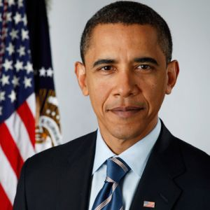
What’s the problem?
“CRE are nightmare bacteria.”
Dr Tom Frieden, CDC Director
“If we don't take action, then we may all be back in an almost 19th Century environment where infections kill us as a result of routine operations.”
Dame Sally Davies, Chief Medical Officer
“If we fail to act, we are looking at an almost unthinkable scenario where antibiotics no longer work and we are cast back into the dark ages of medicine where treatable infections and injuries will kill once again.”
David Cameron, Prime Minister, UK
“The rise of antibiotic-resistant bacteria, however, represents a serious threat to public health and the economy.”
Barack Obama, President USA

Slide 4
Rising threat from MDR-GNR
% of all HAI caused by GNRs.
% of ICU HAI caused by GNRs.
Non-fermenters | Acinetobacter baumannii Pseudomonas aeruginosa Stenotrophomonas maltophilia
Enterobacteriaceae | Klebsiella pneumoniae Escherichia coli Enterobacter cloacae
CPO
CPE
Hidron et al. Infect Control Hosp Epidemiol 2008;29:966-1011.
Peleg & Hooper. N Engl J Med 2010;362:1804-1813.

Slide 5

Enterobacteriaceae vs. non-fermenters
Share | Differ
Gram stain reaction | Risk factors & at-risk population
Concerning AMR | Potential for epidemic spread
 | Infection profile & mortality
 | Prevalence
 | Colonisation site & duration
 | Transmission routes
 | Resistance profile & mechanisms
Notes:
You could (and probably should) dissect the epidemiology of:
K. pneumoniae vs. E. coli
A. baumannii vs. P. aeruginosa
ESBL vs. KPC producing K. pneumoniae

Slide 6

What’s the problem? Resistance
Courtesy of Pat Cattini

Slide 7
What’s the problem? Mortality
 | Enterobacteriaceae |  | Non fermenters
Organism | AmpC / ESBL | CRE | A. baumannii
Attributable mortality | Moderate | Massive (>50%) | Minimal
Shorr et al. Crit Care Med 2009;37:1463-1469.
Patel et al. Iinfect Control Hosp Epidemiol 2008;29:1099-1106.

Slide 8
What’s the problem? Rapid spread
Rapid spread
Clonal expansion
GI carriage
Horizontal gene transfer

Slide 9


Slide 10
Acronym minefield
CPC
CPE
MDR-GNR
CRO
MDR-GNB
ESBL
CPE
CRC
CPE
KPC
CRAB

Slide 11
What are CPE?
Carbapenem-resistant Enterobacteriaceae (CRE) – Enterobacteriaceae that are resistant to carbapenems by any mechanism.
Carbapenemase-producing Enterobacteriaceae (CPE) – Enterobacteriaceae that are resistant to carbapenems by means of an acquired carbapenemase.
CRE
CPE

Slide 12
When CPE is not CRE
Wild-type
Carbapenemase
ESBL / AmpC + porin loss
or true carbapenemase ?
N
0.5 16
Carbapenem MIC
Courtesy of Dr Katie Hopkins, PHE.

Slide 13
Understanding the enemy
Pathogen | CPE¹ | CPAB² | MRSA | VRE | C. difficile
Resistance | +++ | +++ | + | + | +/-
Resistance genes | Multiple | Multiple | Single | Single | n/a
Species | Multiple | Single | Single | Single | Single
HA vs CA | HA & CA | HA (ICU) | HA | HA | HA
At-risk pts | All | ICU | Unwell | Unwell | Old
Virulence | +++ | +/- | ++ | +/- | +
Environment | +/- | +++ | + | ++ | +++
Carbapenemase-producing Enterobacteriaceae.
Carbapenemase-producing Acinetobacter baumannii.

Slide 14
CRE in the USA
NHSN / NNIS data; MMWR 2013;62:165-170.

Slide 15
CRE in LTACs, USA
Lin et al. Clin Infect Dis 2013;57:1246-1252.

Slide 16
Carbapenem-resistant organisms, Europe
EARS-Net

Slide 17

Colistin resistance in Italy
Survey of 191 CPE from 21 labs across Italy.
43%
Colistin resistant K. pneumoniae.
Range = 10-80% for the 21 labs.
Monaco et al. 2014; Euro Surveill 2014;19:pii=20939.

Slide 18

Emergence of CPE in the UK
PHE.

Slide 19




CPE in the UK and US

Slide 20
Evidence-free zone

Slide 21
Guidelines = Policy

Slide 22
MDR-GNR Toolbox
Hand hygiene
Contact precautions
Active screening
Antibiotic stewardship
Cleaning / disinfection
Cohorting staff / patients
Note flagging
HCW screening
Education
Env. screening
Decol.
Otter et al. Clin Microbiol Infect 2015 in press.

Slide 23
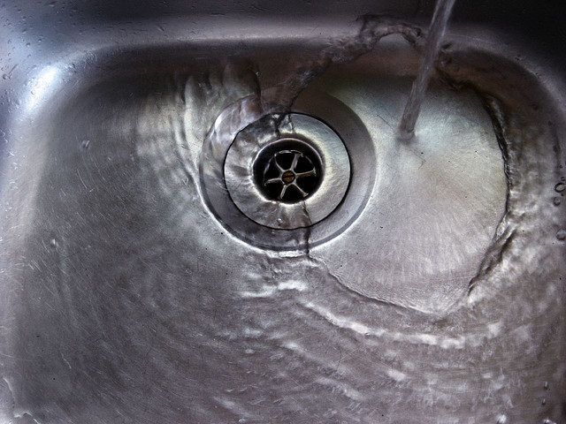
Type | n studies | Failure rate | Odds ratio
Bundled intervention | 75 | 28% | 1.9
Single intervention | 11 | 45%
Cataldo et al. ECCMID 2014. 0125.

Slide 24
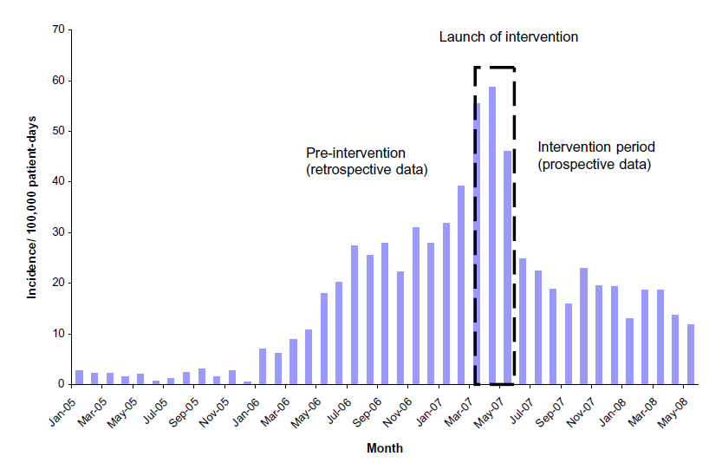
What works? Israel
*
* Physical segregation of CRE carriers; cohorted staff; appointed taskforce.
Schwaber et al. Clin Infect Dis 2011;52:848-855.
Notes:
Physical segregation of CRE carriers; cohorted staff; appointed taskforce.

Slide 25
Summary
MDR-GNR are emerging worldwide and represent a unique threat.
CPE in particular combine resistance, virulence and the potential for rapid spread.
Prevalence in the US appears to be patchy, but increasing.
We do not yet know what is effective in terms of prevention and control, but screening and isolation of carriers seems prudent.
We need to be singing from the same acronym hymnsheet!

Slide 26
CPE, CRE, CPO and CRABs!
Jon Otter, PhD FRCPath
Imperial College Hospitals NHS Trust
jon.otter@imperial.nhs.uk
@jonotter
Blog: www.ReflectionsIPC.com
You can download these slides from www.jonotter.net

