Slide 1

Carbapenem-resistant Gram-negative bacteria
Jon Otter, PhD FRCPath
Imperial College Hospitals NHS Trust
jon.otter@imperial.nhs.uk
@jonotter
Blog: www.ReflectionsIPC.com
You can download these slides from www.jonotter.net

Slide 2
MRSA bacteraemia, England 2001-2013
4
5
6
Mandatory reporting, 2001
‘Gettting ahead of the curve’, 2002
‘Winning ways’, 2003
‘Towards cleaner hospitals’, 2004
‘Cleanyourhands’, 2004
Targets introduced, 2004
Cleanliness improvement, 2005
‘Going further faster’, 2006
Root cause analysis, 2006
Revised national guidelines, 2006
Deep clean, 2007
Screening elective admissions, 2008
Universal screening, 2010
8
9
10
3
7
1
2
11
12
13

Slide 3
C. difficile infection (CDI), England 2004-2013
CDI cases, 2004-2013
2
Mandatory reporting, 2004
Targets, 2007
Revised guidelines, 2009
1
3
Notes:
Trust apportioned = specimens from patients who have been in hospital for 3 days or more (MRSA) or 4 days or more (CDI)

Slide 4

THE END OF ANTIBIOTICS IS NIGH

Slide 5




What’s the problem?
“CRE are nightmare bacteria.”
Dr Tom Frieden, CDC Director
“If we don't take action, then we may all be back in an almost 19th Century environment where infections kill us as a result of routine operations.”
Dame Sally Davies, Chief Medical Officer
“If we fail to act, we are looking at an almost unthinkable scenario where antibiotics no longer work and we are cast back into the dark ages of medicine where treatable infections and injuries will kill once again.”
David Cameron, Prime Minister, UK
“The rise of antibiotic-resistant bacteria, however, represents a serious threat to public health and the economy.”
Barack Obama, President USA

Slide 6
Rising threat from MDR-GNR
% of all HAI caused by GNRs.
% of ICU HAI caused by GNRs.
Non-fermenters | Acinetobacter baumannii Pseudomonas aeruginosa Stenotrophomonas maltophilia
Enterobacteriaceae | Klebsiella pneumoniae Escherichia coli Enterobacter cloacae
CPO
CPE
Hidron et al. Infect Control Hosp Epidemiol 2008;29:966-1011.
Peleg & Hooper. N Engl J Med 2010;362:1804-1813.

Slide 7

Enterobacteriaceae vs. non-fermenters
Share | Differ
Gram stain reaction | Risk factors & at-risk population
Concerning AMR | Potential for epidemic spread
 | Infection profile & mortality
 | Prevalence
 | Colonisation site & duration
 | Transmission routes
 | Resistance profile & mechanisms
Notes:
You could (and probably should) dissect the epidemiology of:
K. pneumoniae vs. E. coli
A. baumannii vs. P. aeruginosa
ESBL vs. KPC producing K. pneumoniae

Slide 8

What’s the problem? Resistance
Courtesy of Pat Cattini

Slide 9
What’s the problem? Mortality
 | Enterobacteriaceae |  | Non fermenters
Organism | AmpC / ESBL | CRE | A. baumannii
Attributable mortality | Moderate | Massive (>50%) | Minimal
Shorr et al. Crit Care Med 2009;37:1463-1469.
Patel et al. Iinfect Control Hosp Epidemiol 2008;29:1099-1106.

Slide 10
What’s the problem? Rapid spread
Rapid spread
Clonal expansion
GI carriage
Horizontal gene transfer

Slide 11


Slide 12
Acronym minefield
CPC
CPE
MDR-GNR
CRO
MDR-GNB
ESBL
CPE
CRC
CPE
KPC
CRAB

Slide 13
What are CPE?
Carbapenem-resistant Enterobacteriaceae (CRE) – Enterobacteriaceae that are resistant to carbapenems by any mechanism.
Carbapenemase-producing Enterobacteriaceae (CPE) – Enterobacteriaceae that are resistant to carbapenems by means of an acquired carbapenemase.
CRE
CPE

Slide 14
Understanding the enemy
Pathogen | CPE¹ | CPAB² | MRSA | VRE | C. difficile
Resistance | +++ | +++ | + | + | +/-
Resistance genes | Multiple | Multiple | Single | Single | n/a
Species | Multiple | Single | Single | Single | Single
HA vs CA | HA & CA | HA (ICU) | HA | HA | HA
At-risk pts | All | ICU | Unwell | Unwell | Old
Virulence | +++ | +/- | ++ | +/- | +
Environment | +/- | +++ | + | ++ | +++
Carbapenemase-producing Enterobacteriaceae.
Carbapenemase-producing Acinetobacter baumannii.

Slide 15
Clinical picture for Enterobacteriaceae vs. non-fermenters
Zarb et al. Euro Surveill 2012; 17(46).

Slide 16
CRE in the USA
NHSN / NNIS data; MMWR 2013;62:165-170.

Slide 17
CRE in LTACs, USA
Lin et al. Clin Infect Dis 2013;57:1246-1252.

Slide 18
Carbapenem-resistant organisms, Europe
EARS-Net

Slide 19

Colistin resistance in Italy
Survey of 191 CPE from 21 labs across Italy.
43%
Colistin resistant K. pneumoniae.
Range = 10-80% for the 21 labs.
Monaco et al. 2014; Euro Surveill 2014;19:pii=20939.

Slide 20

Emergence of CPE in the UK
PHE.

Slide 21




CPE in the UK and US

Slide 22
Evidence-free zone

Slide 23
Guidelines = Policy

Slide 24
MDR-GNR Toolbox
Hand hygiene
Contact precautions
Active screening
Antibiotic stewardship
Cleaning / disinfection
Cohorting staff / patients
Note flagging
HCW screening
Education
Env. screening
Decol.
Otter et al. Clin Microbiol Infect 2015 in press.

Slide 25
Who do I screen?
PHE CPE Toolkit screening triggers:
an inpatient in a hospital abroad, or
an inpatient in a UK hospital which has problems with spread of CPE (if known), or
a ‘previously’ positive case.
Also consider screening admissions to high-risk units such as ICU, and patients who live overseas.

Slide 26
You have positive case: now what?
‘Contact precautions’
Single room+glove/gown
Consider staff cohort
Contact tracing
Trigger for screening contacts or whole unit?
Flagging
Patient notes flagged
Receiving unit informed
Education
Staff
Patient / visitor
Cleaning / disinfection
Use bleach or H₂O₂ vapour at discharge
Decolonization?
‘Selective decontamination’ / chlorhexidine bathing?

Slide 27
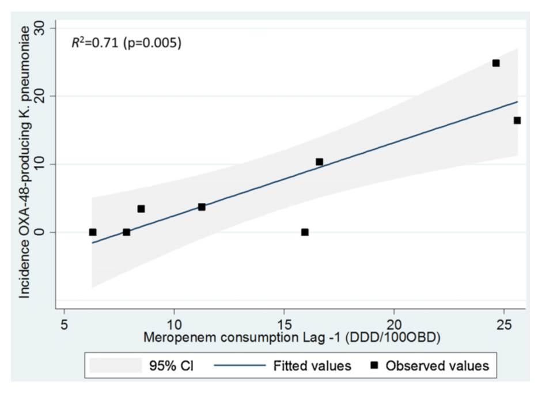
Can we forecast a CPE storm?
Could we find and implement an “alert” level of carbapenem use?
The authors claim a stewardship intervention brought the CPE outbreak under control – but also implemented ‘case isolation, screening of contacts, barrier nursing and other infection control interventions’.
Study focussed only on OXA-48 K. pneumoniae; what about other Enterobacteriaceae and non-fermenters.
What drives carbapenem resistance? The use of meropenem in the previous year plotted against the incidence rate of OXA-48-producing K. pneumoniae
Gharbi et al. Int J Antimicrob Agents 2015 in press.

Slide 28
Decolonisation using faecal microbiota transplantation (FMT)
82 year old colonised with CPE.
Carriage was delaying her admission to a nursing home.
Single dose of FMT decolonised her at 7 and 14 days.
Laiger et al. J Hosp Infect 2015 in press.
Buffie & Pamer. Nat Rev Microbiol 2013;13:790-801.

Slide 29
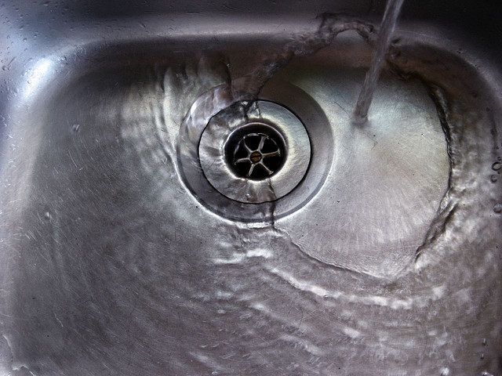
Type | n studies | Failure rate | Odds ratio
Bundled intervention | 75 | 28% | 1.9
Single intervention | 11 | 45%
Cataldo et al. ECCMID 2014. 0125.

Slide 30
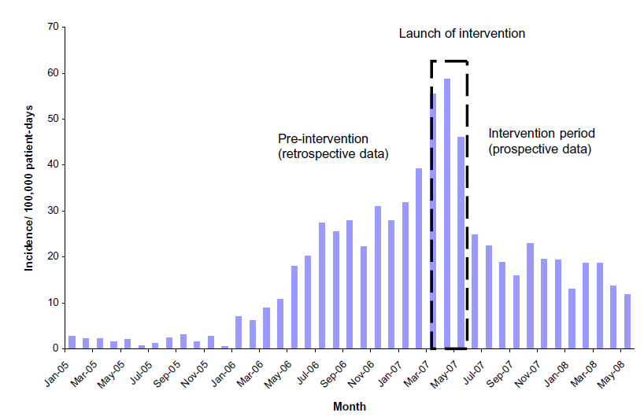
What works? Israel
*
* Physical segregation of CRE carriers; cohorted staff; appointed taskforce.
Schwaber et al. Clin Infect Dis 2011;52:848-855.
Notes:
Physical segregation of CRE carriers; cohorted staff; appointed taskforce.

Slide 31
CPE picture at ICHT
Mookerjee et al. IPS 2015.

Slide 32
KP NDM outbreak; total number of cases
Brannigan et al. FIS 2015.

Slide 33
Summary
MDR-GNR are emerging worldwide and represent a unique threat.
CPE in particular combine resistance, virulence and the potential for rapid spread.
Prevalence appears to be patchy, but increasing.
We do not yet know what is effective in terms of prevention and control, but screening and isolation of carriers seems prudent.
We need to be singing from the same acronym hymnsheet!

Slide 34
Carbapenem-resistant Gram-negative bacteria
Jon Otter, PhD FRCPath
Imperial College Hospitals NHS Trust
jon.otter@imperial.nhs.uk
@jonotter
Blog: www.ReflectionsIPC.com
You can download these slides from www.jonotter.net

