Slide 1
Your hospital room can make you sick!
How improved cleaning and disinfection can help
16/02/16
Jon Otter, PhD FRCPath
Imperial College Healthcare NHS Trust
Blog: www.ReflectionsIPC.com
Twitter: @jonotter
Email: jon.otter@imperial.nhs.uk

Slide 2

2x
Room A
Room B

Slide 3


‘The room lotto’
Patient infected or colonised with a pathogen (e.g. C. difficile, MRSA, VRE,
A. baumannii or P. aeruginosa)
Patient is discharged and the room is cleaned / disinfected; surfaces in the room remain contaminated with the pathogen
The next room occupant is at an increased risk of acquiring the pathogen

Slide 4
Increased risk from the prior room occupant
Otter et al. Am J Infect Control 2013;41(5 Suppl):S6-11.

Slide 5
Taking the ‘lotto’ out of the room
Datta et al. Arch Intern Med 2011;171:491-494.
Passaretti et al. Clin Infect Dis 2013;56:27-35.

Slide 6

Transmission routes
Otter et al. Infect Control Hosp Epidemiol 2011;32:687-699.

Slide 7
86%
58%
93%
85%
59%
French et al. J Hosp Infect 2004;57:31-37.
96%
Notes:
Survive for extended periods

Slide 8
Surface survival
Organism | Survival time
Clostridium difficile (spores) | 5 months
Acinetobacter spp. | 3 days to 5 months
Enterococcus spp. including VRE | 5 days – 4 years (!)¹
Pseudomonas aeruginosa | 6 hours – 16 months
Klebsiella spp. | 2 hours to > 30 months
Staphylococcus aureus, inc. MRSA | 7 days – 7 months
Norovirus (and feline calicivirus) | 8 hours to > 2 weeks²
SARS Coronavirus | 72 hours to >28 days³
Influenza | Hours to several days⁴
Adapted from Kramer et al. BMC Infect Dis 2006;6:130.
Wagenvoort et al. J Hosp Infect 2011;77:282-283.
Doultree et al. J Hosp Infect 1999;41:51-57.
Rabenau et al. Med Microbiol Immunol 2005;194:1-6.
Bean et al. J Infect Dis 1982;146:47-51.

Slide 9
Conventional terminal cleaning
90% of 124 sites
26% reduction
66% of 124 sites
Percentage of MRSA swabs positive
(8 rooms;
2 four-bed bays previously occupied by MRSA patients)
Before cleaning
After cleaning
French et al. J Hosp Infect 2004;57:31-37.

Slide 10

Pathogens can be transferred from hospital surfaces to HCW hands without direct patient contact¹⁻²
52% of 23 HCW acquired VRE on their hands³ | Contact with patient or surface = ~10% risk of acquiring VRE³
45% of 50 HCW acquired MRSA on their hands⁴ | 40% of 50 HCW acquired MRSA on their hands⁴
50% of 30 HCW acquired C. difficile on their hands⁵ | 50% of 30 HCW acquired C. difficile on their hands⁵
Compliance with hand hygiene: 50%⁶ | Compliance with hand hygiene: 80%⁶
Boyce et al. Infect Control Hosp Epidemiol 1997;18:622-627.
Bhalla et al. Infect Cont Hosp Epidemiol 2004;25:164-167.
Hayden et al. Infect Control Hosp Epidemiol 2008;29:149-154.
Stiefel et al. Infect Control Hosp Epidemiol 2011;32:185-187.
Guerrero et al. Am J Infect Control 2012;40:556-558.
Randle et al. J Hosp Infect 2010;76:252-255.

Slide 11
Learning objectives
Understand the key data supporting the role of contaminated surfaces in the transmission of hospital pathogens
Become familiar with the various methods to improve the efficacy of hospital disinfection:
  Tools such as ATP assays and fluorescent markers to evaluate the thoroughness of the cleaning process;
  Methods to improve the education and training of cleaning staff.
Discuss the results of improved cleaning and disinfection in reducing transmission of pathogens
Understand other and emerging approaches including:
  Measures to reduce and contain shedding more effectively;
  New disinfectants, cleaning materials and consideration of automated systems;
  Antimicrobial surfaces;
  Improved design to improve ‘cleanability‘.

Slide 12
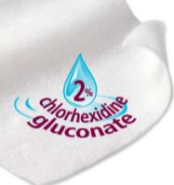
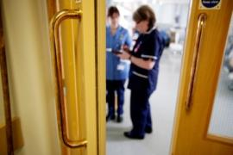



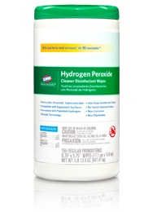

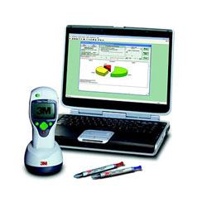

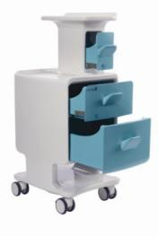
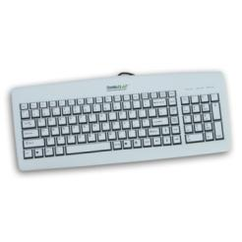
Improve existing procedures
Try something new!

Slide 13
Improve existing procedures
Try something new!

Slide 14
Education & training
Improve existing procedures
Question | “Answer”
What to clean? | Focus of “high-touch” sites seems sensible
Who cleans what? | Checklists can help
What agent(s) to use? | Depends on the situation; sporicidal agent for C. difficile
What materials to use? | Microfibre may help Wipes have pros and cons “Bucket method” most effective
How to educate staff? | More than we currently do! Difficult task
Daily cleaning: how often? | Evidence for daily or twice daily
Terminal cleaning: optimal protocols? | More stringent protocol should be used for terminal disinfection

Slide 15
Improve existing procedures
Try something new!

Slide 16
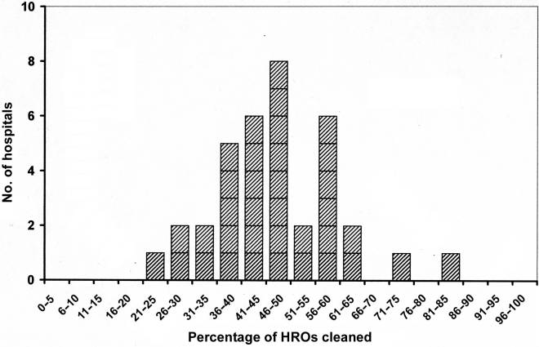
Why bother?
Improve existing procedures
Baseline cleaning rates of ‘high-risk objects’ in 36 acute US hospitals, as determined by removal of a fluorescent marker.
Carling et al. Infect Control Hosp Epidemiol 2008;29:1035-1041.

Slide 17
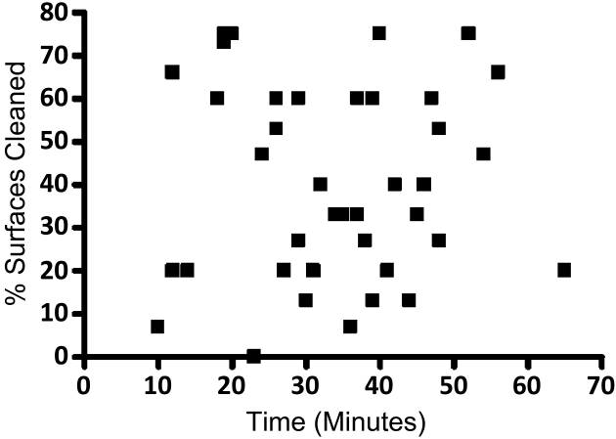
Why bother?
Improve existing procedures
The time taken to clean a room does not correlate with the thoroughness of cleaning, as determined by removal of a fluorescent marker
Rupp et al. Infect Control Hosp Epidemiol 2013;34:100-102.

Slide 18
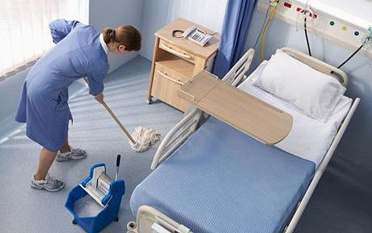
Visual assessment
Improve existing procedures
Visual assessment of hospital cleaning is performed by measuring the apparent cleanliness of a room against a checklist.^{1,2}
A room needs to be visually clean to be acceptable to the current and subsequent occupant.
Visual assessment of hygiene does not correlate with microbial contamination, and can thus be a misleading measure of cleanliness³⁻⁵
Sherlock et al. J Hosp Infect 2009;72:140-146.
Mulvey et al. J Hosp Infect 2011;77:25-30.
Griffith et al. J Hosp Infect 2007;66:352-359.
Cooper et al. Am J Infect Control 2007;66:352-359.
Griffith et al. J Hosp Infect 2000;45:19-28.

Slide 19
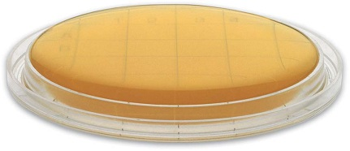
Microbiological samples
Improve existing procedures
Microbiological surface cultures can be qualitative (pathogen presence or absence) or quantitative (aerobic colony counts)
Several different sampling methods available; usually swabs (with or without enrichment) or contact plates
Quality standards for both aerobic colony counts (<2.5 cfu / cm²) and specific indicator organisms (<1 cfu / cm²) have been proposed.^{1,2}
Cost and practicality mean that routine microbiological sampling is rarely performed
Mulvey et al. J Hosp Infect 2011;77:25-30.
Malik et al. Am J Infect Control 2003;31:181-187.

Slide 20
ATP assessment
Improve existing procedures
Adenosine triphosphate (ATP) is the “energy currency” of all living cells.
Surfaces can be swabbed and a hand-held sensor can give a real-time quantitative measurement of ATP from the surface.
Several “quality standards” have been set as relative light unit (RLU) thresholds, ranging from 100-500.¹⁻³
There is no direct correlation between RLU and microbial contamination, but “hygiene fails” determined by aerobic colony count and ATP do correlate^{1,2}
Boyce et al. Infect Control Hosp Epidemiol 2011;32:1187-1189.
Mulvey et al. J Hosp Infect 2011;77:25-30.
Whiteley et al. Healthcare Infection 2012;17:91-97.

Slide 21
Fluorescent markers
Improve existing procedures
Fluorescent material in the form of gel, powder or lotion can be applied to a surface and its removal assessed by a ‘black light’
The % removal of the spots is used to evaluate cleaning performance.^{1,2}
Educational interventions can improve significantly the removal of the marked spots.²⁻³
The removal of marked spots has been shown to correlate with microbial contamination in some studies;²⁻³ cleaning staff may “get wise” to the location of the spots and preferentially target them⁴
Boyce et al. Infect Control Hosp Epidemiol 2011;32:1187-1189.
Carling et al. Infect Control Hosp Epidemiol 2008; 29:1035-1041.
Munoz-Price et al. Infect Control Hosp Epidemiol 2012;33:897-904.
Rutala et al. Infect Control Hosp Epidemiol 2011;32:743-747.

Slide 22
Method comparison
Improve existing procedures
 | Visual | Micro | ATP | Fluorescent
Ease of use | High | Low-Moderate | High | High
Quantitative | No | Yes/No | Yes | No
Correlation with microbial contamination | Poor | Accurate | Indirect | Indirect
Identifies pathogens | No | Yes/No | No | No
Risk of “gaming” by staff | Low | Low | Low | Moderate
Identifies ‘dirty’ surfaces* | Yes | No | Yes | No
Published evidence of attributable clinical impact | No | Yes | No | No
* Non-microbial soiling

Slide 23
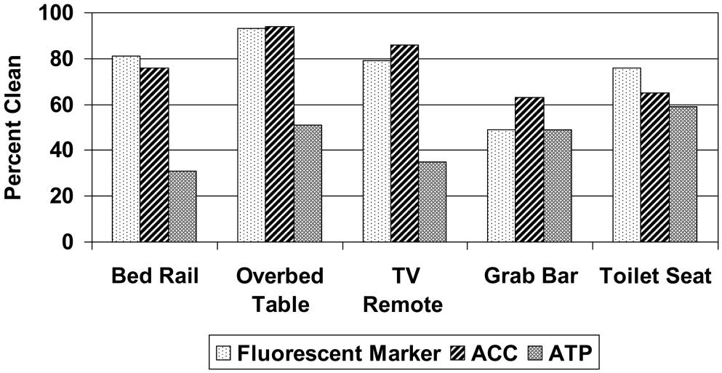
Method comparison
Improve existing procedures
5 sites in 100 patient rooms assessed before and after terminal clean
“Clean” defined as <2.5 cfu/cm², complete removal of fluorescent marker and ATP score of <250 RLU
Boyce et al. Infect Control Hosp Epidemiol 2011;32:1187-1189.

Slide 24
Method comparison
Improve existing procedures
5 sites in 50 patient rooms assessed before and after terminal clean
“Gold standard = <2.5 cfu/cm² compared with complete removal of fluorescent marker and ATP score of <250 RLU
 | Test | Sensitivity (%) | Specificity (%) | PPV (%) | NPV (%)
Overall N = 250 | Dazo | 68 | 50 | 90 | 19
 | ATP | 78 | 38 | 90 | 20
 | Visual | 95 | 9 | 9 | 23
Baseline dirty n = 103 | Dazo | 75 | 40 | 84 | 28
 | ATP | 76 | 35 | 83 | 26
 | Visual | 94 | 10 | 81 | 29
Luick et al. Am J Infect Control 2013 in press.

Slide 25
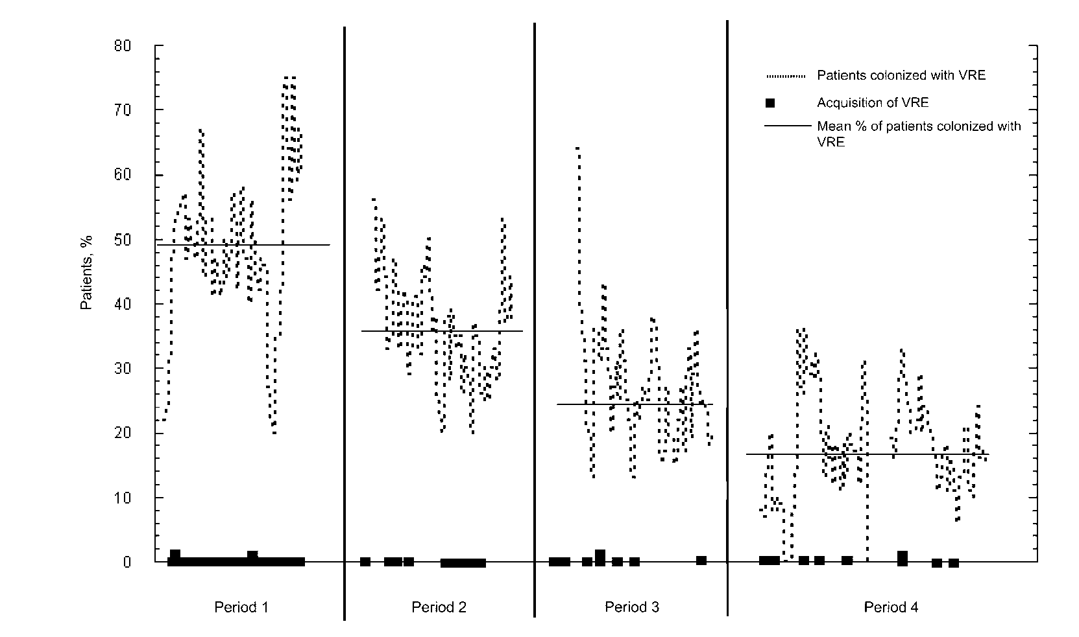
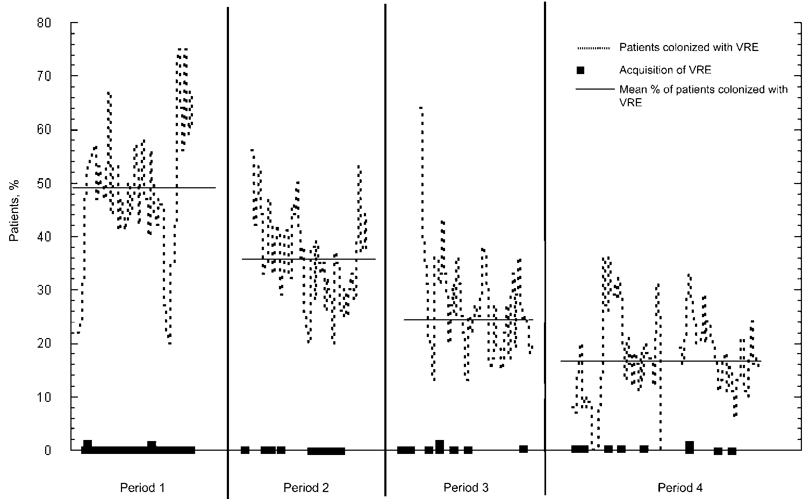
Impact of environmental hygiene intervention on VRE incidence
Research staff monitored cleaners’ work overtly, using a checklist. Cleaners were given immediate, specific feedback about their performance, e.g., “You missed the bedrail.”
% patients
Baseline
Intervention
Washout
HH intervention
Hayden et al. Clin Infect Dis 2006;42:1552-1560.

Slide 26
Improve existing procedures
Try something new!

Slide 27
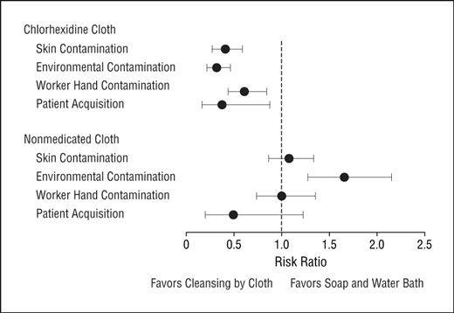
Source control
Try something new!
Daily bathing of patients using chlorhexidine reduces the acquisition of MDROs,^{1,2} including C. difficile.³
Figure from Vernon et al.²
Climo et al. N Engl J Med 2013;368:533-542.
Vernon et al. Arch Intern Med 2006;166:306-312.
Rupp et al. Infect Control Hosp Epidemiol 2012;33:1094-1100.

Slide 28
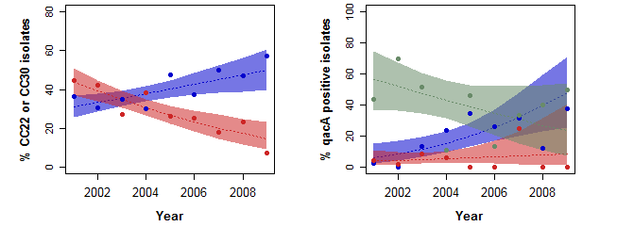
Source control
Try something new!
Proportion of MRSA bloodstream infections caused by CC22 (blue) and CC30 (red)
Carriage of qacA CC22 (blue), CC30 (red) and other (green) clones
Otter et al. J Antimicrob Chemother 2013;68:992-999.

Slide 29
Air control
Try something new!
MRSA contamination of settle plates in multiple locations in the rooms of three patients with MRSA
Boswell & Fox. J Hosp Infect 2006;63:47-54.

Slide 30
Antimicrobial surfaces
Try something new!
Candidate | Pros | Cons
Metal
Copper | Rapidly microbicidal Reduces acquisition | ? Sporicidal Acceptability / retrofitting
Silver | Rapidly microbicidal | ? Sporicidal Tolerance development
Chemical
Organosilane | Easy to apply | Limited microbicidal activity Durability
Light-activated | Broadly microbicidal | ? Sporicidal
Topography
“Liquid glass” | Reduces deposition Improves ‘cleanability’ | Not microbicidal
Sharklet pattern | Reduces deposition Reduced biofilms | Not microbicidal
Page et al. J Mat Chem 2009

Slide 31
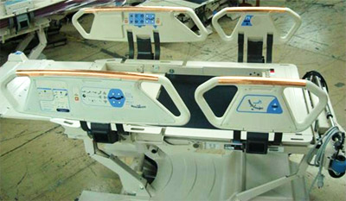
Copper
Try something new!
614 pts in 3 hospitals randomised to ‘copper’ or ‘non-copper’ ICU rooms
-44%
p=0.020
Bedrails
Overbed tables
IV poles
Visitor chair arms
Nurse call button*
Computer mouse*
Computer palm rest*
Rim of monitor*
(* = some rooms only)
-58%
p=0.013
Salgado et al. Infect Control Hosp Epidemiol 2013;34:479-486.

Slide 32
Improve existing procedures
Try something new!

Slide 33
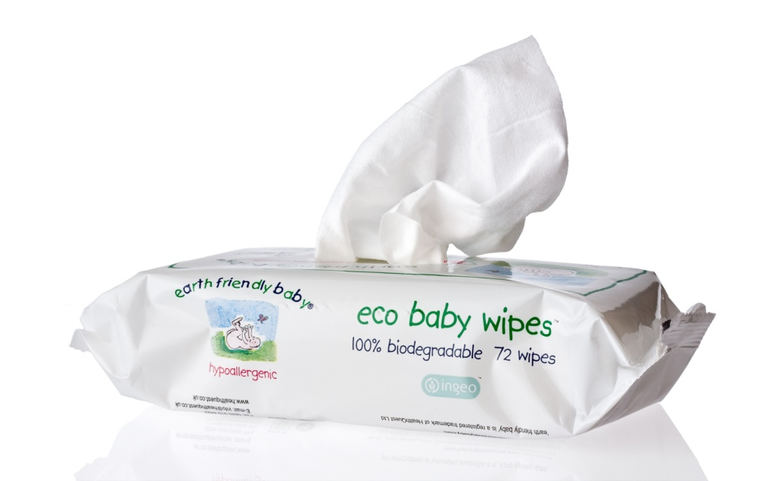
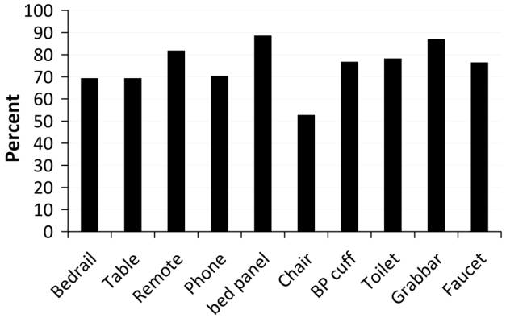
Wipes
Try something new!
Evaluated hydrogen peroxide impregnated wipes by sampling 10 sites in 72 rooms before and after cleaning.
99% of sites <2.5 cfu/cm²
75% of sites no growth after cleaning (figure)
Boyce & Havill. Infect Control Hosp Epidemiol 2013;34:521-523.

Slide 34
Cleaning failure
External
Product
Procedure

Slide 35
‘Given the choice of improving technology or improving human behavior, technology is the better choice’.
Dr Bob Weinstein
Weinstein RA. Emerg Infect Dis 1998;4:416-420.

Slide 36


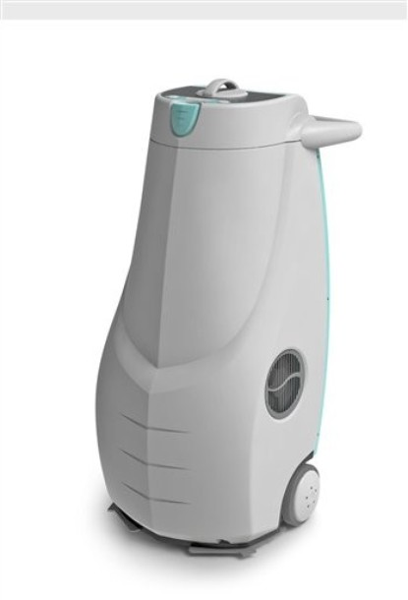
Try something new!
“No touch” disinfection
Hydrogen peroxide vapour (HPV)
Aerosolised hydrogen peroxide (aHP)
Ultraviolet radiation C (UVC)
Pulsed-xenon UV (PX-UV)
Otter et al. J Hosp Infect 2013;83:1-13.

Slide 37
Try something new!
Reduce contamination
140 samples from 9 rooms after 2xbleach
5705 samples from 312 rooms after 4xbleach
2680 sites from 134 rooms after HPV
HPV
Manian et al. Infect Control Hosp Epidemiol 2011;32:667-672.

Slide 38
Try something new!
H₂O₂ systems
Aerosolised hydrogen peroxide (AHP) | Hydrogen peroxide vapour (HPV)
5% H₂O₂ delivered by an aerosol | 35% H₂O₂ delivered as a vapour
Cycle time >2 hrs, single room | Cycle time < 2 hrs, single room
Reduction in contamination but not elimination of pathogens; problems with catalase-positive bacteria | Elimination of pathogens
Incomplete distribution | Homogeneous distribution
No published controlled studies demonstrating a reduction in acquisition | Several published studies showing reduced acquisition
Otter et al. J Hosp Infect 2013;83:1-13.

Slide 39
Try something new!
H₂O₂ systems
52 % reduction
100% reduction
85% reduction
86% reduction
89% reduction
Boyce et al.
Barbut et al.
Shapey et al.
Best et al.
Yui et al.

Slide 40
Try something new!
HPV – clinical impact
Patients admitted to rooms decontaminated using HPV were 64% less likely to acquire any MDRO (incidence rate ratio [IRR]=0.36, CI=0.19-0.70, p<0.001)
64% reduction in the rate of MDRO acquisition
Standard cleaning / disinfection
HPV decontamination
Passaretti et al. Clin Infect Dis 2013;56:27-35.

Slide 41
Try something new!
UV systems
UVC | PX-UV
Continuous UVC (254nm) | Pulsed broad spectrum (200-320nm) UV
May control dose using feedback loop | No feedback loop
Single or dual room location | Multiple room locations (usually 3)
Cycle time range from ~15 to 90 min | Cycle time ~15 mins
1-3 log in C. difficle and 3-4 log reduction in MRSA and VRE;¹⁻⁵ incomplete inactivation of pathogens on hospital surfaces.^{1,4,6} | Limited efficacy data published⁷
Significantly less effective out of direct line of sight¹⁻⁵ | No published data, but likely to be less effective out of direct line of sight
Emerging evidence of clinical impact. | Evidence of reduction of CDI⁸
Nerandzic et al. BMC Infect Dis 2010;10:197.
Mahida et al. J Hosp Infect 2013 in press.
Boyce et al. Infect Control Hosp Epidemiol 2011;32:737-742.
Rutala et al. Infect Control Hosp Epidemiol 2010;31:1025-1029.
Havill et al. Infect Control Hosp Epidemiol 2012;33:507-512.
Anderson et al. Infect Control Hosp Epidemiol 2013;34:466-471.
Stibich et al. Infect Control Hosp Epidemiol 2011;32:286-288.
Levin et al. Am J Infect Control in press.

Slide 42
Try something new!
UVC v PX-UV
Log reductions achieved by a UVC (Tru-D) device and PX-UV (Xenex) when run for 10 mins from the same point in the room 4ft from the coupons.
Nerandzic et al. Infect Control Hosp Epidemiol 2015 in press.

Slide 43
Try something new!
UVC clinical impact
Randomised study over >2 years across 9 hospitals including >25,000 exposed patients (admitted into a room where the previous occupant was known to have an MDRO).
Each hospital performed a randomised sequence of different terminal room disinfection approaches: quaternary ammonium compound (QAC) disinfection (control group), bleach, QAC+UVC, and bleach+UVC.
The primary outcome was the acquisition rate of a composite group of MDROs (MRSA, VRE, C. difficile, and MDR Acinetobacter species).
Compared with the control group, patients admitted into a room decontaminated using UVC were significantly less likely to acquire an MDRO; this difference was 37% (p=0.03) when rooms were pre-cleaned using QAC, and 32% (p=0.01) when rooms were pre-cleaned using bleach.
Surprisingly, patients admitted to rooms disinfected using bleach were not significantly less likely to acquire MDROs compared with the control group (p=0.08).
Anderson et al. ID Week 2015.

Slide 44
Try something new!
HPV vs UV
Characteristics | HPV | UV systems
Cycle time (for single room) | 90 mins | 15 mins to >1hr
Practicalities | Door and air vent sealing and leak detection required | No door and air vent sealing or leak detection required
Distribution | Homogeneous | Affected by line of sight
Microbiological efficacy | Elimination of pathogens from surfaces; 6-log sporicidal reduction | Does not eliminate pathogens from surfaces; 1-3 log sporicidal reduction
Evidence of clinical impact | Published evidence | Emerging evidence
Cost | Lower purchase cost; higher running costs | Higher purchase cost; lower running costs
Otter et al. J Hosp Infect 2013;83:1-13.

Slide 45
Improve existing procedures
Try something new!

Slide 46
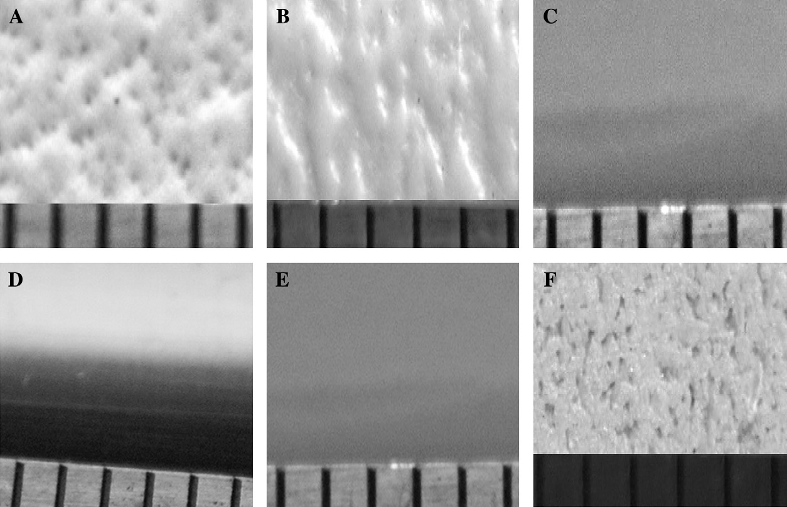
Try something new!
Design
The surface finish of 6 hospital bedrails; ease of cleaning was inversely proportional to the transfer of S. aureus from the surfaces
Ali et al. J Hosp Infect 2012;80:192-198.

Slide 47
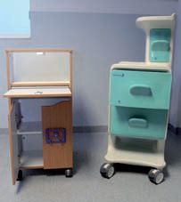
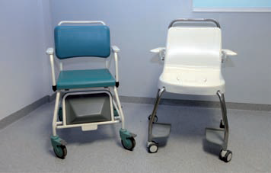
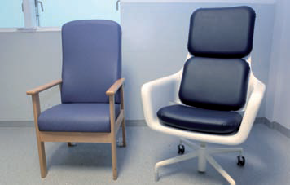
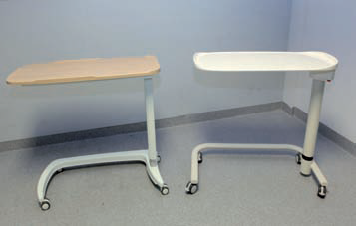
Try something new!
“Design bugs out!”
Design Bugs Out – Product Evaluation Report. The Healthcare Associated Infection Technology Innovation Programme. UK Department of Health. 2011.

Slide 48
Improve existing procedures
Try something new!

Slide 49
Learning objectives
Understand the key data supporting the role of contaminated surfaces in the transmission of hospital pathogens
Become familiar with the various methods to improve the efficacy of hospital disinfection:
  Tools such as ATP assays and fluorescent markers to evaluate the thoroughness of the cleaning process;
  Methods to improve the education and training of cleaning staff.
Discuss the results of improved cleaning and disinfection in reducing transmission of pathogens
Understand other and emerging approaches including:
  Measures to reduce and contain shedding more effectively;
  New disinfectants, cleaning materials and consideration of automated systems;
  Antimicrobial surfaces;
  Improved design to improve ‘cleanability‘.

