Slide 1

Introduction to epidemiology (and infection)
Jon Otter, PhD FRCPath
Imperial College Hospitals NHS Trust
jon.otter@imperial.nhs.uk
@jonotter
Blog: www.ReflectionsIPC.com
You can download these slides from www.jonotter.net

Slide 2
Study designs
Observational
  Case-control study
  Cohort study
Experimental
  Randomised controlled trial (RCT)
  Cluster RCT
  Before-after study (‘quasi-experimental study’)
Literature
  Meta-analysis

Slide 3
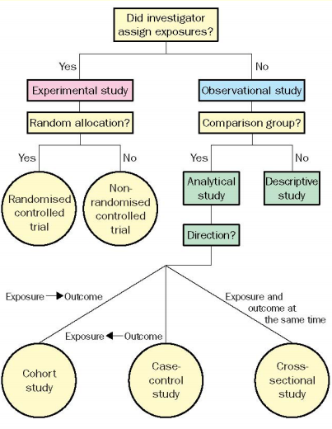
Study designs
Grimes et al. Lancet 2002;359:57-61.

Slide 4
Statistical methods
Descriptive
  Continuous or categorical variables
  Parametric and non-parametric
Hypothesis testing
  Univariate and multiple regression
  Time series analysis

Slide 5
The power of the p value
A population = all members of a given population (e.g. all patients admitted to an intensive care unit)
A sample = the available selection of patients included in the study
Descriptive statistics = techniques used to describe the main features of the sample
Inferential statistics = techniques used to make an informed guess about the population based on the sample
Odds ratio (OR) = [number of patients affected] / [all patients in the sample]
Confidence interval (CI) = measure of variation around an estimate
Incidence rate (IR) = [number of patients affected] / [sum of the length of stay of all patients in the sample, typically divided by 1000]
Relative risk (RR) = [OR of one sample] / [OR of another sample]
Incidence rate ratio (IRR) = [IR of one sample] / [IR of another sample]

Slide 6
Hypothesis testing
You have a group of two samples (e.g. infection rates before and after an intervention) and you want to know whether the difference is statistically significant (i.e. could the difference between the two groups be explained by chance alone)
You make a “null hypothesis”, which is that there is no difference between the two groups
You use a statistical method to test this, which returns a p value
The p value is the probability that the observed difference between the two groups is due to chance. Therefore, if p = 0.50, there is a 50% chance that the observed difference between the two groups is due to chance
Typically, p <0.05 is considered statistically significant (i.e. there is a <5% chance that the observed difference between the two groups is due to chance)
If p<0.05, the null hypothesis is rejected and there is a statistically significant difference

Slide 7
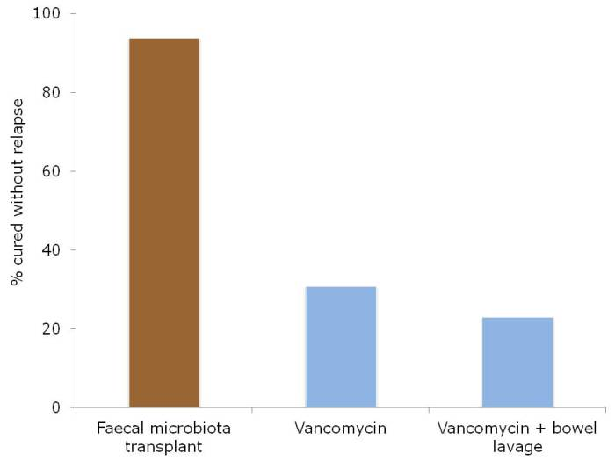
For example…RCT
Faecal microbiota transplant for recurrent CDI. Patients with recurrent CDI randomised to FMT (n=16), vancomycin (n=12) or vancomycin + bowel lavage (n=13).
Colour scheme chosen carefully.
van Nood et al. N Engl J Med 2013;368:407-415.

Slide 8
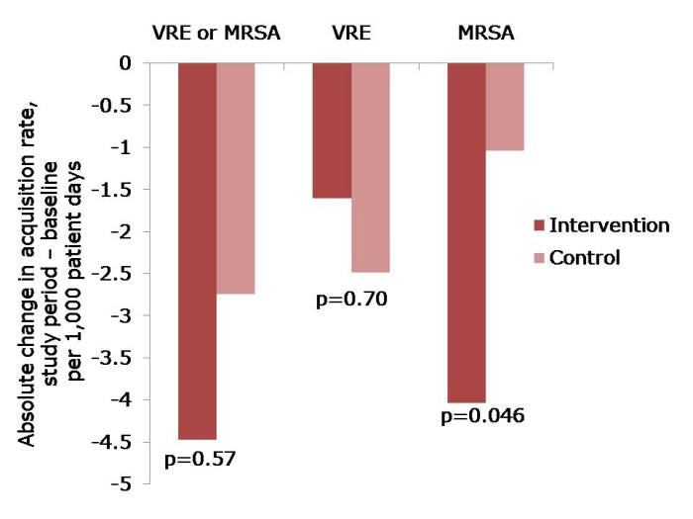
For example…cluster RCT
The change in acquisition rate, comparing the baseline period with the study period for the 20 randomised intervention and control ICUs.
Harris et al. JAMA 2013;310:1571-1580.

Slide 9
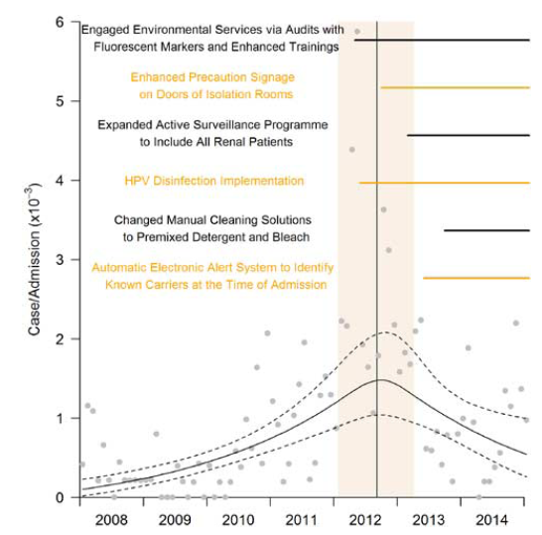
For example…time series analysis
Rate of new VRE cases of infection or colonization
per 1,000 admissions. The breakpoint in rate in August 2012
corresponds to the implementation a bundle of interventions.
Fisher et al. Infect Control Hosp Epidemiol 2016;37:107-109.

Slide 10

For example…meta-analysis
Mitchell et al. J Hosp Infect 2015;91:211-217.

Slide 11
Introduction to epidemiology (and infection)
Jon Otter, PhD FRCPath
Imperial College Hospitals NHS Trust
jon.otter@imperial.nhs.uk
@jonotter
Blog: www.ReflectionsIPC.com
You can download these slides from www.jonotter.net

