Slide 1

My favourite papers on…environmental decontamination
Jon Otter, PhD FRCPath
Imperial College Healthcare NHS Trust
jon.otter@imperial.nhs.uk
@jonotter
Blog: www.ReflectionsIPC.com
You can download these slides from www.jonotter.net

Slide 2
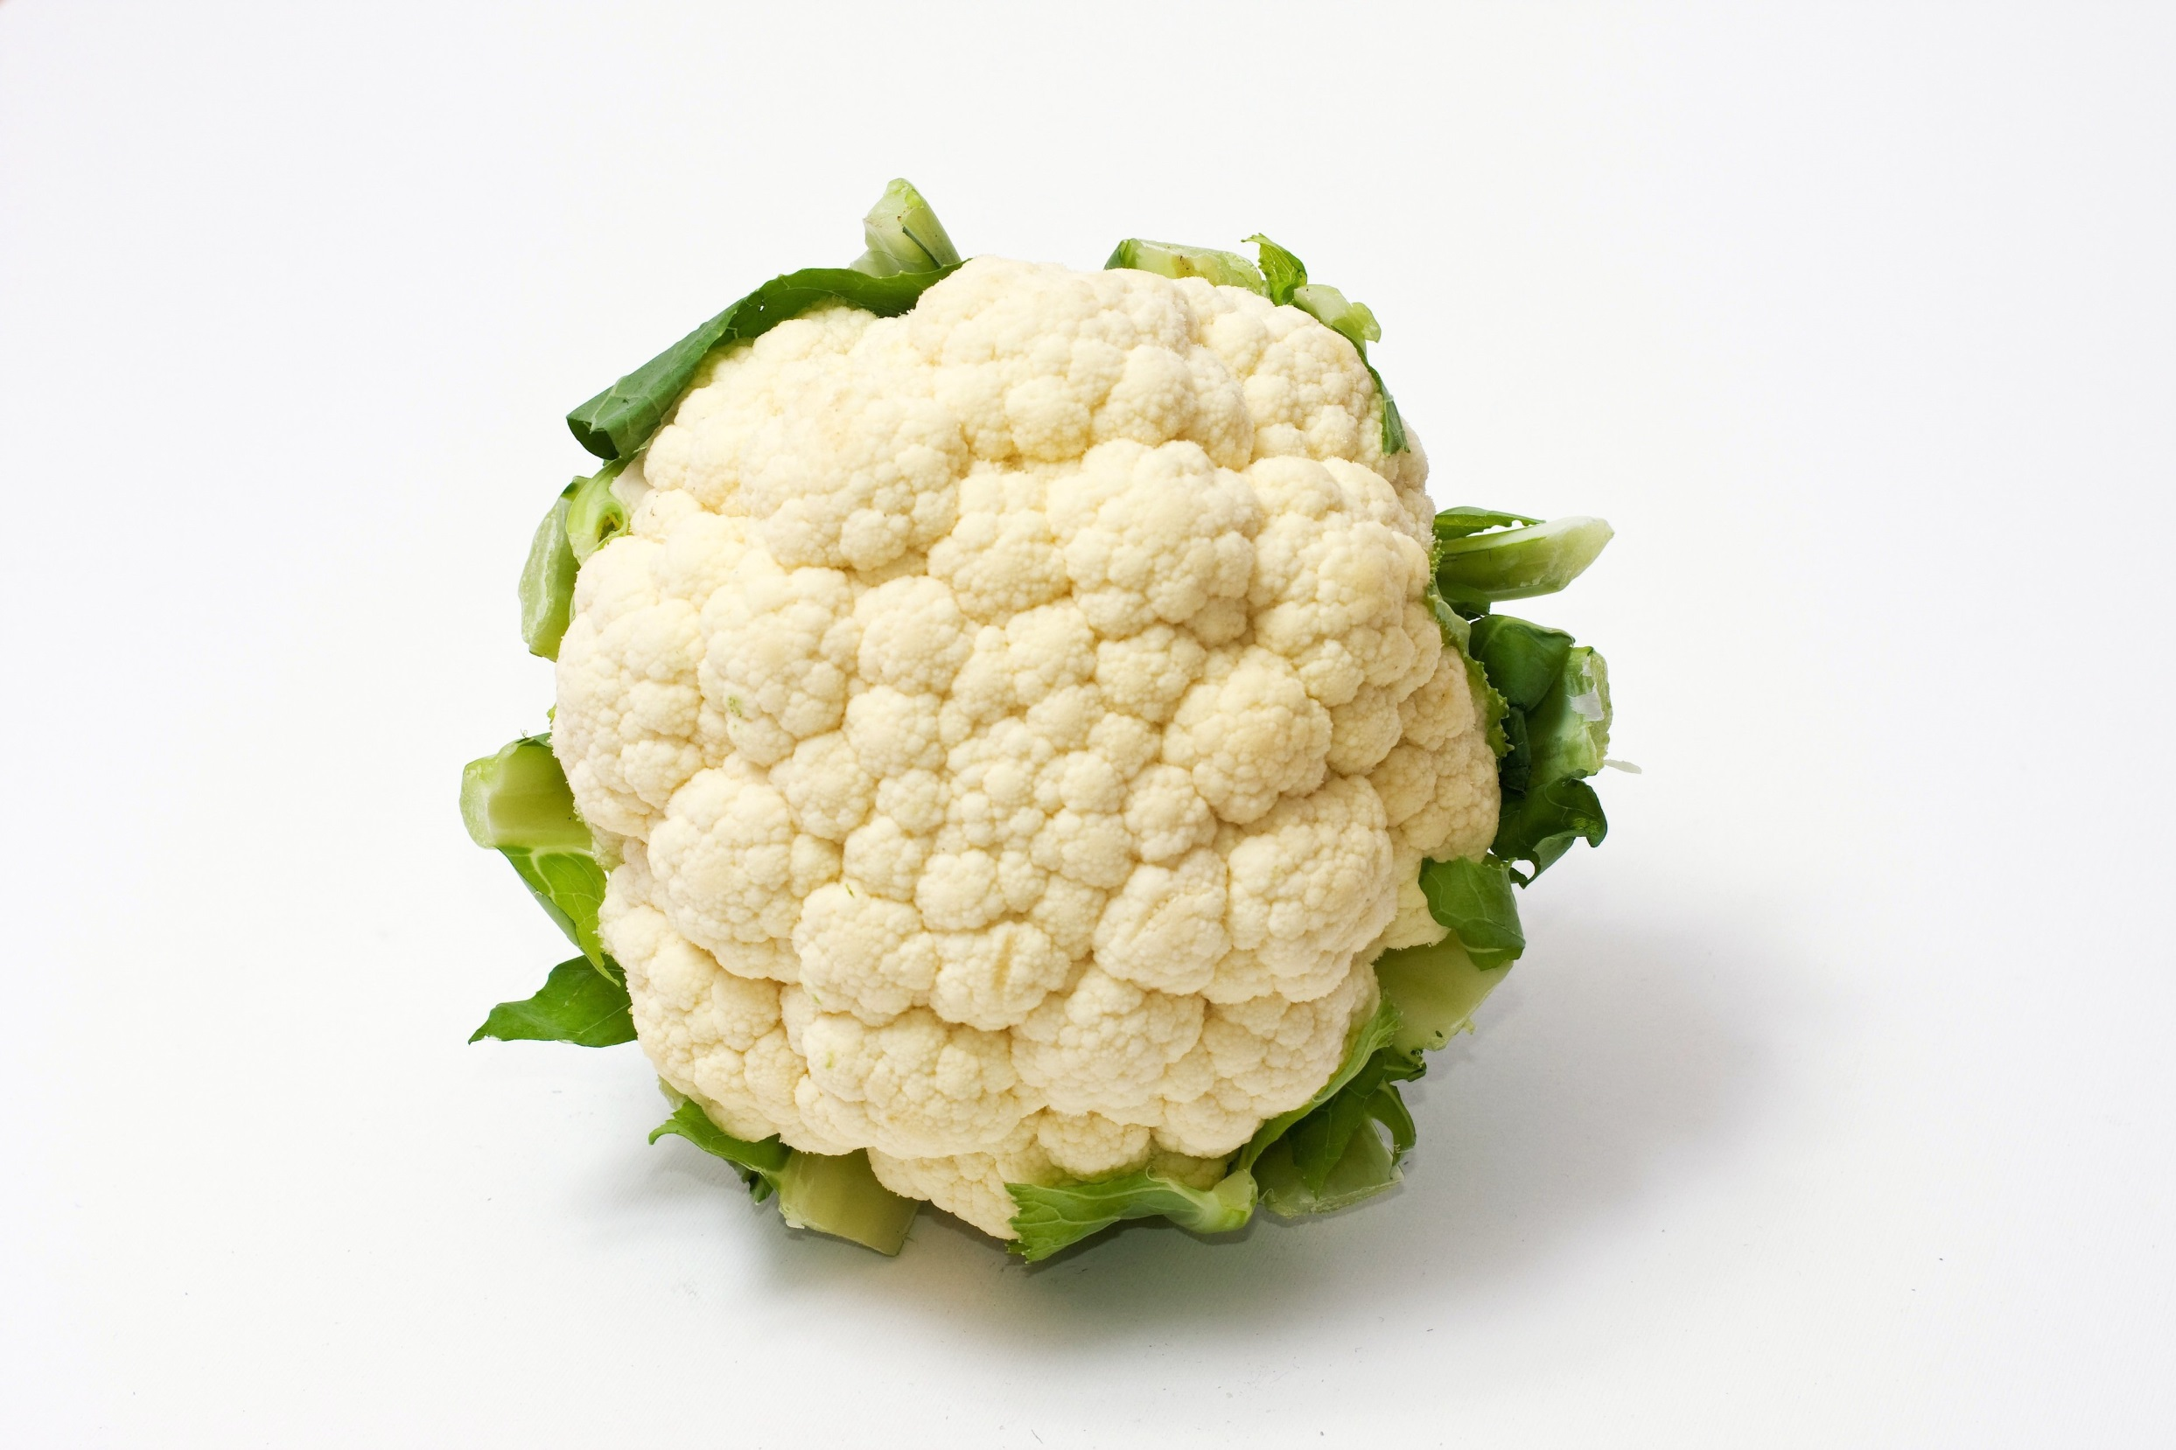

Slide 3

Transfer of a surrogate marker in a NICU
Oelberg et al. Pediatrics 2000;105:311-315.

Slide 4

Transfer over time: inoculated pod

Slide 5

Transfer of a surrogate marker in a NICU

Slide 6

Your hospital room can make you sick!
Mitchell et al. J Hosp Infect 2015;91:211-217.

Slide 7
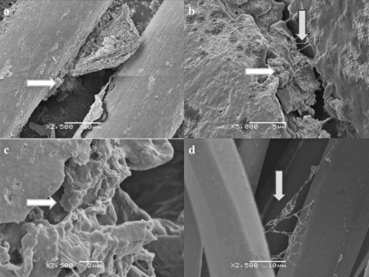
Rethinking the ‘inanimate’ environment
Scanning electron microscopy identified biofilm on 5/6 dry hospital surfaces from an Australian ICU (including MRSA on 3/5).¹
Followup study identified biofilm on 41/44 (93%) of surfaces in an ICU; MRSA from 18%, ESBL from 11% and VRE from 8% of the samples.²
Could explain why vegetative bacteria can survive on dry hospital surfaces for so long
Be part of the reason why they are so difficult to remove or inactivate using disinfectants
Explain (to some degree) the difficulty in recovering environmental pathogens by surface sampling
1. Vickery et al. J Hosp Infect 2012;80:52-55.
2. Hu et al. J Hosp Infect 2015;91:35-44.

Slide 8
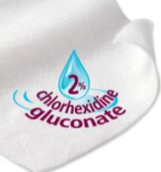
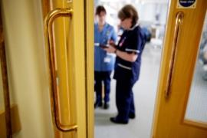



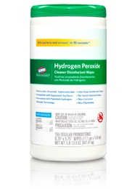

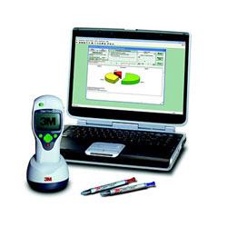

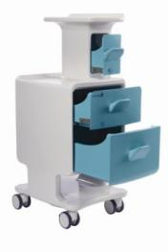
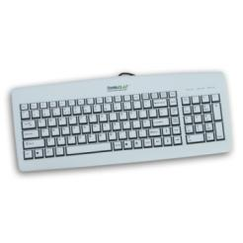
Improve existing procedures
Try something new!

Slide 9
Contamination-sparing therapy?
n = 66 patients (rooms) and 264 surfaces for vancomycin / metronidazole, and 68 patients (rooms) and 272 surfaces for fidaxomycin. p<0.05 for both rooms and surfaces.
Biswas et al. J Hosp Infect 2015;90:267-270

Slide 10
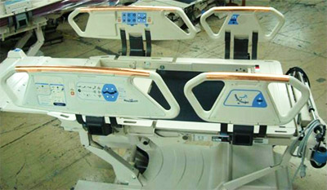
Antimicrobial surfaces (e.g. copper)
614 pts in 3 hospitals randomised to ‘copper’ or ‘non-copper’ ICU rooms
-44%
p=0.020
Bedrails
Overbed tables
IV poles
Visitor chair arms
Nurse call button*
Computer mouse*
Computer palm rest*
Rim of monitor*
(* = some rooms only)
-58%
p=0.013
Salgado et al. Infect Control Hosp Epidemiol 2013;34:479-486.

Slide 11
Control contamination at the source
Pre-post study in a 16-bed ICU in Korea; CHG daily bathing implemented for 12 months after 14-month pre-intervention period. Significant reduction in rate of carbapenem-resistant Acinetobacter baumannii acquisition and environmental contamination.
Chung et al. Am J Infect Control 2015;43:1171-1177.

Slide 12
Improve existing procedures
Try something new!

Slide 13
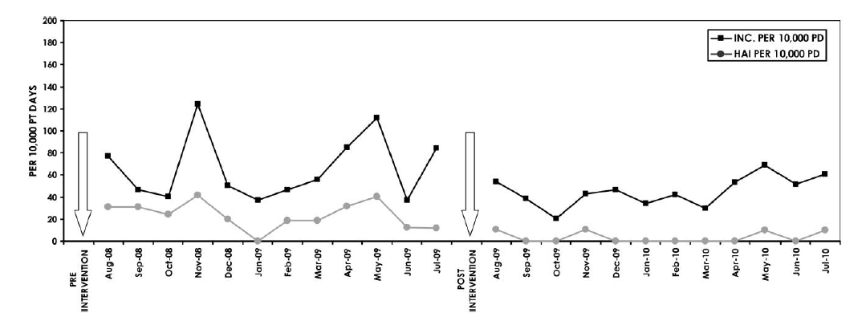
Wiping away infection
Impact of changing from QAC to bleach wipes for daily disinfection of all rooms. Cleaning thoroughness was 97-98% throughout the study using ATP benchmarking (<250 RLUs).
2.4
cases / 1000 patient days
0.4
cases / 1000 patient days
Orenstein et al. Infect Control Hosp Epidemiol 2011;34:521-523.

Slide 14


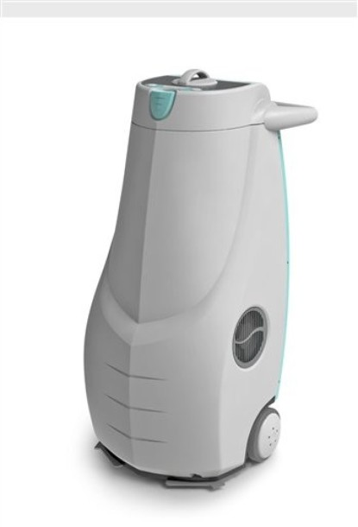
Automated room decontamination
Hydrogen peroxide vapour (HPV)
Aerosolised hydrogen peroxide (AHP)
Ultraviolet radiation C (UVC)
Pulsed-xenon UV (PX-UV)
Otter et al. J Hosp Infect 2013;83:1-13.

Slide 15
HPV: clinical impact
30-month prospective cohort intervention study performed on 6 high-risk units (5 ICUs) including 8813 patients at Johns Hopkins Hospital.
64% reduction in the rate of MDRO acquisition
Standard cleaning / disinfection
HPV decontamination
Passaretti et al. Clin Infect Dis 2013;56:27-35.

Slide 16
UVC vs. PX-UV
Log reductions achieved by a UVC (Tru-D) device and PX-UV (Xenex) when run for 10 mins from the same point in the room 4ft from the coupons.
PX-UV
Nerandzic et al. Infect Control Hosp Epidemiol 2015;36:192-197.

Slide 17
UVC: clinical impact
Randomised study over >2 years across 9 hospitals including >25,000 exposed patients (admitted into a room where the previous occupant was known to have an MDRO).
Each hospital performed a randomised sequence of different terminal room disinfection approaches: quaternary ammonium compound (QAC) disinfection (control group), bleach, QAC+UVC, and bleach+UVC.
The primary outcome was the acquisition rate of a composite group of MDROs (MRSA, VRE, C. difficile, and MDR Acinetobacter species).
Compared with the control group, patients admitted into a room decontaminated using UVC were significantly less likely to acquire an MDRO; this difference was 37% (p=0.03) when rooms were pre-cleaned using QAC, and 32% (p=0.01) when rooms were pre-cleaned using bleach.
Surprisingly, patients admitted to rooms disinfected using bleach were not significantly less likely to acquire MDROs compared with the control group (p=0.08).
Anderson et al. ID Week 2015.

Slide 18
UVC vs. HPV
Characteristics | HPV | UV systems
Cycle time (for single room) | 90 mins | 15 mins to >1hr
Practicalities | Door and air vent sealing and leak detection required | No door and air vent sealing or leak detection required
Distribution | Homogeneous | Affected by line of sight
Microbiological efficacy | Elimination of pathogens from surfaces; 6-log sporicidal reduction | Does not eliminate pathogens from surfaces; 1-3 log sporicidal reduction
Evidence of clinical impact | Published evidence | Emerging evidence
Cost | Lower purchase cost; higher running costs | Higher purchase cost; lower running costs
Otter et al. J Hosp Infect 2013;83:1-13.

Slide 19
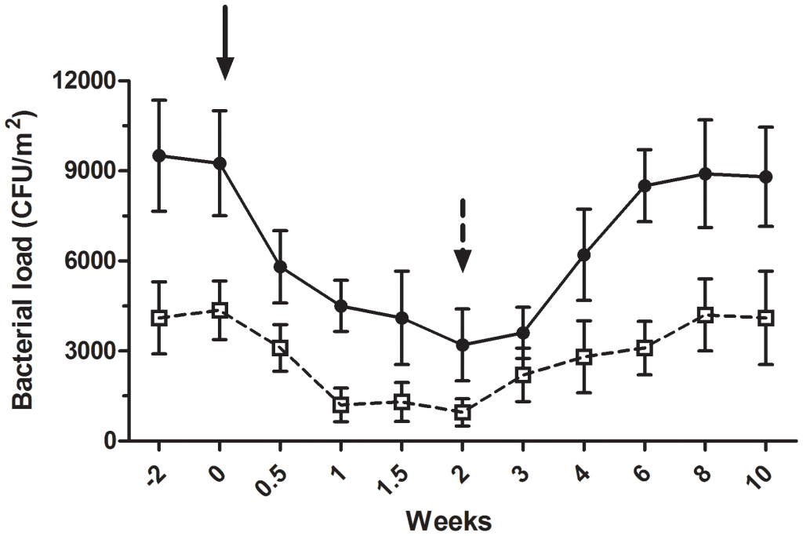
And finally…spread contamination to stop contamination?
Bacterial load of coliforms (black circles) and S. aureus (white circles). Black arrow = beginning of the “live” cleaning agent; black dotted arrow = conventional cleaning agent.
Vandini et al. PLoS One 2014;26;9(9):e108598.
More here if you’re interested.

Slide 20
Improve existing procedures
Try something new!

Slide 21
My favourite papers on…environmental decontamination
Jon Otter, PhD FRCPath
Imperial College Healthcare NHS Trust
jon.otter@imperial.nhs.uk
@jonotter
Blog: www.ReflectionsIPC.com
You can download these slides from www.jonotter.net

