Slide 1


Social media for healthcare professionals: useful or a waste of time?
Jon Otter, PhD FRCPath
Imperial College Healthcare NHS Trust
jon.otter@imperial.nhs.uk
@jonotter
Blog: www.ReflectionsIPC.com
You can download these slides from www.jonotter.net

Slide 2
Disclosures & credits
In the last 3 years:
Consultancy fees to Gama Healthcare Ltd.
Lecture fees to ACIPC, Becton Dickenson, Bioconnections, GovToday, Healthcare Estates, IPS, Serosep, Society For Applied Microbiology, Webber Training, and 3M.
Academic fees to EIDO Ltd, Infectious Diseases Society of America, Imperial College London, Journal of Hospital Infection, and Woodhead Publishing Ltd.
Research funding from the Guy’s and St. Thomas’ Charity, NIHR, FDA, Pfizer.
Part-time employment at Bioquell (ended 03/2015).
Image credits:
Social Media, Social Media Phone, Social Media Montage, Mobile Device Size Evolution, Dinosaur.

Slide 3
“STOP WASTING TIME ON SOCIAL MEDIA AND DO SOME REAL WORK”
Slight (and only slight) paraphrase of a Professor’s comment to me during a recent discussion about whether an infection control journal should have an active Twitter feed.

Slide 4
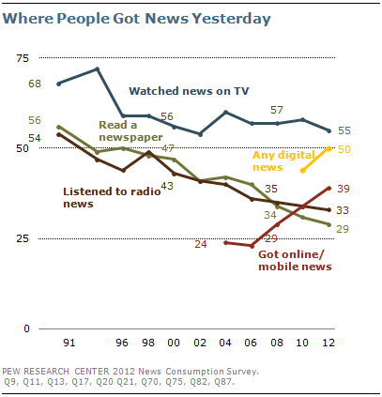
The way we’re learning is changing
Pew survey of access to news, US.

Slide 5
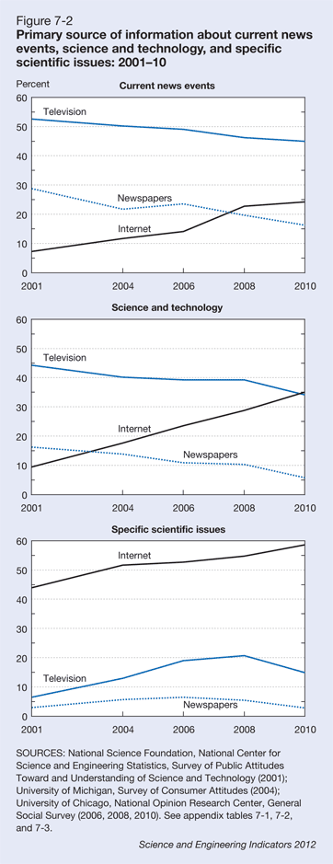
Google it.
2010 General Social Survey, National Science Foundation. Other search engines are available.

Slide 6
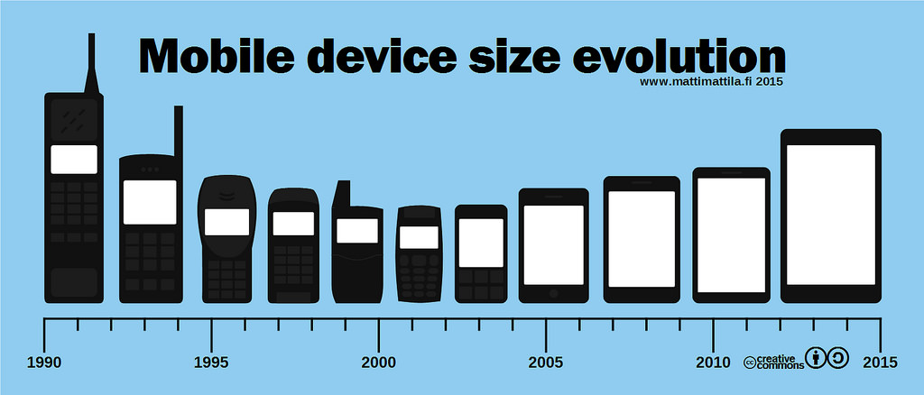

Slide 7
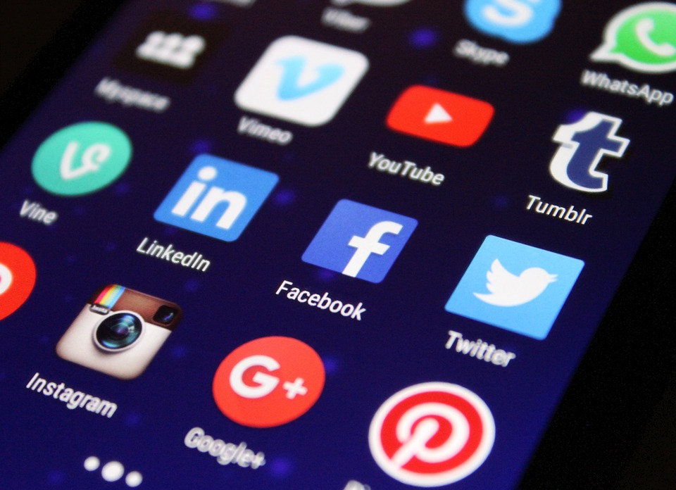

Slide 8
What is social media?
Social media describes web-based applications that allow people to create and exchange content to include:
blogs and microblogs (such as Twitter),
internet forums (such as doctors.net),
content communities (such as YouTube and Flickr), and
social networking sites (such as Facebook and LinkedIn).
GMC: Doctors’ use of social media guidelines.

Slide 9
Social media – common features
Instant gratification! No rigour
Short attention span
Online dialogue with non-expert idiots
Public sharing of dirty laundry
Web-based unreliable sources
Always on never home
Free You get what you pay for

Slide 10
Social media – common features
Instant gratification! No rigour
Short attention span
Online dialogue with non-expert idiots
Public sharing of dirty laundry
Web-based unreliable sources
Always on never home
Free you get what you pay for

Slide 11
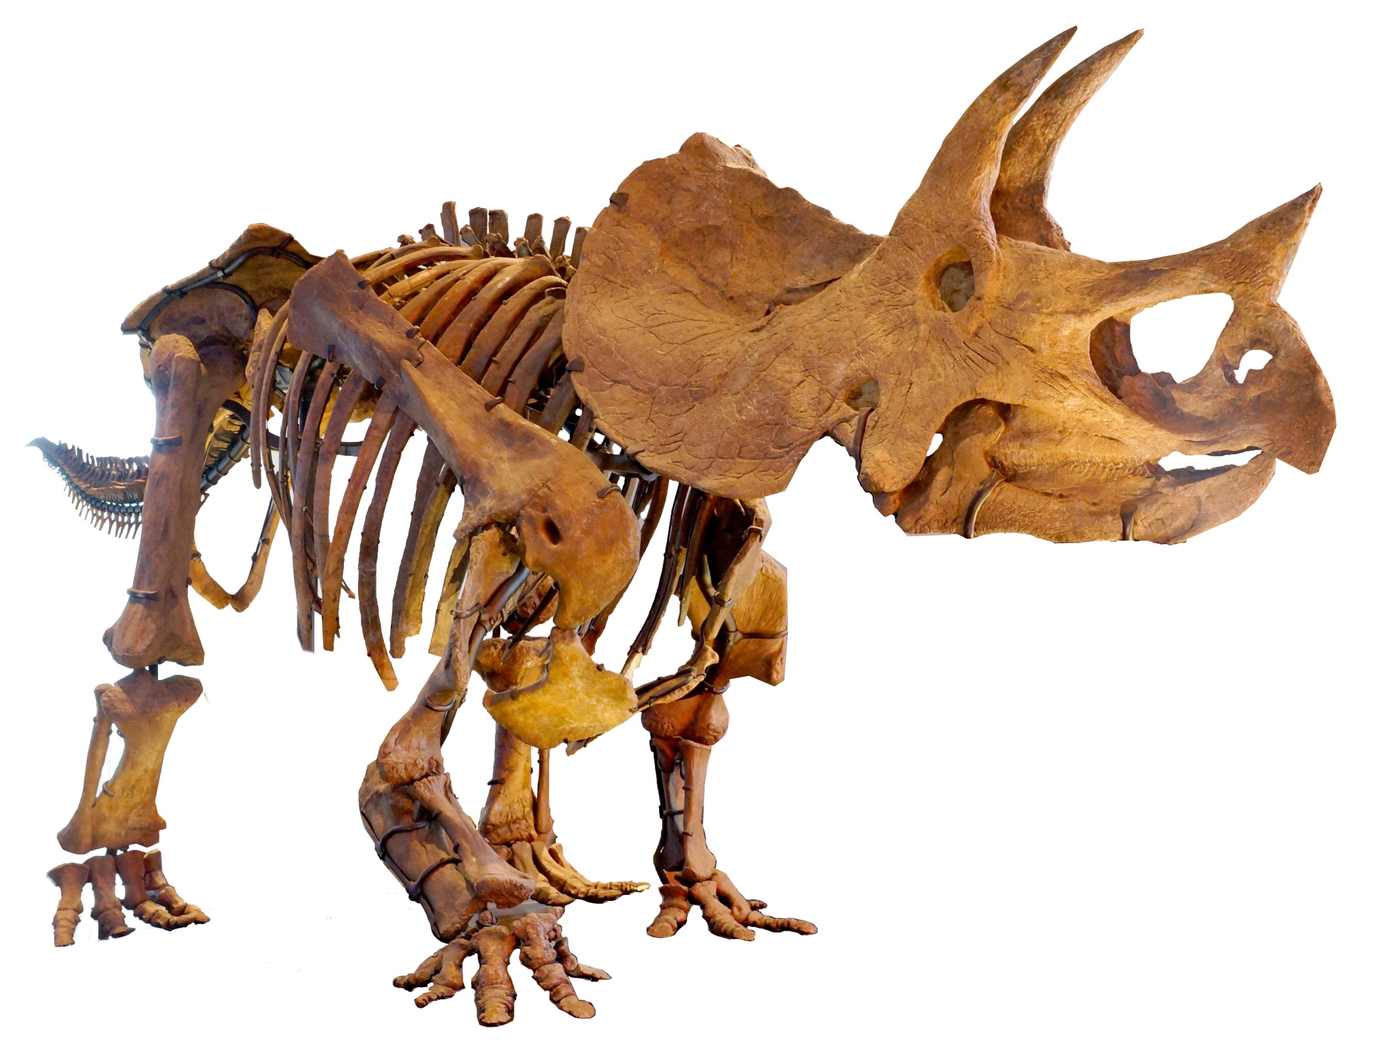

Slide 12
Selling your ideas (or anything, really)
Know your audience
Understand the need
Listen to the client
Be part of a convincing brand
Be quietly tenacious

Slide 13
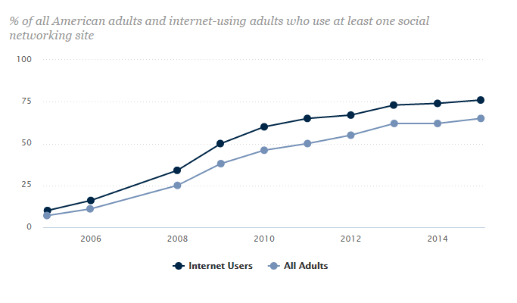
Trends in social media use
Pew survey of social media usage, US.

Slide 14
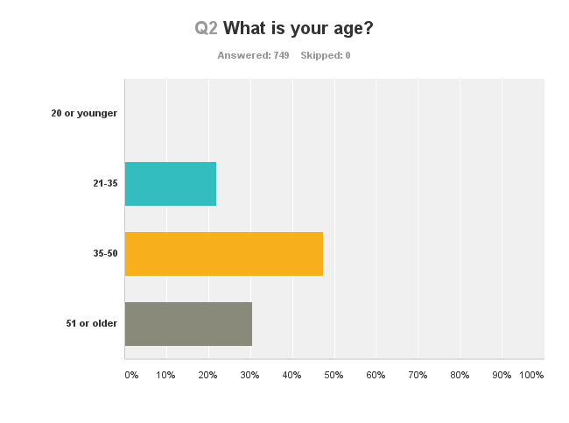
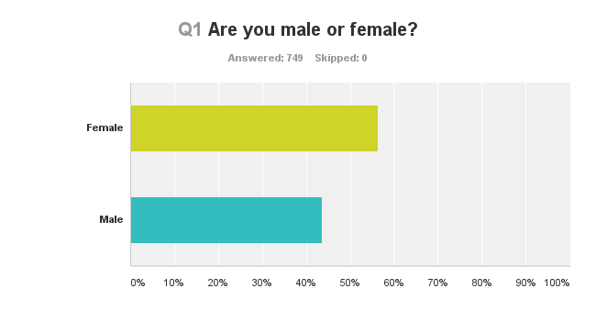
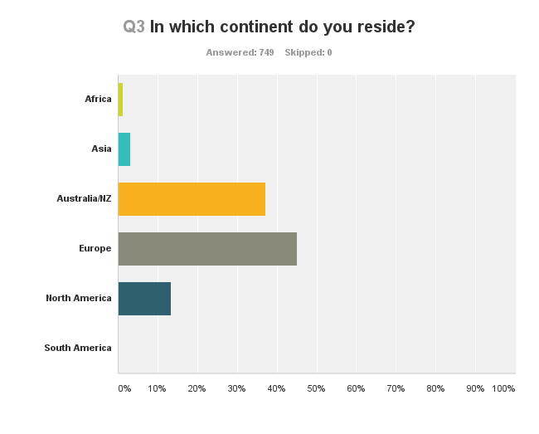
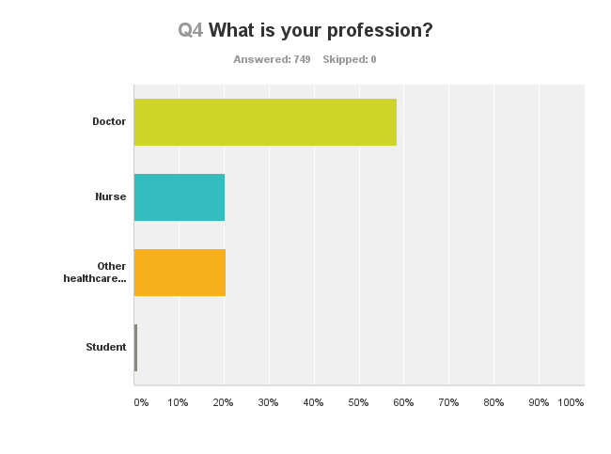
Social media use by healthcare professionals
n=749.

Slide 15
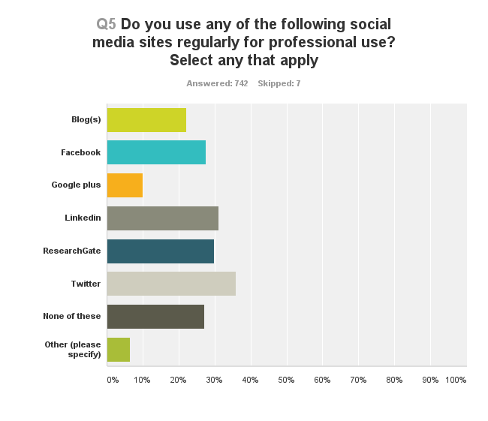
Social media use by healthcare professionals
n=749. No significant correlation between gender, age, location or profession, and social media use.

Slide 16
Twitter use by healthcare professionals
 |  | Total | Twitter user | % | Univariate | Multi-variable | OR | 95% CI
Gender | Female | 422 | 137 | 32.5 | 0.048 | 0.003 | 0.6 | (0.4-0.8)
 | Male (reference) | 327 | 129 | 39.4 | -
Age | 34 or less | 165 | 59 | 35.8 | 0.279 | 0.105 | 1.5 | (0.9-2.3)
 | 35-50 | 355 | 137 | 38.6 | 0.048 | 0.011 | 1.6 | (1.1-2.3)
 | 51 or older (reference) | 229 | 70 | 30.6 | -
Location | Africa | 9 | 7 | 77.8 | 0.097 | 0.060 | 4.8 | (0.9-25.0)
 | Asia | 23 | 7 | 30.4 | 0.154 | 0.302 | 0.6 | (0.2-1.6)
 | Australia/NZ | 279 | 70 | 25.1 | <0.001 | 0.007 | 0.5 | (0.3-0.8)
 | Europe | 338 | 135 | 39.9 | 0.209 | 0.302 | 0.8 | (0.5-1.2)
 | North America (reference) | 100 | 47 | 47.0 | -
Profession | Doctor (reference) | 438 | 128 | 29.2 | - | -
 | Nurse | 152 | 59 | 38.8 | 0.029 | 0.004 | 1.9 | (1.2-2.9)
 | Other healthcare professional | 153 | 76 | 49.7 | <0.001 | 0.000 | 2.3 | (1.5-3.5)
 | Student | 6 | 3 | 50.0 | 0.283 | 0.536 | 1.7 | (0.3-9.0)
n=749.

Slide 17


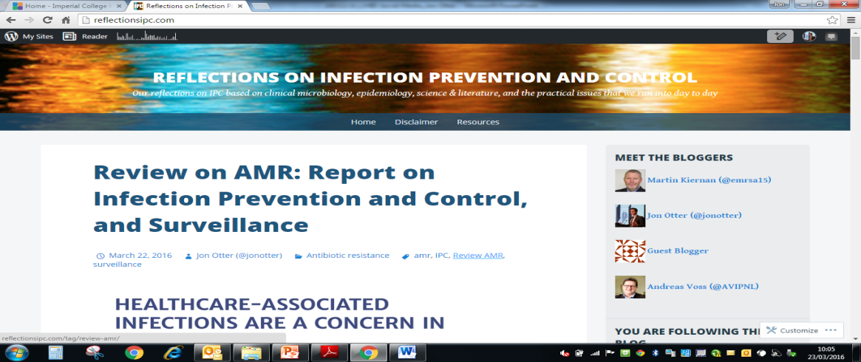
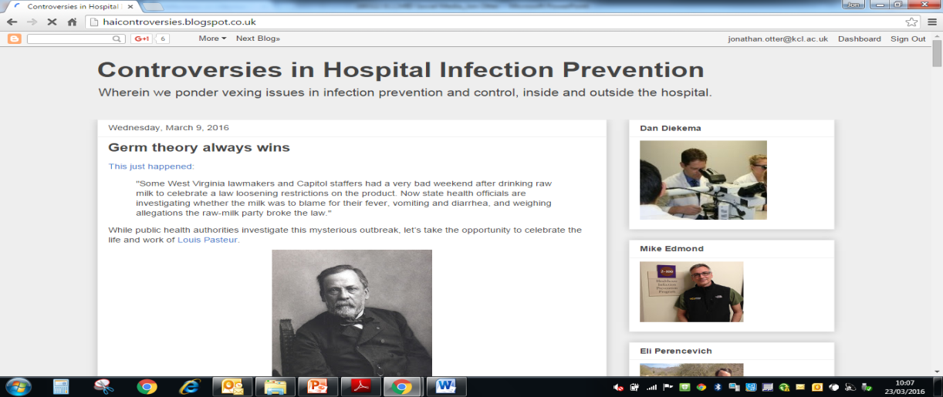
Blogs
Free and easy to set-up.
Posts can be as long or short, and regular or irregular as you like!
Often linked with other social media to spread the word (Twitter, Google+ etc)

Slide 18

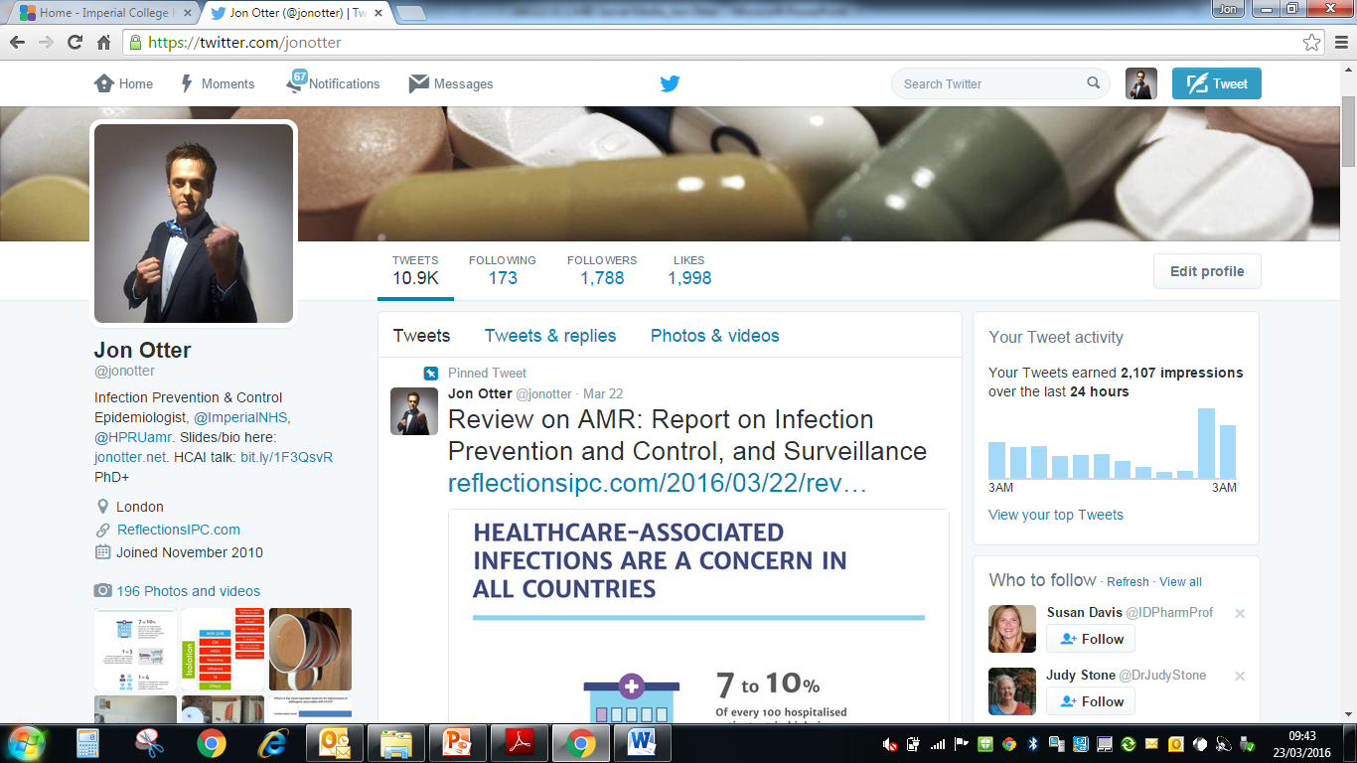
Twitter - individual
Personal newsfeed
No trolls
Time-neutral
Linked to blog
Tweeps
Conference #s

Slide 19
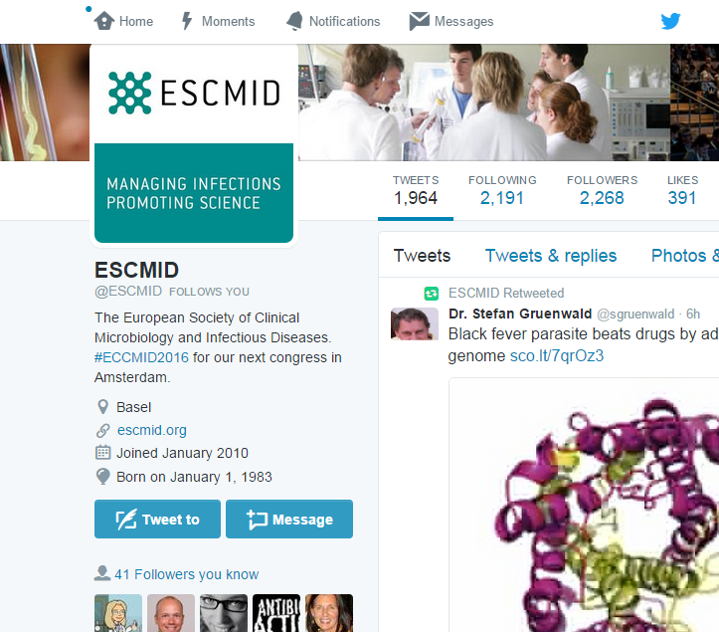
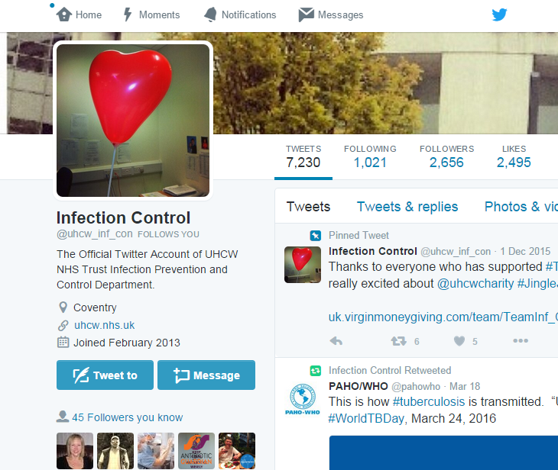
Twitter - organisation
Many hospitals, organisations, some clinical teams, and companies now have active Twitter feeds.

Slide 20
Twitter - getting started
Register (free!) at www.twitter.com
Create short username (creative, not weird)
Upload selfie (again, creative, not weird)
Write a bio (once again, creative, not weird)
Get following (individuals, organisations, journals)
Get tweeting!
Adapted from Goff et al. Clin Infect Dis 2015:1533-1540, which includes useful suggestions for who to follow.

Slide 21
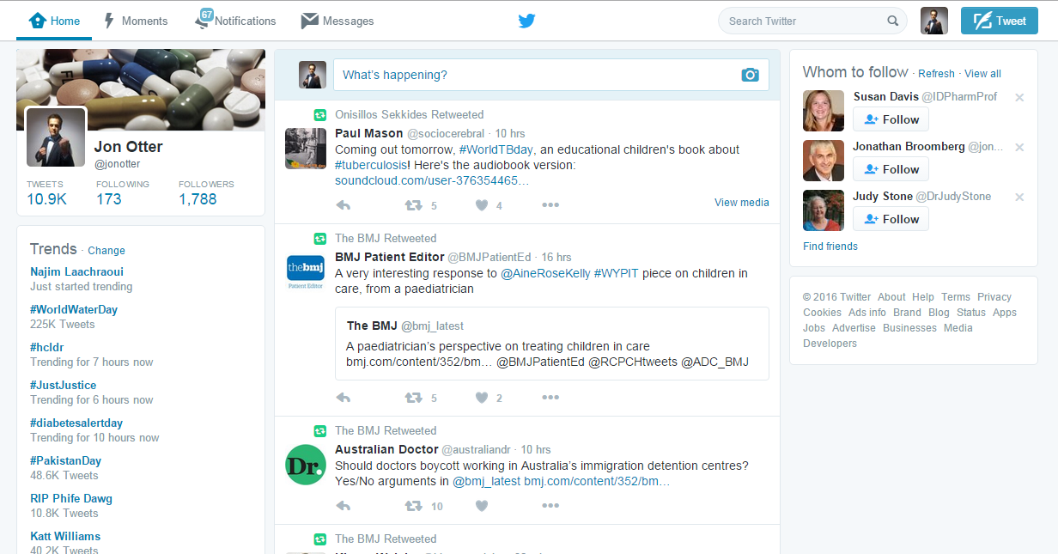
Learning to speak ‘Twitter’
Notifications = your Tweets scored some responses
Direct Message (DM) = Twitter’s ‘email’
# = search tag
Retweet = share with your followers
Favourite = Twitter’s ‘like’

Slide 22
Learning to speak ‘Twitter’
Following = people who follow you
Followers = people who follow you
Bio

Slide 23
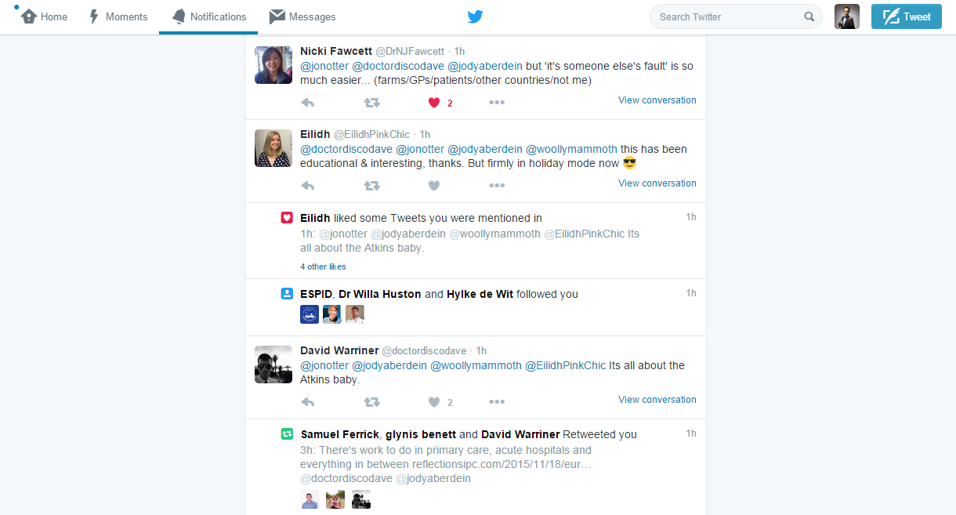
Learning to speak ‘Twitter’
Mention
Favourite
New follower
Retweet

Slide 24
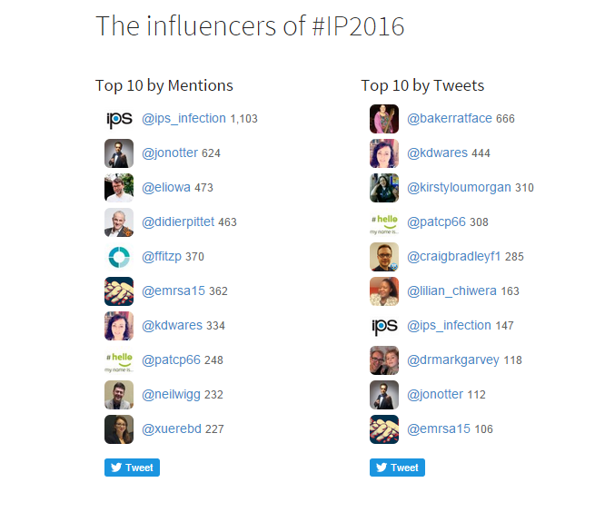
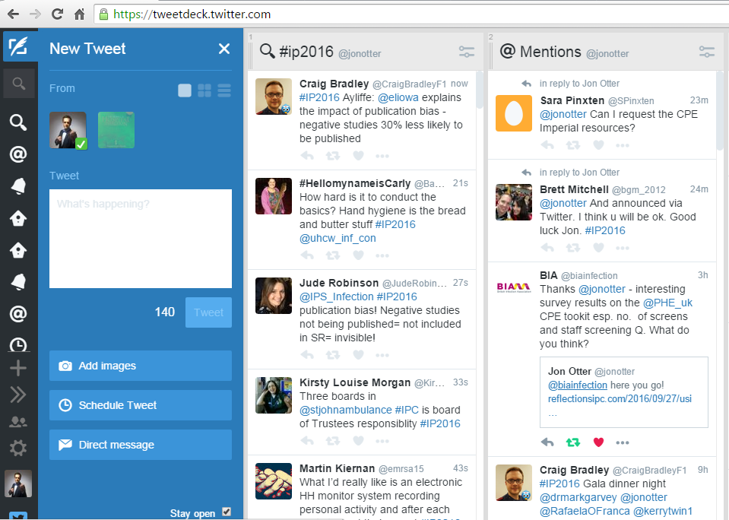
Twitter tools
Symplur conference hashtags project
Tweetdeck

Slide 25



Professional network
Academic network
Social network

Slide 26

My social media network

Slide 27
Social media & new possibilities for IPC/ID
Surveillance (e.g. pandemics, post-discharge surveillance for SSI)¹
Healthcare regulation²
Public engagement³
Patient reminders e.g. to take antibiotics (or not!)⁴
New opportunity for dialogue with patients⁵
Surprisingly accurate public healthcare info⁶
Conferences with a louder voice⁷
Charles-Smith et al. PLoS One 2015;10:e0139701.
Bouwmann et al. BMC Health Serv Res 2015;15:325.
Dyar et al. J Antimicrob Chemother 2014;69:2568-72.
Odone et al. Hum Vaccin Immunother 2015;11:72-82.
Doctors’ use of social media guidelines. (GMC).
Chew & Eysenbach. PLoS One 2010;5:e14118.
Kiernan & Wigglesworth. J Infect Prevent 2011;12:224-225.

Slide 28
Summary
Social media will not replace conventional media
Risks of engaging social media include:
  Time, Unhelpful interactions, New liabilities
Benefits include:
  Improve exposure, Useful interactions
What do you want out of social media?

Slide 29
Resources and Blogroll
Resources:
The Health Communicator’s Social Media Toolkit (CDC.gov).
How to use social media for science (Elsevier).
Doctors’ use of social media guidelines. (GMC).
Review of Twitter for Infectious Diseases Clinicians: Useful or a Waste of Time? (Goff et al. Clin Infect Dis 2015:1533-1540).
The use of social media in the dissemination of information from scientific meetings (Kiernan & Wigglesworth. J Infect Prevent 2011;12:224-225.)
A Scientist’s Guide to Social Media (Sciencemag.org).
Online collaboration: Scientists and the social network. (Nature.com).
Blogroll:
Aetiology*
Bad Science
Controversies in HAI
Reflection on IPC
Musings on Infection
Virology Down Under
* Thanks to Dr Tara Smith for sharing slides with me from a similar talk.
For more extensive Blogrolls go to Reflection on IPC or Controversies in HAI.

Slide 30
Social media for healthcare professionals: useful or a waste of time?
Jon Otter, PhD FRCPath
Imperial College Healthcare NHS Trust
jon.otter@imperial.nhs.uk
@jonotter
Blog: www.ReflectionsIPC.com
You can download these slides from www.jonotter.net

Slide 31
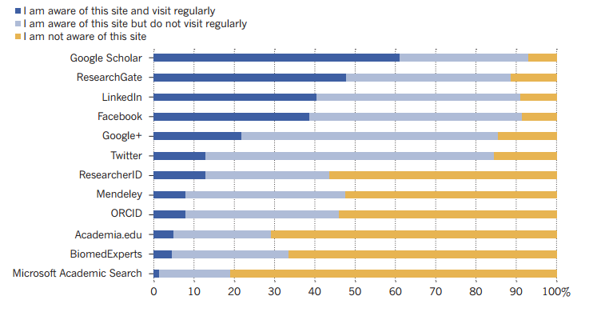
Social media use among scientists
van Noorden. Nature 2014;512. Nature survey of 3500 scientists from 95 countries.

Slide 32
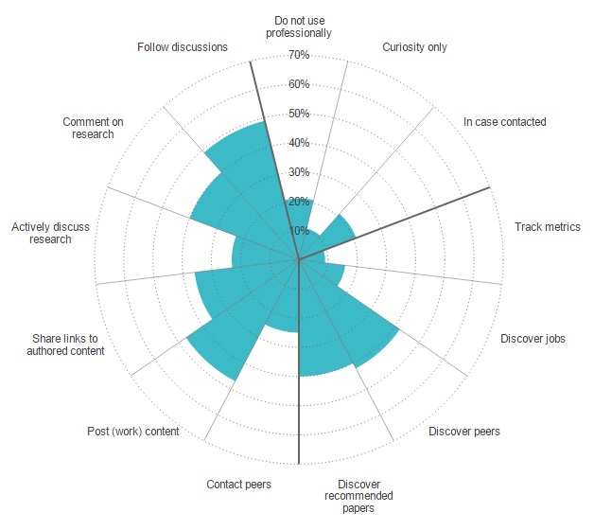
How scientists use social media
van Noorden. Nature 2014;512. Nature survey of 3500 scientists from 95 countries.

