Slide 1

Counting the cost of controlling an outbreak of CPE: an economic evaluation
Jonathan A. Otter,^{1,2} Philip Burgess,³ Frances Davies,² Siddharth Mookerjee,² Julie Singleton,² Mark Gilchrist,² Darren Parsons,² Eimear T. Brannigan,² Julie Robotham,^{1,4} Alison H Holmes.^{1,2}
Imperial College London, NIHR Health Protection Research Unit (HPRU).
Imperial College Healthcare NHS Trust.
Department of Health.
Public Health England (PHE).
j.otter@imperial.ac.uk
@jonotter
Blog: www.ReflectionsIPC.com
You can download these slides from www.jonotter.net

Slide 2
Detection of new CPE cases at ICHT by month
75% screens, 25% clinical cultures

Slide 3
K. pneumoniae NDM outbreak; total number of cases
8 cases first identified by clinical culture, 32 by screening culture; of these 32, 14 had a subsequent positive clinical culture

Slide 4
Methods
Actual expenditure
Opportunity cost
Staff time
Cost categories
Missed surgical revenue
Bed days
Anti-infective costs
Screening
Contact precautions
Ward monitors
HPV decon*
[Estates renovations]
Extended LOS**
Closed beds
* HPV = Hydrogen peroxide vapour
** LOS = Length of stay

Slide 5


Actual expenditure
Opportunity cost
£130k
Estates renovations

Slide 6








Cost hierarchy
Error bars represent range

Slide 7
Bed / bay / ward closures
8 bay and 4 ward closures
£65,250 in bed closures¹
£5,355 in curtain changes, mattress disposal, and infectious waste²
£295,704 in lost revenue from elective vascular surgery³
309 regular level care bed days, and 57 HDU bed days were lost due to closures during the outbreak.
129 curtain changes / laundered. Five regular mattress and four dynamic mattresses were discarded.
72 cases were cancelled (22) or not booked due to reduced capacity (50).

Slide 8
Staff time
 |  | n hours | £
IPC team time | IPC nurse site team (hours)¹ | 1440 | 98927
 | Data and epidemiology team (hours)² | 288 | 17084
 | Management team (hours)³ | 88 | 36427
Staff time outside of IPC | MDT meetings re treatment (hours)⁴ | 18 | 6550
 | Mortality review panel (hours)⁵ | 65 | 3911
 | Facilities (hours)⁶ | 42 | 1827
 | Communications representative (hours)⁷ | 52 | 2668
Total |  | 1993 | 141859
2 days per week (16 hours) at Hospital B for 36 weeks (576 hrs) plus 3 days per week (24 hrs) at Hospital A for 36 weeks (864 hours) = 1440 (each including a band 8a site lead, and a band 7 senior nurse).
1 day (8 hours) per week for 36 weeks (288 hours) (including an 8a hospital epidemiologist, and a band 5 analyst).
1 hour per week for internal outbreak meetings (36 weeks = 36 hours), 2 hours per external teleconferences (26 teleconferences = 52 hours) (including three senior medical consultants (director of infection prevention and control, infection control doctor, and senior microbiologist), a consultant pharmacist, lead IPCN, non-clinical service manager, and an administrator.
MDT = multidisciplinary team: 18 hours required, one for each patient that was treated using antibiotics (including a consultant pharmacist, two infection consultants, a senior IPCN, patient’s consultant, and ward manager).
Cost of 13 reviews. Each review required 2 hours of senior medical consultant time, 1 hour of infection doctor time, 2 hours of co-ordinator time; a total of 65 hours.
9 hours of 8b management time for 2 sites (18 hours) plus 1 hour for each HPV (24 hours).
26 teleconferences = 52 hours of 8c Trust communications representative time.

Slide 9
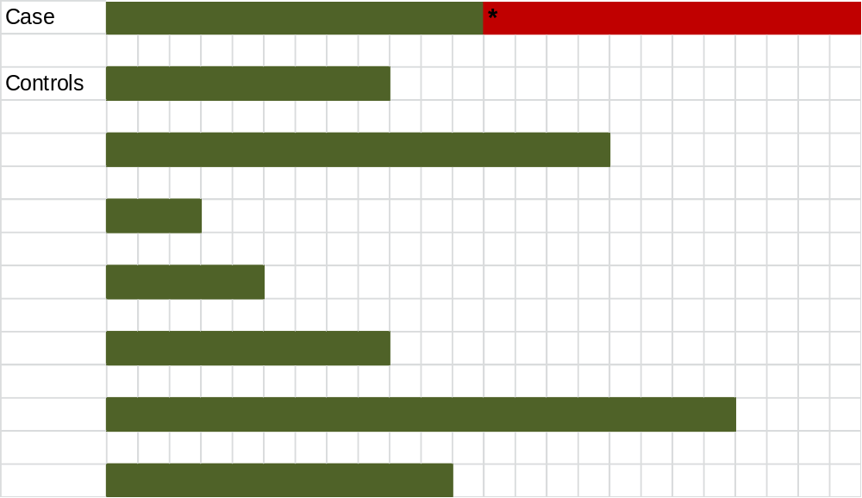
Adjusting for time to event
Nelson et al. Infect Control Hosp Epidemiol 2015;36:1089-94.

Slide 10
Impact of time to event adjustment
Error bars represent range

Slide 11
Screening
 | n screens
Outpatient screens
Renal outpatient screening | 1293
Admission screens
Admission screens - vascular wards¹ | 518
Admission screens - renal wards² | 1178
Total admission screens | 1696
Weekly screens - vascular and renal wards
n inpatient beds - vascular wards | 47
n inpatient beds - renal wards | 79
Total weekly screens (36 weeks) | 4536
Outlier weekly screens³
Weekly screening outliers in non-renal/vascular wards | 2402
Total | 9927
518 (76.8%) of 674 admissions to vascular wards were screened
1178 (90.9%) of 1296 admissions to renal wards were screened.
Outlier’ = patient with a CPE outbreak strain who was an inpatient on a non-renal/vascular ward. In this scenario, weekly screening of all patients on the ward occurred during their stay and for four weeks after their discharge from the ward.
The total cost associated with collecting and processing these screens was £130,999 (£79,416 on lab costs, and £51,583 on staff time collecting the swabs)

Slide 12
Contact precautions
The number of inpatients with known CPE carriage, daily
1831 contact precautions days generated, at a cost of £61,575 (£37,389 in gloves and aprons, £23,588 in stock disposal, and £598 in infectious waste disposal)

Slide 13
Anti-infective costs

Slide 14
Cost hierarchy
Error bars represent range

Slide 15
Results in context
Bubble size represents the total cost of the outbreak
£1m

Slide 16
Discussion
Comprehensive coverage of costs, including actual expenditure and opportunity costs.
Opportunity costs was larger, but more difficult to account for.
We did not include:
  Substantial cleaning costs, which were absorbed by our contract cleaner.
  Litigation costs (none that we are aware of).
  Reputational costs.
  Socioeconomic costs.
  Ongoing costs outside the acute outbreak phase.
  Changes to the antimicrobial programme.
Whilst we did adjust for time to event, our estimate of attributable length of stay is rather crude.
The large cost accrued over 10 months argues for interventions to prevent CPE transmission being cost effective in the long-term.

Slide 17

Otter et al. Clin Microbiol Infect 2016 in press.

Slide 18
Counting the cost of controlling an outbreak of CPE: an economic evaluation
Jonathan A. Otter,^{1,2} Philip Burgess,³ Frances Davies,² Siddharth Mookerjee,² Julie Singleton,² Mark Gilchrist,² Darren Parsons,² Eimear T. Brannigan,² Julie Robotham,^{1,4} Alison H Holmes.^{1,2}
Imperial College London, NIHR Health Protection Research Unit (HPRU).
Imperial College Healthcare NHS Trust.
Department of Health.
Public Health England (PHE).
j.otter@imperial.ac.uk
@jonotter
Blog: www.ReflectionsIPC.com
You can download these slides from www.jonotter.net

Slide 19
 |  | Number | Actual expenditure (£) | Opportunity cost (£)
 |  |  |  | Staffing | Missed revenue | Bed days
Additional bed days case patients (days) |  | 840 |  |  |  | 141918
Anti-infective costs | Anti-infective costs |  | 46031
Laboratory | Screening (n screens) | 9927 | 79416
 | Staff time to collect screens (hrs) | 2482 |  | 51583
IPC team time | IPC nurse site team (hrs) | 1440 |  | 83837
 | Data and epidemiology team (hrs) | 288 |  | 14478
 | Management team (hrs) | 88 |  | 30870
Other staff time | MDT meetings re treatment (hrs) | 18 |  | 5551
 | Mortality review (hrs) | 65 |  | 3314
 | Facilities (hrs) | 42 |  | 1549
 | Trust Communications (hrs) | 52 |  | 2261
Contact precautions | Gloves and aprons (n isolation days) | 1831 | 37389
 | Stock disposal |  | 23588
 | Infectious waste (n isolation days) | 1831 | 598
Ward-based monitors | Hours of HCA time (hours) | 2592 | 35510
Environment | HPV decontamination (n rooms) | 24 | 36312
Estates work |  |  | 130000
Elective surgical missed revenue (n procedures) |  | 72 |  |  | 295704
Closed beds | Bay and ward closures |  |  |  |  | 65250
 | Infectious waste stream |  | 669
 | Curtain changes |  | 1637
 | Mattress disposal |  | 3050
Totals | Grand total = £960514 |  | 264200 | 193442 | 295704 | 207168

