Slide 1

AMR: a clinical perspective
Jon Otter, PhD FRCPath
Imperial College London
j.otter@imperial.ac.uk
@jonotter
Blog: www.ReflectionsIPC.com
You can download these slides from www.jonotter.net

Slide 2

2x
Room A
Room B

Slide 3

Your hospital room can make you sick!
Mitchell et al. J Hosp Infect 2015;91:211-217.

Slide 4
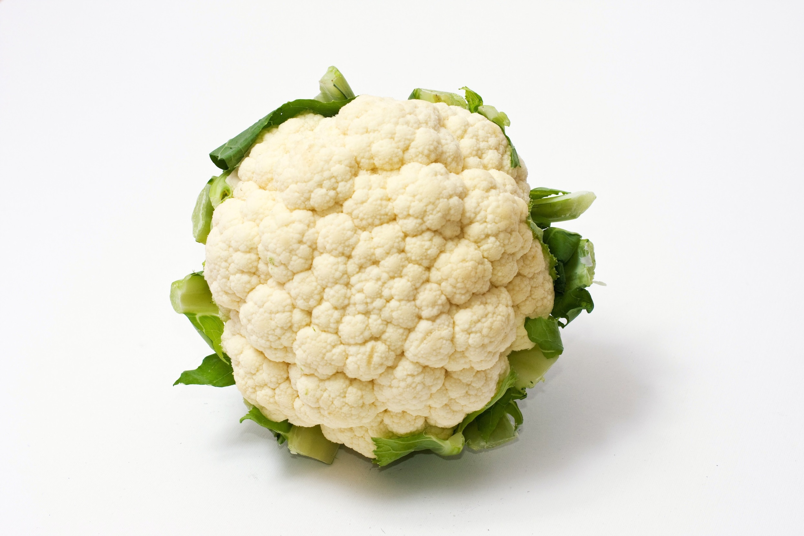

Slide 5

Transfer of a surrogate marker in a NICU
Oelberg et al. Pediatrics 2000;105:311-315.

Slide 6

Transfer over time: inoculated pod

Slide 7

Transfer of a surrogate marker in a NICU

Slide 8

Transmission routes
Otter et al. Infect Control Hosp Epidemiol 2011;32:687-699.

Slide 9

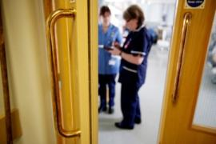



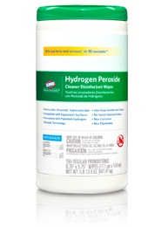

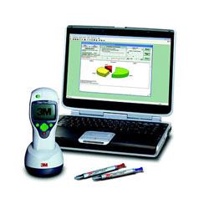

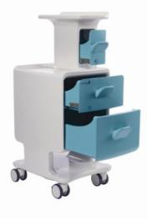
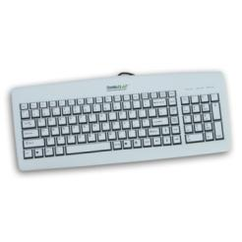
Improve existing procedures
Try something new!

Slide 10
National trends
PHE mandatory reporting data

Slide 11

THE END OF ANTIBIOTICS IS NIGH

Slide 12
Rising threat from MDR-GNR
% of all HAI caused by GNRs.
% of ICU HAI caused by GNRs.
Non-fermenters | Acinetobacter baumannii Pseudomonas aeruginosa Stenotrophomonas maltophilia
Enterobacteriaceae | Klebsiella pneumoniae Escherichia coli Enterobacter cloacae
CPO
CPE
Hidron et al. Infect Control Hosp Epidemiol 2008;29:966-1011.
Peleg & Hooper. N Engl J Med 2010;362:1804-1813.

Slide 13
Creating a monster
Enterobacteriaceae
ESBLs
CPE
Extended-spectrum beta-lactams
Carbapenems

Slide 14
Invasive multidrug-resistant K. pneumoniae
EARS-Net

Slide 15








Counting the cost of CPE
Economic evaluation of a 40 case outbreak of CPE. Error bars represent range
Otter et al. Clin Microbiol Infect 2016 in press.

Slide 16
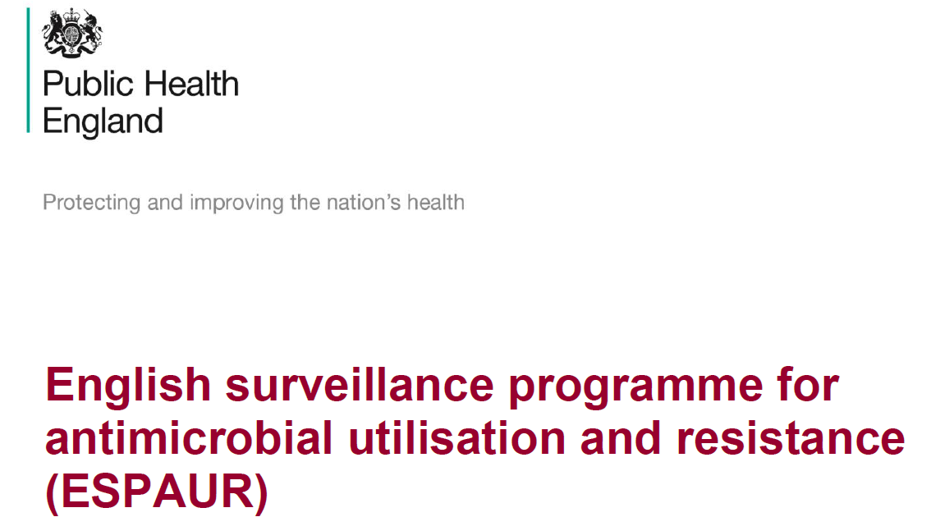
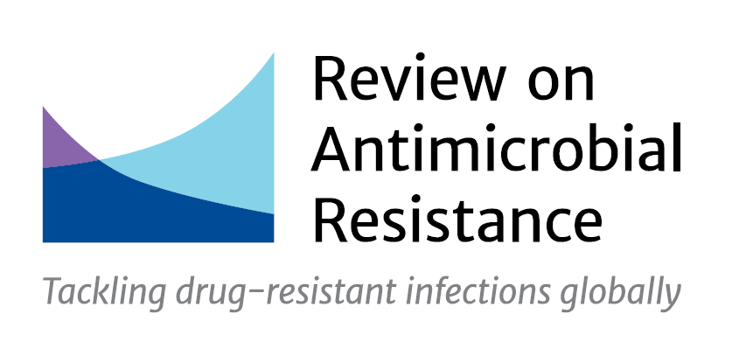
National trends
GNBSI

Slide 17
AMR: a clinical perspective
Jon Otter, PhD FRCPath
Imperial College London
j.otter@imperial.ac.uk
@jonotter
Blog: www.ReflectionsIPC.com
You can download these slides from www.jonotter.net

