Slide 1

The emerging challenge of contaminated water heater-coolers used for cardiothoracic surgery and the risk of Mycobacterium chimaera infections
Jon Otter, PhD FRCPath
Imperial College London
j.otter@imperial.ac.uk
@jonotter
Blog: www.ReflectionsIPC.com
You can download these slides from www.jonotter.net

Slide 2
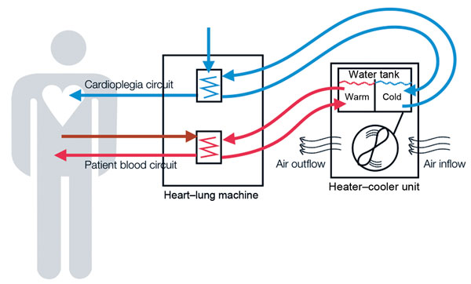
Heater-cooler units (HCUs)
HCUs are stand-alone devices responsible for heat exchange in cardiopulmonary bypass machines
Sommerstein et al. Infect Control Hosp Epidemiol 2016.

Slide 3
Zurich, Switzerland, 2011
Two cases of unusual infection caused by Mycobacterium chimaera following recent prosthetic valve replacement surgery.
  M. chimaera is a slow-growing, nontuberculous mycobacterium (NTM) included in the M. avium complex (MAC).
  Unusual clinical presentation (usually infection in immunocompromised hosts).
  Isolates linked by genotyping; M. chimaera usually diverse.
  Similar isolates of M. chimaera later found in water and air from HCUs.
Achermann et al. J Clin Microbiol 2013;51:1769–1773.
Sax et al. Clin Infect Dis 2015;61:67–75.

Slide 4
Seeking the source
Some evidence suggests a point-source outbreak in the factory of the most common manufacturer of HCUs.
  HCUs in Denmark, the US, and the UK shared the same genotype of M. chimaera, and all contaminated HCUs in Western Australia shared the same genotype of M. chimaera.¹⁻²
  Environmental investigations at a factory suggest manufacturer-site contamination.³
Other evidence suggests a non-HCU related source of M. chimaera infections in CT surgery.²
Svensson et al. Emerg Infect Dis 2017 in press.
Robinson et al. Eurosurveill 2016;21:pii:30396.
Haller et al. Eurosurvell 2016; 21(17).

Slide 5
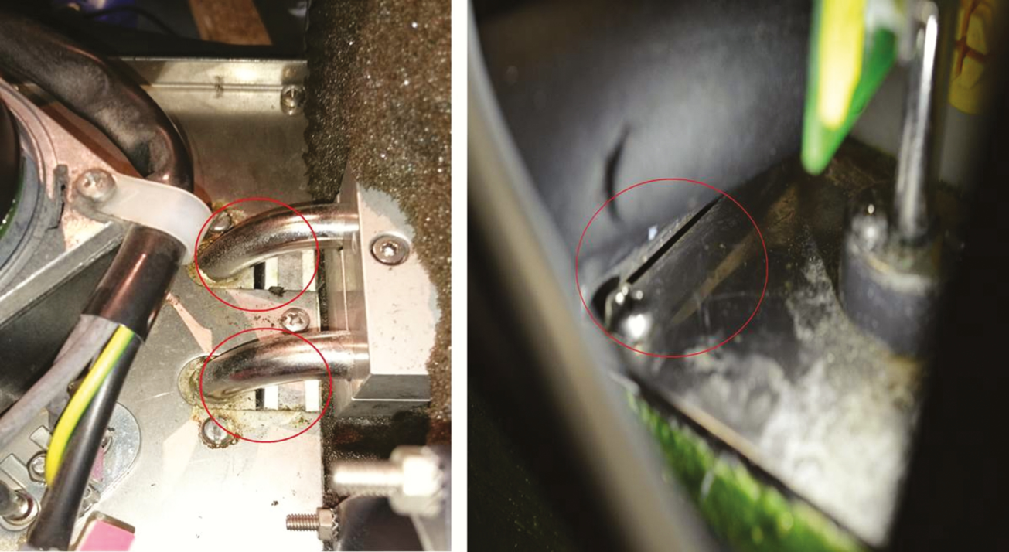
Wholly unsatisfactory design
Holes (highlighted by the red circles) close to the flow and return pipes of both heater-cooler circuits and gap between tank sealing plates identified by an aerodynamic particle sizer as areas of aerosol release.
Chand et al. Clin Infect Dis 2017;64:335-42.

Slide 6
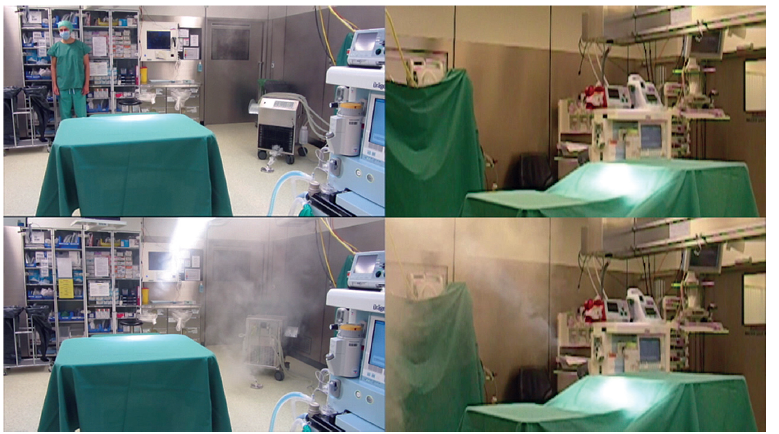
Aerosol tests
https://www.youtube.com/watch?v=YZ41aLoHrhQ
Sommerstein et al. Emerg Infect Dis 2016;22:1008-13.

Slide 7
Clinical presentation
Delayed diagnosis (3 months – 5 years).
Prosthetic valve endocarditis, disseminated infections, or infections of vascular grafts (less commonly wound or surgical space SSIs).
Non-specific symptoms and lab abnormalities.
Poor response to therapy; 50% mortality rate.
Sommerstein et al. Infect Control Hosp Epidemiol 2016 in press.

Slide 8
UK situation
4-year national look-back exercise to detect potential cases.
18 probable cases; 54 possible cases.
Very rare outcome from cardiothoracic surgery (around 1 per 10,000 person-years).
Widespread problem, with a quarter of cardiothoracic centres in the UK reporting a case.
High case-fatality (50%).
Increasing risk (from <0.2 to 1.6 per 10,000 person-years between 2010 and 2013).
Large to huge time lag between the surgery and the detection of the infection: of the 18 probable cases identified, more than half (61%) presented >1 year after surgery, with one case presenting >5 years after surgery!
Chand et al. Clin Infect Dis 2017;64:335-42.

Slide 9
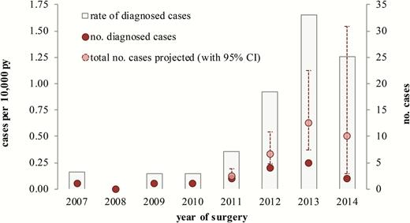
UK situation
Assessment of risk of Mycobacterium chimaera infection following cardiac valve repair or replacement in England, 2007–2014.
Abbreviations: CI, confidence interval; PY, person-years.
Chand et al. Clin Infect Dis 2017;64:335-42.

Slide 10
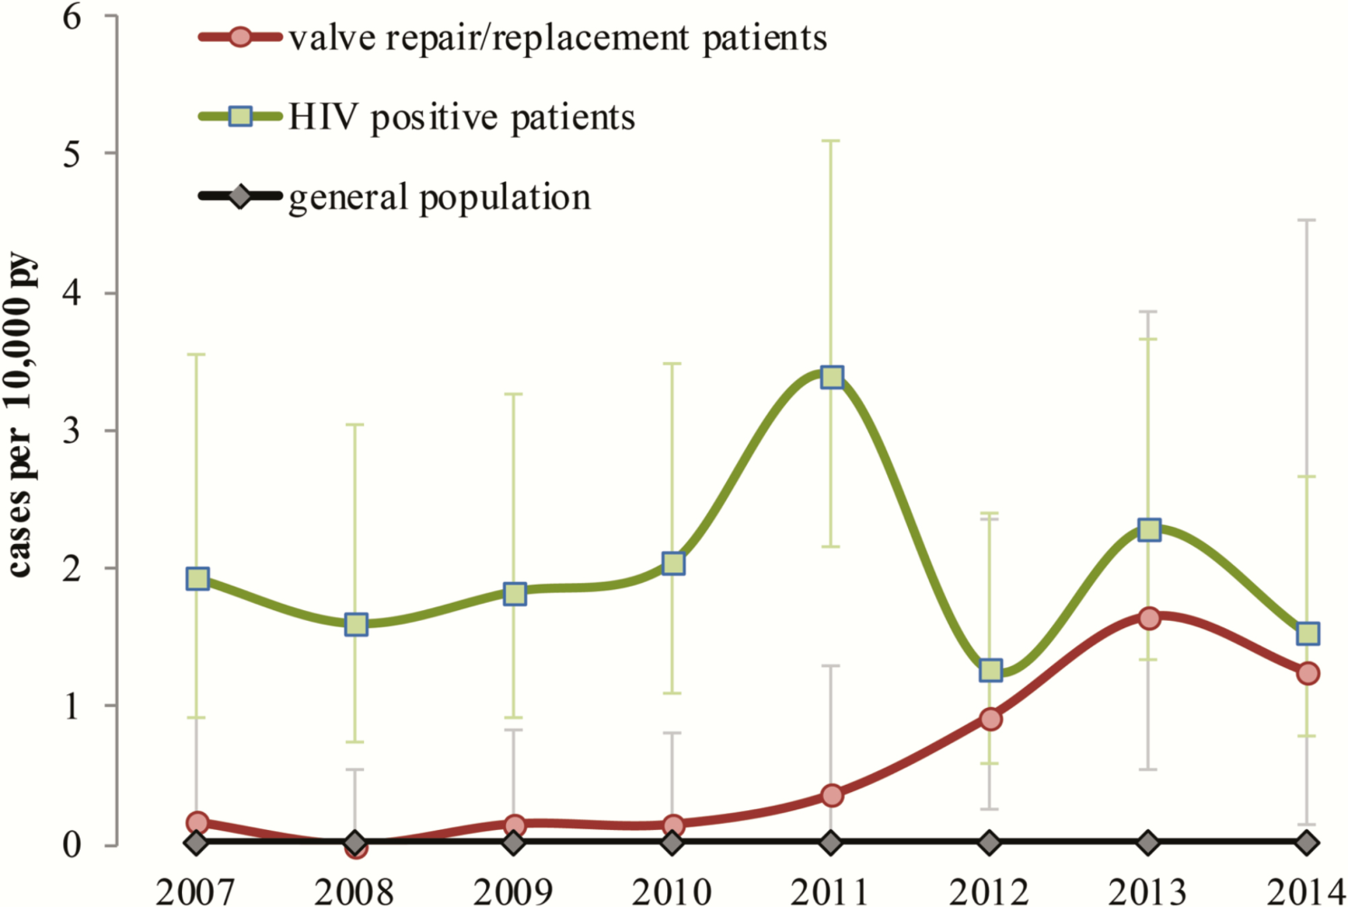
UK situation
Risk of invasive M. avium complex disease in persons HIV, the general population, and patients undergoing cardiac valve replacement or repair, England, 2007–2014.
Chand et al. Clin Infect Dis 2017;64:335-42.

Slide 11
Risk assessment
Extrapolated from rates per 10,000 procedures reported by Chand et al. Clin Infect Dis 2017;64:335-42.

Slide 12
Mitigating / managing the risk
Physical location / encasing HCUs
Water and air testing
Enhanced decon (water change, filters, chemicals, deep clean)
Enhanced surveillance
Communication with patients and staff
Risk assessment (aka ‘the show must go on’)
Traceability of each unit
PHE information for healthcare providers

Slide 13
Enhanced decontamination
Decontamination regime | TVC | Environmental Gram negatives | Pseudomonas sp. | Fungi | M. chimaera
Regime 1 | >300 CFU | + | + | + | +
Regime 2 (chlorine) | >300 CFU | + | + | + | +
First decontamination | 100 CFU | + | - | - | -
Second decontamination | 1 CFU | + | - | - | -
Weekly Counts | ∼1-300 CFU | + | + | + | +
Regime 3 (peracetic acid) | >300 CFU | + | + | + | +
First decontamination | 1-10 CFU | + | - | - | -
Second decontamination | 0 CFU | - | - | - | -
Weekly Counts | ∼1-100 CFU | + | + (0-5 CFU) | + (0-30 CFU) | -
Regime 3 (tubing replaced) | 0 CFU | - | - | - | -
First decontamination | 0 CFU | - | - | - | -
Second decontamination | 0 CFU | - | - | - | -
Weekly Counts | 0 CFU | - | - | - | -
Garvey et al. J Hosp Infect 2016;93:229-34.

Slide 14
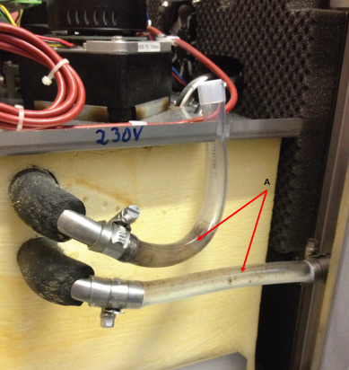
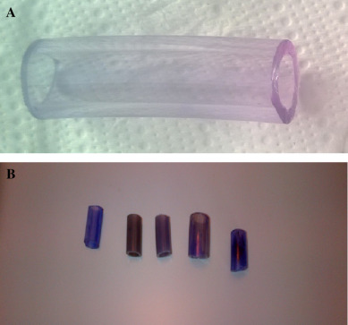
Biofilm
Tubing in HCU with visible biofilm.
Unstained (A) and stained (B) tubing to show the presence of biofilm.
Garvey et al. J Hosp Infect 2016;93:229-34.

Slide 15
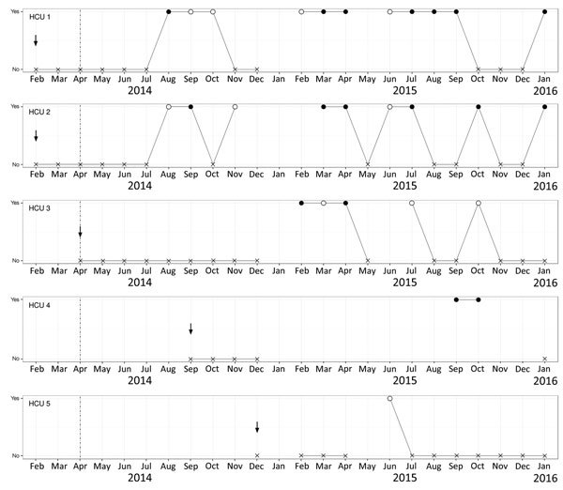
Enhanced decon…failed!
Arrows = start of use of each factory-new HCU in the operating room.
Filled circles = Mycobacterium chimaera; empty circles = other NTM.
HCU 4 sent for repair at the manufacturer during Dec 2014 – Sept 2015.
Schreiber et al. Emerg Infect Dis 2016;22:1830-3.

Slide 16
Other challenges
Uncertain epidemiology
Chronic under-reporting
  Belgian study found that 65% of 149 “M. intracellulare” were actually M. chimaera.¹
M. chimaera has also been identified in thermoregulatory devices are used for extracorporeal membrane oxygenation (ECMO).²
Notification of exposed patients (local patient notification exercises have been done in the US).³
Consent for yet-to-be exposed patients.
What else is lurking in the HCUs (e.g. Legionella)?
Soetaert et al. J Med Microbiol 2016;65:1307-10.
Trudzinski et al. Eurosurveill 2016;21:pii:30398.
Perkins et al. MMWR 2016;65):1117-8.

Slide 17
Key questions
Is this the surgical outcome to focus on?
Are the HCUs fit for purpose?
What do we do about it?
Is this the tip of the iceberg?
Why is it getting worse?

Slide 18
Resources
ECDC rapid risk assessment
PHE information for healthcare providers
CDC practical guidance

Slide 19
The emerging challenge of contaminated water heater-coolers used for cardiothoracic surgery and the risk of Mycobacterium chimaera infections
Jon Otter, PhD FRCPath
Imperial College London
j.otter@imperial.ac.uk
@jonotter
Blog: www.ReflectionsIPC.com
You can download these slides from www.jonotter.net

