Slide 1


Update on hospital cleaning and disinfection (aka what’s lurking in your hospital room?)
Jon Otter, PhD FRCPath
Imperial College London
j.otter@imperial.ac.uk
@jonotter
Blog: www.ReflectionsIPC.com
You can download these slides from www.jonotter.net

Slide 2
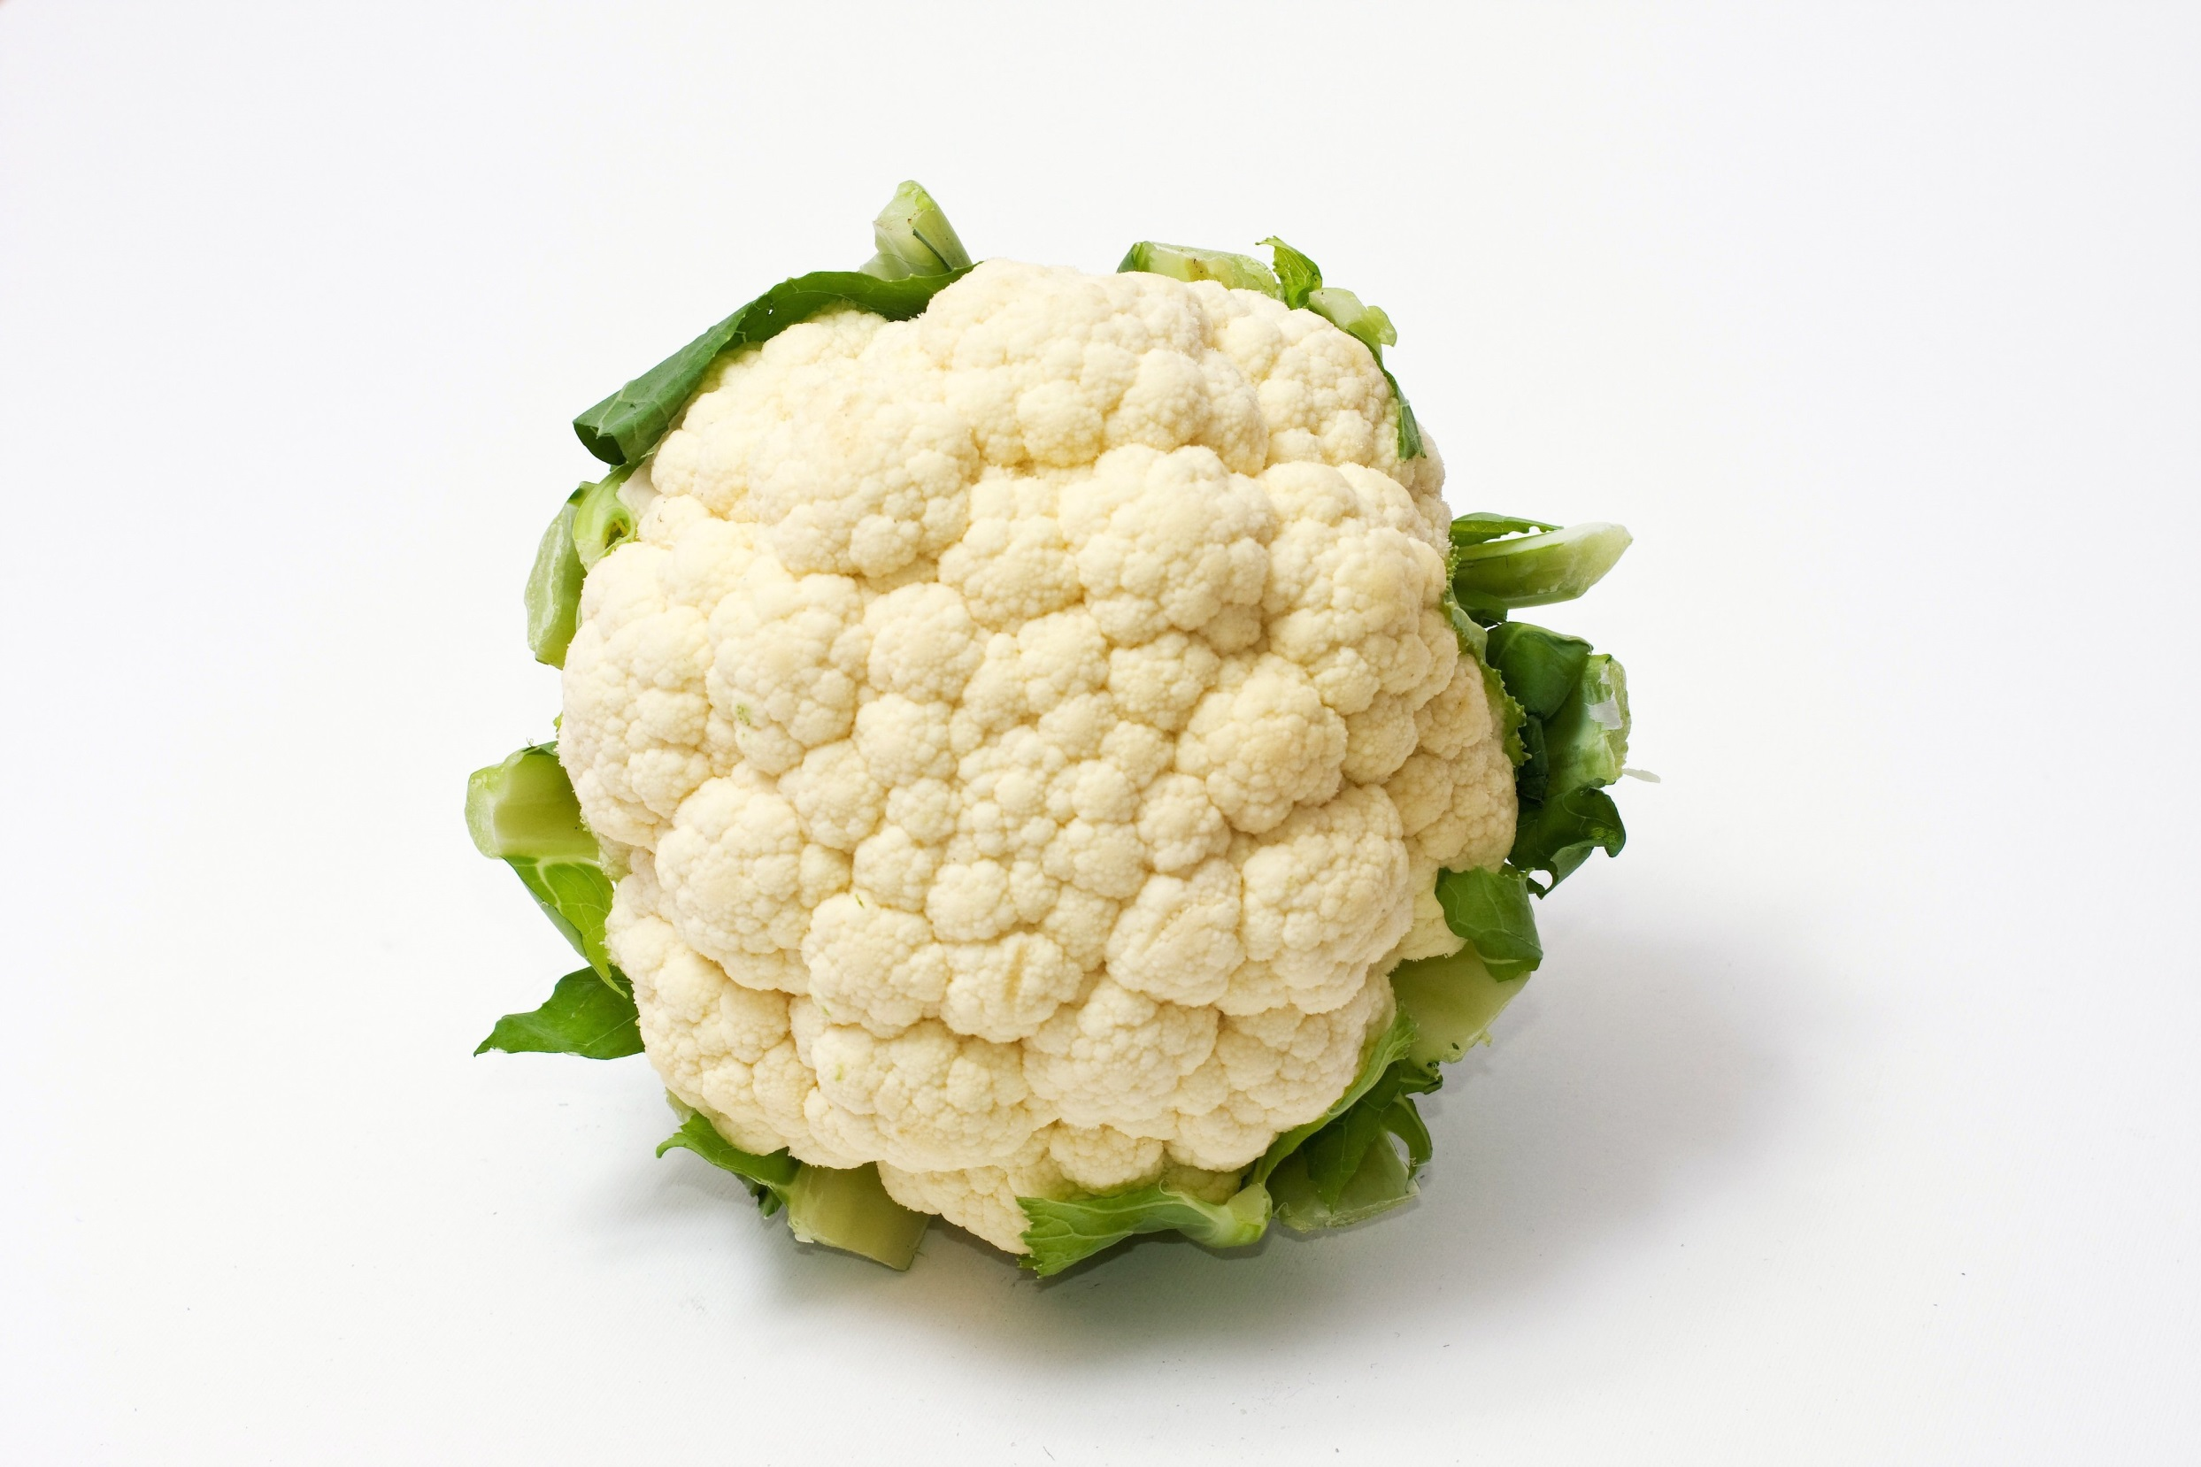

Slide 3

Transfer of a surrogate marker in a NICU
Oelberg et al. Pediatrics 2000;105:311-315.

Slide 4

Transfer over time: inoculated pod

Slide 5

Transfer of a surrogate marker in a NICU

Slide 6

Your hospital room can make you sick!
Mitchell et al. J Hosp Infect 2015;91:211-217.

Slide 7

Transmission routes
Otter et al. Infect Control Hosp Epidemiol 2011;32:687-699.

Slide 8

86%
58%
93%
85%
59%
French et al. J Hosp Infect 2004;57:31-37.
96%
Notes:
Survive for extended periods

Slide 9
Surface survival
Organism | Survival time
Clostridium difficile (spores) | 5 months
Acinetobacter spp. | 3 days to 5 months
Enterococcus spp. including VRE | 5 days – 4 years (!)¹
Pseudomonas aeruginosa | 6 hours – 16 months
Klebsiella spp. | 2 hours to > 30 months
Staphylococcus aureus, inc. MRSA | 7 days – 7 months
Norovirus (and feline calicivirus) | 8 hours to > 2 weeks²
SARS Coronavirus | 72 hours to >28 days³
Influenza | Hours to several days⁴
Adapted from Kramer et al. BMC Infect Dis 2006;6:130.
Wagenvoort et al. J Hosp Infect 2011;77:282-283.
Doultree et al. J Hosp Infect 1999;41:51-57.
Rabenau et al. Med Microbiol Immunol 2005;194:1-6.
Bean et al. J Infect Dis 1982;146:47-51.

Slide 10
Terminal cleaning
90% of 124 sites
26% reduction
66% of 124 sites
Percentage of MRSA swabs positive
(8 rooms;
2 four-bed bays previously occupied by MRSA patients)
Before cleaning
After cleaning
French et al. J Hosp Infect 2004;57:31-37.

Slide 11



Surface -> Hand -> Patient
Pathogens can be transferred from surfaces to HCW hands without direct patient contact¹⁻²
52% of 23 HCW acquired VRE on their hands³ | Contact with patient or surface = ~10% risk of acquiring VRE³
45% of 50 HCW acquired MRSA on their hands⁴ | 40% of 50 HCW acquired MRSA on their hands⁴
50% of 30 HCW acquired C. difficile on their hands⁵ | 50% of 30 HCW acquired C. difficile on their hands⁵
Compliance with hand hygiene: 50%⁶ | Compliance with hand hygiene: 80%⁶
Boyce et al. Infect Control Hosp Epidemiol 1997;18:622-627.
Bhalla et al. Infect Cont Hosp Epidemiol 2004;25:164-167.
Hayden et al. Infect Control Hosp Epidemiol 2008;29:149-154.
Stiefel et al. Infect Control Hosp Epidemiol 2011;32:185-187.
Guerrero et al. Am J Infect Control 2012;40:556-558.
Randle et al. J Hosp Infect 2010;76:252-255.

Slide 12
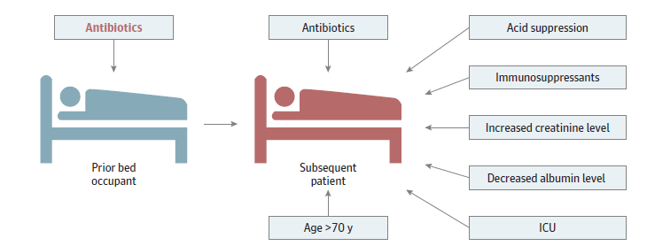
Chased by an antibiotic-induced C.difficile-shaped shadow!
Significant risk factors for CDI.
Freedberg et al. JAMA Intern Med 2016;176:1801-1808.

Slide 13
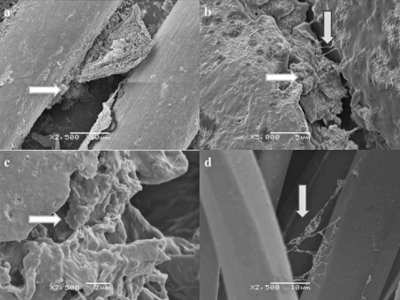
Rethinking the ‘inanimate’ environment
Scanning electron microscopy identified biofilm on 5/6 dry hospital surfaces from an Australian ICU (including MRSA on 3/5).¹
Followup study identified biofilm on 41/44 (93%) of surfaces in an ICU; MRSA from 18%, ESBL from 11% and VRE from 8% of the samples.²
Could explain why vegetative bacteria can survive on dry hospital surfaces for so long
Be part of the reason why they are so difficult to remove or inactivate using disinfectants
Explain (to some degree) the difficulty in recovering environmental pathogens by surface sampling
1. Vickery et al. J Hosp Infect 2012;80:52-55.
2. Hu et al. J Hosp Infect 2015;91:35-44.

Slide 14
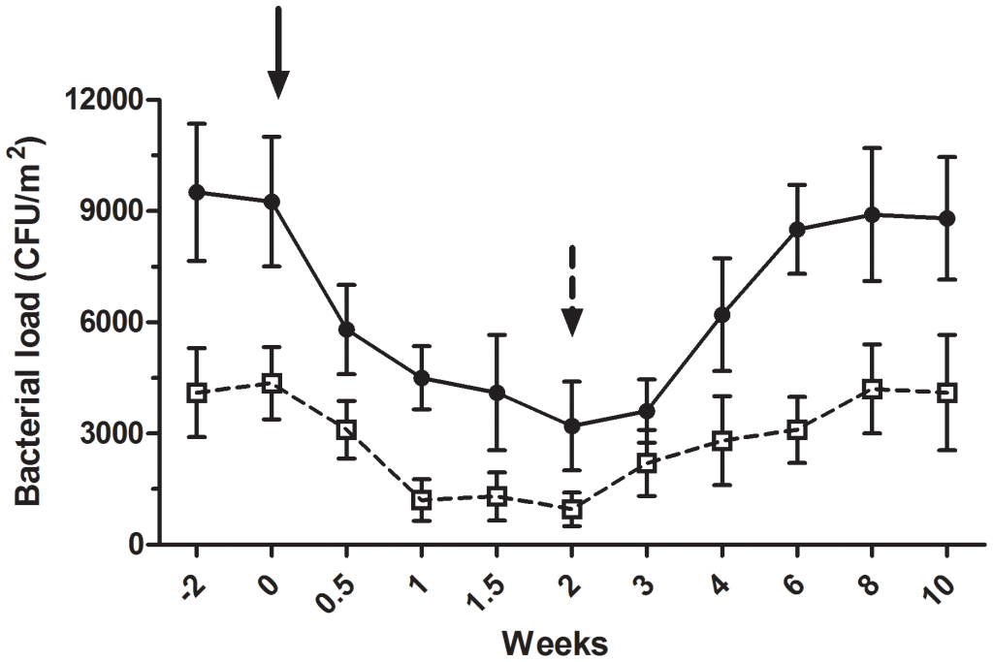
Can we modify the ‘environmentome’
Bacterial load of coliforms (black circles) and S. aureus (white circles). Black arrow = beginning of the “live” cleaning agent; black dotted arrow = conventional cleaning agent.
Vandini et al. PLoS ONE 2014;26;9(9):e108598.
More here if you’re interested.

Slide 15
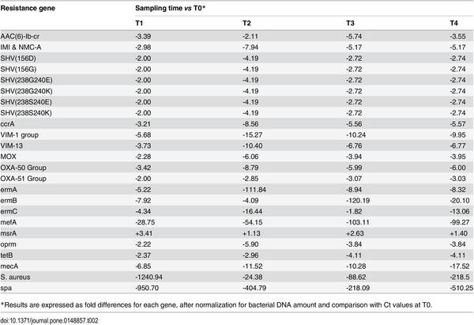
Could spore soup out compete AMR?
Impact of Bacillus-based cleaning on the antibiotic R genes of the contaminant microbiota of hospital surfaces.
Caselli et al. PLoS ONE 2016;11:e0148857.

Slide 16
“It’s airborne”
Detection of C. difficile in the air samples from the rooms of 50 patients.
Best et al. Clin Infect Dis 2010; 50: 1450-7.

Slide 17
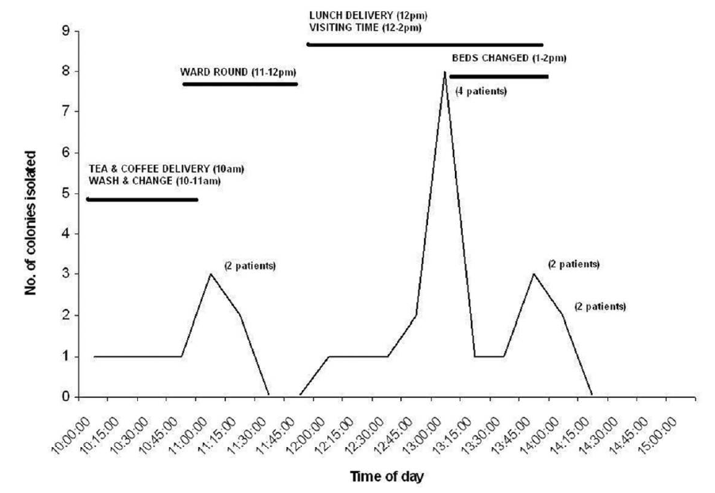
“It’s airborne”
Results of intensive air sampling surrounding 10 patients. C. difficile was detected in the air in 7/10 patients.

Slide 18

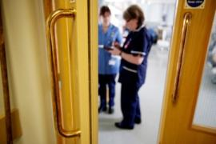



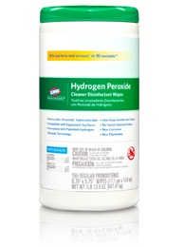

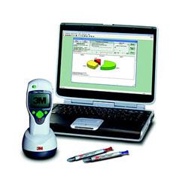

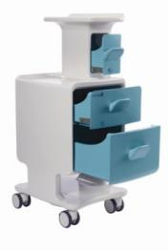
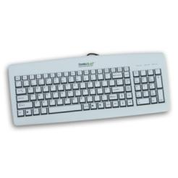
Improve existing procedures
Try something new!

Slide 19
Contamination-sparing therapy?
n = 66 patients (rooms) and 264 surfaces for vancomycin / metronidazole, and 68 patients (rooms) and 272 surfaces for fidaxomycin. p<0.05 for both rooms and surfaces.
Biswas et al. J Hosp Infect 2015;90:267-270

Slide 20
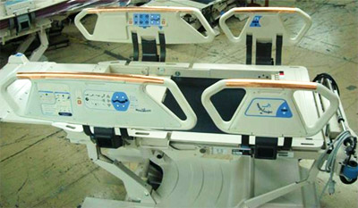
Antimicrobial surfaces (e.g. copper)
614 pts in 3 hospitals randomised to ‘copper’ or ‘non-copper’ ICU rooms
-44%
p=0.020
Bedrails
Overbed tables
IV poles
Visitor chair arms
Nurse call button*
Computer mouse*
Computer palm rest*
Rim of monitor*
(* = some rooms only)
-58%
p=0.013
Salgado et al. Infect Control Hosp Epidemiol 2013;34:479-486.

Slide 21
Control contamination at the source
Pre-post study in a 16-bed ICU in Korea; CHG daily bathing implemented for 12 months after 14-month pre-intervention period. Significant reduction in rate of carbapenem-resistant Acinetobacter baumannii acquisition and environmental contamination.
Chung et al. Am J Infect Control 2015;43:1171-1177.

Slide 22
Improve existing procedures
Try something new!

Slide 23
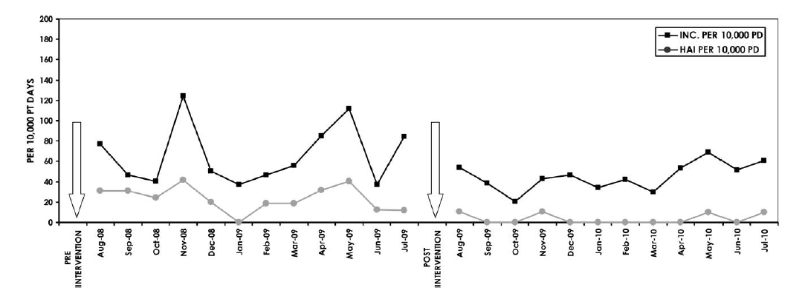
Wiping away infection
Impact of changing from QAC to bleach wipes for daily disinfection of all rooms. Cleaning thoroughness was 97-98% throughout the study using ATP benchmarking (<250 RLUs).
2.4
cases / 1000 patient days
0.4
cases / 1000 patient days
Orenstein et al. Infect Control Hosp Epidemiol 2011;34:521-523.

Slide 24
Cleaning / disinfection failure
External
Product
Procedure

Slide 25
‘Given the choice of improving technology or improving human behavior, technology is the better choice’.
Dr Bob Weinstein
Weinstein RA. Emerg Infect Dis 1998;4:416-420.

Slide 26


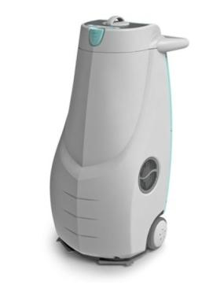
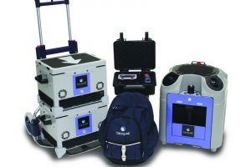
Automated room decontamination (ARD)
Hydrogen peroxide vapour
30% H₂O₂ (HPV)
Aerosolised hydrogen peroxide 5-6% H₂O₂ (AHP)
Ultraviolet radiation (UVC)
Pulsed-xenon UV (PX-UV)
Otter et al. J Hosp Infect 2013;83:1-13.

Slide 27
ARD systems - overview
 | HPV 30-35% H₂O₂ vapour | AHP 5-6% H₂O₂ + Ag aerosol | UVC UVC (280 nm) | PX-UV Pulsed-xenon UV
Efficacy | 1 >6-log reduction | 2 ~4-log reduction | 3 ~2-4 log reduction | 4 ~1-3 log reduction
Distribution | 1 Homogeneous | 2 Non-homogenous | 3 Line of sight issues | 3 Line of sight issues
Ease of use | 4 Multiple units; sealing / monitoring | 3 Sealing & monitoring | 2 Multiple positions; no sealing / monitoring | 2 Multiple positions; no sealing / monitoring
Cycle time | 3 ~1.5 hrs single room | 4 >2 hrs single room | 1 ~10-30 mins | 1 ~10-30 mins
Purchase cost | 2 | 1 | 3 | 3
Running cost | 4 | 3 | 1 | 1
Otter et al. J Hosp Infect 2013;83:1-13.

Slide 28
Persistent contamination – sorted!
140 samples from 9 rooms after 2xbleach
5705 samples from 312 rooms after 4xbleach
2680 sites from 134 rooms after HPV
HPV
Manian et al. Infect Control Hosp Epidemiol 2011;32:667-672.

Slide 29
HPV: clinical impact
30-month prospective cohort intervention study performed on 6 high-risk units (5 ICUs) including 8813 patients at Johns Hopkins Hospital.
64% reduction in the rate of MDRO acquisition
Standard cleaning / disinfection
HPV decontamination
Passaretti et al. Clin Infect Dis 2013;56:27-35.

Slide 30

HPV: clinical impact
2 years before HPV, 2 years during HPV. Breakpoint model indicated significant reduction in rate of CDI when HPV implemented (1.0 to 0.4 per 1000 patient days, 60% reduction).
McCord et al. J Hosp Infect 2016.

Slide 31
UVC: clinical impact
Cluster randomised study over >2 years across 9 hospitals including >25,000 exposed patients (admitted into a room where the previous occupant was known to have an MDRO). * = statistically significant reduction in the per-protocol analysis. ** = statistically significant when rooms occupied by patients with C. difficile removed from the analysis.
**
*
*
*
*
Anderson et al. Lancet 2017;389:805-814.

Slide 32
Improve existing procedures
Try something new!

Slide 33
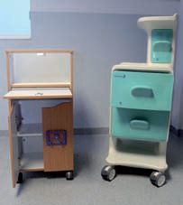
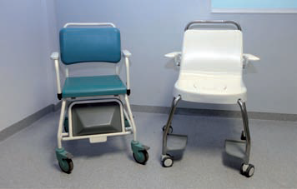
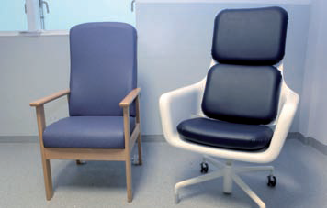
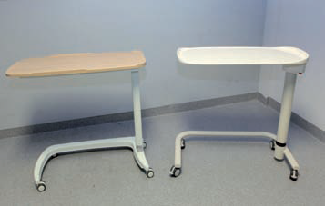
Try something new!
“Design bugs out!”
Design Bugs Out – Product Evaluation Report. The Healthcare Associated Infection Technology Innovation Programme. UK Department of Health. 2011.

Slide 34
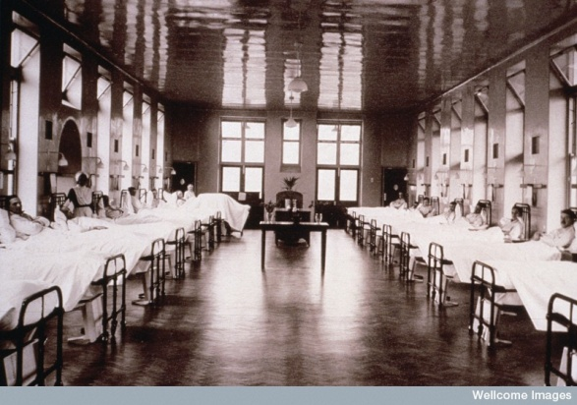
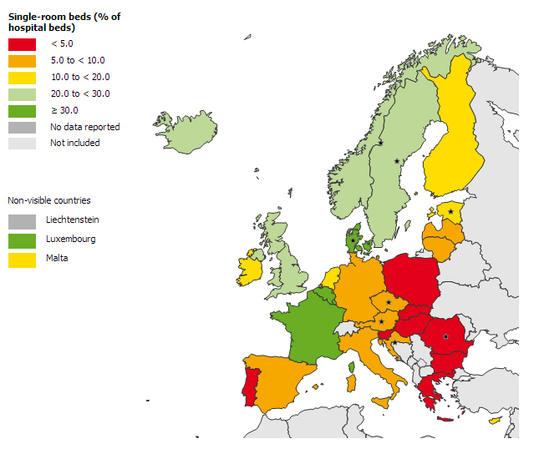
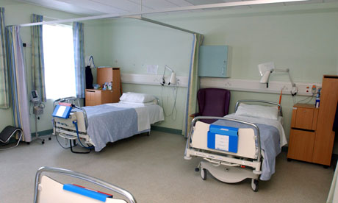
Try something new!
Single room shortage
ECDC Point Prevalence Survey of healthcare-associated infections and antimicrobial use in acute care hospitals (HAI-Net PPS) in the period 2011-2012 as reported to TESSy as of 2013-02-06 14:06:48

Slide 35
‘Privatization’ of an ICU
Try something new!
*
*
Intervention
24 bed ICU
2x10 bed and 4xsingle rooms
Converted to 100% single rooms in 2002
Comparison
25 bed ICU
2, 5, 6 or 8 bed rooms
No change in unit configuration
Change in the acquisition rate ratio before and after privatisation; * = not statistically significant.
Teltsch et al. Arch Intern Med 2011;171:32-38.

Slide 36
Reducing missed isolation days
Pathogen | Pre-pod use |  |  | During pod use |  |  | p value
 | n missed isolation days | Total required isolation days | % isolation days missed | n missed isolation days | Total required isolation days | % isolation days missed
MRSA | 303 | 591 | 51.3 | 33 | 410 | 8.0 | <0.001
ESBL / CRE | 149 | 565 | 26.4 | 118 | 750 | 15.7 | <0.001
Respiratory viruses | 108 | 179 | 60.3 | 38 | 233 | 16.3 | <0.001
Rotavirus | 68 | 138 | 49.3 | 45 | 74 | 60.8 | 0.109
Overall | 662 | 1138 | 58.2 | 205 | 1382 | 14.8 | <0.001
Keward et al. J Infect Prevent in press.

Slide 37
Improve existing procedures
Try something new!

Slide 38
Update on hospital cleaning and disinfection (aka what’s lurking in your hospital room?)
Jon Otter, PhD FRCPath
Imperial College London
j.otter@imperial.ac.uk
@jonotter
Blog: www.ReflectionsIPC.com
You can download these slides from www.jonotter.net

