Slide 1


Can we really halve GNBSIs?
Jon Otter, PhD FRCPath
Imperial College London
j.otter@imperial.ac.uk
@jonotter
Blog: www.ReflectionsIPC.com
You can download these slides from www.jonotter.net
GNBSI

Slide 2
Starters for 10…
What’s the problem with GNBSI?
What is behind the MRSA / CDI reductions?
Why have these not been effective against MSSA and E. coli?
(How) can we reduce GNBSIs?

Slide 3

THE END OF ANTIBIOTICS IS NIGH

Slide 4
Rising threat from AMR-GNR
% of all HAI caused by GNRs.
% of ICU HAI caused by GNRs.
Non-fermenters | Acinetobacter baumannii Pseudomonas aeruginosa Stenotrophomonas maltophilia
Enterobacteriaceae | Klebsiella pneumoniae Escherichia coli Enterobacter cloacae
CPO
CPE
Hidron et al. Infect Control Hosp Epidemiol 2008;29:966-1011.
Peleg & Hooper. N Engl J Med 2010;362:1804-1813.

Slide 5
Creating a monster
Enterobacteriaceae
ESBLs
CPE
Extended-spectrum beta-lactams
Carbapenems

Slide 6

What’s the problem? Antibiotic resistance +++
Courtesy of Pat Cattini

Slide 7
What’s the problem? Poor clinical outcome
 | Enterobacteriaceae |  | Non fermenters
Organism | AmpC / ESBL | CPE | A. baumannii
Attributable mortality | Moderate | Massive (>50%) | Minimal
Shorr et al. Crit Care Med 2009;37:1463-1469.
Patel et al. Iinfect Control Hosp Epidemiol 2008;29:1099-1106.

Slide 8
What’s the problem? Rapid spread
Rapid spread
Clonal expansion
GI carriage
Horizontal gene transfer

Slide 9








What’s the problem? £££
Error bars represent range
Otter et al. Clin Microbiol Infect 2017;23:188-196.

Slide 10
National trends: mandatory surveillance

Slide 11
ESPAUR 2016 report highlights
Increasing prevalence of E. coli and K. pneumoniae BSI, with something in the region of a 20-30% increase in both between 2010 and 2015.
Pip/tazo resistance is on the rise in E. coli and K. pneumoniae, with resistance rates now approaching 12% for E. coli BSIs, and 20% for K. pneumoniae BSIs.
Carbapenem-resistance in Gram-negative BSIs remains low – although the number of cases reported nationally is increasing and almost certainly at least a 10-fold under-estimate of actual prevalence.
There is skewed geographical distribution, and higher rates in both the very young and very old, both in terms of prevalence and resistance for Gram-negative bacteria.
The overall use of antimicrobials has declined across the healthcare sector for the first time, although hospital use of key agents (pip/tazo, carbapenems, and colistin) continues to increase. CQUIN programmes have been launched to try to address this in hospitals.
ESPAUR 2016.

Slide 12
Carbapenem-resistant organisms, Europe
EARS-Net

Slide 13

Emergence of CPE in the UK
PHE.

Slide 14
The emerging threat of AMR GNR!
Pathogen | GNR | MRSA | VRE | C. difficile
Resistance | +++ | + | + | +/-
Resistance genes | Multiple | Single | Single | n/a
Species | Multiple | Single | Single | Single
HA vs CA | HA & CA | HA | HA | HA
At-risk pts | All | Unwell | Unwell | Old
Virulence | +++ | ++ | +/- | +
Environment | +/- | + | ++ | +++

Slide 15

Enterobacteriaceae vs. non-fermenters
Share | Differ
Gram stain reaction | Risk factors & at-risk population
Concerning AMR | Potential for epidemic spread
 | Infection profile & mortality
 | Prevalence
 | Colonisation site & duration
 | Transmission routes
 | Resistance profile & mechanisms
Notes:
You could (and probably should) dissect the epidemiology of:
K. pneumoniae vs. E. coli
A. baumannii vs. P. aeruginosa
ESBL vs. KPC producing K. pneumoniae

Slide 16


Slide 17
Acronym minefield
CPC
CRE
MDR-GNR
CRO
MDR-GNB
ESBL
CPE
CRC
NDM
KPC
CRAB

Slide 18
MRSA bacteraemia, England 2001-2013
4
5
6
Mandatory reporting, 2001
‘Getting ahead of the curve’, 2002
‘Winning ways’, 2003
‘Towards cleaner hospitals’, 2004
‘Cleanyourhands’, 2004
Targets introduced, 2004
Cleanliness improvement, 2005
‘Going further faster’, 2006
Root cause analysis, 2006
Revised national guidelines, 2006
Deep clean, 2007
Screening elective admissions, 2008
Universal screening, 2010
8
9
10
3
7
1
2
11
12
13

Slide 19
C. difficile infection (CDI), England 2004-2013
CDI cases, 2004-2013
3
National Antimicrobial Stewardship Group (ASG) formed in England, 2003
Mandatory reporting, 2004
Targets, 2007
Revised national guidelines, 2009
‘Start Smart Then Focus’ lauchned
ESPAUR formed
1 2
4
5
6
Notes:
Trust apportioned = specimens from patients who have been in hospital for 3 days or more (MRSA) or 4 days or more (CDI)

Slide 20
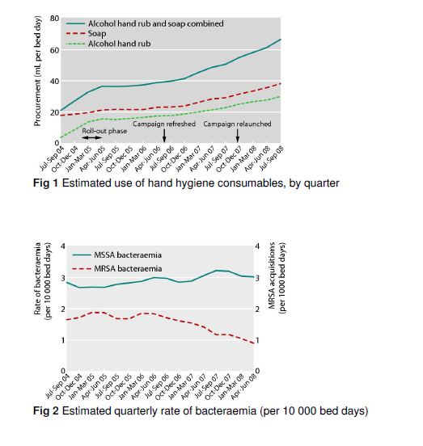
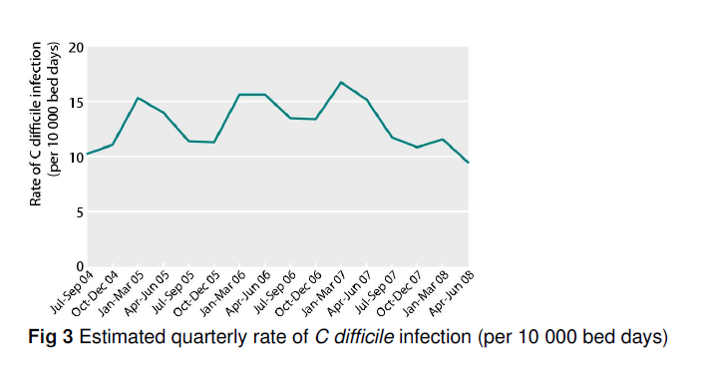
Does hand hygiene explain the reductions?
‘The Cleanyourhands campaign was associated with sustained increases in hospital procurement of alcohol rub and soap, which the results suggest has an important role in reducing rates of some healthcare associated infections.’
Stone et al. BMJ 2012;344:e3005.

Slide 21
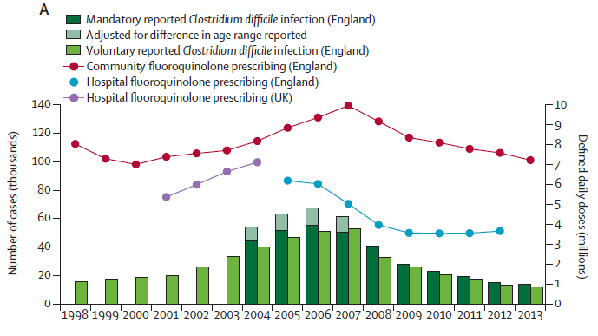
Does antimicrobial stewardship explain the reduction?
Dingle et al. Lancet Infect Dis 2017 in press.

Slide 22
Why no reduction in MSSA or E. coli bacteraemia?

Slide 23
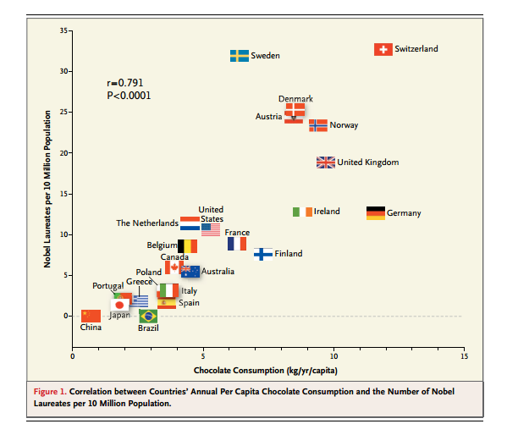
Spurious correlation?
Correlation between national chocolate consumption and rate of Nobel prize winners.
Messerli FH. New Engl J Med 2012;367:1562-4.

Slide 24
MRSA bacteraemia, England 2001-2013
4
5
6
Mandatory reporting, 2001
‘Getting ahead of the curve’, 2002
‘Winning ways’, 2003
‘Towards cleaner hospitals’, 2004
‘Cleanyourhands’, 2004
Targets introduced, 2004
Cleanliness improvement, 2005
‘Going further faster’, 2006
Root cause analysis, 2006
Revised national guidelines, 2006
Deep clean, 2007
Screening elective admissions, 2008
Universal screening, 2010
8
9
10
3
7
1
2
11
12
13

Slide 25
Targeted approach to MRSA infection prevention
Reduction targets introduced in 2004 and reinforced in 2006
High impact interventions launched in 2006
Root cause analysis launched in 2006
Revised national guidelines launched in 2006 (including screening, isolation, and suppression for carriers)

Slide 26
‘Going further faster’ (2006)
Key challenge | Specific Focus
Challenge 1 | Engage the board and use performance management at every level
Challenge 2 | Ensure clinical ownership across organisation
Challenge 3 | Screen and/or decontaminate according to risk assessment
Challenge 4 | Use HIIs* to monitor and increase compliance
Challenge 5 | Integrate with risk and clinical governance framework
Challenge 6 | Ensure infection control is part of induction and ongoing training
Challenge 7 | Effectively coordinate bed management with infection control input
Challenge 8 | Clean and decontaminate
Challenge 9 | Proactively manage your reputation, engage all staff and local community
* HII = high impact interventions: Central venous catheter care bundle; Peripheral intravenous cannula care bundle; Renal catheter care bundle; Care bundle to prevent surgical site infection; Care bundle for ventilated patients; Urinary catheter care bundle; Care bundle to reduce the risk from Clostridium difficile.
From ‘Going further faster’

Slide 27

From ‘Going further faster’, 2006

Slide 28
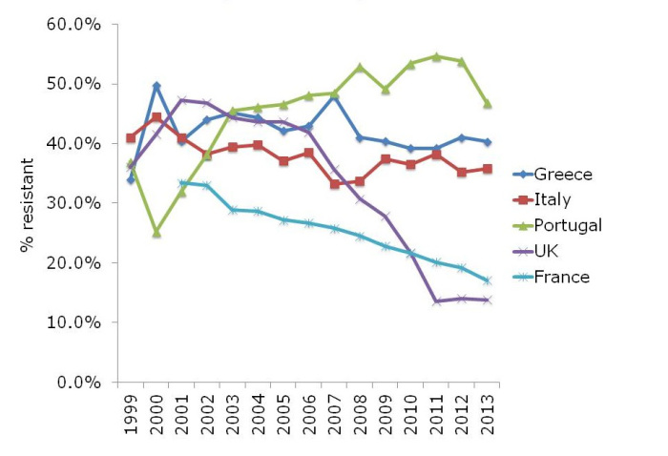
MRSA invasive infections, Europe
EARS-Net

Slide 29
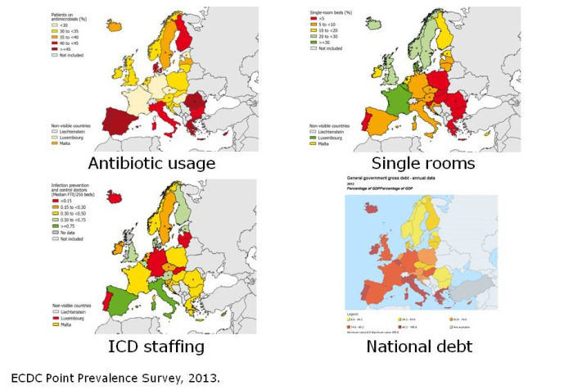
Explanatory correlations in Europe?

Slide 30
GNR Toolbox
Hand hygiene
Contact precautions
Active screening
Antibiotic stewardship
Cleaning / disinfection
Cohorting staff / patients
Note flagging
HCW screening
Education
Env. screening
Decol.
Otter et al. Clin Microbiol Infect 2015 2015;21:1057–1066.

Slide 31
Understanding and preventing E. coli BSI
E. coli BSI
Devices
UTI
SSI / wounds
High risk patients
AMR

Slide 32
NHS improvement: plans to reduce GNBSI
ambition to halve healthcare-associated GNBSI by 2021
exemplifying and sharing best practice across the health system
improving training on infection prevention for NHS staff
showing the figures for E. coli cases on wards, making them visible to patients and visitors in the same way that MRSA and C. difficile cases are currently displayed
improving incentives to promote the reduction in infection rates e.g. with a £45 million quality premium
working with the Care Quality Commission (CQC) to encourage a focus on infection prevention during inspections
Ruth May letter, 15/07/2017.

Slide 33
NHS improvement: resources to reduce GNBSI
an improvement resource of good practice, co-produced with Public Health England (PHE) and colleagues across the NHS, which will continue evolve as we understand the most effective interventions
regular Performance Improvement Network events throughout the year for the NHS to share examples of good practice, successes and challenges
visits to healthcare economies to understand and share good practice across the country
further analysis based on the data that PHE publishes to help organisations make rapid progress
Ruth May letter, 15/07/2017.

Slide 34
Can we really halve GNBSIs?
Jon Otter, PhD FRCPath
Imperial College London
j.otter@imperial.ac.uk
@jonotter
Blog: www.ReflectionsIPC.com
You can download these slides from www.jonotter.net
GNBSI

