Slide 1


Using a stand-alone air disinfection unit to reduce the risk from contaminated aerosols from heater-cooler units used for cardiothoracic surgery
Eleonora Dyakova, Siddharth Mookerjee,
Moya Alexander, Hugo Donaldson, Henry Bishop,
Danni Owens, Gillian Bleeze, Anan Ghazy,
Kathy Bamford, Jon Otter
Imperial College London / Imperial College Healthcare NHS Trust
j.otter@imperial.ac.uk
@jonotter

Slide 2
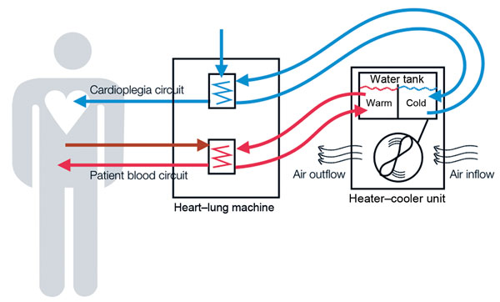
Heater-cooler units (HCUs)
HCUs are stand-alone devices responsible for heat exchange in cardiopulmonary bypass machines
Sommerstein et al. Infect Control Hosp Epidemiol 2016.

Slide 3
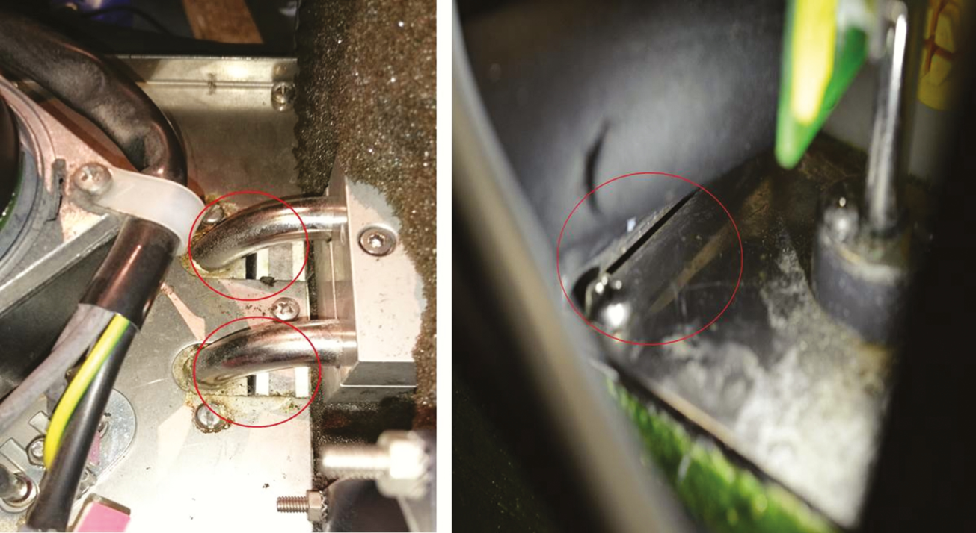
Wholly unsatisfactory design
Holes (highlighted by the red circles) close to the flow and return pipes of both heater-cooler circuits and gap between tank sealing plates identified by an aerodynamic particle sizer as areas of aerosol release.
Chand et al. Clin Infect Dis 2017;64:335-42.
Notes:
Emergence of the issue. Sax et al. Clin Infect Dis 2015;61:67–75.
Swiss 2015 cases in CID; 2 cases linked by genotyping, and same organism found in water and theatre air
Clinical presentation:
Delayed diagnosis (3 months – 5 years).
Prosthetic valve endocarditis, disseminated infections, or infections of vascular grafts (less commonly wound or surgical space SSIs).
Non-specific symptoms and lab abnormalities.
Poor response to therapy; 50% mortality rate.

Slide 4
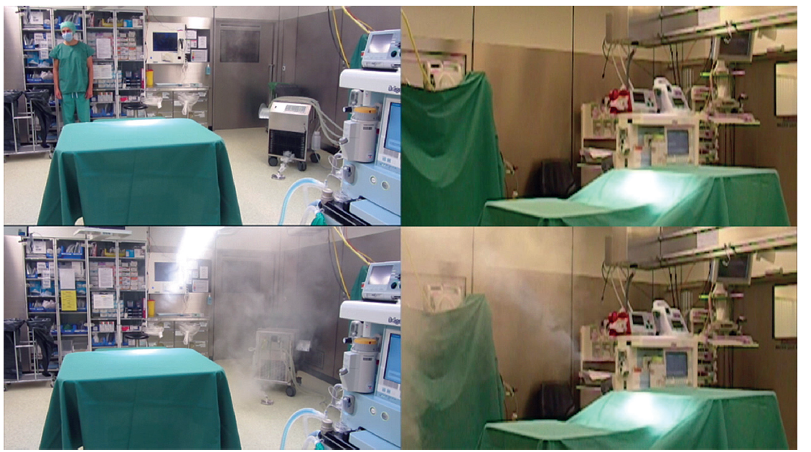
Aerosol tests
https://www.youtube.com/watch?v=YZ41aLoHrhQ
Sommerstein et al. Emerg Infect Dis 2016;22:1008-13.

Slide 5
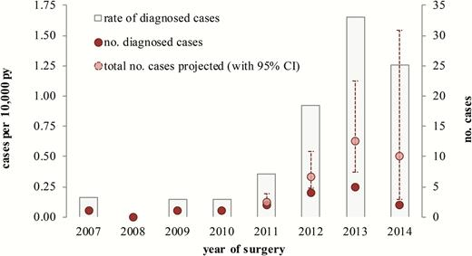
UK situation
Assessment of risk of Mycobacterium chimaera infection following cardiac valve repair or replacement in England, 2007–2014.
Abbreviations: CI, confidence interval; PY, person-years.
Chand et al. Clin Infect Dis 2017;64:335-42.
Notes:
4-year national look-back exercise to detect potential cases.
18 probable cases; 54 possible cases.
Very rare outcome from cardiothoracic surgery (around 1 per 10,000 person-years).
Widespread problem, with a quarter of cardiothoracic centres in the UK reporting a case.
High case-fatality (50%).
Increasing risk (from <0.2 to 1.6 per 10,000 person-years between 2010 and 2013).
Large to huge time lag between the surgery and the detection of the infection: of the 18 probable cases identified, more than half (61%) presented >1 year after surgery, with one case presenting >5 years after surgery!

Slide 6
Risk assessment
Extrapolated from rates per 10,000 procedures reported by Chand et al. Clin Infect Dis 2017;64:335-42.

Slide 7
Mitigating / managing the risk
Physical location / encasing HCUs
Water and air testing
Enhanced decon (water change, filters, chemicals, deep clean)
Enhanced surveillance
Communication with patients and staff
Risk assessment (aka ‘the show must go on’)
Traceability of each unit
PHE information for healthcare providers

Slide 8
Methods
ICHT has three theatres that are used for cardiothoracic surgery.
In August and September 2016, a Plasmair air disinfection unit was placed in one of the theatres (‘test’) and the other theatres as controls.
Active air sampling for fungi was performed in each of the theatres in July (before the unit was installed), September (during the use of the unit), and in November (after the unit was removed).
Air samples were collected from the front and rear outlets of the HCUs.
The mean fungal counts in test theatre were compared with counts from control theatres using T-tests.

Slide 9
Mean fungal count in test vs. control theatres before, during, and after air disinfection unit use
*
*
Error bars represent minus one standard deviation.
* = significant difference between test and control theatres.

Slide 10
Trend in fungal counts
*
*
*
*
*
*
*
* = Airborne Mycobacterium species identified.
Error bars represent minus one standard deviation.

Slide 11
Commissioning the air handling unit
0.5μm reduction

Slide 12
Impact of different settings
Error bars represent minus one standard deviation.
Low = 800 m³ / hr; High = 1500 m³ / hr.

Slide 13
Enhanced decontamination
Decontamination regime | TVC | Environmental Gram negatives | Pseudomonas sp. | Fungi | M. chimaera
Regime 1 | >300 CFU | + | + | + | +
Regime 2 (chlorine) | >300 CFU | + | + | + | +
First decontamination | 100 CFU | + | - | - | -
Second decontamination | 1 CFU | + | - | - | -
Weekly Counts | ∼1-300 CFU | + | + | + | +
Regime 3 (peracetic acid) | >300 CFU | + | + | + | +
First decontamination | 1-10 CFU | + | - | - | -
Second decontamination | 0 CFU | - | - | - | -
Weekly Counts | ∼1-100 CFU | + | + (0-5 CFU) | + (0-30 CFU) | -
Regime 3 (tubing replaced) | 0 CFU | - | - | - | -
First decontamination | 0 CFU | - | - | - | -
Second decontamination | 0 CFU | - | - | - | -
Weekly Counts | 0 CFU | - | - | - | -
Garvey et al. J Hosp Infect 2016;93:229-34.

Slide 14
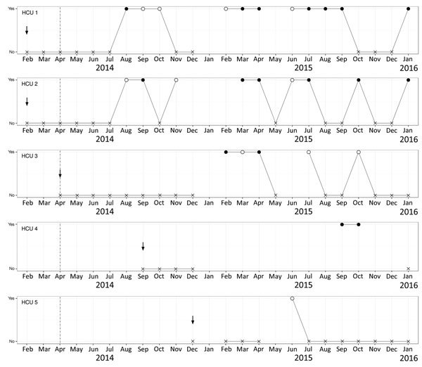
Enhanced decon…failed!
Arrows = start of use of each factory-new HCU in the operating room.
Filled circles = Mycobacterium chimaera; empty circles = other NTM.
HCU 4 sent for repair at the manufacturer during Dec 2014 – Sept 2015.
Schreiber et al. Emerg Infect Dis 2016;22:1830-3.

Slide 15
Discussion points
Uncertain epidemiology
  Outcome of national patient notification exercise
Chronic under-reporting
  Belgian study found that 65% of 149 “M. intracellulare” were actually M. chimaera.¹
M. chimaera has also been identified in thermoregulatory devices are used for extracorporeal membrane oxygenation (ECMO).²
Notification of exposed patients (local patient notification exercises have been done in the US).³
Consent for yet-to-be exposed patients.
What else is lurking in the HCUs (e.g. Legionella)?
Soetaert et al. J Med Microbiol 2016;65:1307-10.
Trudzinski et al. Eurosurveill 2016;21:pii:30398.
Perkins et al. MMWR 2016;65):1117-8.

Slide 16
Key questions
Is this the surgical outcome to focus on?
Are the HCUs fit for purpose?
What do we do about it?
Is this the tip of the iceberg?
Why is it getting worse?
Is there a role for stand-alone air disinfection units to mitigate the HCU risk?

Slide 17
Using a stand-alone air disinfection unit to reduce the risk from contaminated aerosols from heater-cooler units used for cardiothoracic surgery
Eleonora Dyakova, Siddharth Mookerjee,
Moya Alexander, Hugo Donaldson, Henry Bishop,
Danni Owens, Gillian Bleeze, Anan Ghazy,
Kathy Bamford, Jon Otter
Imperial College London / Imperial College Healthcare NHS Trust
j.otter@imperial.ac.uk
@jonotter

