Slide 1

CPE: coming to a hospital near you!
Jon Otter, PhD FRCPath
Imperial College London
j.otter@imperial.ac.uk
@jonotter
Blog: www.ReflectionsIPC.com
Slides: www.jonotter.net

Slide 2
MRSA bacteraemia, England 2001-2013
4
5
6
Mandatory reporting, 2001
‘Gettting ahead of the curve’, 2002
‘Winning ways’, 2003
‘Towards cleaner hospitals’, 2004
‘Cleanyourhands’, 2004
Targets introduced, 2004
Cleanliness improvement, 2005
‘Going further faster’, 2006
Root cause analysis, 2006
Revised national guidelines, 2006
Deep clean, 2007
Screening elective admissions, 2008
Universal screening, 2010
8
9
10
3
7
1
2
11
12
13

Slide 3
C. difficile infection (CDI), England 2004-2013
CDI cases, 2004-2013
2
Mandatory reporting, 2004
Targets, 2007
Revised guidelines, 2009
1
3
Notes:
Trust apportioned = specimens from patients who have been in hospital for 3 days or more (MRSA) or 4 days or more (CDI)

Slide 4

THE END OF ANTIBIOTICS IS NIGH

Slide 5
National trends: mandatory surveillance

Slide 6
The emerging threat of AMR GNR!
Pathogen | GNR | MRSA | VRE | C. difficile
Resistance | +++ | + | + | +/-
Resistance genes | Multiple | Single | Single | n/a
Species | Multiple | Single | Single | Single
HA vs CA | HA & CA | HA | HA | HA
At-risk pts | All | Unwell | Unwell | Old
Virulence | +++ | ++ | +/- | +
Environment | +/- | + | ++ | +++

Slide 7
Rising threat from MDR-GNR
% of all HAI caused by GNRs.
% of ICU HAI caused by GNRs.
Non-fermenters | Acinetobacter baumannii Pseudomonas aeruginosa Stenotrophomonas maltophilia
Enterobacteriaceae | Klebsiella pneumoniae Escherichia coli Enterobacter cloacae
CPO
CPE
Hidron et al. Infect Control Hosp Epidemiol 2008;29:966-1011.
Peleg & Hooper. N Engl J Med 2010;362:1804-1813.

Slide 8
Creating a monster
Enterobacteriaceae
ESBLs
CPE
Extended-spectrum beta-lactams
Carbapenems

Slide 9

What’s the problem? Resistance
Courtesy of Pat Cattini

Slide 10
What’s the problem? Mortality
 | Enterobacteriaceae |  | Non fermenters
Organism | AmpC / ESBL | CPE | A. baumannii
Attributable mortality | Moderate | Massive (>50%) | Minimal
Shorr et al. Crit Care Med 2009;37:1463-1469.
Patel et al. Iinfect Control Hosp Epidemiol 2008;29:1099-1106.

Slide 11
What’s the problem? Rapid spread
Rapid spread
Clonal expansion
GI carriage
Horizontal gene transfer

Slide 12








What’s the problem? ££££
Economic evaluation of a 40 case outbreak of CPE. Error bars represent range
Otter et al. Clin Microbiol Infect 2016 in press.

Slide 13

Emergence of CPE in the UK
PHE.

Slide 14
Simple, stark, sobering sums
0.5%¹ x 186,393 = 932 (!)
0.1%² x 186,393 = 186
0.1% x 15.892m* = 15,892
* Admissions to NHS acute hospitals, Financial Year 14/15. NHS Confederation, Key Statistics on the NHS,
Mookerjee et al. ECCMID 2016.
Otter et al. J Antimicrob Chemother 2016 in press.
Notes:
Taking our carriage rate of CPE – 0.5% and applying it to our yearly patient admissions, means we can see close to 900 CPE positive patients
0.1% which is a conservative estimate, apply that, and its 186
0.1 is the conservative estimate, applying that to all NHS hospitals, 16,000 pos patients, currently reporting around1600, 10 fold underestimate of CPE positive patients

Slide 15
CPE in the USA
NHSN / NNIS data; MMWR 2013;62:165-170.

Slide 16
Invasive multidrug-resistant K. pneumoniae
EARS-Net

Slide 17

Colistin resistance in Italy
Survey of 191 CPE from 21 labs across Italy.
43%
Colistin resistant K. pneumoniae.
Range = 10-80% for the 21 labs.
Monaco et al. 2014; Euro Surveill 2014;19:pii=20939.

Slide 18




CPE in the UK and US

Slide 19
Evidence-free zone

Slide 20
Guidelines = Policy

Slide 21
CPE Toolbox
Hand hygiene
Contact precautions
Active screening
Antibiotic stewardship
Cleaning / disinfection
Cohorting staff / patients
Note flagging
HCW screening
Education
Env. screening
Decol.
Otter et al. Clin Microbiol Infect 2015 2015;21:1057–1066.

Slide 22
CPE Toolbox
Hand hygiene
Contact precautions
Active screening
Antibiotic stewardship
Cleaning / disinfection
Cohorting staff / patients
Note flagging
HCW screening
Education
Env. screening
Decol.
Otter et al. Clin Microbiol Infect 2015 2015;21:1057–1066.

Slide 23
Who do I screen?
UK PHE CPE Toolkit screening triggers:
an inpatient in a hospital abroad, or
an inpatient in a UK hospital which has problems with spread of CPE (if known), or
a‘previously’positive case.
Also consider screening admissions to high-risk units such as ICU, and patients who live overseas.

Slide 24
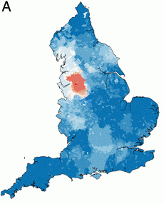
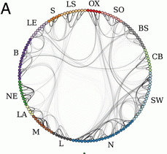
Distant large problems vs. small local ones?
CPE introductions come from hospitals within a regional referral network, even if the prevalence in another referral network is much higher (more than 100x higher, in fact)!
Donker et al. BMC Med 2017.

Slide 25

How do I screen?
Rectal swab is the best sample
  Insert no more than 2cm into rectum
  Twist gently and withdraw
  Ideally want to see faeces on swab.
Patient and staff education as to why this is needed in order to overcome taboos
Alternate specimen is stool sample, but have to wait for the patient to ‘go’
Notes:
Thank you Jon,
So how do I screen a patient for CRE?
A rectal swab provides the best results.
The swab should be inserted into the rectum no more than 2 cm or an inch twisted gently and withdrawn. The aim is to stain it brown!
Unfortunately , not many people are happy to have a sample taken in this way. And Issues such as child protection have been raised.
Clear explanations are needed to gain patient understanding and informed consent and we need some public education for us all to make this more normal and acceptable.
In the meantime
If it is really not possible to get a rectal sample then a stool sample can be used. This is not quite as good as apart form anything it may be delayed while we wait for the patient to ‘perform’

Slide 26
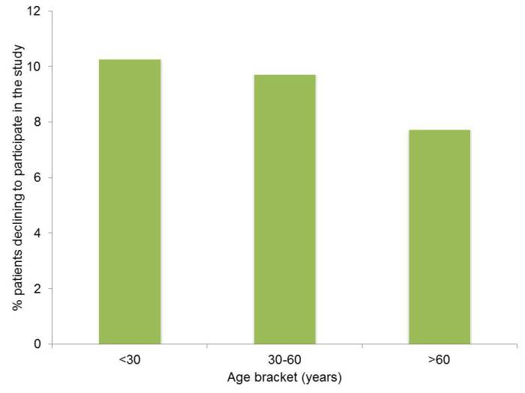
Can I swab your rectum please?
Factors associated with patients declining to provide a rectal swab were:
younger age (odds ratio (OR) 0.99, 95% confidence interval (CI) 0.99-1.00) female gender (OR 1.26, CI 1.04-1.52),
transfers from other hospitals (OR 1.77, CI 1.07-2.93) or an unknown admission route (OR 1.61, CI 1.09-2.37),
admission before the change in study description (OR 0.39, CI 0.31-0.48)
the staff member who consented the patient (p<0.001);
ethnicity was not a significant factor.
Dyakova et al. Clin Microbiol Infect 2017 in press.

Slide 27
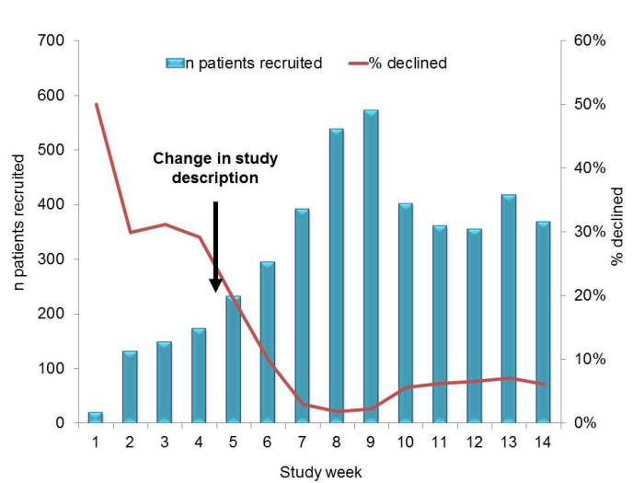
Improving screening compliance
Dyakova et al. Clin Microbiol Infect 2017 in press.

Slide 28
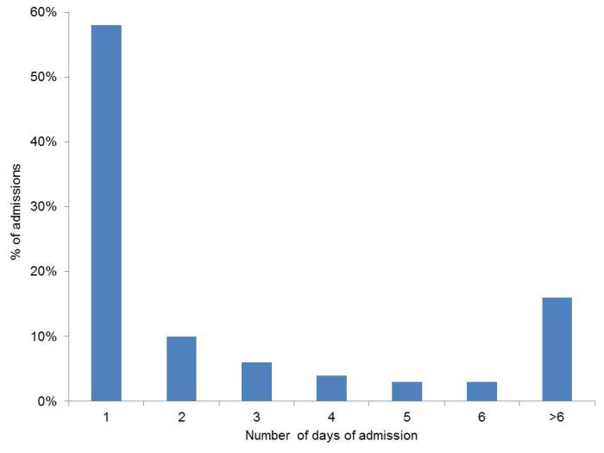
Serial admission screens?
Vella et al. J Hosp Infect 2016;94:118-24.

Slide 29
CPE Toolbox
Hand hygiene
Contact precautions
Active screening
Antibiotic stewardship
Cleaning / disinfection
Cohorting staff / patients
Note flagging
HCW screening
Education
Env. screening
Decol.
Otter et al. Clin Microbiol Infect 2015 2015;21:1057–1066.

Slide 30

The bed location lottery
Mitchell et al. J Hosp Infect 2015;91:211-217.
Notes:
Ajao study: only 53% of the 32 odd patients that acquired when the prior occupant was positive acquired the same species of ESBL; only 6% of the 32 had an indistinguishable or closely related strain of the same species.

Slide 31
MDR-GNB cleaning & disinfection checklist
Clean / declutter
Monitor cleaning process (e.g. fluorescent markers)
All equipment disinfected before leaving room
Enhanced daily disinfection using bleach
Terminal disinfection using bleach or, ideally, H₂O₂ vapor¹⁻³
Gopinath et al. Infect Control Hosp Epidemiol 2013;34:99-100.
Snitkin et al. Sci Transl Med 2012;4:148ra116.
Verma et al. J Infect Prevent 2013;7:S37.

Slide 32
CPE Toolbox
Hand hygiene
Contact precautions
Active screening
Antibiotic stewardship
Cleaning / disinfection
Cohorting staff / patients
Note flagging
HCW screening
Education
Env. screening
Decol.
Otter et al. Clin Microbiol Infect 2015 2015;21:1057–1066.

Slide 33
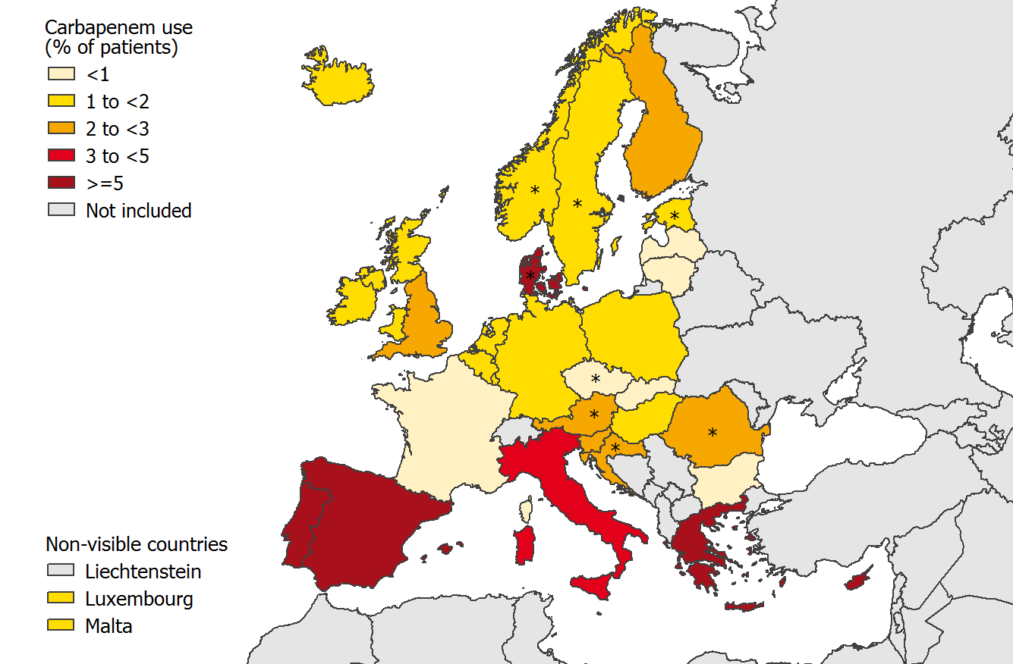
Carbapenem use, Europe
ECDC point prevalence survey 2013.

Slide 34
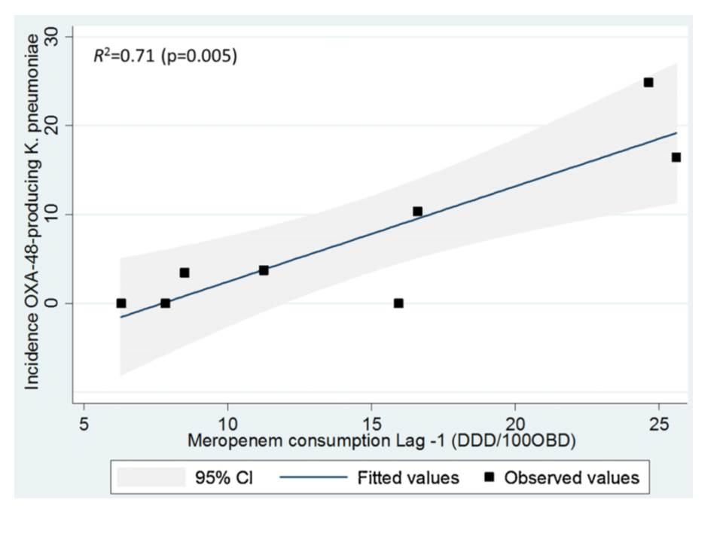
Can we forecast a CPE storm?
Could we find and implement an “alert” level of carbapenem use?
The authors claim a stewardship intervention brought the CPE outbreak under control – but also implemented ‘case isolation, screening of contacts, barrier nursing and other infection control interventions’.
Study focussed only on OXA-48 K. pneumoniae; what about other Enterobacteriaceae and non-fermenters.
What drives carbapenem resistance? The use of meropenem in the previous year plotted against the incidence rate of OXA-48-producing K. pneumoniae
Gharbi et al. Int J Antimicrob Agents 2015 in press.

Slide 35
Antimicrobial stewardship – impact
Evaluating impact of 6 month antimicrobial stewardship intervention on an ICU by comparing bacterial resistance for matched 6 month periods either side of intervention.
*
*
*
*
*
*
Hou et al. PLoS ONE 2014;9:e101447; * = significant difference before vs. after.

Slide 36
CPE Toolbox
Hand hygiene
Contact precautions
Active screening
Antibiotic stewardship
Cleaning / disinfection
Cohorting staff / patients
Note flagging
HCW screening
Education
Env. screening
Decol.
Otter et al. Clin Microbiol Infect 2015 2015;21:1057–1066.

Slide 37
Summary
CPE combine resistance, virulence, the potential for rapid spread, and high costs.
Prevalence in the US and Europe appears to be patchy, but increasing; rates in parts of S. Europe are high.
We do not yet know what is effective in terms of prevention and control, but screening and isolation of carriers seems prudent.
CPE is here to stay in the UK.

Slide 38
The rising threat from antibiotic-resistant Gram-negative bacteria
Jon Otter, PhD FRCPath
Imperial College London
j.otter@imperial.ac.uk
@jonotter
Blog: www.ReflectionsIPC.com
Slides: www.jonotter.net

