Slide 1
Managing repeated screening for known CPE carriers: once positive always positive?
Siddharth Mookerjee, Eleonora Dyakova, Frances Davies, Kathleen Bamford, Tracey Galletly, Eimear Brannigan, Alison Holmes, Jonathan Otter
Siddharth Mookerjee, MPH
Imperial College Healthcare NHS Trust
Siddharth.mookerjee@imperial.nhs.uk
Notes:
This presentation has two aims
How do we manage screening for CPE as per the PHE guidance
Does the theory – once positive always positive for CPE stand
Add contact details

Slide 2
Carbapenemase-producing
Enterobacteriaceae (CPE): ‘triple threat’
CPE
Resistance
Rapid spread
Mortality
Notes:
CPE poses a triple threat – organisms are highly resistant, they lead significant increase in mortality, and they spread rapidly

Slide 3
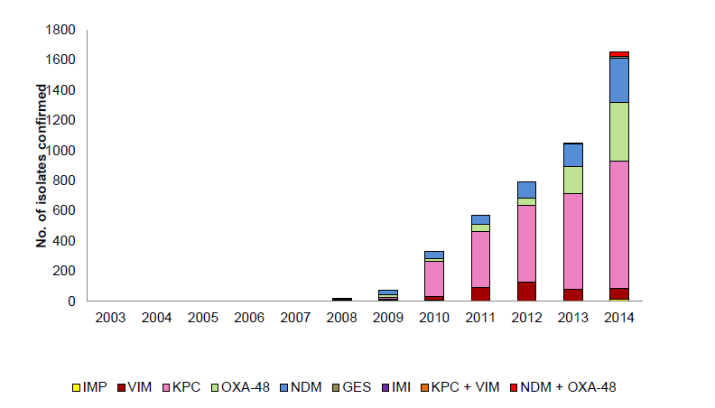
CPE reported to PHE’s reference lab
ESPAUR 2015.
Notes:
Latest ESPAUR 2014 report - Can clearly see the dramatic increase in CPE cases reported to PHE, from under 200 cases in 2009, to over 1600 in 2014

Slide 4
CPE prevention & control
Hand hygiene
Contact precautions
Active screening
Antibiotic stewardship
Cleaning / disinfection
Otter et al. Clin Microbiol Infect 2015;21:1057-1066.
Notes:
These are all the interventions you can throw at CPE
Focus of this talk is active screening for CPE
Action - Make all the same colour, apart from active screening

Slide 5
CPE screening recommendations
Guidelines to prevent the spread of CPE recommend screening to detect asymptomatic carriers.¹⁻³
Public Health England (PHE) issued a Toolkit to prevent the spread of CPE, which includes recommendations for risk-factor based screening of all admissions.⁴
PHE recommend that patients ‘at-risk’ are screened on three separate occasions, each separated by 48 hours:
An inpatient in a hospital abroad
An inpatient in UK hospital which has problems CPE spread
Previous positive case
Wilson et al. J Hosp Infect 2016 in press.
Otter et al. Microbiol Infect 2015; 21:1057-1066.
Tacconelli et al. Clin Microbiol Infect 2014; 20 Suppl 1:1-55.
Public Health England. CPE Toolkit. 2013.
Notes:
PHE toolkit recommends a risk factor based approach to CPE screening, specifically to detect asymptomatic carriers, 3 screens separated by 48 hours
Specify the risk factors noted by PHE

Slide 6
Local screening strategy
Risk-factor based admission screening of all admissions
Universal admission screening in ‘high-risk’ specialties
Weekly screening in high-risk specialties, and around known carriers.
Contact tracing screening for newly identified cases.
Admission screening and contact tracing was performed using three screens, each separated by 48 hours. Weekly screening was performed using a single screen.
Rectal swabs were requested, some perineal swabs were sent; both were included in the analysis.
Notes:
Risk factors = Patients with overnight hospitalisation in any hospital (including our own readmissions) with in the past 12 months, and overseas residents.
Universal screening: ICU, renal, vascular and haematology in-patient wards.

Slide 7
New CPE cases, April 2014 – June 2016
Universal risk-factor based admission screening was introduced in June 2015 to extend screening that was being performed in high-risk specialties. The majority of cases are from screens, without evidence of clinical infection.
Notes:
Here is the trend in new CPE case, Apr 14 onwards, we at Imperial initiated universal and risk factor based screening in Jun-15, can see a spike in new cases, vast majority from screens, without evidence of clinical infections

Slide 8
Aims
Determine CPE carriage rate on admission.
Establish the value of serial admission screens to confirm negative CPE carriage status.
Explore the pattern of apparent carriage to test a “once positive, always positive” approach.
Notes:
We undertook a piece of work with the following aims
1), 2), 3)
Taking into account all CRE screens from Jun to Dec 15

Slide 9
Methods
For admission screens, the timelines applied to evaluate the benefit of serial screens were:
  1st screen at <24 hours,
  2nd between 25-72 hours, and
  3rd between 73-120 hours.
Screening swabs plated onto chromogenic media (ColorexTM mSuperCARBATM, E&O Laboratories, UK).
Suspicious colonies were tested for antimicrobial susceptibility (EUCAST disc diffusion), and carbapenemase gene detection by PCR (Xpert® Carba-R, Cepheid Inc, USA).
CPE identified locally and PCR- suspicious isolates sent to the PHE AMRHAI reference unit for confirmation.
Notes:
Standard methods based on chromogenic medium, PCR locally to confirm carrier status and ref lab referal for confirmation

Slide 10
Methods – bacterial groups
Gram-negative bacteria
Enterobacteriaceae
*Resistant Enterobacteriaceae
CPE
  * Resistant to ertapenem, meropenem, temocillin or tazocin.
Notes:
The biggest group here is the GNB, a sub-set of that….
Worth noting that since isolates grown on chromogenic media, all GNR are resistant, the resistant Enterobacteriaceae are just the highly resistant ones

Slide 11
Methods
Data was de-duplicated separately for each time-point.
Carriage rate at the three screening points was tested for a significant trend-change using logistic regression analysis for each organism-group, accounting for repeated measure where relevant.
This work was considered a service evaluation, and did not require an application to the NHS Research Ethics Service.
Notes:
Data de-duplicated for each time-point, significant change in trend analysed using logistic regression and repeated measures logistic regression analysis, work done as part of a service evaluation

Slide 12
Carriage rate by screening time-point
*
* = significant trend-change: p<0.05.
Notes:
What did we find?
11, 378 Patients screened at time point 1, time point 2, time point 3, significant change in trend only in Enterobacteriaceae

Slide 13
Carriage rate by screening time-point (patients who received all 3 screens)
n=221. No significant trend-change for any of the organism-groups: p>0.05.
Notes:
Just check this with ED
Small number of patients - 221 Patients who have had all 3 screens, with 3 screens taken at the specific time points, no significant change in trend

Slide 14
Carriage rate for patients who received 3 screens at any time-point
*
*
*
n=1509. * = significant trend-change: p<0.05.
Notes:
1509 Patients who have had 3 screens, where 3 screens need not fall at specific time points, i.e. consecutive, significant change in trend in GN, Enterobacteriaceae and resistant Entero
In contrast the most interesting slide is the one for patients who received 3 screens at any time-points

Slide 15
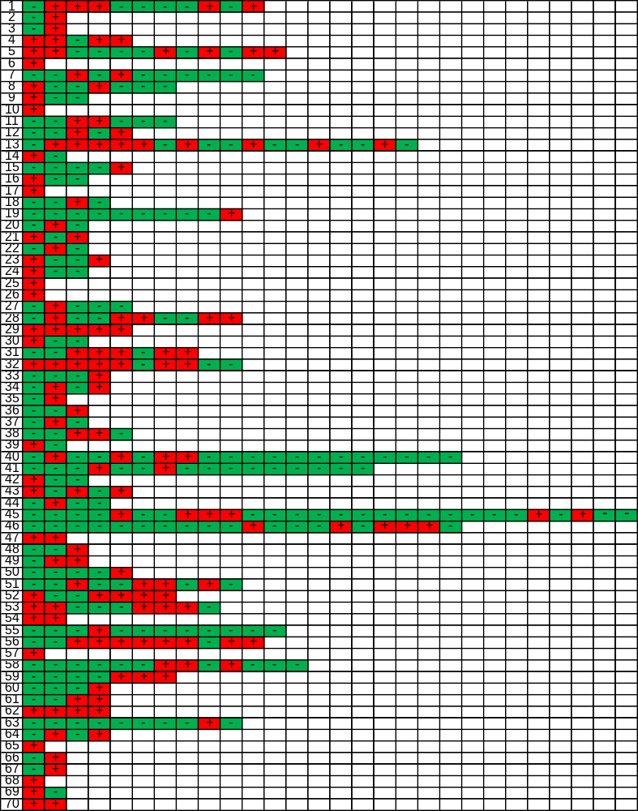
Once positive, always positive?
Of 51 that had least three screens, 24 (47.1%) had a ‘+-+’ pattern.
60 / 64 (93.8%) patients had at least one negative surveillance culture during their hospital stay (excluding 6 patients with a single positive screen).
Serial CPE screens from 70 patients who were found to be CPE positive by screening cultures during June – December 2015. Red = positive. Green = negative.
Notes:
Moving onto the 2nd aim, once positive for CPE, always positive? Lets see…
We map out serial CPE screens from 70 patients who were found to be CPE positive from screening culture, red = pos, green = negative
47%, almost half of the 51 who had atlleast 3 screens, had a + - + pattern
Then go through whats on screens and then give example of line 4..
Not sure if we should believe the negative screens

Slide 16
Discussion
The carriage rate on admission was low (0.5%), consistent with the few other studies in the UK ¹
Serial admission screens add little value in detecting cases.
  We are not aware of any other evaluation of the performance of serial admission screens for CPE.
Rectal swabs as effective as stool samples, and 2x as effective at detecting resistant Enterobacteriacaea than perineal.^{2,3}
A negative CPE screen is not to be trusted for known carriers, as found in other studies.^{4,5}
Otter et al. J Antimicrob Chemother. 2016; 71(10)
Lerner et al. Antimicrob Agents Chemother 2013;57:1474-1479.
Dyakova et al. IPS 2015, and submitted.
O’Fallon et al. Clin Infect Dis 2009;48:1375e1381.
Feldman et al. Clin Microbiol Infect 2013;19:E190eE196.
Notes:
Low carriage rate of 0.6%
Little value in serial admission screening
Rectal swabs as effective as stool samples
Don’t trust negative CPE screen for known carriers

Slide 17
Recommendations
Serial screening to confirm negative CPE carriage status when admission screening and contact tracing has ceased.
Weekly screening in high-risk areas and around all patients with known CPE.
Regular screening of long-stay patients for carriage of resistant Gram-negative bacteria should be considered.
“Once positive, always positive” approach.
Notes:
We ceased serial screening to confirm negative CPE carriage status
We continue weekly screening in high-risk areas known to have CPE patients
Regular screening of long-stay patients for carriage of GNB should be considered
Once pos always pos!

Slide 18
Simple, stark, sobering sums
0.5% x 186,393 = 932 (!)
0.1% x 186,393 = 186
0.1% x 15.892m* = 15,892
* Admissions to NHS acute hospitals, Financial Year 14/15. NHS Confederation, Key Statistics on the NHS,
Notes:
Taking our carriage rate of CPE – 0.5% and applying it to our yearly patient admissions, means we can see close to 900 CPE positive patients
0.1% which is a conservative estimate, apply that, and its 186
0.1 is the conservative estimate, applying that to all NHS hospitals, 16,000 pos patients, currently reporting around1600, 10 fold underestimate of CPE positive patients

Slide 19
Managing repeated screening for known CPE carriers: once positive always positive?
Siddharth Mookerjee, Eleonora Dyakova, Frances Davies, Kathleen Bamford, Tracey Galletly, Eimear Brannigan, Alison Holmes, Jonathan Otter
Siddharth Mookerjee, MPH
Imperial College Healthcare NHS Trust
Siddharth.mookerjee@imperial.nhs.uk

