Slide 1


Implementing innovation when financial times are hard
Jon Otter, PhD FRCPath
Imperial College London
j.otter@imperial.ac.uk
@jonotter
Blog: www.ReflectionsIPC.com
You can download these slides from www.jonotter.net

Slide 2
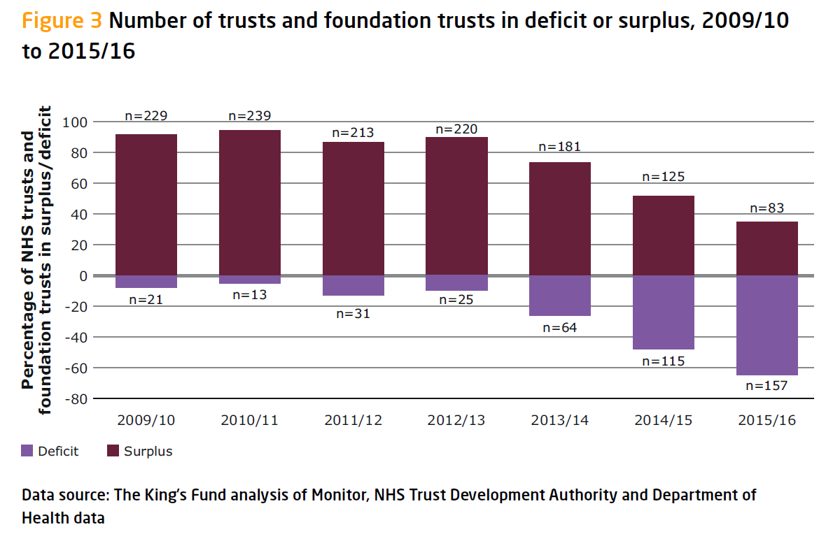
The King’s Fund Briefing. Deficits in the NHS 2016.

Slide 3
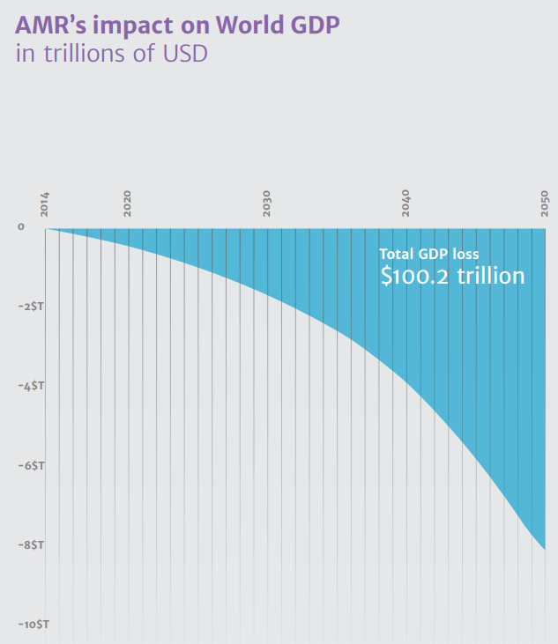
Cost of HCAI / AMR
The Review on AMR, 2014.

Slide 4
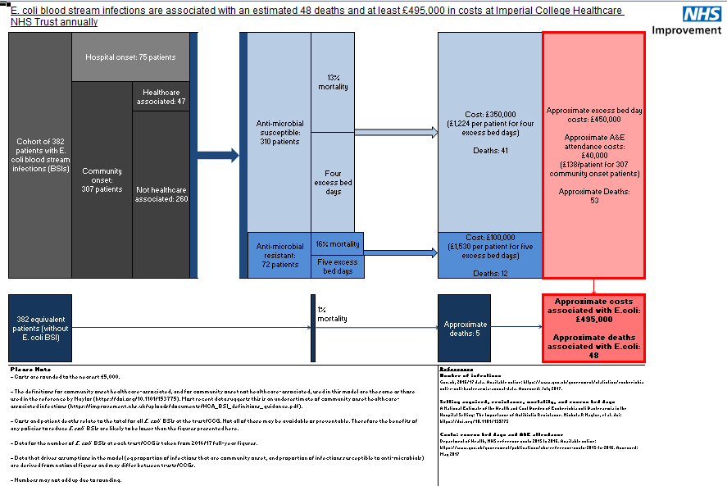
NHSI E. coli BSI cost calculator.

Slide 5
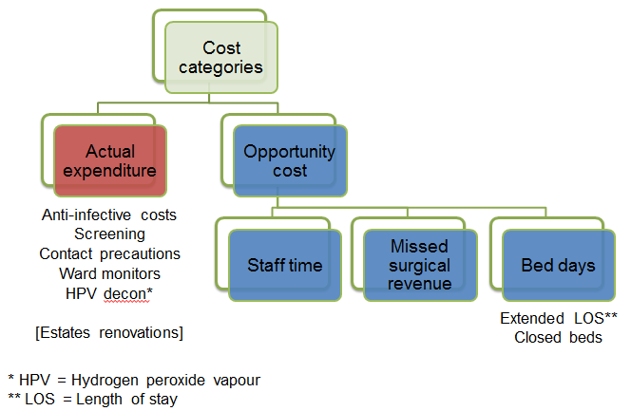
Cost of an outbreak - methods

Slide 6
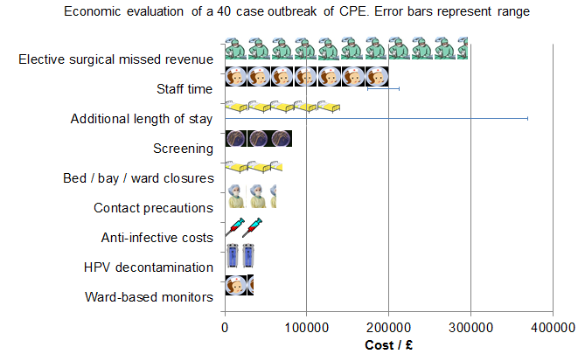
Cost of an outbreak - results
Otter et al. Clin Microbiol Infect 2017.

Slide 7
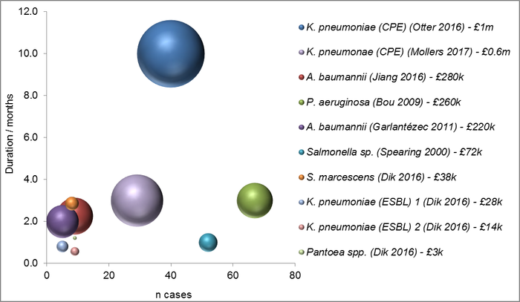
Cost of an outbreak - in context

Slide 8
ESPAUR 2017: Highlights
The number of GNBSIs is up (E. coli from 32,000 in 2012 to 40,000 in 2016; K. pneumonaie from 5,000 in 2012 to 6,500 in 2016); resistance to key antibiotics substantial but stable (e.g. co-amoxiclav resistance in around 40% in E. coli and 25% in K. pneumoniae). Carbapenem resistance remains low in BSIs.
Trends in mandatory reporting of HCAI in England.

Slide 9
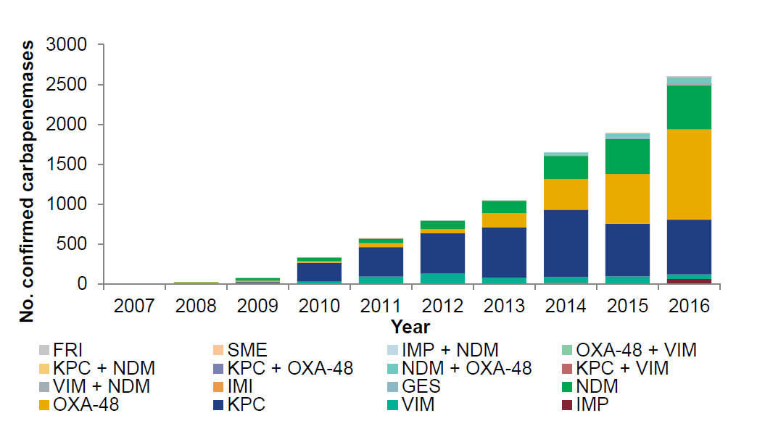
Referrals of CPE to the national ref lab continue to increase – up to more than 2,500 in 2016, with OXA-48 now being the main culprit. Is this referral bias, increased screening, or a genuine increase?
Stepwise increase in CPE referred to the national reference lab in England.

Slide 10
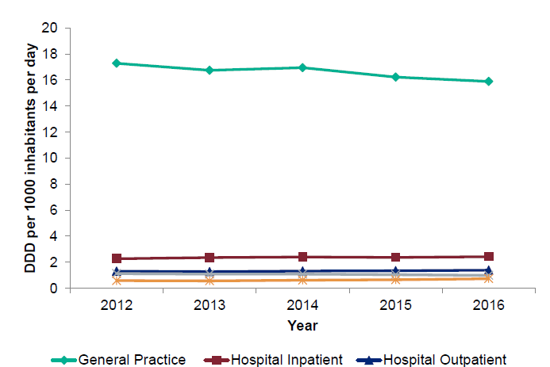
Between 2012 and 2016, antibiotic prescribing (defined daily doses per 1000 inhabitants per day) reduced by 5%, but 7% increase in hospitals.
In hospitals, the consumption of both pip/tazo and carbapenems increased up to 2015 but has decreased by 4% in 2016, which seems likely to be a direct impact of the CQUIN around reduced prescribing of broad spectrum antibiotic.
Total antibiotic consumption, expressed as DDD per 1000 inhabitants per day, England, 2012-2016.

Slide 11
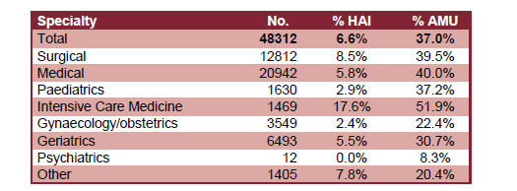
The report includes summary data from the 2016 national PPS
This was a huge undertaking that included 48,312 patients from 88 NHS Trusts and 6 private hospitals.
7% of patients had an HCAI and 33% were on an antimicrobial; amazingly, these rates remain broadly the same as the last PPS in 2011.
Pneumonia was the most common HCAI (29%) followed by UTI (17%) then SSI (15).
Prevalence of peripheral vascular cannula (43%), central venous catheters (7%), urinary catheters (20%), and intubation (2%).
HCAI and antimicrobial use by speciality.

Slide 12

The most expensive HCAI is…HAP!
Cassini et al. Plos Med 2016.

Slide 13
Selling your ideas (or anything, really)
Know your audience
Understand the need
Listen to the client
Be part of a convincing brand
Be quietly tenacious

Slide 14
Writing a compelling business case
Step 1: Frame the problem and the solution
Step 2: Discuss the case in principle with key stakeholders
Step 3: Determine the cost of your solution
Step 4: Determine the benefits of your solution (financial and otherwise)
Step 5: Make the case for your case!
Step 6: Monitor progress of your case once funded
Adapted from Perencevich et al. Infect Control Hosp Epidemiol 2007;28.

Slide 15
Business case writing: resources
Building a business case. Library and Knowledge Healthcare Services, Health Education England.
Building Your Business Case. Johnson et al. Am J Infect Control 2011;39:E126.
Raising Standards While Watching the Bottom Line: Making a Business Case for Infection Control. Perencevich et al. Infect Control Hosp Epidemiol 2007;28.
Making the business case for infection control: Pitfalls and opportunities. Dunagan et al. Am J Infect Control 2002;30:86-92.

Slide 16
HPV: clinical impact
Study | ARD system | Design | Outcome | Confounders
McCord 2016 | HPV | 4 year before-after | CDI rate fell from 1.0 to 0.4 cases per 1,000 pt days; 60% reduction, p<0.001. | No data on IPC compliance / abx use.
Horn 2015 | HPV | 3 year before-after | CDI, VRE, ESBL and MRSA rate fell significantly. | Concurrent increase in hand hygiene compliance.
Passaretti 2013 | HPV | 36 month cohort | Pts admitted to rooms decontaminated using HPV 64% less likely to acquire MDRO (IRR=0.36, CI=0.19-0.70, p<0.001). | Not randomised.
Manian 2013 | HPV | 2 year before-after | CDI rate fell from 0.9 to 0.5 cases per 1,000 pt days; 39% reduction (IRR=0.63, CI=0.50-0.79, p<0.001). | Bleach disinfection enhanced concurrently.
Boyce 2008 | HPV | 2 year before-after | CDI rate fell from 1.9 to 0.9 cases per 1,000 pt days on high-risk wards; 53% reduction, p=0.047). | Outbreak? No significant reduction hospital wide; changes in abx usage.

Slide 17

HPV: clinical impact
2 years before HPV, 2 years during HPV. Breakpoint model indicated significant reduction in rate of CDI when HPV implemented (1.0 to 0.4 per 1000 patient days, 60% reduction).
McCord et al. J Hosp Infect 2016.

Slide 18





Cost-perspectiveness

Slide 19
Cost-effectiveness
2 years before HPV, 2 years during HPV. Breakpoint model indicated significant reduction in rate of CDI when HPV implemented (1.0 to 0.4 per 1000 patient days, 60% reduction).
Cases averted per annum | 67
Cost range for HA-CDI | £2000-19,500
Total cost per annum | £134,000-1,306,500
Adapted from McCord et al. J Hosp Infect 2016 with cost information from Gabriel et al. J Hosp Infect 2014.

Slide 20
The King’s Fund Briefing. Deficits in the NHS 2016.

Slide 21
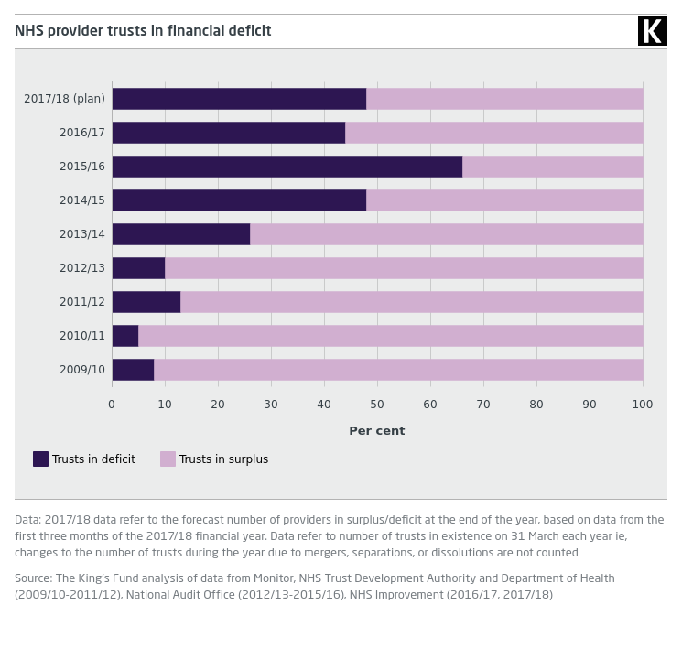
The King’s Fund. Trusts in deficit.

Slide 22
Summary
HCAI and AMR have enormous financial and non-financial cost.
Despite the perilous financial position of many NHS Trust, money will be found for improving the quality of patient care and reducing HCAI.
Understand the risks and priorities in terms of HCAI / AMR, and the wider challenges of NHS hospitals.
Business cases are vital; you need to know your audience and consult widely.

Slide 23
Implementing innovation when financial times are hard
Jon Otter, PhD FRCPath
Imperial College London
j.otter@imperial.ac.uk
@jonotter
Blog: www.ReflectionsIPC.com
You can download these slides from www.jonotter.net

