Slide 1

Tackling the challenge of CRE –
the London experience
Jon Otter, PhD FRCPath
Imperial College London
j.otter@imperial.ac.uk
@jonotter
Blog: www.ReflectionsIPC.com
Slides: www.jonotter.net

Slide 2
MRSA bacteraemia, England 2001-2013
4
5
6
Mandatory reporting, 2001
‘Gettting ahead of the curve’, 2002
‘Winning ways’, 2003
‘Towards cleaner hospitals’, 2004
‘Cleanyourhands’, 2004
Targets introduced, 2004
Cleanliness improvement, 2005
‘Going further faster’, 2006
Root cause analysis, 2006
Revised national guidelines, 2006
Deep clean, 2007
Screening elective admissions, 2008
Universal screening, 2010
8
9
10
3
7
1
2
11
12
13

Slide 3
C. difficile infection (CDI), England 2004-2013
CDI cases, 2004-2013
2
Mandatory reporting, 2004
Targets, 2007
Revised guidelines, 2009
1
3
Notes:
Trust apportioned = specimens from patients who have been in hospital for 3 days or more (MRSA) or 4 days or more (CDI)

Slide 4

THE END OF ANTIBIOTICS IS NIGH

Slide 5
National trends: mandatory surveillance

Slide 6
The emerging threat of CRE
Pathogen | CRE | MRSA | VRE | C. difficile
Resistance | +++ | + | + | +/-
Resistance genes | Multiple | Single | Single | n/a
Species | Multiple | Single | Single | Single
HA vs CA | HA & CA | HA | HA | HA
At-risk pts | All | Unwell | Unwell | Old
Virulence | +++ | ++ | +/- | +
Environment | +/- | + | ++ | +++

Slide 7
Rising threat from MDR-GNR
% of all HAI caused by GNRs.
% of ICU HAI caused by GNRs.
Non-fermenters | Acinetobacter baumannii Pseudomonas aeruginosa Stenotrophomonas maltophilia
Enterobacteriaceae | Klebsiella pneumoniae Escherichia coli Enterobacter cloacae
CRO
CRE
Hidron et al. Infect Control Hosp Epidemiol 2008;29:966-1011.
Peleg & Hooper. N Engl J Med 2010;362:1804-1813.

Slide 8
Creating a monster
Enterobacteriaceae
ESBLs
CRE
Extended-spectrum beta-lactams
Carbapenems

Slide 9

What’s the problem? Resistance
Courtesy of Pat Cattini

Slide 10
What’s the problem? Mortality
 | Enterobacteriaceae |  | Non fermenters
Organism | AmpC / ESBL | CRE | A. baumannii
Attributable mortality | Moderate | Massive (>50%) | Minimal
Shorr et al. Crit Care Med 2009;37:1463-1469.
Patel et al. Iinfect Control Hosp Epidemiol 2008;29:1099-1106.

Slide 11
What’s the problem? Rapid spread
Rapid spread
Clonal expansion
GI carriage
Horizontal gene transfer

Slide 12








What’s the problem? ££££
Economic evaluation of a 40 case outbreak of CRE. Error bars represent range
Otter et al. Clin Microbiol Infect 2016 in press.

Slide 13
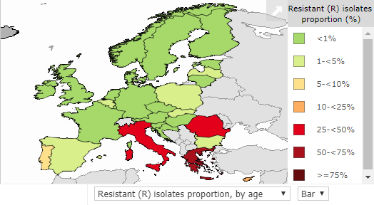
CRE in Europe, 2016
% invasive K. pneumoniae isolates resistant to carbapenems
EARS-Net 2018.

Slide 14
Emergence of in Europe, 2005-2016
EARS-Net 2018.

Slide 15
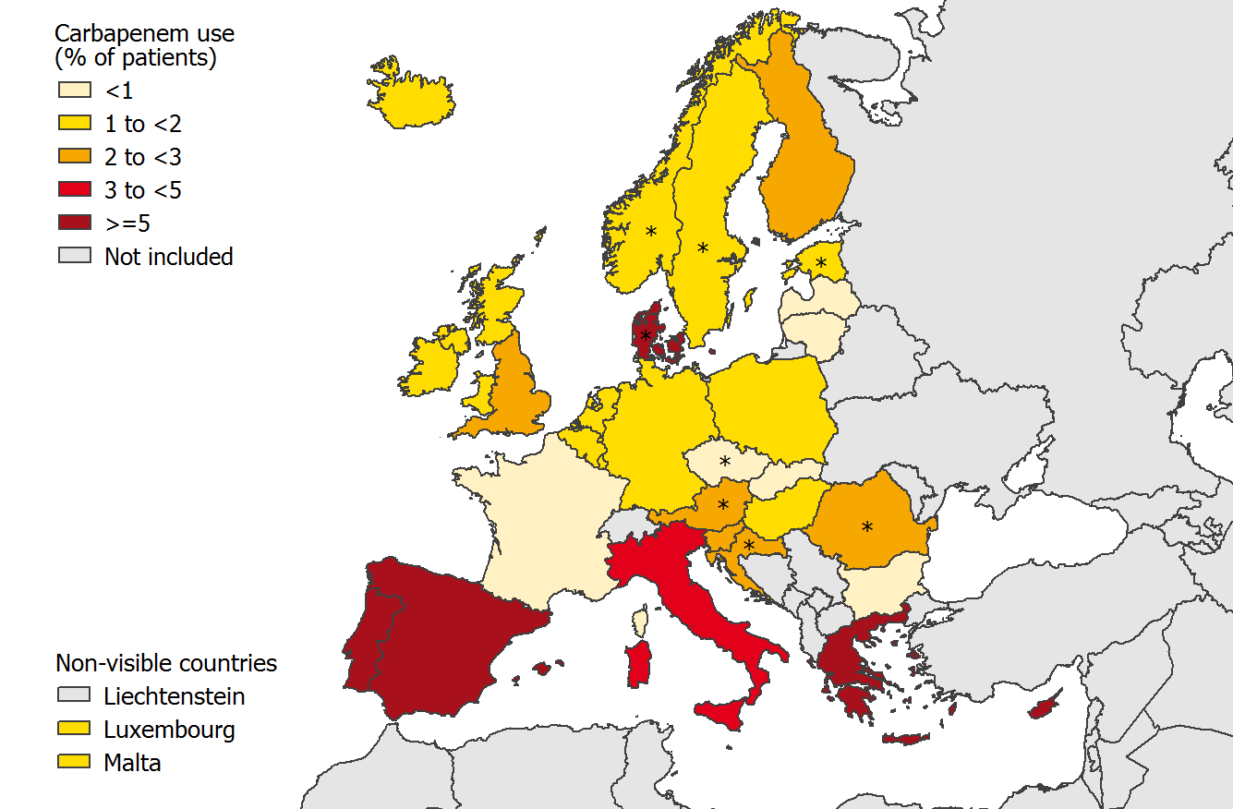
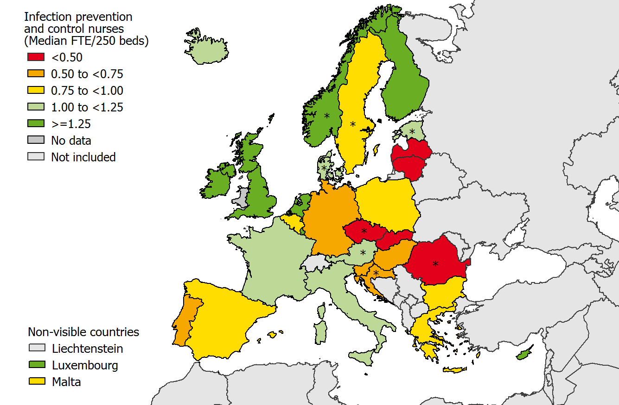
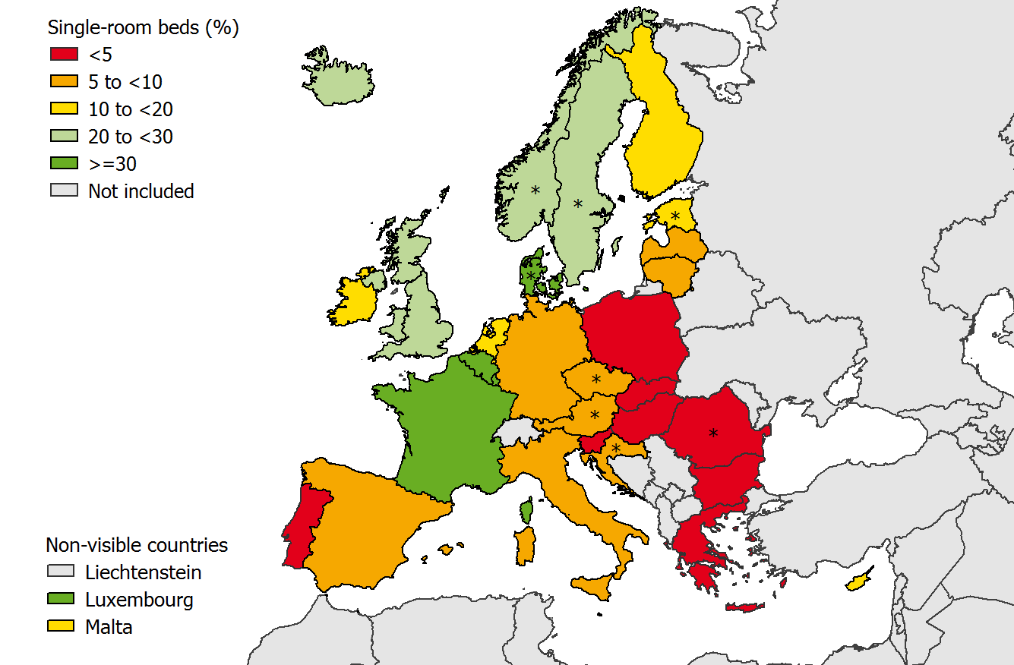
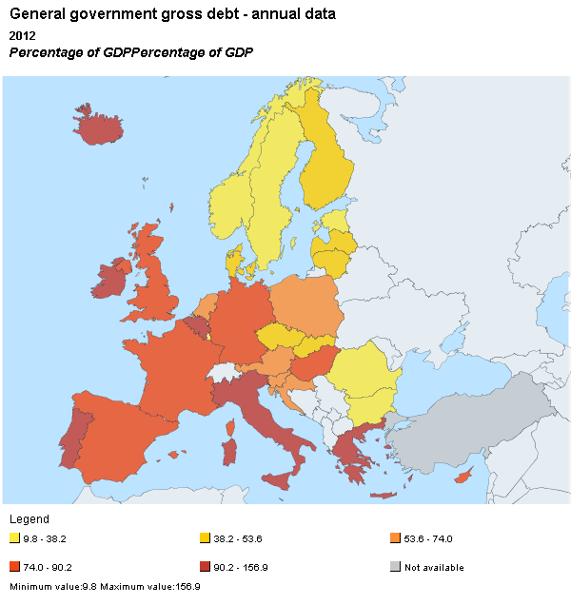
What drives the European ‘north-south divide’?
Antibiotic use
Infection control staffing
Single room availability
National debt
1. ECDC Point Prevalence Survey, 2013.
2, National debt as a percentage of GDP. "Eurostat public debt GDP" by Eurostat. Licensed under Attribution via Wikimedia Commons.

Slide 16
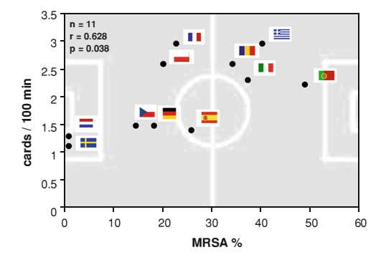
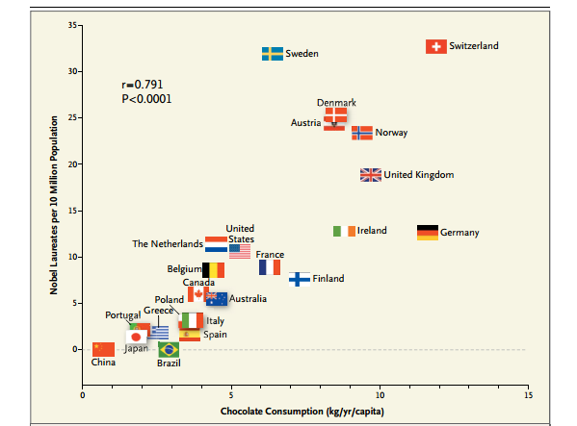
What drives the European ‘north-south divide’?
Correlation between MRSA rate in BSIs and an indicator for fair play from the European Football Championships (red or yellow cards / 100 min)¹
Correlation between national chocolate consumption and rate of Nobel prize winners.²
Meyer et al. Infection 2012 in press.
Messerli FH. New Engl J Med 2012;367:1562-4.

Slide 17
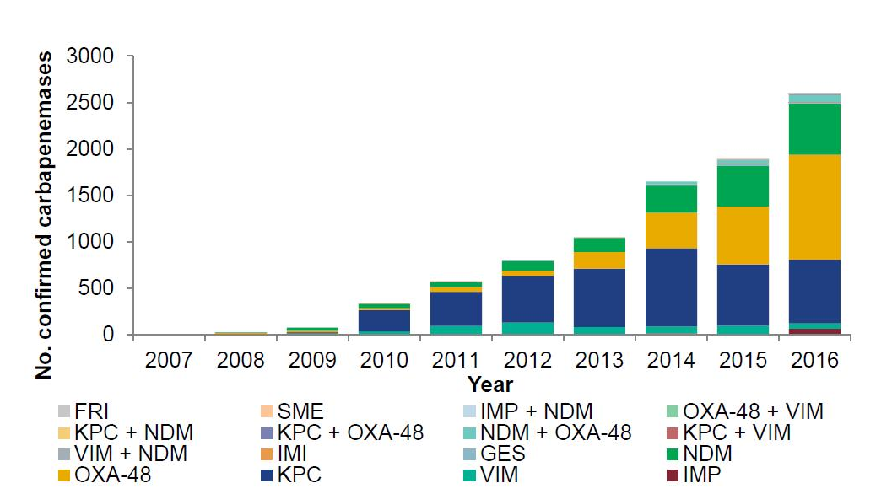
Emergence of CRE in the UK
ESPAUR 2017.

Slide 18
Simple, stark, sobering sums
0.5%¹ x 186,393 = 932 (!)
0.1%² x 186,393 = 186
0.1% x 15.892m* = 15,892
* Admissions to NHS acute hospitals, Financial Year 14/15. NHS Confederation, Key Statistics on the NHS,
Mookerjee et al. ECCMID 2016.
Otter et al. J Antimicrob Chemother 2016 in press.
Notes:
Taking our carriage rate of CRE – 0.5% and applying it to our yearly patient admissions, means we can see close to 900 CRE positive patients
0.1% which is a conservative estimate, apply that, and its 186
0.1 is the conservative estimate, applying that to all NHS hospitals, 16,000 pos patients, currently reporting around1600, 10 fold underestimate of CRE positive patients

Slide 19

Colistin resistance in Italy
Survey of 191 CRE from 21 labs across Italy.
43%
Colistin resistant K. pneumoniae.
Range = 10-80% for the 21 labs.
Monaco et al. 2014; Euro Surveill 2014;19:pii=20939.

Slide 20
CRE in the USA
NHSN / NNIS data; MMWR 2013;62:165-170.

Slide 21




CRE in the UK and US

Slide 22
Evidence-free zone

Slide 23
CRE Toolbox
Hand hygiene
Contact precautions
Active screening
Antibiotic stewardship
Cleaning / disinfection
Cohorting staff / patients
Note flagging
HCW screening
Education
Env. screening
Decol.
Otter et al. Clin Microbiol Infect 2015 2015;21:1057–1066.

Slide 24
CRE Toolbox
Hand hygiene
Contact precautions
Active screening
Antibiotic stewardship
Cleaning / disinfection
Cohorting staff / patients
Note flagging
HCW screening
Education
Env. screening
Decol.
Otter et al. Clin Microbiol Infect 2015 2015;21:1057–1066.

Slide 25
Who do I screen?
UK PHE CRE Toolkit screening triggers:
an inpatient in a hospital abroad, or
an inpatient in a UK hospital which has problems with spread of CRE (if known), or
a‘previously’positive case.
Also consider screening admissions to high-risk units such as ICU, and patients who live overseas.

Slide 26
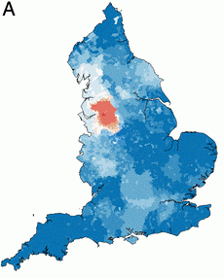
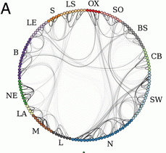
Distant large problems vs. small local ones?
CRE introductions come from hospitals within a regional referral network, even if the prevalence in another referral network is much higher (more than 100x higher, in fact)!
Donker et al. BMC Med 2017.

Slide 27

How do I screen?
Rectal swab is the best sample
  Insert no more than 2cm into rectum
  Twist gently and withdraw
  Ideally want to see faeces on swab.
Patient and staff education as to why this is needed in order to overcome taboos
Alternate specimen is stool sample, but have to wait for the patient to ‘go’
Notes:
Thank you Jon,
So how do I screen a patient for CRE?
A rectal swab provides the best results.
The swab should be inserted into the rectum no more than 2 cm or an inch twisted gently and withdrawn. The aim is to stain it brown!
Unfortunately , not many people are happy to have a sample taken in this way. And Issues such as child protection have been raised.
Clear explanations are needed to gain patient understanding and informed consent and we need some public education for us all to make this more normal and acceptable.
In the meantime
If it is really not possible to get a rectal sample then a stool sample can be used. This is not quite as good as apart form anything it may be delayed while we wait for the patient to ‘perform’

Slide 28
How do I screen?
Rectal swab
Agar plate
NAAT
(PCR)
AST
MADLDI-TOF MS
WGS
NAAT
(PCR)
NAAT = nucleic acid amplification techniques
AST = antimicrobial susceptibility testing
MALDI-TOF = Matrix-assisted laser desorption /ionization – time of flight mass spectrometry
WGS = whole genome sequencing

Slide 29
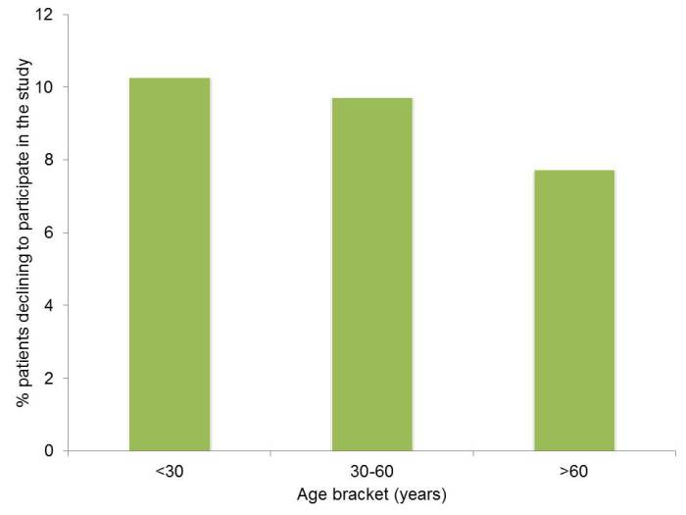
Can I swab your rectum please?
Factors associated with patients declining to provide a rectal swab were:
younger age (odds ratio (OR) 0.99, 95% confidence interval (CI) 0.99-1.00) female gender (OR 1.26, CI 1.04-1.52),
transfers from other hospitals (OR 1.77, CI 1.07-2.93) or an unknown admission route (OR 1.61, CI 1.09-2.37),
admission before the change in study description (OR 0.39, CI 0.31-0.48)
the staff member who consented the patient (p<0.001);
ethnicity was not a significant factor.
Dyakova et al. Clin Microbiol Infect 2017 in press.

Slide 30
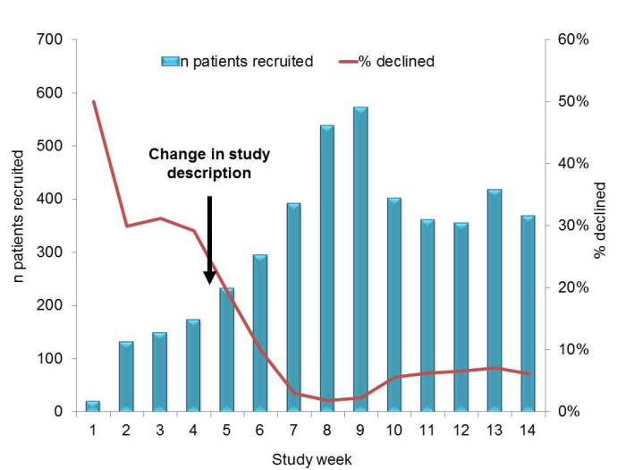
Improving screening compliance
Dyakova et al. Clin Microbiol Infect 2017 in press.

Slide 31
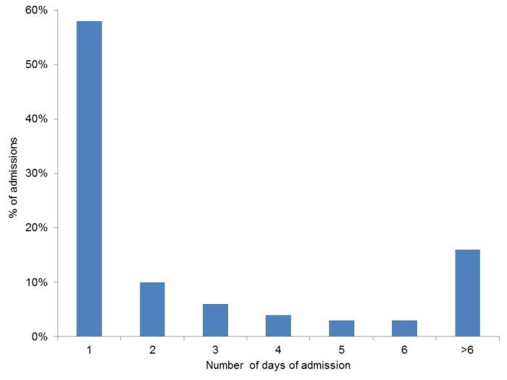
Serial admission screens?
Vella et al. J Hosp Infect 2016;94:118-24.

Slide 32
CRE Toolbox
Hand hygiene
Contact precautions
Active screening
Antibiotic stewardship
Cleaning / disinfection
Cohorting staff / patients
Note flagging
HCW screening
Education
Env. screening
Decol.
Otter et al. Clin Microbiol Infect 2015 2015;21:1057–1066.

Slide 33

The bed location lottery
Mitchell et al. J Hosp Infect 2015;91:211-217.
Notes:
Ajao study: only 53% of the 32 odd patients that acquired when the prior occupant was positive acquired the same species of ESBL; only 6% of the 32 had an indistinguishable or closely related strain of the same species.

Slide 34
MDR-GNB cleaning & disinfection checklist
Clean / declutter
Monitor cleaning process (e.g. fluorescent markers)
All equipment disinfected before leaving room
Enhanced daily disinfection using bleach
Terminal disinfection using bleach or, ideally, H₂O₂ vapor¹⁻³
Gopinath et al. Infect Control Hosp Epidemiol 2013;34:99-100.
Snitkin et al. Sci Transl Med 2012;4:148ra116.
Verma et al. J Infect Prevent 2013;7:S37.

Slide 35
CRE Toolbox
Hand hygiene
Contact precautions
Active screening
Antibiotic stewardship
Cleaning / disinfection
Cohorting staff / patients
Note flagging
HCW screening
Education
Env. screening
Decol.
Otter et al. Clin Microbiol Infect 2015 2015;21:1057–1066.

Slide 36
Antimicrobial stewardship – impact
Evaluating impact of 6 month antimicrobial stewardship intervention on an ICU by comparing bacterial resistance for matched 6 month periods either side of intervention.
*
*
*
*
*
*
Hou et al. PLoS ONE 2014;9:e101447; * = significant difference before vs. after.

Slide 37
CRE Toolbox
Hand hygiene
Contact precautions
Active screening
Antibiotic stewardship
Cleaning / disinfection
Cohorting staff / patients
Note flagging
HCW screening
Education
Env. screening
Decol.
Otter et al. Clin Microbiol Infect 2015 2015;21:1057–1066.

Slide 38
Summary
CRE combine resistance, virulence, the potential for rapid spread, and high costs.
Prevalence in the US and Europe appears to be patchy, but increasing; rates in parts of southern Europe are high.
We do not yet know what is effective in terms of prevention and control, but screening and isolation of carriers seems prudent.
CRE is here to stay in the UK and elsewhere!

Slide 39
Tackling the challenge of CRE –
the London experience
Jon Otter, PhD FRCPath
Imperial College London
j.otter@imperial.ac.uk
@jonotter
Blog: www.ReflectionsIPC.com
Slides: www.jonotter.net

