Slide 1

Decontamination of medical devices
Jon Otter, PhD FRCPath
Imperial College London
j.otter@imperial.ac.uk
@jonotter
Blog: www.ReflectionsIPC.com
Slides: www.jonotter.net

Slide 2
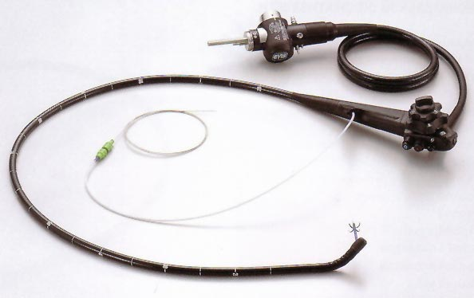
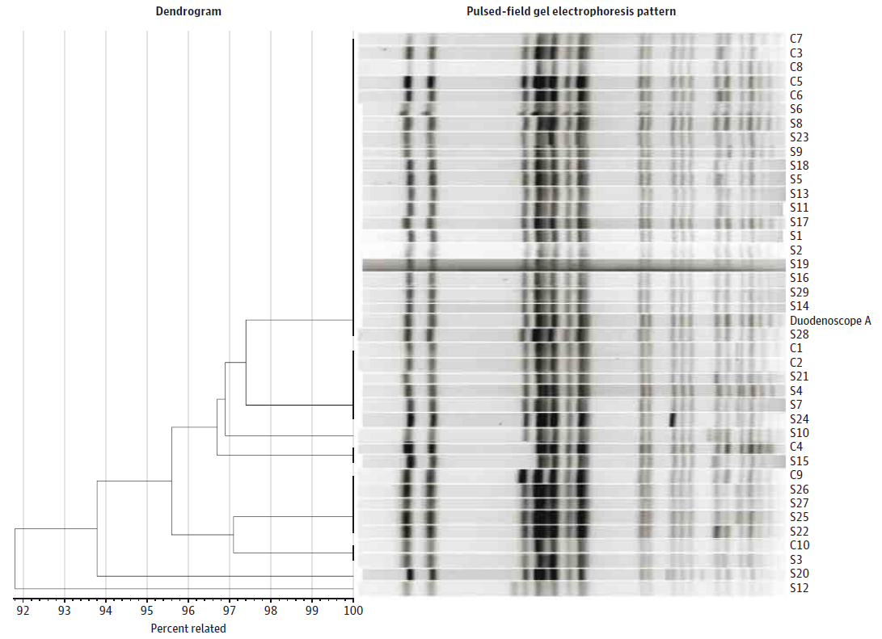
When medical device decontamination fails…
39 patient CRE outbreak in 2013 in Illinois.¹
Odds ratio for duodenoscope exposure in case patients 78 (confidence interval 6-1008).
No breakdown in compliance with decon procedures.
Outbreak resolved when decon approach for the scopes modified.
Has prompted a global review and change in the way that these devices are decontaminated.²
Epstein et al. JAMA. 2014;312:1447-55.
Rutala & Weber. Am J Infect Control 2016;44 (Suppl):e47-51

Slide 3
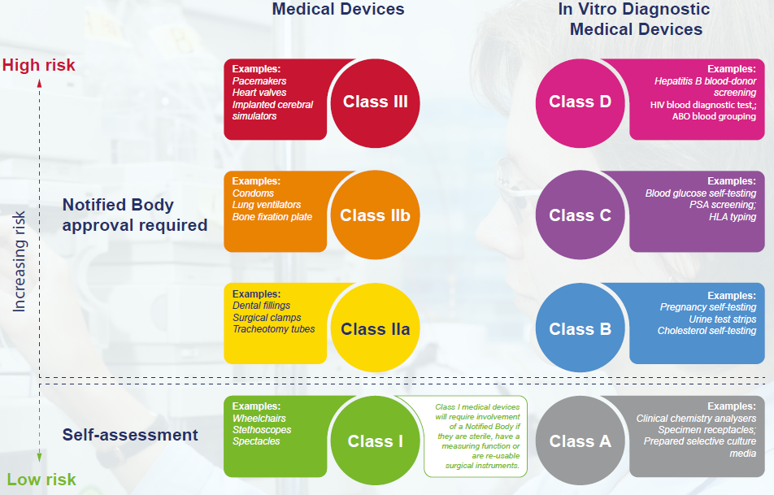
Medical device classification

Slide 4
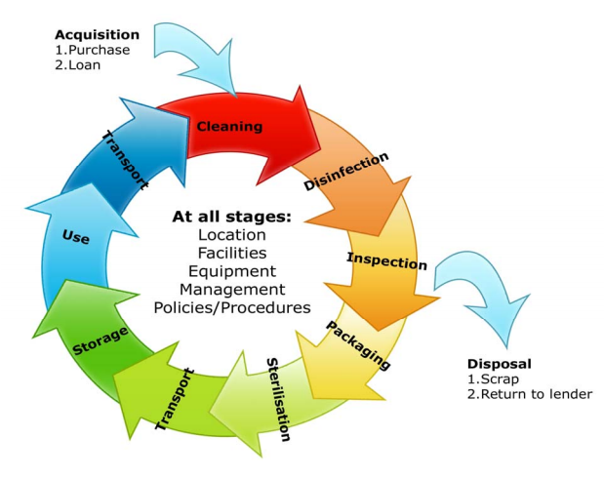
Principles of medical device decon

Slide 5
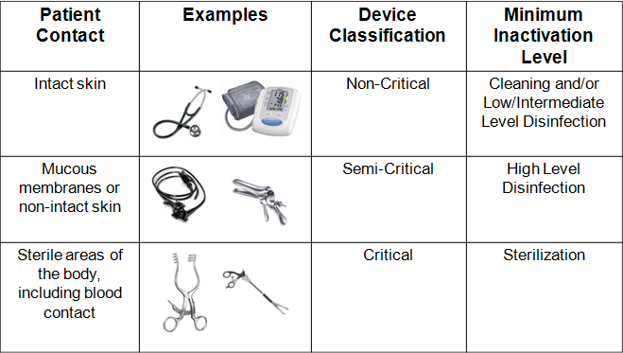
Spaulding classification

Slide 6
Which decon method?
Intended use
Infection risk
Soiling
Notes:
Also: cost, availability, expertise

Slide 7
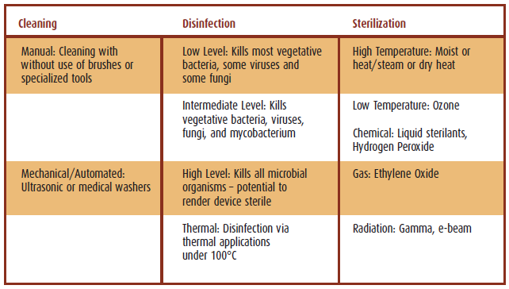
Decontamination options

Slide 8
Decon and compatibility
Medical device companies
Regulators
Users
Decon companies
Notes:
Differences in regulatory frameworks in different countries

Slide 9
Future perspectives
Centralisation
Standardisation
Regulation
Notes:
Standardisation of developing manufacturers’ guidelines

Slide 10
Summary
Importance of decon (e.g. CPE in endoscopes)
Principles of medical device decon
Overview of decon options
Decontamination and compatibility
Future perspectives

Slide 11
Resources
Managing Medical Devices. Guidance for healthcare and social services organisations. MHRA, April 2015.
Institute of Decontamination Sciences (IDSC) publications.
Guidelines for Environmental Infection Control in Health-Care Facilities. MMWR 2003; 52(RR10):1-42.
Decontamination of surgical instruments (HTM 01-01).
Management and decontamination of flexible endoscopes (HTM 01-06).

Slide 12
Decontamination of medical devices
Jon Otter, PhD FRCPath
Imperial College London
j.otter@imperial.ac.uk
@jonotter
Blog: www.ReflectionsIPC.com
Slides: www.jonotter.net

