Slide 1


Main modes of transmission CPE
Jon Otter, PhD FRCPath
Imperial College London
j.otter@imperial.ac.uk
@jonotter
Blog: www.ReflectionsIPC.com
Slides: www.jonotter.net

Slide 2
CPE
Rapid spread
Clinical impact
£
AMR

Slide 3
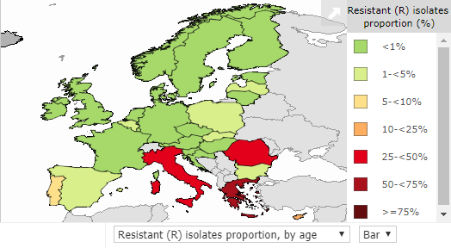
CPE in Europe, 2016
% invasive K. pneumoniae isolates resistant to carbapenems
EARS-Net 2018.

Slide 4
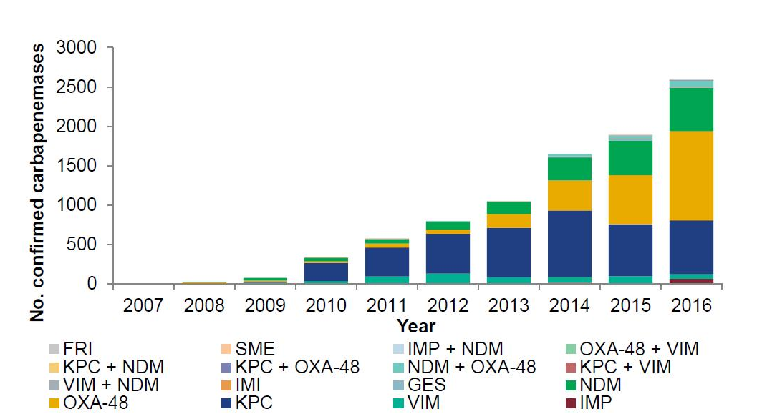
Emergence of CPE in the UK
ESPAUR 2017.

Slide 5
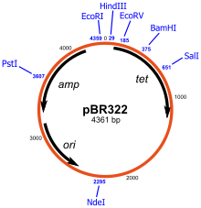

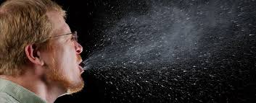
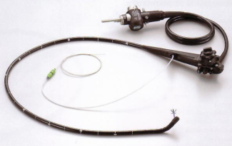
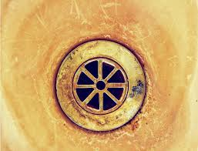
Transmission modes
Otter et al. Infect Control Hosp Epidemiol 2011;32:687-699.

Slide 6
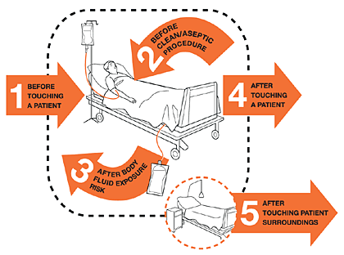
Contaminated hands
40%
Erasmus et al. Infect Control Hosp Epidemiol 2010;31:283-94.

Slide 7

Contaminated surfaces
Mitchell et al. J Hosp Infect 2015;91:211-217.

Slide 8

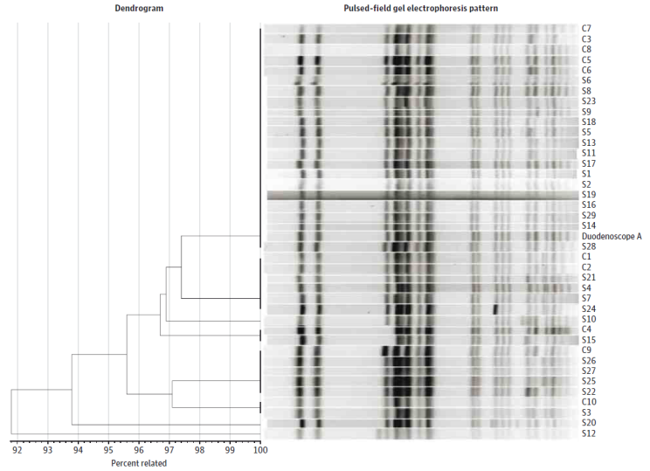
When medical device decon fails…
39 patient CRE outbreak in 2013 in Illinois.¹
Odds ratio for duodenoscope exposure in case patients 78 (95% CI 6-1008).
No breakdown in compliance with decon procedures; has prompted a global review and change in the way that these devices are decontaminated.²
Meticulously cleaning duodenoscopes prior to high-level disinfection should reduce the risk of transmitting infection, but may not entirely eliminate it. (FDA Feb 23 2015).
Epstein et al. JAMA. 2014;312:1447-55.
Rutala & Weber. Am J Infect Control 2016;44 (Suppl):e47-51

Slide 9
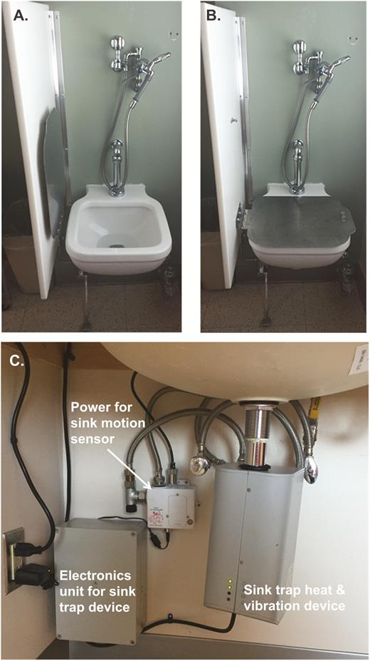
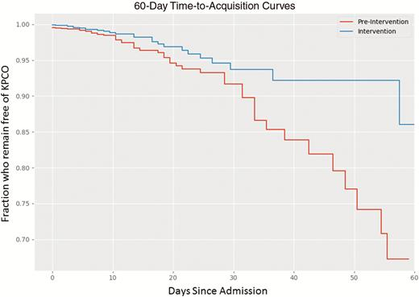
Contaminated sinks / drains
CPE (K. pneumoniae) acquisition and clinical infection halved through improved management of sinks (OR = 0.51 for acquisions, and 0.29 for clinical cultures) (n=~7,500 pts).
Mathers et al. Clin Infect Dis 2018 in press.

Slide 10
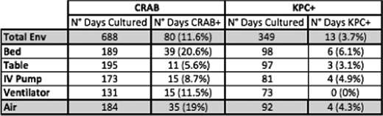
“It’s airborne”?
Detection of carbapenem-resistant A. baumannii (CRAB) (24 patients) or KPC-producing K. pneumoniae (12 patients) from surfaces and air in a Miami ICU.
Shimose et al. Open Forum Infect Dis 2015;733.

Slide 11

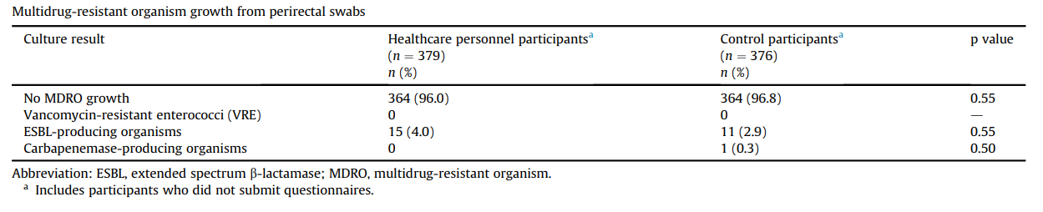
Colonised staff?
Decker et al. Clin Microbiol Infect 2018;24:82.e1-82.e4.

Slide 12
Promiscuous plasmids
Inter-species plasmid transfer of AMR genes was investigated in the 1970s regarding gentamicin-resistance.¹
There are several convincing individual small outbreaks where it is clear that inter-species plasmid transfer of AMR genes has occurred in Gram-negative bacteria.²
In one plasmid outbreak,³ multiple carbapenemases were dealt out like a pack of cards to multiple Enterobacteriaceae species from a single index patient.
More broadly, the population structure of KPC-producing K. pneumoniae is consistent with horizontal gene transfer.^{4,5}
Need to look beyond ‘same-bug-same-gene’ transmission dynamics.
Lee et al. Antimicrob Agents Chemother 1986;29(4):654-9.
Sheppard et al. Antimicrob Agents Chemother 2016;23:3767-78.
Hammerum et al. J Antimicrob Chemother. 2016;71:3117-3124.
Chen et al. Trends Microbiol 2014;22:686-96.
Doumith et al. J Antimicrob Chemother 2017;72:2241-2248.

Slide 13
Transmission modulators
Transmissibility / fitness
Antibiotic use
Unmasking
Stealth
Notes:
Other modulators: patient variables (e.g. superspreaders), IPC practice,

Slide 14
Transmissibility / fitness
Conclusion
Klebsiella species 3.7x more transmissible than E. coli in the ICU.¹
K. pneumoniae seems to be more environmental than E. coli.^{2,3}
Surface contamination on five standardized sites surrounding patients infected or colonized with ESBL-producing Klebsiella spp. (n=48) or ESBL-producing E. coli (n=46).²
p<0.001
p<0.001
1. Gurieva et al. Clin Infect Dis 2018;66:489-93. 2. Guet-Revillet et al. Am J Infect Control 2012;40:845-8.
3. Gbaguidi-Haore. Am J Infect Cont 2013;41:664-5.
Notes:
14
Inter-species variation? Inter-carbapenemase variation?

Slide 15
Antibiotic use
Evaluating impact of 6 month antimicrobial stewardship intervention on an ICU by comparing bacterial resistance for matched 6 month periods either side of intervention.
*
*
*
*
*
*
Hou et al. PLoS ONE 2014;9:e101447; * = significant difference before vs. after.

Slide 16
The tip of the iceberg…
0.5%¹ x 186,393 = 932 (!)
0.1%² x 186,393 = 186
0.1% x 15.892m* = 15,892
* Admissions to NHS acute hospitals, Financial Year 14/15. NHS Confederation, Key Statistics on the NHS,
Mookerjee et al. ECCMID 2016.
Otter et al. J Antimicrob Chemother 2016;71:3556-356.
Notes:
Taking our carriage rate of CRE – 0.5% and applying it to our yearly patient admissions, means we can see close to 900 CRE positive patients
0.1% which is a conservative estimate, apply that, and its 186
0.1 is the conservative estimate, applying that to all NHS hospitals, 16,000 pos patients, currently reporting around1600, 10 fold underestimate of CRE positive patients

Slide 17
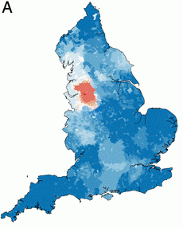
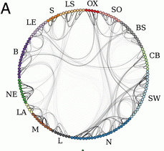
Distant large problems vs. small local ones?
CPE introductions come from hospitals within a regional referral network, even if the prevalence in another referral network is much higher (more than 100x higher, in fact)!
Donker et al. BMC Med 2017.

Slide 18
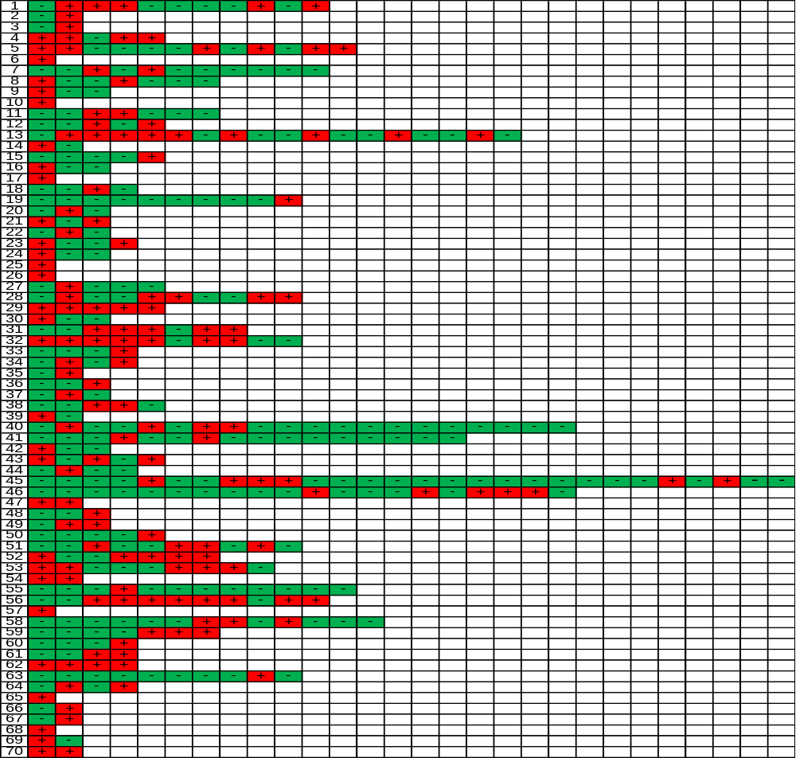
Unmasking?
Of 51 that had least three screens, 24 (47.1%) had a ‘+-+’ pattern.
60 / 64 (93.8%) patients had at least one negative surveillance culture during their hospital stay (excluding 6 patients with a single positive screen).
Serial CPE screens from 70 patients who were found to be CPE positive by screening cultures during June – December 2015. Red = positive. Green = negative.

Slide 19
Summary
CPE transmission modes include contaminated hands, surfaces, and medical devices, and may also include sinks / drains / wastewater, colonised staff, air, and independent plasmid spread.
Transmission modulators include bacterial transmissibility, antibiotic use, undetected colonisation, ‘unmasking’…and IPC practice.
We need to understand this better!

Slide 20
Main modes of transmission CPE
Jon Otter, PhD FRCPath
Imperial College London
j.otter@imperial.ac.uk
@jonotter
Blog: www.ReflectionsIPC.com
Slides: www.jonotter.net

