Slide 1


Before an outbreak - what to do after first MDR Gram-negatives enter your hospital?
Jon Otter, PhD FRCPath
Imperial College London
j.otter@imperial.ac.uk
@jonotter
Blog: www.ReflectionsIPC.com
Slides: www.jonotter.net

Slide 2
Rising threat from MDR-GNR
% of all HAI caused by GNRs.
% of ICU HAI caused by GNRs.
Non-fermenters | Acinetobacter baumannii Pseudomonas aeruginosa Stenotrophomonas maltophilia
Enterobacteriaceae | Klebsiella pneumoniae Escherichia coli Enterobacter cloacae
CPO
CPE
Hidron et al. Infect Control Hosp Epidemiol 2008;29:966-1011.
Peleg & Hooper. N Engl J Med 2010;362:1804-1813.

Slide 3
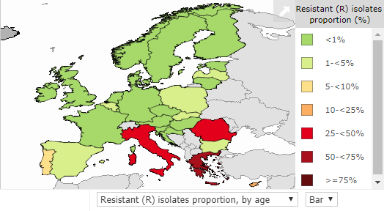
CRE in Europe, 2016
% invasive K. pneumoniae isolates resistant to carbapenems
EARS-Net 2018.

Slide 4
Emergence of CRE in Europe, 2005-2016
EARS-Net 2018.

Slide 5
Carbapenem-resistant P. aeruginosa in Europe, 2005-2016
EARS-Net 2018.

Slide 6
K. pneumoniae NDM outbreak; total number of cases
8 cases first identified by clinical culture, 32 by screening culture; of these 32, 14 had a subsequent positive clinical culture
Otter et al. Sci Rep 2017;7:12711.

Slide 7
Outbreak response
Screening
Lab methods
Comms
Peer learning
Hand hygiene
Cleaning / disinfection / decon
External reviews
Antibiotics stewardship
Applied research

Slide 8
MDR-GNR Toolbox
Hand hygiene
Contact precautions
Active screening
Antibiotic stewardship
Cleaning / disinfection
Cohorting staff / patients
Note flagging
HCW screening
Education
Env. screening
Decol.
Otter et al. Clin Microbiol Infect 2015 2015;21:1057–1066.

Slide 9
MDR-GNR Toolbox
Hand hygiene
Contact precautions
Active screening
Antibiotic stewardship
Cleaning / disinfection
Cohorting staff / patients
Note flagging
HCW screening
Education
Env. screening
Decol.
Otter et al. Clin Microbiol Infect 2015 2015;21:1057–1066.

Slide 10
Who should be screened at the time of hospital admission?

Slide 11

How do I screen for CPE?
Rectal swab is the best sample
  Insert no more than 2cm into rectum
  Twist gently and withdraw
  Ideally want to see faeces on swab.
Patient and staff education as to why this is needed in order to overcome taboos
Alternate specimen is stool sample, but have to wait for the patient to ‘go’
Notes:
Thank you Jon,
So how do I screen a patient for CRE?
A rectal swab provides the best results.
The swab should be inserted into the rectum no more than 2 cm or an inch twisted gently and withdrawn. The aim is to stain it brown!
Unfortunately , not many people are happy to have a sample taken in this way. And Issues such as child protection have been raised.
Clear explanations are needed to gain patient understanding and informed consent and we need some public education for us all to make this more normal and acceptable.
In the meantime
If it is really not possible to get a rectal sample then a stool sample can be used. This is not quite as good as apart form anything it may be delayed while we wait for the patient to ‘perform’

Slide 12
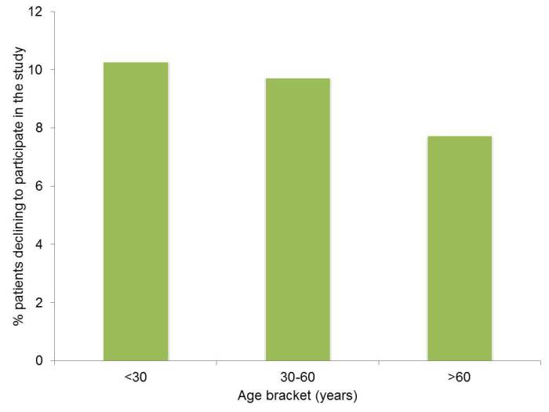
Can I swab your rectum please?
Factors associated with patients declining to provide a rectal swab were:
younger age (odds ratio (OR) 0.99, 95% confidence interval (CI) 0.99-1.00) female gender (OR 1.26, CI 1.04-1.52),
transfers from other hospitals (OR 1.77, CI 1.07-2.93) or an unknown admission route (OR 1.61, CI 1.09-2.37),
admission before the change in study description (OR 0.39, CI 0.31-0.48)
the staff member who consented the patient (p<0.001);
ethnicity was not a significant factor.
Dyakova et al. Clin Microbiol Infect 2017;23:577.e1-577.e3.

Slide 13
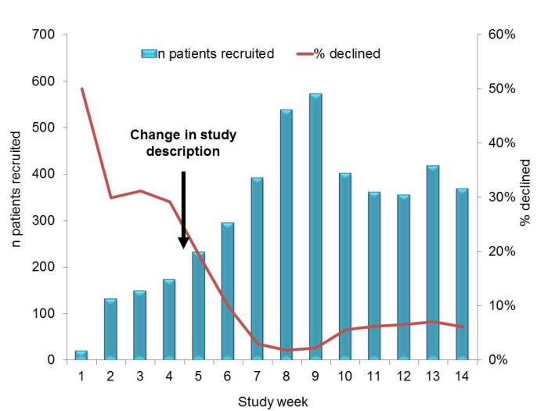
Improving screening compliance
Dyakova et al. Clin Microbiol Infect 2017;23:577.e1-577.e3.

Slide 14

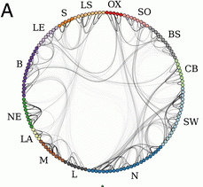
Distant large problems vs. small local ones?
CPE introductions come from hospitals within a regional referral network, even if the prevalence in another referral network is much higher (more than 100x higher, in fact)!
Donker et al. BMC Med 2017.

Slide 15
MDR-GNR Toolbox
Hand hygiene
Contact precautions
Active screening
Antibiotic stewardship
Cleaning / disinfection
Cohorting staff / patients
Note flagging
HCW screening
Education
Env. screening
Decol.
Otter et al. Clin Microbiol Infect 2015 2015;21:1057–1066.

Slide 16
What should be used for terminal disinfection following a case?

Slide 17

Contaminated surfaces
Mitchell et al. J Hosp Infect 2015;91:211-217.

Slide 18
MDR-GNR cleaning & disinfection checklist
Clean / declutter
Monitor cleaning process (e.g. fluorescent markers)
All equipment disinfected before leaving room
Enhanced daily disinfection using bleach
Terminal disinfection using bleach or, ideally, H₂O₂ vapor¹⁻³
Gopinath et al. Infect Control Hosp Epidemiol 2013;34:99-100.
Snitkin et al. Sci Transl Med 2012;4:148ra116.
Verma et al. J Infect Prevent 2013;7:S37.

Slide 19
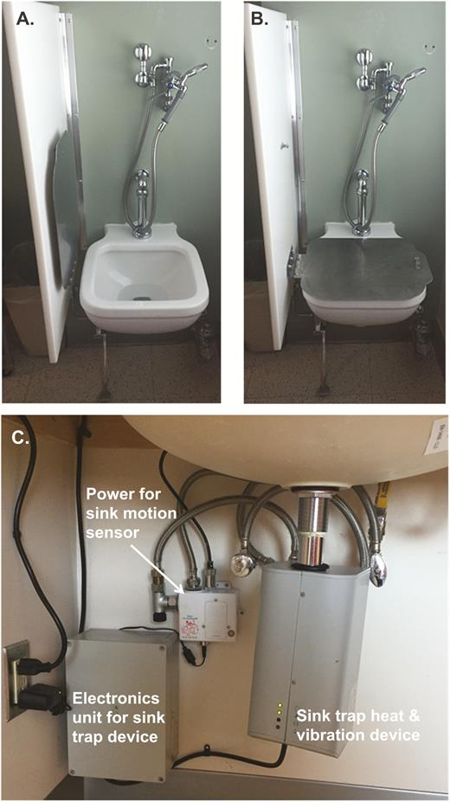
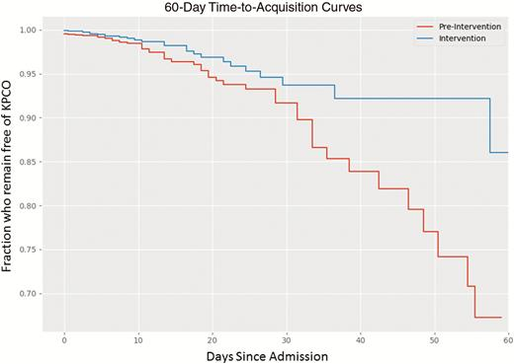
Contaminated sinks / drains
CPE (K. pneumoniae) acquisition and clinical infection halved through improved management of sinks (OR = 0.51 for acquisions, and 0.29 for clinical cultures) (n=~7,500 pts).
Mathers et al. Clin Infect Dis 2018 in press.

Slide 20

Enterobacteriaceae vs. non-fermenters
Share | Differ
Gram stain reaction | Risk factors & at-risk population
Concerning AMR | Potential for epidemic spread
 | Infection profile & mortality
 | Prevalence
 | Colonisation site & duration
 | Transmission routes
 | Resistance profile & mechanisms
Notes:
You could (and probably should) dissect the epidemiology of:
K. pneumoniae vs. E. coli
A. baumannii vs. P. aeruginosa
ESBL vs. KPC producing K. pneumoniae

Slide 21
What is the single most important intervention to reduce the spread of MDR-GNR in hospitals?

Slide 22
When the first MDR-GNR (especially CPE) enter your hospital…
Get communicating
Get screening
Get out the disinfection ‘big guns’

Slide 23
Before an outbreak - what to do after first MDR Gram-negatives enter your hospital?
Jon Otter, PhD FRCPath
Imperial College London
j.otter@imperial.ac.uk
@jonotter
Blog: www.ReflectionsIPC.com
Slides: www.jonotter.net

