Slide 1




Fast and expensive or cheap and slow?
A mathematical modelling study to explore screening for carbapenem resistant Enterobacteriaceae in UK hospitals
Gwenan M Knight, Eleonora Dyakova, Siddharth Mookerjee, Frances Davies, Eimear T Brannigan, Jonathan A Otter, Alison H Holmes
Notes:
10 min slot => aiming for 8.5 min talk, 1.5min for questions

Slide 2

Fast and expensive or cheap and slow?
Gwen (modeller),
Elie, Sid (ICHNT data within…)
Frances, Eimear, Jon, Alison (IPC team)
Notes:
10 min slot => aiming for 8.5 min talk, 1.5min for questions

Slide 3
ICHNT has an increasing prevalence of CRE

Slide 4

Acronyms…

Slide 5

Acronyms…
ICHNT =
PHE =

Slide 6
Acronyms…
ICHNT =
PHE =
CRE = carbapenem-resistant Enterobacteriaceae
  Resistant by any mechanism
CRE

Slide 7
Acronyms…
ICHNT =
PHE =
CRE = carbapenem-resistant Enterobacteriaceae
  Resistant by any mechanism
CP-CRE = carbapenemase-producing CRE
  Resistant to carbapenems by the production of carbapenemases
CRE
CP-CRE

Slide 8
Acronyms…
ICHNT =
PHE =
CRE = carbapenem-resistant Enterobacteriaceae
  Resistant by any mechanism
CP-CRE = carbapenemase-producing CRE
  Resistant to carbapenems by the production of carbapenemases
NCP-CRE = non-carbapenemase-producing CRE
  Resistant to carbapenems not through the production of carbapenemases
CRE
NCP-CRE
CP-CRE

Slide 9
How can we tackle CP-CRE?
Notes:
What can we do about CRE?
Can’t decolonize like MRSA
Limited prophylaxis (and hence treatment) options
Key is to prevent transmission – stop people getting it in the first place, one step back
ICHNT has been but many screening methods available – which to choose?

Slide 10
How can we tackle CP-CRE?
Decolonization
Limited prophylaxis (and treatment) options
Prevent transmission
Notes:
What can we do about CRE?
Can’t decolonize like MRSA
Limited prophylaxis (and hence treatment) options
Key is to prevent transmission – stop people getting it in the first place, one step back
ICHNT has been but many screening methods available – which to choose?

Slide 11
How can we tackle CP-CRE?
Decolonization
Limited prophylaxis (and treatment) options
Prevent transmission
Find who has it and isolate
Notes:
What can we do about CRE?
Can’t decolonize like MRSA
Limited prophylaxis (and hence treatment) options
Key is to prevent transmission – stop people getting it in the first place, one step back
ICHNT has been but many screening methods available – which to choose?

Slide 12
How can we tackle CP-CRE?
Decolonization
Limited prophylaxis (and treatment) options
Prevent transmission
ICHNT = universal screening for high-risk specialties since 2015
BUT various screening methods available
Find who has it and isolate
Notes:
What can we do about CRE?
Can’t decolonize like MRSA
Limited prophylaxis (and hence treatment) options
Key is to prevent transmission – stop people getting it in the first place, one step back
ICHNT has been but many screening methods available – which to choose?

Slide 13
How can we tackle CP-CRE?
Decolonization
Limited prophylaxis (and treatment) options
Prevent transmission
ICHNT = universal screening for high-risk specialties since 2015
BUT various screening methods available
Find who has it and isolate
  QN: What algorithm should ICHNT use for CP-CRE screening?
Notes:
What can we do about CRE?
Can’t decolonize like MRSA
Limited prophylaxis (and hence treatment) options
Key is to prevent transmission – stop people getting it in the first place, one step back
ICHNT has been but many screening methods available – which to choose?

Slide 14
Modelling
Notes:
Great way to compare quantitatively is mathematical modelling
Simulation model with ICHNT data
Go through

Slide 15
Modelling
Informed by ICHNT data
Notes:
Great way to compare quantitatively is mathematical modelling
Simulation model with ICHNT data
Go through

Slide 16
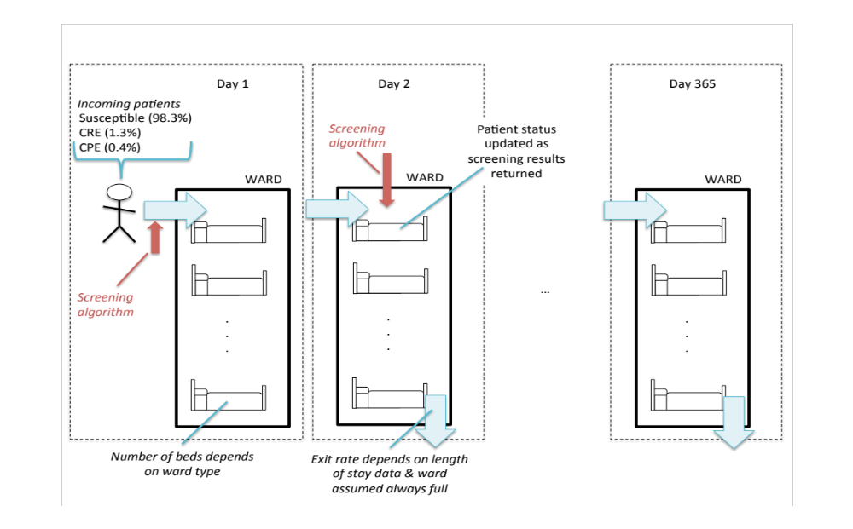
Modelling
Informed by ICHNT data
Number of beds
(depends on ward type)
Exit rate
(depends on length of stay,
assume ward always full)
(Knight, GM et al., under review)
Notes:
Great way to compare quantitatively is mathematical modelling
Simulation model with ICHNT data
Go through

Slide 17
Modelling
Incoming patients
Susceptible (98%)
CP-CRE (1.6%)
NCP-CRE (0.4%)
Informed by ICHNT data
Number of beds
(depends on ward type)
Exit rate
(depends on length of stay,
assume ward always full)
(Knight, GM et al., under review)
Notes:
Great way to compare quantitatively is mathematical modelling
Simulation model with ICHNT data
Go through

Slide 18
Modelling
Incoming patients
Susceptible (98%)
CP-CRE (1.6%)
NCP-CRE (0.4%)
Informed by ICHNT data
Number of beds
(depends on ward type)
Exit rate
(depends on length of stay,
assume ward always full)
(Knight, GM et al., under review)
Notes:
Great way to compare quantitatively is mathematical modelling
Simulation model with ICHNT data
Go through

Slide 19
Modelling
Incoming patients
Susceptible (98%)
CP-CRE (1.6%)
NCP-CRE (0.4%)
Informed by ICHNT data
Number of beds
(depends on ward type)
Exit rate
(depends on length of stay,
assume ward always full)
(Knight, GM et al., under review)
Notes:
Great way to compare quantitatively is mathematical modelling
Simulation model with ICHNT data
Go through

Slide 20
Modelling
ICU focus (also looked at Renal / Vascular / Haematology)
Incoming patients
Susceptible (98%)
CP-CRE (1.6%)
NCP-CRE (0.4%)
Informed by ICHNT data
Number of beds
(depends on ward type)
Exit rate
(depends on length of stay,
assume ward always full)
(Knight, GM et al., under review)
Notes:
Great way to compare quantitatively is mathematical modelling
Simulation model with ICHNT data
Go through

Slide 21
Algorithms
Bacteria carried by the patient
Hospital info. on bacterial status
 | ½ day | Day 1 |  | Day 2 |  | Day 3
Enter
1%
KEY
Bacteria carried by patient
No CRE
NCP-CRE
CP-CRE
Hospital information
on bacterial carriage status
Unknown
No CRE
CRE phenotype
NCP-CRE
CP-CRE
Resistance found
No resistance found
96%
(A)
1%
(A) DIRECT PCR
99%
4%
99%
Culture 1
Culture 2
PCR
89%
100%
1%
89%
100%
98%
(B)
9%
15%
1%
(B) CULTURE + PCR
11%
85%
99%
11%
2%
91%
99%
(Knight, GM et al., under review)
Notes:
Go through differences

Slide 22
Algorithms
Bacteria carried by the patient
Hospital info. on bacterial status
 | ½ day | Day 1 |  | Day 2 |  | Day 3
Enter
1%
KEY
Bacteria carried by patient
No CRE
NCP-CRE
CP-CRE
Hospital information
on bacterial carriage status
Unknown
No CRE
CRE phenotype
NCP-CRE
CP-CRE
Resistance found
No resistance found
96%
(A)
1%
(A) DIRECT PCR
99%
4%
99%
Culture 1
Culture 2
PCR
89%
100%
1%
89%
100%
98%
(B)
9%
15%
1%
(B) CULTURE + PCR
11%
85%
99%
11%
2%
91%
99%
(Knight, GM et al., under review)
Notes:
Go through differences

Slide 23
Algorithms
Bacteria carried by the patient
Hospital info. on bacterial status
 | ½ day | Day 1 |  | Day 2 |  | Day 3
Enter
1%
KEY
Bacteria carried by patient
No CRE
NCP-CRE
CP-CRE
Hospital information
on bacterial carriage status
Unknown
No CRE
CRE phenotype
NCP-CRE
CP-CRE
Resistance found
No resistance found
96%
(A)
1%
(A) DIRECT PCR
99%
4%
99%
Culture 1
Culture 2
PCR
89%
100%
1%
89%
100%
98%
(B)
9%
15%
1%
(B) CULTURE + PCR
11%
85%
99%
11%
2%
91%
99%
(Knight, GM et al., under review)
Notes:
Go through differences

Slide 24
Algorithms
Bacteria carried by the patient
Hospital info. on bacterial status
 | ½ day | Day 1 |  | Day 2 |  | Day 3
Enter
1%
KEY
Bacteria carried by patient
No CRE
NCP-CRE
CP-CRE
Hospital information
on bacterial carriage status
Unknown
No CRE
CRE phenotype
NCP-CRE
CP-CRE
Resistance found
No resistance found
96%
(A)
1%
(A) DIRECT PCR
99%
4%
99%
Culture 1
Culture 2
PCR
89%
100%
1%
89%
100%
98%
(B)
9%
15%
1%
(B) CULTURE + PCR
11%
85%
99%
11%
2%
91%
99%
(Knight, GM et al., under review)
Notes:
Go through differences

Slide 25
Algorithms
Bacteria carried by the patient
Hospital info. on bacterial status
 | ½ day | Day 1 |  | Day 2 |  | Day 3
Enter
1%
KEY
Bacteria carried by patient
No CRE
NCP-CRE
CP-CRE
Hospital information
on bacterial carriage status
Unknown
No CRE
CRE phenotype
NCP-CRE
CP-CRE
Resistance found
No resistance found
96%
(A)
1%
(A) DIRECT PCR
99%
4%
99%
Culture 1
Culture 2
PCR
89%
100%
1%
89%
100%
98%
(B)
9%
15%
1%
(B) CULTURE + PCR
11%
85%
99%
11%
2%
91%
99%
(C) = (B) x 3 + PHE PCR
(Knight, GM et al., under review)
Notes:
Go through differences

Slide 26
Scenarios and outcomes
Screening coverage
CP-CRE prevalence
(Knight, GM et al., under review)
Notes:
What settings we explored
[Many need to trim / remove some detail]

Slide 27
Scenarios and outcomes
Screening coverage
CP-CRE prevalence
1.6%
ICHNT
ICU
(Knight, GM et al., under review)
Notes:
What settings we explored
[Many need to trim / remove some detail]

Slide 28
Scenarios and outcomes
Screening coverage
ICHNT
100%
CP-CRE prevalence
1.6%
ICHNT
ICU
(Knight, GM et al., under review)
Notes:
What settings we explored
[Many need to trim / remove some detail]

Slide 29
Scenarios and outcomes
Screening coverage
ICHNT
100%
1
CP-CRE prevalence
1.6%
ICHNT
ICU
(Knight, GM et al., under review)
Notes:
What settings we explored
[Many need to trim / remove some detail]

Slide 30
Scenarios and outcomes
Screening coverage
ICHNT
100%
1
2
63%
CP-CRE prevalence
1.6%
ICHNT
ICU
(Knight, GM et al., under review)
Notes:
What settings we explored
[Many need to trim / remove some detail]

Slide 31
Scenarios and outcomes
Screening coverage
ICHNT
100%
1
4
2
3
63%
CP-CRE prevalence
1.6%
20%
ICHNT
ICU
(Knight, GM et al., under review)
Notes:
What settings we explored
[Many need to trim / remove some detail]

Slide 32
Scenarios and outcomes
confirmed CP-CRE
Screening coverage
ICHNT
100%
1
4
2
3
63%
CP-CRE prevalence
1.6%
20%
ICHNT
ICU
(Knight, GM et al., under review)
Notes:
What settings we explored
[Many need to trim / remove some detail]

Slide 33

Scenarios and outcomes
confirmed CP-CRE
Staff + screening (Otter, 2016)
Screening coverage
ICHNT
100%
1
4
PCR: £28.74
Culture (x2): £10.22
Isolation bed day: £20.22 + one-off costs
2
3
63%
CP-CRE prevalence
1.6%
20%
ICHNT
ICU
(Knight, GM et al., under review)
Notes:
What settings we explored
[Many need to trim / remove some detail]

Slide 34
Scenarios and outcomes
confirmed CP-CRE
Staff + screening (Otter, 2016)
Screening coverage
ICHNT
100%
1
4
PCR: £28.74
Culture (x2): £10.22
Isolation bed day: £20.22 + one-off costs
2
3
63%
CP-CRE prevalence
Outcomes:
(1) Number of “days at risk”
(2) Cost per averted risk day
1.6%
20%
ICHNT
ICU
(Knight, GM et al., under review)
Notes:
What settings we explored
[Many need to trim / remove some detail]

Slide 35
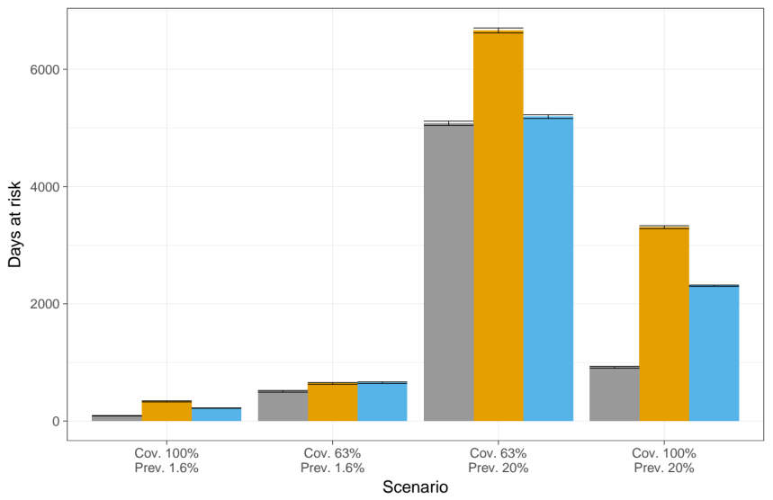
Results
ICU
Days at risk
(Knight, GM et al., under review)
Notes:
Run through
Could add in additional results from reviewer (additional cost – may just say)

Slide 36
Results
ICU
Days at risk
1
2
3
4
(Knight, GM et al., under review)
Notes:
Run through
Could add in additional results from reviewer (additional cost – may just say)

Slide 37
Results
ICU
Days at risk
Culture + PCR
Direct PCR
PHE
1
2
3
4
(Knight, GM et al., under review)
Notes:
Run through
Could add in additional results from reviewer (additional cost – may just say)

Slide 38
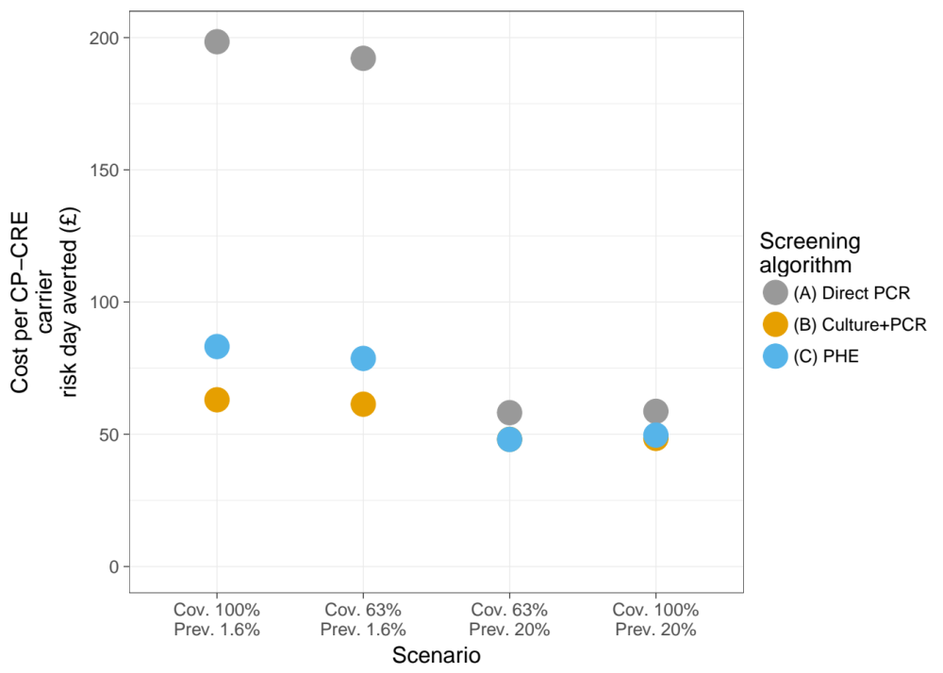
Results
ICU
Cost per CP-CRE risk day averted
Days at risk
Culture + PCR
Direct PCR
PHE
1
2
3
4
(Knight, GM et al., under review)
Notes:
Run through
Could add in additional results from reviewer (additional cost – may just say)

Slide 39
Results
ICU
Cost per CP-CRE risk day averted
Days at risk
Culture + PCR
Direct PCR
PHE
1
2
3
4
1
2
3
4
(Knight, GM et al., under review)
Notes:
Run through
Could add in additional results from reviewer (additional cost – may just say)

Slide 40
Results
‘Direct PCR’ lowest # of risk days
ICU
Cost per CP-CRE risk day averted
Days at risk
Culture + PCR
Direct PCR
PHE
1
2
3
4
1
2
3
4
(Knight, GM et al., under review)
Notes:
Run through
Could add in additional results from reviewer (additional cost – may just say)

Slide 41
Results
Under higher CP-CRE prevalence:
similar
‘Direct PCR’ lowest # of risk days
ICU
Cost per CP-CRE risk day averted
Days at risk
Culture + PCR
Direct PCR
PHE
1
2
3
4
1
2
3
4
(Knight, GM et al., under review)
Notes:
Run through
Could add in additional results from reviewer (additional cost – may just say)

Slide 42
Results
Under current CP-CRE prevalence:
Lowest for ‘Culture + PCR’
Under higher CP-CRE prevalence:
similar
‘Direct PCR’ lowest # of risk days
ICU
Cost per CP-CRE risk day averted
Days at risk
Culture + PCR
Direct PCR
PHE
1
2
3
4
1
2
3
4
(Knight, GM et al., under review)
Notes:
Run through
Could add in additional results from reviewer (additional cost – may just say)

Slide 43
Results
Sensitivity: trend of results same for vascular / hematology / renal
Under current CP-CRE prevalence:
Lowest for ‘Culture + PCR’
Under higher CP-CRE prevalence:
similar
‘Direct PCR’ lowest # of risk days
ICU
Cost per CP-CRE risk day averted
Days at risk
Culture + PCR
Direct PCR
PHE
1
2
3
4
1
2
3
4
(Knight, GM et al., under review)
Notes:
Run through
Could add in additional results from reviewer (additional cost – may just say)

Slide 44

Conclusions
Link to data
Missing complexity: transmission / heterogeneity / implementation
Notes:
Main conclusions

Slide 45
Conclusions
Link to data
“Fast and expensive” too costly, unless higher prevalence
“Cheap and slow” best for ICHNT now
Next steps: PCR after first culture?
Missing complexity: transmission / heterogeneity / implementation
Notes:
Main conclusions

Slide 46
Conclusions
Model available
Inputs required: prevalence / length of stay / ward size / costs
Link to data
“Fast and expensive” too costly, unless higher prevalence
“Cheap and slow” best for ICHNT now
Next steps: PCR after first culture?
Missing complexity: transmission / heterogeneity / implementation
Notes:
Main conclusions

Slide 47
Conclusions
Model available
Inputs required: prevalence / length of stay / ward size / costs
Link to data
“Fast and expensive” too costly, unless higher prevalence
“Cheap and slow” best for ICHNT now
Next steps: PCR after first culture?
Missing complexity: transmission / heterogeneity / implementation
X-AMR
New cross-disciplinary pop-up journal from Microbiology society
Notes:
Main conclusions

Slide 48

Conclusions
Model available
Inputs required: prevalence / length of stay / ward size / costs
Link to data
“Fast and expensive” too costly, unless higher prevalence
“Cheap and slow” best for ICHNT now
Next steps: PCR after first culture?
Missing complexity: transmission / heterogeneity / implementation
X-AMR
New cross-disciplinary pop-up journal from Microbiology society
Thanks to:
- Elie Dyakova, Sid Mookerjee, Frances Davies, Eimear Brannigan, Jon Otter & Alison Holmes
- ICHNT laboratory staff: Preetha Shibu and Jyothsna Dronavalli
- The team at NIHR HPRU in HCAI and AMR at Imperial College London
gwen.knight@lshtm.ac.uk
Notes:
Main conclusions

Slide 50
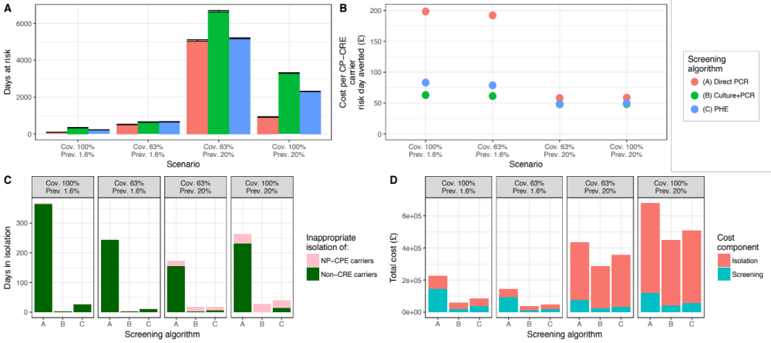
Results
Sensitivity: trend of results same for vascular / hematology / renal
1
2
3
4
PHE
Direct PCR
Culture + PCR
Direct PCR has high false positive rate…
… and is costly
(Knight, GM et al., under review)
Notes:
Run through
Could add in additional results from reviewer (additional cost – may just say)

Slide 51
Costs
Incremental cost per additional averted risk day:
(A) £744 (C) £289
Screening test | Components | Staff cost | Cost of screening | Total
Culture | Culture test 1 | £1.22 | £1 | £2.22
 | Culture sensitivity test (CRE prevalence x 2) | / | £8 | £8.00
ICHNT PCR | In-house PCR test | £8.74 | £20 | £28.74
PHE PCR |  | / | / | £0
Isolation bed day: - daily cost of £20.22
- one-off stock disposal cost of £385 for ICU, £113 for other specialties

Slide 52
Implementation effects
3,650 isolation bed days available at ICU: Cap at this
Screening algorithm | Scenario
 | Speciality | Screening coverage | CP-CRE prevalence | Number of “days at risk” | Number of “days at risk (implementation)” | Cost per risk day averted (£)
(A) Direct PCR | ICU | 100% | 1.6% | 90 (4.39) | 90 (19.01) | 198.45
 |  | 63% | 1.6% | 508 (14.83) | 508 (22.33) | 192.18
 |  | 63% | 20% | 5080 (36.2) | 8906 (62.24) | 97.85
 |  | 100% | 20% | 918 (14.39) | 8840 (51.3) | 141.95
(B) Culture +PCR |  | 100% | 1.6% | 335 (9.31) | 335 (19.83) | 63.05
 |  | 63% | 1.6% | 642 (14.06) | 642 (21.14) | 61.38
 |  | 63% | 20% | 6664 (42.32) | 8952 (57.38) | 65.50
 |  | 100% | 20% | 3308 (24.68) | 8911 (58.48) | 91.60
(C) PHE |  | 100% | 1.6% | 221 (3.74) | 221 (19.29) | 83.18
 |  | 63% | 1.6% | 655 (14) | 655 (22.51) | 78.69
 |  | 63% | 20% | 5194 (31.49) | 8992 (55.18) | 76.90
 |  | 100% | 20% | 2309 (11.15) | 8905 (53.43) | 102.73
Big increase in number of risk days at high prevalence
But cost per risk day patterns the same (B < C < A), but greater relative difference B to C

Slide 53
Parameters for all specialties
Parameter | Description |  | Value | References & notes
CP-CRE prevalence at admission | ICU |  | 1.6% (16/1007) | Calculated from universal screening data of a total of 2,870 patients, over a 9 month period
 | Renal |  | 1.9% (16/858)
 | Vascular |  | 0.4% (2/541)
 | Haematology |  | 1.3% (6/464)
Coverage of initial admission screening | ICU |  | 63.0%
 | Renal |  | 67.0%
 | Vascular |  | 48.0%
 | Haematology |  | 68.0%
Number of speciality beds | ICU |  | 112 | Sum of all wards in each speciality as in March 2016
 | Renal |  | 71
 | Vascular |  | 65
 | Haematology |  | 66
Length of stay (mean/median) | ICU | S* | 7.9/4.0 | Taken from speciality data and based on initial screening result
 |  | CRE | 15.9/10.0
 | Renal | S | 7.8/5.0
 |  | CRE | 15.5/12.0
 | Vascular | S | 6.2/4.0
 |  | CRE | 12.4/7.0
 | Haematology | S | 9.6/5.0
 |  | CRE | 19.6/9.0
Time to result (days) | Culture |  | 2 | For single component test
 | PHE PCR |  | 7**
 | PCR |  | 0.5
 | (A) Direct PCR |  | 0.5 | For complete algorithm
 | (B) Culture + PCR |  | 2.5
 | (C) PHE |  | 13

Slide 54
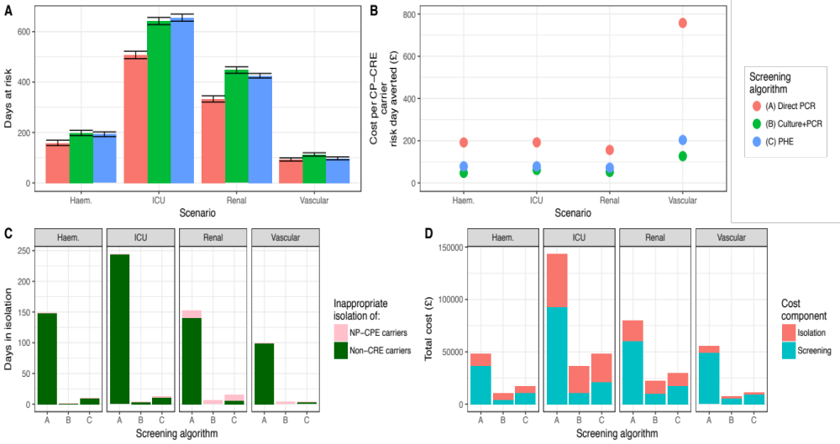
Outcomes for all four specialties
Baseline prevalence
100% screening coverage
1
0.4% CP-CRE prev

Slide 55
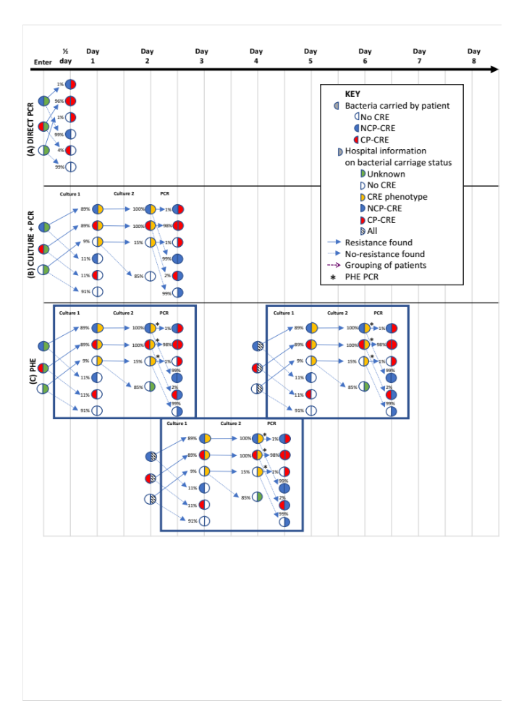
All algorithms

Slide 56
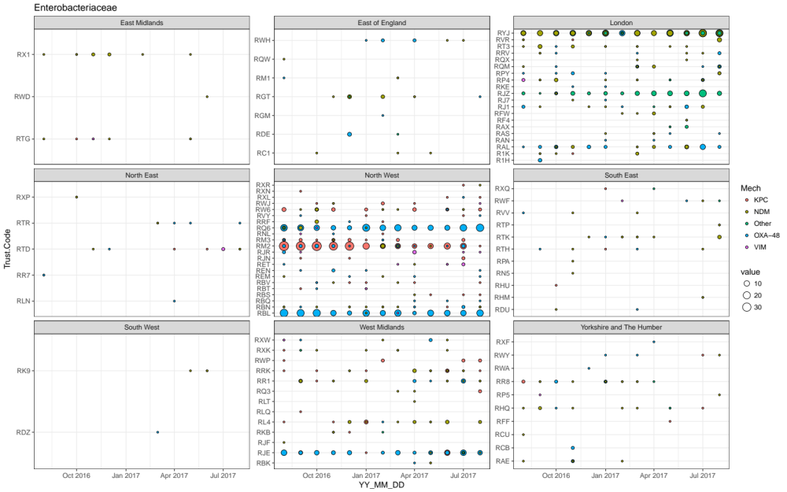
ICHNT has an increasing prevalence of CRE
(Electronic Reporting System for the Enhanced Surveillance of Carbapenemase-Producing Gram-Negative Bacteria, PHE 2017)
Notes:
Particularly a problem at ICHNT
[should I mention this may be due to increased screening?]

Slide 57
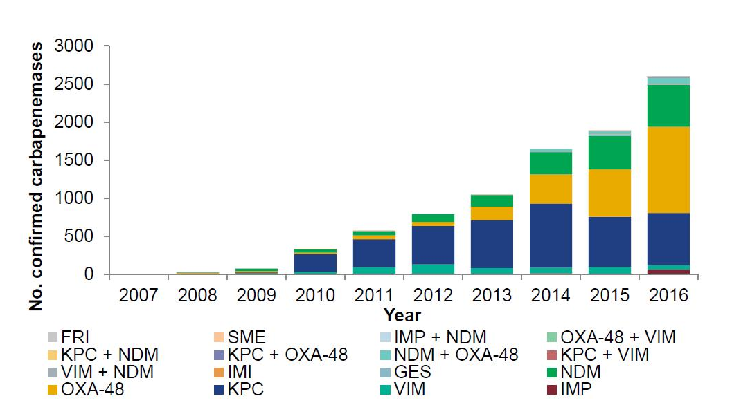
Carbapenem resistant Enterobacteriaceae (CRE) in the UK
(ESPAUR 2017)
Notes:
Study based in the UK
Growing issue with CRE in the UK

