Slide 1


The cost of an outbreak
Jon Otter, PhD FRCPath
Imperial College London
j.otter@imperial.ac.uk
@jonotter
Blog: www.ReflectionsIPC.com
Slides: www.jonotter.net

Slide 2
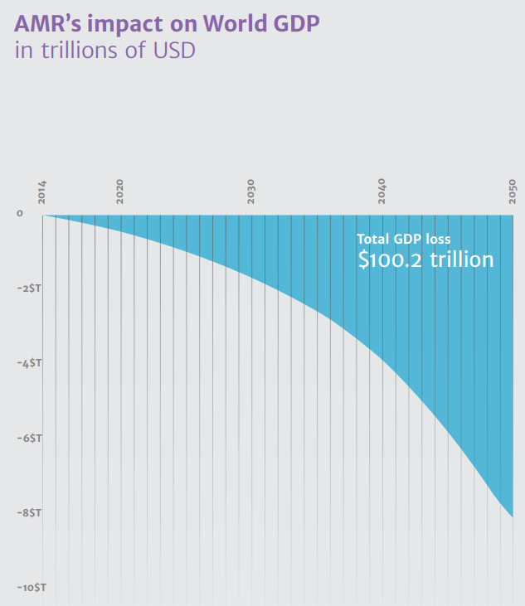
Cost of HCAI / AMR
The Review on AMR, 2014.

Slide 3
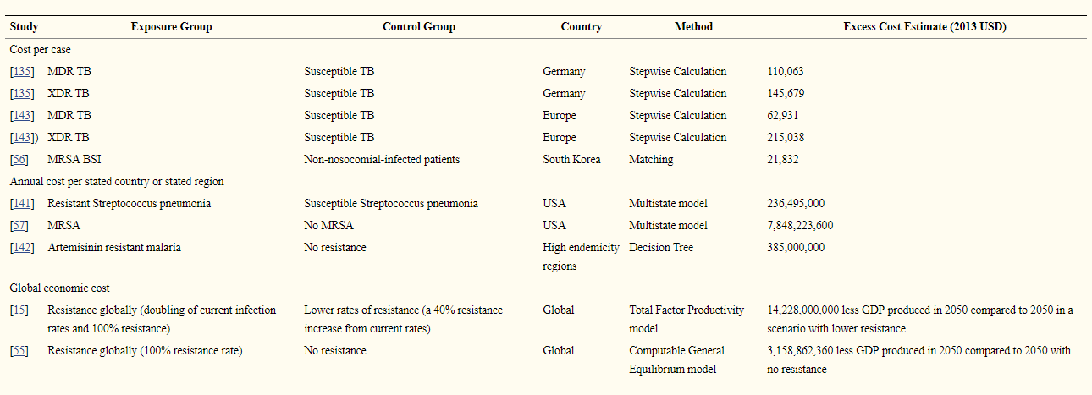
The cost and economic burden of AMR
Naylor et al. ARIC 2018.

Slide 4
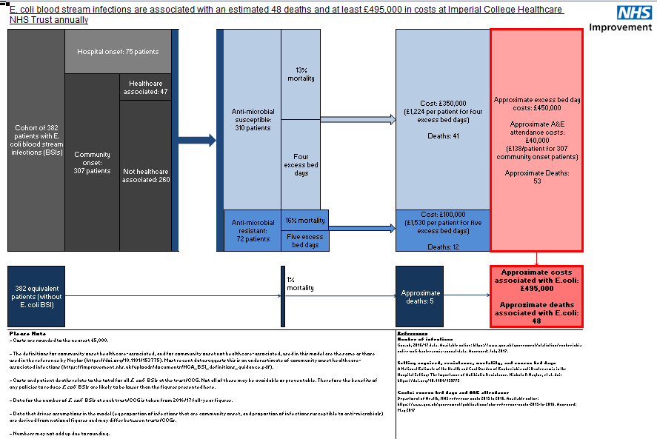
NHSI E. coli BSI cost calculator.

Slide 5

The most expensive HCAI is…HAP!
Cassini et al. Plos Med 2016.

Slide 6
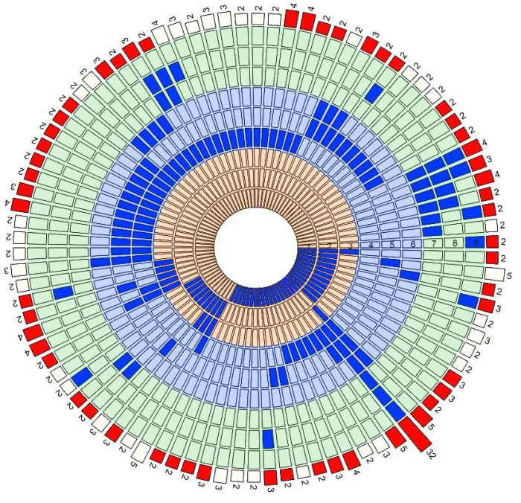
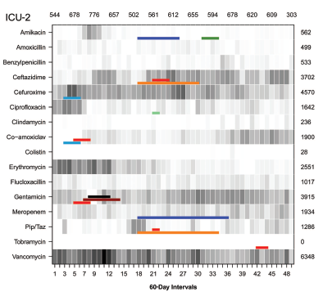
An epidemic of missed outbreaks
Undetected outbreaks¹
Resistance outbreaks²
1. Tosas et al. Clin Infect Dis 2018.
2. Vlek et al. Clin Infect Dis 2013.

Slide 7
K. pneumoniae NDM outbreak; total number of cases
8 cases first identified by clinical culture, 32 by screening culture; of these 32, 14 had a subsequent positive clinical culture
Otter et al. Sci Rep 2017;7:12711.

Slide 8
Outbreak response
Screening
Lab methods
Comms
Peer learning
Hand hygiene
Cleaning / disinfection / decon
External reviews
Antibiotics stewardship
Applied research

Slide 9
Communications
Internal
Occ. health
Clinical governance
Clin micro
Estates / Facilities
CEO / CFO / board
Ward staff
Micro lab
Comms team
External
CCG
NHSE/I
Local hospitals
PHE
Regional hospitals
Scientific community
Patients / public
Department of Health

Slide 10
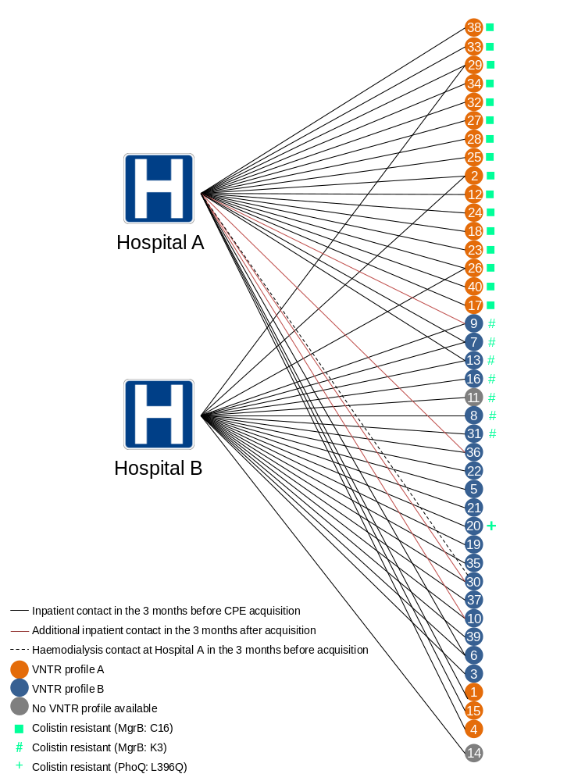
Emergence of colistin resistance
Otter et al. Sci Rep 2017;7:12711.
Notes:
66% of isolates colistin resistant (according to ref lab); 24% of isolates colistin resistant when tested locally.

Slide 11
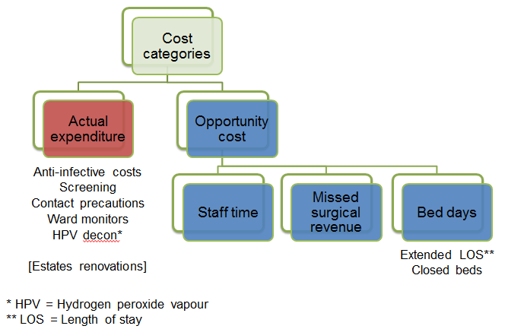
Cost of an outbreak - methods

Slide 12

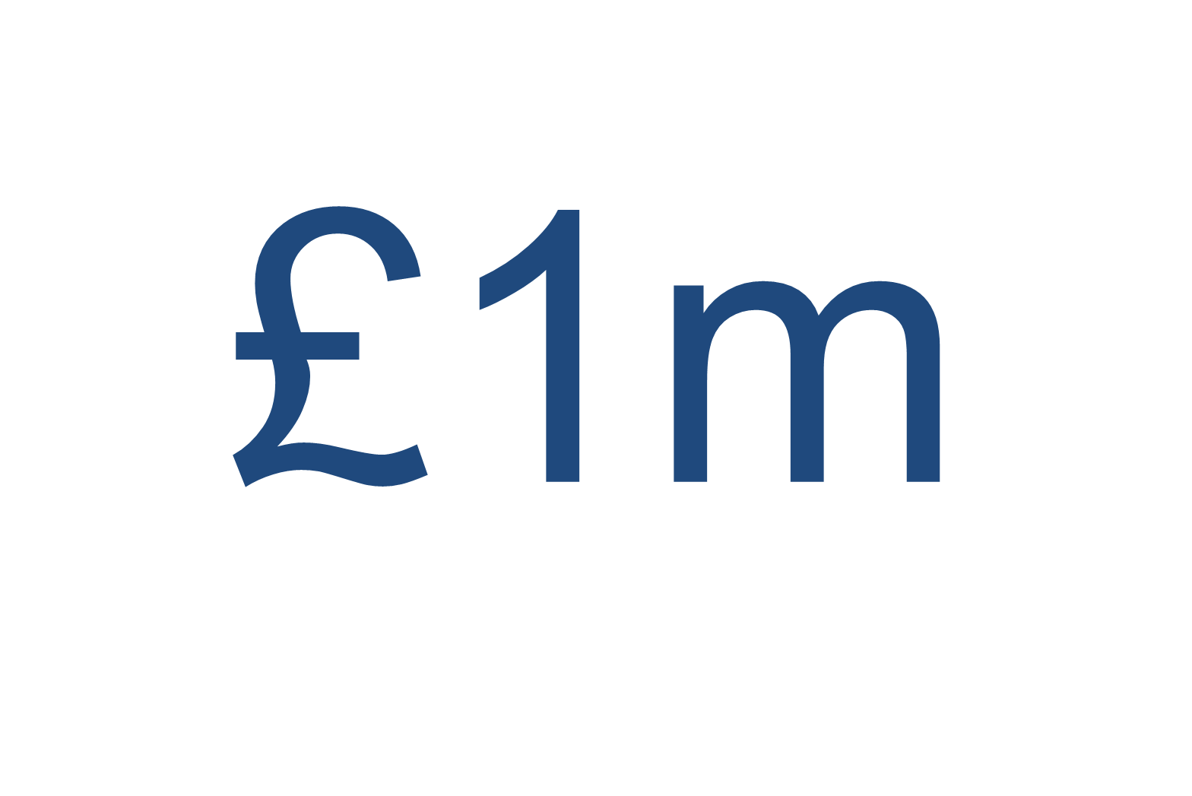
Actual expenditure
Opportunity cost
£130k
Estates renovations

Slide 13
Bed / bay / ward closures
8 bay and 4 ward closures
£65,250 in bed closures¹
£5,355 in curtain changes, mattress disposal, and infectious waste²
£295,704 in lost revenue from elective vascular surgery³
309 regular level care bed days, and 57 HDU bed days were lost due to closures during the outbreak.
129 curtain changes / laundered. Five regular mattress and four dynamic mattresses were discarded.
72 cases were cancelled (22) or not booked due to reduced capacity (50).

Slide 14
Staff time
 |  | n hours | £
IPC team time | IPC nurse site team (hours)¹ | 1440 | 98,927
 | Data and epidemiology team (hours)² | 288 | 17,084
 | Management team (hours)³ | 88 | 36,427
Staff time outside of IPC | MDT meetings re treatment (hours)⁴ | 18 | 6,550
 | Mortality review panel (hours)⁵ | 65 | 3,911
 | Facilities (hours)⁶ | 42 | 1,827
 | Communications representative (hours)⁷ | 52 | 2,668
Total |  | 1993 | 141,859
2 days per week (16 hours) at Hospital B for 36 weeks (576 hrs) plus 3 days per week (24 hrs) at Hospital A for 36 weeks (864 hours) = 1440 (each including a band 8a site lead, and a band 7 senior nurse).
1 day (8 hours) per week for 36 weeks (288 hours) (including an 8a hospital epidemiologist, and a band 5 analyst).
1 hour per week for internal outbreak meetings (36 weeks = 36 hours), 2 hours per external teleconferences (26 teleconferences = 52 hours) (including three senior medical consultants (director of infection prevention and control, infection control doctor, and senior microbiologist), a consultant pharmacist, lead IPCN, non-clinical service manager, and an administrator.
MDT = multidisciplinary team: 18 hours required, one for each patient that was treated using antibiotics (including a consultant pharmacist, two infection consultants, a senior IPCN, patient’s consultant, and ward manager).
Cost of 13 reviews. Each review required 2 hours of senior medical consultant time, 1 hour of infection doctor time, 2 hours of co-ordinator time; a total of 65 hours.
9 hours of 8b management time for 2 sites (18 hours) plus 1 hour for each HPV (24 hours).
26 teleconferences = 52 hours of 8c Trust communications representative time.

Slide 15
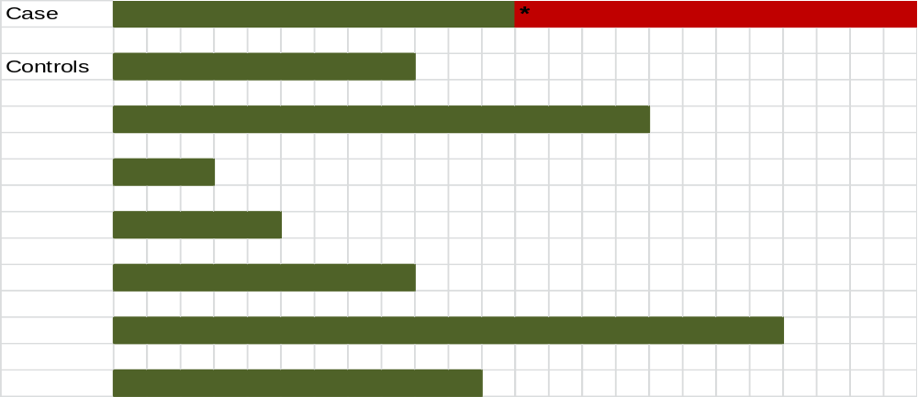
Adjusting for time to event
Nelson et al. Infect Control Hosp Epidemiol 2015;36:1089-94.

Slide 16
Impact of time to event adjustment
Error bars represent range

Slide 17
Screening
 | n screens
Outpatient screens
Renal outpatient screening | 1,293
Admission screens
Admission screens - vascular wards¹ | 518
Admission screens - renal wards² | 1,178
Total admission screens | 1,696
Weekly screens - vascular and renal wards
n inpatient beds - vascular wards | 47
n inpatient beds - renal wards | 79
Total weekly screens (36 weeks) | 4,536
Outlier weekly screens³
Weekly screening outliers in non-renal/vascular wards | 2,402
Total | 9,927
518 (76.8%) of 674 admissions to vascular wards were screened
1178 (90.9%) of 1296 admissions to renal wards were screened.
Outlier’ = patient with a CPE outbreak strain who was an inpatient on a non-renal/vascular ward. In this scenario, weekly screening of all patients on the ward occurred during their stay and for four weeks after their discharge from the ward.
The total cost associated with collecting and processing these screens was £130,999 (£79,416 on lab costs, and £51,583 on staff time collecting the swabs)

Slide 18
Contact precautions
The number of inpatients with known CPE carriage, daily
1831 contact precautions days generated, at a cost of £61,575 (£37,389 in gloves and aprons, £23,588 in stock disposal, and £598 in infectious waste disposal)

Slide 19
Antibiotic costs

Slide 20








Cost of an outbreak - results
Economic evaluation of a 40 case outbreak of CPE. Error bars represent range
Otter et al. Clin Microbiol Infect 2017.

Slide 21
Summary of our findings
Comprehensive coverage of costs, including actual expenditure and opportunity costs.
Opportunity costs was larger, but more difficult to account for.
We did not include:
  Substantial cleaning costs, which were absorbed by our contract cleaner.
  Litigation costs (none that we are aware of).
  Reputational costs.
  Socioeconomic costs.
  Ongoing costs outside the acute outbreak phase.
  Changes to the antimicrobial programme.
Whilst we did adjust for time to event, our estimate of attributable length of stay is rather crude.
The large cost accrued over 10 months argues for interventions to prevent CPE transmission being cost effective in the long-term.

Slide 22
Counting the cost of an outbreak
(cost[Title] OR costs[Title]) AND (outbreak[Title] OR outbreaks[Title])
Articles: 99
Included articles that described the cost of an outbreak in an acute hopsital setting, including cost of outbreak, number of cases, and duration: 21

Slide 23
Cost of a Gram-negative outbreak

Slide 24
Cost of other outbreaks

Slide 25
Cost per case

Slide 26
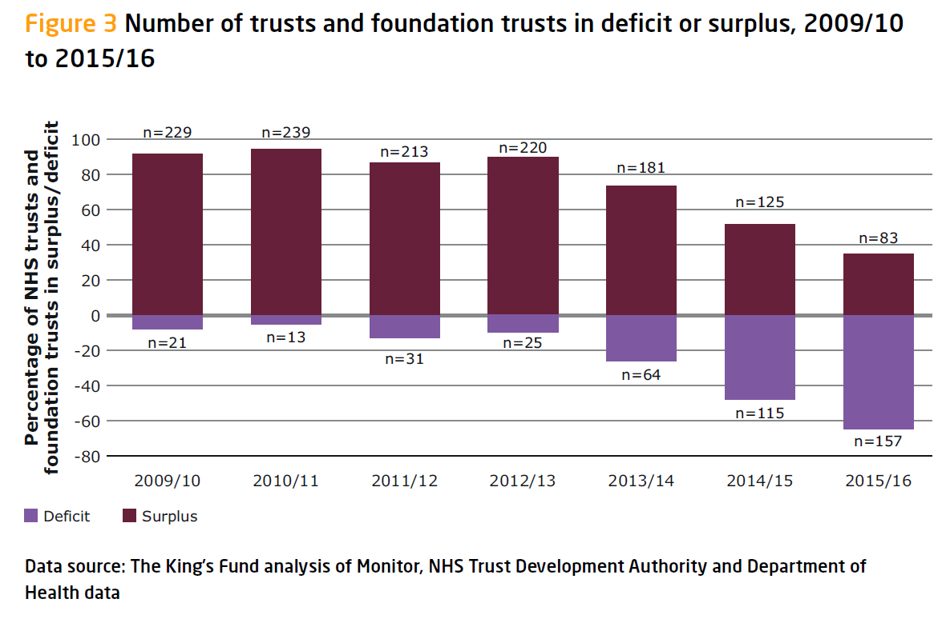
The King’s Fund Briefing. Deficits in the NHS 2016.

Slide 27
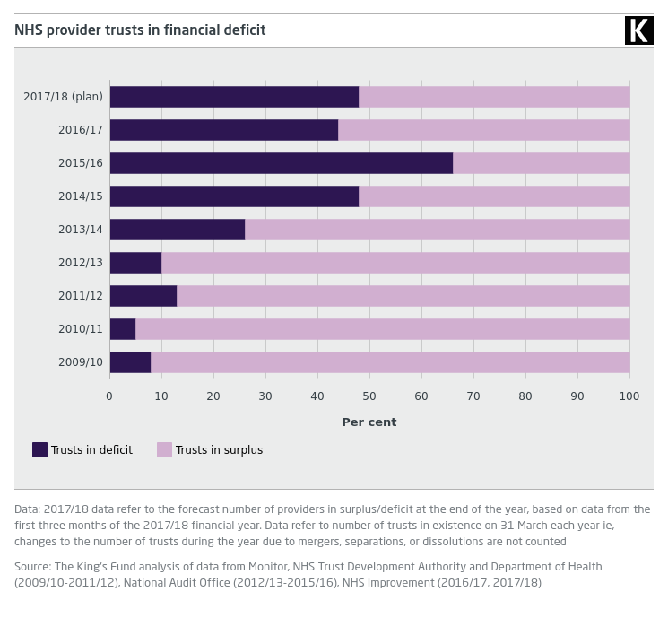
The King’s Fund. Trusts in deficit.

Slide 28





Cost-perspectiveness

Slide 29
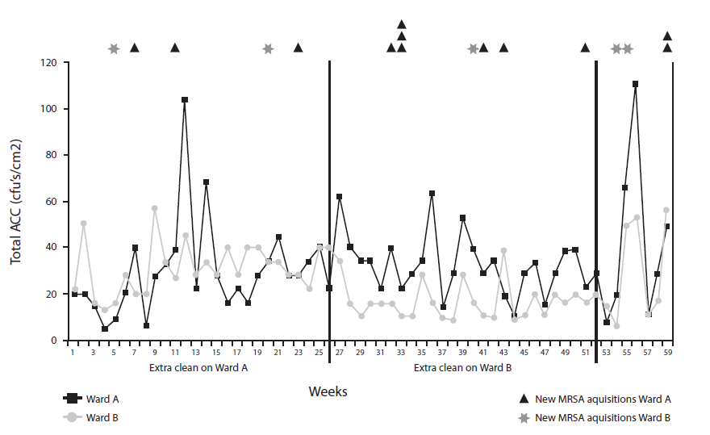
The cost-effectiveness of prevention (e.g. MRSA)
The impact of an extra cleaner was modelled in a 12 month ward cross-over study. The cleaner cost £12k per year, and each MRSA infection was assumed to cost £9k.
MRSA infection
-27%
Financial position
+£30k to +£70k
Dancer et al. BMC Med 2009;7:28.

Slide 30
Summary
HCAI and outbreaks are expensive
This argues for ‘prevention is better than cure’
We need to have accurate, meaningful costs of outbreaks to justify investment in enhanced outbreak detection and prevention

Slide 31
The cost of an outbreak
Jon Otter, PhD FRCPath
Imperial College London
j.otter@imperial.ac.uk
@jonotter
Blog: www.ReflectionsIPC.com
Slides: www.jonotter.net

Slide 32
 |  | Number | Actual expenditure (£) | Opportunity cost (£)
 |  |  |  | Staffing | Missed revenue | Bed days
Additional bed days case patients (days) |  | 840 |  |  |  | 141918
Anti-infective costs | Anti-infective costs |  | 46031
Laboratory | Screening (n screens) | 9927 | 79416
 | Staff time to collect screens (hrs) | 2482 |  | 51583
IPC team time | IPC nurse site team (hrs) | 1440 |  | 83837
 | Data and epidemiology team (hrs) | 288 |  | 14478
 | Management team (hrs) | 88 |  | 30870
Other staff time | MDT meetings re treatment (hrs) | 18 |  | 5551
 | Mortality review (hrs) | 65 |  | 3314
 | Facilities (hrs) | 42 |  | 1549
 | Trust Communications (hrs) | 52 |  | 2261
Contact precautions | Gloves and aprons (n isolation days) | 1831 | 37389
 | Stock disposal |  | 23588
 | Infectious waste (n isolation days) | 1831 | 598
Ward-based monitors | Hours of HCA time (hours) | 2592 | 35510
Environment | HPV decontamination (n rooms) | 24 | 36312
Estates work |  |  | 130000
Elective surgical missed revenue (n procedures) |  | 72 |  |  | 295704
Closed beds | Bay and ward closures |  |  |  |  | 65250
 | Infectious waste stream |  | 669
 | Curtain changes |  | 1637
 | Mattress disposal |  | 3050
Totals | Grand total = £960514 |  | 264200 | 193442 | 295704 | 207168

