Slide 1


Healthcare-associated C. difficile infections: acquisition of C. difficile not antibiotic use is the most important factor
Jon Otter, PhD FRCPath
Honorary Senior Lecturer in HCAI and AMR, Imperial College London
j.otter@imperial.ac.uk
@jonotter
Blog: www.ReflectionsIPC.com
Slides: www.jonotter.net

Slide 2
Trends in HCAI in England

Slide 3
Drivers of C. difficile
Lab testing
Targets
Patient sampling
Patient exposures
Antibiotics
Immuno-therapy
Chemo-therapy
Gut surgery
Gastric acid inhibitors
Acquisition
Sources
Humans
Transmission routes
Hands
Environment
Animals
Food
Soil

Slide 4
Drivers of C. difficile
Lab testing
Targets
Patient sampling
Patient exposures
Antibiotics
Immuno-therapy
Chemo-therapy
Gut surgery
Gastric acid inhibitors
Acquisition
Sources
Humans
Transmission routes
Hands
Environment
Animals
Food
Soil

Slide 5



Rates of colonisation with C. difficile
0.5%¹
Up to 50% ²
5% ³
FMT ⁴
Colonised patients 5.9 x higher risk of subsequent CDI (RR 5.86; 95% CI 4.2-8.2).³
Manzoor et al. J Hosp Infect 2017;97:153-5.
Hung et al. J Microbiol Immunol Infect 2015;48:241-8.
Zacharioudakis et al. Am J Gastroenterol 2015;110:381-90.
Allegretti et al. Clin Microbiol Infect. 2017;24:780.e1-780.e3.

Slide 6
Patient exposures promoting gut dysbiosis
Lab testing
Targets
Patient sampling
Patient exposures
Antibiotics
Immuno-therapy
Chemo-therapy
Gut surgery
Gastric acid inhibitors
Acquisition
Sources
Humans
Transmission routes
Hands
Environment
Animals
Food
Soil

Slide 7
Antibiotics aren’t the only cause of gut dysbiosis
Patient exposures
Antibiotics
Immuno-therapy
Chemo-therapy
Gut surgery
Gastric acid inhibitors
Systematic review and meta-analysis of risk factors for CA-CDI.
Antibiotic exposure was associated with a higher risk of CA-CDI in the US (OR, 9.16; 95% CI, 5.47–15.34) compared with Europe (4.54, 2.68–7.70), whereas proton-pump inhibitor exposure was associated with a higher risk in Europe (OR, 2.56; 95% CI, 1.40–4.71) than in the US (1.12, 0.64–1.95).
Furuya-Kanamori et al. Infect Control Hosp Epidemiol 2015;36:132-41.

Slide 8
The English C. difficile miracle
Mandatory reporting, 2004
‘Cleanyourhands’, 2004
‘A matron's charter: an action plan for cleaner hospitals’,2004
‘Towards cleaner hospitals and lower rates of infection’, 2004
Health Act, 2006
‘Going Further Faster,’ 2006
Targets, 2007
Saving Lives,2007
Deep clean, 2007
Revised guidelines, 2009
1,2,3
5,6
7,8,9
10

Slide 9
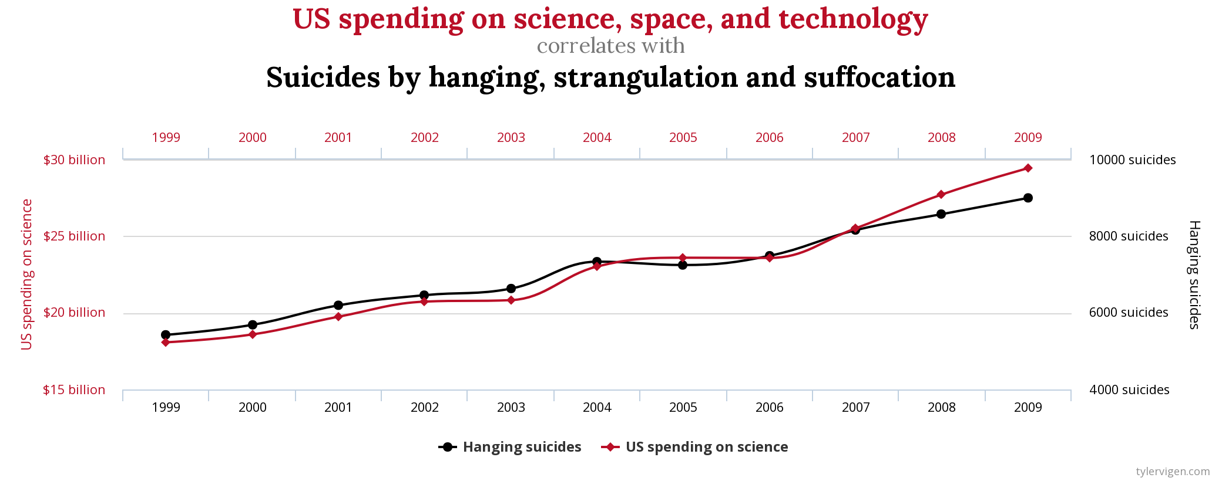
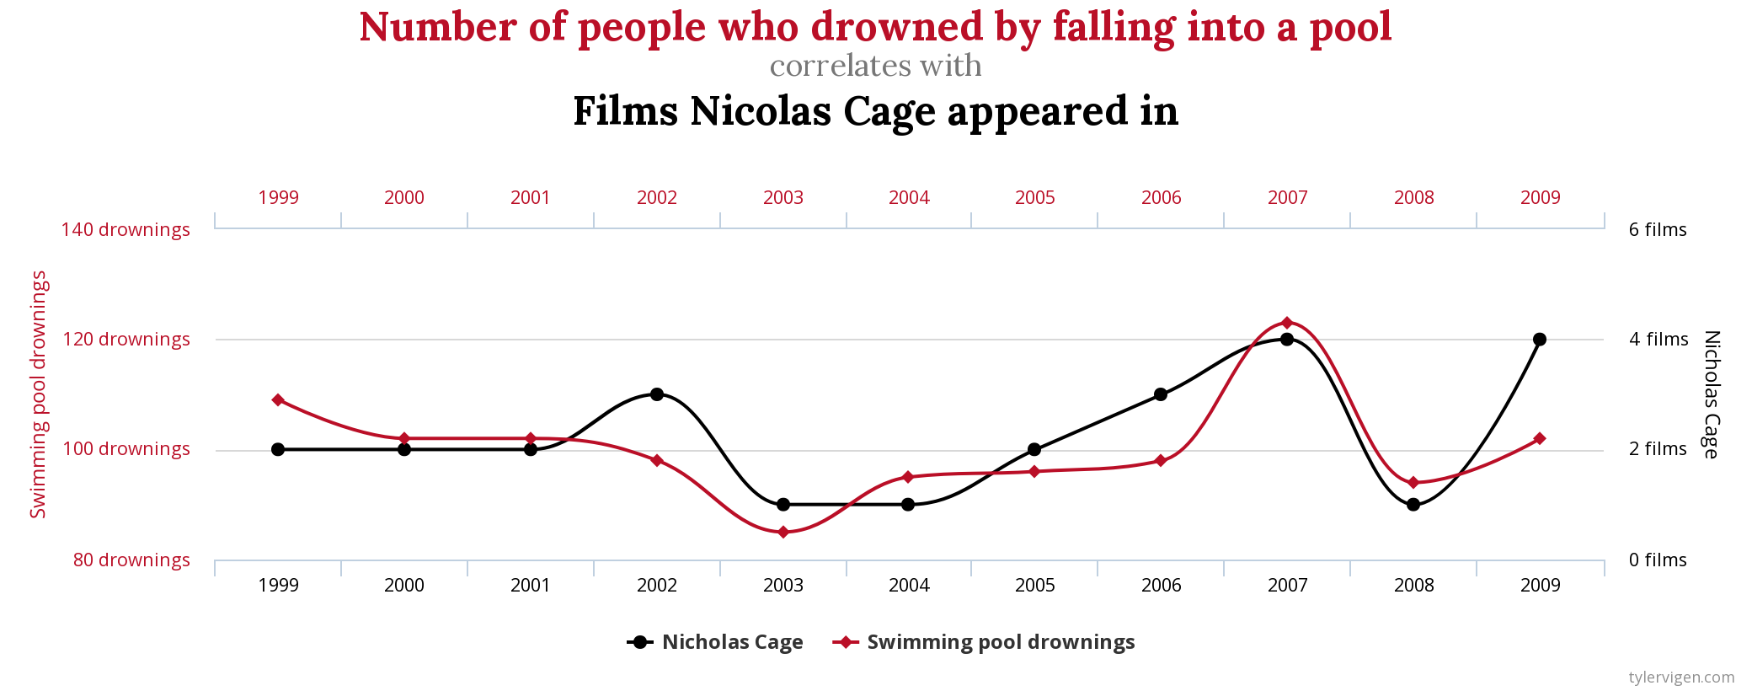
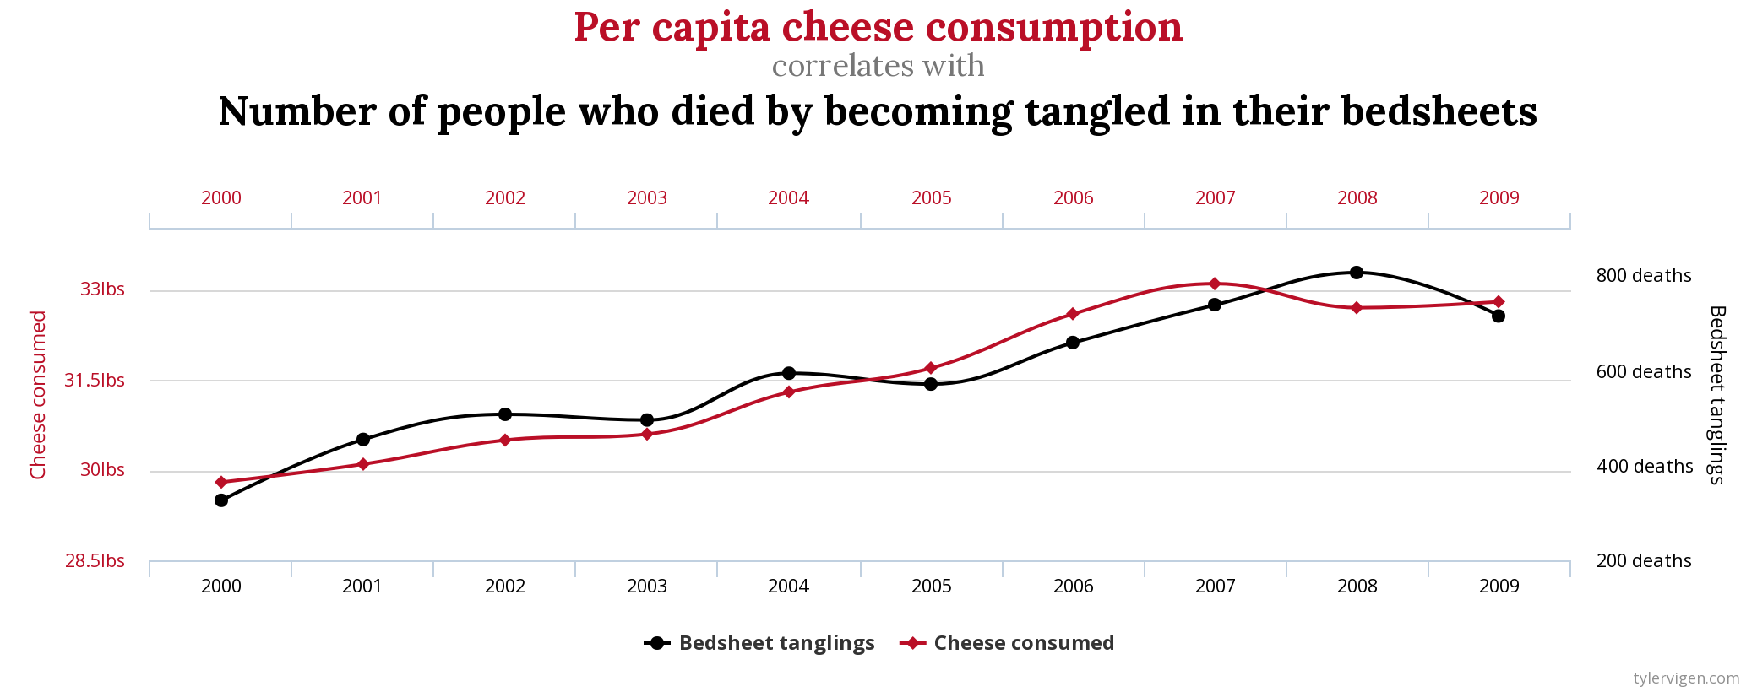
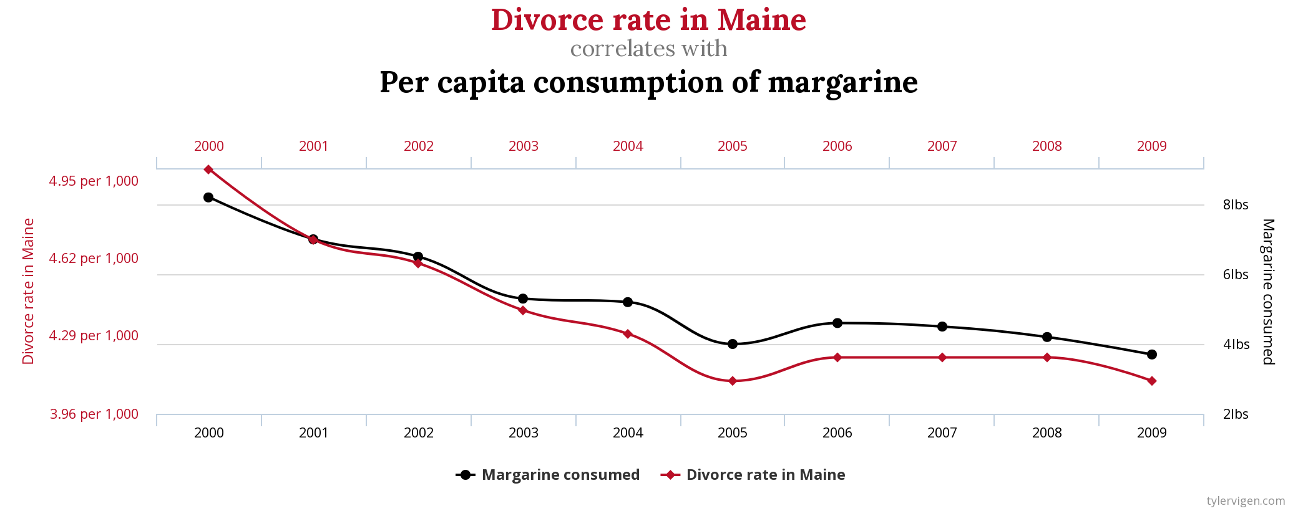
Spurious correlations
http://www.tylervigen.com/spurious-correlations

Slide 10
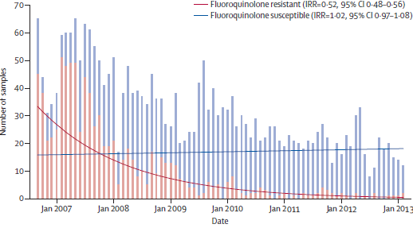
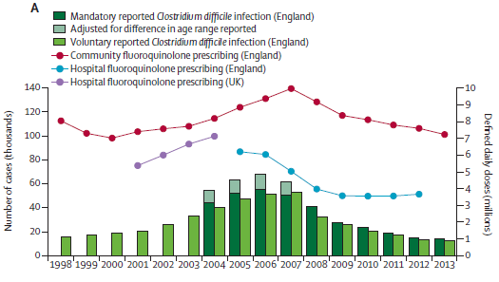
Is the English C. difficile miracle explained by fluoroquinolones?
Reductions in CDI in the Oxfordshire region correlated with reduced fluoroquinolone use.
Fluoroquinolone-resistant strains disproportionately affected by the reduction in fluoroquinolone use.
Dingle et al. Lancet Infect Dis 2017;17:411-21.

Slide 11
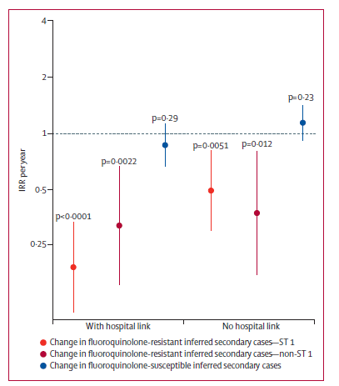
Is the English C. difficile miracle explained by fluoroquinolones?
Secondary transmission of fluoroquinolone-resistant isolates reduced, both for isolates with and without a link to hospitals.
However, secondary transmission of fluoroquinolone-susceptible isolates did not change significantly.
This supports the idea that reducing the selective pressure of fluoroquinolone use was more important than hospital infection control interventions.
Dingle et al. Lancet Infect Dis 2017;17:411-21.

Slide 12


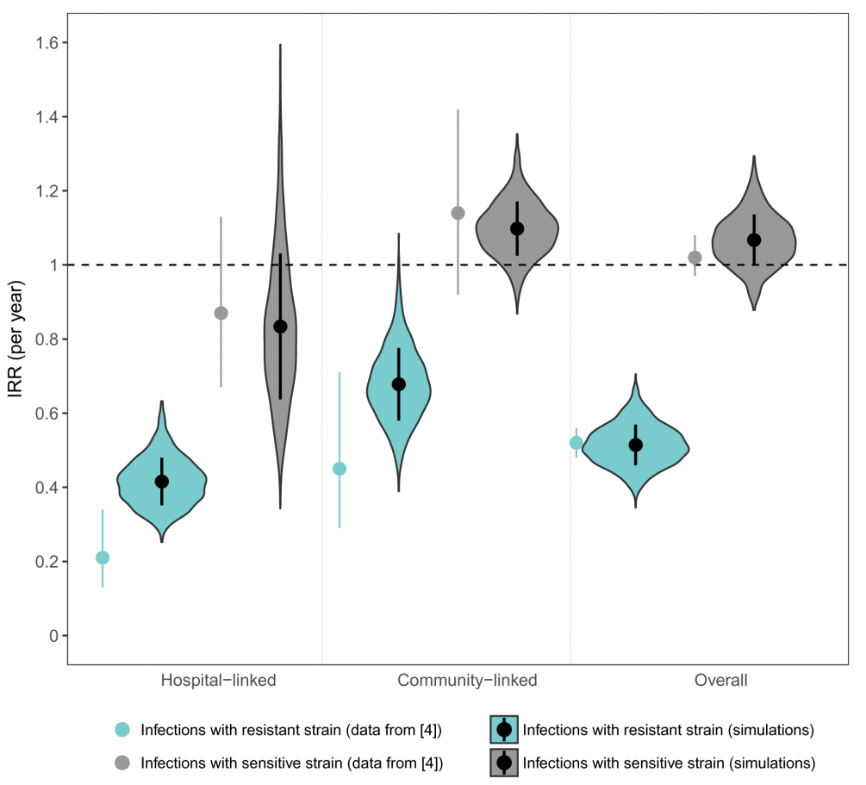
Why antibiotic susceptible bacteria are resistant to hospital-based IPC intervention
Mathematical model to investigate transmission in hospitals and their surrounding catchment area.
Included a competitive advantage for resistant bacteria in hospitals and sensitive bacteria in the community.
Modelling the impact of improving hand hygiene by 10%.
Antibiotic-resistant bacteria were disproportionately affected in hospitals!
van Kleef et al. BMC Infect Dis 2013;13:294.

Slide 13
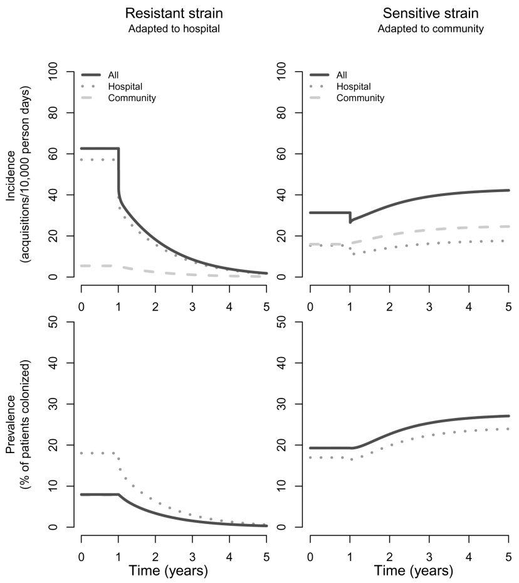
Why antibiotic susceptible bacteria are resistant to hospital-based IPC intervention
van Kleef et al. BMC Infect Dis 2013;13:294.

Slide 14
The acquisition of C. difficile
Lab testing
Targets
Patient sampling
Patient exposures
Antibiotics
Immuno-therapy
Chemo-therapy
Gut surgery
Gastric acid inhibitors
Acquisition
Sources
Humans
Transmission routes
Hands
Environment
Animals
Food
Soil

Slide 15
Isn’t it proven that patient to patient transmission is a rare cause of healthcare-associated CDI?
Epidemiological relationships between 333 genetically related cases.
‘Ward contact’ = shared time on the same ward; ‘Hospital contact’ = shared time in the same hospital, without direct ward contact; ‘Ward contamination’ = admitted to the same ward within 28 days of the discharge of a symptomatic patient; ‘Same GP’ = no hospital contact, but shared the same GP; ‘Same postcode’ = no hospital contact, but shared the same postal code).
Eyre et al. New Engl J Med 2013;369:1195-1205.

Slide 16
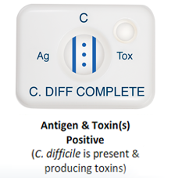

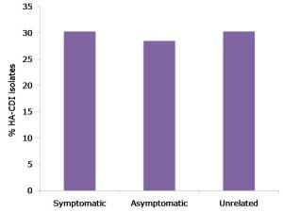
Only half the story…
Sensitivity of lab test method used can be very low (~50%)¹
C. difficile contamination of hospital and air is common in hospitals.^{2,3}
Asymptomatic carriers were not included. Of 56 cases of CDI, 17 were associated with symptomatic patients, and 16 with asymptomatic carriers.⁴
Humphreys et al. J Clin Microbiol 2013;51:869-873.
Otter et al. Infect Control Hosp Epidemiol. 2011;32:687-99.
Best et al. Clin Infect Dis 2010;50:1450-7.
Curry et al. Clin Infect Dis. 2013;57:1094-102.

Slide 17
The role of the environment in C. difficle transmission
Lab testing
Targets
Patient sampling
Patient exposures
Antibiotics
Immuno-therapy
Chemo-therapy
Gut surgery
Gastric acid inhibitors
Acquisition
Sources
Humans
Transmission routes
Hands
Environment
Animals
Food
Soil

Slide 18

Your hospital room can make you sick!
Mitchell et al. J Hosp Infect 2015;91:211-217.

Slide 19
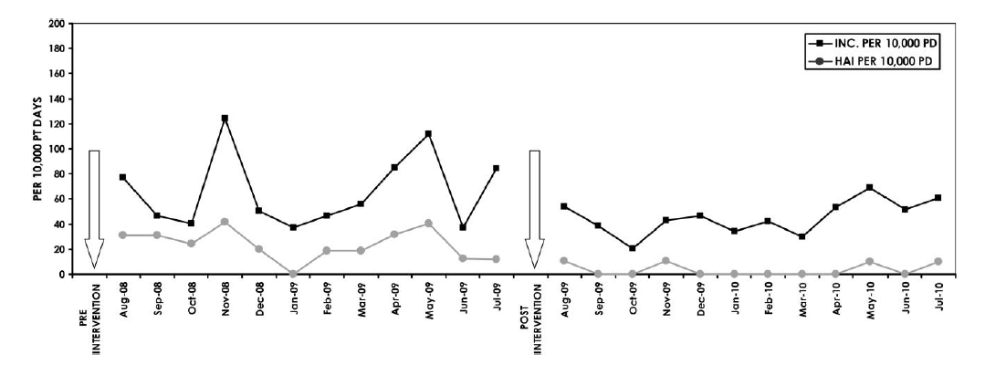
Wiping away infection
Impact of changing from QAC to chlorine wipes for daily disinfection of all rooms. Cleaning thoroughness was 97-98% throughout the study using ATP benchmarking (<250 RLUs).
2.4
cases / 1000 patient days
0.4
cases / 1000 patient days
Orenstein et al. Infect Control Hosp Epidemiol 2011;34:521-523.

Slide 20

HPV: clinical impact
2 years before HPV, 2 years during HPV. Breakpoint model indicated significant reduction in rate of CDI when HPV implemented (1.0 to 0.4 per 1000 patient days, 60% reduction).
McCord et al. J Hosp Infect 2016;94:185-7.

Slide 21
Scaling the reduction
40%
Study | ARD system | Design | Outcome | Confounders
McCord 2016 | HPV | 4 year before-after | CDI rate fell from 1.0 to 0.4 cases per 1,000 pt days; 60% reduction, p<0.001. | No data on IPC compliance / abx use.
Horn 2015 | HPV | 3 year before-after | CDI rate fell from 1.4 to 0.9 cases per 1,000 patient days; 36% reduction. P<0.001. | Concurrent increase in hand hygiene compliance.
Manian 2013 | HPV | 2 year before-after | CDI rate fell from 0.9 to 0.5 cases per 1,000 pt days; 39% reduction (IRR=0.63, CI=0.50-0.79, p<0.001). | Chlorine disinfection enhanced concurrently.
Boyce 2008 | HPV | 2 year before-after | CDI rate fell from 1.9 to 0.9 cases per 1,000 pt days on high-risk wards; 53% reduction, p=0.047). | Outbreak? No significant reduction hospital wide; changes in abx usage.
Anderson 2018 | UVC | 2 year cluster RCT | CDI rate fell from 1.0 to 0.9 cases per 1,000 patient days (RR 0.89, 95% CI, 0.80–0.99; p=0.031); 11% reduction. | This RCT was controlled carefully for key confounders including IPC practice but not abx use.
Pegues 2016 | UVC | 2 yr before -after | CDI rate fell from 3.0 to 2.3 cases per 1,000 pt days; 27% reduction. | Monitored potential confounders
Napolitano 2015 | UVC | 3 yr before -after | CDI rate fell from 1.2 to 0.7 cases per 1,000 pt days; 42% reduction. | No data on IPC compliance / abx use.
Vianna 2016 | PX-UV | 4 yr before - after | CDI rate fell from 0.7 to 0.4 cases per 1,000 pt days; 40% reduction. | No data on IPC compliance / abx use.
Levin 2013 | PX-UV | 2 yr before -after | CDI rate fell from 0.9 to 0.4 cases per 1,000 pt days; 53% reduction. | Abx changes.

Slide 22
The role of hand hygiene in C. difficle transmission
Lab testing
Targets
Patient sampling
Patient exposures
Antibiotics
Immuno-therapy
Chemo-therapy
Gut surgery
Gastric acid inhibitors
Acquisition
Sources
Humans
Transmission routes
Hands
Environment
Animals
Food
Soil

Slide 23
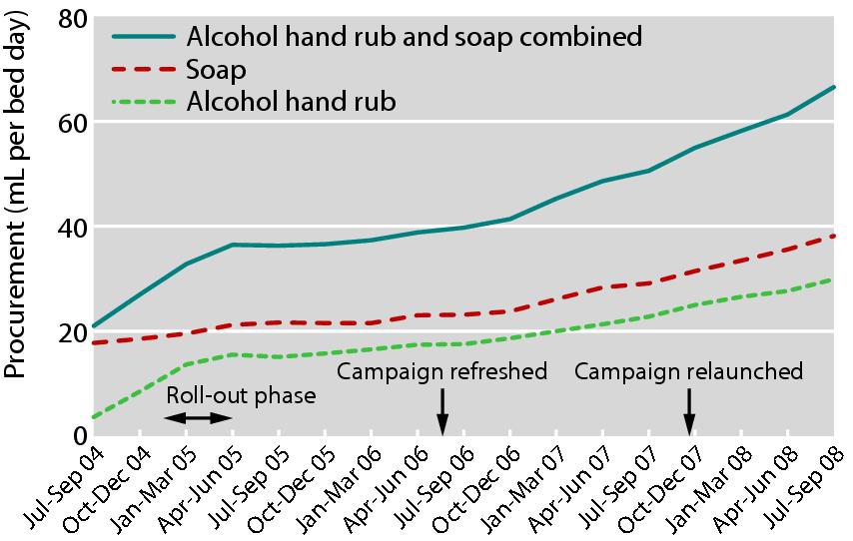
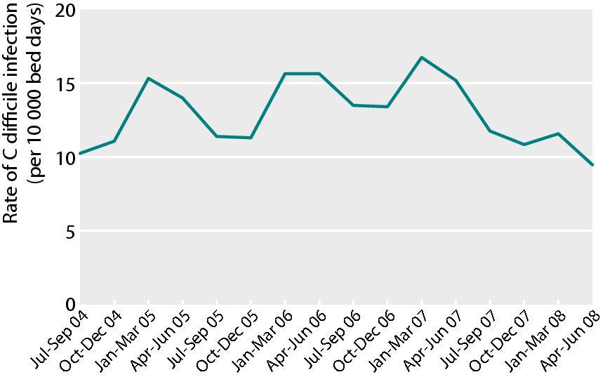
Evidence that improved hand hygiene reduces CDI
Increased procurement of soap was independently associated with reduced CDI throughout the study (each 10 mL increase per patient bed day associated with a 7% reduction in CDI, adjusted incidence rate ratio 0.993, 95% CI 0.990 to 0.996; P<0.0001).
Conversely, increased procurement of alcohol hand rub was independently associated with increased CDI (adjusted incidence rate ratio 1.010, 95% CI 1.006 to 1.013; P<0.0001).
Stone et al. BMJ 2012;344:e3005..

Slide 24
Time to tackle C. difficile asymptomatic colonisation
Lab testing
Targets
Patient sampling
Patient exposures
Antibiotics
Immuno-therapy
Chemo-therapy
Gut surgery
Gastic acid inhibitors
Acquisition
Sources
Humans
Transmission routes
Hands
Environment
Animals
Food
Soil

Slide 25
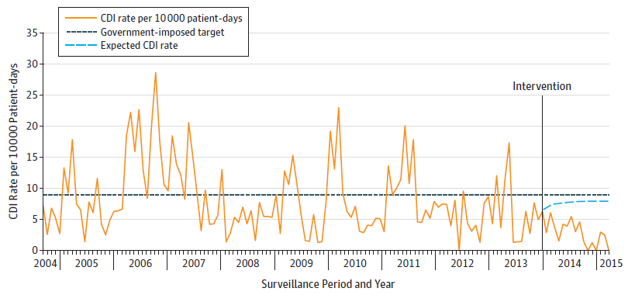
Time to start screening and isolation for C. difficile?
Introducing PCR screening for C. difficile (tcdB) resulting in a significant reduction in CDI; 63 of 101 (62.4%) expected cases were prevented.
Longtin et al. JAMA Intern Med 2016;176:796-804.

Slide 26
The sufficient-component cause model
 | Necessary | Sufficient
Antibiotic exposure | ✘ | ✘
C. difficile acquisition | ✓ | ?

Slide 27
You can suffer C. difficile infection without exposure to antibiotics, but you can’t suffer C. difficile infection without exposure to C. difficile!

