Slide 1
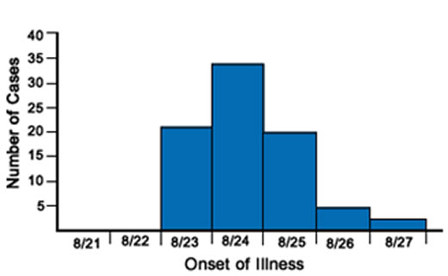


An introduction to infectious diseases epidemiology
Jon Otter, PhD FRCPath
Imperial College London
j.otter@imperial.ac.uk
@jonotter
Blog: www.ReflectionsIPC.com
Slides: www.jonotter.net

Slide 2


Slide 3
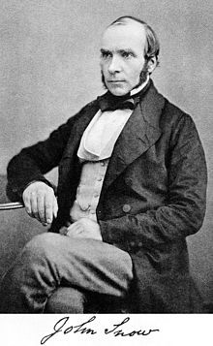


Slide 4



Slide 5
Infectious diseases are caused by pathogenic microorganisms, such as bacteria, viruses, parasites or fungi; the diseases can be spread, directly or indirectly, from one person to another (World Health Organisation)

Slide 6
Healthcare-associated infections (HCAIs)
MRSA
C. difficile
CPE
Tropical diseases
Zika
Dengue
Worms
Vaccine-preventable
Smallpox
Measles
Mumps
Sexually transmitted infections (STIs)
Chlamydia
Gonorrhoea
HPV
HIV

Slide 7
Antibiotics & HCAI*
Crapsules
Applied research
Disease Detectives
Vaccines
ID** epi needs you
* HCAI = Healthcare-associated infection.
** ID = infectious diseases.

Slide 8
Antibiotics & HCAI*
Crapsules
Applied research
Disease Detectives
Vaccines
ID** epi needs you
* HCAI = Healthcare-associated infection.
** ID = infectious diseases.

Slide 9
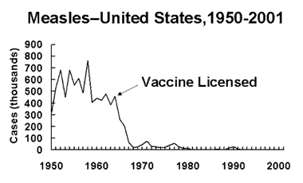

Slide 10
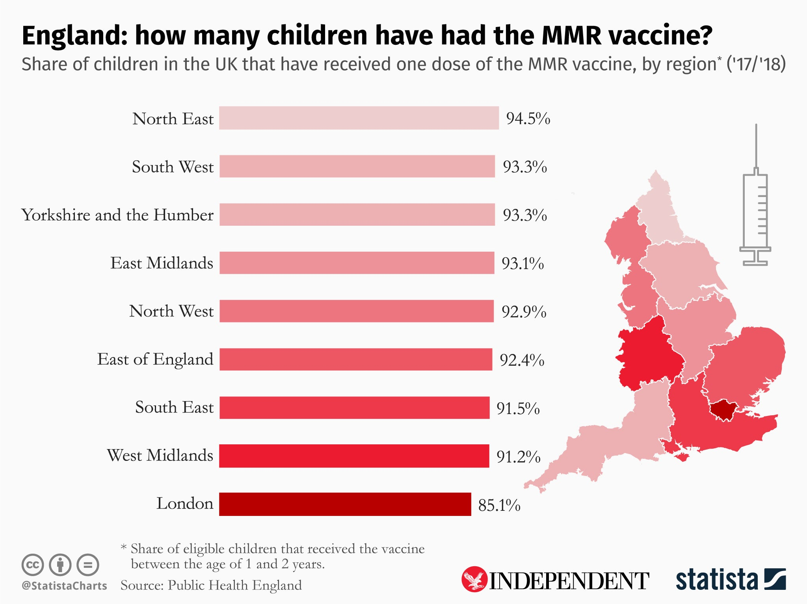

Slide 11
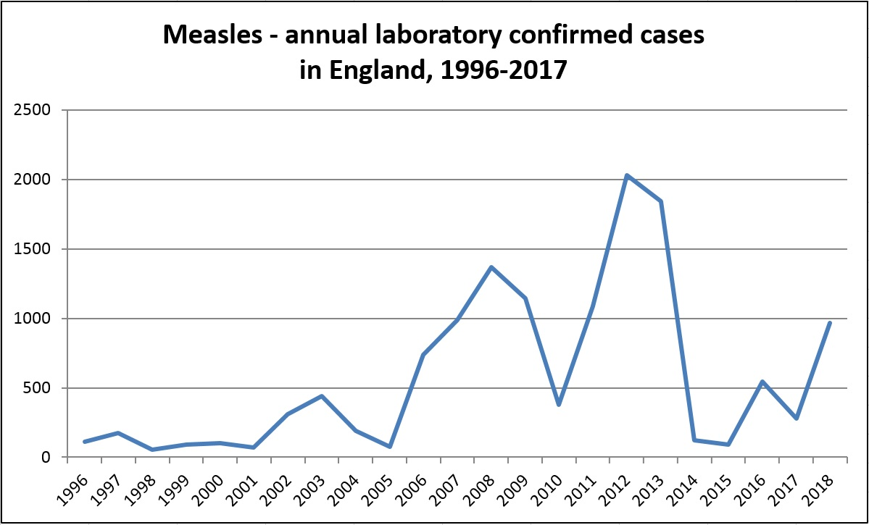

Slide 12
Antibiotics & HCAI*
Crapsules
Applied research
Disease Detectives
Vaccines
ID** epi needs you
* HCAI = Healthcare-associated infection.
** ID = infectious diseases.

Slide 13
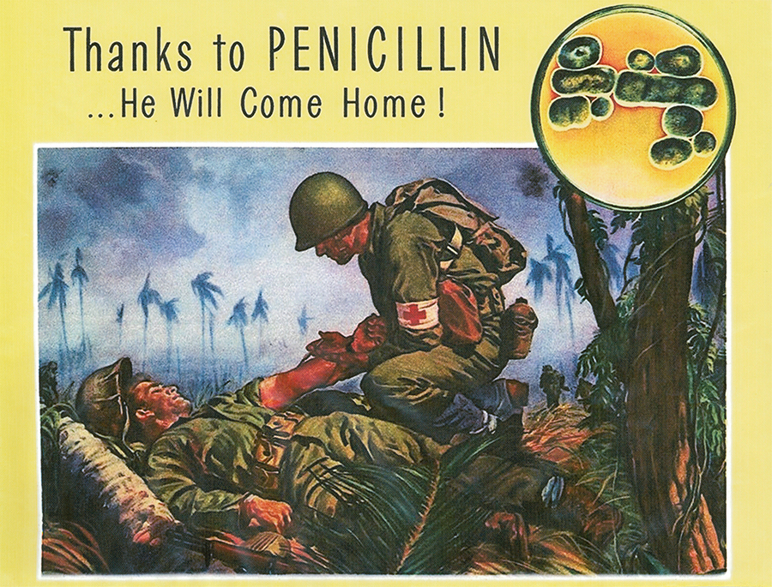

Slide 14
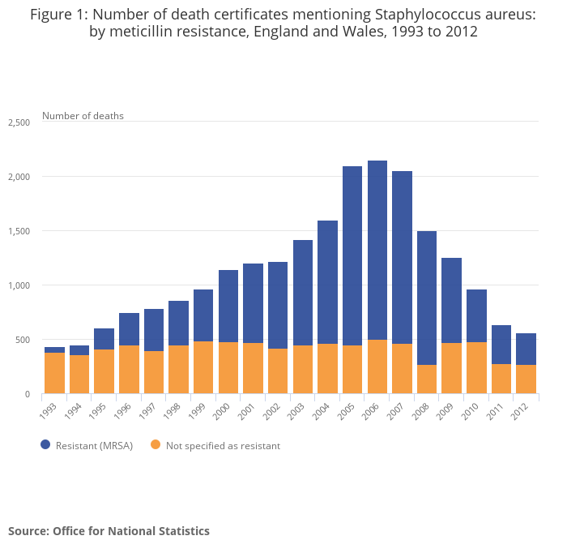
MRSA infection

Slide 15
Antibiotics & HCAI*
Crapsules
Applied research
Disease Detectives
Vaccines
ID** epi needs you
* HCAI = Healthcare-associated infection.
** ID = infectious diseases.

Slide 16
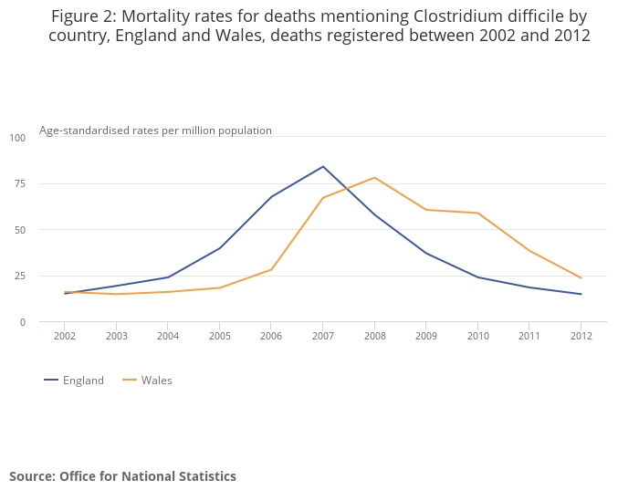
Clostridium difficile infection
Notes:
Recurrence rate 15-35%

Slide 17
Faecal microbiota transplant for recurrent CDI
Patients with recurrent CDI randomised to FMT (n=16), vancomycin (n=12) or vancomycin + bowel lavage (n=13)
van Nood et al. N Engl J Med 2013;368:407-415.

Slide 18


Slide 19
Recurrent CDI is just the start…
Disease group | Diseases
Intestinal | Recurrent CDI, Chron’s disease, ulcerative colitis, IBS, dislodging antibiotic resistant bacteria
Metabolic | Metabolic syndrome, obesity, Type 2 diabetes, cardiovascular diseases, non-alcoholic liver diseases
Neuropsychiatric | Parkinson’s, MS, myoclonus dystonia, autism, chronic fatigue syndrome
Autoimmune | Arthritis, various other
Allergic | Atopy, asthma, various cancers
Xu et al. World J Gasteroenterol 2015;21:102-111.

Slide 20
Antibiotics & HCAI*
Crapsules
Applied research
Disease Detectives
Vaccines
ID** epi needs you
* HCAI = Healthcare-associated infection.
** ID = infectious diseases.

Slide 21
CPE outbreak; total number of cases
8 cases first identified by clinical culture, 32 by screening culture; of these 32, 14 had a subsequent positive clinical culture
Otter et al. Sci Rep 2017;7:12711.

Slide 22








Cost of an outbreak - results
Economic evaluation of a 40 case outbreak of CPE. Error bars represent range
Otter et al. Clin Microbiol Infect 2017;23:188-196.

Slide 23
Antibiotics & HCAI*
Crapsules
Applied research
Disease Detectives
Vaccines
ID** epi needs you
* HCAI = Healthcare-associated infection.
** ID = infectious diseases.

Slide 24


Slide 25
Antibiotics & HCAI*
Crapsules
Applied research
Disease Detectives
Vaccines
ID** epi needs you
* HCAI = Healthcare-associated infection.
** ID = infectious diseases.

Slide 26
Routes into infectious disease epidemiology
Clinical
Medicine, Nursing, Pharmacy, Clinical Scientist
Academic
Microbiology, Maths, Public Health, IT/Data Science
Other
Laboratory science, chemistry

Slide 27
Resources
Link | Description
BBC Bitesize | Seeing the unseen bacteria on hands
CDC Zombie Preparedness | Educational epi games and resources
CDC Epidemic Intelligence Service | Where “Disease Detectives” are made in America
e-Bug | Educational resources for HCAI and AMR aimed at school children
ECDC Disease Atlas | European data on HCAI indicators and AMR
ICL HCAI & AMR school resources | Resources for school activities from Imperial College London
Institute of Biomedical Sciences | The professional body for biomedical scientists and support staff.
PHE AMR Fingertips portal | English data on HCAI indicators
PHE infectious diseases index | Alphabetical index of infectious diseases
PHE Field Epidemiology Service | Where “Disease Detectives” are make in the UK
Reflections on IPC blog | Weekly (ish) blog on applied HCAI and AMR epidemiology
Vomiting Larry | This ‘friendly’ mannequin shows us what happens when we puke…
WHO infectious diseases pages | Information about infectious diseases from the WHO

Slide 28
An introduction to infectious diseases epidemiology
Jon Otter, PhD FRCPath
Imperial College London
j.otter@imperial.ac.uk
@jonotter
Blog: www.ReflectionsIPC.com
Slides: www.jonotter.net

