Slide 1


Getting to grips with healthcare-associated Gram-negative bloodstream infection?
Jon Otter, PhD FRCPath
Imperial College London
j.otter@imperial.ac.uk
@jonotter
Blog: www.ReflectionsIPC.com

Slide 2
Background and epi
How to tackle GNBSI
Drivers of GNBSI
Learning from G+ success?

Slide 3
Background and epi
How to tackle GNBSI
Drivers of GNBSI
Learning from G+ success?

Slide 4
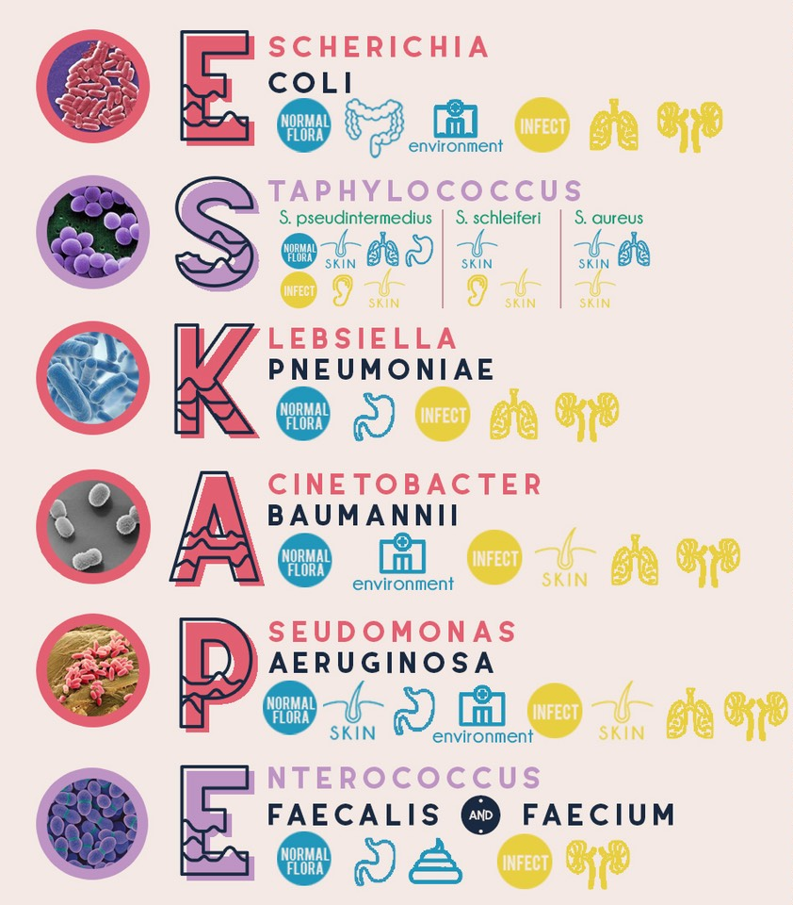
Source: DMAP.

Slide 5
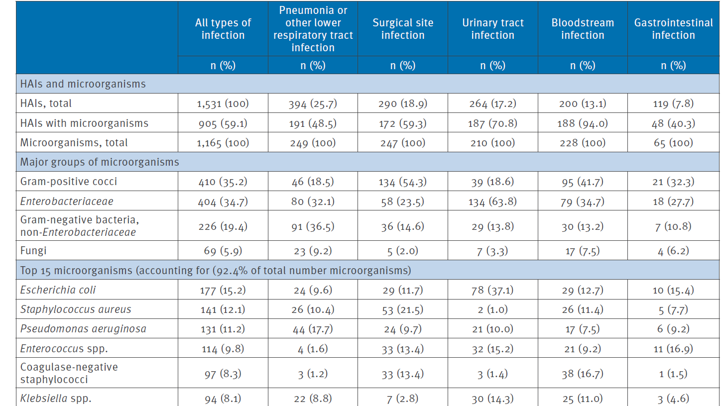
Point prevalence
Around 0.5 (2016 UK PPS) to 1% (2012 European PPS) of hospital inpatients will have a BSI at any one time.
Zarb et al. Eurosurvellance 2012. European Point Prevalence Survey of HCAI.

Slide 6
Rising threat from AMR-GNR
% of all HAI caused by GNRs.
% of ICU HAI caused by GNRs.
Non-fermenters | Acinetobacter baumannii Pseudomonas aeruginosa Stenotrophomonas maltophilia
Enterobacteriaceae | Klebsiella pneumoniae Escherichia coli Enterobacter cloacae
CPO
CPE
Hidron et al. Infect Control Hosp Epidemiol 2008;29:966-1011.
Peleg & Hooper. N Engl J Med 2010;362:1804-1813.

Slide 7
Gram-negative BSIs are getting more common
Data: Public Health England.

Slide 8
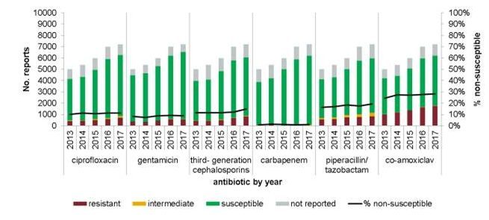
Gram-negative BSIs are getting harder to treat
Data: ESPAUR 2018.

Slide 9
Carbapenem-resistant organisms, Europe
EARS-Net

Slide 10

BSIs are expensive
Cassini et al. Plos Med 2016.

Slide 11

Enterobacteriaceae vs. non-fermenters
Share | Differ
Gram stain reaction | Risk factors & at-risk population
Concerning AMR | Potential for epidemic spread
 | Infection profile & mortality
 | Prevalence
 | Colonisation site & duration
 | Transmission routes
 | Resistance profile & mechanisms
Notes:
You could (and probably should) dissect the epidemiology of:
K. pneumoniae vs. E. coli
A. baumannii vs. P. aeruginosa
ESBL vs. KPC producing K. pneumoniae

Slide 12
What’s the problem? Poor clinical outcome
 | Enterobacteriaceae |  | Non fermenters
Organism | AmpC / ESBL | CPE | A. baumannii
Attributable mortality | Moderate | Massive (>50%) | Minimal
Shorr et al. Crit Care Med 2009;37:1463-1469.
Patel et al. Iinfect Control Hosp Epidemiol 2008;29:1099-1106.

Slide 13
The emerging threat of AMR GNR!
Pathogen | GNR | MRSA | VRE | C. difficile
Resistance | +++ | + | + | +/-
Resistance genes | Multiple | Single | Single | n/a
Species | Multiple | Single | Single | Single
HA vs CA | HA & CA | HA | HA | HA
At-risk pts | All | Unwell | Unwell | Old
Virulence | +++ | ++ | +/- | +
Environment | +/- | + | ++ | +++

Slide 14
Background and epi
How to tackle GNBSI
Drivers of GNBSI
Learning from G+ success?

Slide 15
Drivers of Gram-negative BSI
Lab testing
Patient sampling
Deprivation
Seasonal variation
Acquisition
Sources
Humans
Transmission routes
Hands
Environment
Animals
Food
Soil
Patient factors
Devices
AMR
Surgery & wounds
High risk patients
Hydration & UTI

Slide 16
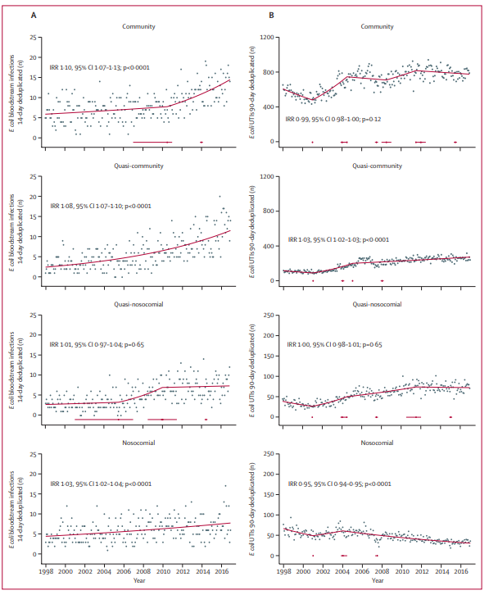
Trends in classification of E. coli BSIs
Classification and trends of E. coli BSIs in Oxfordshire, England.
Vihta et al. Lancet Infectious Dis 2018.

Slide 17
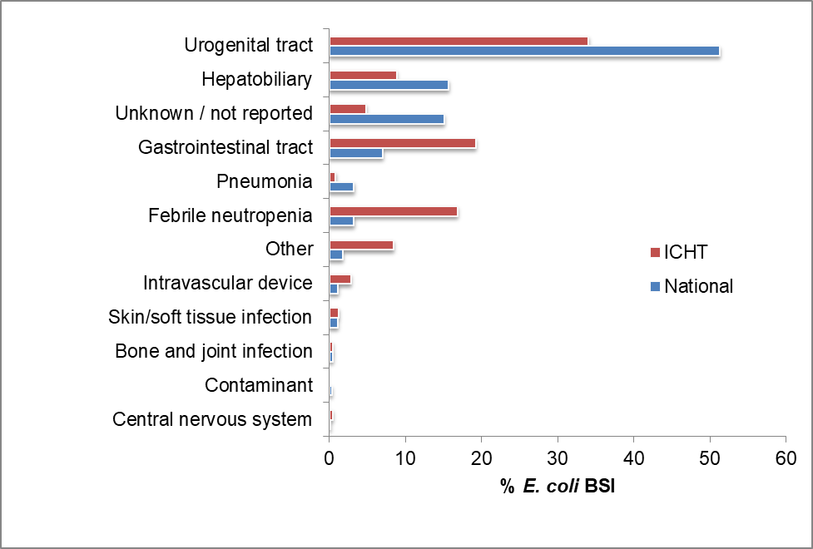
Getting to grips with the source of E. coli BSIs
Comparing the source of 250 healthcare-associated E. coli BSIs with the national picture, 2015-2017.
Otter et al. J Hosp Infect 2018.

Slide 18
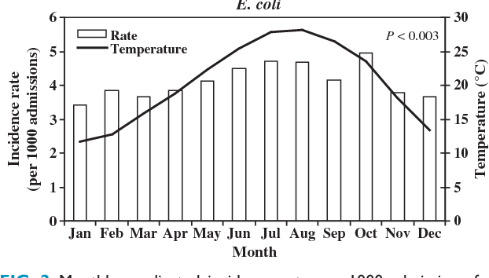
Seasonal variation in E. coli BSIs
The monthly rate of 2810 E. coli BSIs in a region of Israel plotted against ambient temperature.
Chazan et al. Clinical Microbiol Infect 2011.

Slide 19
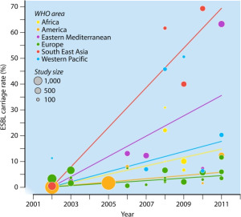
Social and material deprivation
We performed a risk factor analysis, which included both individual-level variables (such as overseas travel, antibiotic exposure, and age) and were also able to include community-level variables (such as markers of household overcrowding, deprivation, immigration, and ethnicity).
We found that risk factors for ESBL were travel to Asia (OR 4.4, CI 2.5-7.6), or Africa (OR 2.4, CI 1.2-4.8) in the 12 months prior to admission, two or more courses of antibiotics in the 6 months prior to admission (OR 2.0, CI 1.3-3.0), and residence in a district with a higher than average prevalence of overcrowded households (OR 1.5, CI 1.05-2.2).
The global prevalence of ESBL in the community, from Woerther et al.
Otter et al. Clinical Microbiol Infect 2019.

Slide 20
Background and epi
How to tackle GNBSI
Drivers of GNBSI
Learning from G+ success?

Slide 21
MRSA bacteraemia, England 2001-2013
4
5
6
Mandatory reporting, 2001
‘Getting ahead of the curve’, 2002
‘Winning ways’, 2003
‘Towards cleaner hospitals’, 2004
‘Cleanyourhands’, 2004
Targets introduced, 2004
Cleanliness improvement, 2005
‘Going further faster’, 2006
Root cause analysis, 2006
Revised national guidelines, 2006
Deep clean, 2007
Screening elective admissions, 2008
Universal screening, 2010
8
9
10
3
7
1
2
11
12
13

Slide 22
C. difficile infection (CDI), England 2004-2013
CDI cases, 2004-2013
3
National Antimicrobial Stewardship Group (ASG) formed in England, 2003
Mandatory reporting, 2004
Targets, 2007
Revised national guidelines, 2009
‘Start Smart Then Focus’ lauchned
ESPAUR formed
1 2
4
5
6
Notes:
Trust apportioned = specimens from patients who have been in hospital for 3 days or more (MRSA) or 4 days or more (CDI)

Slide 23
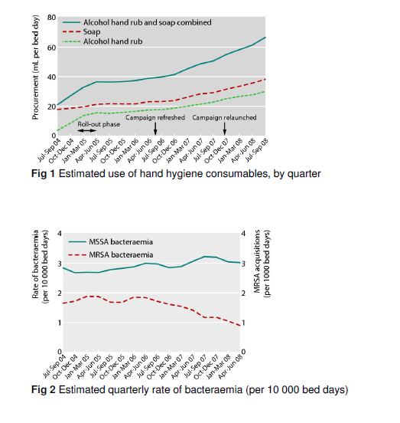
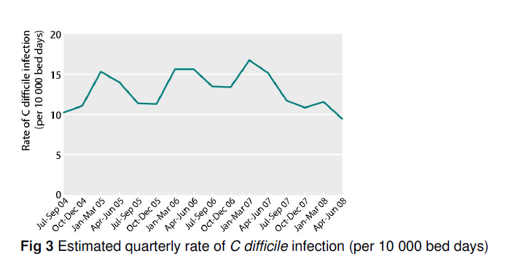
Does hand hygiene explain the reductions?
‘The Cleanyourhands campaign was associated with sustained increases in hospital procurement of alcohol rub and soap, which the results suggest has an important role in reducing rates of some healthcare associated infections.’
Stone et al. BMJ 2012;344:e3005.

Slide 24
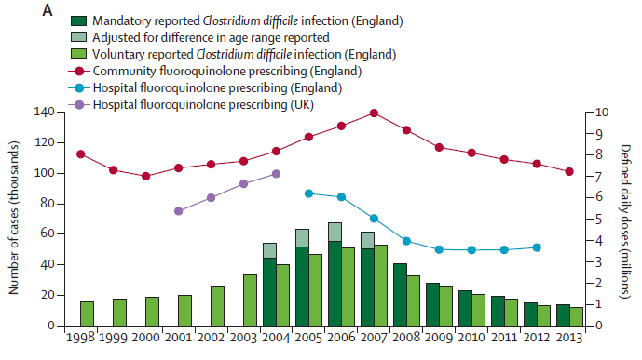
Does antimicrobial stewardship explain the reduction?
Dingle et al. Lancet Infect Dis 2017 in press.

Slide 25
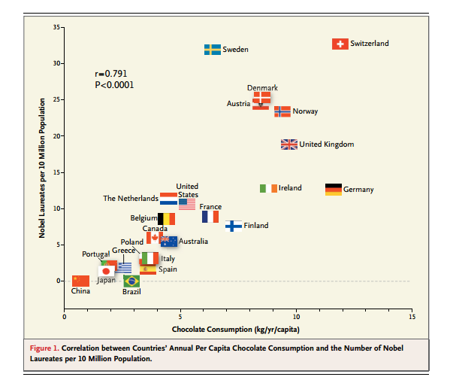
Spurious correlation?
Correlation between national chocolate consumption and rate of Nobel prize winners.
Messerli FH. New Engl J Med 2012;367:1562-4.

Slide 26
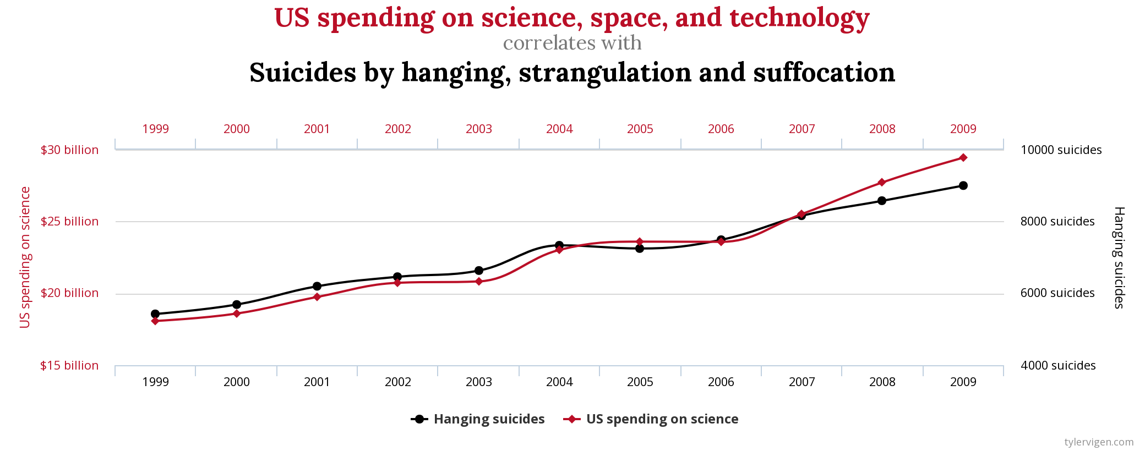
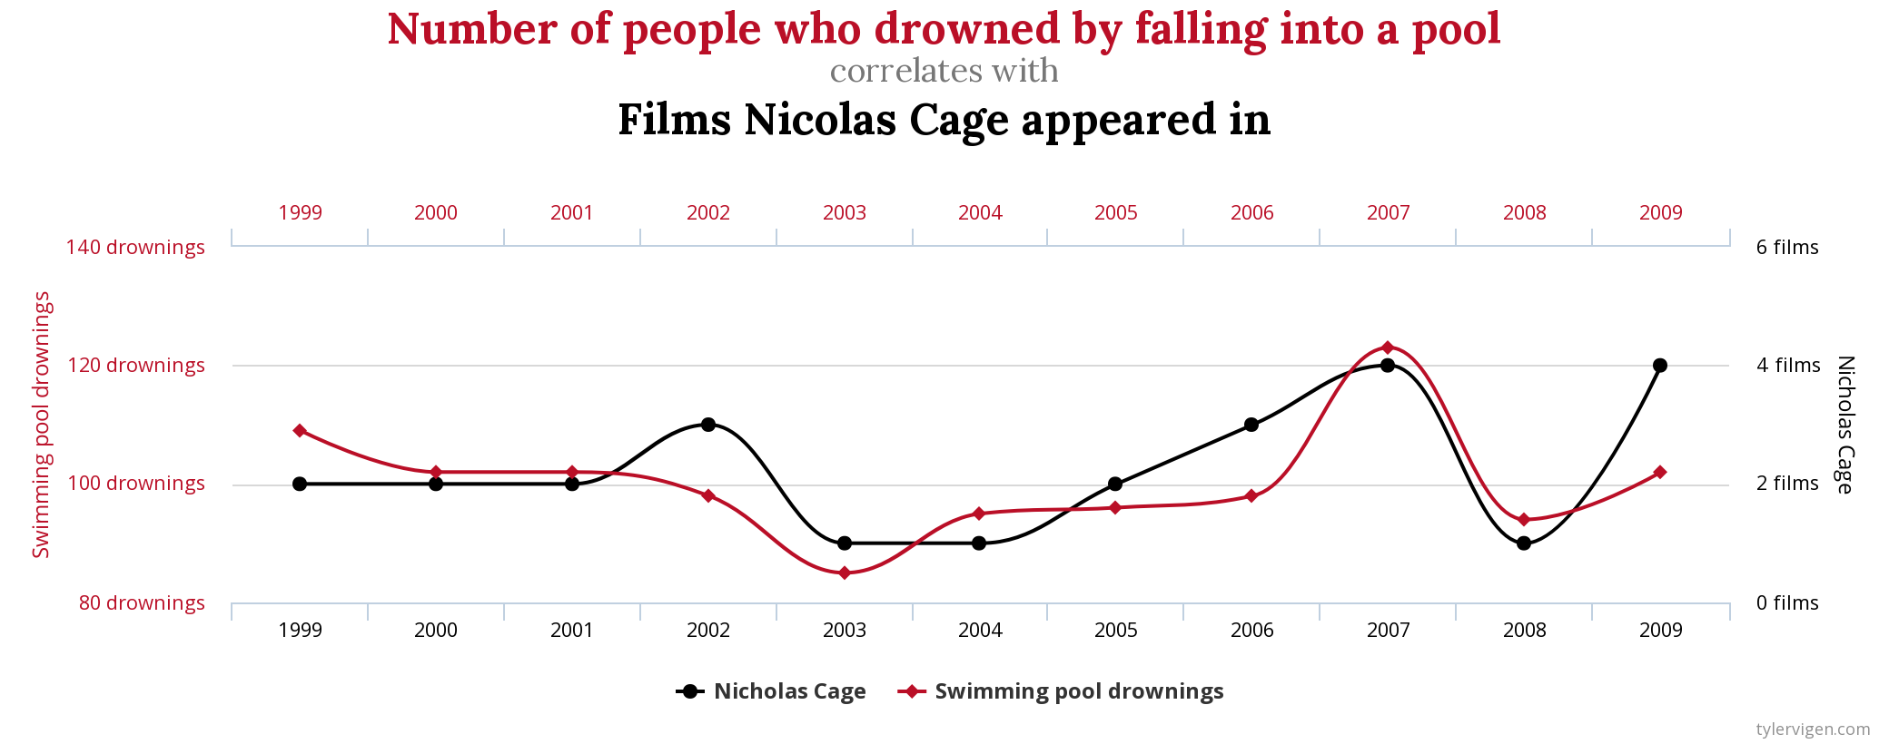
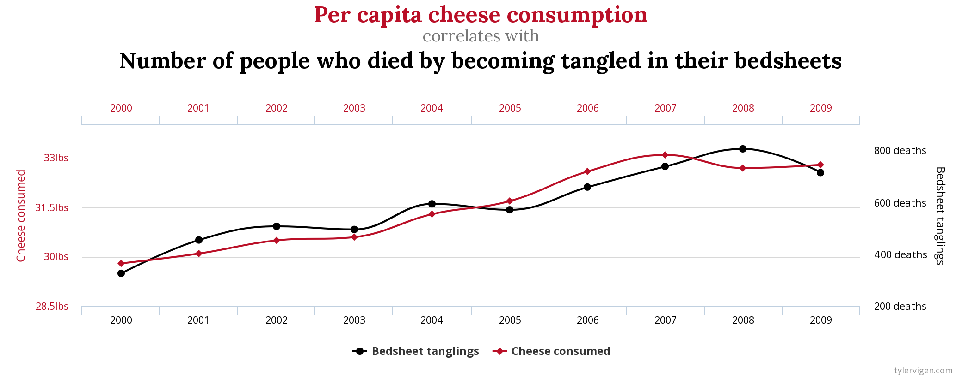
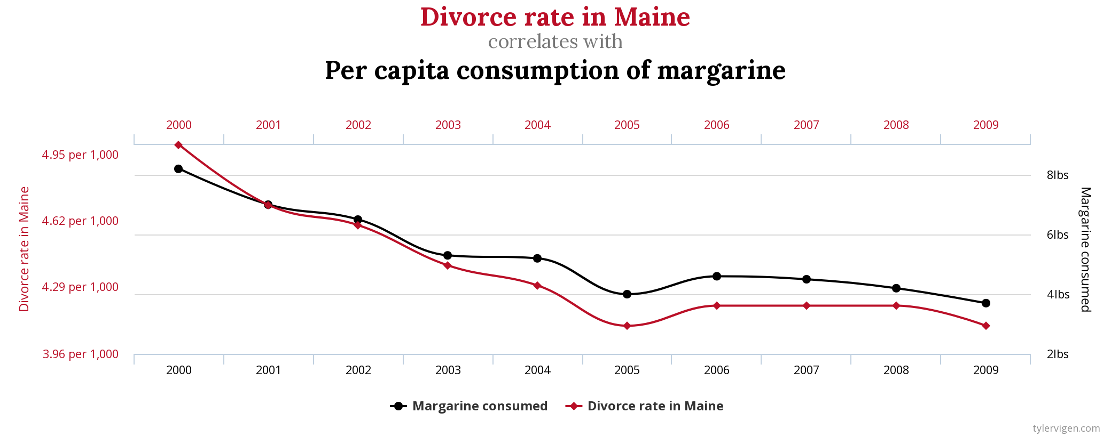
Spurious correlations
http://www.tylervigen.com/spurious-correlations

Slide 27
Spurious correlations
http://www.tylervigen.com/spurious-correlations

Slide 28
Spurious correlations
http://www.tylervigen.com/spurious-correlations

Slide 29
What’s driving increases in MSSA and E. coli BSI?

Slide 30
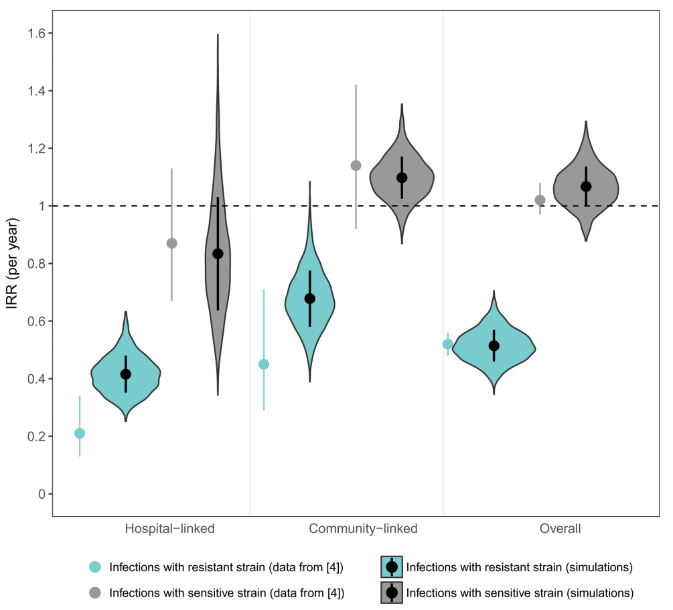
Why antibiotic susceptible bacteria are resistant to hospital-based IPC intervention
Mathematical model to investigate transmission in hospitals and their surrounding catchment area.
Included a competitive advantage for resistant bacteria in hospitals and sensitive bacteria in the community.
Modelling the impact of improving hand hygiene by 10%.
Antibiotic-resistant bacteria were disproportionately affected in hospitals!
van Kleef et al. BMC Infect Dis 2013;13:294.

Slide 31
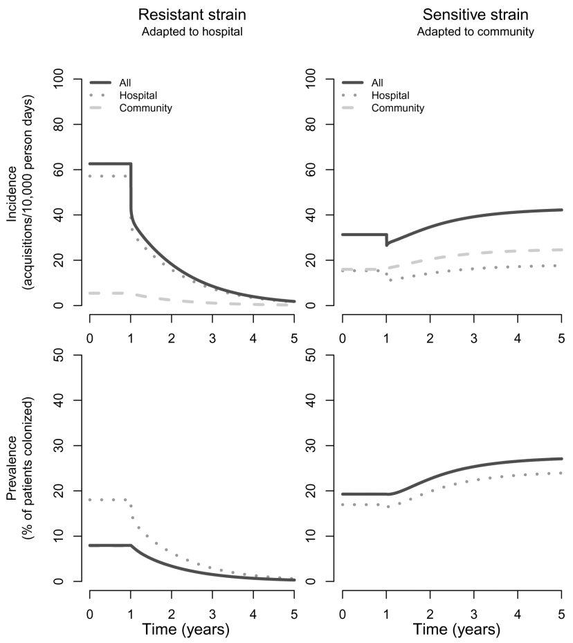
Why antibiotic susceptible bacteria are resistant to hospital-based IPC intervention
van Kleef et al. BMC Infect Dis 2013;13:294.

Slide 32
MRSA bacteraemia, England 2001-2013
4
5
6
Mandatory reporting, 2001
‘Getting ahead of the curve’, 2002
‘Winning ways’, 2003
‘Towards cleaner hospitals’, 2004
‘Cleanyourhands’, 2004
Targets introduced, 2004
Cleanliness improvement, 2005
‘Going further faster’, 2006
Root cause analysis, 2006
Revised national guidelines, 2006
Deep clean, 2007
Screening elective admissions, 2008
Universal screening, 2010
8
9
10
3
7
1
2
11
12
13

Slide 33
Targeted approach to MRSA infection prevention
Reduction targets introduced in 2004 and reinforced in 2006
High impact interventions launched in 2006
Root cause analysis launched in 2006
Revised national guidelines launched in 2006 (including screening, isolation, and suppression for carriers)

Slide 34
‘Going further faster’ (2006)
Key challenge | Specific Focus
Challenge 1 | Engage the board and use performance management at every level
Challenge 2 | Ensure clinical ownership across organisation
Challenge 3 | Screen and/or decontaminate according to risk assessment
Challenge 4 | Use HIIs* to monitor and increase compliance
Challenge 5 | Integrate with risk and clinical governance framework
Challenge 6 | Ensure infection control is part of induction and ongoing training
Challenge 7 | Effectively coordinate bed management with infection control input
Challenge 8 | Clean and decontaminate
Challenge 9 | Proactively manage your reputation, engage all staff and local community
* HII = high impact interventions: Central venous catheter care bundle; Peripheral intravenous cannula care bundle; Renal catheter care bundle; Care bundle to prevent surgical site infection; Care bundle for ventilated patients; Urinary catheter care bundle; Care bundle to reduce the risk from Clostridium difficile.
From ‘Going further faster’

Slide 35

From ‘Going further faster’, 2006

Slide 36
Background and epi
How to tackle GNBSI
Drivers of GNBSI
Learning from G+ success?

Slide 37
Drivers of Gram-negative BSI
Lab testing
Patient sampling
Deprivation
Seasonal variation
Acquisition
Sources
Humans
Transmission routes
Hands
Environment
Animals
Food
Soil
Patient factors
Devices
AMR
Surgery & wounds
High risk patients
Hydration & UTI

Slide 38
Getting to grips with the source of E. coli BSIs
Comparing the source of 250 healthcare-associated E. coli BSIs with the national picture, 2015-2017.
Otter et al. J Hosp Infect 2018.

Slide 39
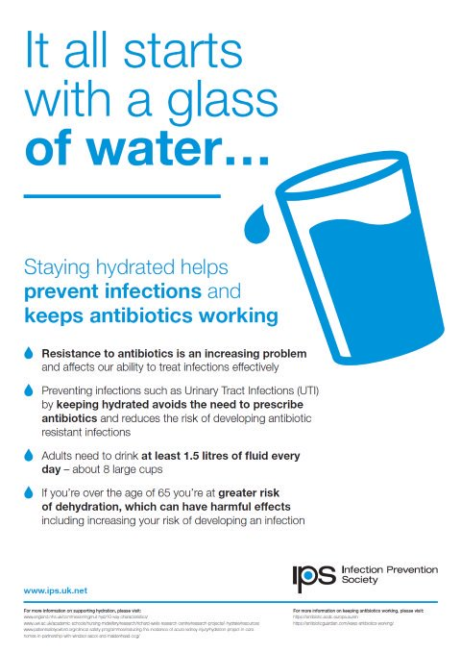
You’re givin’ me good hydration
Simple interventions (e.g. offering people a drink and giving them a choice of fluids) made a big impact on hydration levels (Wilson, Clin Nutr, 2019)

Slide 40
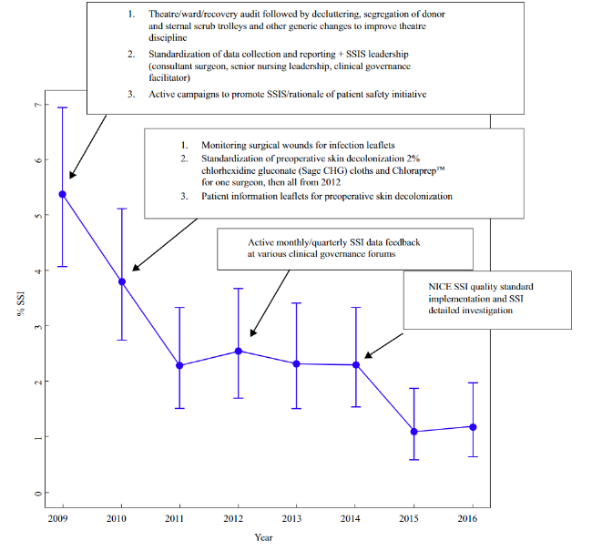
Prevent preventable SSIs
% patients with SSI following cardiothoracic surgery.
Chiwera et al. J Hosp Infect 2018.

Slide 41
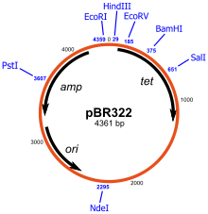


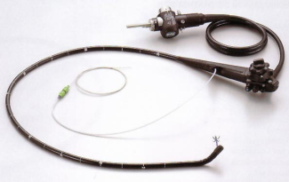

Transmission modes of Gram-negative bacteria
Otter et al. Infect Control Hosp Epidemiol 2011;32:687-699.

Slide 42
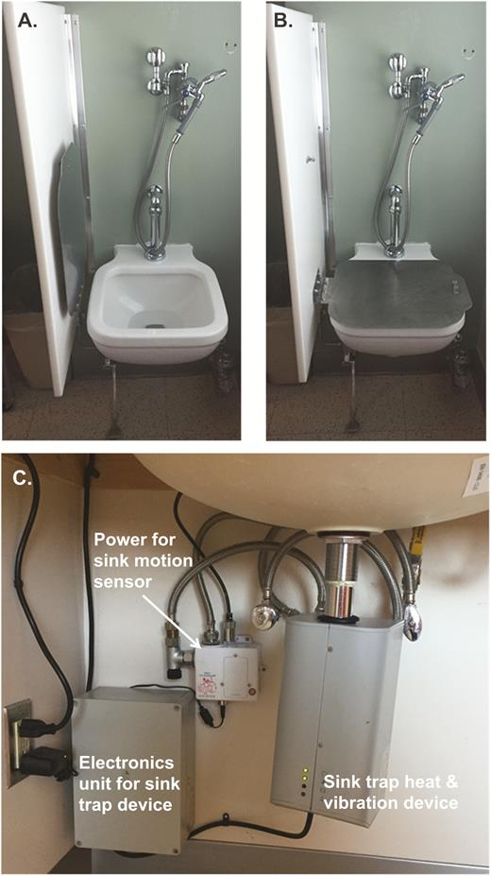
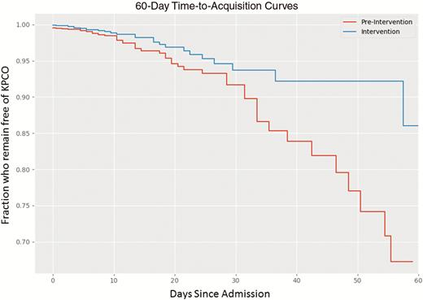
Contaminated sinks / drains
CPE (K. pneumoniae) acquisition and clinical infection halved through improved management of sinks (OR = 0.51 for acquisions, and 0.29 for clinical cultures) (n=~7,500 pts).
Mathers et al. Clin Infect Dis 2018 in press.

Slide 43
Transmissibility / fitness
Klebsiella species 3.7x more transmissible than E. coli in the ICU.¹
K. pneumoniae seems to be more environmental than E. coli.^{2,3}
Conclusion
Surface contamination on five standardized sites surrounding patients infected or colonized with ESBL-producing Klebsiella spp. (n=48) or ESBL-producing E. coli (n=46).²
p<0.001
p<0.001
1. Gurieva et al. Clin Infect Dis 2018;66:489-93. 2. Guet-Revillet et al. Am J Infect Control 2012;40:845-8.
3. Gbaguidi-Haore. Am J Infect Cont 2013;41:664-5.
Notes:
43
Inter-species variation? Inter-carbapenemase variation?

Slide 44
Background and epi
How to tackle GNBSI
Drivers of GNBSI
Learning from G+ success?

Slide 45
GNBSI

Slide 46
Getting to grips with healthcare-associated Gram-negative bloodstream infection?
Jon Otter, PhD FRCPath
Imperial College London
j.otter@imperial.ac.uk
@jonotter
Blog: www.ReflectionsIPC.com

