Slide 1

Automated room decontamination: Ready for the big time?
Jon Otter, PhD FRCPath
Imperial College London
j.otter@imperial.ac.uk
@jonotter
Blog: www.ReflectionsIPC.com
You can download these slides from: www.jonotter.net

Slide 2
There’s a problem lurking in your hospital room
Manual approaches are doomed to failure
ARD* systems work
ARD systems are feasible & cost-effective
HPV, UV, both, or other?
* ARD = automated room decontamination.

Slide 3
There’s a problem lurking in your hospital room
Manual approaches are doomed to failure
ARD* systems work
ARD systems are feasible & cost-effective
HPV, UV, both, or other?
* ARD = automated room decontamination.

Slide 4
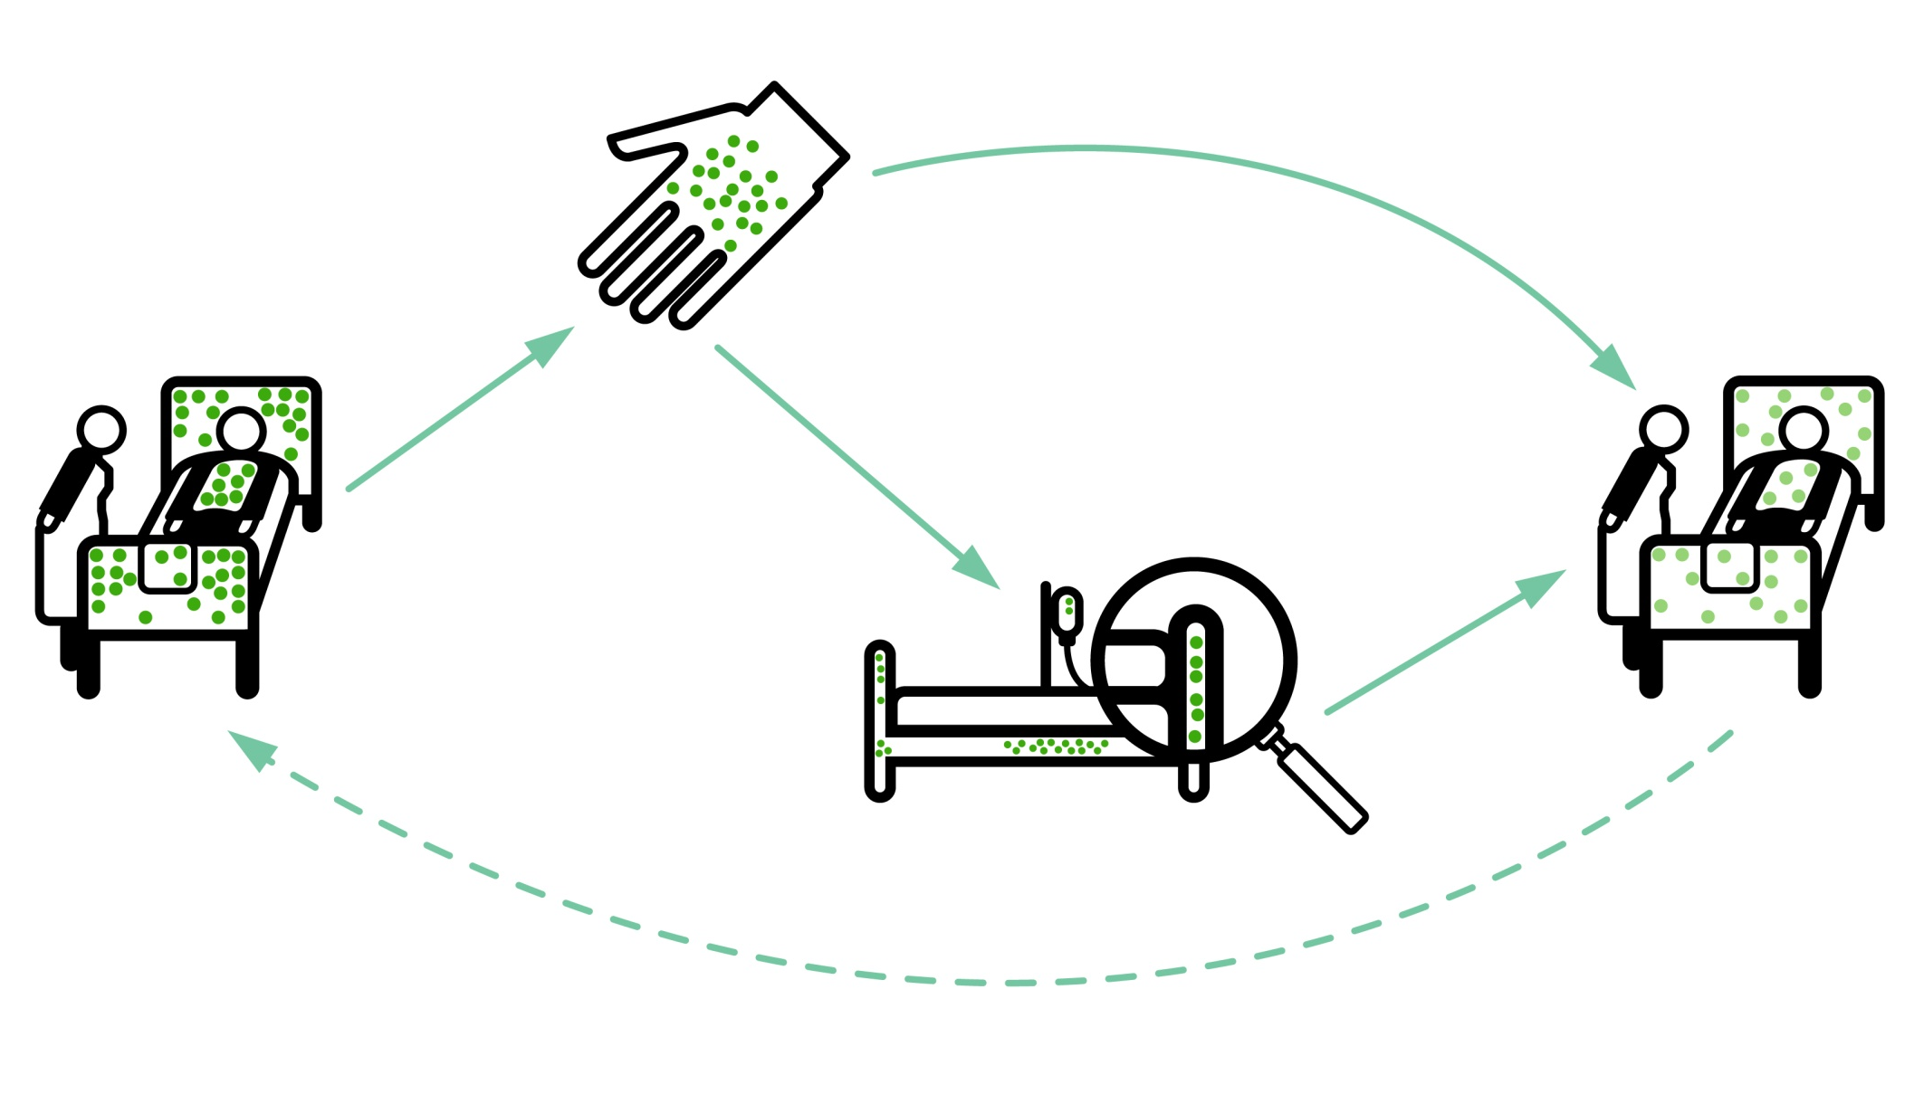
Transmission routes
Otter et al. Infect Control Hosp Epidemiol 2011;32:687-699.

Slide 5

Your hospital room can make you sick!
Mitchell et al. J Hosp Infect 2015;91:211-217.

Slide 6
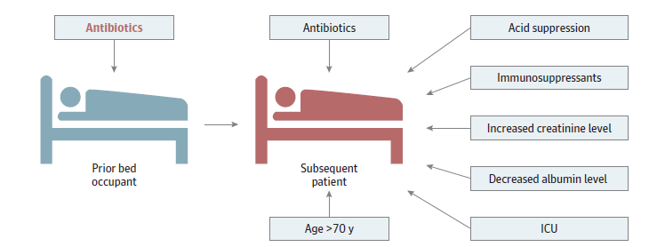
Chased by an antibiotic-induced C.difficile-shaped shadow!
Significant risk factors for CDI.
Freedberg et al. JAMA Intern Med 2016 in press.

Slide 7

86%
58%
93%
85%
59%
French et al. J Hosp Infect 2004;57:31-37.
96%

Slide 8
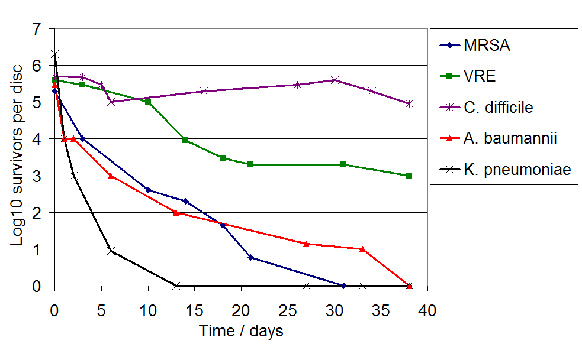
Surface survival
1400
Otter and French. J Clin Microbiol 2009;47:205-207.
Wagenvoort et al. J Hosp Infect 2011;77:282-283.

Slide 9



Surface -> Hand -> Patient
Pathogens can be transferred from surfaces to HCW hands without direct patient contact¹⁻²
52% of 23 HCW acquired VRE on their hands³ | Contact with patient or surface = ~10% risk of acquiring VRE³
45% of 50 HCW acquired MRSA on their hands⁴ | 40% of 50 HCW acquired MRSA on their hands⁴
50% of 30 HCW acquired C. difficile on their hands⁵ | 50% of 30 HCW acquired C. difficile on their hands⁵
Compliance with hand hygiene: 50%⁶ | Compliance with hand hygiene: 80%⁶
Boyce et al. Infect Control Hosp Epidemiol 1997;18:622-627.
Bhalla et al. Infect Cont Hosp Epidemiol 2004;25:164-167.
Hayden et al. Infect Control Hosp Epidemiol 2008;29:149-154.
Stiefel et al. Infect Control Hosp Epidemiol 2011;32:185-187.
Guerrero et al. Am J Infect Control 2012;40:556-558.
Randle et al. J Hosp Infect 2010;76:252-255.

Slide 10
How good is “good enough”?
Disinfection = to reduce contamination to ‘safe’ levels.
Pragmatist | Prior room occupantist
A reduction in contamination is good enough. A low level of residual contamination with pathogens represents a negligible risk and is acceptable. | Each patient should be admitted into a room free from contamination with pathogens. Residual contamination at any level represents unacceptable risk.

Slide 11
Decontamination level ∝ transmission reduction
Transmission
Contamination level

Slide 12
Lawley et al. Appl Environ Microbiol 2010;76:6895-6900.

Slide 13
An environmental ‘dose-response’?
Setting & design: 14-month prospective study on 2 ICUs, Boston, USA.
Methods: All patients were screened on admission and twice weekly, and the environment was screened weekly for VRE. The 50 patients who acquired VRE were compared with the 588 who did not.
Independent predictors of VRE acquisition
VRE colonised prior room occupant
VRE colonised occupant in the prior 2 weeks
Hazard ratio
Drees et al. Clin Infect Dis 2008;46:678-685.

Slide 14
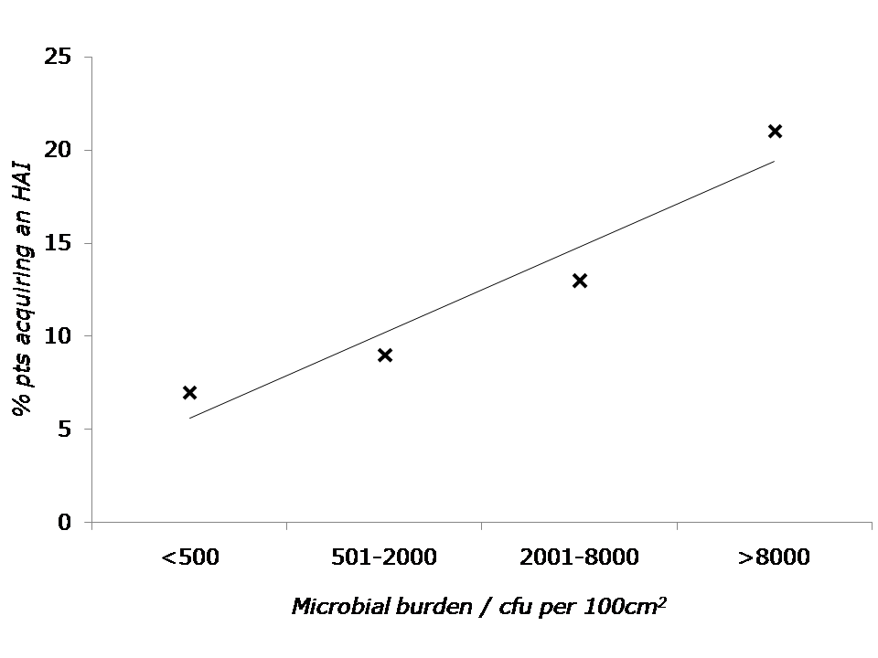
An environmental ‘dose-response’?
There was a significant correlation between burden and HAI risk (p=0.038).
Salgado et al. Infect Control Hosp Epidemiol 2013;34:479-486.

Slide 15
Is there a “safe” level of surface contamination?
Pathogen | Amount shed | Minimum infectious dose
Norovirus | Up to 10¹² per g faeces | 1-100
C. difficile | Up to 10⁹ per g faeces | 1 cfu / cm²
S. aureus | Up to 10⁷ per g faeces | <15 cfu
Otter et al. Infect Control Hosp Epidemiol 2011;32:687-699.

Slide 16
Amount shed 1,000,000,000,000
Minimum infectious dose
1
Otter et al. Infect Control Hosp Epidemiol 2011;32:687-699.

Slide 17
There’s a problem lurking in your hospital room
Manual approaches are doomed to failure
ARD* systems work
ARD systems are feasible & cost-effective
HPV, UV, both, or other?
* ARD = automated room decontamination.

Slide 18
Conventional terminal decontamination
Notes:
Studies that have evaluated the effectiveness of terminal cleaning and disinfection have consistently demonstrated that conventional methods fail to eliminate reliably contamination with pathogens.

Slide 19
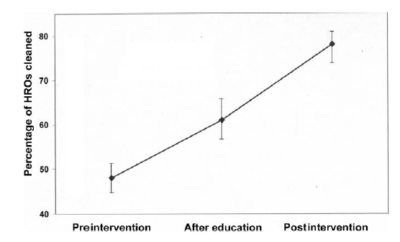
But we can do better (to a point)
Increase in cleaning performance in 36 acute hospitals judged by removal of fluorescent markers from high-risk objects.
>20% of high-risk objects not even touched, let alone disinfected!
Carling et al. Infect Control Hosp Epidemiol 2008;29:1035-41.

Slide 20
Persistent contamination
140 samples from 9 rooms after 2xbleach
5705 samples from 312 rooms after 4xbleach
HPV
26.6% of rooms remained contaminated with either MRSA or A. baumannii following 4 rounds of bleach disinfection
Manian et al. Infect Control Hosp Epidemiol 2011;32:667-672.

Slide 21
Cleaning / disinfection failure
External
Product
Procedure

Slide 22
There’s a problem lurking in your hospital room
Manual approaches are doomed to failure
ARD* systems work
ARD systems are feasible & cost-effective
HPV, UV, both, or other?
* ARD = automated room decontamination.

Slide 23
‘Given the choice of improving technology or improving human behavior, technology is the better choice’.
Dr Bob Weinstein
Weinstein RA. Emerg Infect Dis 1998;4:416-420.

Slide 24


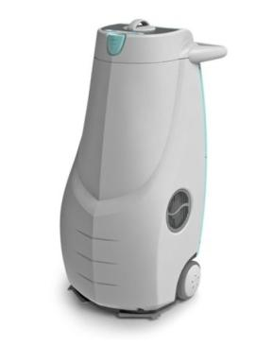
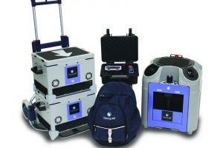
Automated room decontamination (ARD)
Hydrogen peroxide vapour
30% H₂O₂ (HPV)
Aerosolised hydrogen peroxide 5-6% H₂O₂ (AHP)
Ultraviolet radiation (UVC)
Pulsed-xenon UV (PX-UV)
Otter et al. J Hosp Infect 2013;83:1-13.

Slide 25
ARD systems - overview
 | HPV 30-35% H₂O₂ vapour* | AHP 5-6% H₂O₂ + Ag aerosol | UVC UVC (280 nm) | PX-UV Pulsed-xenon UV
Efficacy | 1 >6-log reduction | 2 ~4-log reduction | 3 ~2-4 log reduction | 4 ~1-3 log reduction
Distribution | 1 Homogeneous | 2 Non-homogenous | 3 Line of sight issues | 3 Line of sight issues
Ease of use | 4 Multiple units; sealing / monitoring | 3 Sealing & monitoring | 2 Multiple positions; no sealing / monitoring | 2 Multiple positions; no sealing / monitoring
Cycle time | 3 ~1.5 hrs single room | 4 >2 hrs single room | 1 ~10-30 mins | 1 ~10-30 mins
Purchase cost | 2 | 1 | 3 | 3
Running cost | 4 | 3 | 1 | 1
* Emerging evidence that low concentration hydrogen peroxide / peracetic acid combination can reach similar levels of efficacy to high concentration hydrogen peroxide (Mana et al. Am J Infect Control 2017;45:327-329)..
Otter et al. J Hosp Infect 2013;83:1-13.

Slide 26
Persistent contamination – sorted!
140 samples from 9 rooms after 2xbleach
5705 samples from 312 rooms after 4xbleach
2680 sites from 134 rooms after HPV
HPV
Manian et al. Infect Control Hosp Epidemiol 2011;32:667-672.

Slide 27
HPV vs. AHP
Room
Bathroom
‘Challenge’
Soiled
HPV
AHP
* BSA = bovine serum albumin.
BSA*, room
BSA, bathroom
Fu et al. J Hosp Infect 2012;80:199-205.

Slide 28
UVC vs. PX-UV
Log reductions achieved by a UVC (Tru-D) device and PX-UV (Xenex) when run for 10 mins from the same point in the room 4ft from the coupons.
PX-UV
Nerandzic et al. Infect Control Hosp Epidemiol 2015;36:192-197.

Slide 29
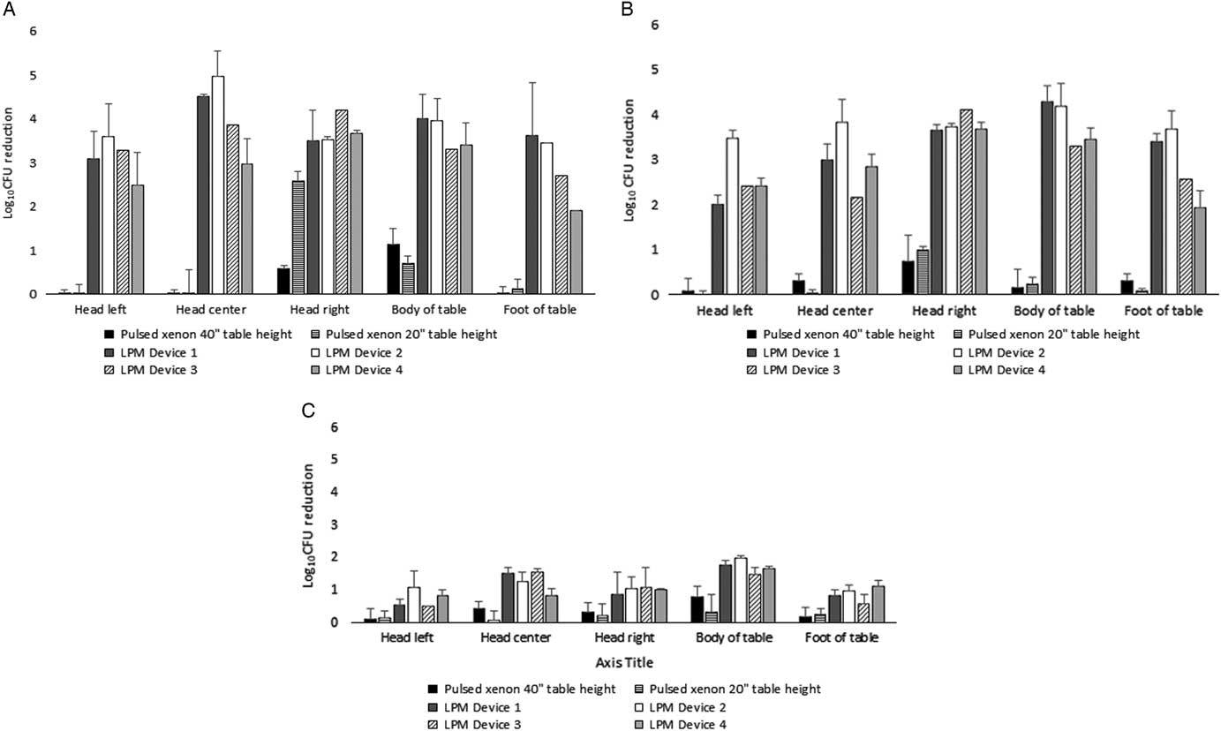
UVC vs. UVC vs. PX-UV
Log reductions achieved by 5 different UV systems. Inoculated discs were located at various points in the room. The devices were placed in a standardised location (to the extent possible), and operated for the same duration (4 minutes).
MRSA
VRE
C. difficile spores
Cadnam et al. Infect Control Hosp Epidemiol 2019;40:158-163.

Slide 30
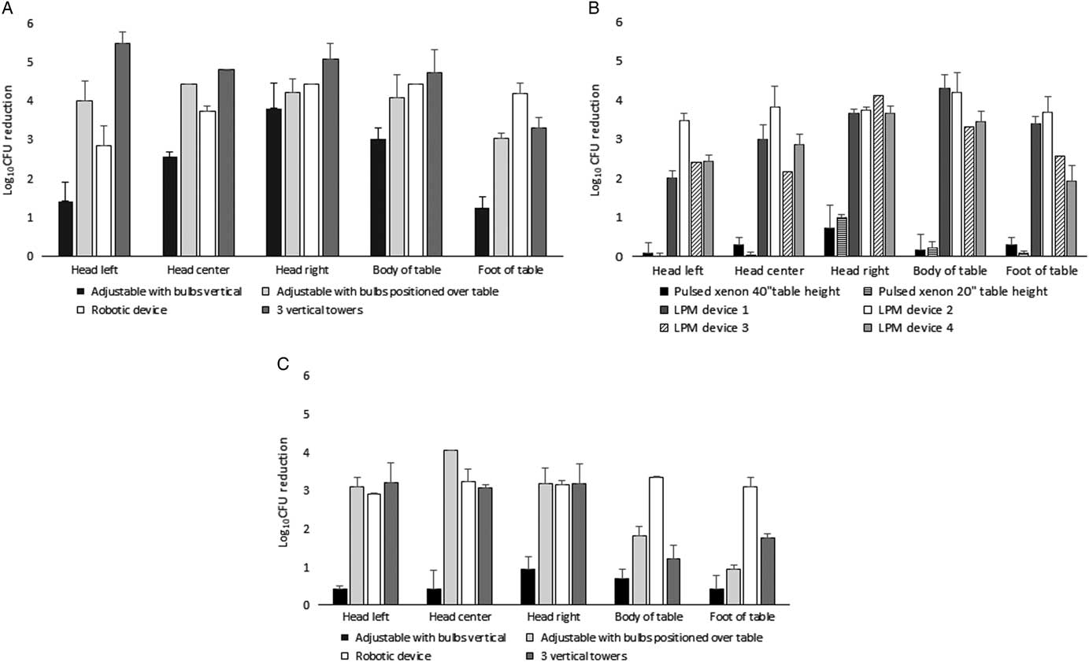
UVC vs. UVC vs. PX-UV
Log reductions achieved by 5 different UV systems. Inoculated discs were located at various points in the room. The devices were placed in a standardised location (to the extent possible), and operated for the same duration (4 minutes).
MRSA
VRE
C. difficile spores
Cadnam et al. Infect Control Hosp Epidemiol 2019;40:158-163.

Slide 31
UVC: clinical impact
Cluster randomised study over >2 years across 9 hospitals including >25,000 exposed patients (admitted into a room where the previous occupant was known to have an MDRO). * = statistically significant reduction in the per-protocol analysis. ** = statistically significant when rooms occupied by patients with C. difficile removed from the analysis.
**
*
*
*
*
Anderson et al. Lancet 2017;389:805-814.

Slide 32
UVC: clinical impact
Cluster randomised study over >2 years across 9 hospitals including 300,000 admissions. Incidence of hospital acquisition of target multidrug-resistant organisms compared with standard manual disinfection (the reference group).
Organism | Relative risk (95% CI); p value
All target organisms | 0.89 (0.79 to 1.00); 0.052
Clostridium difficile | 0.89 (0.80 to 0.99); 0031
MRSA | 1.08 (0.89 to 1.30); 0.42
VRE | 0.56 (0.31 to 0.996); 0.048
MDR Acinetobacter | 0.10 (−0.07 to 0.28); n/a.
Anderson et al. Lancet Infect Dis 2018;18:845–853.

Slide 33
HPV: clinical impact
Patients admitted to rooms decontaminated using HPV were 64% less likely to acquire any MDRO (incidence rate ratio [IRR]=0.36, CI=0.19-0.70, p<0.001)*
* The difference between cohorts was adjusted for patient level variables such as length of stay, morbidities and other variables that could explain the difference. This means that the difference between cohorts is attributable to HPV alone.
Passaretti et al. Clin Infect Dis 2013;56:27-35.

Slide 34

HPV: clinical impact
2 years before HPV, 2 years during HPV. Breakpoint model indicated significant reduction in rate of CDI when HPV implemented (1.0 to 0.4 per 1000 patient days, 60% reduction).
McCord et al. J Hosp Infect 2016;94:185-7.

Slide 35
HPV: clinical impact
Study | ARD system | Design | Outcome | Confounders
McCord 2016 | HPV | 4 year before-after | CDI rate fell from 1.0 to 0.4 cases per 1,000 pt days; 60% reduction, p<0.001. | No data on IPC compliance / abx use.
Horn 2015 | HPV | 3 year before-after | CDI, VRE, ESBL and MRSA rate fell significantly. | Concurrent increase in hand hygiene compliance.
Passaretti 2013 | HPV | 36 month cohort | Pts admitted to rooms decontaminated using HPV 64% less likely to acquire MDRO (IRR=0.36, CI=0.19-0.70, p<0.001). | Not randomised.
Manian 2013 | HPV | 2 year before-after | CDI rate fell from 0.9 to 0.5 cases per 1,000 pt days; 39% reduction (IRR=0.63, CI=0.50-0.79, p<0.001). | Bleach disinfection enhanced concurrently.
Boyce 2008 | HPV | 2 year before-after | CDI rate fell from 1.9 to 0.9 cases per 1,000 pt days on high-risk wards; 53% reduction, p=0.047). | Outbreak? No significant reduction hospital wide; changes in abx usage.

Slide 36
UV: clinical impact
Study | ARD system | Design | Outcome | Confounders
Pavia 2018 | UVC | 2 yr before-after | Significant reduction in viral infection in a paediatric long term care unit | No other concurrent interventions
Anderson 2016 | UVC | Cluster RCT | Significant MDRO acquisition reduction on an individual and hospital level | Monitored potential confounders
Pegues 2016 | UVC | 2 yr before -after | Significant reduction in C. difficile compared with control wards | Monitored potential confounders
Vianna 2016 | PX-UV | 4 yr before - after | Significant reductions of C. difficile (hospital-wide) and VRE (ICU) | No data on IPC compliance / abx use.
Catalanotti 2016 | PX-UV | 4 yr before - after | Significant reduction in class I (clean) SSI. | Dedicated housekeeper.
Fornwalt 2016 | PX-UV | 2 yr before -after | Significant reduction in hip and knee SSIs. | QIP programme including PX-UV.
Napolitano 2015 | UVC | 3 yr before -after | Significant reduction in the incidence of HAI. | No data on IPC compliance / abx use.
Miller 2015 | PX-UV | 3 yr before -after | Significant reduction in C. difficile. | Outbreak? Patient management changes.
Haas 2014 | PX-UV | 4 yr before -after | Significant reduction in HAI. | ‘Many simultaneous interventions’.
Levin 2013 | PX-UV | 2 yr before -after | Significant reduction in C. difficile. | Abx changes.
Simmons 2013 | PX-UV | 3 yr before -after | Significant reduction in MRSA. | Bundled intervention.

Slide 37
UV: clinical impact
Study | ARD system | Design | Outcome | Confounders
Pavia 2018 | UVC | 2 yr before-after | Significant reduction in viral infection in a paediatric long term care unit | No other concurrent interventions
Anderson 2016 | UVC | Cluster RCT | Significant MDRO acquisition reduction on an individual and hospital level | Monitored potential confounders
Pegues 2016 | UVC | 2 yr before -after | Significant reduction in C. difficile compared with control wards | Monitored potential confounders
Vianna 2016 | PX-UV | 4 yr before - after | Significant reductions of C. difficile (hospital-wide) and VRE (ICU) | No data on IPC compliance / abx use.
Catalanotti 2016 | PX-UV | 4 yr before - after | Significant reduction in class I (clean) SSI. | Dedicated housekeeper.
Fornwalt 2016 | PX-UV | 2 yr before -after | Significant reduction in hip and knee SSIs. | QIP programme including PX-UV.
Napolitano 2015 | UVC | 3 yr before -after | Significant reduction in the incidence of HAI. | No data on IPC compliance / abx use.
Miller 2015 | PX-UV | 3 yr before -after | Significant reduction in C. difficile. | Outbreak? Patient management changes.
Haas 2014 | PX-UV | 4 yr before -after | Significant reduction in HAI. | ‘Many simultaneous interventions’.
Levin 2013 | PX-UV | 2 yr before -after | Significant reduction in C. difficile. | Abx changes.
Simmons 2013 | PX-UV | 3 yr before -after | Significant reduction in MRSA. | Bundled intervention.

Slide 38
There’s a problem lurking in your hospital room
Manual approaches are doomed to failure
ARD* systems work
ARD systems are feasible & cost-effective
Why we should all be enthusiasts
* ARD = automated room decontamination.

Slide 39
Feasibility and cycle times in busy hospitals
  Although bed pressures are high, rooms are rarely missed due to an immediate need to admit a new occupant.^{1,2}
    One study found that rooms remainted vacant for a median of 2 hours after HPV.¹
  HPV is faster than often cited (around 1.5 hour cycle time).¹⁻⁵
  UV systems may bridge a ‘technology gap’ and facilitate ARD of a much wider proportion of discharges, with a minimal addition to mean turnaround time.⁶⁻⁷
  Staff acceptability of ARD systems is better than you may think.
Regular use of ARD systems in busy hospitals is feasible
Otter et al. Infect Control Hosp Epidemiol 2009;30:574-577.
Passaretti et al. Clin Infect Dis 2013;56:27-35.
Barbut et al. Burns 2013;39:395-340.
Otter et al. J Hosp Infect 2013;83:1-13.
DoH / PASA. Bioquell SHP report, 2009.
Pegues et al. Infect Control Hosp Epidemiol 2016.
Anderson et al. Lancet accepted.

Slide 40
Compatibility of HPV with electronics
Yale New Haven Hospital (St. Raphael’s Campus) compared the frequency of calls for repair or replacement of the physiological monitors in the years before HPV (2000-2004) compared with years when HPV was used regularly to decontaminate the ICU rooms (2006-2010). The rate of service calls was significantly lower during periods when HPV was used in the CCU and SICU.
Boyce et al. Infect Control Hosp Epidemiol 2014;35:92-93.

Slide 41





Cost-perspectiveness

Slide 42
Cost-effectiveness
2 years before HPV, 2 years during HPV. Breakpoint model indicated significant reduction in rate of CDI when HPV implemented (1.0 to 0.4 per 1000 patient days, 60% reduction).
Cases averted per annum | 67
Cost range for HA-CDI | £2000-19,500
Total cost per annum | £134,000-1,306,500
Adapted with addition of cost data from McCord et al. J Hosp Infect 2016.

Slide 43
The Sceptic | The Enthusiast
You can achieve the same end by improving manual processes. | Only with a research team and a bucket of bleach; not sustainable!
Improving manual processes reduces transmission. | Introducing ARD reduces transmission further.
The quality of evidence supporting the use of ARD systems is poor; no RCTs. | Quality of evidence supporting ARDs as good if not better than for manual processes (now including an RCT!).
ARD systems are expensive. | That depends on your perspective; evidence they are cost-effective.
We should invest in other solutions before ARD systems. | Is that your opinion or do you have a detailed cost-effectiveness evaluation?
I’d much rather employ another domestic. | ARD systems offer something different, to augment existing processes.
ARD systems are not feasible in the busy hospital environment. | ARD systems can be adopted with little operational impact, and will have long term gains in throughput.
ARD systems are not safe and will eat my equipment. | ARD systems are safe (if used correctly) and no worse for equipment than, say, bleach.

Slide 44
There’s a problem lurking in your hospital room
Manual approaches are doomed to failure
ARD* systems work
ARD systems are feasible & cost-effective
HPV, UV, both, or other?
* ARD = automated room decontamination.

Slide 45

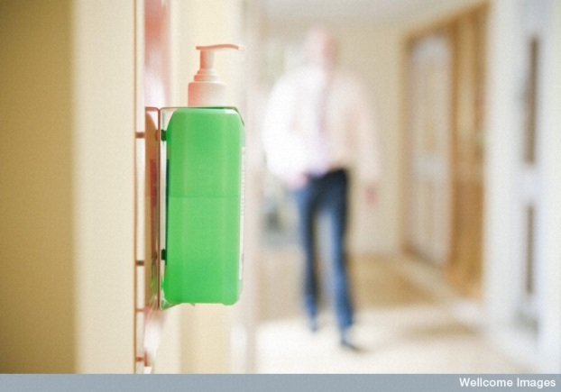
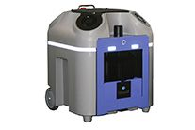
Hand washing with soap and water is to alcohol gel what HPV is to UV
Faster, easier, but less effective

Slide 46
UVC vs. HPV
Characteristics | HPV | UV systems
Cycle time (for single room) | 90 mins | 15 mins to >1hr
Practicalities | Door and air vent sealing and leak detection required | No door and air vent sealing or leak detection required
Distribution | Homogeneous | Affected by line of sight
Microbiological efficacy | Elimination of pathogens from surfaces; 6-log sporicidal reduction | Does not eliminate pathogens from surfaces; 1-3 log sporicidal reduction
Cost | Lower purchase cost; higher running costs | Higher purchase cost; lower running costs
Otter et al. J Hosp Infect 2013;83:1-13.

Slide 47


Slide 48
Automated room decontamination: Ready for the big time?
Jon Otter, PhD FRCPath
Imperial College London
j.otter@imperial.ac.uk
@jonotter
Blog: www.ReflectionsIPC.com
You can download these slides from: www.jonotter.net

