Slide 1
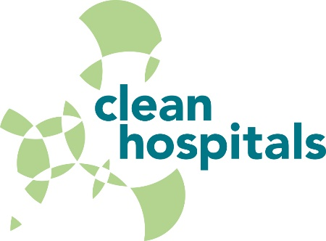


Cost and value of environmental hygiene in hospitals
Jon Otter, PhD FRCPath
Imperial College London
j.otter@imperial.ac.uk
@jonotter
Blog: www.ReflectionsIPC.com
Slides: www.jonotter.net
Notes:
Counting the cost of HCAI and AMR
Finanical considerations for a hospital cleaning and disinfection service
The cost-effectiveness of hospital cleaning and disinfection
Building the business case for hospital cleaning and disinfection

Slide 2
The cost of failure
Cost & cost-effectiveness
The evidence
The challenge
The business case

Slide 3
The cost of failure
Cost & cost-effectiveness
The evidence
The challenge
The business case

Slide 4
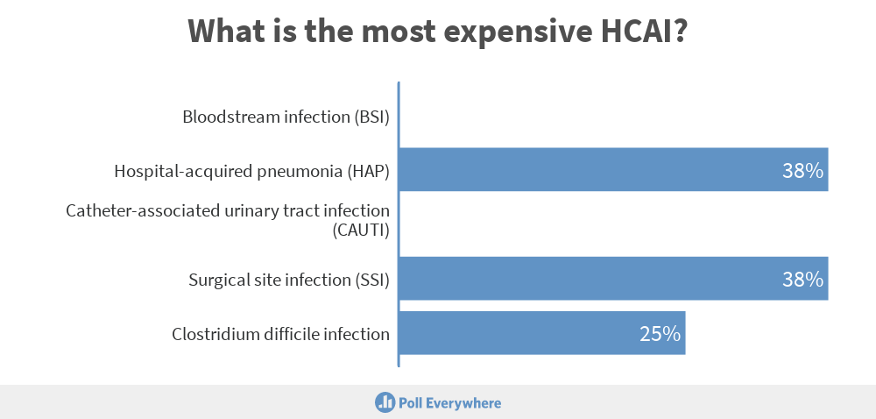

Slide 5
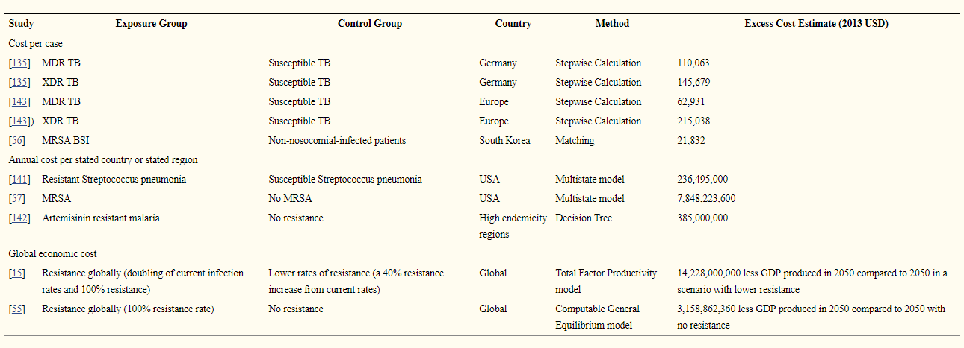
The cost and economic burden of AMR
Naylor et al. ARIC 2018.

Slide 6
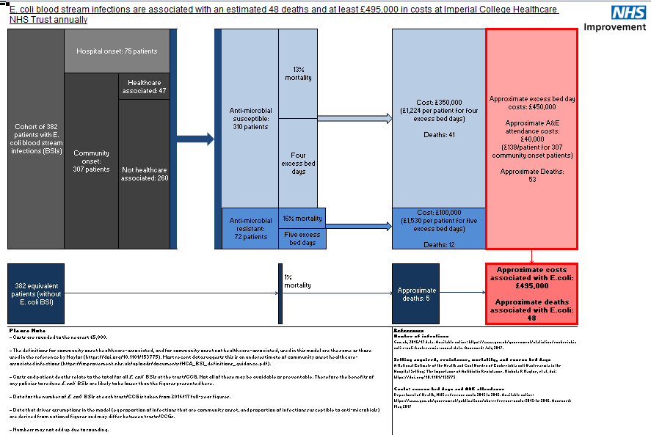
NHSI E. coli BSI cost calculator.

Slide 7
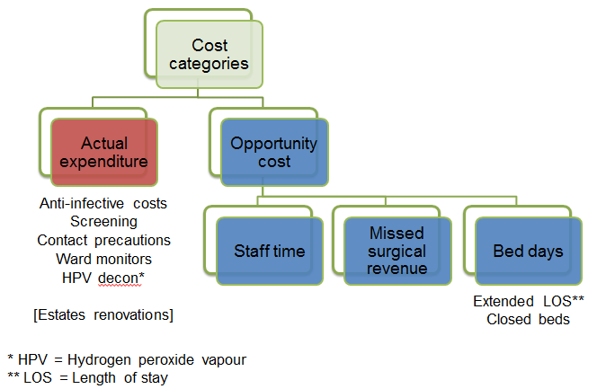
Cost of an outbreak - methods

Slide 8








Cost of an outbreak - results
Economic evaluation of a 40 case outbreak of CPE. Error bars represent range
Otter et al. Clin Microbiol Infect 2017.

Slide 9
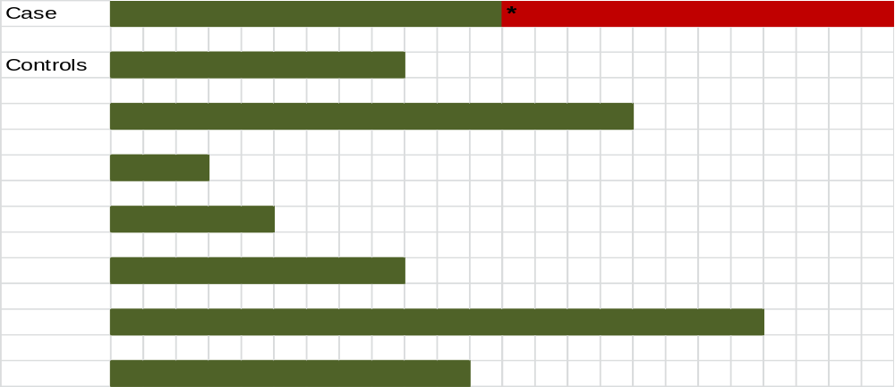
Adjusting for time to event
Timepoint at which the case acquired the pathogen
Nelson et al. Infect Control Hosp Epidemiol 2015;36:1089-94.

Slide 10

The most expensive HCAI is…HAP!
Cassini et al. Plos Med 2016.

Slide 11
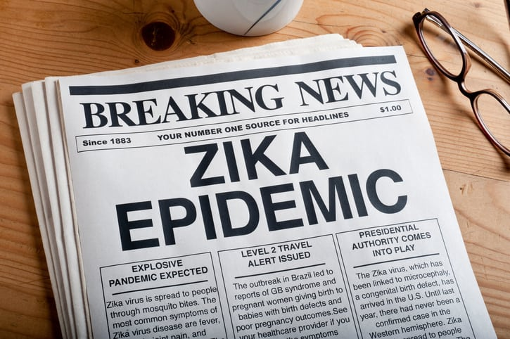


Non-financial / indirect costs of HCAI

Slide 12
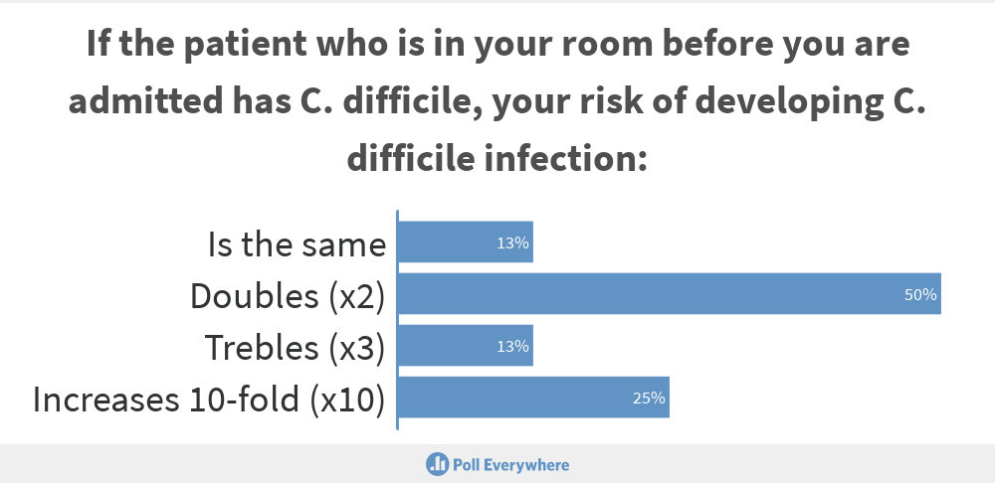

Slide 13
The cost of failure
Cost & cost-effectiveness
The evidence
The challenge
The business case

Slide 14

Your hospital room can make you sick!
Mitchell et al. J Hosp Infect 2015;91:211-217.

Slide 15
Hospital cleaning and disinfection works
Key studies illustrating the impact of improved cleaning and disinfection
Author/year | Design | Result
Dancer et al. 2009 | Cross-over study of extra ward cleaner | 27% reduction in MRSA infection
Orenstein et al. 2011 | Before-after study of disinfectant wipes | HCAI reduced from 2.4 to 0.4 per 1000 patient days
Datta et al. 2011 | Cohort intervention study of enhanced disinfection | Significant reduction in VRE acquisition from the prior room occupant
Anderson et al. 2017 | Cluster RCT of UVC room disinfection | Significant reduction in MDRO acquisition from the prior room occupant
Mitchell et al. 2019 | Cluster RCT of cleaning bundle | Improved rate of cleaning high touch items and reduced incidence of VRE

Slide 16
The cost of failure
Cost & cost-effectiveness
The evidence
The challenge
The business case

Slide 17
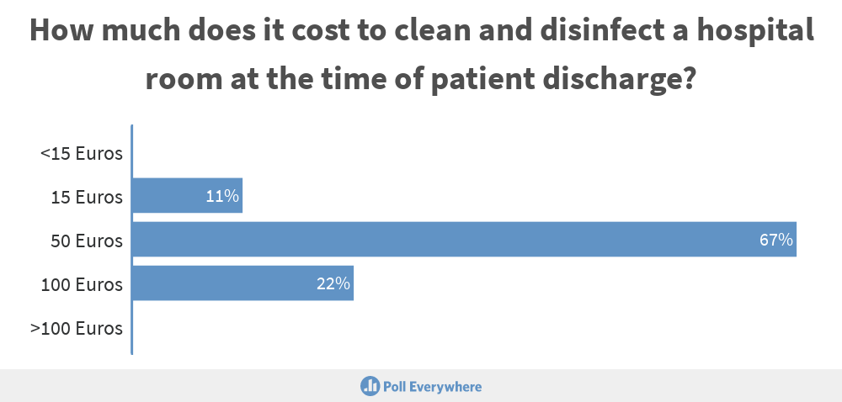

Slide 18
How much does it cost to clean a hospital room?
Includes staff cost + equipment + consumables for each method.
Doan et al. J Hosp Infect 2012;82:114-21.

Slide 19
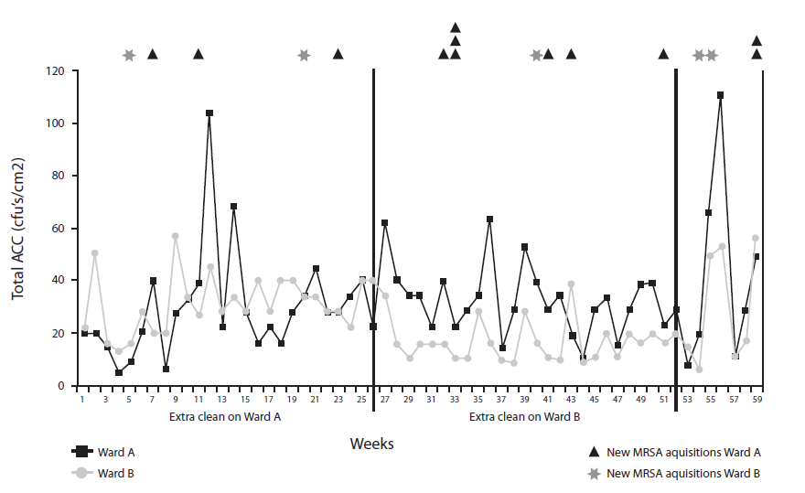
The cost-effectiveness of cleaning (MRSA)
The impact of an extra cleaner was modelled in a 12 month ward cross-over study. The cleaner cost £12k per year, and each MRSA infection was assumed to cost £9k.
MRSA infection
-27%
Financial position
+£30k to +£70k
Dancer et al. BMC Med 2009;7:28.

Slide 20

Cost-effectiveness modelling (C. difficile)
2 years before HPV, 2 years during HPV. Breakpoint model indicated significant reduction in rate of CDI when HPV implemented (1.0 to 0.4 per 1000 patient days, 60% reduction).
Cases averted per annum | 67
Cost range for HA-CDI | £2000-19,500
Total cost per annum | £134,000-1,306,500
Adapted from McCord et al. J Hosp Infect 2016 with cost information from Gabriel et al. J Hosp Infect 2014.

Slide 21
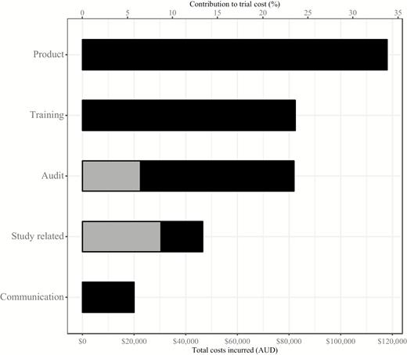
The cost-effectiveness of a cleaning bundle
Cost-effectiveness analysis of a randomised controlled trial of a cleaning bundle to reduce HCAI in 11 Australian hospitals.
Implementing the cleaning bundle cost AUD$349,000 and generated AUD$147,500 in cost savings.
Infections prevented under the cleaning bundle returned a net monetary benefit of AUD$1.02 million and an incremental cost-effectiveness ratio of $4,684 per QALY gained.
There was an 86% chance that the bundle was cost-effective compared with existing hospital cleaning practices.
Summary of trial costs: grey =
pre- intervention, black = intervention.
White et al. Clin Infect Dis 2019 in press.

Slide 22
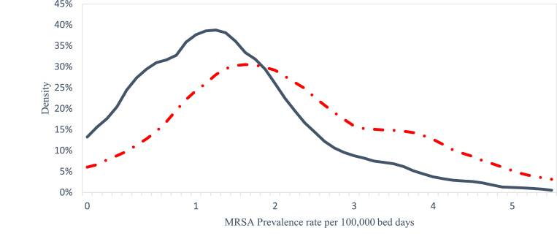
Hidden costs?
Outsourcing cleaning is an attractive and often cost-saving option. But does it pay off in the long term? Evidence from 126 English acute hospital groups suggests not. Red dashed line = density for Trusts with contracted-out cleaning services; blue line = density for Trust with in-house cleaning service.
Toffolutti et al. Soc Sci Med 2017;174:64-69.

Slide 23





Cost-perspectiveness

Slide 24
The cost of failure
Cost & cost-effectiveness
The evidence
The challenge
The business case

Slide 25
The challenge
Your ICU has had ongoing issues with
C. difficile transmission. Poor standards of cleaning feature regularly in clinical reviews of the unit. You conclude that an environmental hygiene bundle is the solution. Your mission is to convince your organisation that this is the best way forwards…

Slide 26
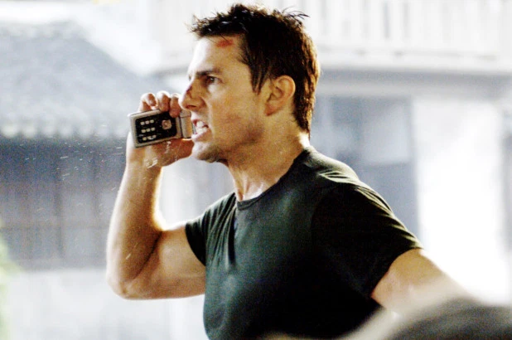

Slide 27
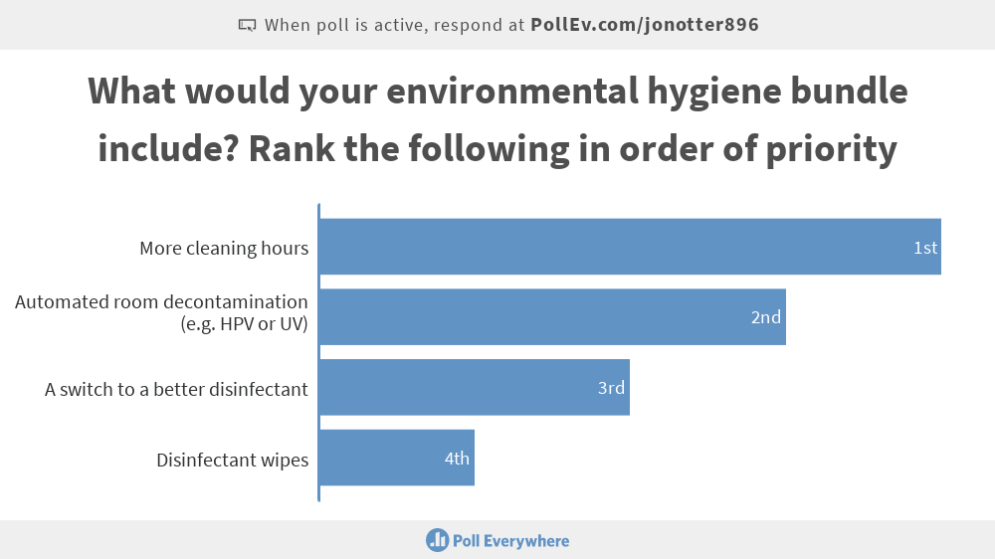

Slide 28
The cost of failure
Cost & cost-effectiveness
The evidence
The challenge
The business case

Slide 29
Financial considerations for hospital cleaning and disinfection services
Invest in quality
Tools
Innovation
Workforce
Commercial models
Training / education

Slide 30
Writing a compelling business case for cleaning and disinfection
Step 1: Frame the problem and the solution
Step 2: Discuss the case in principle with key stakeholders
Step 3: Determine the cost of your solution
Step 4: Determine the benefits of your solution (financial and otherwise)
Step 5: Make the case for your case!
Step 6: Monitor progress of your case once funded
Adapted from Perencevich et al. Infect Control Hosp Epidemiol 2007;28.

Slide 31
Tips for making a compelling case
Concise evidence summary
Capture value (not just cost)
Patient stories
Understand the approval process
Implement well & feedback
Guidelines / peer comparisons

Slide 32
Summary
HCAI and AMR have enormous financial and non-financial cost.
You need to make the best of the evidence that you have for your intervention (which may not be great).
Perspectives on the cost and value will vary with different groups (i.e. CEO vs. CFO vs. cleaner vs. patient).
Business cases are vital; you need to know your audience and consult widely.
An investment that is poorly implemented and monitored will probably be the last investment that you secure!

Slide 33
Business case writing: resources
Building a business case. Library and Knowledge Healthcare Services, Health Education England.
Building Your Business Case. Johnson et al. Am J Infect Control 2011;39:E126.
Raising Standards While Watching the Bottom Line: Making a Business Case for Infection Control. Perencevich et al. Infect Control Hosp Epidemiol 2007;28.
Making the business case for infection control: Pitfalls and opportunities. Dunagan et al. Am J Infect Control 2002;30:86-92.

Slide 34
Cost and value of environmental hygiene in hospitals
Jon Otter, PhD FRCPath
Imperial College London
j.otter@imperial.ac.uk
@jonotter
Blog: www.ReflectionsIPC.com
Slides: www.jonotter.net
Notes:
Counting the cost of HCAI and AMR
Finanical considerations for a hospital cleaning and disinfection service
The cost-effectiveness of hospital cleaning and disinfection
Building the business case for hospital cleaning and disinfection

