Slide 1

Controversies in guidelines for the control of multidrug-resistant Gram-negative bacteria in EU countries
Jon Otter, PhD FRCPath
Blog: www.ReflectionsIPC.com
Twitter: @jonotter
Email: j.otter@imperial.ac.uk

Slide 2


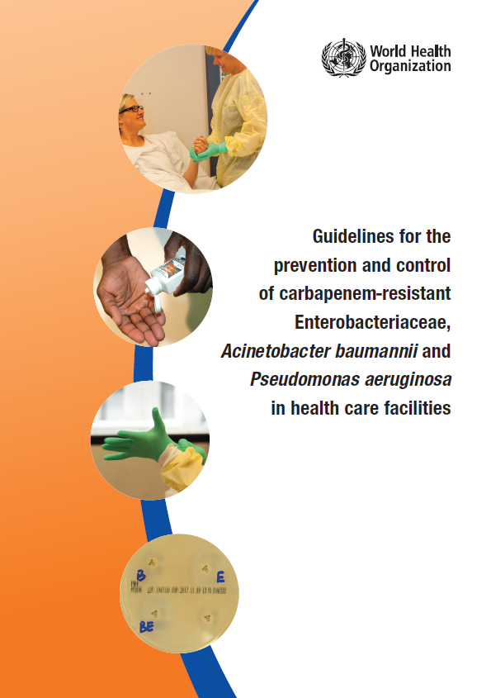
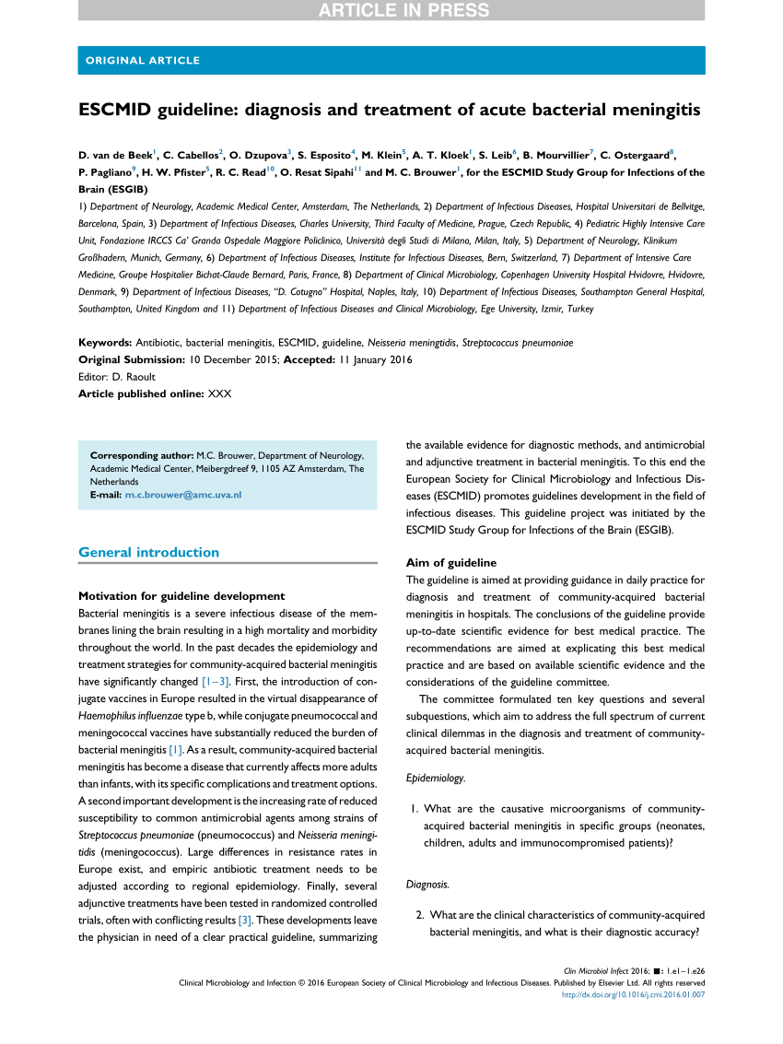
MDR-GNB: guidelines galore!

Slide 3
Rising threat from MDR-GNB
% of all HAI caused by GNRs.
% of ICU HAI caused by GNRs.
Non-fermenters | Acinetobacter baumannii Pseudomonas aeruginosa Stenotrophomonas maltophilia
Enterobacteriaceae | Klebsiella pneumoniae Escherichia coli Enterobacter cloacae
CPO
CPE
Hidron et al. Infect Control Hosp Epidemiol 2008;29:966-1011.
Peleg & Hooper. N Engl J Med 2010;362:1804-1813.

Slide 4

Enterobacteriaceae vs. non-fermenters
Share | Differ
Gram stain reaction | Risk factors & at-risk population
Concerning AMR | Potential for epidemic spread
 | Infection profile & mortality
 | Prevalence
 | Colonisation site & duration
 | Transmission routes
 | Resistance profile & mechanisms
Notes:
You could (and probably should) dissect the epidemiology of:
K. pneumoniae vs. E. coli
A. baumannii vs. P. aeruginosa
ESBL vs. KPC producing K. pneumoniae

Slide 5
Universal or targeted approach?

Slide 6
Evidence-free zone

Slide 7
Guidelines = Policy

Slide 8


Slide 9
Acronym minefield
CPC
CPE
MDR-GNR
CRO
MDR-GNB
ESBL
CRE
CRC
CPE
KPC
CRAB

Slide 10
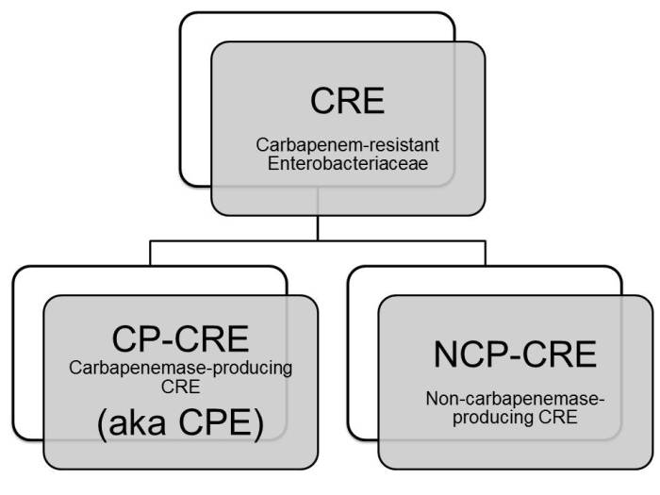
CPE or CRE? Let’s go with both shall we?

Slide 11
Risk assessment
Patient placement
Resp hygiene
Linens
Care equipment
BBF spillage
BBF exposure
prevention
& management
Safe Injection practices
Safe lumbar Puncture practices
Resuscitation safety
Waste disposal
Care environment
Hand hygiene
PPE
Safe use and disposal of sharps
Asepsis: optimal use of invasive
devices; PVC, CVC, UC
Health Protection Scotland: http://www.documents.hps.scot.nhs.uk/hai/infection-control/ic-manual/ipcm-p-v2-3.pdf
Centres for Disease Control: http://www.cdc.gov/HAI/settings/outpatient/outpatient-care-gl-standared-precautions.html
UK Epic3: http://www.sciencedirect.com/science/article/pii/S0195670113600122
WHO: www.who.int/csr/resources/publications/EPR_AM2_E7.pdf

Slide 12
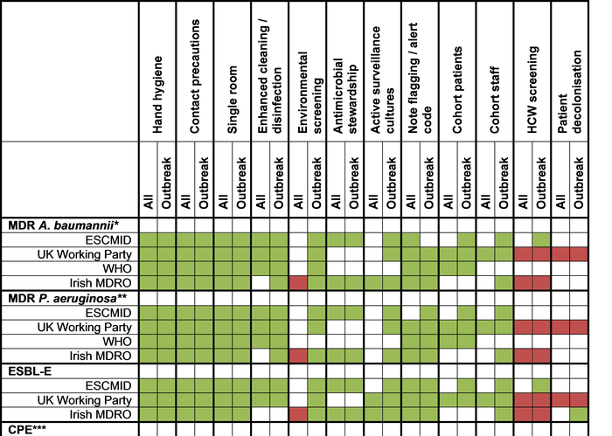
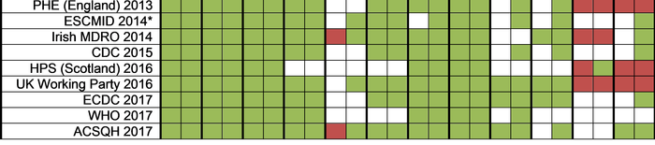

Slide 14
Risk factors & at-risk population
 | Enterobacteriaceae | Non-fermenters
Risk factors | LOS ICU stay Catheters / devices Ventilation Prior antibiotics Travel | LOS ICU stay Catheters / devices Ventilation Prior antibiotics Trauma (esp. burns)
At-risk population | Patients in acute settings, particularly those with recent travel to areas of high prevalence. Potential for community spread. | High-risk patients in the ICU and burns units; rare cause of community-acquired infection.

Slide 15

Sites of colonisation – 103 CRAB patients
80% tracheal aspirate
69% sternal skin
25% urine
69% rectal
Apisarnthanarak et al. Clin Infect Dis 2013;56:1057-1059.

Slide 16
Who do I screen?
UK PHE CPE Toolkit screening triggers:
an inpatient in a hospital abroad, or
an inpatient in a UK hospital which has problems with spread of CPE (if known), or
a‘previously’positive case.
Also consider screening admissions to high-risk units such as ICU, and patients who live overseas.

Slide 17

How do I screen?
Rectal swab is the best sample
  Insert no more than 2cm into rectum
  Twist gently and withdraw
  Ideally want to see faeces on swab.
Patient and staff education as to why this is needed in order to overcome taboos
Alternate specimen is stool sample, but have to wait for the patient to ‘go’
Notes:
Thank you Jon,
So how do I screen a patient for CRE?
A rectal swab provides the best results.
The swab should be inserted into the rectum no more than 2 cm or an inch twisted gently and withdrawn. The aim is to stain it brown!
Unfortunately , not many people are happy to have a sample taken in this way. And Issues such as child protection have been raised.
Clear explanations are needed to gain patient understanding and informed consent and we need some public education for us all to make this more normal and acceptable.
In the meantime
If it is really not possible to get a rectal sample then a stool sample can be used. This is not quite as good as apart form anything it may be delayed while we wait for the patient to ‘perform’

Slide 18
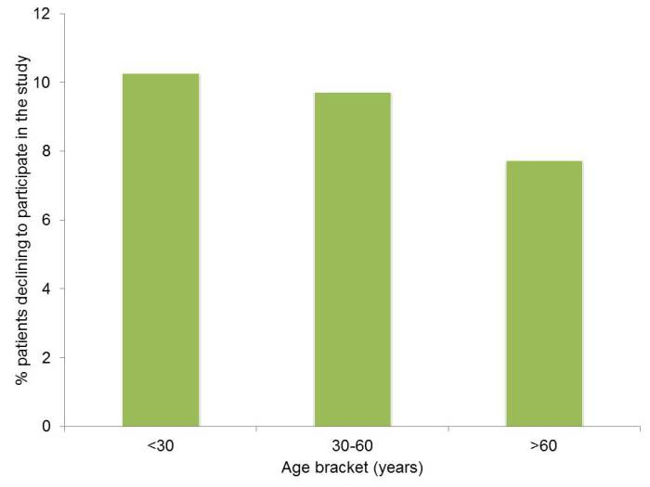
Can I swab your rectum please?
Factors associated with patients declining to provide a rectal swab were:
younger age (odds ratio (OR) 0.99, 95% confidence interval (CI) 0.99-1.00) female gender (OR 1.26, CI 1.04-1.52),
transfers from other hospitals (OR 1.77, CI 1.07-2.93) or an unknown admission route (OR 1.61, CI 1.09-2.37),
admission before the change in study description (OR 0.39, CI 0.31-0.48)
the staff member who consented the patient (p<0.001);
ethnicity was not a significant factor.
Dyakova et al. Clin Microbiol Infect 2017 in press.

Slide 19
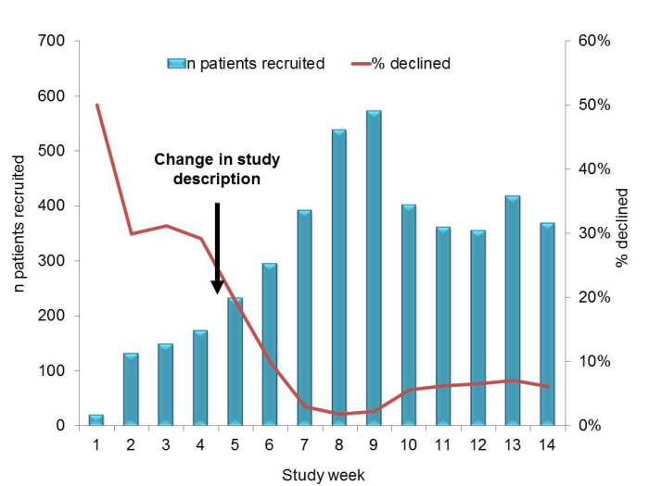
Improving screening compliance
Dyakova et al. Clin Microbiol Infect 2017 in press.

Slide 20
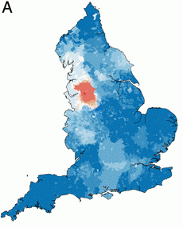
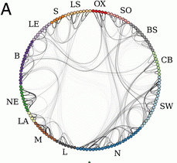
Distant large problems vs. small local ones?
CRE introductions come from hospitals within a regional referral network, even if the prevalence in another referral network is much higher (more than 100x higher, in fact)!
Donker et al. BMC Med 2017.

Slide 21
Does screening and isolation work?
 | All MDROs | MRSA | VRE | ESBLs
Baseline trend | – | ↑ | – | –
Hygiene intervention step-change | – | – | – | –
Hygiene intervention trend change | ↓ | ↓ | – | –
Screening step-change | – | – | – | –
Screening trend change | – | ↑ | – | –
Rapid vs. conventional step-change | ↑ | – | – | ↑
Rapid vs. conventional trend-change | – | – | – | –
Derde et al. Lancet Infect Dis 2014;14:31-39.

Slide 23
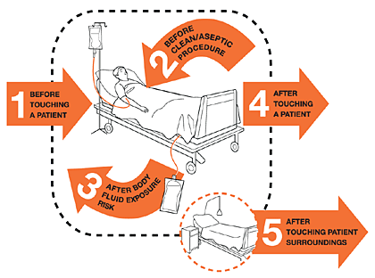
Hand hygiene
40%
Median hand hygiene compliance from 95 studies.
Erasmus et al. Infect Control Hosp Epidemiol 2010;31:283-294.

Slide 25

The bed location lottery
Mitchell et al. J Hosp Infect 2015;91:211-217.
Notes:
Ajao study: only 53% of the 32 odd patients that acquired when the prior occupant was positive acquired the same species of ESBL; only 6% of the 32 had an indistinguishable or closely related strain of the same species.

Slide 26
Surface survival
Otter & French. J Clin Microbiol 2009;47:205-207.

Slide 27
Surface survival – strain variation
Otter & French. J Clin Microbiol 2009;47:205-207.

Slide 28
Conclusion
K. pneumoniae vs. E. coli
K. pneumoniae seems to be more environmental than E. coli.^{1,2}
Surface contamination on five standardized sites surrounding patients with ESBL-producing Klebsiella spp. (n=48) or ESBL-producing E. coli (n=46).¹
P<0.001
Risk factors for ESBL-E contamination = ESBL-KP, urinary catheter; carbapenem therapy was protective.³
P<0.001
Guet-Revillet et al. Am J Infect Control 2012;40:845-848.
Gbaguidi-Haore. Am J Infect Cont 2013;41:664-665.
Freeman et al. Antimicrob Resist Infect Control 2014;3:5.
Notes:
28

Slide 29
Persistent contamination
140 samples from 9 rooms after 2xbleach
5705 samples from 312 rooms after 4xbleach
2680 sites from 134 rooms after HP vapor
HP vapor decon
26.6% of rooms remained contaminated with either MRSA or A. baumannii following 4 rounds of bleach disinfection
Manian et al. Infect Control Hosp Epidemiol 2011;32:667-672.

Slide 30
Enterobacteriaceae “less environmental”
Nseir et al. Clin Microbiol Infect 2011;17:1201-1208.
Ajao et al. Infect Control Hosp Epidemiol 2013;34:453-458.
Notes:
Ajao study: only 53% of the 32 odd patients that acquired when the prior occupant was positive acquired the same species of ESBL; only 6% of the 32 had an indistinguishable or closely related strain of the same species.

Slide 31
MDR-GNR cleaning & disinfection checklist
Clean / declutter
Monitor cleaning process (e.g. fluorescent markers)
Enhanced daily disinfection using bleach
All equipment disinfected before leaving room
Terminal disinfection using bleach or, ideally, H₂O₂ vapor or UV¹⁻³
Gopinath et al. Infect Control Hosp Epidemiol 2013;34:99-100.
Snitkin et al. Sci Transl Med 2012;4:148ra116.
Verma et al. J Infect Prevent 2013;7:S37.

Slide 32
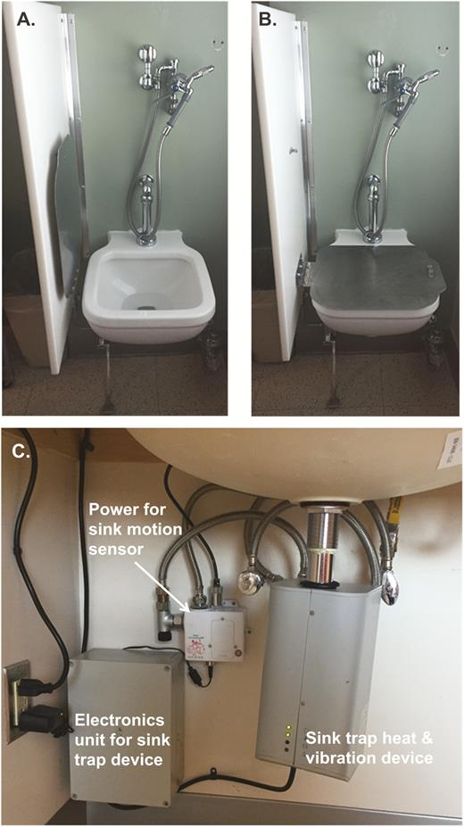
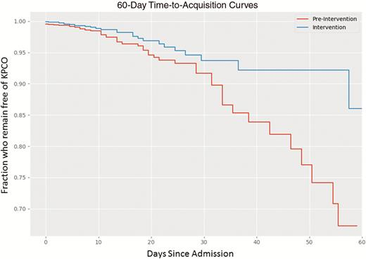
Contaminated sinks / drains
CPE (K. pneumoniae) acquisition and clinical infection halved through improved management of sinks (OR = 0.51 for acquisions, and 0.29 for clinical cultures) (n=~7,500 pts).
Mathers et al. Clin Infect Dis 2018 in press.

Slide 34
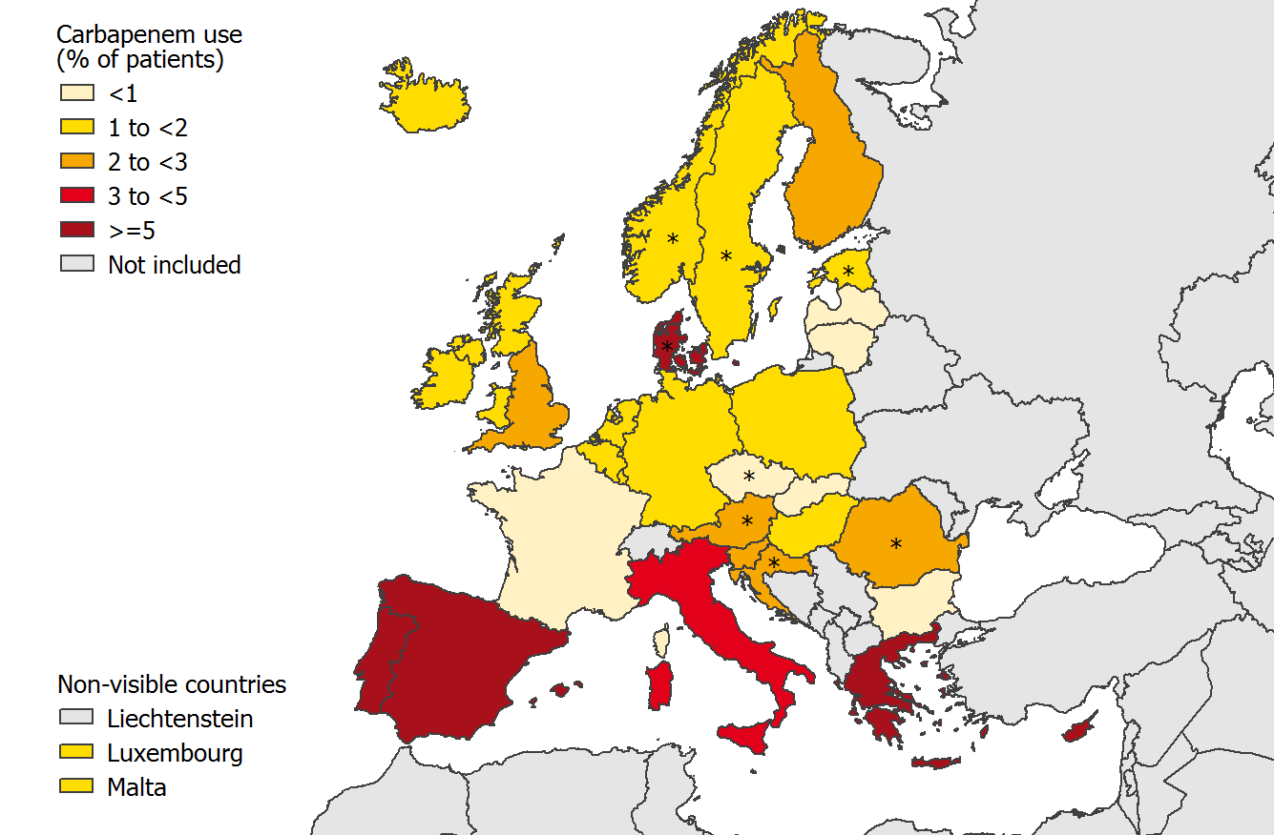
Carbapenem use, Europe
ECDC point prevalence survey 2013.

Slide 35
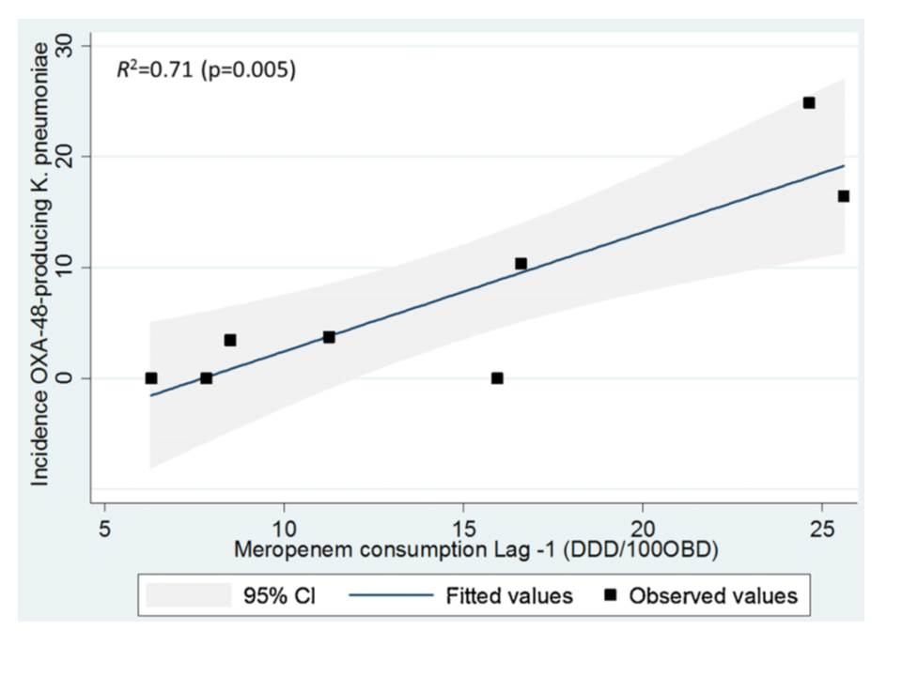
Can we forecast a CPE storm?
Could we find and implement an “alert” level of carbapenem use?
The authors claim a stewardship intervention brought the CPE outbreak under control – but also implemented ‘case isolation, screening of contacts, barrier nursing and other infection control interventions’.
Study focussed only on OXA-48 K. pneumoniae; what about other Enterobacteriaceae and non-fermenters.
What drives carbapenem resistance? The use of meropenem in the previous year plotted against the incidence rate of OXA-48-producing K. pneumoniae
Gharbi et al. Int J Antimicrob Agents 2015 in press.

Slide 36
Antimicrobial stewardship – impact
Evaluating impact of 6 month antimicrobial stewardship intervention on an ICU by comparing bacterial resistance for matched 6 month periods either side of intervention.
*
*
*
*
*
*
Hou et al. PLoS ONE 2014;9:e101447; * = significant difference before vs. after.

Slide 38
‘Selective’ digestive decontamination
20 CRE colonized patients in each arm given gentamicin + polymyxin (SDD arm) or placebo (Control arm)
Saidel-Odes et al. Infect Control Hosp Epidemiol 2012;33:14-19.

Slide 39

Notes:
Antibiotics have a profound and sustained effect on the human microbiome (even those that are typically associated with no or few side effects). This results in a reduction in both diversity and change in composition, which is bad news for human health. In particular, this leave the gut more open to colonization with unwanted intruders aka antibiotic resistant bacteria.

Slide 40
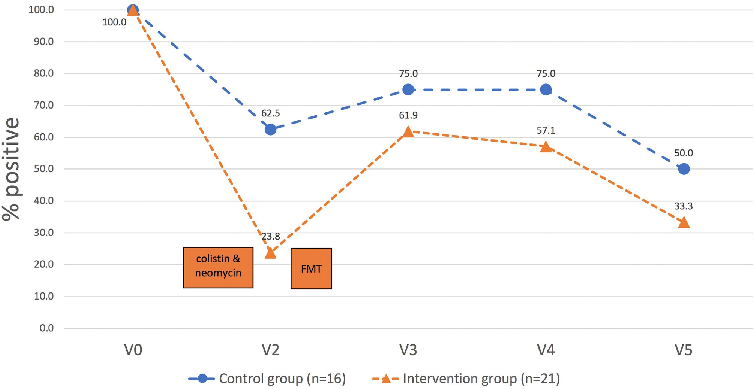
Decolonisation using FMT
39 ESBL or CPE colonized patients randomised to oral abx + FMT (brown(!) line) or no intervention (blue line)
Huttner et al. Clin Microbiol Infect 2019.

Slide 41
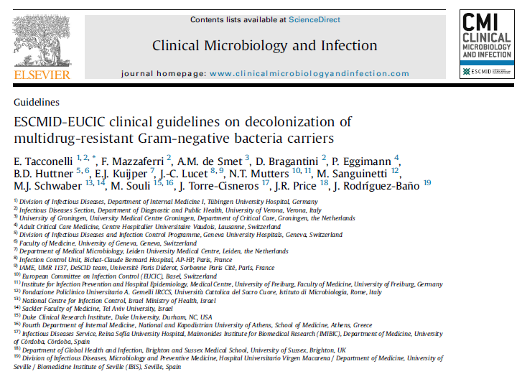
“The panel does not recommend routine decolonization of CRE.”
“Evidence is insufficient to provide a recommendation for or
against decolonization of carbapenem-resistant A. baumannii.”
Tacconelli et al. Clin Microbiol Infect 2019.

Slide 42
Chlorhexidine – efficacy
Impact of chlorhexidine gluconate (CHG) daily bathing on skin colonization with KPC-producing K. pneumoniae in 64 long-term acute care patients.
Lin et al. Infect Control Hosp Epidemiol 2014; 35:440-442.

Slide 43
Chlorhexidine – reduced susceptibility
Proportion of BSI isolates with reduced susceptibility to chlorhexidine on units using chlorhexidine gluconate (CHG) daily bathing (n=28) or not (n=94).
33% (p=0.028)
Suwantarat et al. Infect Control Hosp Epidemiol 2014;35:1183-1186.

Slide 44
Deisolation?
Author | Year | Setting | N pts | Organism | Duration of colonization
Bird¹ | 1998 | Elderly care facilities, Scotland | 38 | ESBL K. pneumoniae | Mean 160 days (range 7-548)
Pacio² | 2003 | Long term care facility, USA | 8 | Resistant Gram-negative rods | Median 77 days (range 47-189)
Zahar³ | 2010 | Paediatric hospital, France | 62 | ESBL Enterobacteriaceae | Median 132 days (range 65-228)
O'Fallon⁴ | 2009 | Long term care facility, USA | 33 | Resistant Gram-negative rods | Median 144 days (range 41–349)
Zimmerman⁵ | 2013 | Patients discharged from hospital, Israel | 97 | CRE | Mean 387 days
Bird et al. J Hosp Infect 1998;40:243-247.
Pacio et al. Infect Control Hosp Epidemiol 2003;24:246-250.
Zahar et al. J Hosp Infect 2010;75:76-78.
O'Fallon et al. Clin Infect Dis 2009;48:1375-1381.
Zimmerman et al. Am J Infect Control 2013;41:190-194.

Slide 46
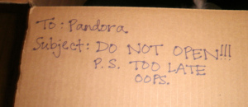
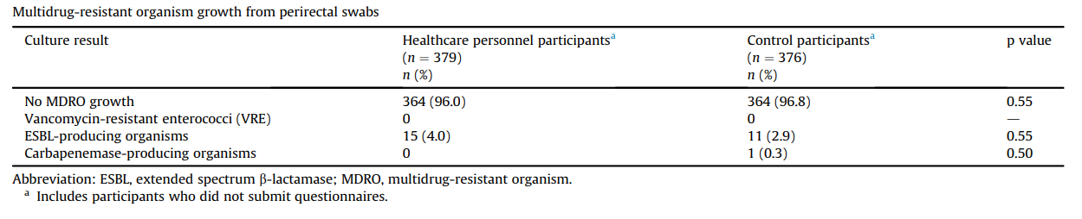
Colonised staff?
Decker et al. Clin Microbiol Infect 2018;24:82.e1-82.e4.

Slide 47
Which do you consider to be the most important measure to prevent transmission?
Data from around 150 webinar participants, mainly in the US, 2014.

Slide 48
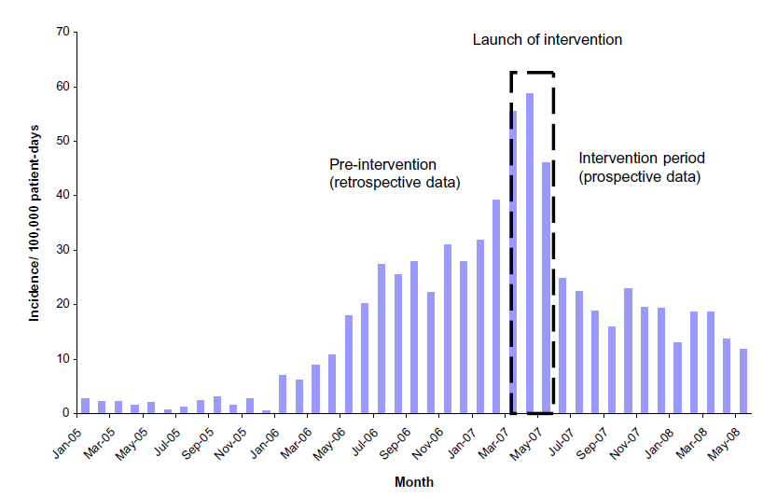
What works? Israel
*
* Physical segregation of CRE carriers; cohorted staff; appointed taskforce.
Schwaber et al. Clin Infect Dis 2011;52:848-855.
Notes:
Physical segregation of CRE carriers; cohorted staff; appointed taskforce.

Slide 49
Key questions
Which interventions work?
Are they different for Enterobacteriaceae and non-fermenters? (Probably, given their epidemiology.)
What is the prevalence of CPE?
How much do we believe a single negative screen? What is the duration of colonisation?
Do we need rapid molecular diagnostics?
Are there decolonisation strategies other than (virtually non) ‘selective decontamination’ using abx?

Slide 50
Summary
MDR-GNB are emerging worldwide and represent a unique threat.
CPE in particular combine resistance, virulence and the potential for rapid spread.
Prevalence in the US appears to be patchy, but increasing.
We do not yet know what is effective in terms of prevention and control, but screening and isolation of carriers seems prudent.
Diagnosis can be challenging, and relies on close liaison with the microbiology laboratory.

Slide 51
Controversies in guidelines for the control of multidrug-resistant Gram-negative bacteria in EU countries
Jon Otter, PhD FRCPath
Blog: www.ReflectionsIPC.com
Twitter: @jonotter
Email: j.otter@imperial.ac.uk

