Slide 1



The environment as a driver of AMR
Jon Otter, PhD FRCPath
Imperial College London
j.otter@imperial.ac.uk
@jonotter
Blog: www.ReflectionsIPC.com
Slides: www.jonotter.net
Notes:
Counting the cost of HCAI and AMR
Finanical considerations for a hospital cleaning and disinfection service
The cost-effectiveness of hospital cleaning and disinfection
Building the business case for hospital cleaning and disinfection

Slide 2
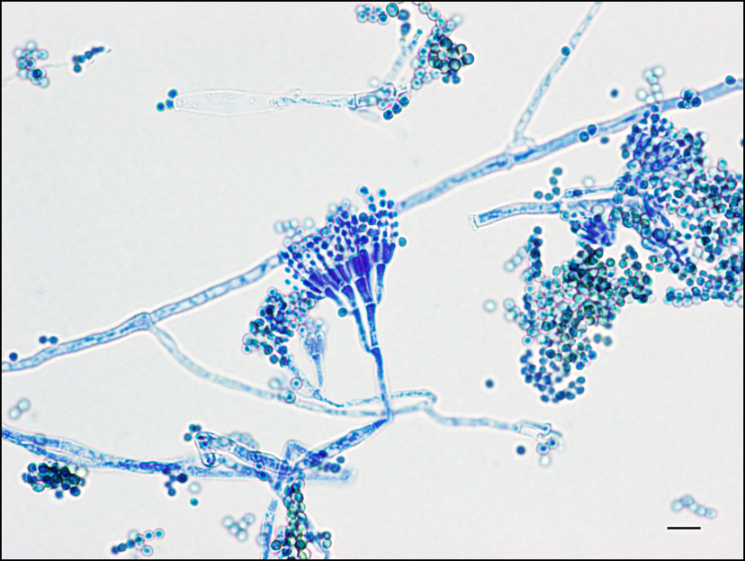

Slide 3


Slide 4

2x

Slide 5
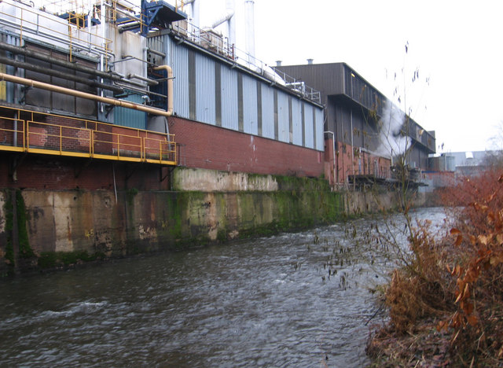
Notes:
One plant in India released phenomenal amounts of one particular antibiotic, ciprofloxacin, in waste water: 44kg per day. To put this in context, that’s almost 5x the amount of the same antibiotic consumed by the whole of Sweden per day, and the concentration of the antibiotic in the waste water was higher than therapeutic levels of the drug in humans!

Slide 6
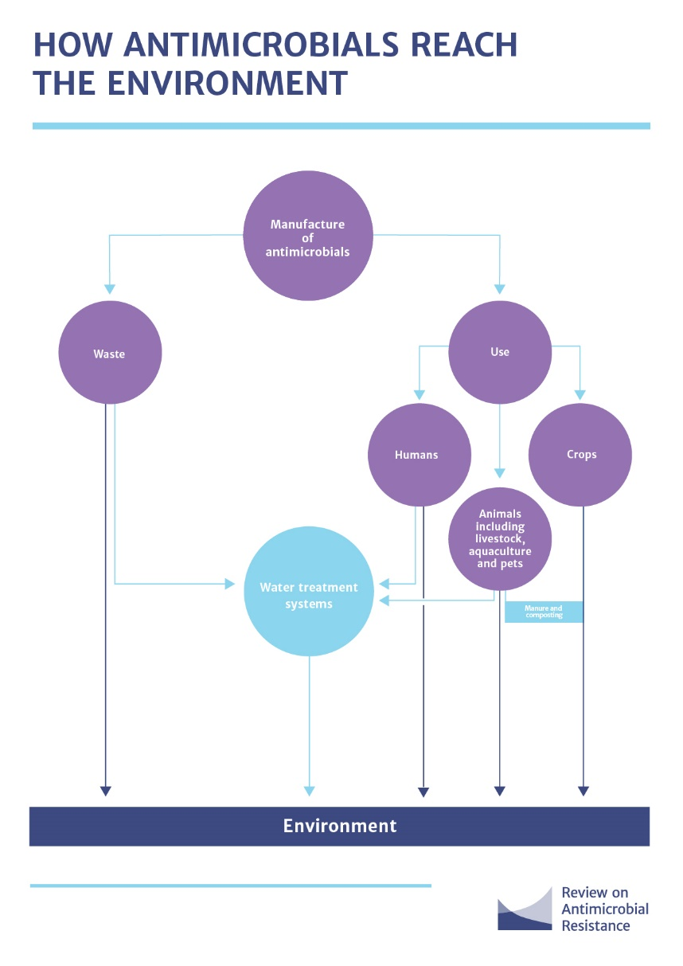
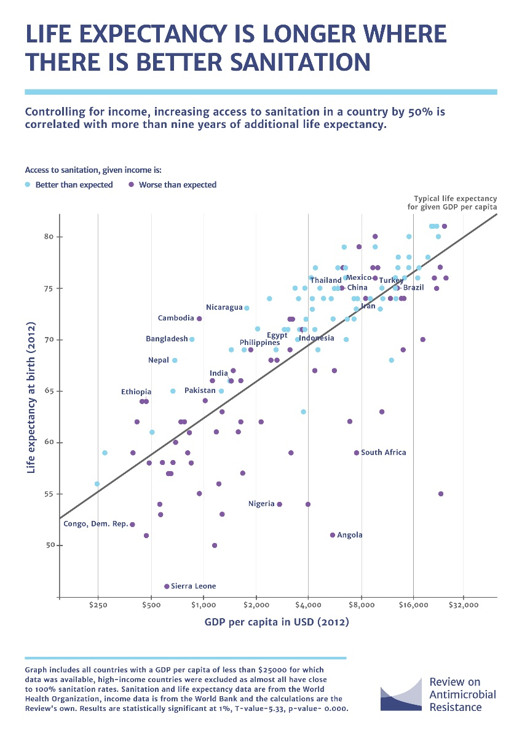

Slide 7
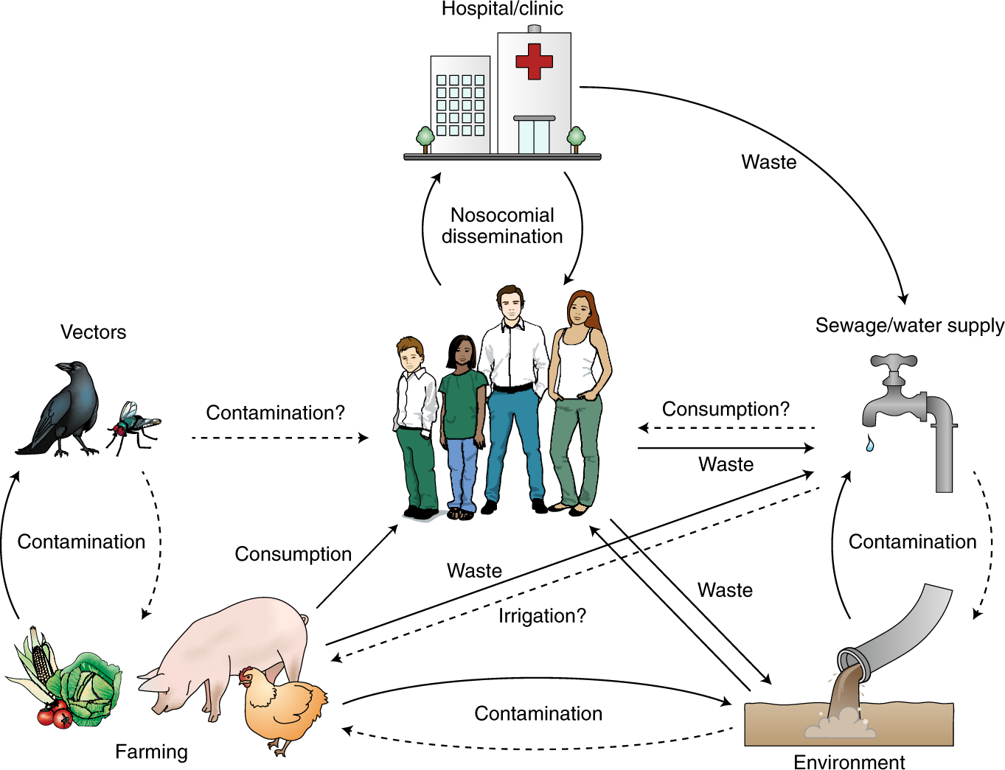
Walsh T. Nature Microbiol 2018.

Slide 8
The environment as a driver of AMR
Jon Otter, PhD FRCPath
Imperial College London
j.otter@imperial.ac.uk
@jonotter
Blog: www.ReflectionsIPC.com
Slides: www.jonotter.net
Notes:
Counting the cost of HCAI and AMR
Finanical considerations for a hospital cleaning and disinfection service
The cost-effectiveness of hospital cleaning and disinfection
Building the business case for hospital cleaning and disinfection

