Slide 1


Literature reviewing: a crash course
Jon Otter, PhD FRCPath
Imperial College London
j.otter@imperial.ac.uk
@jonotter
Blog: www.ReflectionsIPC.com
Slides: www.jonotter.net

Slide 2
Why lit reviews are great
Information sources
Getting started:
Research question
Selection criteria
Search strategy
Synthesis / summary
Writing up
Watch your review change practice

Slide 3
Why lit reviews are great
Information sources
Getting started:
Research question
Selection criteria
Search strategy
Synthesis / summary
Writing up
Watch your review change practice

Slide 4
What is a literature review?
‘A literature review surveys books, scholarly articles, and any other sources relevant to a particular issue, area of research, or theory, and by so doing, provides a description, summary, and critical evaluation of these works in relation to the research problem being investigated.’
‘…your task is to build an argument, not a library.’
(Rudestam, K.E. and Newton, R.R. (1992)Surviving your dissertation: A comprehensive guide to content and process. California: Sage, p49.)
Notes:
We’ll ask everybody to introduce themselves and what they hope to get out of the day

Slide 5
Why literature reviews are great
Literature reviews will buy you a lot of citations (my most-cited article is a 2011 literature review….on the role of the environment in transmission)!
It’s your opportunity to tell a story (informed by the information you find!) – and make a mark in the academic literature
Reviews have the power to influence practice and subsequent guidelines more than any individual article
Notes:
We’ll ask everybody to introduce themselves and what they hope to get out of the day

Slide 6
Types of literature review
Narrative review
Systematic review
  With or without meta-analysis
Concise review / opinion (e.g. editorial)

Slide 7
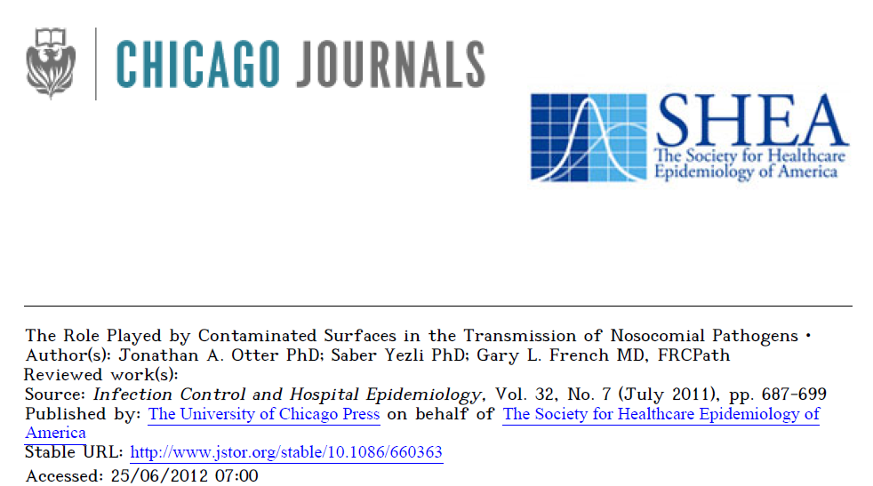
Types of literature review: narrative

Slide 8
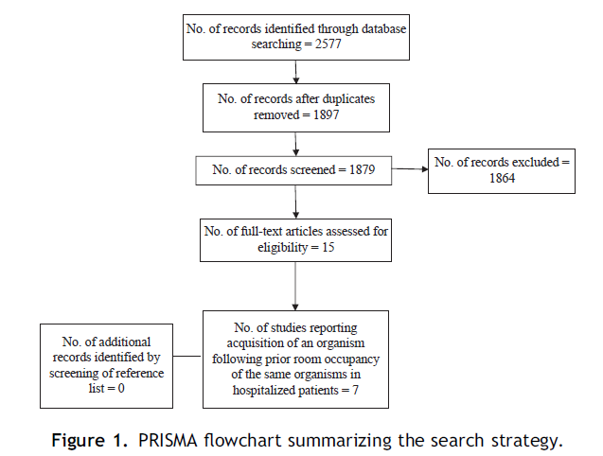
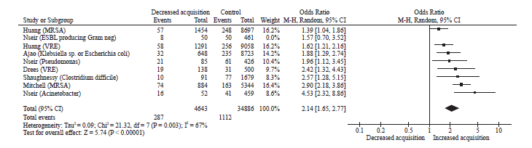
Types of literature review: systematic
Mitchell et al. J Hosp Infect 2015.

Slide 9
Source of information
Primary literature
  Peer-reviewed published journal articles
  Theses (e.g. PhD, MSc)
  “Grey” literature (e.g. conference abstracts, non-peer reviewed articles)
Secondary literature
  Other literature reviews

Slide 10
Why lit reviews are great
Information sources
Getting started:
Research question
Selection criteria
Search strategy
Synthesis / summary
Writing up
Watch your review change practice

Slide 11
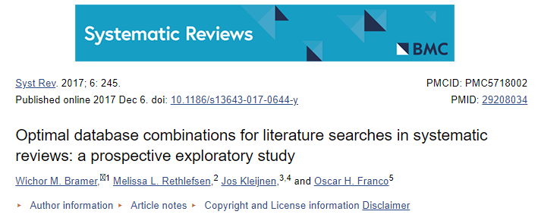
Source of information: searching
Academic databases
  Medline/Pubmed
  Web of Science
  Cochrane
  Google Scholar
  Embase

Slide 12
Why lit reviews are great
Information sources
Getting started:
Research question
Selection criteria
Search strategy
Synthesis / summary
Writing up
Watch your review change practice

Slide 13
Getting started: research question
Carefully define your research question
  A poor research question may make your findings unpublishable – and send you down a long, painful, and unfruitful path
  Make sure you get plenty of input – this is perhaps the single most important step in the process
For example (from Mitchell et al. J Hosp Infect 2015):
  We conducted a systematic review of observational (cross-sectional, cohort, and case control) studies published in the last 30 years regarding hospitalized patients who had acquired organisms from prior room occupants.

Slide 14
Getting started: inclusion / exclusion criteria
Carefully define inclusion / exclusion criteria
  The aim is to make the search results comprehensive but not overwhelming
For example (from Mitchell et al. J Hosp Infect 2015):
  Publications included if they reported acquisition prevalence rates, and only peer-reviewed material was considered.
  All grey material, non-peer-reviewed literature (e.g. conference abstracts, letters to editors, etc.), in languages other than English and reviews excluded
  Studies must have examined exposure or acquisition in a hospitalized population where the prior room occupant was colonized or infected with a specific organism
    Eligible organisms: Acinetobacter, Escherichia coli, Klebsiella, Pseudomonas, Enterobacter, Citrobacter, Proteus, Serratia, Enterococcus, C. difficile, S. aureus, MRSA, and VRE.

Slide 15
Getting started: search strategy
You need a clear search strategy before you begin, which is set to match your research question and help you in implementing your inclusion and exclusion criteria
For example (from Mitchell et al. J Hosp Infect 2015):
  Bibliographic databases Medline/PubMed, Cochrane and CINHAL searched for material published between Jan 1st, 1984 and Dec 1st, 2014
  Searches conducted for words in title or abstract
  Search filters were 30-year publication time-period, published in English and conducted on humans
  Reference lists of studies identified from electronic databases and included subsequently hand searched for additional studies
  Names of specific organisms and terms ‘prior room occupancy’, ‘occupancy’ and ‘acquisition’ used to search bibliographic databases
    specific organisms searched ‘Acinetobacter’, ‘Escherichia coli’, ‘Klebsiella’, ‘Pseudomonas’, ‘Enterobacter’, ‘Citrobacter’, ‘Proteus’, ‘Serratia’, ‘Enterococcus’, ‘Clostridium difficile’, ‘Staphylococcus aureus’, ‘methicillin-resistant Staphylococcus aureus’ and ‘vancomycin-resistant Enterococcus’.

Slide 16
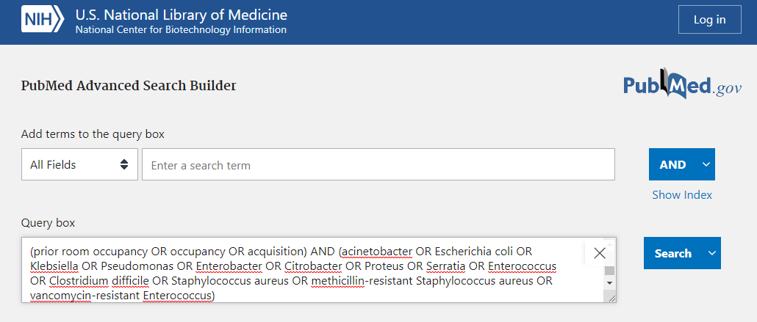
Getting started: search strategy

Slide 17
Why lit reviews are great
Information sources
Getting started:
Research question
Selection criteria
Search strategy
Synthesis / summary
Writing up
Watch your review change practice

Slide 18
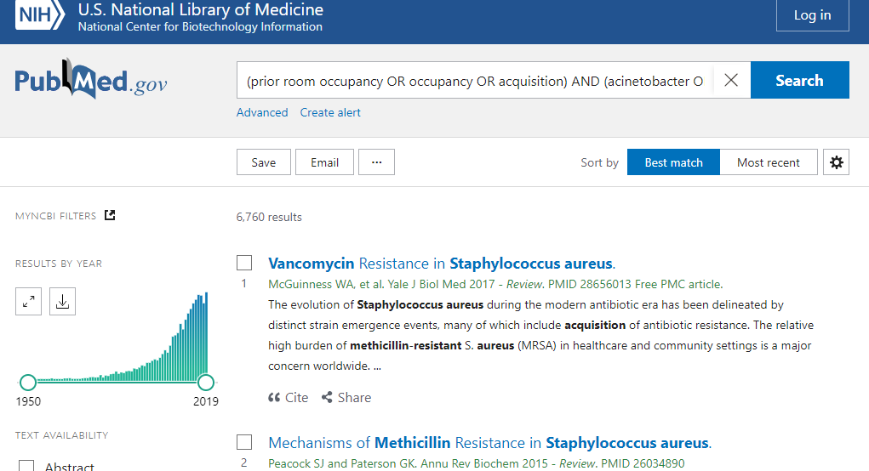
Synthesis

Slide 19
Synthesis
Find a way to review all the literature that your search identifies.
  Makes sense to review the abstracts first to make a judgment as to which articles should be excluded, so you only read the eligible ones in full.
Some sort of data extraction tool should be used
  This could be an excel spreadsheet with fixed columns for the information that you want from each article
  Literature review software is available to help here
You need to critically evaluate and compare the literature you identify, not just collate the information

Slide 20
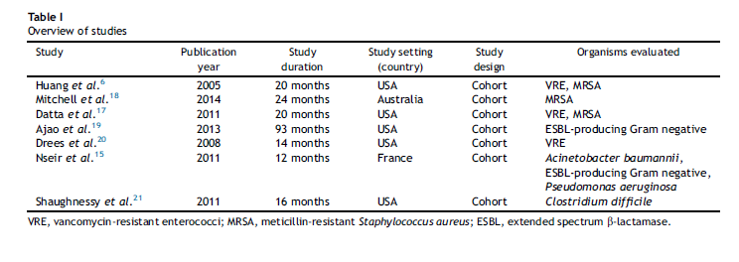
Summarising (aka the power of tables)
Work out an appropriate structure for your summary with headings / sub-headings
Tables are an excellent way to summarise information
For example (from Mitchell et al. J Hosp Infect 2015):

Slide 21
Why lit reviews are great
Information sources
Getting started:
Research question
Selection criteria
Search strategy
Synthesis / summary
Writing up
Watch your review change practice

Slide 22
Taking it home (aka writing it up)
This is the fun part!
Write into the structure that you decided on at the synthesis / summarising stage
Remember, you are writing a narrative / commentary on your findings (not regurgitating the information)

Slide 23
Tips
Favour a systematic review over a narrative review
Get some reference managing software – it takes a while to get set up, but will save you lots of time in the long run (I use Endnote)
When writing, work to a sensible word count from the start – this will save a lot of time later!

Slide 24
Help!
Some resources:
Literature review guidance: Imperial College London
Literature review guidance: University of Edinburgh
Doing a literature review: University of Leicester
Writing narrative literature reviews for peer-reviewed journals: secrets of the trade
Undertaking a Literature Review: A Step-By-Step Approach
PRISMA guidelines for systematic reviews

Slide 25
Why lit reviews are great
Information sources
Getting started:
Research question
Selection criteria
Search strategy
Synthesis / summary
Writing up
Watch your review change practice

Slide 26
Why literature reviews can be bad
May exclude significant literature published outside of timescale
May exclude good papers in languages other that English
Restricted to the databases searched
Selection of search terms will restrict the papers that are found
  Could introduce bias
Needs some skill in data extraction and analysis / meta-analysis

Slide 27
Where do guidelines come from?
Government
Legal mandates (e.g. Hygiene Code in England)
Non-governmental expert groups (e.g. World Health Organisation, CDC, Public Health England, ECDC, NICE)
Professional societies
Expert groups
The private sector

Slide 28
Types of guidelines
Evidence-based guidelines
Best-practice guidelines
Expert opinion based recommendations

Slide 29
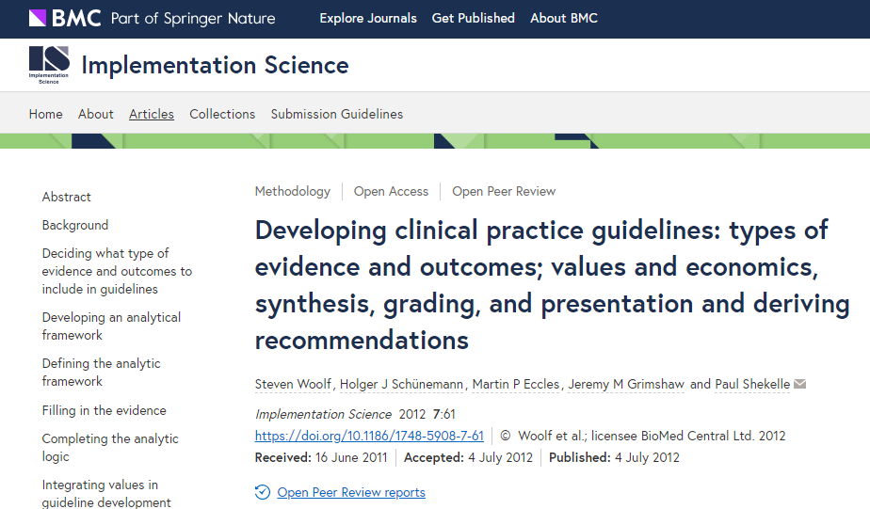
Recommended reading

Slide 30
Guideline mapping and analysis: worked examples

Slide 31
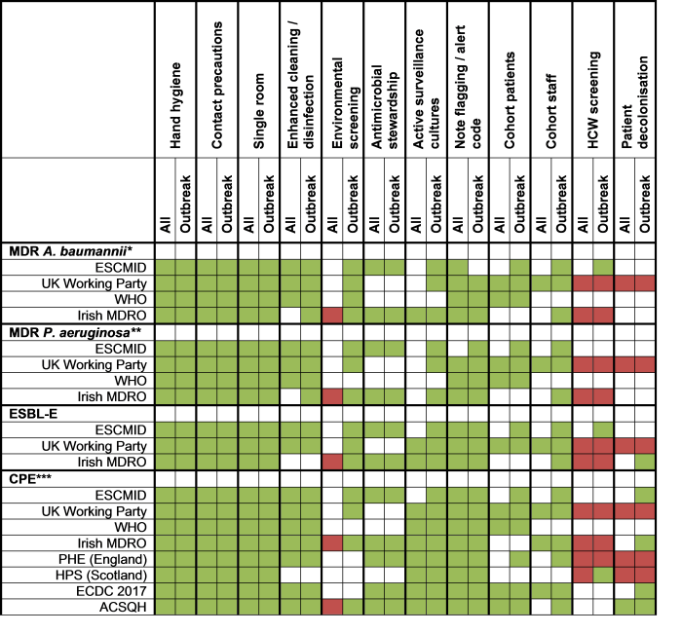
Otter et al. Clin Microbiol Infect 2016.

Slide 32
Risk assessment
Patient placement
Resp hygiene
Linens
Care equipment
BBF spillage
BBF exposure
prevention
& management
Safe Injection practices
Safe lumbar Puncture practices
Resuscitation safety
Waste disposal
Care environment
Hand hygiene
PPE
Safe use and disposal of sharps
Asepsis: optimal use of invasive
devices; PVC, CVC, UC
Health Protection Scotland: http://www.documents.hps.scot.nhs.uk/hai/infection-control/ic-manual/ipcm-p-v2-3.pdf
Centres for Disease Control: http://www.cdc.gov/HAI/settings/outpatient/outpatient-care-gl-standared-precautions.html
UK Epic3: http://www.sciencedirect.com/science/article/pii/S0195670113600122
WHO: www.who.int/csr/resources/publications/EPR_AM2_E7.pdf

Slide 33
Why guidelines can fail
Literature reviews restricted to RCTs means that there is little evidence in IPC and so much ‘expert’ opinion
Can be written by experts who have limited or out-of-date experience “at the coal-face” of delivering healthcare
  A guideline that has taken years to develop may fail as soon as it hits the ground

Slide 34
Summary
Literature reviews are really important, and have the power to change practice and influence guidelines
Systematic reviews (with meta-analysis) are increasingly recognised as the gold-standard approach
There is still room in the literature for a well-performed narrative review
A step-by-step approach can be followed to build towards a publishable literature review
  The research question & inclusion / exclusion criteria are the first and probably most important part of the process

