Slide 1
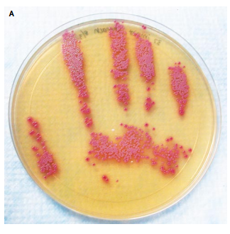


The hand hygiene journey (improving the accuracy of audit & QI)
Jon Otter PhD FRCPath
Honorary Senior Lecturer, Imperial College London
jon.otter@nhs.net
@jonotter
Blog: www.ReflectionsIPC.com
Slides: www.jonotter.net

Slide 2
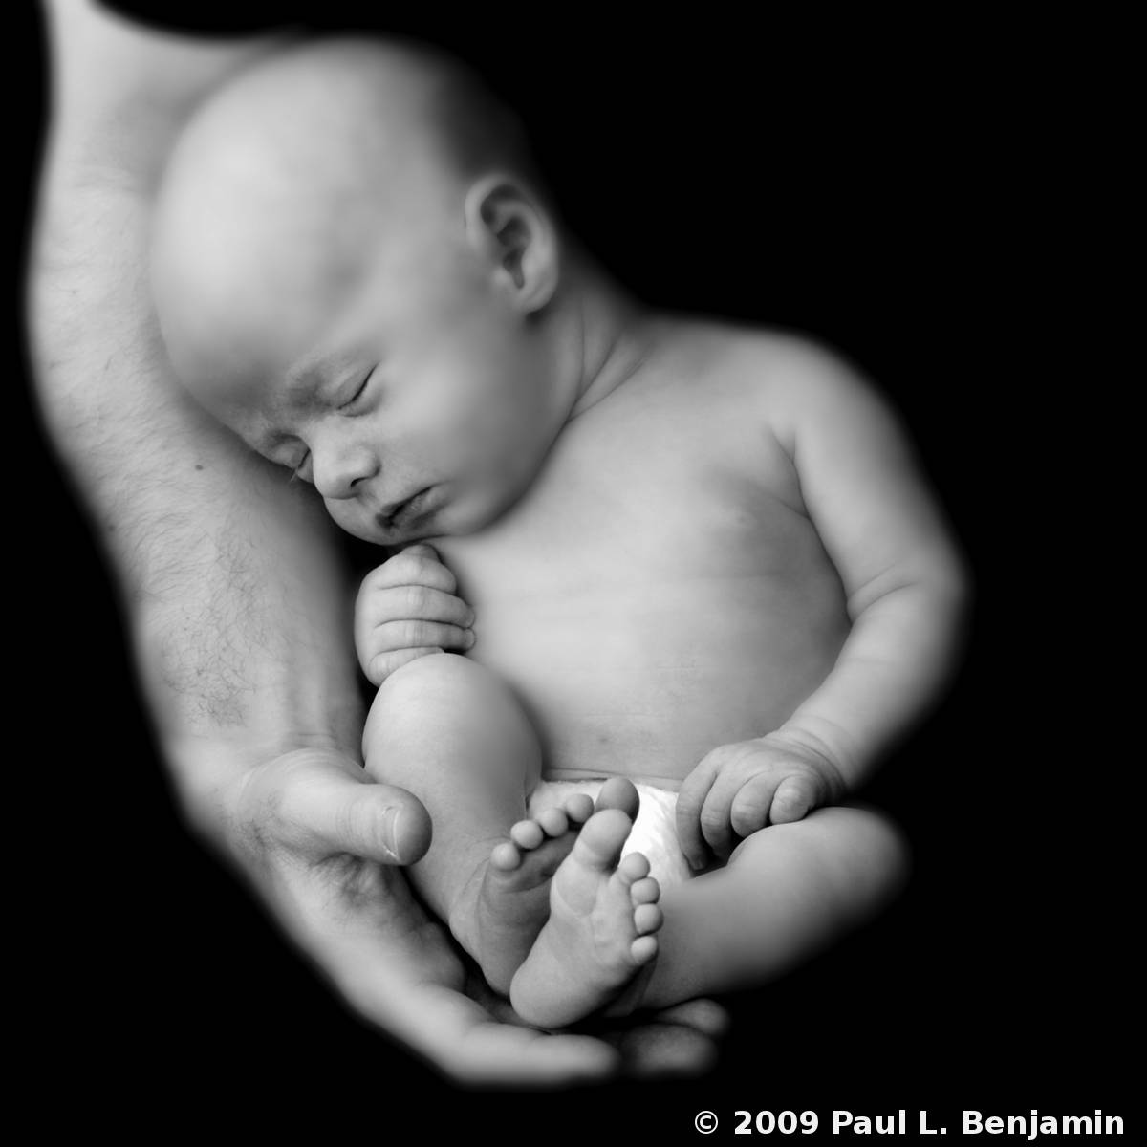

Slide 3


Slide 4
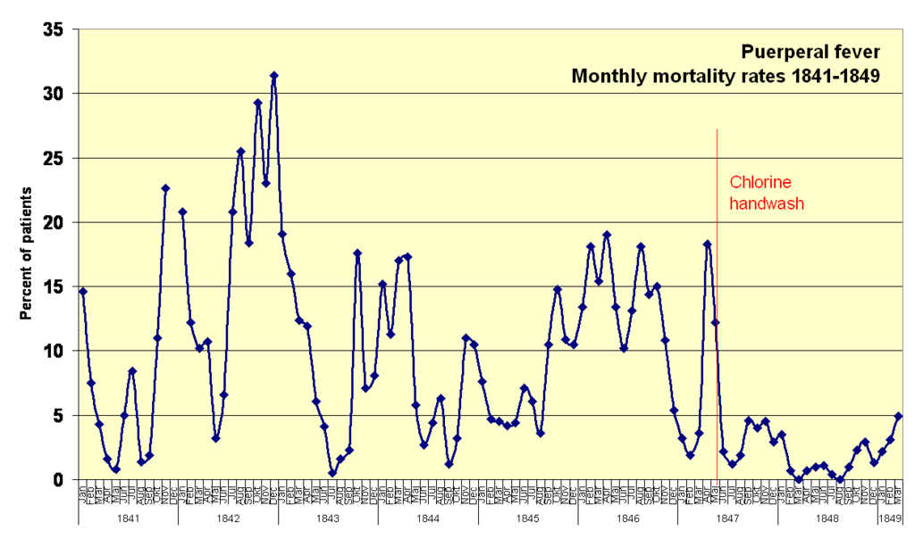

Slide 5
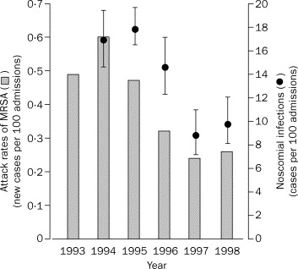
Improved hand hygiene reduces HCAI
A Swiss study evaluated the clinical impact of improved hand hygiene, hospital wide.
Hand hygiene compliance improved progressively from 48% in 1994, to 66% in 1997 (p<0.001).
Overall HCAI decreased from 16·9% in 1994 to 9·9% in 1998; p=0.04.
Pittet et al. Lancet 2000;356:1307-12.

Slide 6
Hand hygiene is really important
Hands become extensively contaminated during patient care
If you don’t wash your hands, transmission of bacteria between patients occurs
Improving hand hygiene compliance results in fewer HCAIs
Hand hygiene reduces the microbial burden on hands
There’s no specific evidence that being bare below the elbows improves patient outcomes per se – but it makes washing your hands easier – so why wouldn’t you?
Encouraging patients to perform hand hygiene can improve patient outcomes (e.g. reduced SSI).
There’s some important modelling work suggesting that improvements in hand hygiene compliance above the 65-70% mark make little impact in reducing transmission risk.
All this data is nicely summarised in the WHO hand hygiene guidelines.

Slide 7
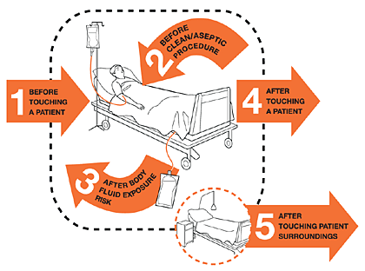


Hand hygiene, anyone?
32%
48%
40%
ICU: 30-40%
Other wards: 50-60%
21%
47%
Erasmus et al. Infect Control Hosp Epidemiol 2010;31:283-94. Systematic review of 96 studies of hand hygiene compliance.

Slide 8
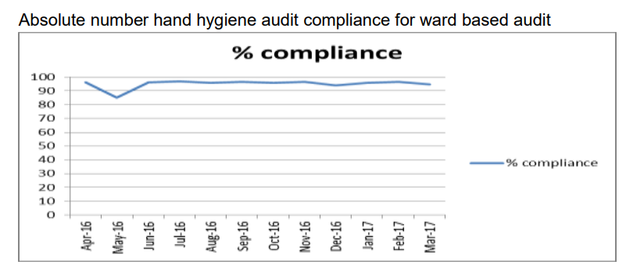
Improving the accuracy of audit
An IPC Annual Report, 2016/17.

Slide 9
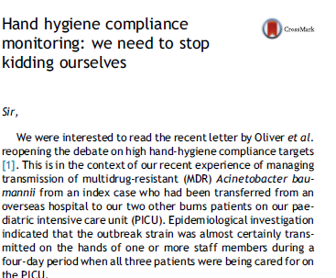
Jones et al. J Hosp Infect 2017.

Slide 10
Getting meaningful audit data
Hand hygiene compliance: ward audits versus IPC audits (n=223 observations for the IPC validation audits, and n=471 for the data on reported by wards)
Ward

Slide 11
Accurate hand hygiene compliance data
Hand hygiene compliance by Moment, from audits performed in 74 inpatient ward areas in May 2018. Moment 1 – before touching a patient. Moment 2 – before clean/aseptic procedures, Moment 3 – after body fluid exposure or risk, Moment 4 – after touching a patient, and Moment 5 – after touching patient surroundings. Overall compliance = 56%.

Slide 12
Audit
Improvement
Comms

Slide 13
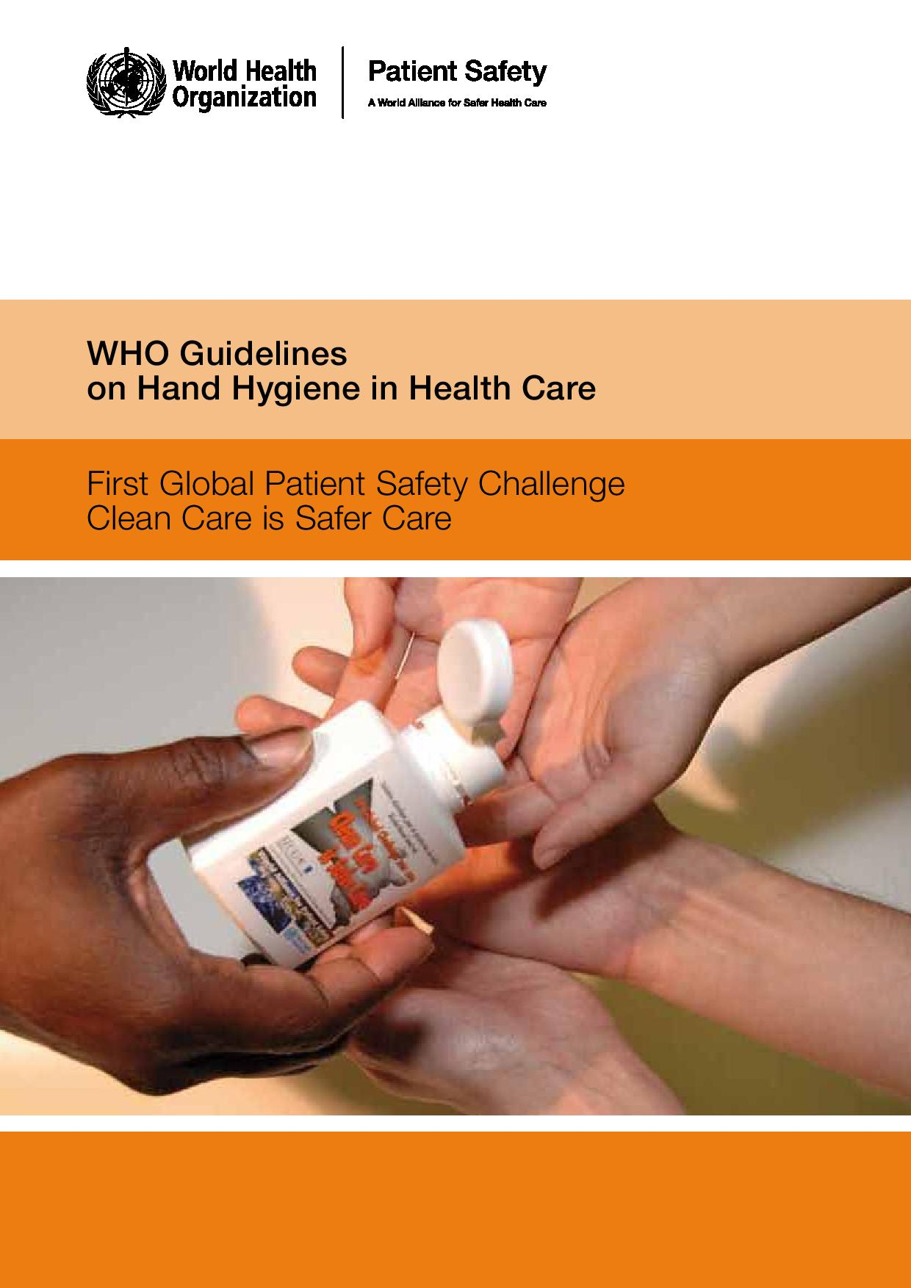
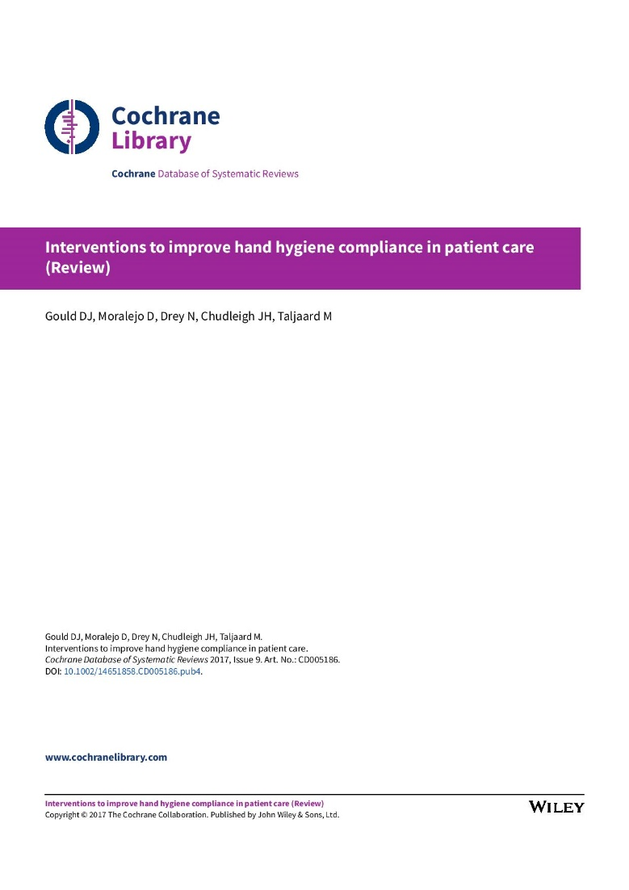

Slide 14
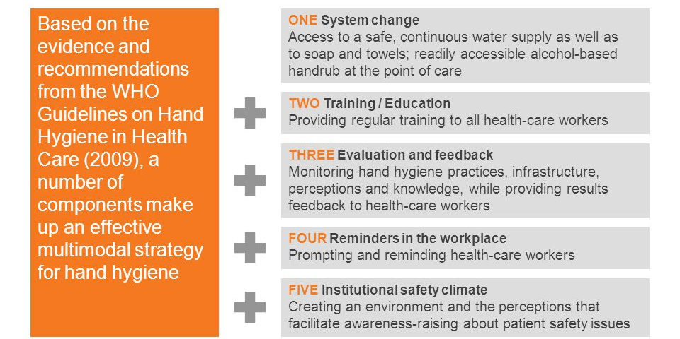
WHO multimodal improvement model

Slide 15
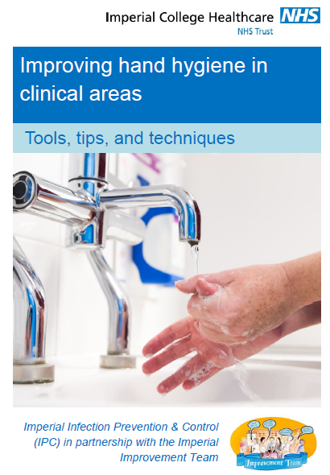
Improvement journey
All wards: locally developed improvement plans.
“Focus wards” with lowest audit results selected to create locally development improvement plans supported by the Improvement Team and IPC.
Specific staff groups: therapists targeted for further support.

Slide 16
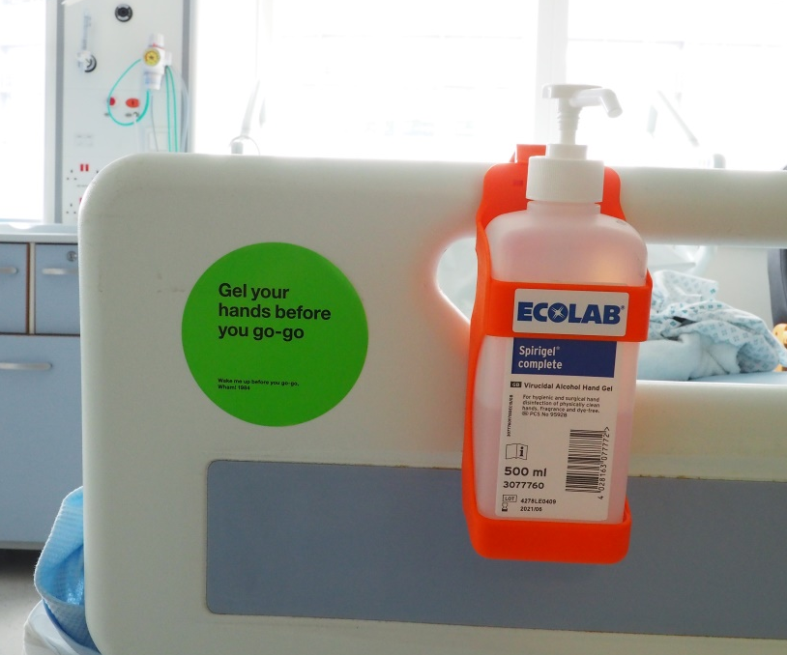
Communications – awareness campaign

Slide 17
Impact – real improvement
Hand hygiene compliance trends in the “focus” wards.

Slide 18
Impact – real improvement
Hand hygiene compliance trends by staff group.

Slide 19
Impact – more work to do
Overall hand hygiene compliance trend. Number of observations = 3560 in May 2018, 1576 in November 2018, 3083 in February 2019, and 2410 in September 2019.

Slide 20
Summary
Hand hygiene improvement must start with accurate information on hand hygiene practice.
Pick a tool any tool for improvement; it will work only if it’s locally owned.
We need to think of fresh ways to reach staff.

Slide 21
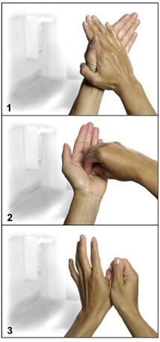
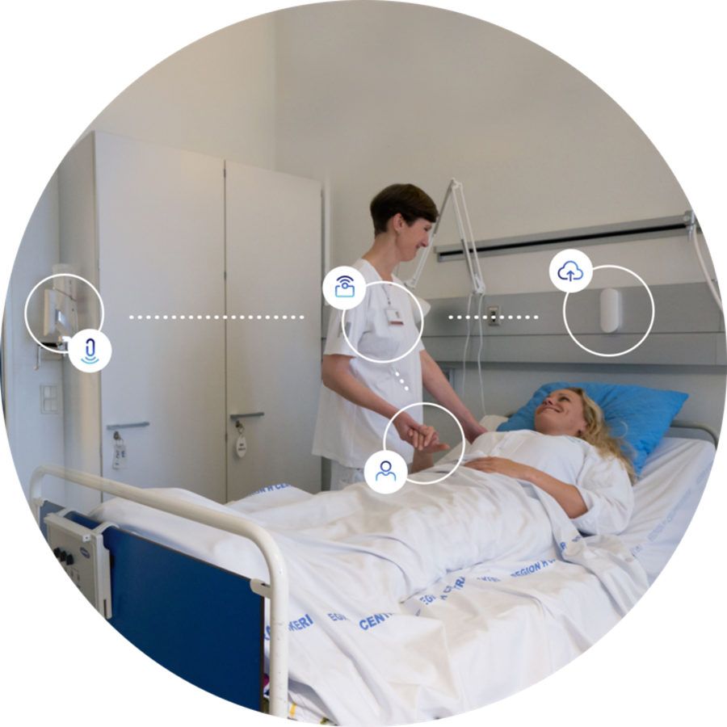
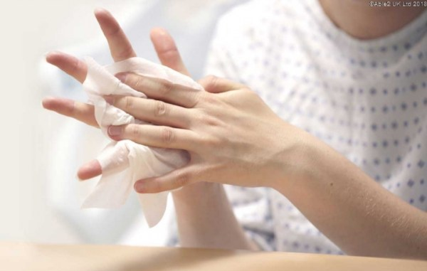
Future perspectives

Slide 22

0.2%
de Leon Rosales et al. Lancet Infect Dis 2005;5:131-2.

Slide 23
The hand hygiene journey (improving the accuracy of audit & QI)
Jon Otter PhD FRCPath
Honorary Senior Lecturer, Imperial College London
jon.otter@nhs.net
@jonotter
Blog: www.ReflectionsIPC.com
Slides: www.jonotter.net

