Slide 1



HCAI & AMR – an overview
27 February 2020
Jon Otter, PhD FRCPath
Imperial College London
j.otter@imperial.ac.uk
@jonotter
Blog: www.ReflectionsIPC.com
Slides: www.jonotter.net

Slide 2


Slide 3
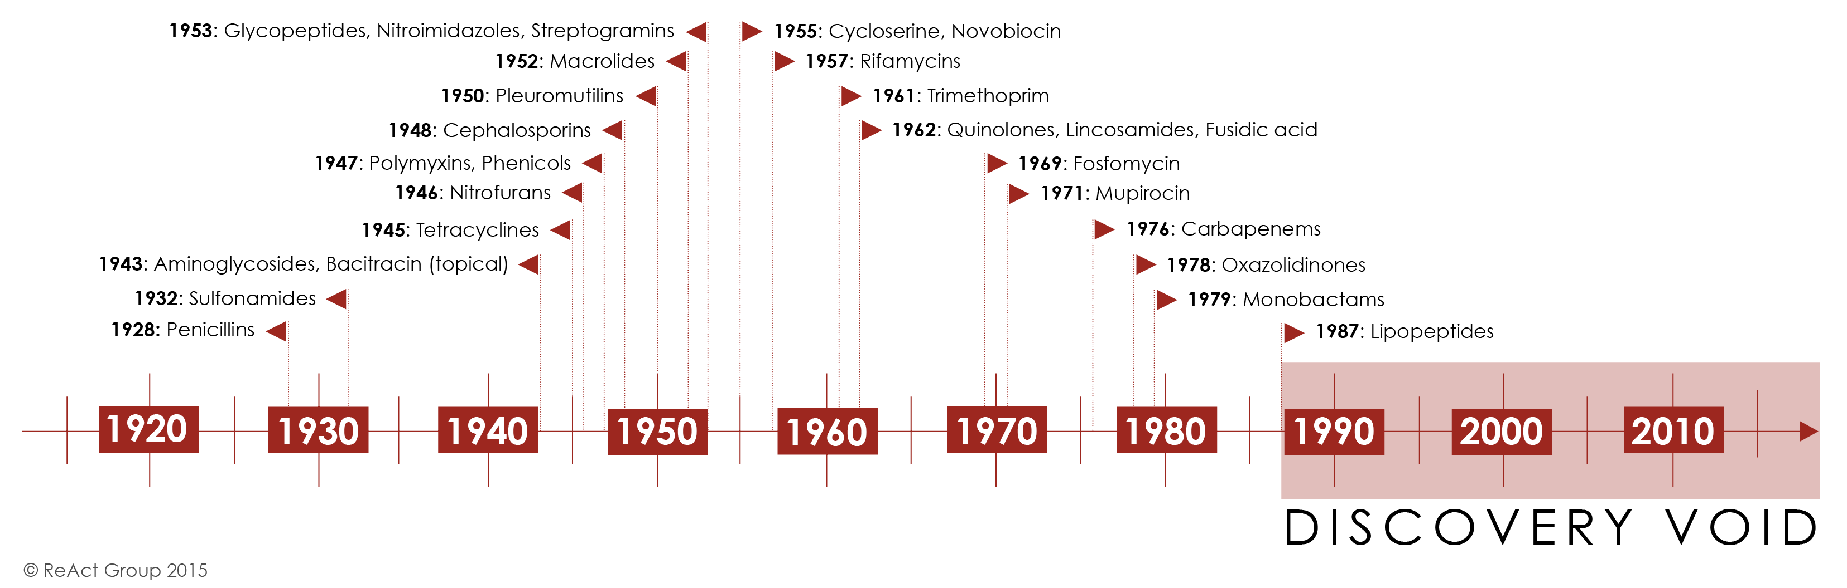
ReAct.

Slide 4
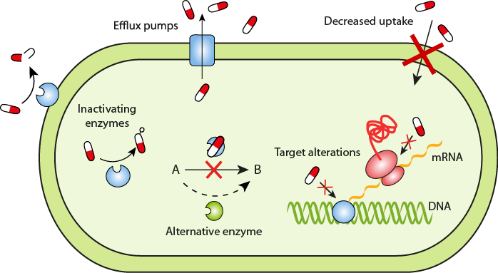
ReAct.

Slide 5
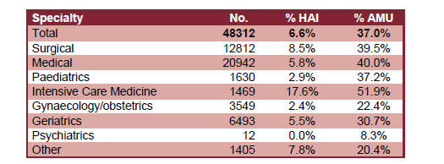
Prevalence of HCAI
The 2016 national PPS was a huge undertaking that included 48,312 patients from 88 NHS Trusts and 6 private hospitals.
7% of patients had an HCAI and 33% were on an antimicrobial.
Pneumonia was the most common HCAI (29%) followed by UTI (17%) then SSI (15).
Prevalence of peripheral vascular cannula (43%), central venous catheters (7%), urinary catheters (20%), and intubation (2%).
HCAI and antimicrobial use by speciality.
ESPAUR Report 2017.

Slide 6
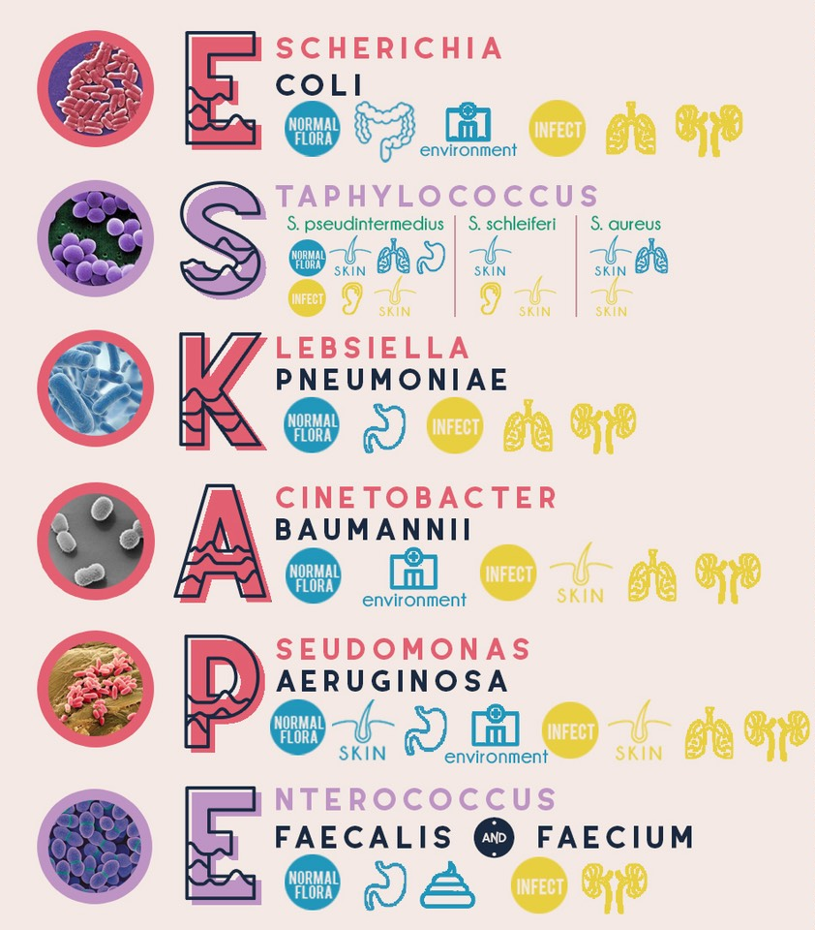
Source: DMAP.
Source: ESPAUR 2017.

Slide 7
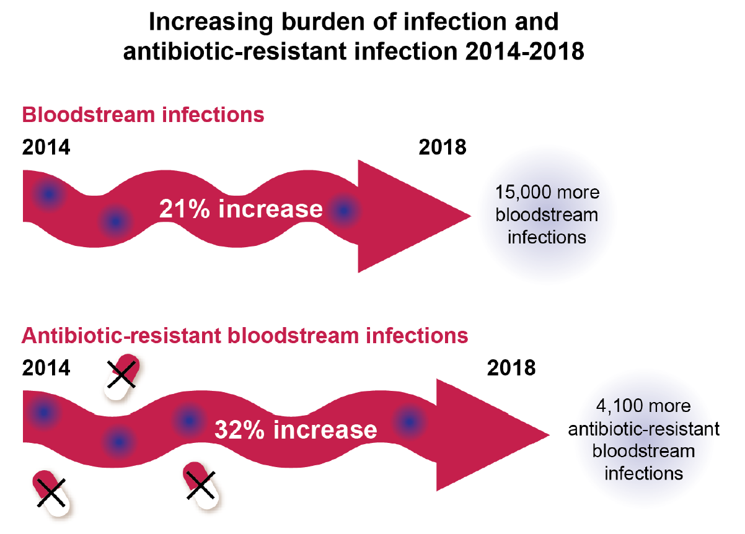
ESPAUR 2019.

Slide 8

AMR bacteria

Slide 9
MRSA

Slide 10
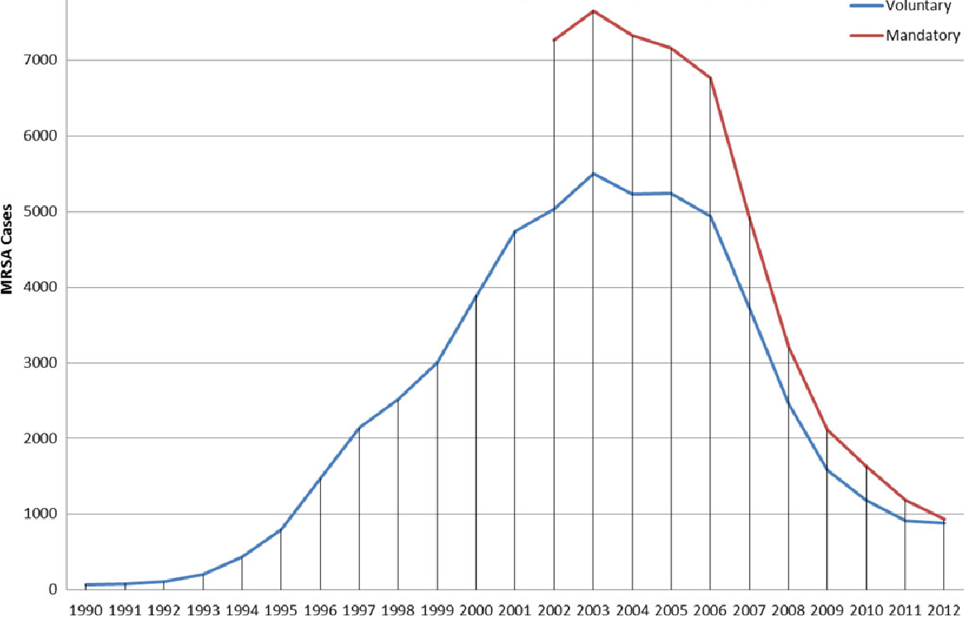
MRSA bacteraemia, England 1990-2012
Duerden et al. Open Forum Infect Dis 2015.

Slide 11
MRSA bacteraemia, England 2001-2013
4
5
6
Mandatory reporting, 2001
‘Gettting ahead of the curve’, 2002
‘Winning ways’, 2003
‘Towards cleaner hospitals’, 2004
‘Cleanyourhands’, 2004
Targets introduced, 2004
Cleanliness improvement, 2005
‘Going further faster’, 2006
Root cause analysis, 2006
Revised national guidelines, 2006
Deep clean, 2007
Screening elective admissions, 2008
Universal screening, 2010
8
9
10
3
7
1
2
11
12
13

Slide 12
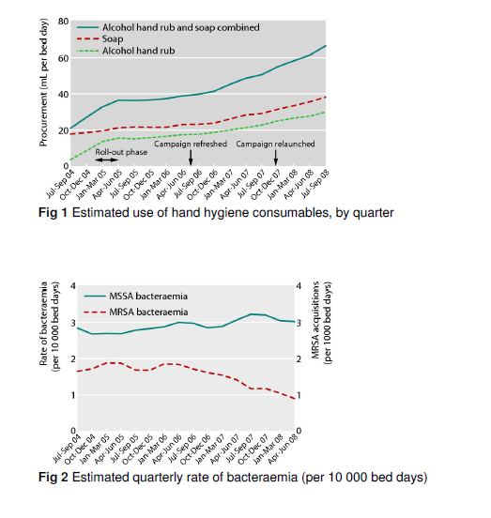
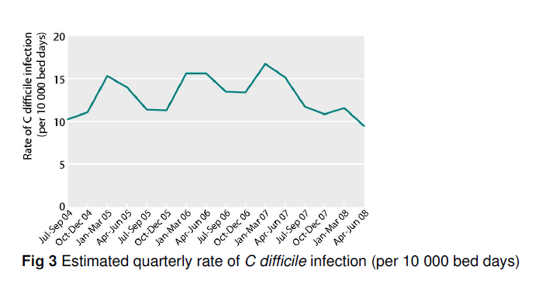
Does hand hygiene explain the reductions?
‘The Cleanyourhands campaign was associated with sustained increases in hospital procurement of alcohol rub and soap, which the results suggest has an important role in reducing rates of some healthcare associated infections.’
Stone et al. BMJ 2012;344:e3005.

Slide 13
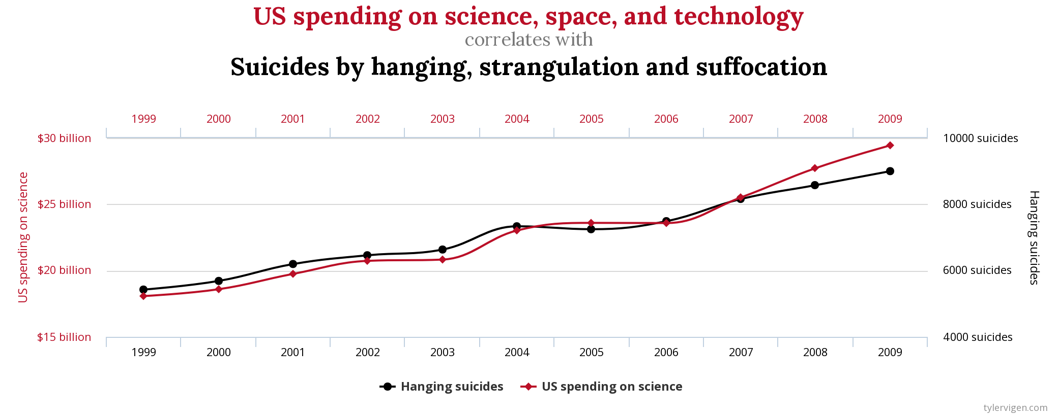
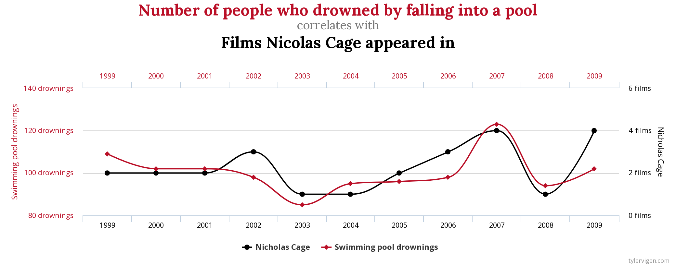
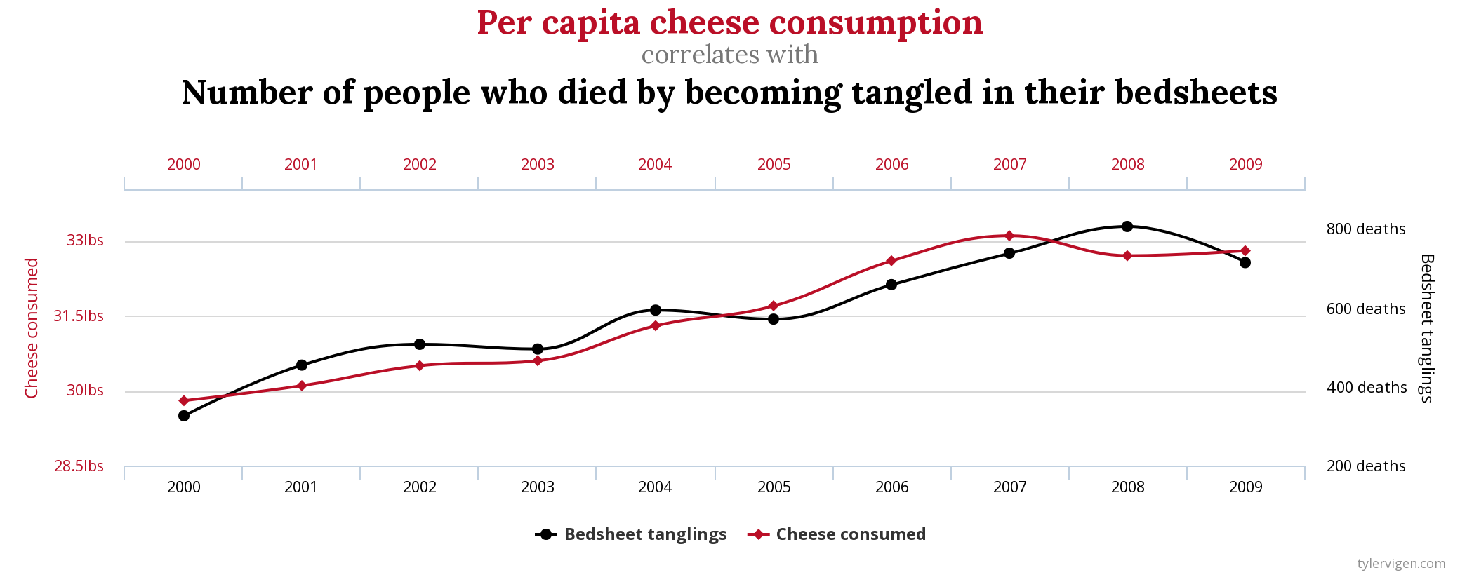
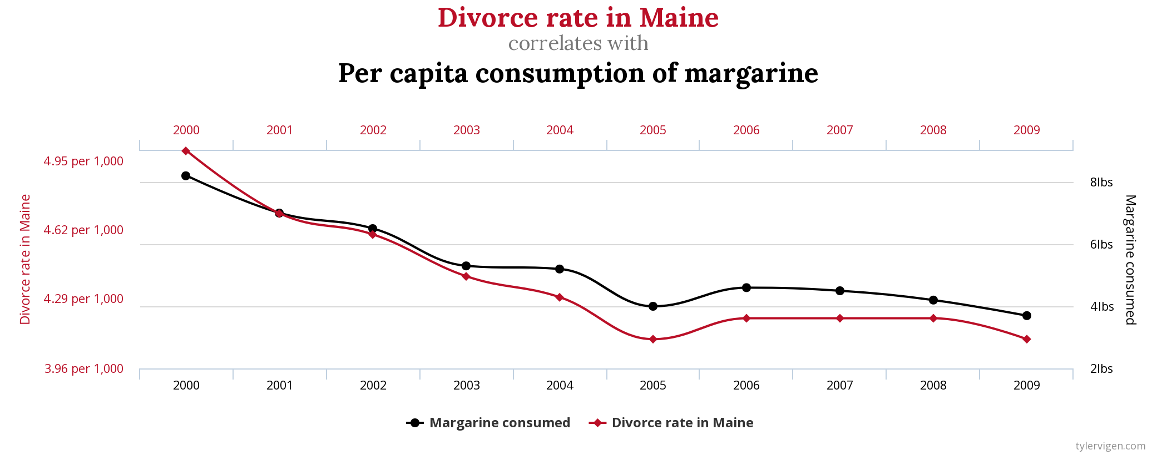
Spurious correlations
http://www.tylervigen.com/spurious-correlations

Slide 14
Spurious correlations
http://www.tylervigen.com/spurious-correlations

Slide 15
Spurious correlations
http://www.tylervigen.com/spurious-correlations

Slide 16
MRSA bacteraemia, England 2001-2013
4
5
6
Mandatory reporting, 2001
‘Gettting ahead of the curve’, 2002
‘Winning ways’, 2003
‘Towards cleaner hospitals’, 2004
‘Cleanyourhands’, 2004
Targets introduced, 2004
Cleanliness improvement, 2005
‘Going further faster’, 2006
Root cause analysis, 2006
Revised national guidelines, 2006
Deep clean, 2007
Screening elective admissions, 2008
Universal screening, 2010
8
9
10
3
7
1
2
11
12
13

Slide 17
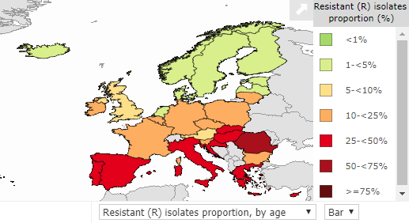
MRSA in Europe, 2016
% invasive S. aureus isolates resistant to meticillin.
EARS-Net 2018.

Slide 18
MRSA in Europe, 2000 to 2016
% invasive S. aureus isolates resistant to meticillin.
EARS-Net 2018.

Slide 19
CPE

Slide 20
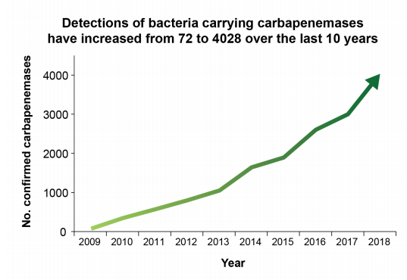
Emergence of CPE in the UK
ESPAUR 2019.

Slide 21
The emerging threat of CPE
Pathogen | CPE | MRSA | VRE | C. difficile
Resistance | +++ | + | + | +/-
Resistance genes | Multiple | Single | Single | n/a
Species | Multiple | Single | Single | Single
HA vs CA | HA & CA | HA | HA | HA
At-risk pts | All | Unwell | Unwell | Old
Virulence | +++ | ++ | +/- | +
Environment | +/- | + | ++ | +++

Slide 22
Creating a monster
Enterobacteriaceae
ESBLs
CPE
Extended-spectrum beta-lactams
Carbapenems

Slide 23
CPE
Rapid spread
Clinical impact
£
AMR

Slide 24
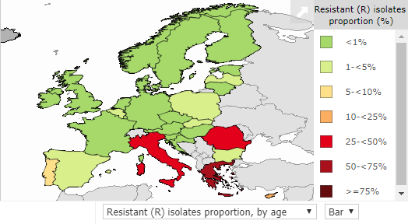
CRE in Europe, 2016
% invasive K. pneumoniae isolates resistant to carbapenems
EARS-Net 2018.

Slide 25
Emergence of CRE in Europe, 2005-2016
EARS-Net 2018.

Slide 26
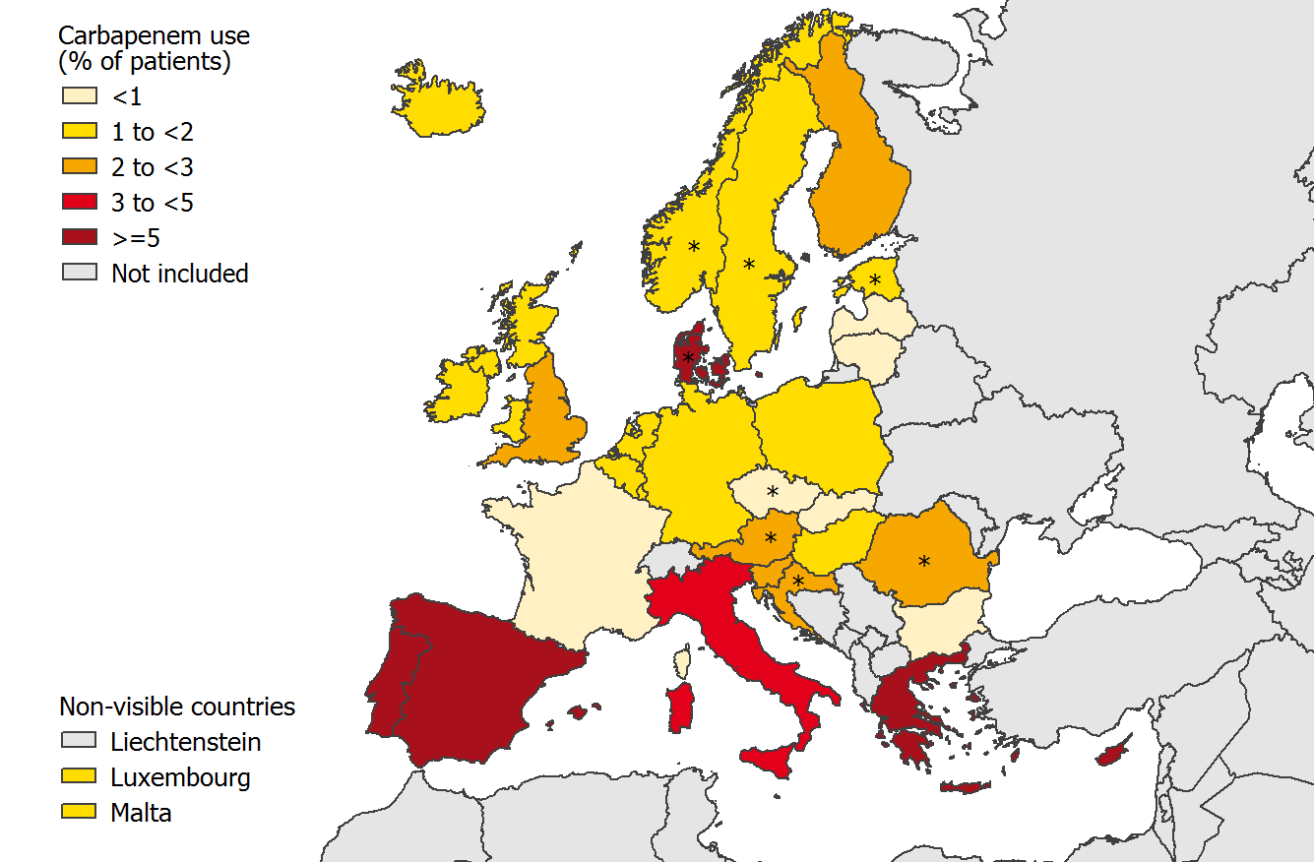
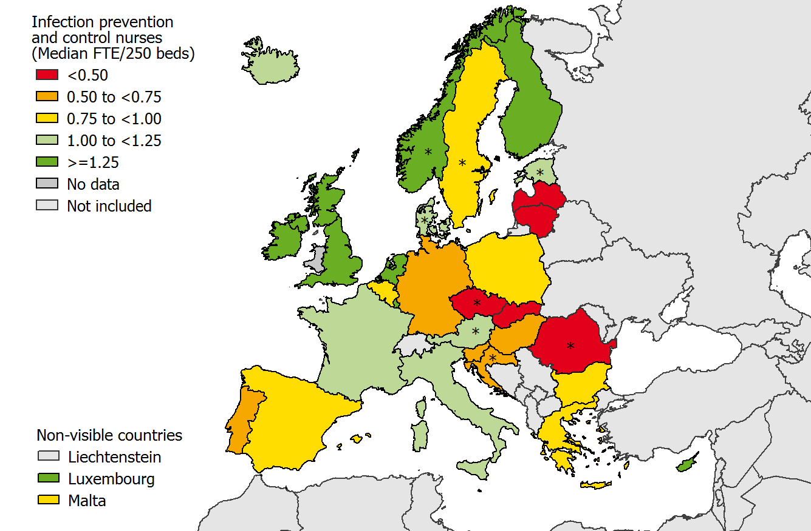
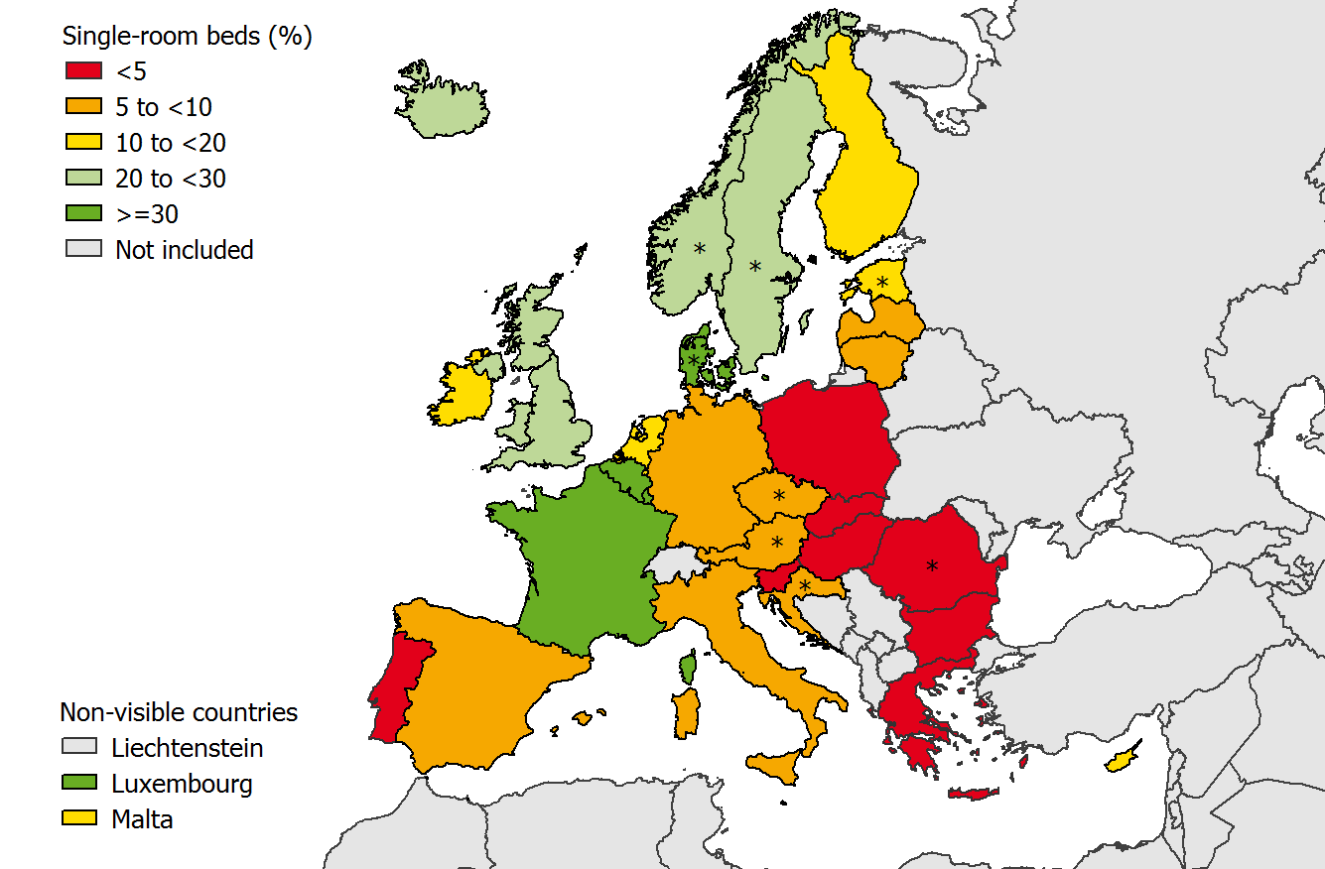
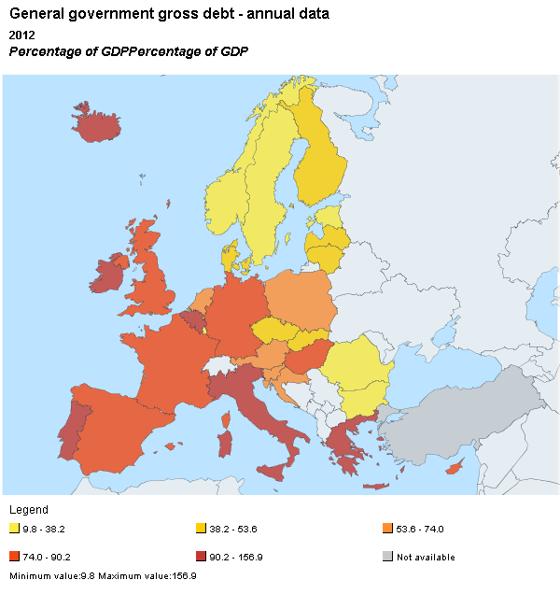
What drives the European ‘north-south divide’?
Antibiotic use
Infection control staffing
Single room availability
National debt
1. ECDC Point Prevalence Survey, 2013.
2, National debt as a percentage of GDP. "Eurostat public debt GDP" by Eurostat. Licensed under Attribution via Wikimedia Commons.

Slide 27
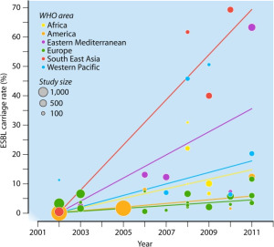
Social and material deprivation
We performed a risk factor analysis, which included both individual-level variables (such as overseas travel, antibiotic exposure, and age) and were also able to include community-level variables (such as markers of household overcrowding, deprivation, immigration, and ethnicity).
We found that risk factors for ESBL were travel to Asia (OR 4.4, CI 2.5-7.6), or Africa (OR 2.4, CI 1.2-4.8) in the 12 months prior to admission, two or more courses of antibiotics in the 6 months prior to admission (OR 2.0, CI 1.3-3.0), and residence in a district with a higher than average prevalence of overcrowded households (OR 1.5, CI 1.05-2.2).
The global prevalence of ESBL in the community, from Woerther et al.
Otter et al. Clin Microbiol Infect 2019.

Slide 28
CRE in the USA
NHSN / NNIS data; MMWR 2013;62:165-170.

Slide 29
Prevention is better than cure
Reduced antibiotic use
Improved diagnostics
Surveillance for action
Phages and vaccines
Highlight high cost of AMR
New antibiotics
Public awareness
Pay and recognition for AMR folk
Based on Laxminarayan et al. Lancet Infect Dis 2013;13:1057-1098, and Review on AMR.

Slide 30
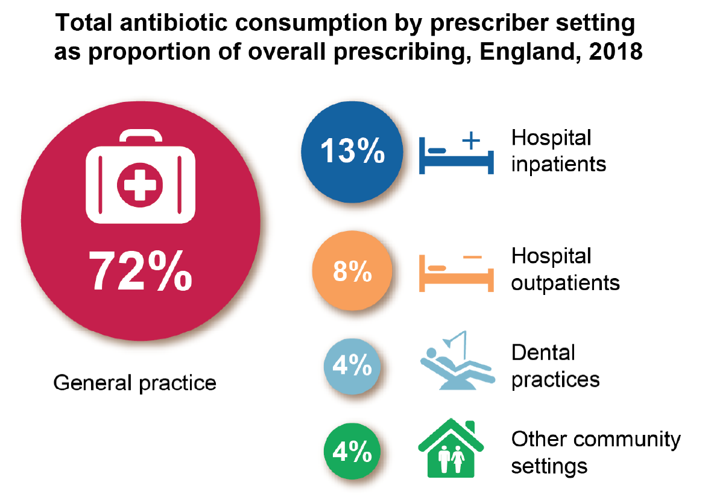
ESPAUR 2019.

Slide 31
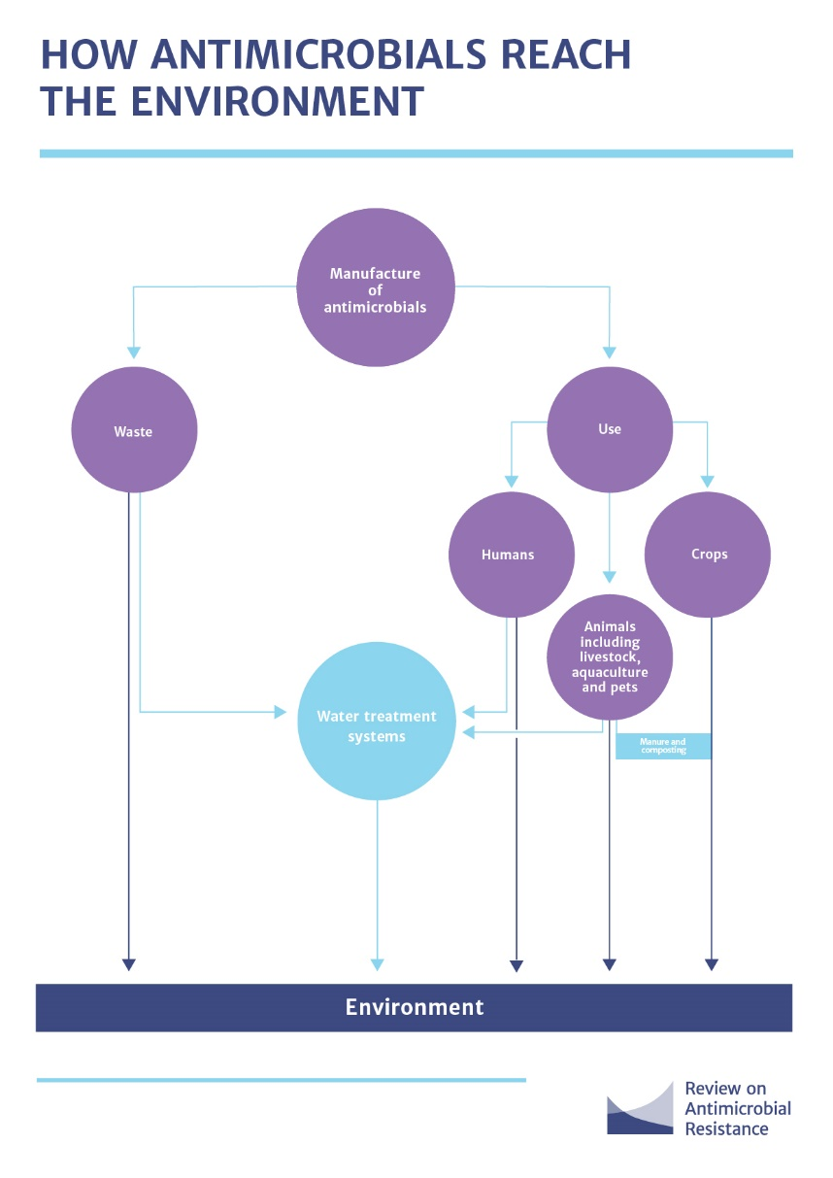
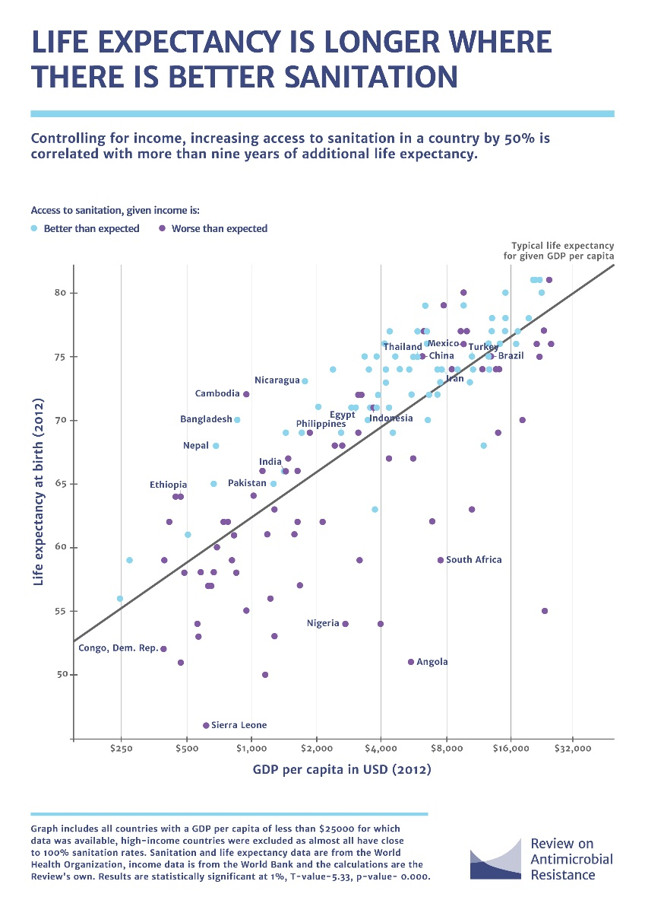

Slide 32
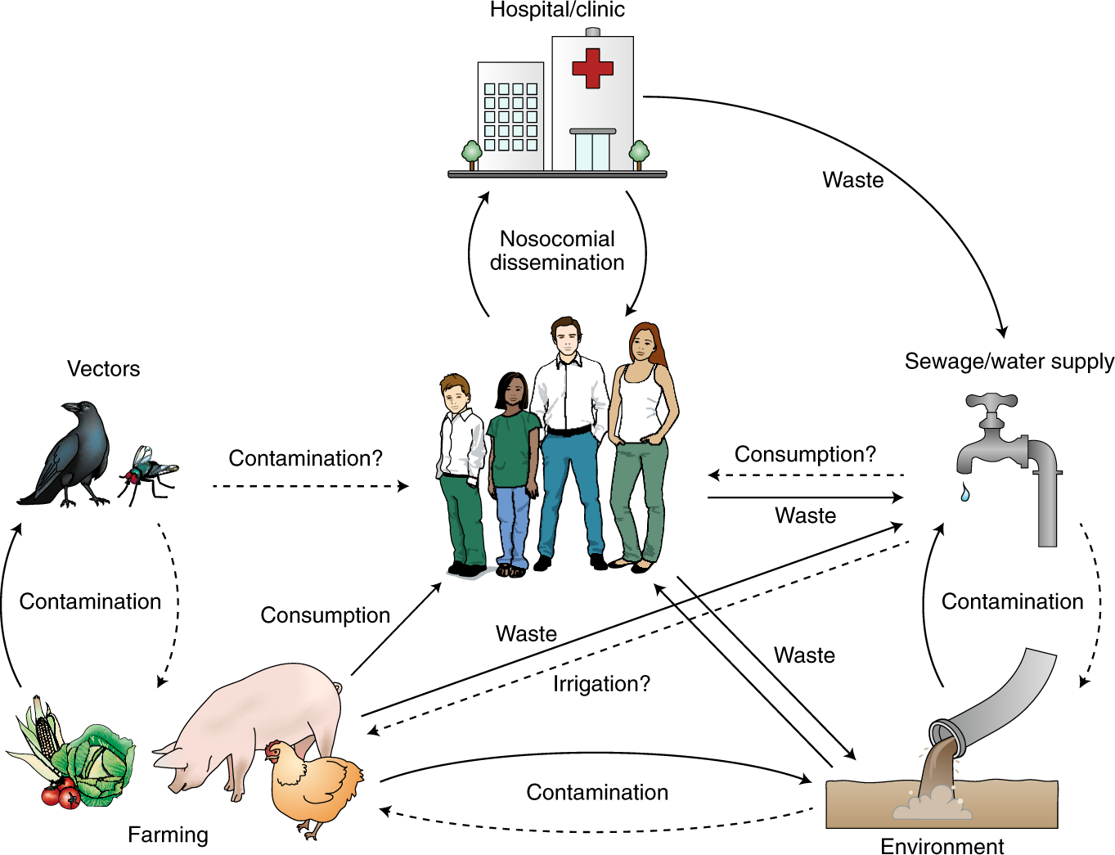
Walsh T. Nature Microbiol 2018.

Slide 33
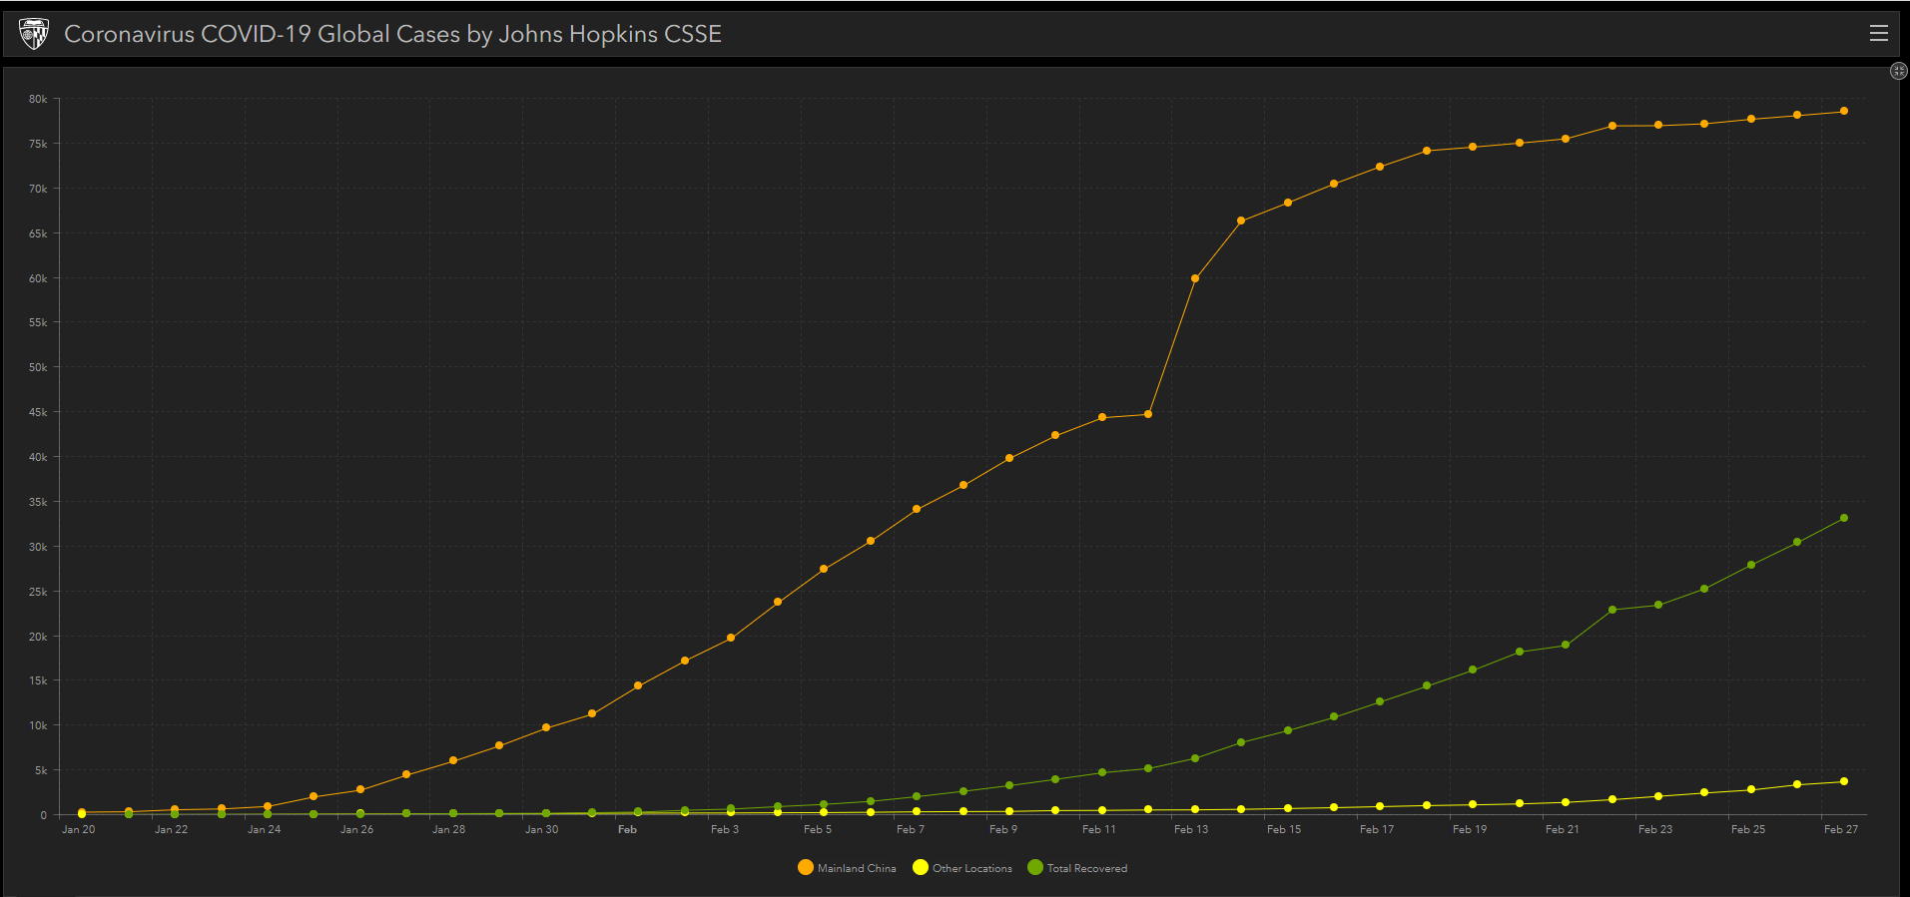
Johns Hopkins Coronavirus Dashboard.

Slide 34
HCAI & AMR – an overview
27 February 2020
Jon Otter, PhD FRCPath
Imperial College London
j.otter@imperial.ac.uk
@jonotter
Blog: www.ReflectionsIPC.com
Slides: www.jonotter.net

