Slide 1




How “smart surfaces” can be applied in clinical settings to improve patient outcomes
04 March 2020
Jon Otter, PhD FRCPath
Imperial College London
j.otter@imperial.ac.uk
@jonotter
Blog: www.ReflectionsIPC.com
Slides: www.jonotter.net

Slide 2
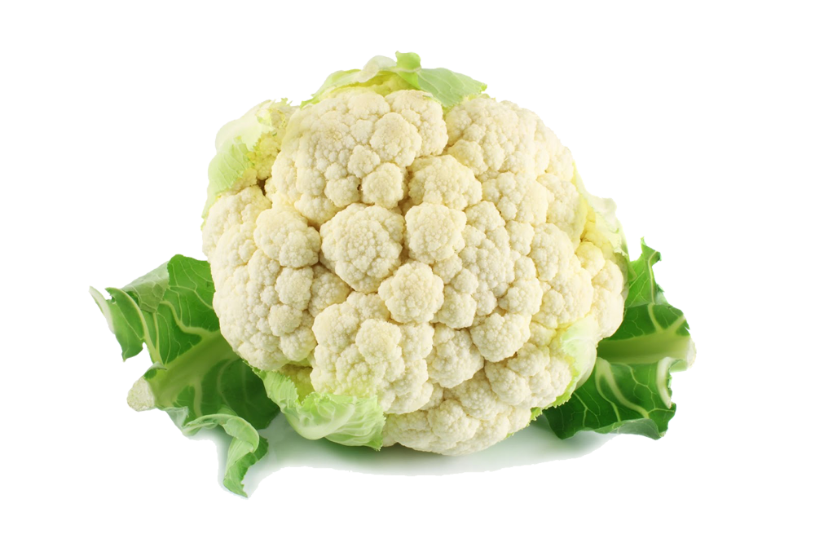

Slide 3

Transfer of a surrogate marker in a NICU
Oelberg et al. Pediatrics 2000;105:311-315.

Slide 4

Transfer over time: inoculated pod
Oelberg et al. Pediatrics 2000;105:311-315.

Slide 5

Your hospital room can make you sick!
Mitchell et al. J Hosp Infect 2015;91:211-217.

Slide 6
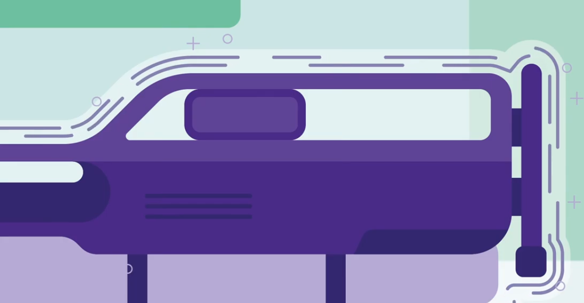

Slide 7
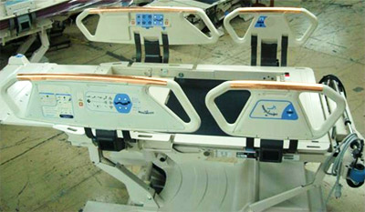

Slide 8
“Smart” touch surfaces
614 pts in 3 hospitals randomised to ‘copper’ or ‘non-copper’ ICU rooms
Bedrails
Overbed tables
IV poles
Visitor chair arms
Nurse call button*
Computer mouse*
Computer palm rest*
Rim of monitor*
(* = some rooms only)
-44%
p=0.020
-58%
p=0.013
Salgado et al. Infect Control Hosp Epidemiol 2013;34:479-486.

Slide 9

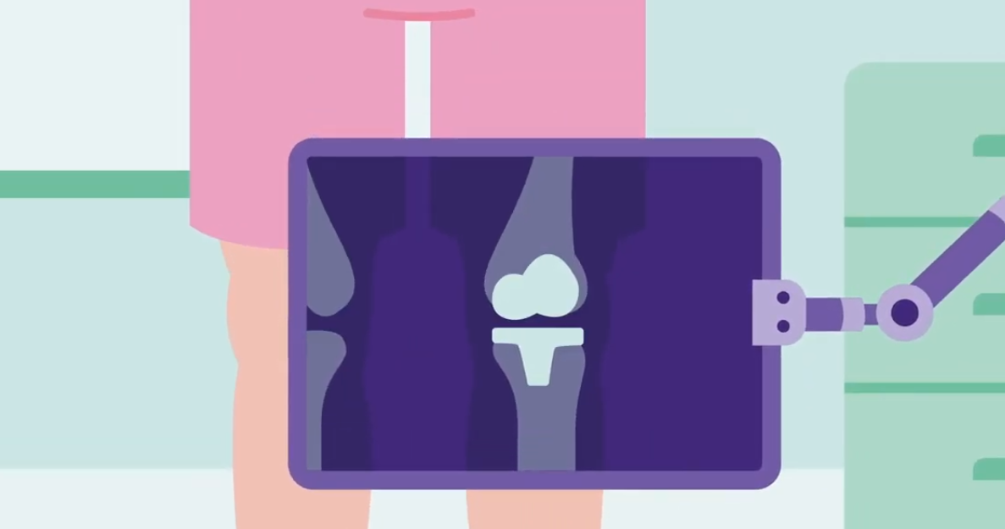
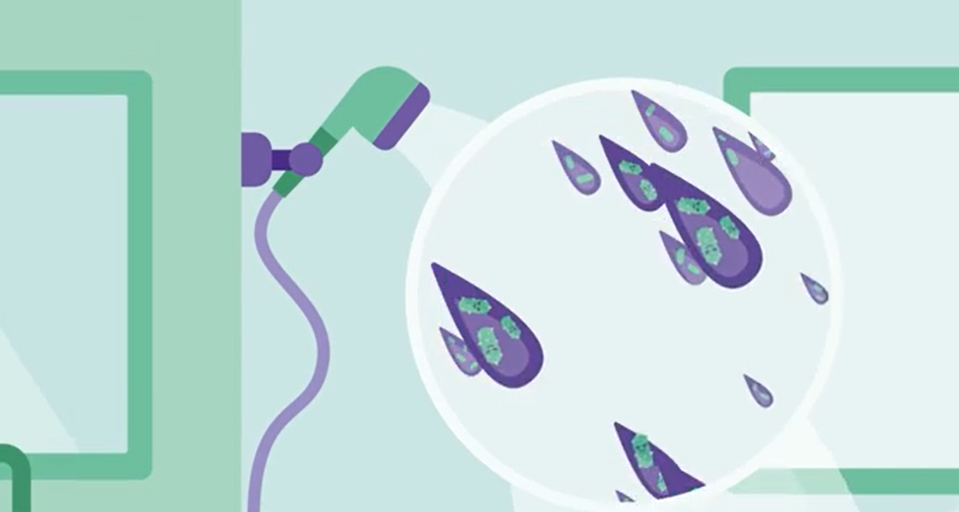

Slide 10
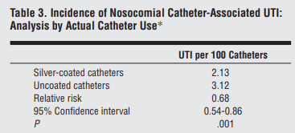
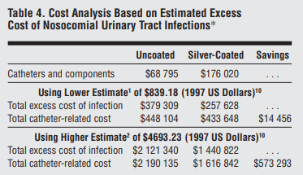
“Smart” medical devices
27,878 patients randomised to either silver-coated or non-silver-coated urinary catheters.
Karchmer et al. Arch Intern Med 2000;160:3294-3298.

Slide 11
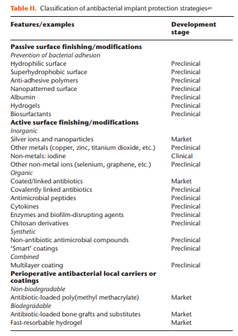
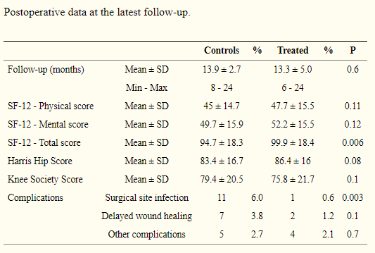
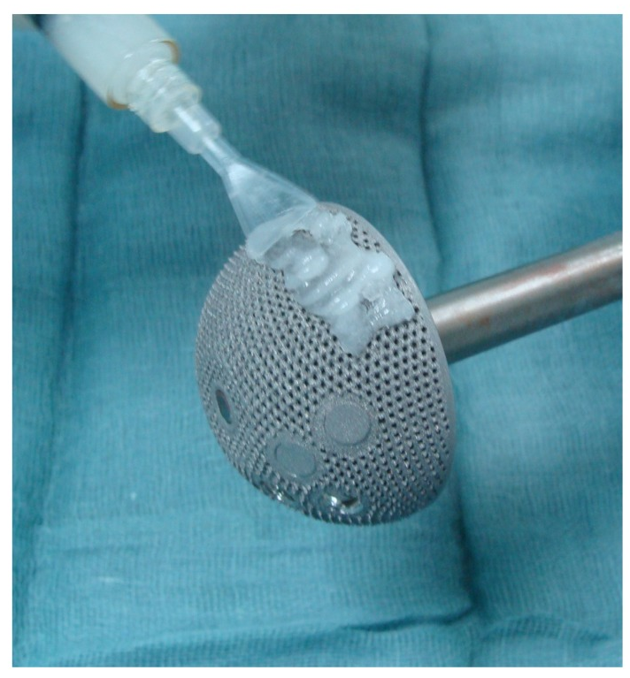
“Smart” indwelling prosthesis
1
380 patients randomised to either hydrogel coated or non-coated prosthesis for total hip or knee arthroplasty.²
Romanò et al. Bone Joint Res 2019;8:199-206.
Romanò et al. J Bone Jt Infect 2016;1:34-41.

Slide 12
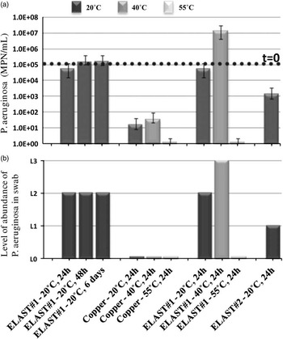
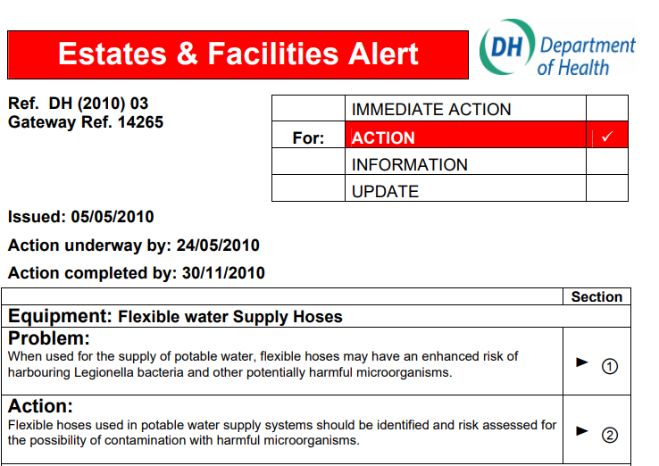
“Smart” plumbing
Laboratory comparison of Pseudomonas aeruginsa growth on flexible plastic hoses and copper pipes.
Charron et al. Infect Control Hosp Epidemiol 2015;36:311-319.

Slide 13
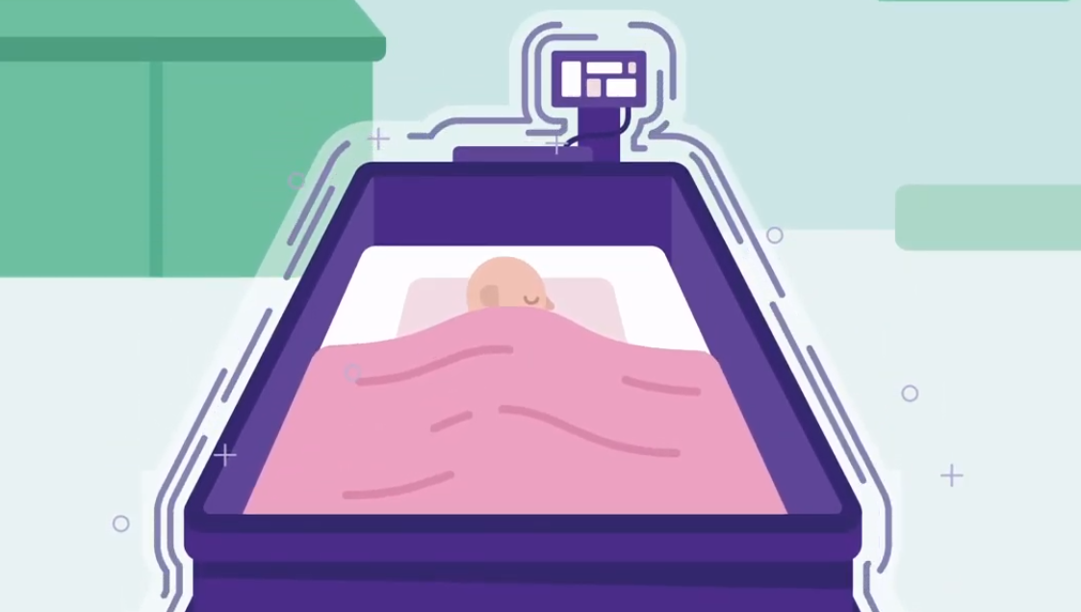

Slide 14
How “smart surfaces” can be applied in clinical settings to improve patient outcomes
04 March 2020
Jon Otter, PhD FRCPath
Imperial College London
j.otter@imperial.ac.uk
@jonotter
Blog: www.ReflectionsIPC.com
Slides: www.jonotter.net

