Slide 1
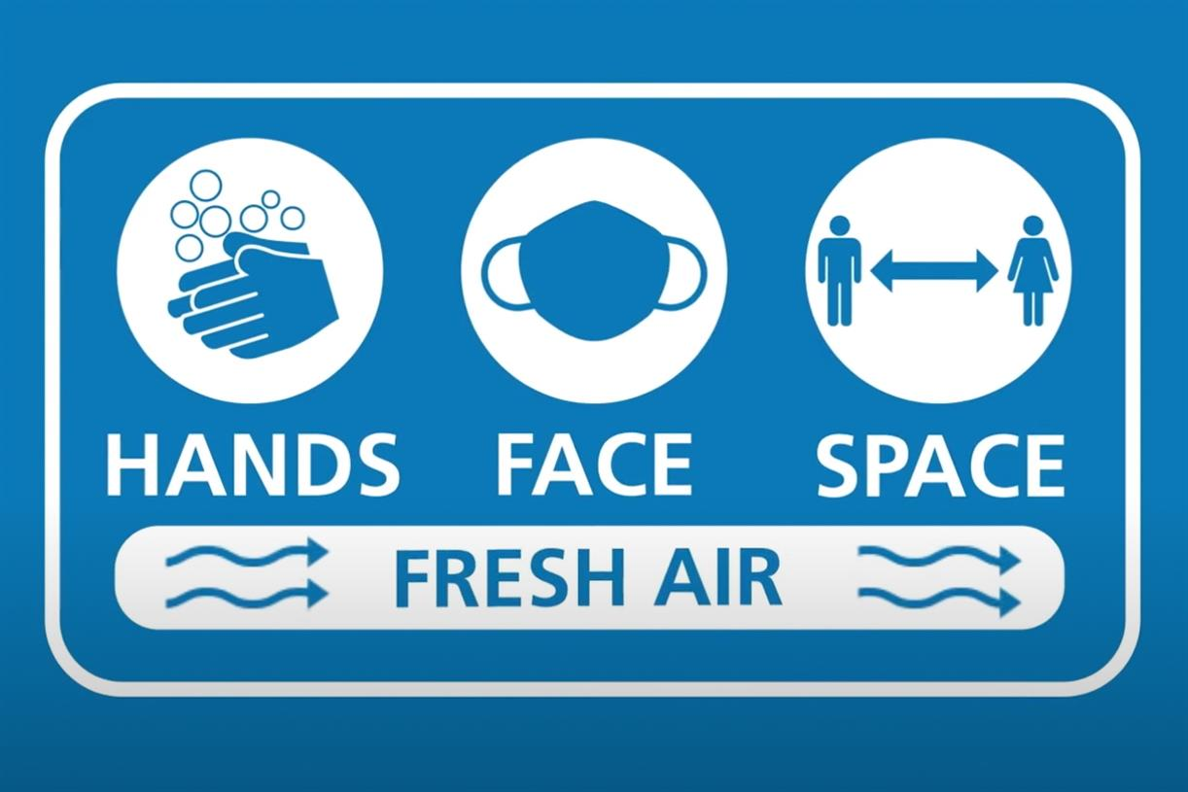


Ventilation across health and social care settings following the COVID-19 pandemic
Jon Otter PhD FRCPath
j.otter@imperial.ac.uk
@jonotter

Slide 2




Slide 3


Slide 4
Transmission routes
Innovation
Guidelines and evolving policy
PPE
Other pathogens
Engineering controls

Slide 5
Transmission routes
Innovation
Guidelines and evolving policy
PPE
Other pathogens
Engineering controls

Slide 6
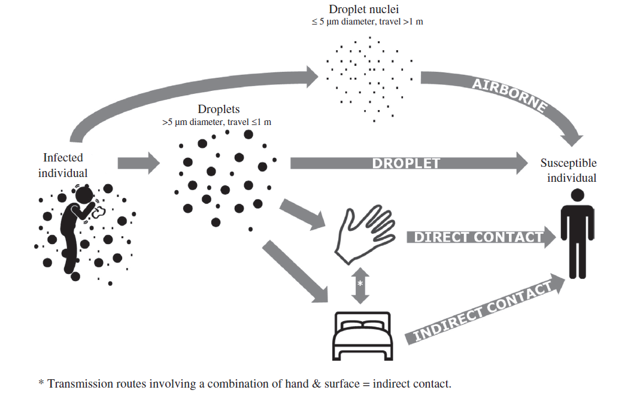
Transmission routes
AGP?
Otter et al. J Hosp Infect 2016.

Slide 7
Pooled SAR for SAR-CoV-2 transmission in various settings
Setting | Pooled SAR | 95% Confidence Interval
Households | 21.1% | 17.4% – 24.8%
Social gatherings with family and friends | 5.9% | 3.8% – 8.1%
Travel | 5.0% | 0.3% – 9.8%
Healthcare | 3.6% | 1.0% – 6.9%
Workplace | 1.9% | 0.0% – 3.9%
Casual close contacts | 1.2% | 0.3% – 2.1%
https://www.imperial.ac.uk/media/imperial-college/medicine/mrc-gida/2020-11-27-COVID19-Report-38.pdf

Slide 8
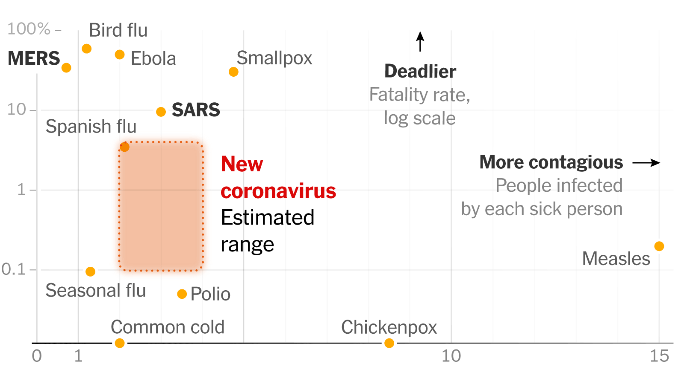
Average case-fatality rate (log scale)
R₀
New York Times.

Slide 9
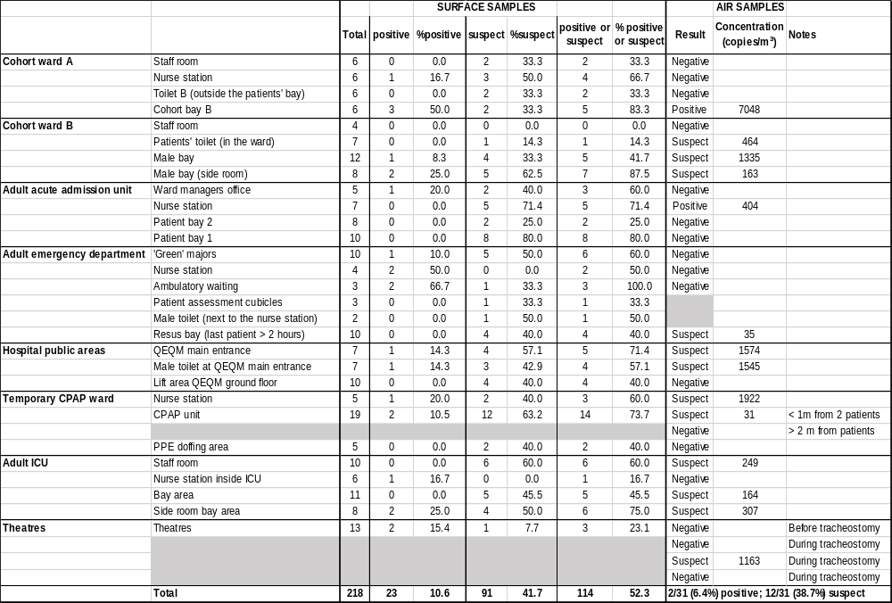
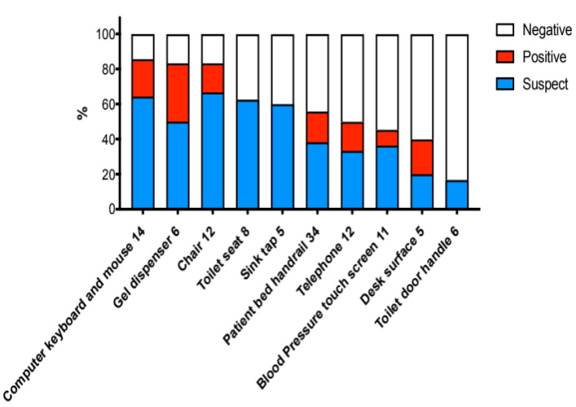
Investigating SARS-CoV-2 surface and air contamination
Overall percentage of surface and air samples positive for SARS-CoV-2 RNA in April 2020; 218 surfaces and 27 air samples were collected in April 2020.
Zhou et al. Clin Infect Dis 2020.

Slide 10
Dismantling “airborne” myths
1. ‘aerosols are droplets with a diameter of 5 μm or less’
2. ‘all particles larger than 5 μm fall within 1–2 m of the source’
3. ‘if it is short range, it cannot be airborne’
4. ‘if the basic reproductive number, R0, is not as large as for measles, then it cannot be airborne’
5a. ‘If it is airborne, surgical masks (or cloth face coverings) will not work’
5b. ‘the virus is only 100 nm (0.1 μm) in size so filters and masks will not work’
6. ‘unless it grows in tissue culture, it is not infectious’
Tang et al. J Hosp Infect 2021.

Slide 11

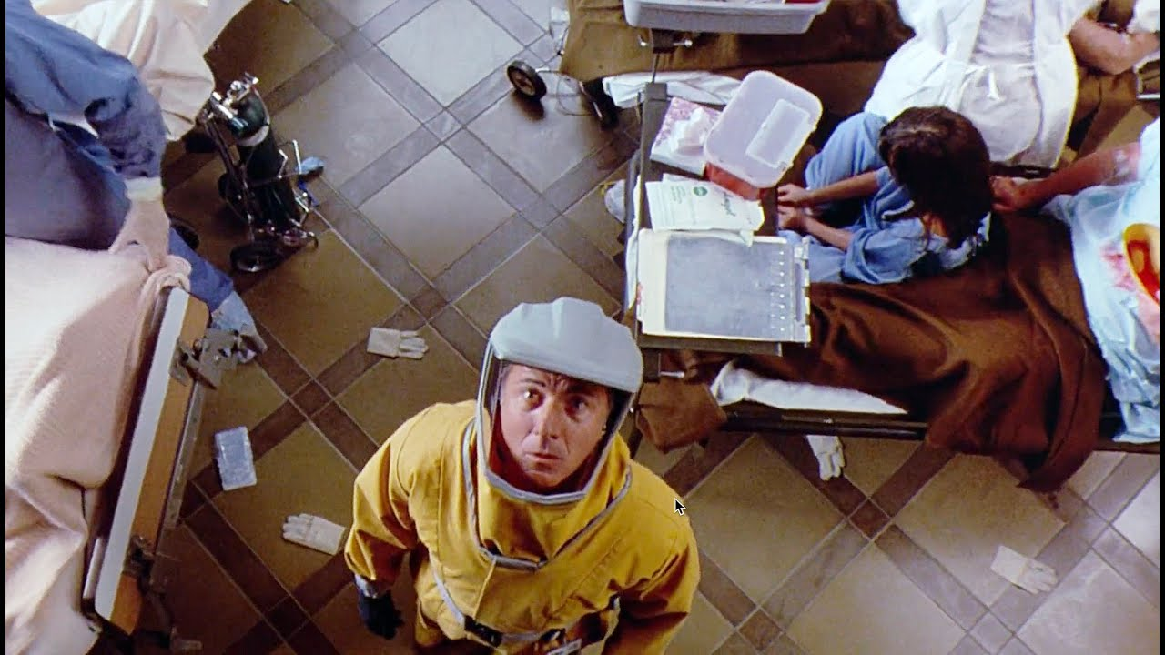
‘…the greatest medical crisis in the world is about to happen.’
Transmission routes (“it’s airborne”)
Role of quarantine
PPE
Lab safety
Image source: http://en.wikipedia.org/wiki/Outbreak_(film) and Youtube.

Slide 12
Transmission routes
Innovation
Guidelines and evolving policy
PPE
Other pathogens
Engineering controls

Slide 13
What do the public health agencies say? WHO
The virus can spread from an infected person’s mouth or nose in small liquid particles when they cough, sneeze, speak, sing or breathe. These particles range from larger respiratory droplets to smaller aerosols.
  Current evidence suggests that the virus spreads mainly between people who are in close contact with each other, typically within 1 metre (short-range). A person can be infected when aerosols or droplets containing the virus are inhaled or come directly into contact with the eyes, nose, or mouth.
  The virus can also spread in poorly ventilated and/or crowded indoor settings, where people tend to spend longer periods of time. This is because aerosols remain suspended in the air or travel farther than 1 metre (long-range).
People may also become infected by touching surfaces that have been contaminated by the virus when touching their eyes, nose or mouth without cleaning their hands.
Coronavirus disease (COVID-19): How is it transmitted?

Slide 14
What do the public health agencies say? CDC
The principal mode by which people are infected with SARS-CoV-2 (the virus that causes COVID-19) is through exposure to respiratory droplets carrying infectious virus.
Respiratory viruses are transmitted in multiple ways (contact, droplet, and airborne routes)
The epidemiology of SARS-CoV-2 indicates that most infections are spread through close contact, not airborne transmission
Airborne transmission of SARS-CoV-2 can occur under special circumstances
  Enclosed spaces within which an infectious person either exposed susceptible people at the same time or to which susceptible people were exposed shortly after the infectious person had left the space.
  Prolonged exposure to respiratory particles, often generated with expiratory exertion (e.g., shouting, singing, exercising) that increased the concentration of suspended respiratory droplets in the air space.
  Inadequate ventilation or air handling.
SARS-CoV-2 and Potential Airborne Transmission

Slide 15
What do the public health agencies say? PHE
SARS-CoV-2 is primarily transmitted between people through respiratory (droplet and aerosol) and contact routes.
Transmission risk is highest where people are in close proximity (within 2 metres).
Airborne transmission can occur in health and care settings in which procedures or support treatments that generate aerosols are performed.
Airborne transmission may also occur in poorly ventilated indoor spaces, particularly if individuals are in the same room together for an extended period of time.
COVID-19: epidemiology, virology and clinical features

Slide 16
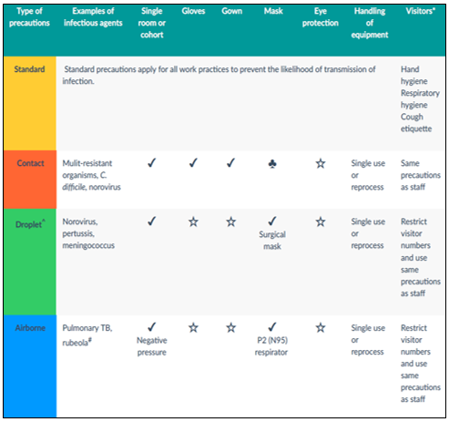
Standard and transmission-based precautions
♣ Surgical mask required if infectious agent located in sputum
☆ Risk assess based on the task at hand
* Visitors should be given instruction about correct procedures
^ Droplets can contaminate surfaces close to the source patient and consideration should be given to the need for additional personal protective equipment (PPE)
# For vaccine preventable disease, where possible, only staff and visitors who have confirmed immunity to the specific infectious agent should enter the room
Australian Guidelines for the Prevention and Control of Infection in Healthcare (2019)

Slide 17
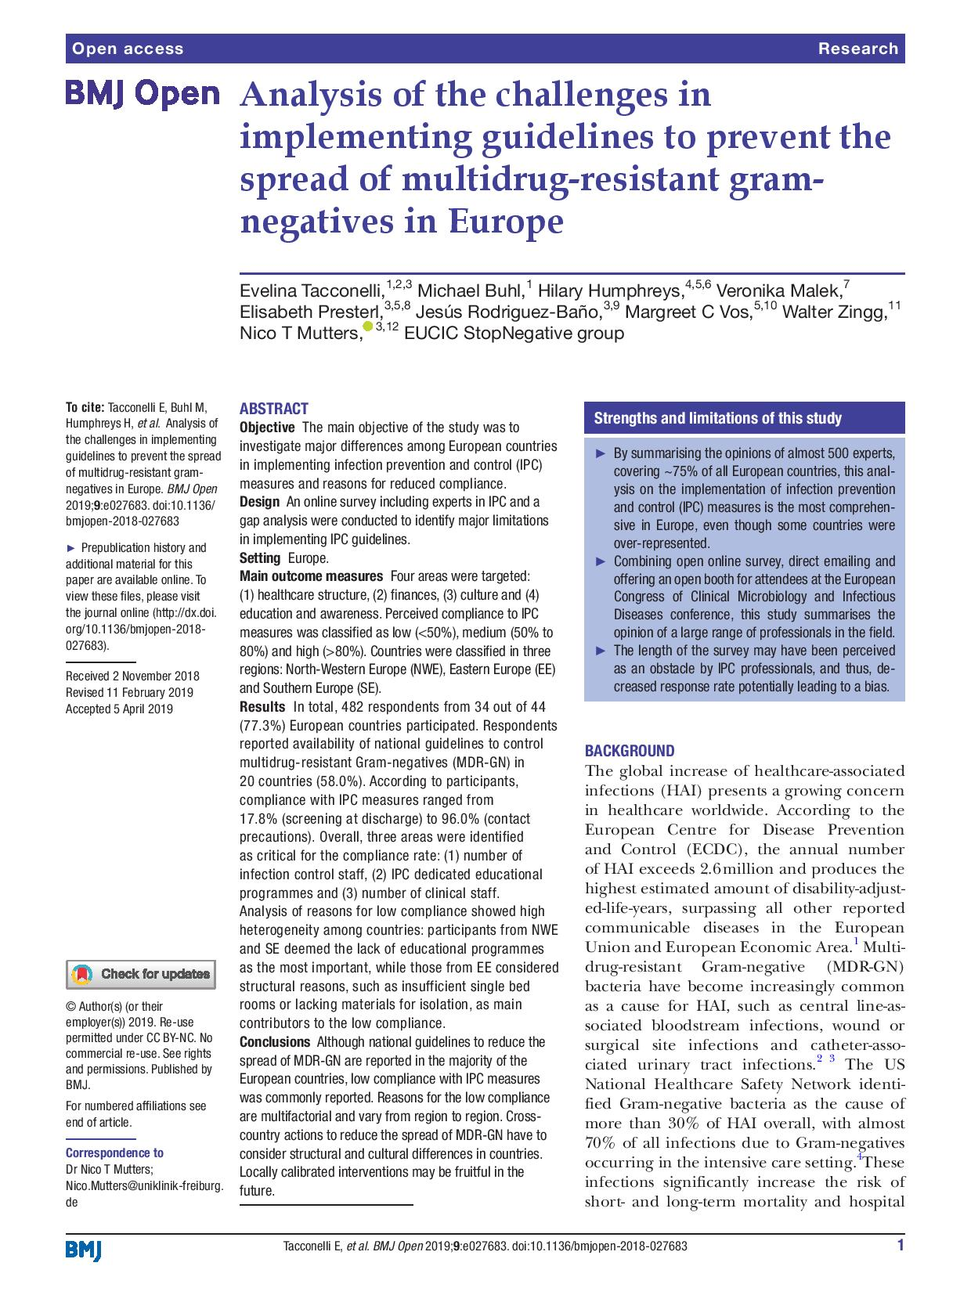
Guidelines and policy development
Consultation process for new guidelines
Timing of new guidelines
Discrepancy between different groups
Implementation gaps
Local interpretation of national guidance
Challenges in developing a local policy

Slide 18
Transmission routes
Innovation
Guidelines and evolving policy
PPE
Other pathogens
Engineering controls

Slide 19
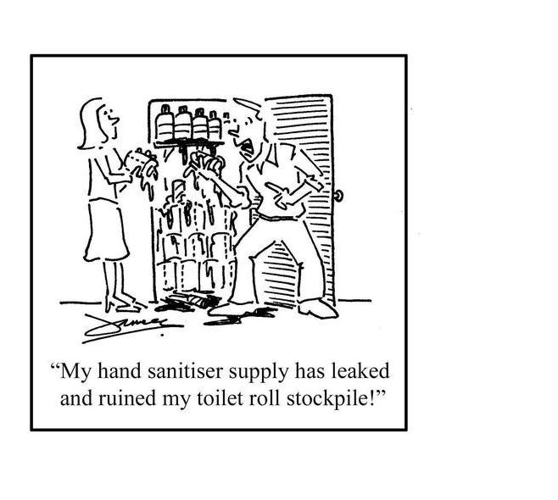
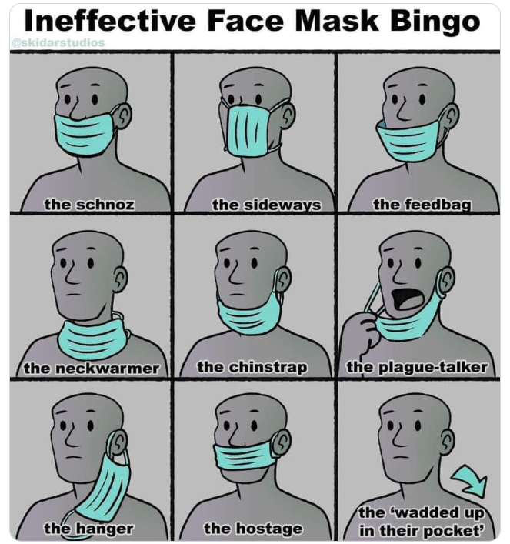

Slide 20
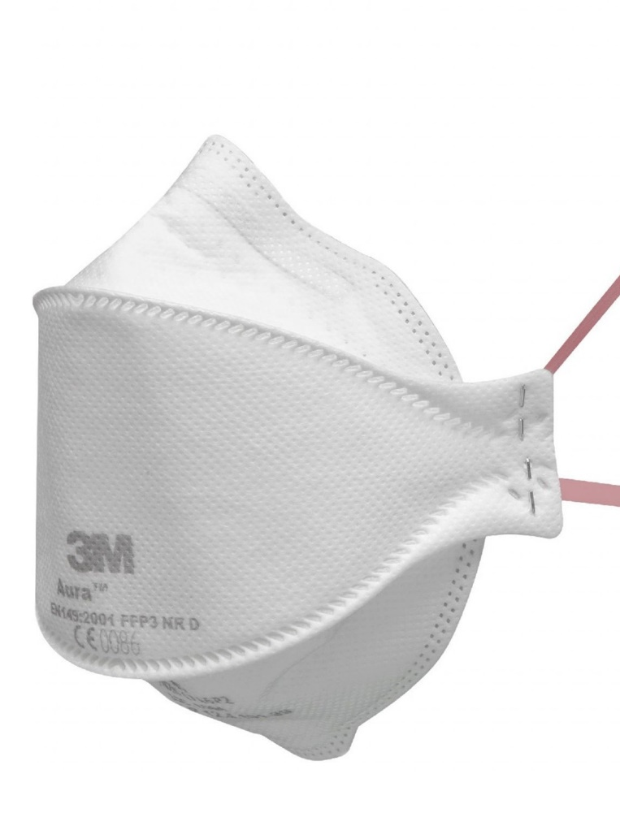
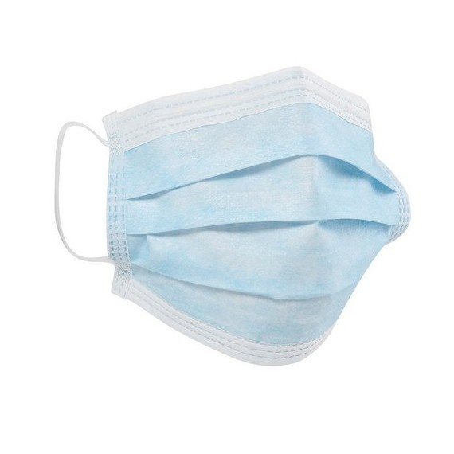

Slide 21

PPE and hand hygiene improvements nudged by COVID-19
Overuse and misuse of PPE results in increased risk to the wearer (through self-inoculation) and increased risk of cross-transmission.^{1, 2}
  Under-appreciated risks related to PPE doffing and disposal.
  Overuse and misuse of gloves/gowns makes hand hygiene harder and results in more cross-transmission.
The pandemic has raised important questions about respiratory protection, especially for AGPs.
  Emerging evidence suggests that mask wearing has reduced all respiratory diseases in inpatients.³
On-the-ground support has proved vital to improving PPE practice and reduce PPE-related anxiety.⁴
[1] Verbeek et al. Cochrane Reviews 2020. [2] Loveday et al. J Hosp Infect 2014; 86 Suppl 1: S1-S70. [3] Chou et al. Annals Intern Med 2020; 173: 542-55.[4] Castro-Sánchez et al. J Hosp Infect 2021; 109: 68-77.
Dynamic PPE risk-assessments will never be the same again!
We understand better how to support staff towards PPE best-practice.

Slide 22
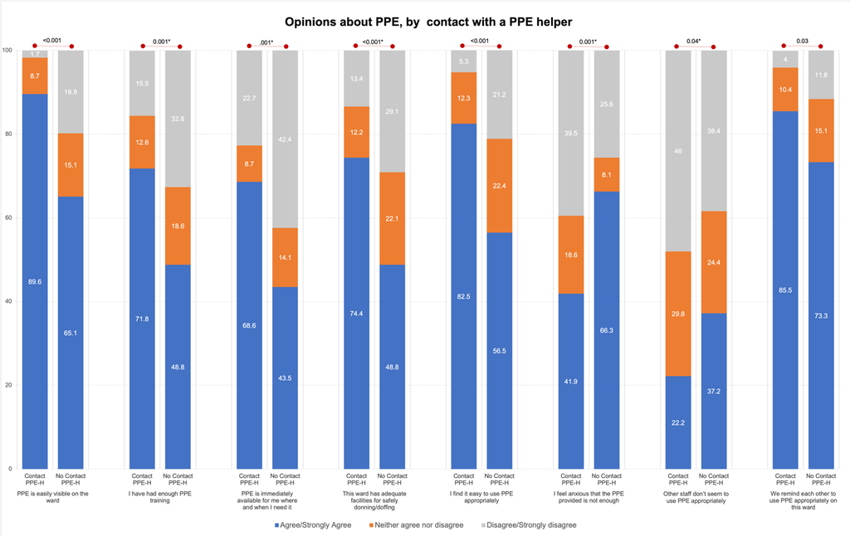
PPE Helper Programme
Staff perceptions around PPE, stratified by contact with a PPE helper (statistically significant findings only).
Castro-Sanchez et al. J Hosp Infect 2021.

Slide 23
Transmission routes
Innovation
Guidelines and evolving policy
PPE
Other pathogens
Engineering controls

Slide 24
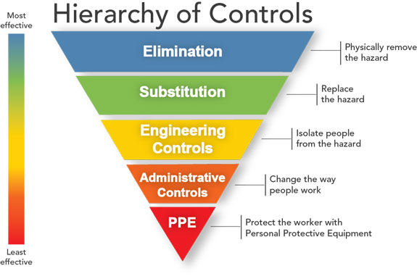
Hierarchy of controls

Slide 25
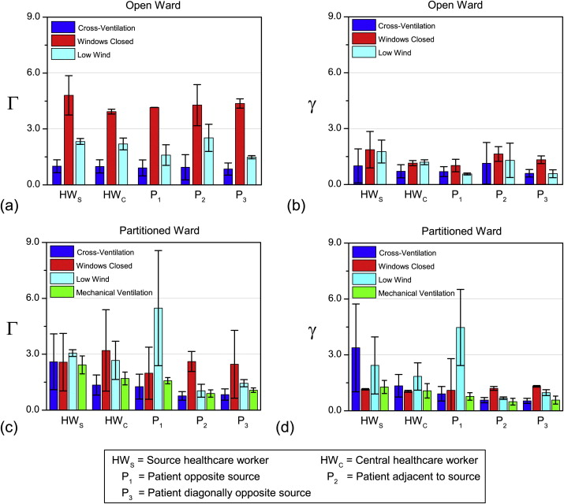
Role for natural ventilation
An experimental study is carried out in a 200 m³ cross-ventilated Nightingale hospital ward.
Pulse-injection gas tracer method applied to measure ventilation and airborne infection risk.
Local wind speeds of 1–4 m/s lead to natural ventilation rates of 3.4–6.5 ACH.
Potential infection risk is uniform in open wards but more heterogeneous in partitioned spaces.
Closing windows dramatically increases infection risk, thus hybrid ventilation may be necessary.
Gilkeson et al. Building and Environment 2013.

Slide 26
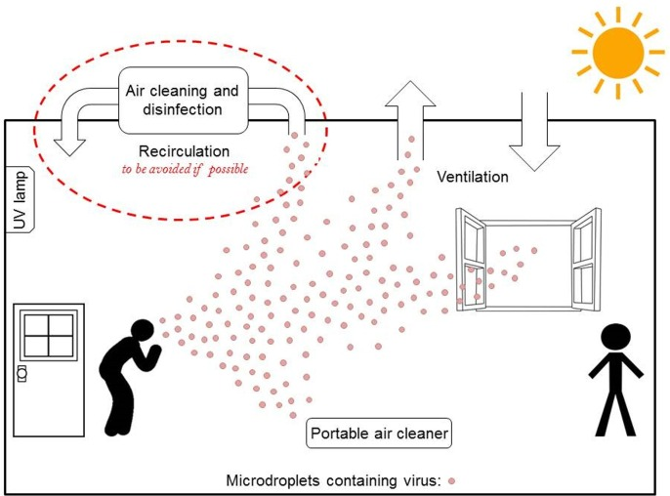
Improving indoor air quality
High ceilings
Modified from Morawska et al. Environ Int 2020.

Slide 27
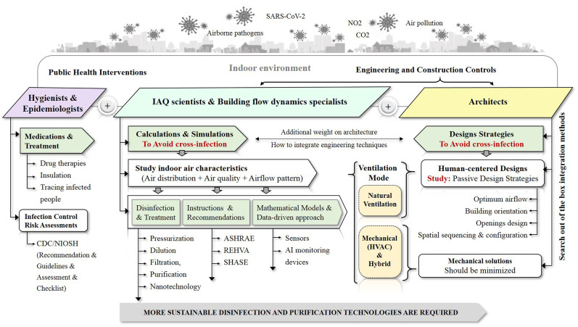
Improving indoor air quality
Megahed and Ghoneim. Environ Res 2021.

Slide 28
Practical steps to improving ventilation
Measure | Considerations
Get to know your ventilation systems | Natural, mechanical, specialist – and read the relevant HTM 03-01.
Increased use of natural ventilation (e.g. opening window and door) | Relies on human behaviour; temperature issues; potential safety/security issues; temporary changes less effective but mitigates some of these risks.
Find ways to get more out of existing HVAC systems | Increase fresh air, reduce recircualation, extend operation; requires input from Estates; may disrupt airflows; may require qualification testing.
Installation of new passive (louvres/air bricks) or mechanical (extract fans, new HVAC) systems | Requires input from Estates; may be costly; may disrupt airflows.
Breaks or fallow periods between occupants | May interrupt patient or staff flow in an area.
Use of local air filtration / disinfection devices | Lack of evidence of clinical impact; may be useful in enclosed indoor spaces,
Role of Ventilation in Controlling SARS-CoV-2 Transmission SAGE-EMG and Morawska et al. Environ Int 2020.

Slide 29
Transmission routes
Innovation
Guidelines and policy development
Engineering controls
PPE
Other pathogens

Slide 30
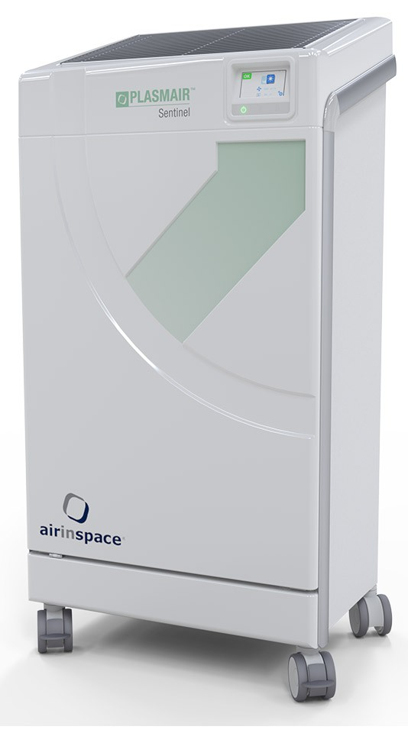
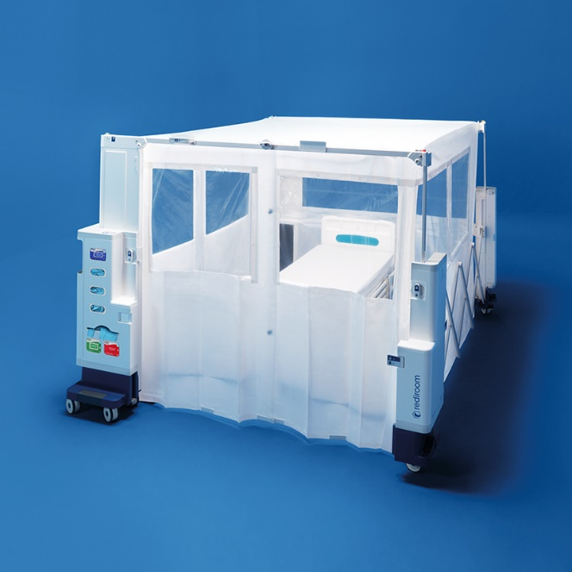
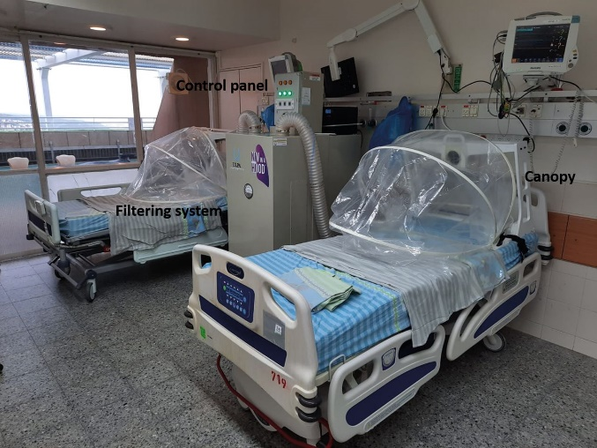
Innovate approaches to improve air hygiene

Slide 31
Air filtration / disinfection
Air disinfection/ filtration options
Emit light or chemical into the air e.g. hyroxyl radical emitters / far-UVC / upper air UVC
Pull air from a space and pass it through a disinfection / filtration unit
Pass air through filters without chemical or physical disinfection e.g. HEPA
Products that use chemical or physical processes to kill micro-organisms e.g. UVC
Combined filtration plus chemical/physical disinfection e.g. HEPA and plasma

Slide 32
Evidence that air disinfection improves patient outcomes
There are emerging studies showing that various air disinfection approaches improve the microbiological quality of air.¹⁻⁵
However, there is no direct published evidence that air disinfection in healthcare settings improves patient outcomes.
A recently published randomised controlled trial concluded that an ultraviolet C air steriliser did not improve the outcomes of patients undergoing cardiac surgery.⁶
Boswell TC, Fox PC. Reduction in MRSA environmental contamination with a portable HEPA-filtration unit. J Hosp Infect 2006; 63: 47-54.
Maclean M, McKenzie K, Anderson JG, Gettinby G, MacGregor SJ. 405 nm light technology for the inactivation of pathogens and its potential role for environmental disinfection and infection control. J Hosp Infect 2014; 88: 1-11.
Hakim H, Gilliam C, Tang L, Xu J, Lee LD. Effect of a shielded continuous ultraviolet-C air disinfection device on reduction of air and surface microbial contamination in a pediatric oncology outpatient care unit. Am J Infect Control 2019; doi 10.1016/j.ajic.2019.03.026.
Wong V, Staniforth K, Boswell TC. Environmental contamination and airborne microbial counts: a role for hydroxyl radical disinfection units? J Hosp Infect 2011; 78: 194-9.
Buchan AG, Yang L, Atkinson KD. Predicting airborne coronavirus inactivation by far-UVC in populated rooms using a high-fidelity coupled radiation-CFD model. Scientific reports 2020; 10: 19659.
Heredia-Rodriguez M, Alvarez-Fuente E, Bustamante-Munguira J et al. Impact of an ultraviolet air sterilizer on cardiac surgery patients, a randomized clinical trial. Medicina clinica 2018; 151: 299-307.

Slide 33
Air disinfection/filtration: potential application areas
General ward
Adjacent to patients with pathogens
Operating theatres
Protective isolation
Scavenging odours / gasses
Accelerate H2O2 aeration
Public spaces / non-clinical areas
Adjacent to AGPs

Slide 34
Air disinfection unit – evaluation
The risk of Mycobacterium chimaera infection associated with heater-cooler units used in cardiothoracic surgery emerged in 2015.
In August and September 2016, an air disinfection unit (Plasmair) was placed in one of the three cardiothoracic theatres (‘test’) and the other two theatres as controls.
Active air sampling for fungi was performed in each of the theatres in July (before the unit was installed), September (during the use of the unit), and in November (after the unit was removed).
Air samples were collected from the front and rear outlets of the HCUs.
The mean fungal counts in test theatre were compared with counts from control theatres using T-tests.
Dyakova et al. Infection Prevention Society (IPS) Annual Meeting 2017.

Slide 35
Mean fungal count in test vs. control theatres before, during, and after air disinfection unit use
*
*
Error bars represent minus one standard deviation.
* = significant difference between test and control theatres.

Slide 36
Commissioning the air handling unit
0.5μm reduction

Slide 37
Aerosol containment
Evaluated the containment of smoke and the integrity of the HEPA filter.
Promising results, but further evaluation required.
Adir et al. European Respiratory Journal 2020.

Slide 38

Temporary single rooms
Missed isolation days in a 15 bed paediatric ICU comparing 12 months before vs. the first 12 months following the installation of three temporary single rooms
Keward et al. J Infect Prevent 2017.

Slide 39
Transmission routes
Innovation
Engineering controls
Guidelines and policy development
Other pathogens
PPE

Slide 40
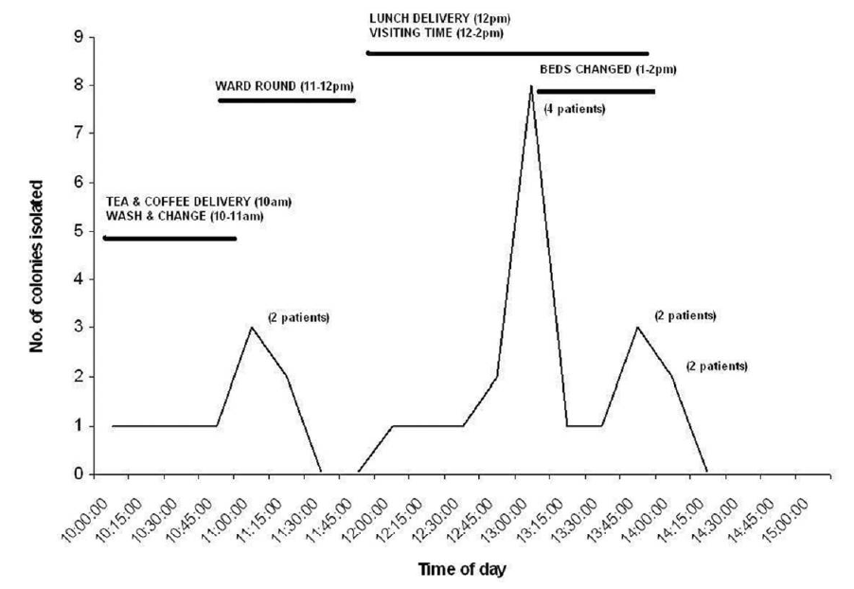
C. difficile in the air?
Detection of C. difficile in the air samples from the rooms of 50 patients.
Results of intensive air sampling surrounding 10 patients. C. difficile was detected in the air in 7/10 patients.
Best et al. Clin Infect Dis 2010; 50: 1450-7.

Slide 41

MRSA in the air and bed making
Air was sampled with an Andersen air sampler in the rooms of 13 inpatients with MRSA infection or colonization.
Shiomori et al. J Hosp Infect 2002.

Slide 42
Transmission routes
Innovation
Engineering controls
Guidelines and policy development
Other pathogens
PPE

Slide 43
Ventilation across health and social care settings following the COVID 19 pandemic
Jon Otter PhD FRCPath
j.otter@imperial.ac.uk
@jonotter

