Slide 1


The use of social media in antimicrobial stewardship
Jon Otter, PhD FRCPath
Imperial College London
j.otter@imperial.ac.uk
@jonotter
Blog: www.ReflectionsIPC.com
You can download these slides from www.jonotter.net

Slide 2
“STOP WASTING TIME ON SOCIAL MEDIA AND DO SOME REAL WORK”
Slight (and only slight) paraphrase of a Professor’s comment to me during a recent discussion about whether an infection control journal should have an active Twitter feed.

Slide 3
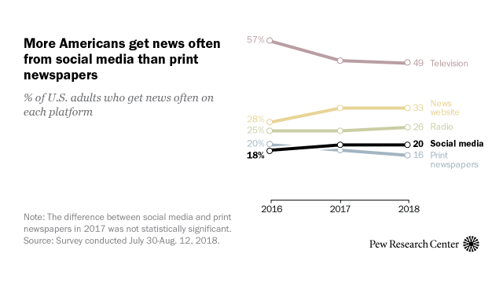
The way we’re learning is changing
Pew survey of access to news, US.

Slide 4
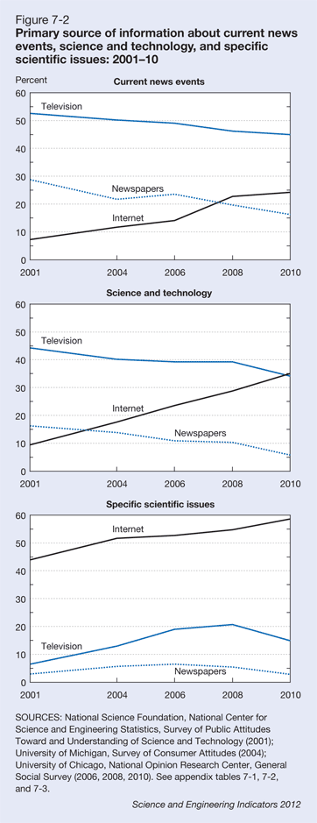
Google it.
2010 General Social Survey, National Science Foundation. Other search engines are available.

Slide 5
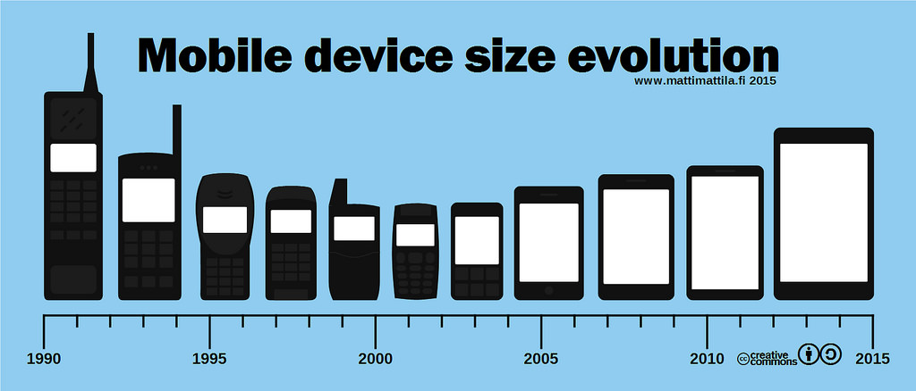

Slide 6
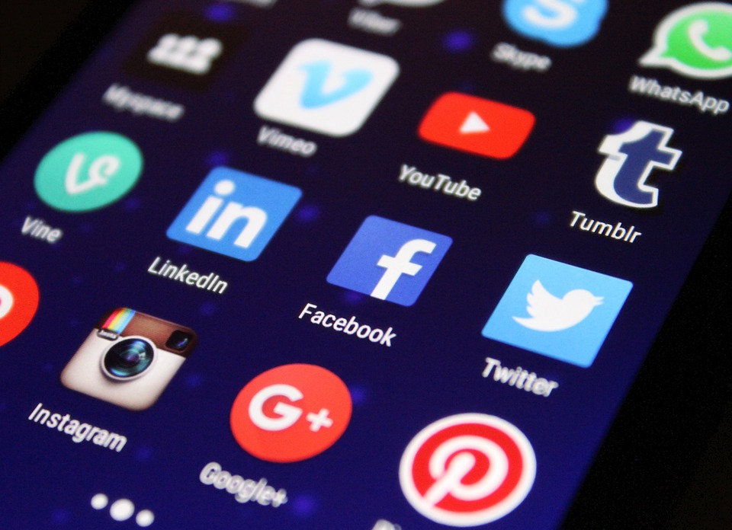

Slide 7
What is social media?
Social media describes web-based applications that allow people to create and exchange content to include:
blogs and microblogs (such as Twitter),
internet forums (such as doctors.net),
content communities (such as YouTube and Flickr), and
social networking sites (such as Facebook and LinkedIn).
GMC: Doctors’ use of social media guidelines.

Slide 8
Social media – common features
Instant gratification! No rigour
Short attention span
Online dialogue with non-expert idiots
Public sharing of dirty laundry
Web-based unreliable sources
Always on never home
Free You get what you pay for

Slide 9
Social media – common features
Instant gratification! No rigour
Short attention span
Online dialogue with non-expert idiots
Public sharing of dirty laundry
Web-based unreliable sources
Always on never home
Free you get what you pay for

Slide 10
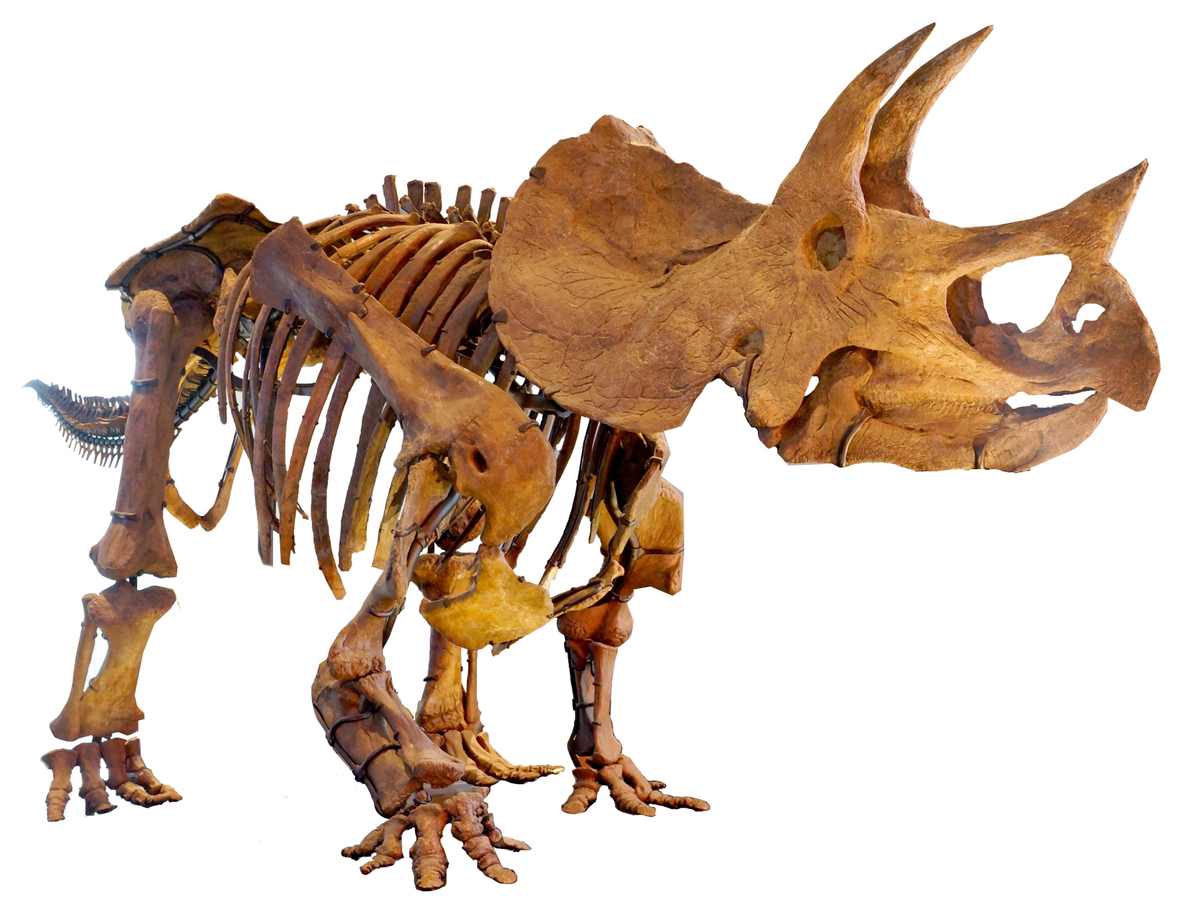

Slide 11
Selling your ideas (or anything, really)
Know your audience
Understand the need
Listen to the client
Be part of a convincing brand
Be quietly tenacious

Slide 12
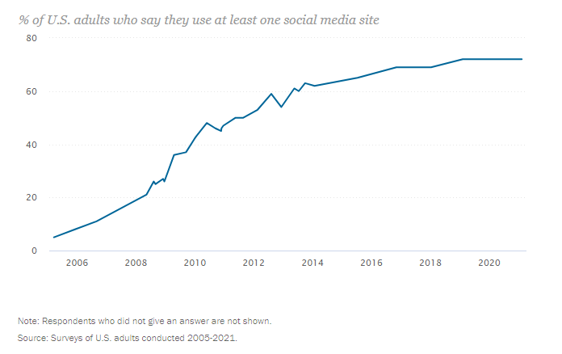
Trends in social media use
Pew survey of social media usage, US.

Slide 13
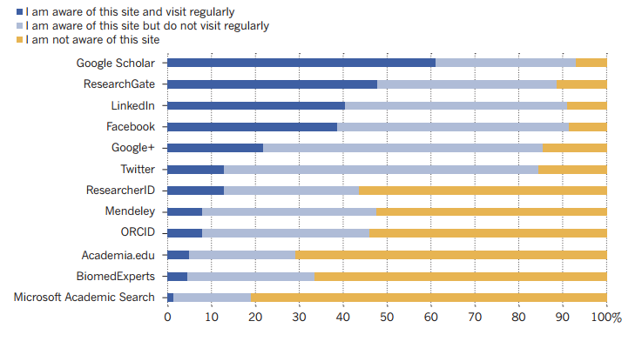
Social media use among scientists
van Noorden. Nature 2014;512. Nature survey of 3500 scientists from 95 countries.

Slide 14
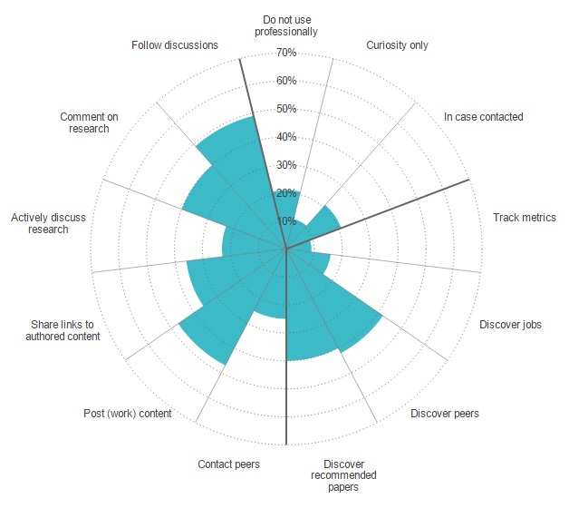
How scientists use social media
van Noorden. Nature 2014;512. Nature survey of 3500 scientists from 95 countries.

Slide 15


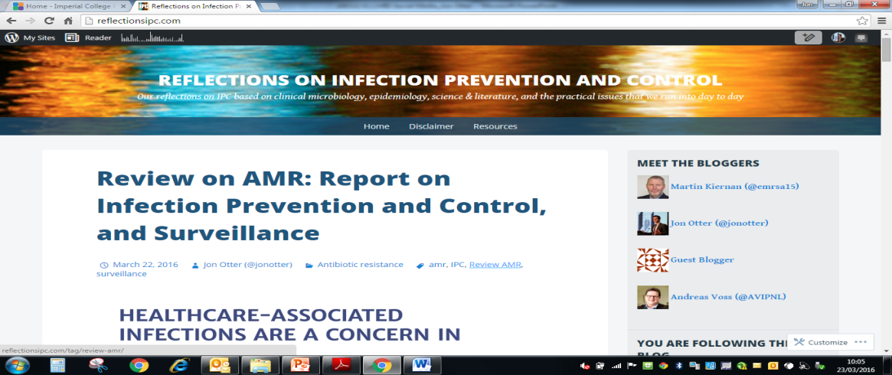
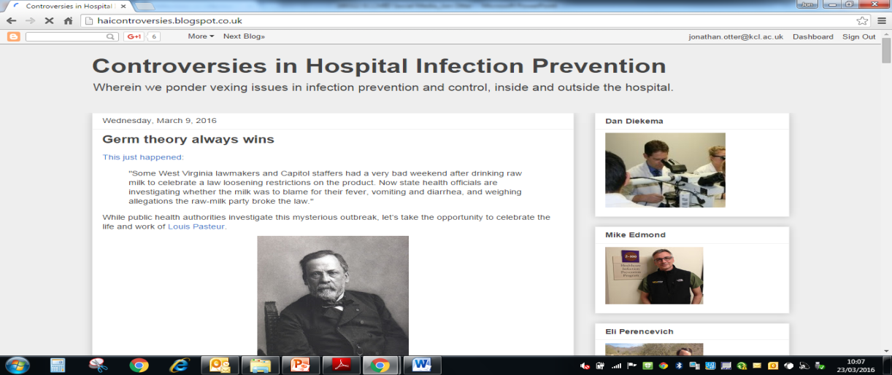
Blogs
Free and easy to set-up.
Posts can be as long or short, and regular or irregular as you like!
Often linked with other social media to spread the word (Twitter, Google+ etc)

Slide 16

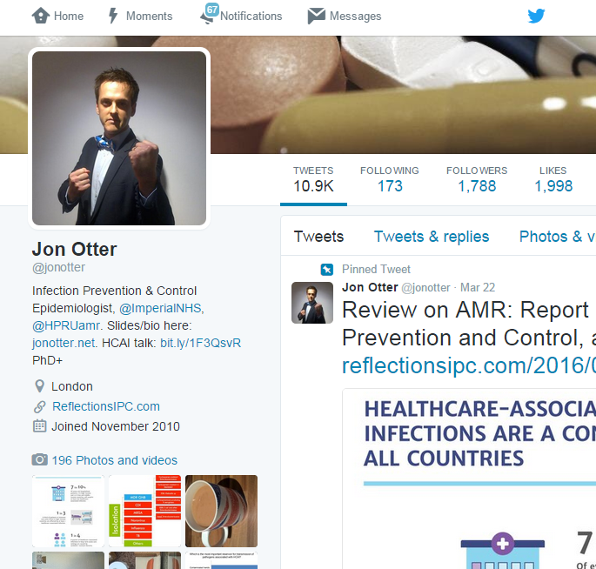
Twitter - individual
Personal newsfeed
No trolls
Time-neutral
Linked to blog
Tweeps
Conference #s

Slide 17
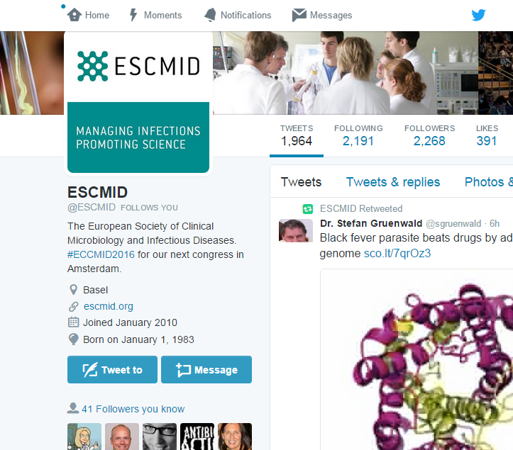
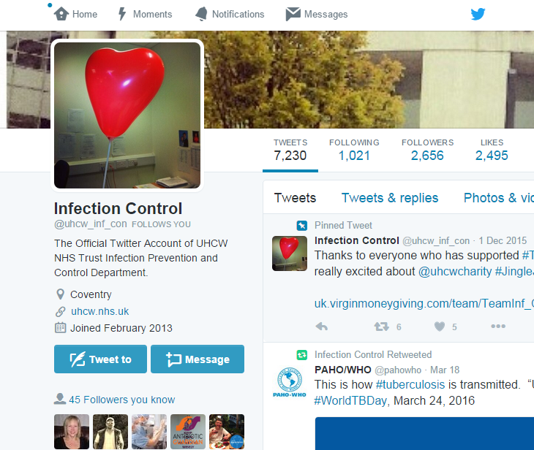
Twitter - organisation
Many hospitals, organisations, some clinical teams, and companies now have active Twitter feeds.

Slide 18
Twitter - getting started
Register (free!) at www.twitter.com
Create short username (creative, not weird)
Upload selfie (again, creative, not weird)
Write a bio (once again, creative, not weird)
Get following (individuals, organisations, journals)
Get tweeting!
Adapted from Goff et al. Clin Infect Dis 2015:1533-1540, which includes useful suggestions for who to follow.

Slide 19



Professional network
Academic network
Social network

Slide 20

My social media network

Slide 21
Social media & new possibilities for IPC/ID
Surveillance (e.g. pandemics, post-discharge surveillance for SSI)¹
Healthcare regulation²
Public engagement³
Patient reminders e.g. to take antibiotics (or not!)⁴
New opportunity for dialogue with patients⁵
Surprisingly accurate public healthcare info⁶
Conferences with a louder voice⁷
Charles-Smith et al. PLoS One 2015;10:e0139701.
Bouwmann et al. BMC Health Serv Res 2015;15:325.
Dyar et al. J Antimicrob Chemother 2014;69:2568-72.
Odone et al. Hum Vaccin Immunother 2015;11:72-82.
Doctors’ use of social media guidelines. (GMC).
Chew & Eysenbach. PLoS One 2010;5:e14118.
Kiernan & Wigglesworth. J Infect Prevent 2011;12:224-225.

Slide 22
The role of social media in AMR/AMS
Public engagement
Expert education
Behavior change

Slide 23
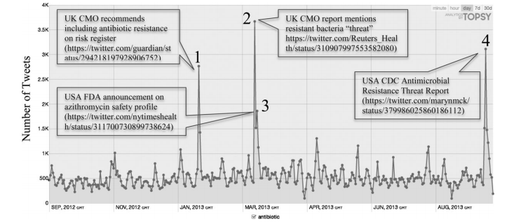
Improving public engagement
An analysis of ‘what gets people talking about antibiotics’ on Twitter.
Dyar et al. J Antimicrob Chemother 2014;69:2568-72.

Slide 24
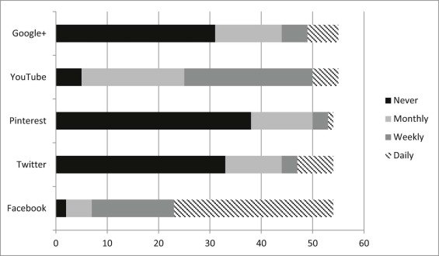
Improving AMS expert knowledge
39 internal medicine residents’ (IMR) knowledge of AMS was tested before and after 6 months of subscription to social media posts from an antimicrobial stewardship programme.
Median scores for Abx knowledge increased from 12 to 13 (P = 0.048);
IMRs knowing how to access the ASP Web site increased from 70% to 94%.
More IMRs indicated that they used the clinical pathways “sometimes, frequently, or always” after the intervention (33% vs 61%, P = .004)
Pisano et al. Am J Infect Control 2016;44:1231-1236.

Slide 25
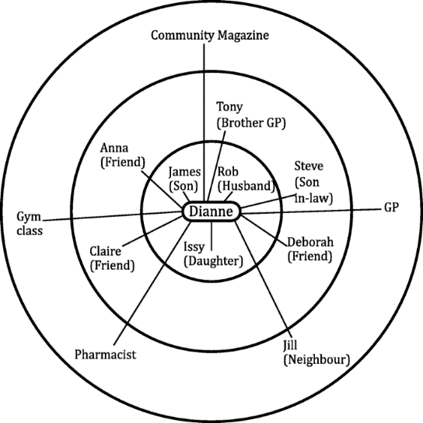
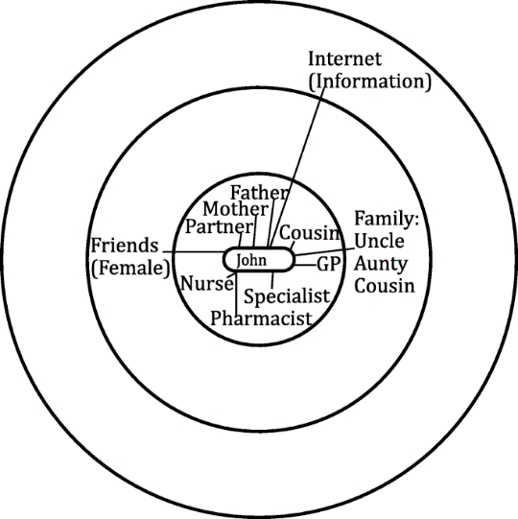
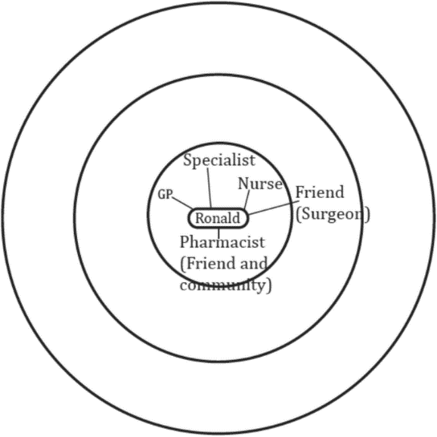
Prompting behaviour change
14 adults and 10 parents of young children who had recently had an antibiotic prescription were enrolled; their social network was analysed, and a semi-structured interview was undertaken.
Diverse network
Family and friend centred network
Restricted network
Participants with more diverse networks were more likely to delay in help seeking from healthcare professionals as they draw upon self-care strategies advised by network members
Ellis et al. BMC Family Practice 2019;20:63.

Slide 26
Summary
Social media will not replace conventional media
Social media can be a useful tool to:
  Improve public awareness of AMR
  Improve expert knowledge of AMS/AMR
  Prompt behaviour change to reduce antibiotic usage

Slide 27
The use of social media in antimicrobial stewardship
Jon Otter, PhD FRCPath
Imperial College London
j.otter@imperial.ac.uk
@jonotter
Blog: www.ReflectionsIPC.com
You can download these slides from www.jonotter.net

