Slide 1

Healthcare-associated infections associated with medical device reprocessing
Jon Otter, PhD FRCPath
Imperial College London
j.otter@imperial.ac.uk
@jonotter
Blog: www.ReflectionsIPC.com
Slides: www.jonotter.net

Slide 2
Medical devices and decontamination
When decontamination goes wrong
Future perspectives
Making medical device decontamination safer to prevent HCAI

Slide 3
Medical devices and decontamination
When decontamination goes wrong
Future perspectives
Making medical device decontamination safer to prevent HCAI

Slide 4
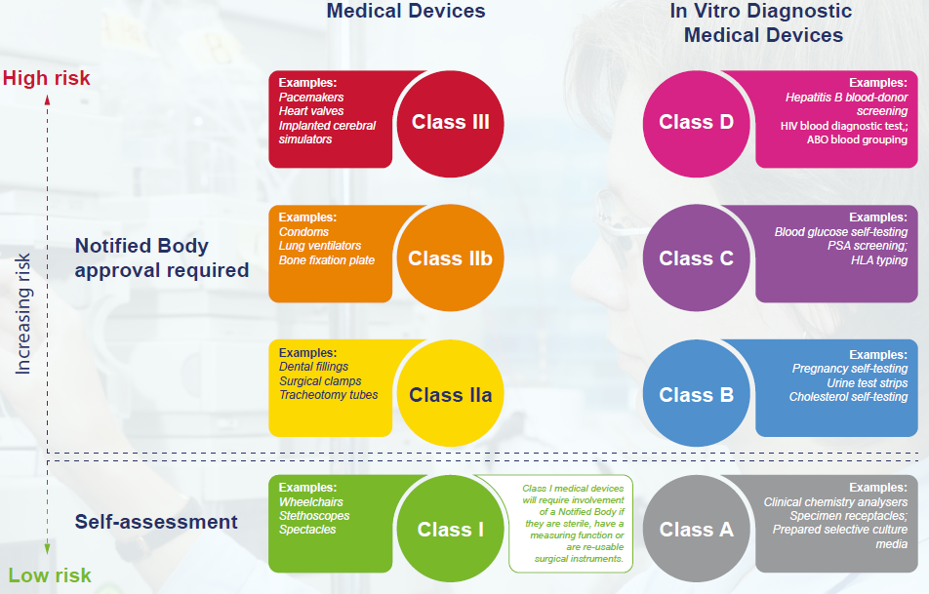
Medical device classification

Slide 5
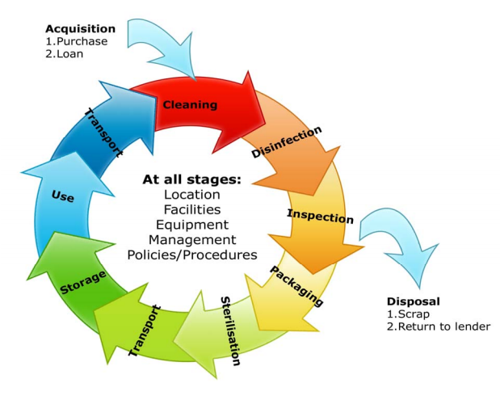
Principles of medical device decon

Slide 6
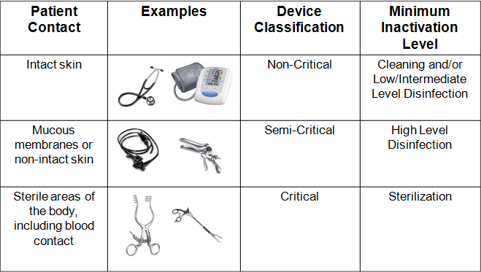
Spaulding classification

Slide 7
Which decon method?
Intended use
Infection risk
Soiling
Notes:
Also: cost, availability, expertise

Slide 8
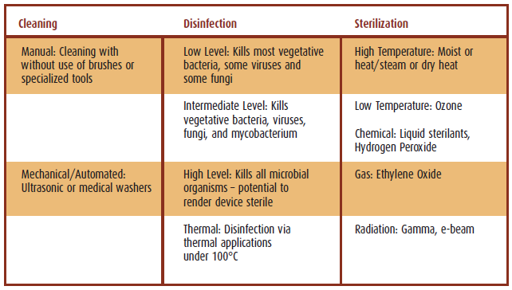
Decontamination options

Slide 9
Decon and compatibility
Medical device companies
Regulators
Users
Decon companies
Notes:
Differences in regulatory frameworks in different countries

Slide 10
Medical devices and decontamination
When decontamination goes wrong
Future perspectives
Making medical device decontamination safer to prevent HCAI

Slide 11
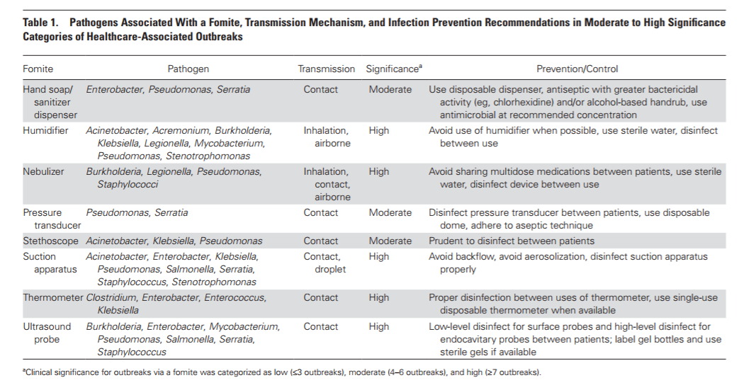
HCAI – non-critical devices
Kanamori et al. Clin Infect Dis 2017.

Slide 12
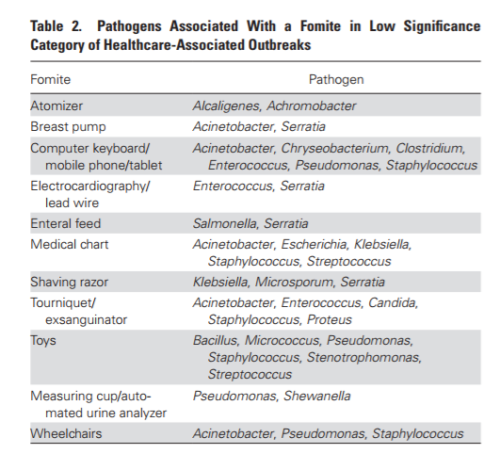
HCAI – non-critical devices
Kanamori et al. Clin Infect Dis 2017.

Slide 13
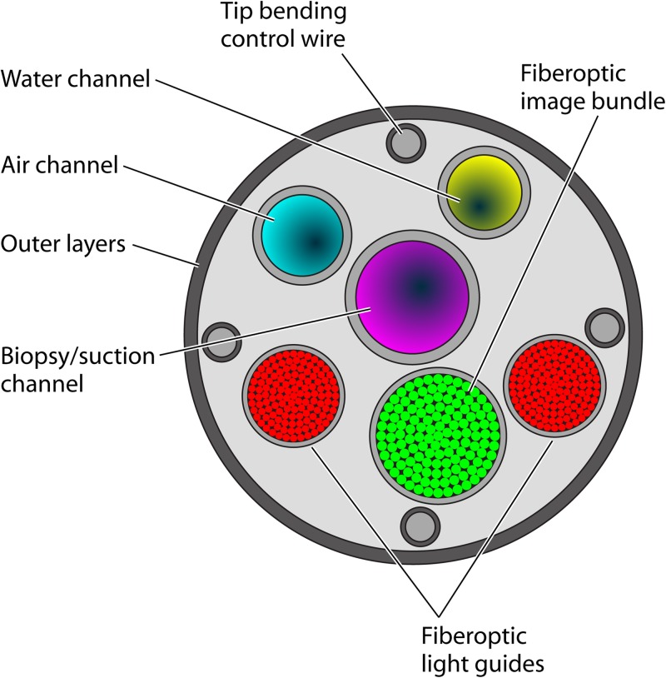
HCAI – semi-critical devices (endoscopes)
Kovaleva et al. Clin Microbiol Rev 2013.

Slide 14
HCAI – semi-critical devices (endoscopes)
Microorganism(s) | No. of contaminated patients after endoscopy | No. of infected patients | Infection type(s) | Detection of endoscope contamination | Cause(s) of contaminationª
P. aeruginosa | 3 | 2 | Sepsis | Yes | Inappropriate cleaning and disinfection (benzalkonium chloride)
P. aeruginosa | 4 | 3 | Pneumonia, lung abscess | Yes | Inappropriate cleaning and disinfection (cetrimide)
P. aeruginosa | 4 | 4 | Sepsis | Yes | Contaminated water bottle and water supply; inappropriate cleaning and disinfection
P. aeruginosa | 99 | No data | Bacteremia/sepsis, cholangitis, pneumonia | Yes | Contaminated AER (a flaw in design, presence of biofilm); drying with no ethanol flushing
H. pylori | 1 | 1 | Gastritis | Not tested | Biopsy forceps not sterilized
H. pylori | 2 | 2 | Gastritis | Yes | Inappropriate disinfection between patients (ethanol); biopsy forceps not sterilized
H. pylori | 1 | 1 | Gastritis | Yes | Inappropriate cleaning and disinfection between patients
Salmonella Typhi | 1 | 1 | Bacteremia | Not tested | Inappropriate cleaning and disinfection
SalmonellaTyphimurium | 7 | 7 | Gastroenteritis, peritoneal abscess | Yes | Inappropriate cleaning and disinfection
SalmonellaTyphimurium | 1 | 1 | Urinary tract infection | Yes | Lack of manual cleaning; insufficient disinfectant exposure
Salmonella Agona | 5 | 5 | Gastroenteritis, bacteremia/sepsis | Yes | Inappropriate cleaning and disinfection (cetrimide)
SalmonellaKedougou | 15 | 12 | Gastroenteritis | No | Inappropriate cleaning and disinfection (cetrimide)
HBV | 1 | 1 | HBV infection | Not tested | Inappropriate cleaning and disinfection (cetrimide); no disinfection between patients
HBV | 1 | 1 | HBV infection | Not tested | Endoscope reprocessing not described
HBV | 1 | 1 | HBV infection | Not tested | Lack of disinfection procedure
HCV | 9 | 9 | HCV infection | Not tested | Contaminated syringe or anesthetic vial; inappropriate cleaning and disinfection
Strongyloides stercoralis | 4 | 4 | Esophagitis | Not tested | Not found
Trichosporon spp. | 9 | 0 | No | Yes | Inappropriate cleaning and disinfection (cetrimide)
Trichosporon asahii | 1 | 1 | Esophagitis | Yes | Biopsy forceps not sterilized
Kovaleva et al. Clin Microbiol Rev 2013.

Slide 15
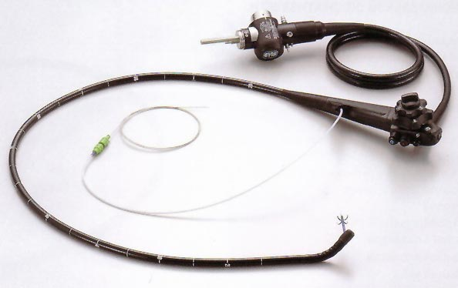
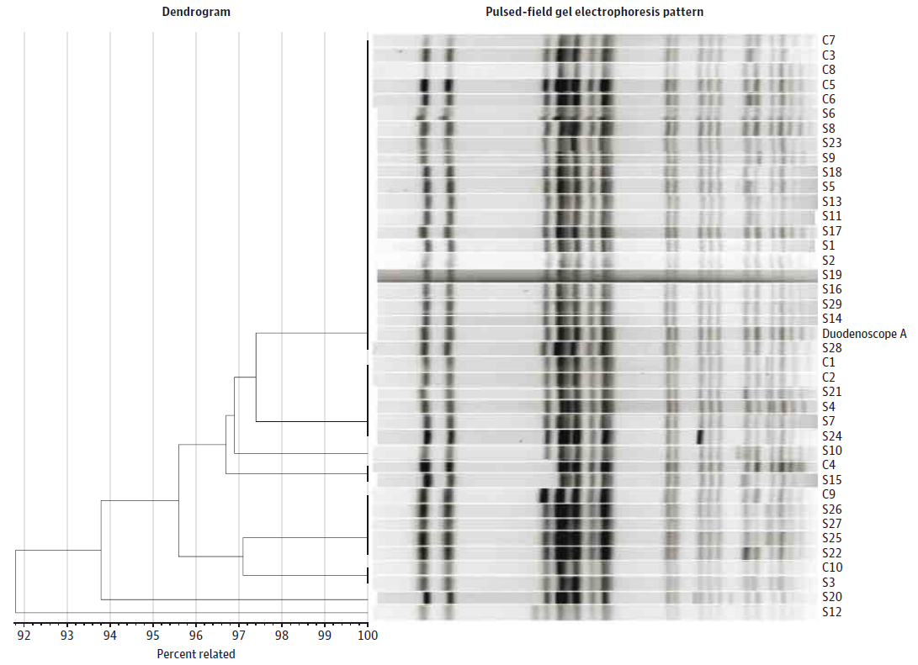
When medical device decontamination fails…
39 patient CRE outbreak in 2013 in Illinois.¹
Odds ratio for duodenoscope exposure in case patients 78 (confidence interval 6-1008).
No breakdown in compliance with decon procedures.
Outbreak resolved when decon approach for the scopes modified.
Has prompted a global review and change in the way that these devices are decontaminated.²
Epstein et al. JAMA. 2014;312:1447-55.
Rutala & Weber. Am J Infect Control 2016;44 (Suppl):e47-51

Slide 16

HCAI – critical devices
Rare to have documented transmission events linked to critical device, such as surgical instruments.
Rutala & Weber. Infectious Disease Clinics of North America 2021.

Slide 17
Medical devices and decontamination
When decontamination goes wrong
Future perspectives
Making medical device decontamination safer to prevent HCAI

Slide 18
Safer medical device decontamination
Non-critical devices
Establish effective sterilisation methods
Define responsibilities for cleaning
Optimise selection of cleaning/disinfection products
Implement effective point-of-use decontamination methods where possible
Semi-critical devices
Select appropriate high-level disinfection measures based on the intended use of the item
Identify high-risk devices that need special decontamination measures (e.g. duodenoscopes)
Critical devices
Ensure that process controls are suitable, validated, and audited

Slide 19
Medical devices and decontamination
When decontamination goes wrong
Future perspectives
Making medical device decontamination safer to prevent HCAI

Slide 20
Future perspectives
Centralisation
Standardisation
Regulation
Notes:
Standardisation of developing manufacturers’ guidelines

Slide 21
Summary
Overview of medical device decontamination in the context of HCAI.
Summary of HCAI associated with medical device reprocessing.
Learning from past failures in medical device decontamination to prevent HCAI.
A look at medical device decontamination of the future.

Slide 22
Resources
Managing Medical Devices. Guidance for healthcare and social services organisations. MHRA, April 2015.
Institute of Decontamination Sciences (IDSC) publications.
Guidelines for Environmental Infection Control in Health-Care Facilities. MMWR 2003; 52(RR10):1-42.
Decontamination of surgical instruments (HTM 01-01).
Management and decontamination of flexible endoscopes (HTM 01-06).

Slide 23
Healthcare-associated infections associated with medical device reprocessing
Jon Otter, PhD FRCPath
Imperial College London
j.otter@imperial.ac.uk
@jonotter
Blog: www.ReflectionsIPC.com
Slides: www.jonotter.net

