Slide 1






The future of healthcare and infection prevention & control
Jon Otter PhD FRCPath
Director of Infection Prevention and Control
jon.otter@gstt.nhs.uk
@jonotter
Blog: www.ReflectionsIPC.com
Slides: www.jonotter.net

Slide 2
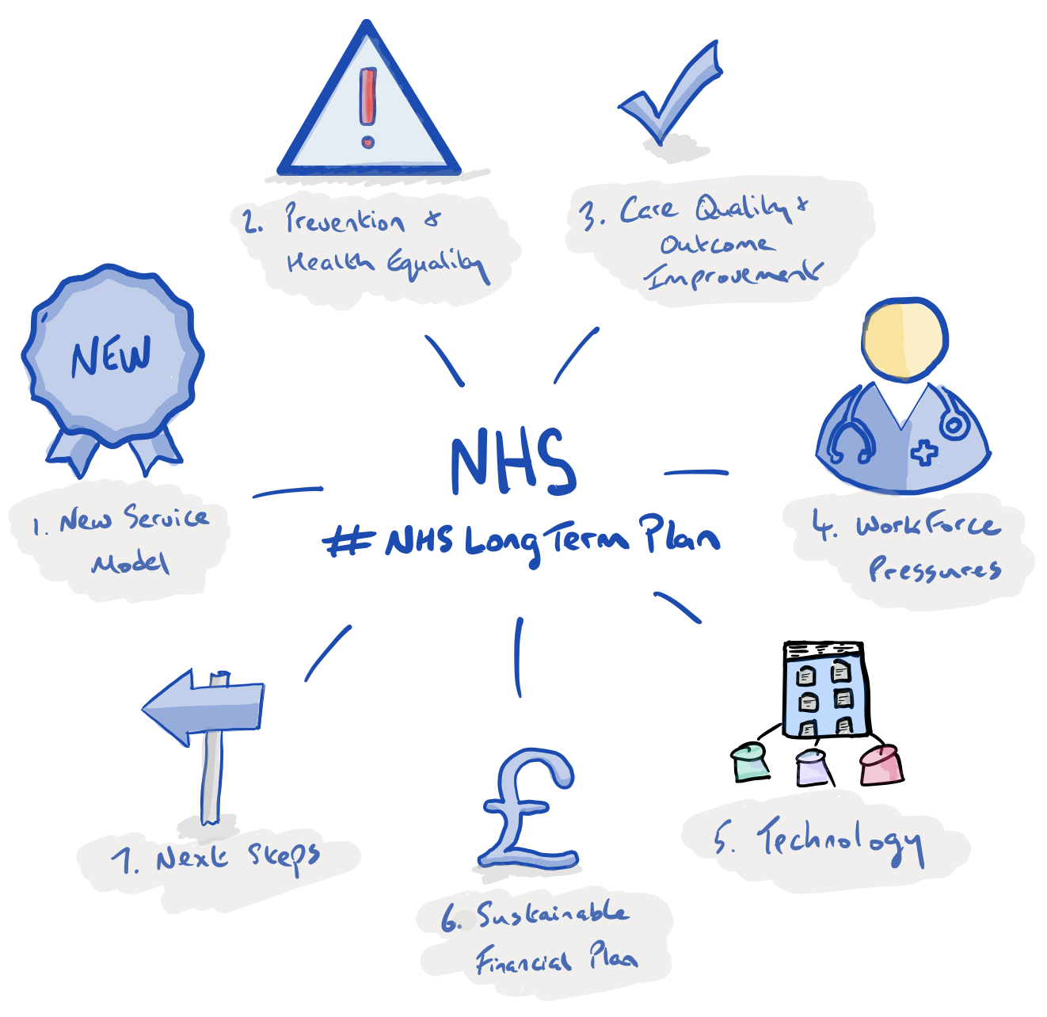

Slide 3
Promoting antimicrobial stewardship
Embedding digital systems to enhance our clinical services
Preventing SSI
Preventing the transmission of SARS-CoV-2 in our hospitals
Preventing Gram-negative bloodstream infection

Slide 4
Promoting antimicrobial stewardship
Embedding digital systems to enhance our clinical services
Preventing SSI
Preventing the transmission of SARS-CoV-2 in our hospitals
Preventing Gram-negative bloodstream infection

Slide 5


Slide 6
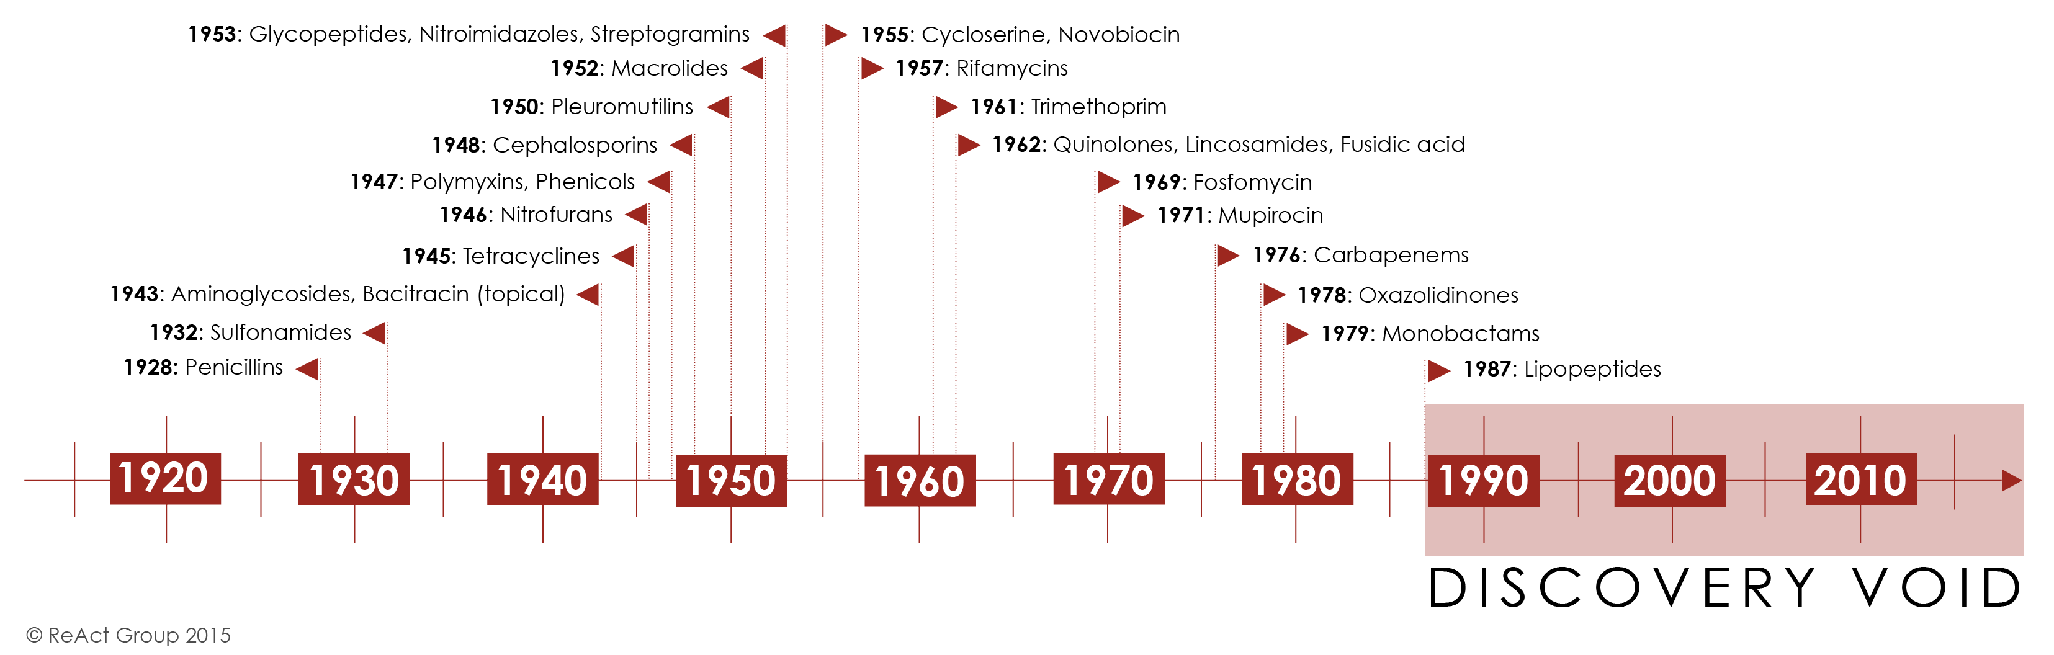
ReAct.

Slide 7
But I would like to sound one note of warning…There may be a danger, though, in underdosage. The time may come when penicillin can be bought by anyone in the shops. Then there is the danger that the ignorant man may easily underdose himself and by exposing his microbes to non-lethal quantities of the drug make them resistant. Here is a hypothetical illustration. Mr X has a sore throat. He buys some penicillin and gives himself, not enough to kill the streptococci but enough to educate them to resist penicillin. He then infects his wife. Mrs X gets pneumonia and is treated with penicillin. As the streptococci are now resistant to penicillin the treatment fails. Mrs X dies. Who is primarily responsible for Mrs X’s death? Why Mr X whose negligent use of penicillin changed the nature of the microbe. Moral: If you use penicillin, use enough.
Alexander Fleming, Nobel Lecture, December 11 1945.

Slide 8
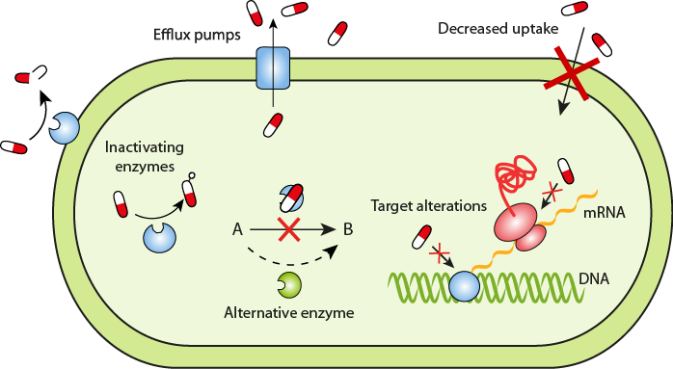
ReAct.

Slide 9
Rising threat from MDR-GNR
% of all HAI caused by GNRs.
% of ICU HAI caused by GNRs.
Non-fermenters | Acinetobacter baumannii Pseudomonas aeruginosa Stenotrophomonas maltophilia
Enterobacteriaceae | Klebsiella pneumoniae Escherichia coli Enterobacter cloacae
CPO
CPE
Hidron et al. Infect Control Hosp Epidemiol 2008;29:966-1011.
Peleg & Hooper. N Engl J Med 2010;362:1804-1813.

Slide 10
The emerging threat of CPE
Pathogen | CPE | MRSA | VRE | C. difficile
Resistance | +++ | + | + | +/-
Resistance genes | Multiple | Single | Single | n/a
Species | Multiple | Single | Single | Single
HA vs CA | HA & CA | HA | HA | HA
At-risk pts | All | Unwell | Unwell | Old
Virulence | +++ | ++ | +/- | +
Environment | +/- | + | ++ | +++

Slide 11
Creating a monster
Enterobacterales
ESBLs
CPE
Extended-spectrum beta-lactams
Carbapenems

Slide 12
CPE
Rapid spread
Clinical impact
£
AMR

Slide 13
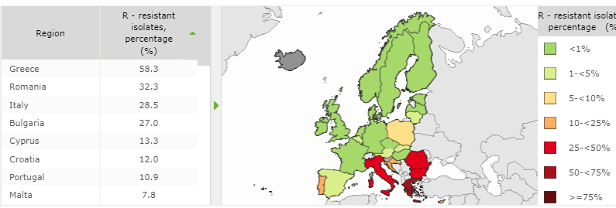
CRE in Europe, 2019
% invasive K. pneumoniae isolates resistant to carbapenems
EARS-Net 2018.

Slide 14
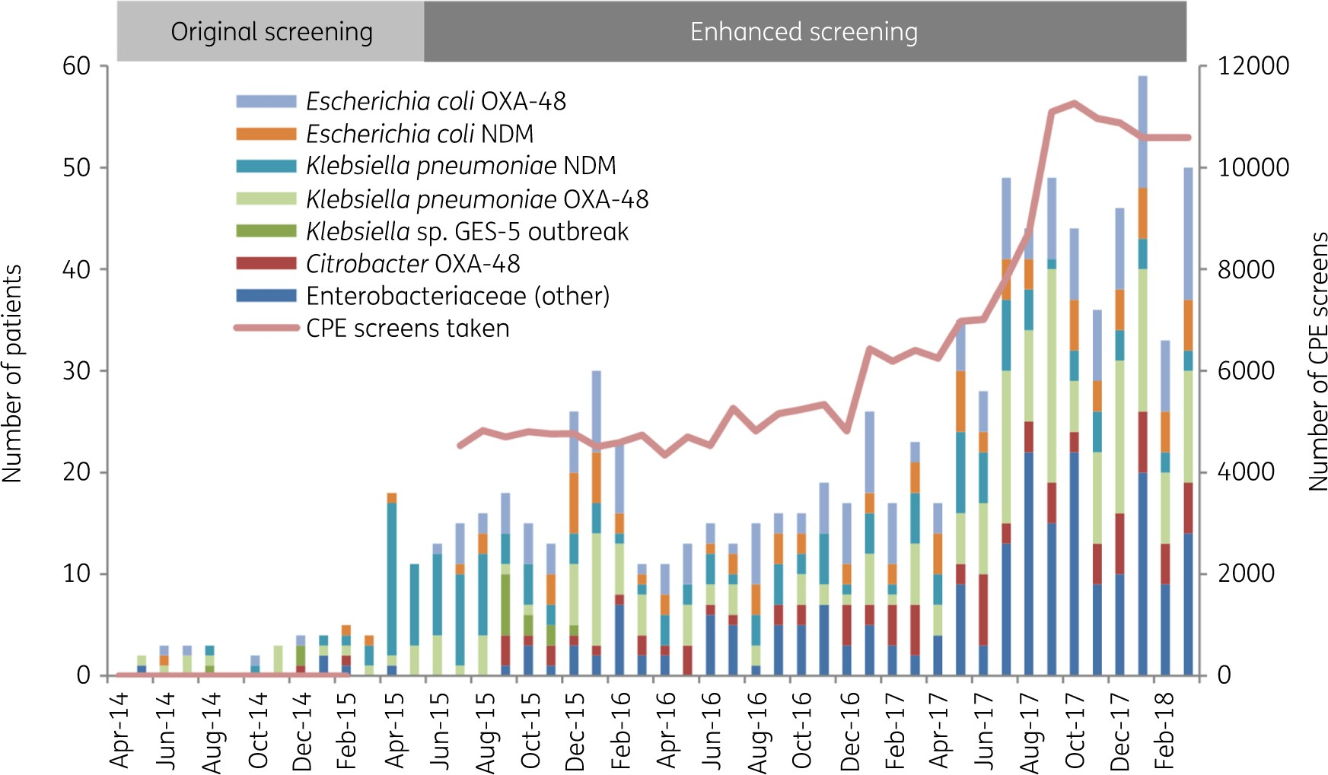
CPE: seek and ye shall find?
Overall trend in CPE detected at Imperial, by bacterial species and mechanisms, deduplicated by patient
Otter et al. J Antimicrob Chemother 2020.

Slide 15
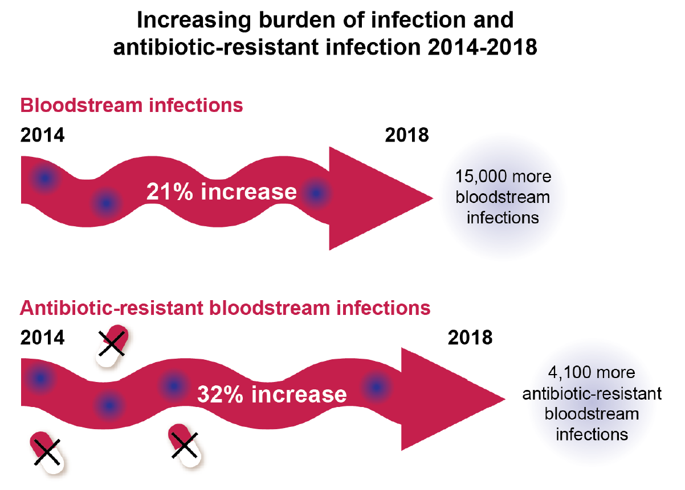
ESPAUR 2019.

Slide 16
Prevention is better than cure
Reduced antibiotic use
Improved diagnostics
Surveillance for action
Phages and vaccines
Highlight high cost of AMR
New antibiotics
Public awareness
Pay and recognition for AMR folk
Based on Laxminarayan et al. Lancet Infect Dis 2013;13:1057-1098, and Review on AMR.

Slide 17
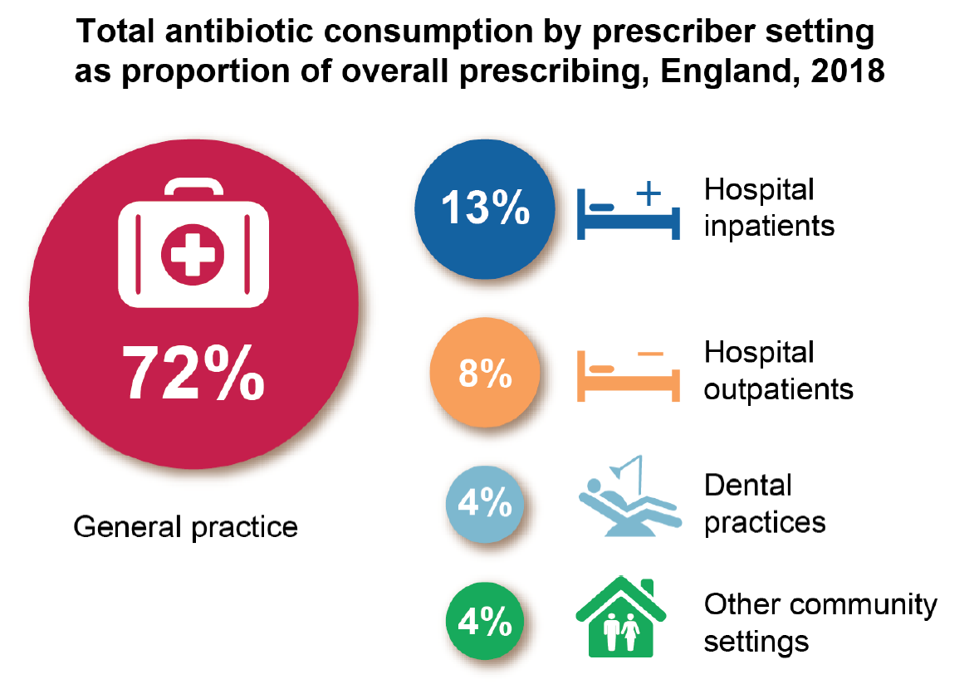
ESPAUR 2019.

Slide 18
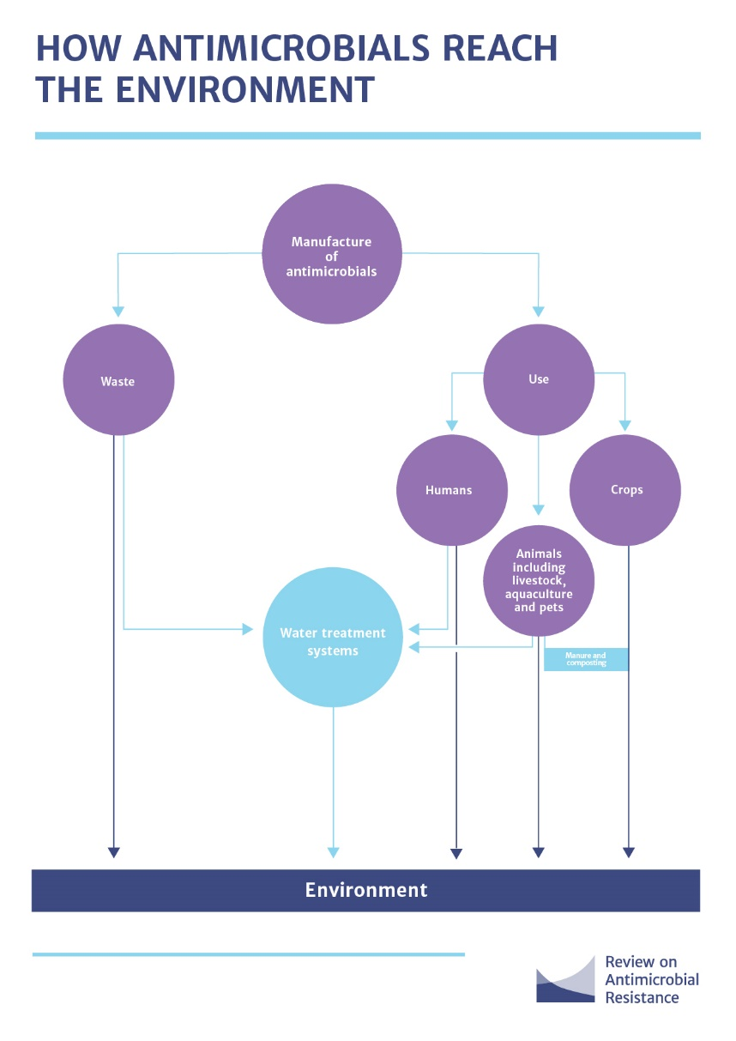
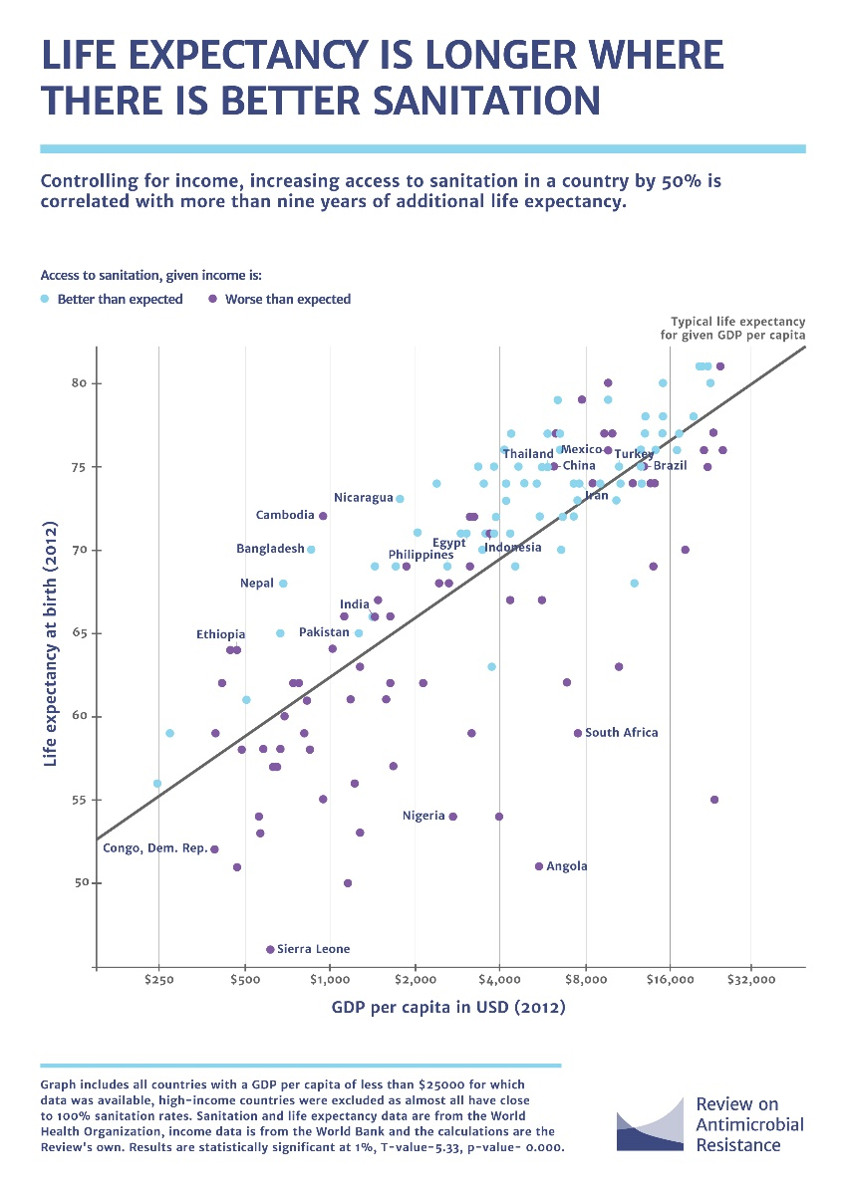

Slide 19
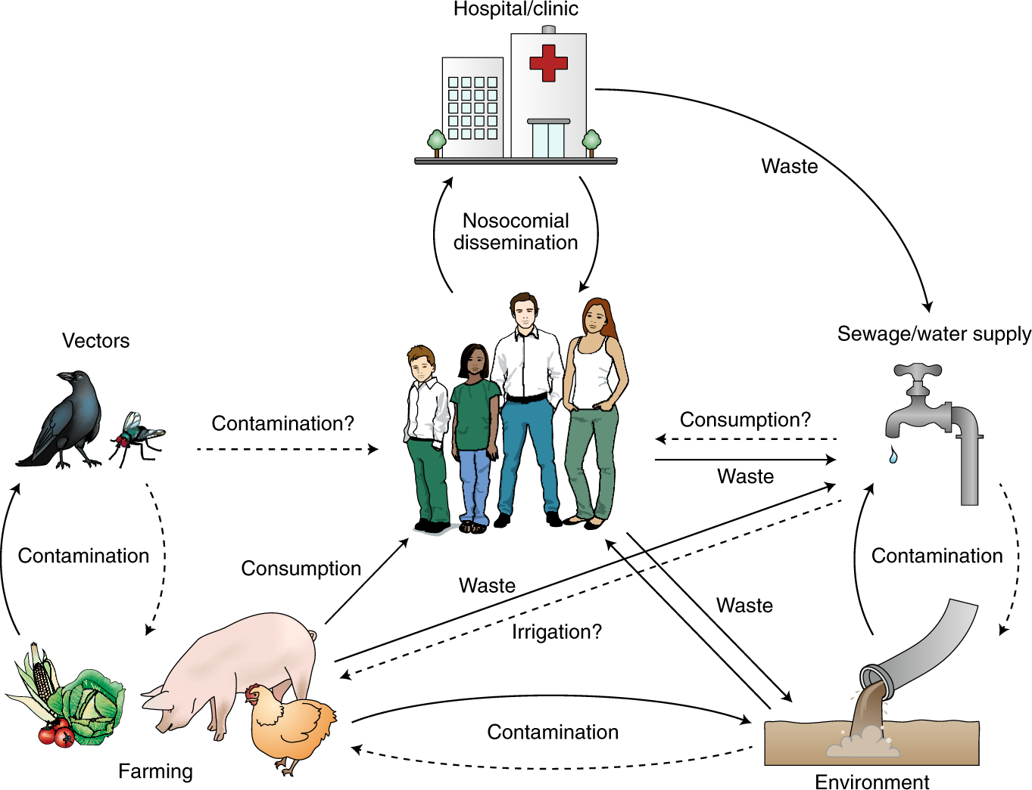
Walsh T. Nature Microbiol 2018.

Slide 20
Promoting antimicrobial stewardship
Embedding digital systems to enhance our clinical services
Preventing SSI
Preventing the transmission of SARS-CoV-2 in our hospitals
Preventing Gram-negative bloodstream infection

Slide 21
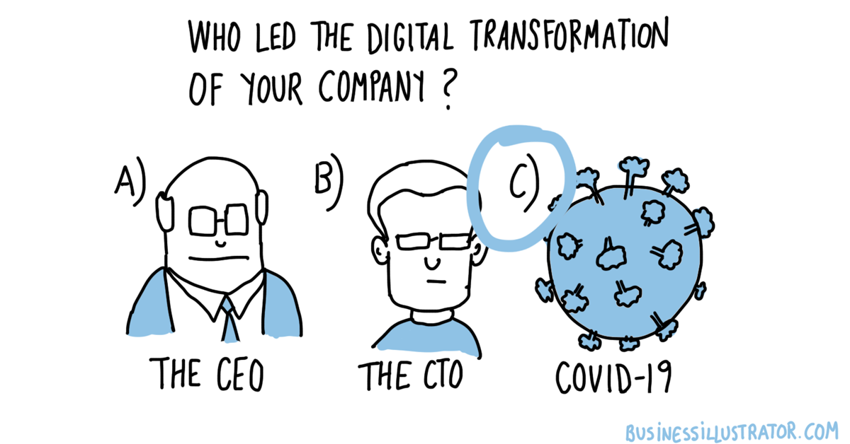

Slide 22
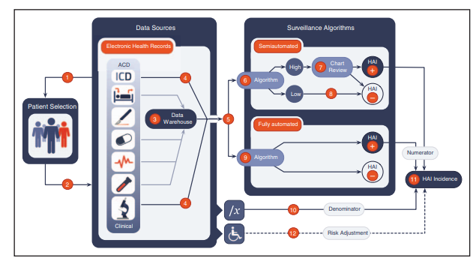
Sips et al. Curr Opin Infect Dis 2017;30:425-431.

Slide 23
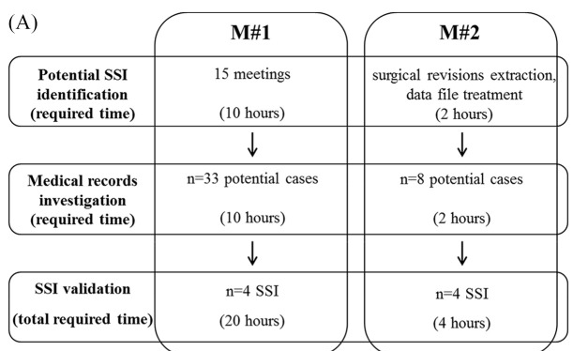
Semi-automated surveillance
M#1 = manual review of all cases; M#2 = semi-automated surveillance
Kuczewski et al. J Infect Prevent 2020

Slide 24
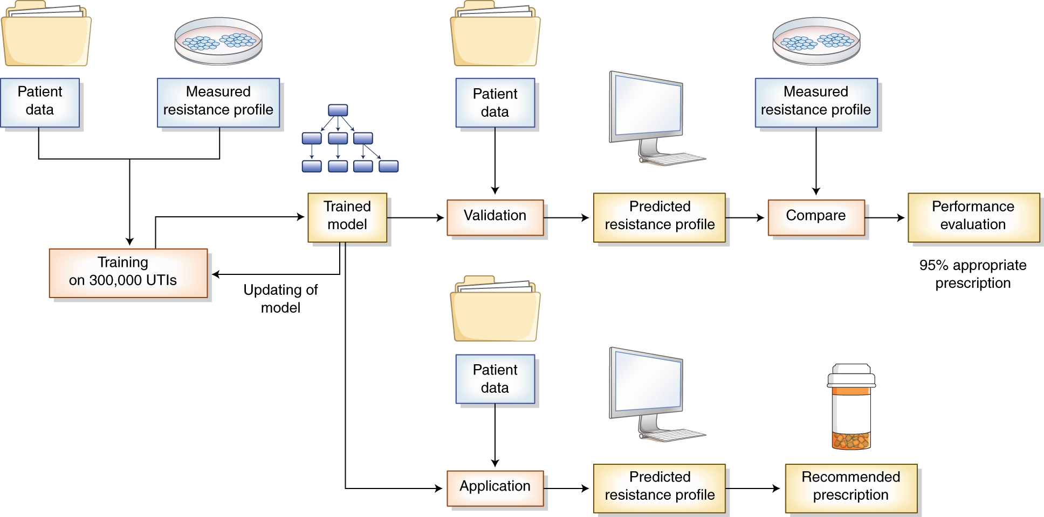
Machine learning / AI: antimicrobial prescribing decision support
Didelot et al. Nature Medicine 2019.

Slide 25
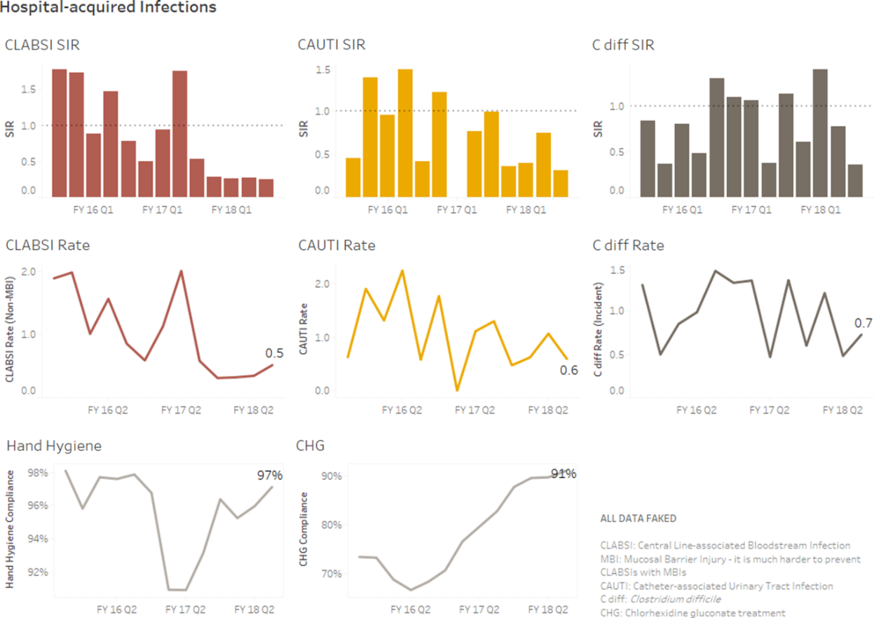
Data visualisation
Salinas et al. Infect Control Hosp Epidemiol 2020.

Slide 26
Promoting antimicrobial stewardship
Embedding digital systems to enhance our clinical services
Preventing SSI
Preventing the transmission of SARS-CoV-2 in our hospitals
Preventing Gram-negative bloodstream infection

Slide 27
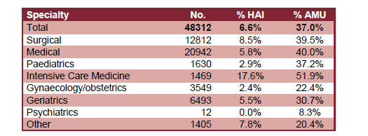
Prevalence of HCAI
The 2016 national PPS was a huge undertaking that included 48,312 patients from 88 NHS Trusts and 6 private hospitals.
7% of patients had an HCAI and 33% were on an antimicrobial.
Pneumonia was the most common HCAI (29%) followed by UTI (17%) then SSI (15%).
Prevalence of peripheral vascular cannula (43%), central venous catheters (7%), urinary catheters (20%), and intubation (2%).
HCAI and antimicrobial use by speciality.
ESPAUR Report 2017.

Slide 28

HCAIs are expensive
Cassini et al. Plos Med 2016.

Slide 29
Gram-negative BSIs are getting more common
Data: Public Health England.

Slide 30
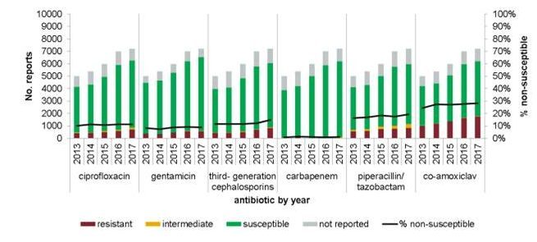
Gram-negative BSIs are getting harder to treat
Data: ESPAUR 2018.

Slide 31
Drivers of Gram-negative BSI
Lab testing
Patient sampling
Deprivation
Seasonal variation
Acquisition
Sources
Humans
Transmission routes
Hands
Environment
Animals
Food
Soil
Patient factors
Devices
AMR
Surgery & wounds
High risk patients
Hydration & UTI

Slide 32
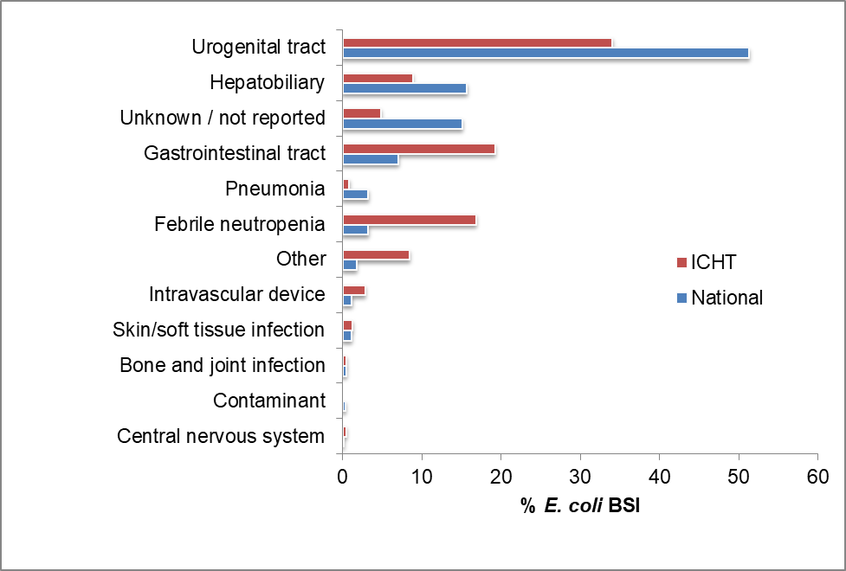
Getting to grips with the source of E. coli BSIs
Comparing the source of 250 healthcare-associated E. coli BSIs with the national picture, 2015-2017.
Otter et al. J Hosp Infect 2018.

Slide 33
Driving down GNBSI?
Reduce GNBSI (E. coli BSI)
Enhanced epidemiology / intelligence
Enhanced reporting to PHE
Prevent UTI / CAUTI
Monthly MDT review of HA E. coli BSI to scrutinize sources and identify learning
Interventions in specialist high-risk patient groups (haematology, renal, NICU and post-surgical wards)
Optimising antimicrobial treatment of infection
Improving the identification and management of sepsis
Regular review of local antibiotic susceptibility and treatment guidelines
Bi-annual PPS of antimicrobial prescribing indicators
Support non-acute colleagues in reviewing CA E. coli BSI cases
Applied research to share generalizable findings
Improve patient hydration
Oprimising urinary catheter utilization
Collaborating in the E. coli cancer collaborative
HCAI / AMR CQUIN on lower UTI

Slide 34
Promoting antimicrobial stewardship
Embedding digital systems to enhance our clinical services
Preventing SSI
Preventing the transmission of SARS-CoV-2 in our hospitals
Preventing Gram-negative bloodstream infection

Slide 35
SSI
Patient experience
Costs
Reputation/ patient choice
Antimicrobial resistance

Slide 36
Patient experience
17 patients who had suffered an SSI were enrolled into a semi-structured interview
‘I was crying, I was just not well at all. I couldn’t keep a drink down. The GP came and said what do you expect, you’ve had major surgery. I started to think I was going mad, perhaps you are supposed to feel like this. My husband was at his wits end, he didn’t know what to do. He called the NHS helpline and they said to buy some anti-sickness tablets from the chemist but they didn’t work. He rang the hospital and they weren’t very helpful, he rang the ward and they said she has been discharged so there is nothing we can do. Then after three or four days I was getting terrific pains in my stomach and I felt like I had wet myself, there was a lot of blood just gushing out of me.’
Tanner et al. J Infect Prevent 2012

Slide 37
Cost of SSI
Median cost of SSI is ~£5,200 (Jenks et al. J Hosp Infect 2014)
Direct costs
Indirect costs
ICU stay
Repeated surgery
Hospital readmission
Medical costs
Investigation/diagnostics
Staff time
Hospital overheads
Antibiotics
Increased length of stay
Morbidity & mortality
Decrease in quality of life
Loss of earnings
Iskander et al. World J Emerg Surg 2019

Slide 38
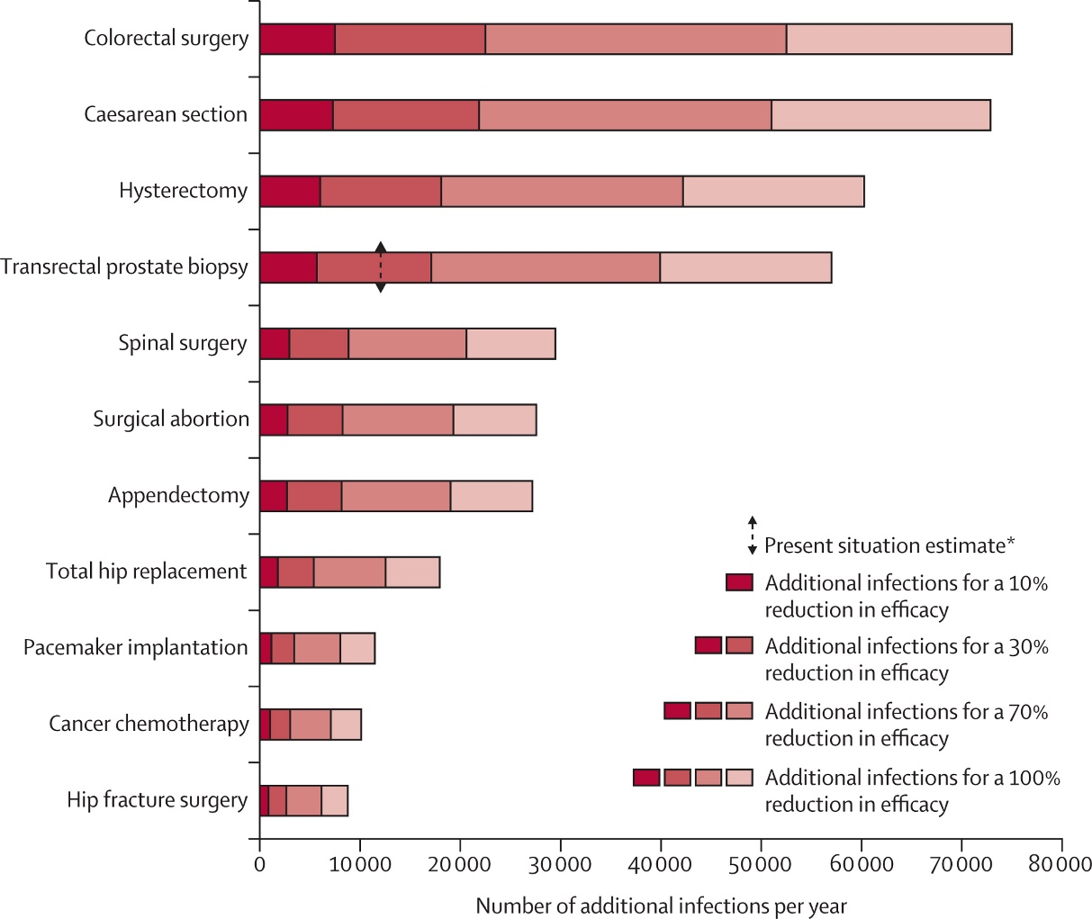
Antimicrobial resistance and SSI
Teillant et al. Lancet Infect Dis 2015.

Slide 39


Reputation…and patient choice

Slide 40
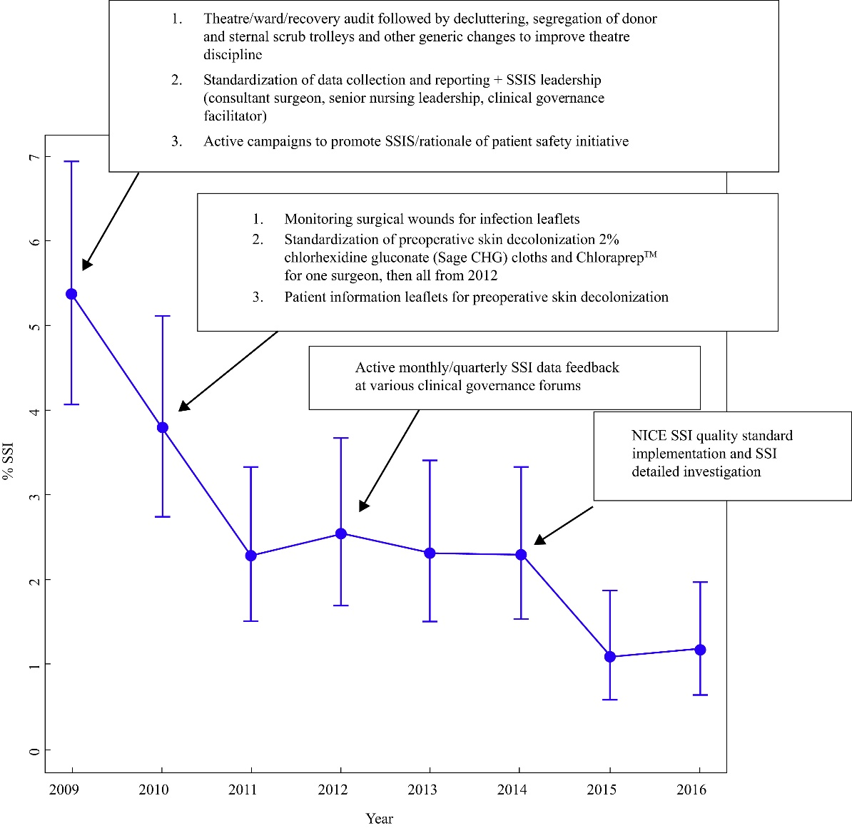
SSI prevention: a success story
SSI surveillance for adult cardiac surgery commenced in 2009.
Prospective SSI surveillance was undertaken, and potential practice concerns were identified and improved thorough a series of initiatives.
Chiwera et al. J Hosp Infect 2018.

Slide 41
SSI prevention: a success story
SSI surveillance at GSTT began to be enhanced in January 2009. The Trust now performs SSI surveillance in 12 surgical specialties. Assuming that the latest and lowest rate of SSI was achievable from the start of the programme, the reductions achieved suggest that 774 SSIs have been prevented. Assuming each SSI costs £5,239, this has resulted in savings of £4,056,443 over 6 years.
Unpublished data, with permission from GSTT.

Slide 42
Promoting antimicrobial stewardship
Embedding digital systems to enhance our clinical services
Preventing SSI
Preventing the transmission of SARS-CoV-2 in our hospitals
Preventing Gram-negative bloodstream infection

Slide 43


Slide 44
PPE
Transmission routes
Vaccination
Organizational transformation
Regulatory framework
Outbreaks
Non-COVID pathogens
Antimicrobial stewardship
Digital transformation
Applied research
Guidelines and policy development
Testing and laboratory factors

Slide 45
Promoting antimicrobial stewardship
Embedding digital systems to enhance our clinical services
Preventing SSI
Preventing the transmission of SARS-CoV-2 in our hospitals
Preventing Gram-negative bloodstream infection

Slide 46
The future of healthcare and infection prevention & control
Jon Otter PhD FRCPath
Director of Infection Prevention and Control
jon.otter@gstt.nhs.uk
@jonotter
Blog: www.ReflectionsIPC.com
Slides: www.jonotter.net

