Slide 1
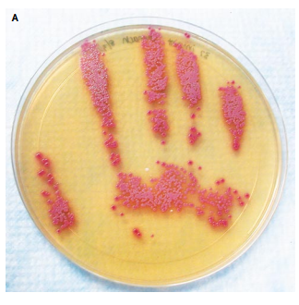





The thorny 5th Moment for Hand Hygiene: hands and surfaces collide
Jon Otter PhD FRCPath
Director of Infection Prevention and Control
jon.otter@gstt.nhs.uk
@jonotter
Blog: www.ReflectionsIPC.com
Slides: www.jonotter.net

Slide 2
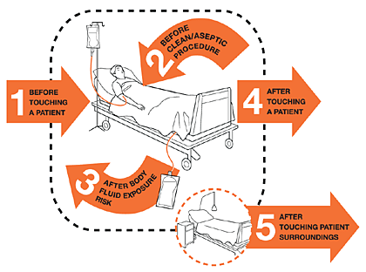

Slide 3
Hand hygiene is really important
Environmental hygiene (aka surfaces) is really important
Hands and surfaces collide
Where to next?

Slide 4
Hand hygiene is really important
Environmental hygiene (aka surfaces) is really important
Hands and surfaces collide
Where to next?

Slide 5
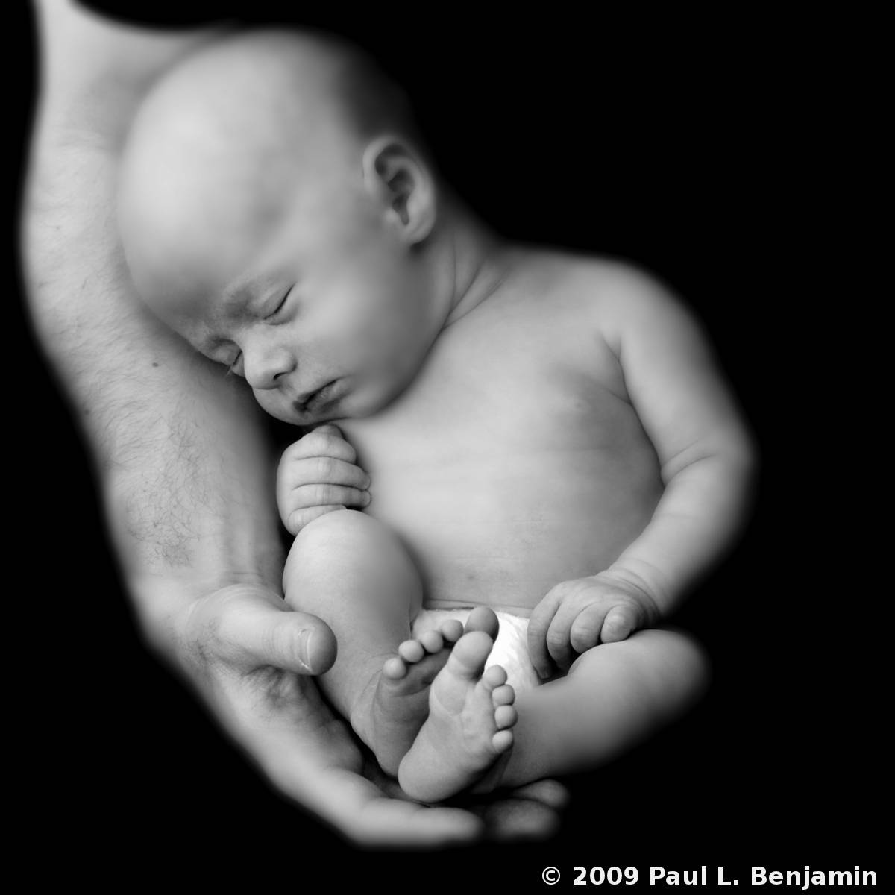

Slide 6


Slide 7
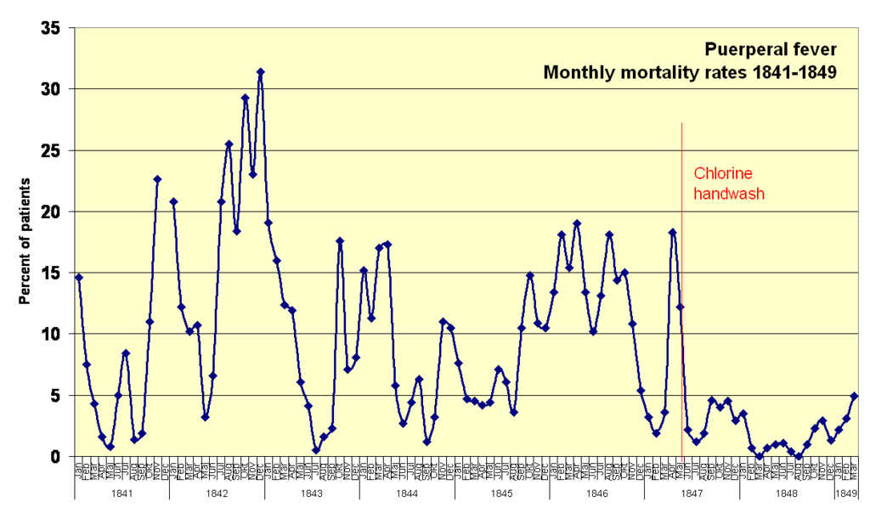

Slide 8
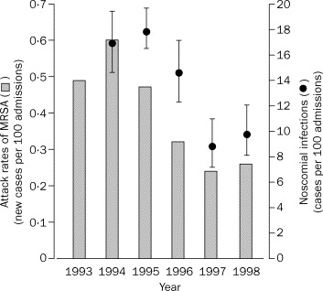
Improved hand hygiene reduces HCAI
A Swiss study evaluated the clinical impact of improved hand hygiene, hospital wide.
Hand hygiene compliance improved progressively from 48% in 1994, to 66% in 1997 (p<0.001).
Overall HCAI decreased from 16·9% in 1994 to 9·9% in 1998; p=0.04.
Pittet et al. Lancet 2000;356:1307-12.

Slide 9
Evidence that hand hygiene is important
Hands can become extensively contaminated¹ during patient care
If you don’t wash your hands, transmission of bacteria between patients occurs²
Improving hand hygiene compliance results in fewer HCAIs⁴
Hand hygiene reduces the microbial burden on hands³
Encouraging patients to perform hand hygiene can improve patient outcomes (e.g. reduced SSI⁵).
Modelling suggests that hand hygiene improvements above 70% are unlikely to further reduce transmission.⁶
All this data is nicely summarised⁷ in the WHO hand hygiene guidelines.
Thu et al. Infect Control Hosp Epidemiol 2007;28:583-588.
Beggs et al. BMC Infect Dis 2008;8:114.
WHO guidelines on hand hygiene in healthcare, 2009.

Slide 10
Hand hygiene is really important
Environmental hygiene (aka surfaces) is really important
Hands and surfaces collide
Where to next?

Slide 11

2x
Room A
Room B

Slide 12

Your hospital room can make you sick!
Mitchell et al. J Hosp Infect 2015;91:211-217.

Slide 13
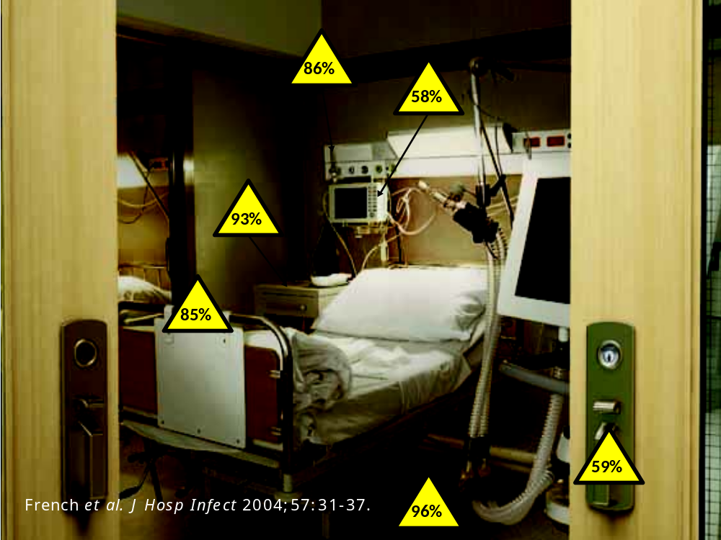

Slide 14
Surface survival
Organism | Survival time
Clostridium difficile (spores) | 5 months
Acinetobacter spp. | 3 days to 5 months
Enterococcus spp. including VRE | 5 days – 4 years (!)¹
Pseudomonas aeruginosa | 6 hours – 16 months
Klebsiella spp. | 2 hours to > 30 months
Staphylococcus aureus, inc. MRSA | 7 days – 7 months
Norovirus (and feline calicivirus) | 8 hours to > 2 weeks²
SARS Coronavirus | 72 hours to >28 days³
Influenza | Hours to several days⁴
Adapted from Kramer et al. BMC Infect Dis 2006;6:130.
Wagenvoort et al. J Hosp Infect 2011;77:282-283.
Doultree et al. J Hosp Infect 1999;41:51-57.
Rabenau et al. Med Microbiol Immunol 2005;194:1-6.
Bean et al. J Infect Dis 1982;146:47-51.

Slide 15
Conventional terminal decontamination
Notes:
Studies that have evaluated the effectiveness of terminal cleaning and disinfection have consistently demonstrated that conventional methods fail to eliminate reliably contamination with pathogens.

Slide 16
Equalising the risk from the prior room occupant
Datta et al. Arch Intern Med 2011;171:491-494.
Passaretti et al. Clin Infect Dis 2013;56:27-35.

Slide 17
Hand hygiene is really important
Environmental hygiene (aka surfaces) is really important
Hands and surfaces collide
Where to next?

Slide 18


Slide 19

Transfer of a surrogate marker in a NICU
Oelberg et al. Pediatrics 2000;105:311-315.

Slide 20

Transfer over time: inoculated pod
Oelberg et al. Pediatrics 2000;105:311-315.

Slide 21

Transfer of a surrogate marker in a NICU
Oelberg et al. Pediatrics 2000;105:311-315.

Slide 22

Transmission routes
Otter et al. Infect Control Hosp Epidemiol 2011;32:687-699.

Slide 23



Surface <> Hand <> Patient
Pathogens can be transferred from surfaces to HCW hands without direct patient contact¹⁻²
52% of 23 HCW acquired VRE on their hands³ | Contact with patient or surface = ~10% risk of acquiring VRE³
45% of 50 HCW acquired MRSA on their hands⁴ | 40% of 50 HCW acquired MRSA on their hands⁴
50% of 30 HCW acquired C. difficile on their hands⁵ | 50% of 30 HCW acquired C. difficile on their hands⁵
Compliance with hand hygiene: 50%⁶ | Compliance with hand hygiene: 80%⁶
Boyce et al. Infect Control Hosp Epidemiol 1997;18:622-627.
Bhalla et al. Infect Cont Hosp Epidemiol 2004;25:164-167.
Hayden et al. Infect Control Hosp Epidemiol 2008;29:149-154.
Stiefel et al. Infect Control Hosp Epidemiol 2011;32:185-187.
Guerrero et al. Am J Infect Control 2012;40:556-558.
Randle et al. J Hosp Infect 2010;76:252-255.

Slide 24
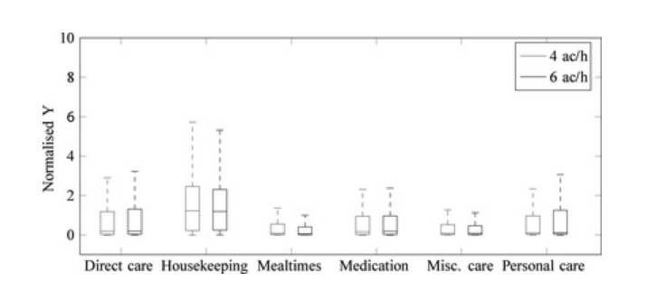
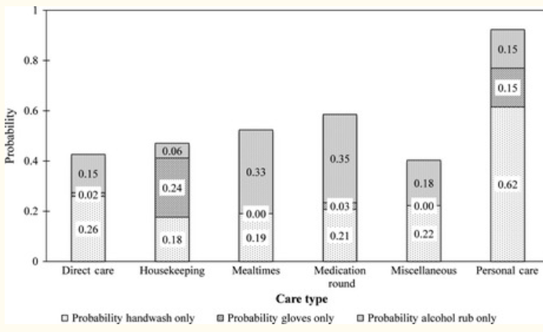
Where are your hands going?
Model to evaluate the estimated density of hand contamination related to various health and care activities (top panel) and the estimated probability of hand hygiene following these activities (bottom panel)
King et al. Indoor Air 2015.

Slide 25
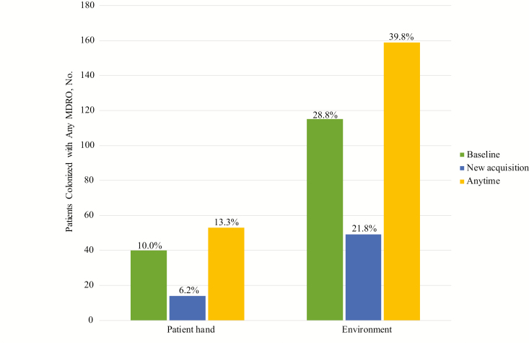
Patients’ hands and their environment
Longitudinal sampling of 399 patient hands and high-touch surface samples throughout their hospital stay.
Mody et al. Clin Infect Dis 2019.

Slide 26
Factors influencing the relative importance of hands / surfaces
Microbial
Amount shed
Procedures (e.g. AGP)
Therapy (e.g. abx)
Environmental
Organism
Density
Airflows / ventilation
Behavioural
Hand hygiene / PPE user
Environmental hygiene
Source control (e.g. chlorhexidine)
Patient density
Temperature / humidity
Indoor / outdoor
Task undertaken (e.g. frequency of surface contact)
Biofilm formation
Surface survival

Slide 27
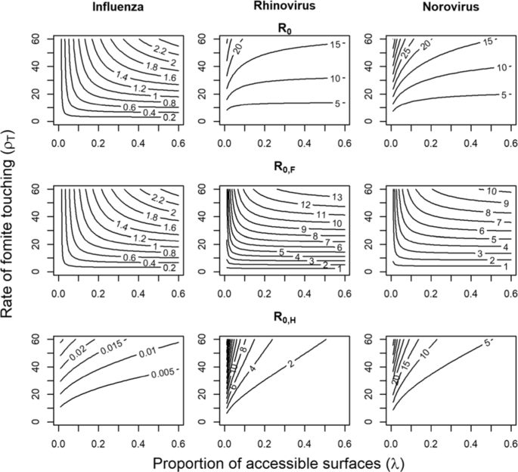
Modelling the relative importance of hands / surfaces
Mathematical model simulating the transmission of Influenza, Rhinovirus, and Norovirus under various conditions
R₀ = all routes combined
R_{0,F} = fomite mediated transmission
R_{0,H} = hand-fomite mediate transmission
Kraay et al. BMC Infect Dis 2018.

Slide 28
Hand hygiene is really important
Environmental hygiene (aka surfaces) is really important
Hands and surfaces collide
Where to next?

Slide 29
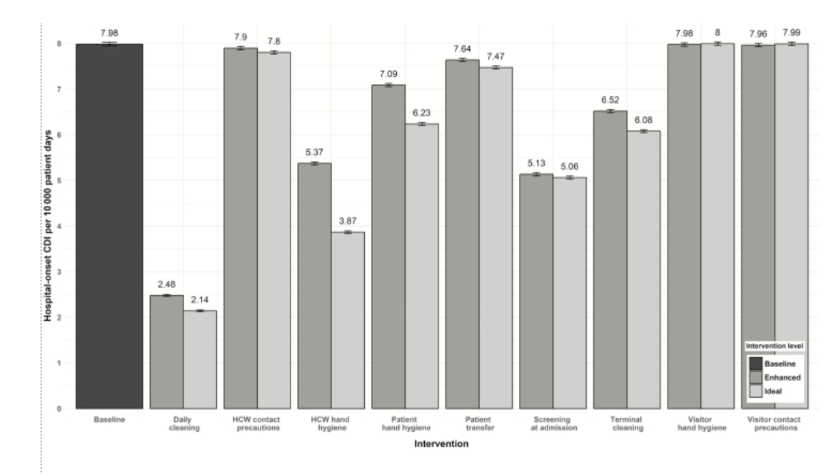
Comparative effectiveness: hand vs. environmental hygiene
A transmission-based model of the impact of various interventions in reducing the transmission of C. difficile.
Hand hygiene
Daily cleaning
Barker et al. Clin Infect Dis 2018.

Slide 30
Combined impact: hand vs. environmental hygiene
A transmission-based model of the impact of various interventions in reducing the transmission of C. difficile.
Bundle Components | HO-CDI per 10000 Patient-days (95% CI)
Baseline | 7.98 (7.95–8.02)
Patient and HCW HH | 4.74 (4.71–4.77)
Terminal and daily cleaning | 2.44 (2.41–2.46)
Screening, patient HH, patient transfer | 3.75 (3.73–3.78)
Daily cleaning, surveillance | 1.41 (1.39–1.43)
Daily cleaning, surveillance, HCW HH | 1.18 (1.17–1.20)
Daily cleaning, surveillance, HCW HH, patient HH | 1.13 (1.11–1.14)
Daily cleaning, surveillance, HCW HH, patient HH, terminal cleaning | 1.12 (1.10–1.13)
Daily cleaning, surveillance, HCW HH, patient HH, terminal cleaning, patient transfer | 1.11 (1.10–1.12)
Barker et al. Clin Infect Dis 2018.

Slide 31
The thorny 5th Moment for Hand Hygiene: hands and surfaces collide
Jon Otter PhD FRCPath
Director of Infection Prevention and Control
jon.otter@gstt.nhs.uk
@jonotter
Blog: www.ReflectionsIPC.com
Slides: www.jonotter.net

