Slide 1
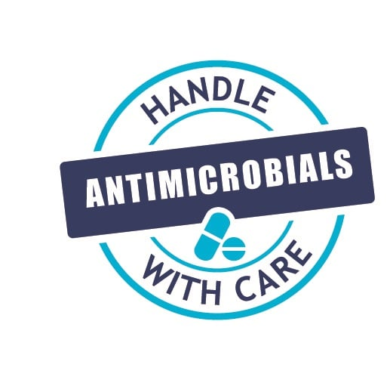



World Antibiotic Awareness Week 2022:
Prevention (IPC & vaccination)
Jon Otter PhD FRCPath
Director of Infection Prevention and Control & Consultant Clinical Scientist
Guy’s and St Thomas’ NHS Foundation Trust
@jonotter
jon.otter@gstt.nhs.uk
Blog: www.reflectionsIPC.com
Slides: www.jonotter.net

Slide 2
Day 1 – Fri 18th November 2022
Day 2 – Mon 21st November 2022
Day 3 – Tues 22nd November 2022
Day 4 – Weds 23rd November 2022
‘Prevention’ theme (including Infection Prevention and Control measures and vaccination)
‘Antimicrobials in clinical practice’ theme
‘Optimising diagnostics’ theme
‘Antimicrobials and untrue or spurious allergy’ theme
‘Antimicrobial resistance and the environment/sustainability and research’ theme
Day 5 – Thurs 24th November 2022

Slide 3
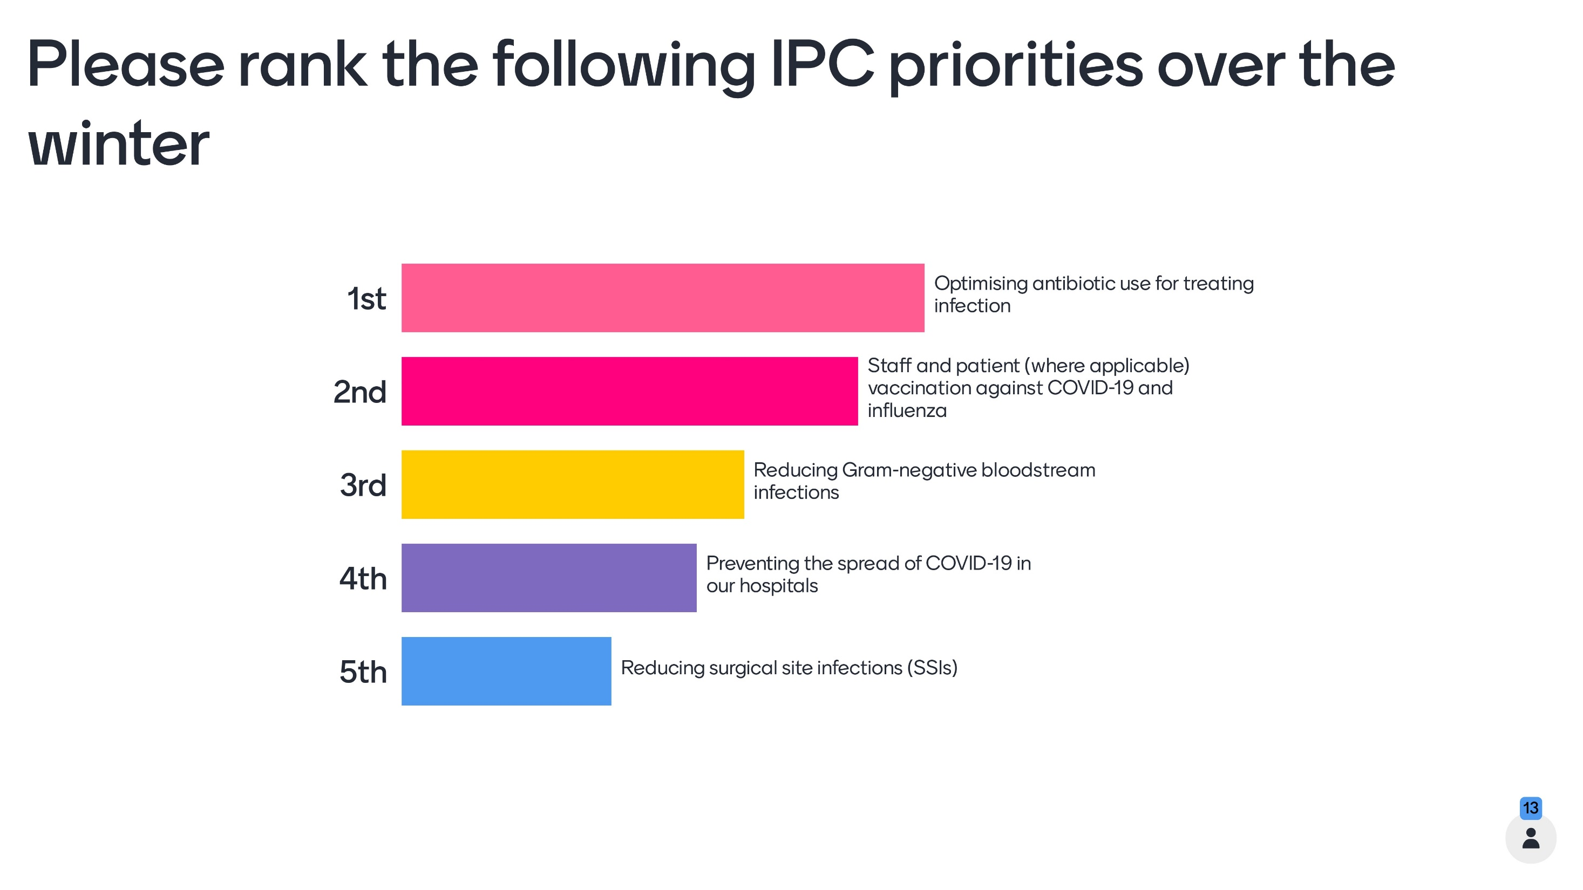

Slide 4
Oi! Watch your language
Prevent spread – reduce AMR
Future perspectives
Celebrating vaccination

Slide 5
Oi! Watch your language
Prevent spread – reduce AMR
Future perspectives
Celebrating vaccination

Slide 6
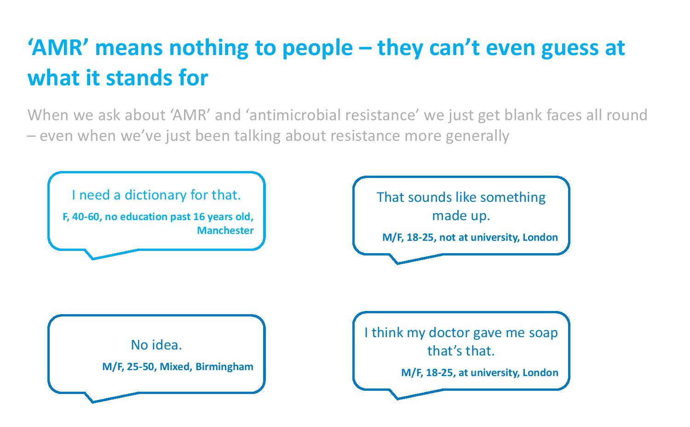
Wellcome Trust “Exploring the consumer perspective on antimicrobial resistance”, 2015.

Slide 7
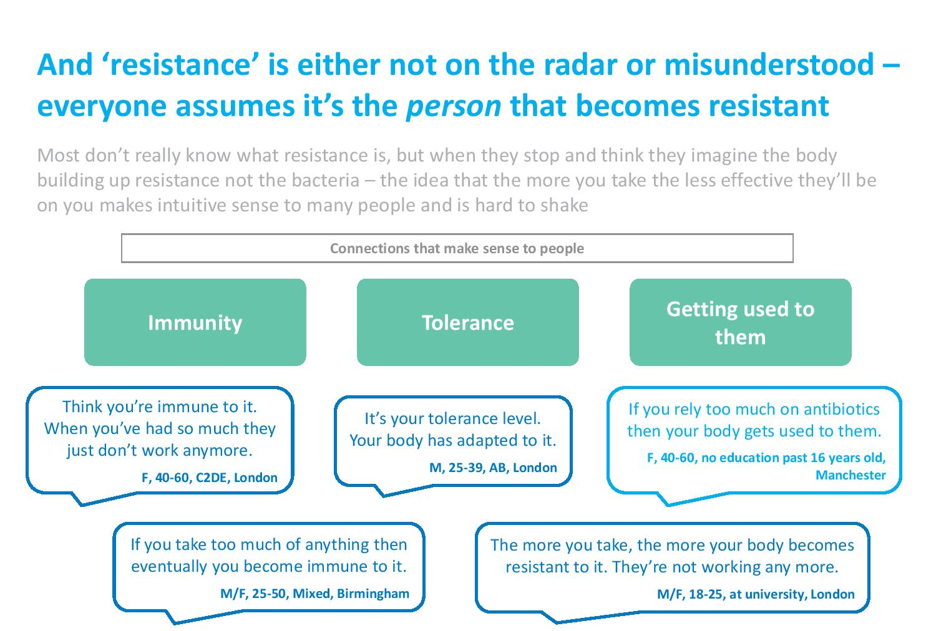
Wellcome Trust “Exploring the consumer perspective on antimicrobial resistance”, 2015.

Slide 8
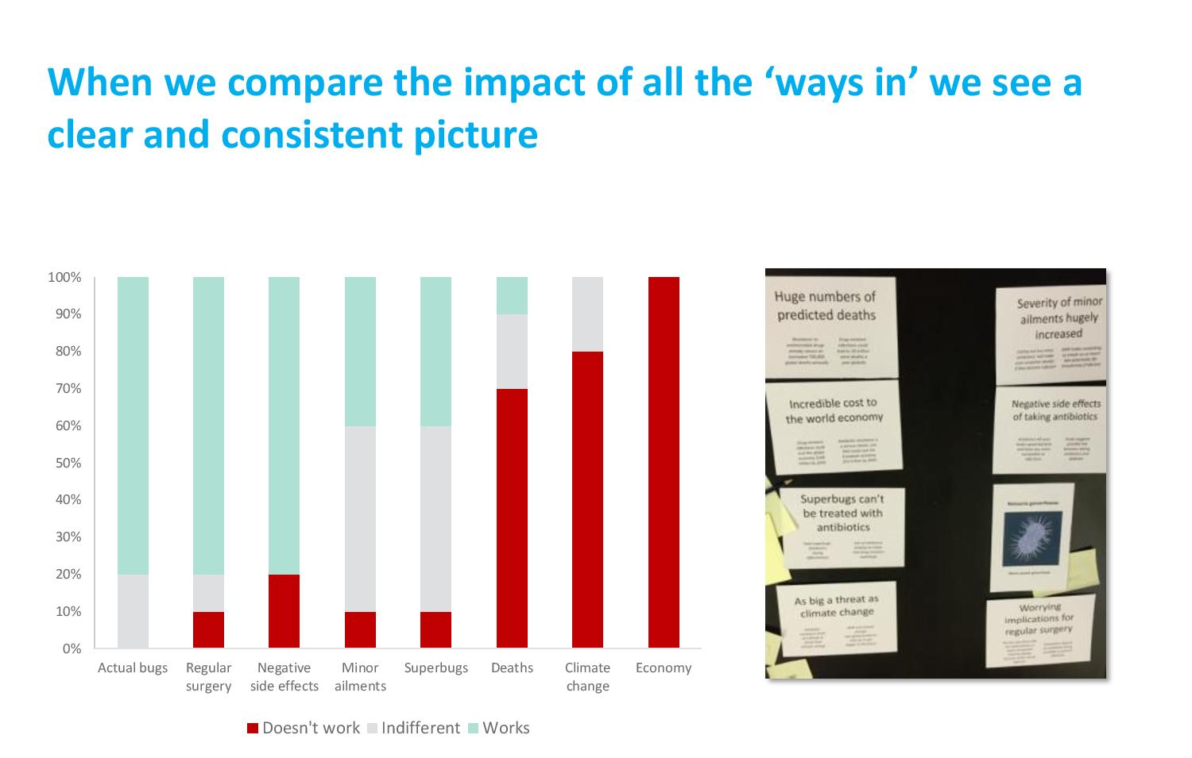
Wellcome Trust “Exploring the consumer perspective on antimicrobial resistance”, 2015.

Slide 9
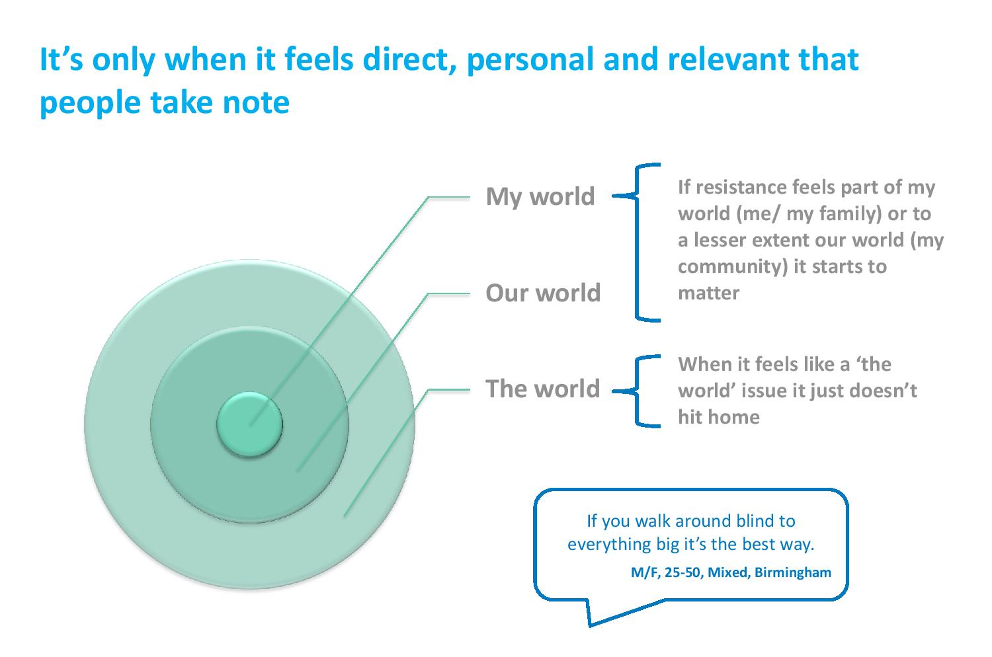
Wellcome Trust “Exploring the consumer perspective on antimicrobial resistance”, 2015.

Slide 10
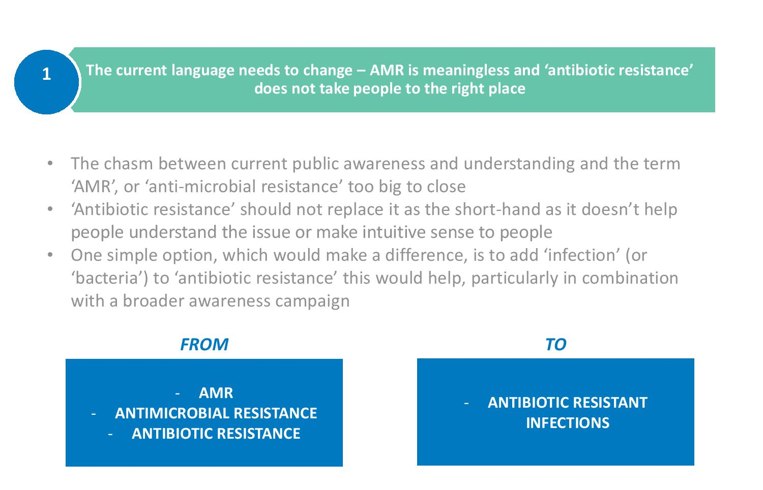
Wellcome Trust “Exploring the consumer perspective on antimicrobial resistance”, 2015.

Slide 11
Impact of a simplified C. diff lab report
Evaluating the impact of a simplified C. difficile lab report on clinician decisions around treatment and patient isolation.
 | C. difficile positive |  | C. difficile negative
 | Treat? | Isolate? | Treat? | Isolate?
Correct responses at Time Point 1 (%) | 86 | 93 | 86 | 83
Correct responses at Time Point 2 (%) | 86 | 100 | 98 | 84
P-value | 0.99 | 0.03 | 0.01 | 0.83
Tuke et al. J Hosp Infect 2017;96:205-206.

Slide 12
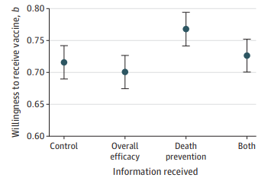
Public health: vaccine uptake
Evaluation of williningness to recieve a COVID-19 vaccine based on differences in information provided to 2556 Canadian adults.
Merkley & Loewen JAMA Netw Open 2021;4:e2126635.

Slide 13
Oi! Watch your language
Prevent spread – reduce AMR
Future perspectives
Celebrating vaccination

Slide 14
MRSA bacteraemia, England 2001-2013
4
5
6
Mandatory reporting, 2001
‘Gettting ahead of the curve’, 2002
‘Winning ways’, 2003
‘Towards cleaner hospitals’, 2004
‘Cleanyourhands’, 2004
Targets introduced, 2004
Cleanliness improvement, 2005
‘Going further faster’, 2006
Root cause analysis, 2006
Revised national guidelines, 2006
Deep clean, 2007
Screening elective admissions, 2008
Universal screening, 2010
8
9
10
3
7
1
2
11
12
13

Slide 15
MRSA in Europe, 2000 to 2016
% invasive S. aureus isolates resistant to meticillin.
EARS-Net 2018.

Slide 16
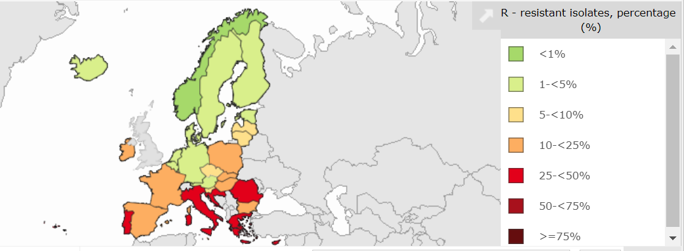
MRSA in Europe, 2022
% invasive S. aureus isolates resistant to meticillin.
EARS-Net 2022.

Slide 17
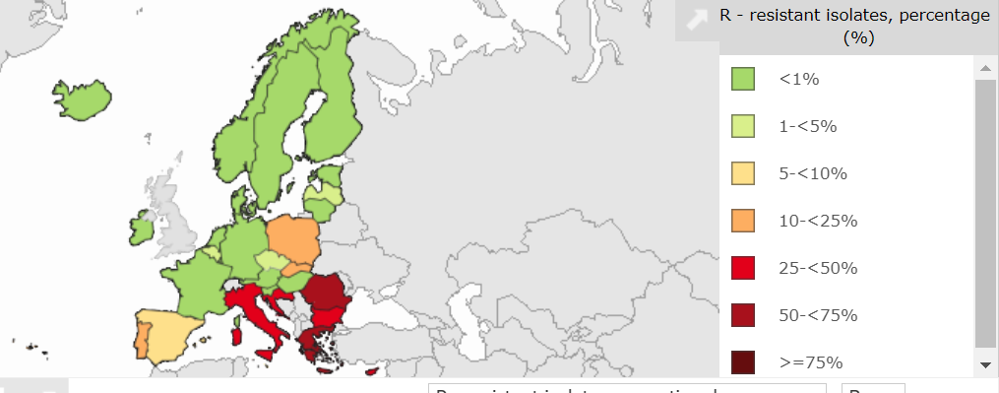
CRE (K. pneumoniae) in Europe, 2022
% invasive Klebsiella pneumoniae isolates resistant to carbapenems.
EARS-Net 2022.

Slide 18
Oi! Watch your language
Prevent spread – reduce AMR
Future perspectives
Celebrating vaccination

Slide 19
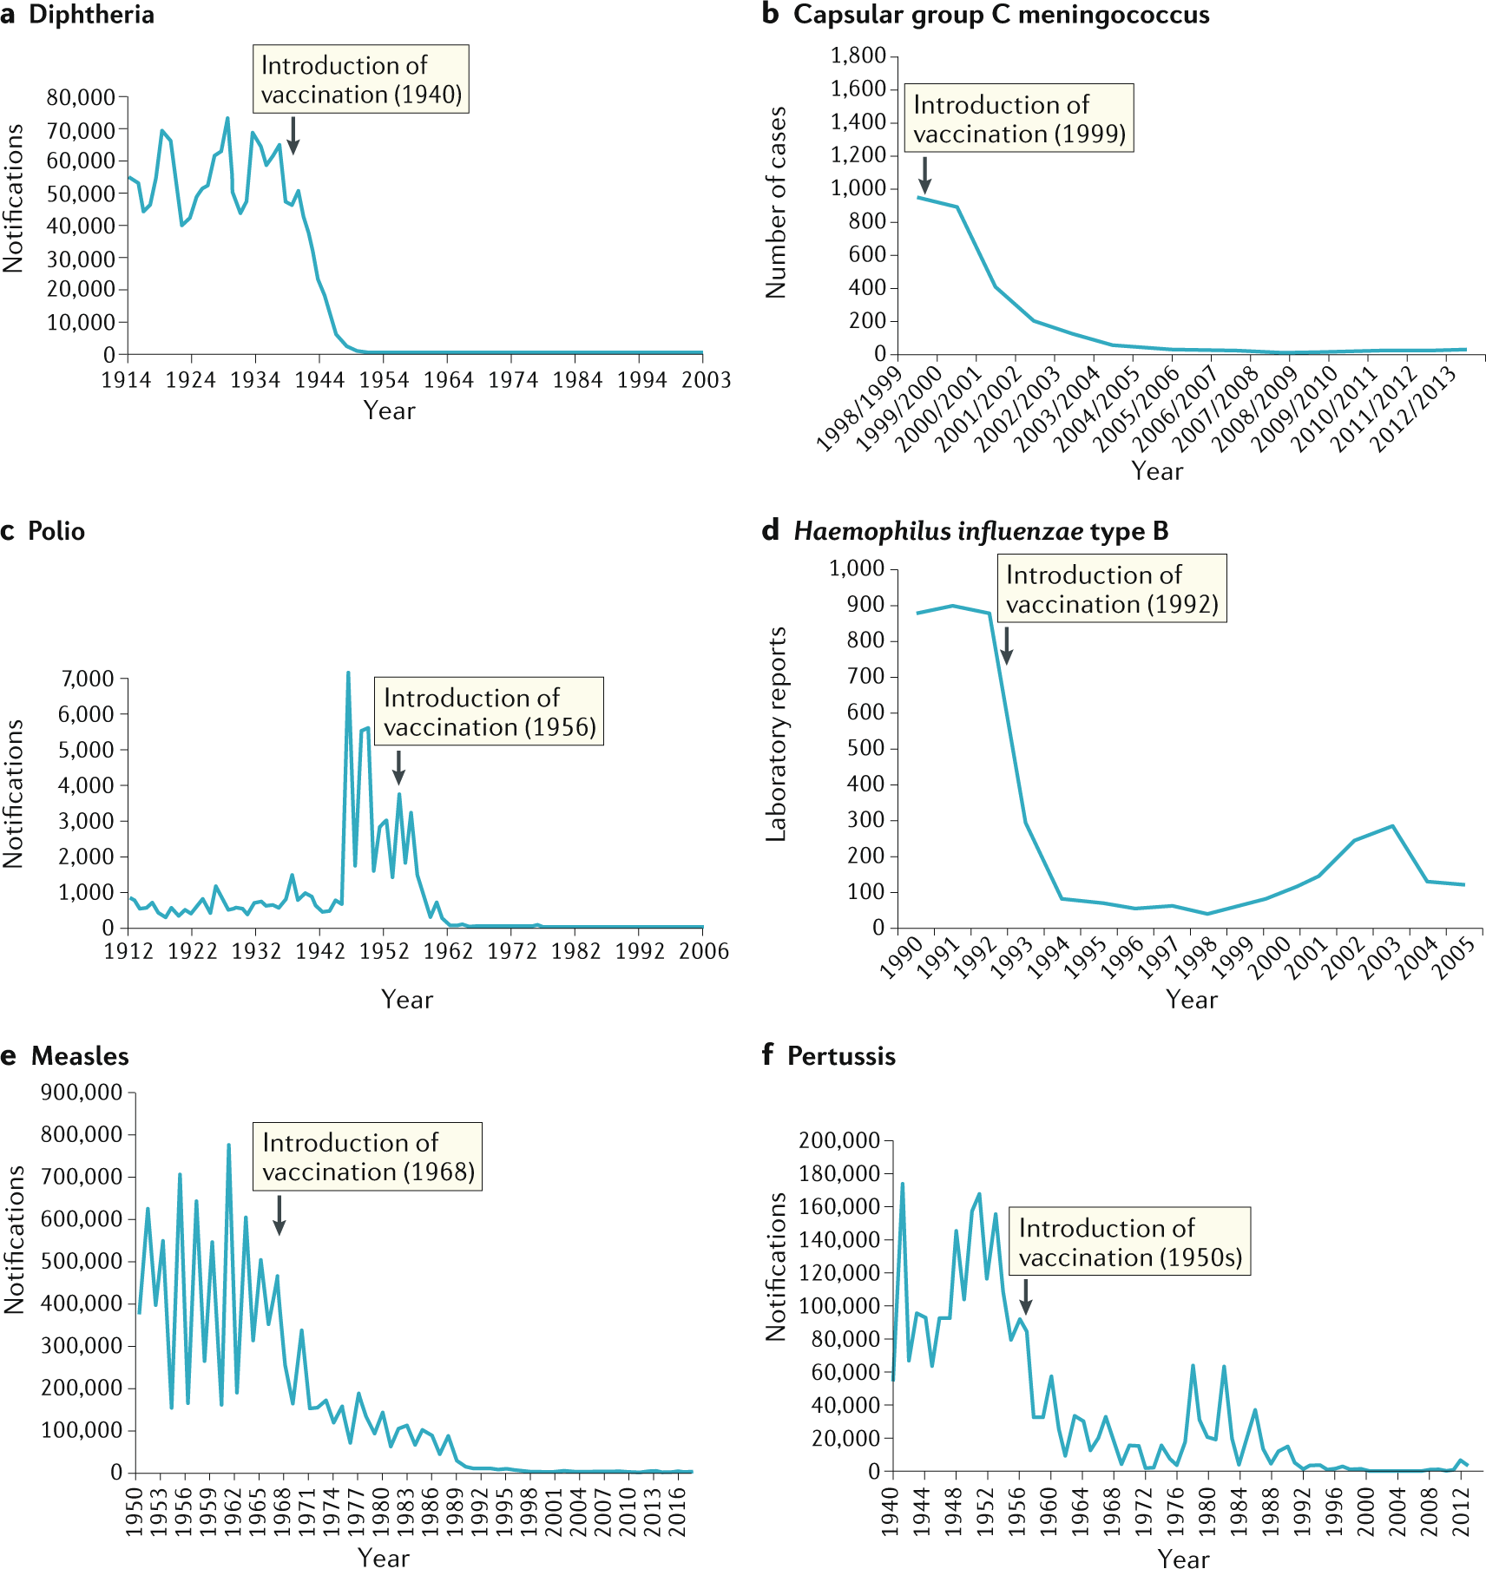
The impact of vaccination on selected diseases in the UK
Pollard & Bijker. Nature Rev Immunol 2020.

Slide 20
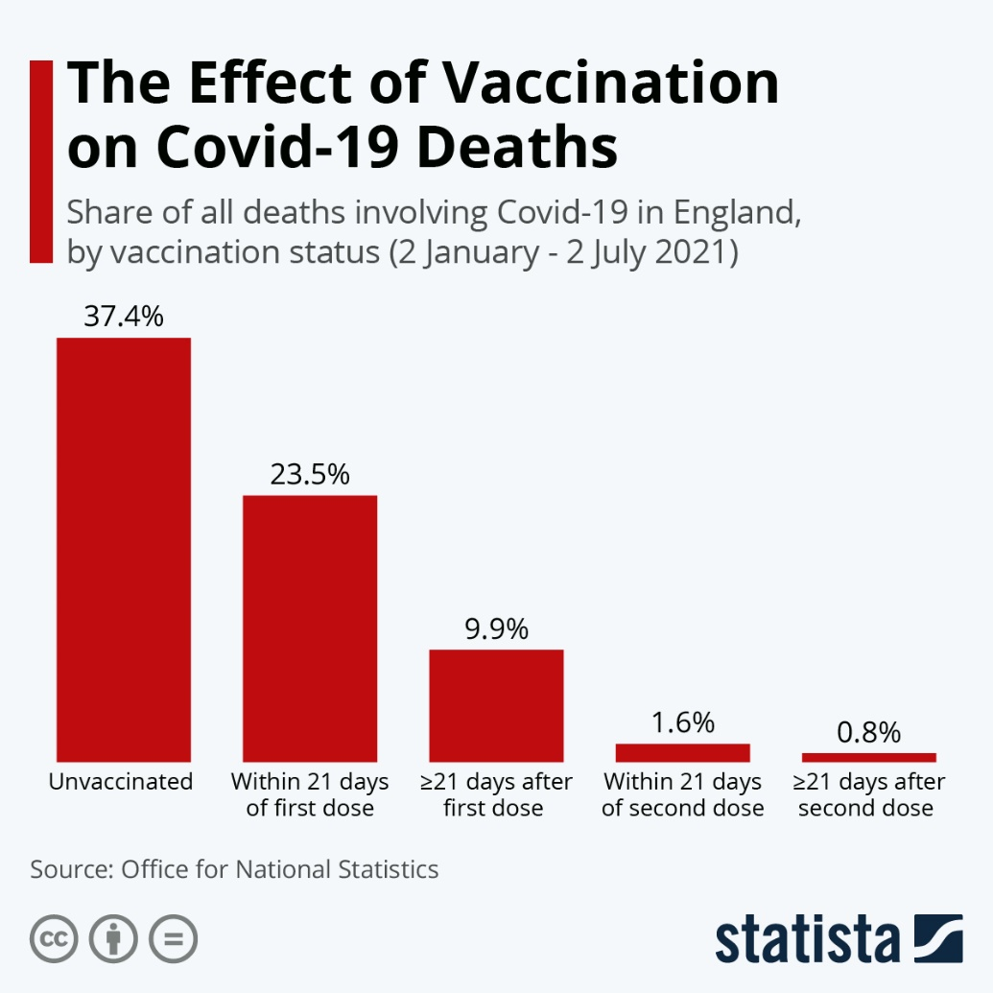
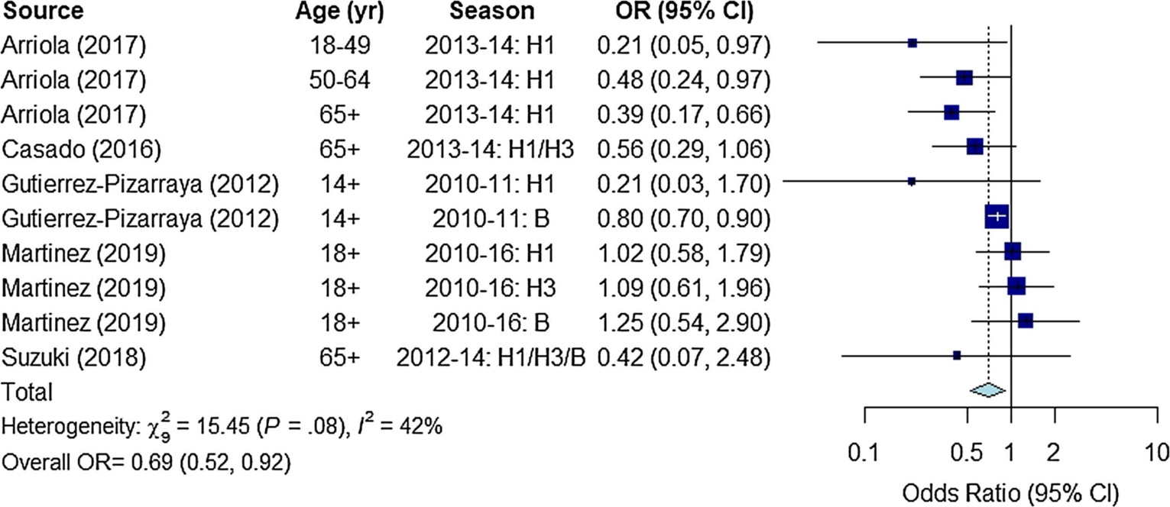
Vaccination means you are less likely to die from COVID-19 or flu!
Odds ratio for death amongst influenza vaccinated vs. unvaccinated hospitalised adults with laboratory confirmed influenza.
Summary odds ratio (95% CI) is 0.69 (0.52, 0.92).
Ferdinands et al. Vaccine 2021.

Slide 21
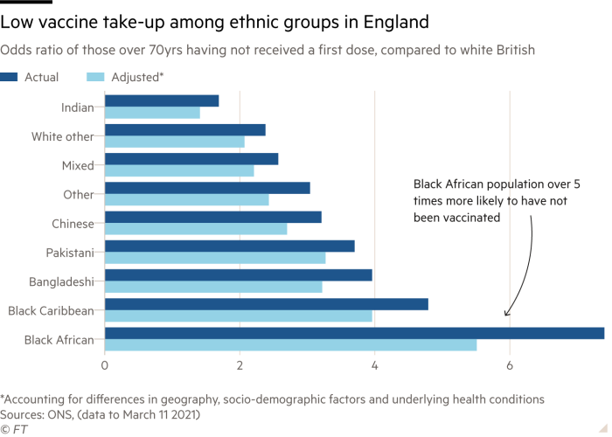
Vaccination: variation in uptake

Slide 22
How does vaccination reduce antibiotic demand?
Vaccination
Direct reduction in prevalence of antibiotic resistant bacteria (e.g. pneumococcal vaccine)
Reduce acute febrile disease, which often results in (ineffective) antibiotic use
Reduce secondary bacterial infection
Vaccination against antibiotic resistant bacteria
Microli et al. Nature Rev Microbiol 2021.

Slide 23
Oi! Watch your language
Prevent spread – reduce AMR
Future perspectives
Celebrating vaccination

Slide 24
Prevention is better than cure
Reduced antibiotic use
Improved diagnostics
Surveillance for action
Phages and vaccines
Highlight high cost of AMR
New antibiotics
Public awareness
Pay and recognition for AMR folk
Based on Laxminarayan et al. Lancet Infect Dis 2013;13:1057-1098, and Review on AMR.

Slide 25
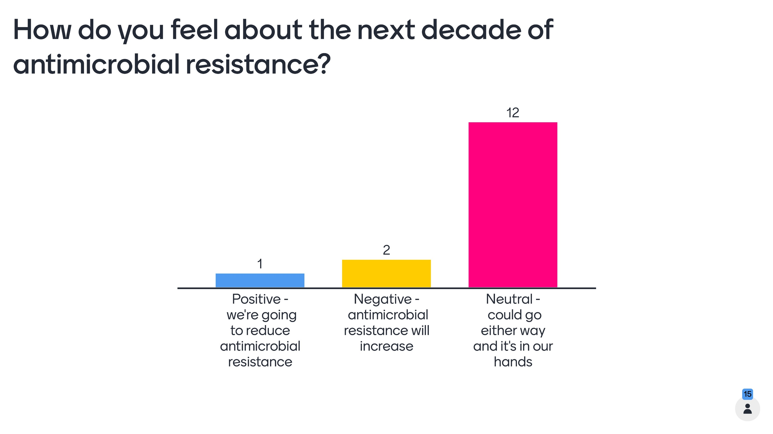
How do you feel about the next decade?
Negative – a post-antibiotic era
Positive – we’ll see a reduction in AMR
Could go either way

Slide 26
Day 1 – Fri 18th November 2022
Day 2 – Mon 21st November 2022
Day 3 – Tues 22nd November 2022
Day 4 – Weds 23rd November 2022
‘Prevention’ theme (including Infection Prevention and Control measures and vaccination)
‘Antimicrobials in clinical practice’ theme
‘Optimising diagnostics’ theme
‘Antimicrobials and untrue or spurious allergy’ theme
‘Antimicrobial resistance and the environment/sustainability and research’ theme
Day 5 – Thurs 24th November 2022

Slide 27
World Antibiotic Awareness Week 2022:
Prevention (IPC & vaccination)
Jon Otter PhD FRCPath
Director of Infection Prevention and Control & Consultant Clinical Scientist
Guy’s and St Thomas’ NHS Foundation Trust
@jonotter
jon.otter@gstt.nhs.uk
Blog: www.reflectionsIPC.com
Slides: www.jonotter.net

