Slide 1
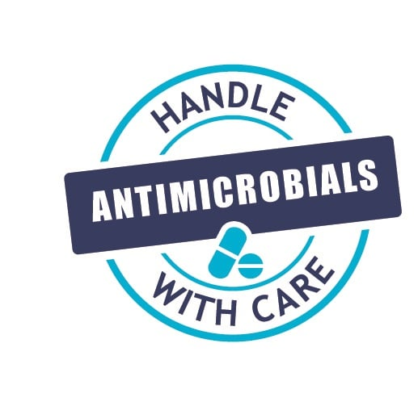



Creative infection prevention and control issues
Jon Otter PhD FRCPath
Director of Infection Prevention and Control & Consultant Clinical Scientist
Guy’s and St Thomas’ NHS Foundation Trust
@jonotter
jon.otter@gstt.nhs.uk
Blog: www.reflectionsIPC.com
Slides: www.jonotter.net

Slide 2
Transpoosion
COVID/PPE
The environment
AMR

Slide 3
Transpoosion
COVID/PPE
The environment
AMR

Slide 4
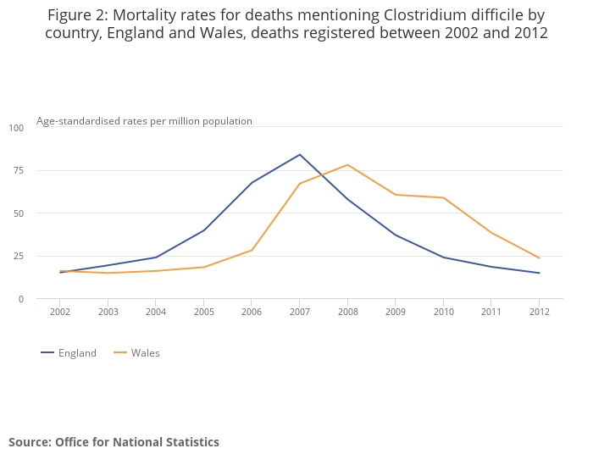
Clostridium difficile infection
Notes:
Recurrence rate 15-35%

Slide 5
Preventing recurrent CDI: FMT
Patients with recurrent CDI randomised to FMT (n=16), vancomycin (n=12) or vancomycin + bowel lavage (n=13)
van Nood et al. N Engl J Med 2013;368:407-415.

Slide 6


Slide 7
Recurrent CDI is just the start…
Disease group | Diseases
Intestinal | Recurrent CDI, Chron’s disease, ulcerative colitis, IBS, dislodging antibiotic resistant bacteria
Metabolic | Metabolic syndrome, obesity, Type 2 diabetes, cardiovascular diseases, non-alcoholic liver diseases
Neuropsychiatric | Parkinson’s, MS, myoclonus dystonia, autism, chronic fatigue syndrome
Autoimmune | Arthritis, various other
Allergic | Atopy, asthma, various cancers
Xu et al. World J Gasteroenterol 2015;21:102-111.

Slide 8
Transpoosion
COVID/PPE
The environment
AMR

Slide 9
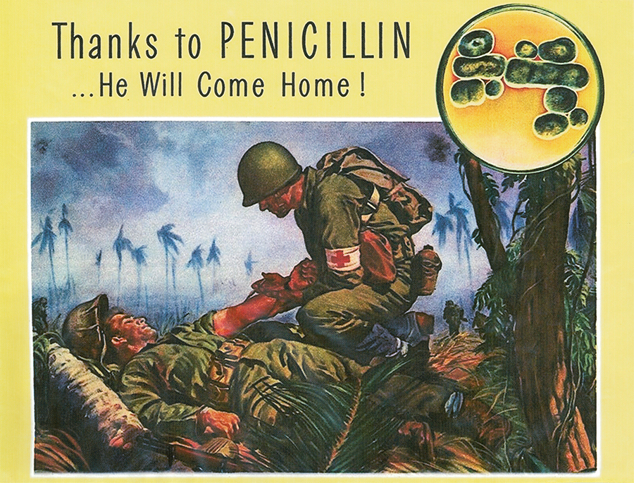

Slide 10
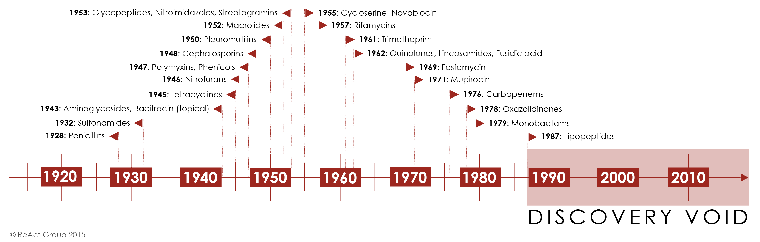
ReAct.

Slide 11
But I would like to sound one note of warning…There may be a danger, though, in underdosage. The time may come when penicillin can be bought by anyone in the shops. Then there is the danger that the ignorant man may easily underdose himself and by exposing his microbes to non-lethal quantities of the drug make them resistant. Here is a hypothetical illustration. Mr X has a sore throat. He buys some penicillin and gives himself, not enough to kill the streptococci but enough to educate them to resist penicillin. He then infects his wife. Mrs X gets pneumonia and is treated with penicillin. As the streptococci are now resistant to penicillin the treatment fails. Mrs X dies. Who is primarily responsible for Mrs X’s death? Why Mr X whose negligent use of penicillin changed the nature of the microbe. Moral: If you use penicillin, use enough.
Alexander Fleming, Nobel Lecture, December 11 1945.

Slide 12
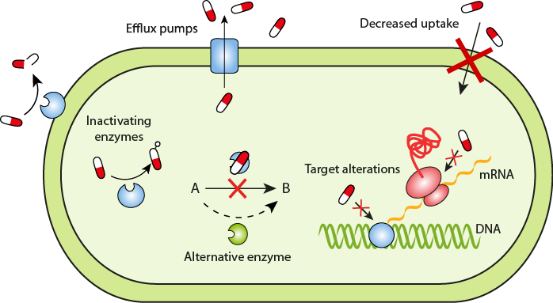
ReAct.

Slide 13
MRSA bacteraemia, England 2001-2013
4
5
6
Mandatory reporting, 2001
‘Gettting ahead of the curve’, 2002
‘Winning ways’, 2003
‘Towards cleaner hospitals’, 2004
‘Cleanyourhands’, 2004
Targets introduced, 2004
Cleanliness improvement, 2005
‘Going further faster’, 2006
Root cause analysis, 2006
Revised national guidelines, 2006
Deep clean, 2007
Screening elective admissions, 2008
Universal screening, 2010
8
9
10
3
7
1
2
11
12
13

Slide 14
MRSA in Europe, 2000 to 2016
% invasive S. aureus isolates resistant to meticillin.
EARS-Net 2018.

Slide 15
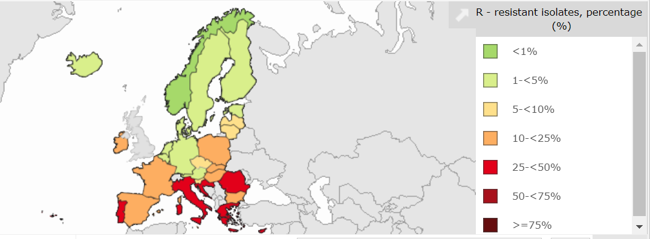
MRSA in Europe, 2022
% invasive S. aureus isolates resistant to meticillin.
EARS-Net 2022.

Slide 16
Rising threat from MDR-GNR
% of all HAI caused by GNRs.
% of ICU HAI caused by GNRs.
Non-fermenters | Acinetobacter baumannii Pseudomonas aeruginosa Stenotrophomonas maltophilia
Enterobacteriaceae | Klebsiella pneumoniae Escherichia coli Enterobacter cloacae
CPO
CPE
Hidron et al. Infect Control Hosp Epidemiol 2008;29:966-1011.
Peleg & Hooper. N Engl J Med 2010;362:1804-1813.

Slide 17
The emerging threat of CPE
Pathogen | CPE | MRSA | VRE | C. difficile
Resistance | +++ | + | + | +/-
Resistance genes | Multiple | Single | Single | n/a
Species | Multiple | Single | Single | Single
HA vs CA | HA & CA | HA | HA | HA
At-risk pts | All | Unwell | Unwell | Old
Virulence | +++ | ++ | +/- | +
Environment | +/- | + | ++ | +++

Slide 18
Creating a monster
Enterobacterales
ESBLs
CPE
Extended-spectrum beta-lactams
Carbapenems

Slide 19
CPE
Rapid spread
Clinical impact
£
AMR

Slide 20
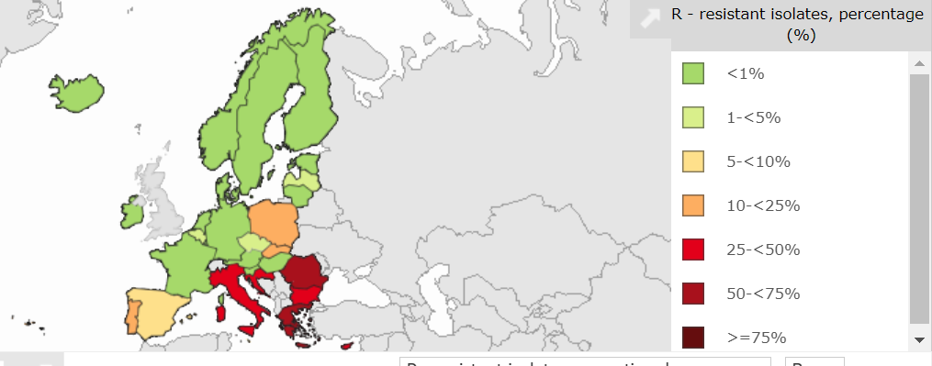
CRE (K. pneumoniae) in Europe, 2022
% invasive Klebsiella pneumoniae isolates resistant to carbapenems.
EARS-Net 2022.

Slide 21
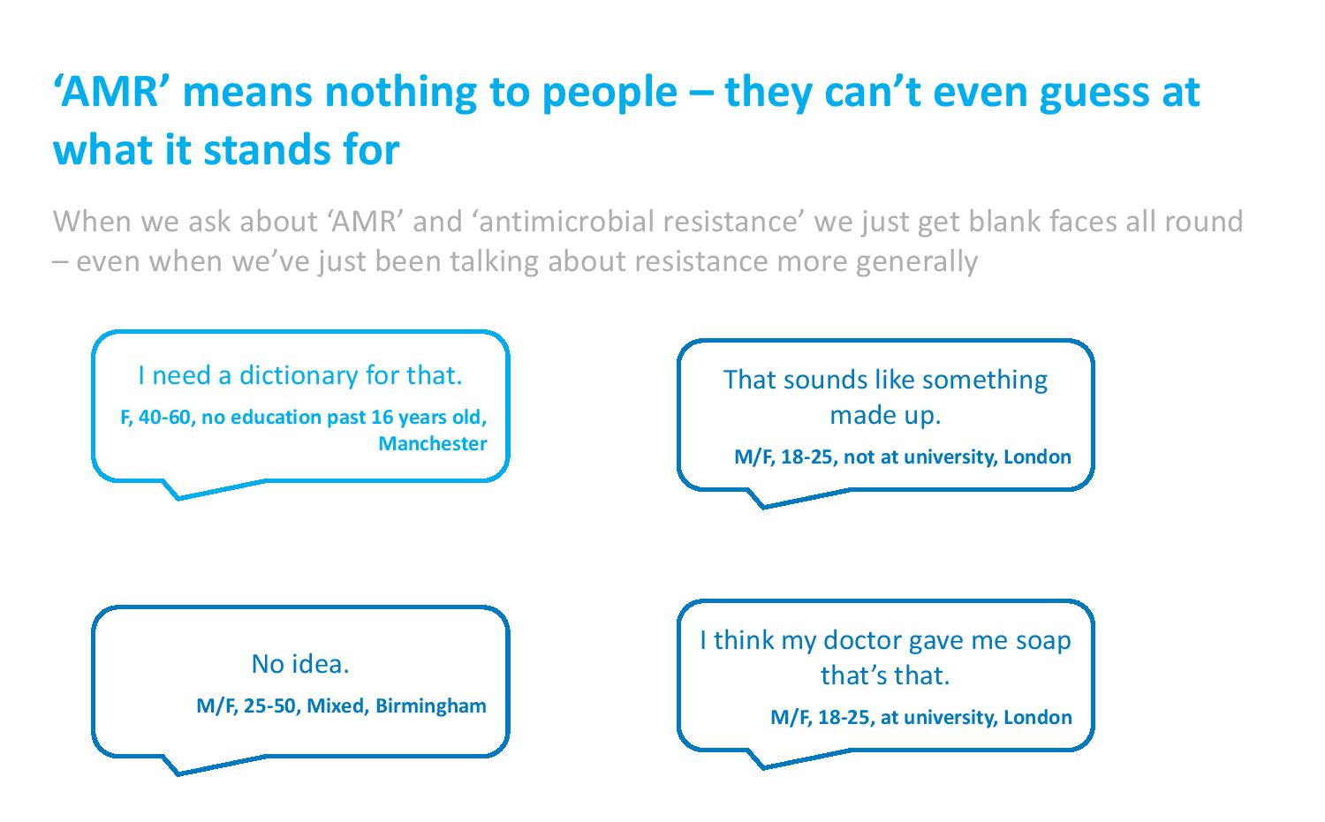
Wellcome Trust “Exploring the consumer perspective on antimicrobial resistance”, 2015.

Slide 22
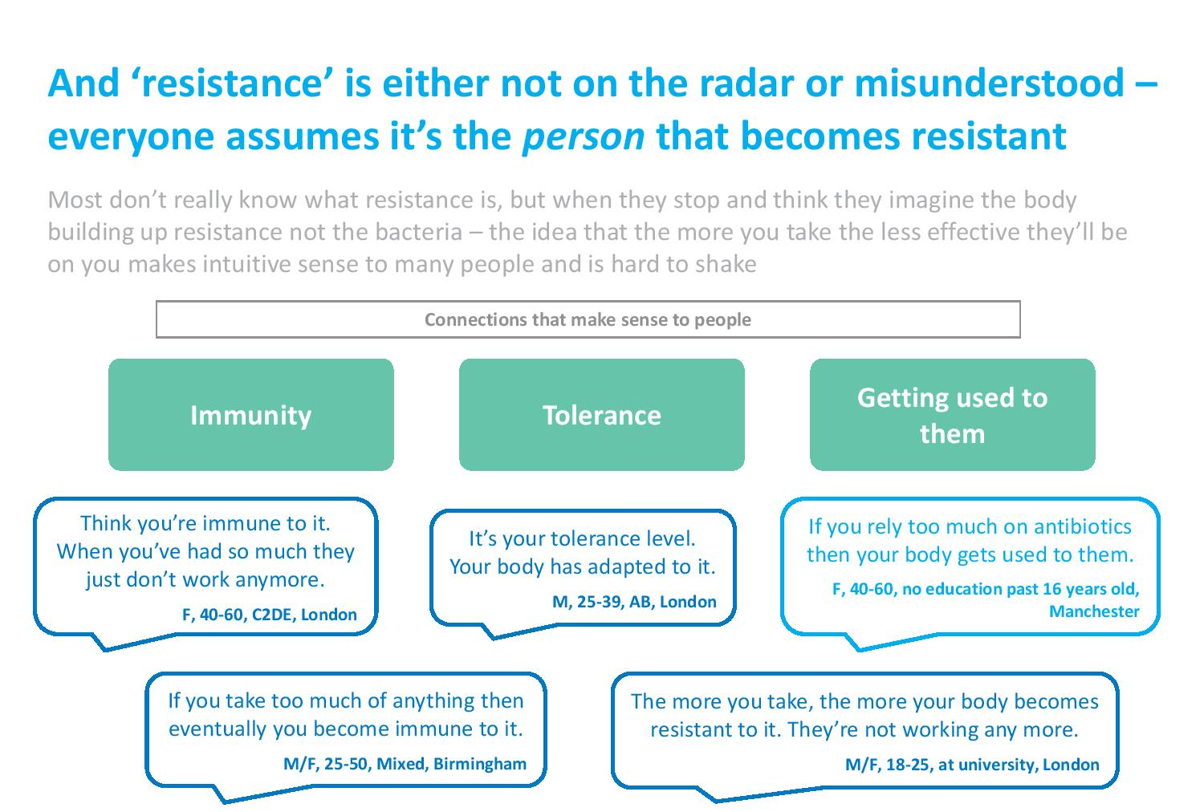
Wellcome Trust “Exploring the consumer perspective on antimicrobial resistance”, 2015.

Slide 23
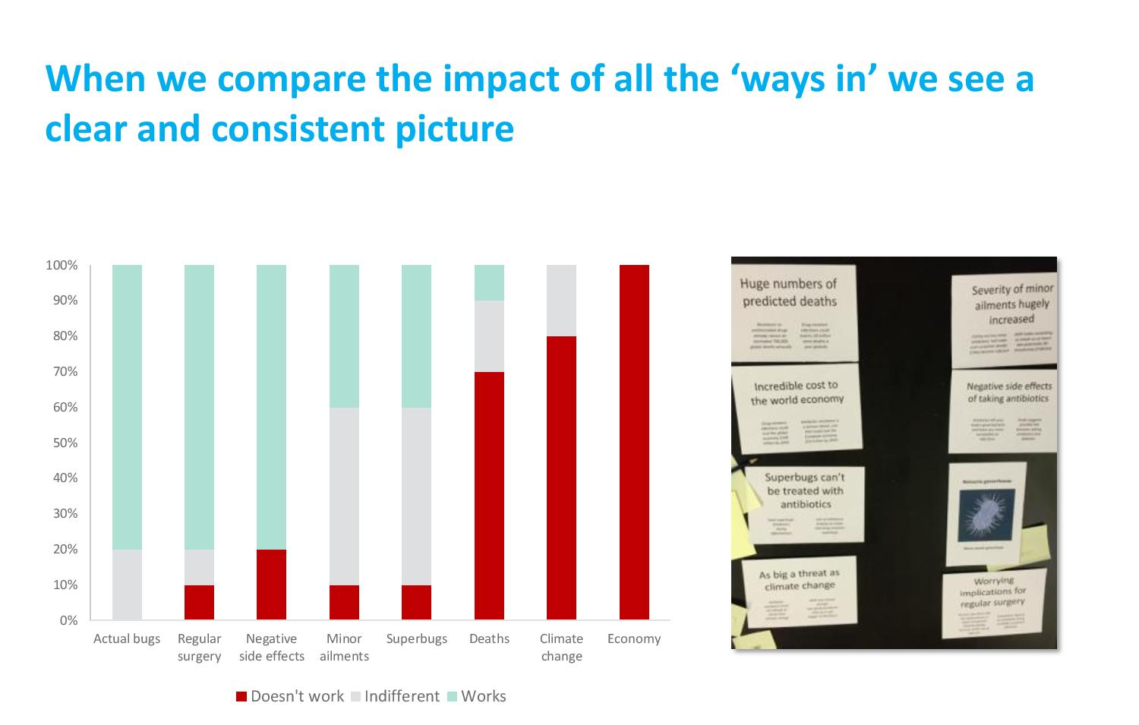
Wellcome Trust “Exploring the consumer perspective on antimicrobial resistance”, 2015.

Slide 24
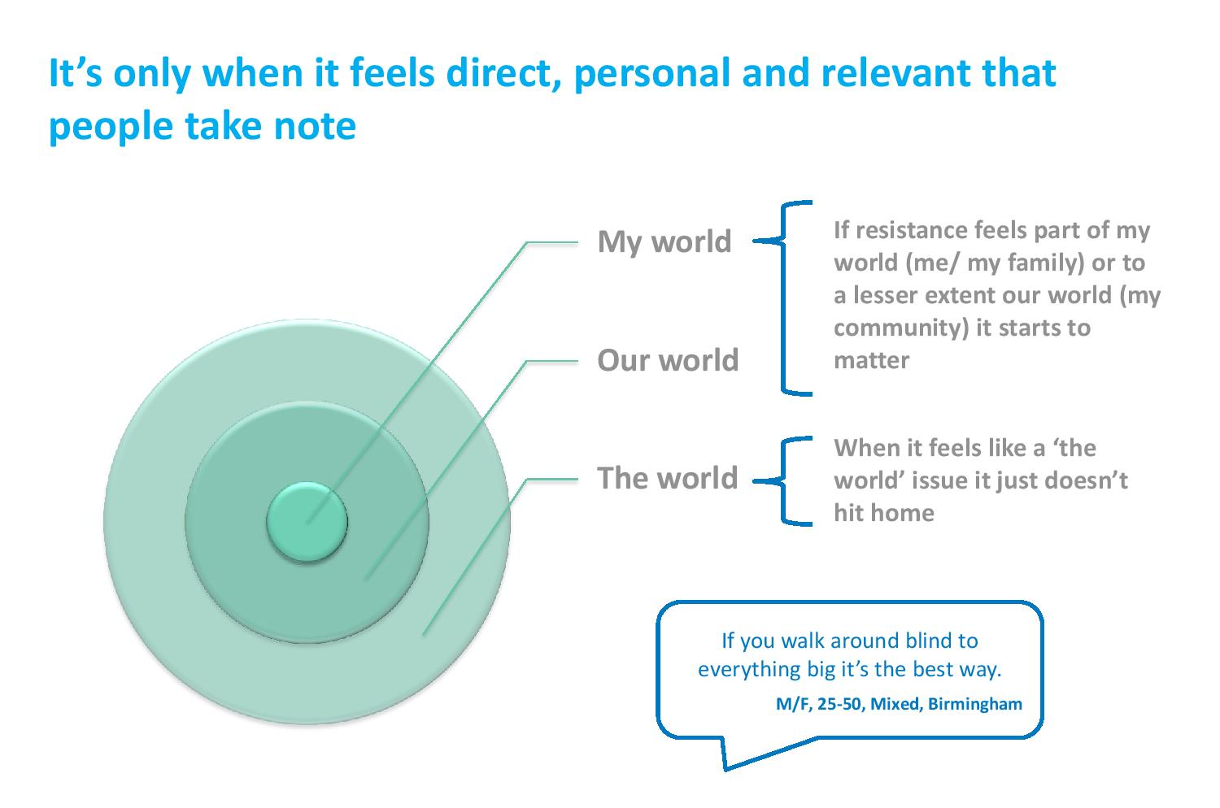
Wellcome Trust “Exploring the consumer perspective on antimicrobial resistance”, 2015.

Slide 25
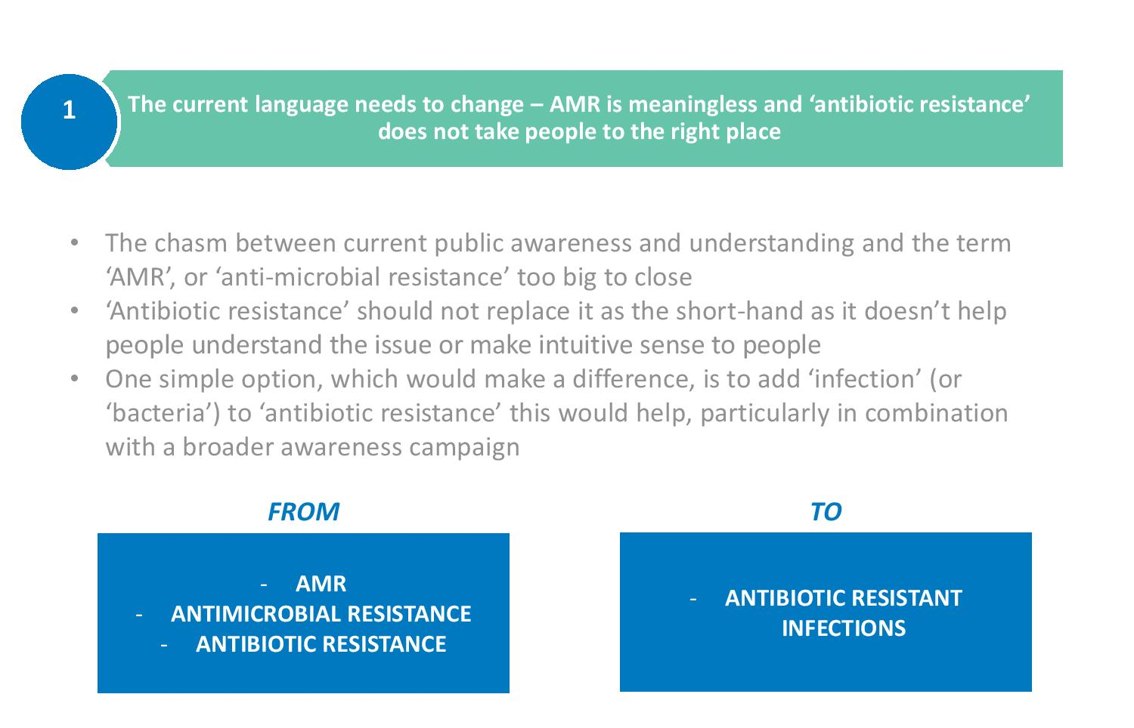
Wellcome Trust “Exploring the consumer perspective on antimicrobial resistance”, 2015.

Slide 26
Impact of a simplified C. diff lab report
Evaluating the impact of a simplified C. difficile lab report on clinician decisions around treatment and patient isolation.
 | C. difficile positive |  | C. difficile negative
 | Treat? | Isolate? | Treat? | Isolate?
Correct responses at Time Point 1 (%) | 86 | 93 | 86 | 83
Correct responses at Time Point 2 (%) | 86 | 100 | 98 | 84
P-value | 0.99 | 0.03 | 0.01 | 0.83
Tuke et al. J Hosp Infect 2017;96:205-206.

Slide 27
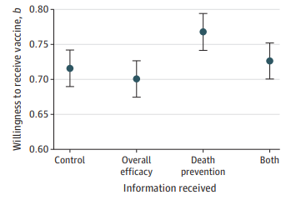
Public health: vaccine uptake
Evaluation of williningness to recieve a COVID-19 vaccine based on differences in information provided to 2556 Canadian adults.
Merkley & Loewen JAMA Netw Open 2021;4:e2126635.

Slide 28
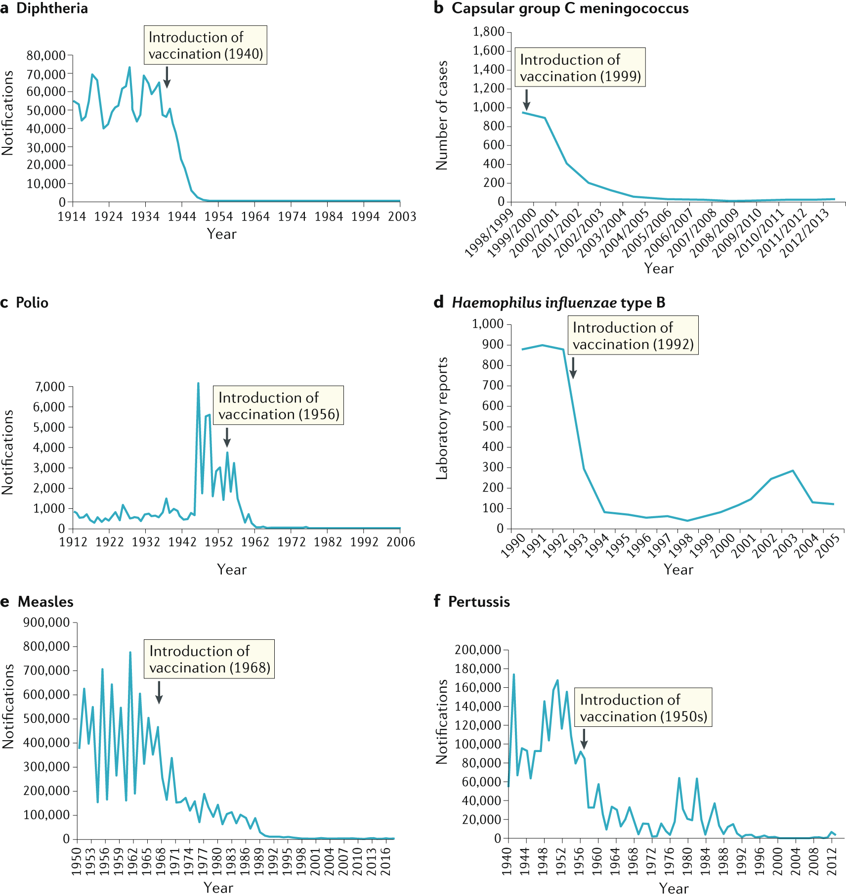
The impact of vaccination on selected diseases in the UK
Pollard & Bijker. Nature Rev Immunol 2020.

Slide 29
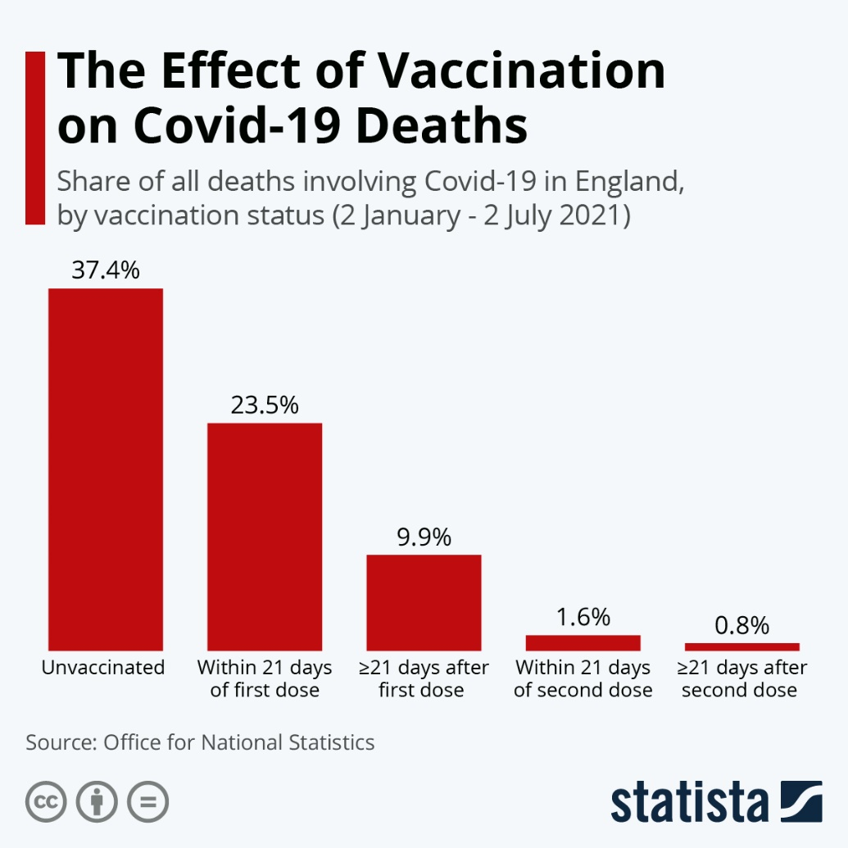
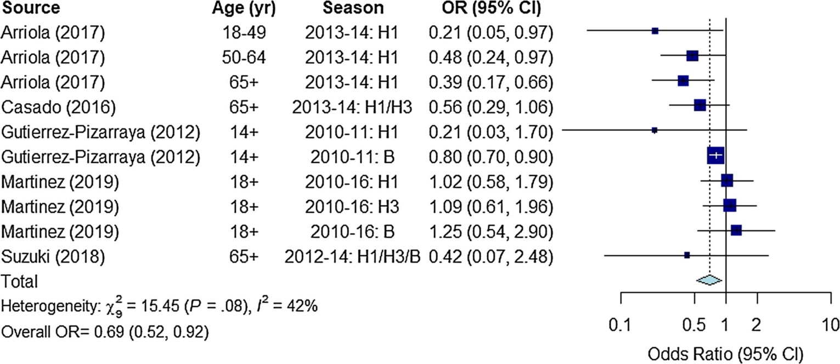
Vaccination means you are less likely to die from COVID-19 or flu!
Odds ratio for death amongst influenza vaccinated vs. unvaccinated hospitalised adults with laboratory confirmed influenza.
Summary odds ratio (95% CI) is 0.69 (0.52, 0.92).
Ferdinands et al. Vaccine 2021.

Slide 30
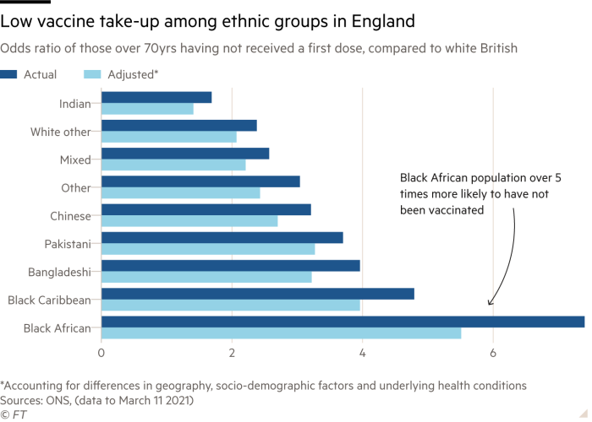
Vaccination: variation in uptake

Slide 31
How does vaccination reduce antibiotic demand?
Vaccination
Direct reduction in prevalence of antibiotic resistant bacteria (e.g. pneumococcal vaccine)
Reduce acute febrile disease, which often results in (ineffective) antibiotic use
Reduce secondary bacterial infection
Vaccination against antibiotic resistant bacteria
Microli et al. Nature Rev Microbiol 2021.

Slide 32
Transpoosion
COVID/PPE
The environment
AMR

Slide 33


Slide 34
PPE
Transmission routes
Vaccination
Organizational transformation
Regulatory framework
Outbreaks
Non-COVID pathogens
Antimicrobial stewardship
Digital transformation
Applied research
Guidelines and policy development
Testing and laboratory factors

Slide 35
PPE
Transmission routes
Vaccination
Organizational transformation
Regulatory framework
Outbreaks
Non-COVID pathogens
Antimicrobial stewardship
Digital transformation
Applied research
Guidelines and policy development
Testing and laboratory factors

Slide 36
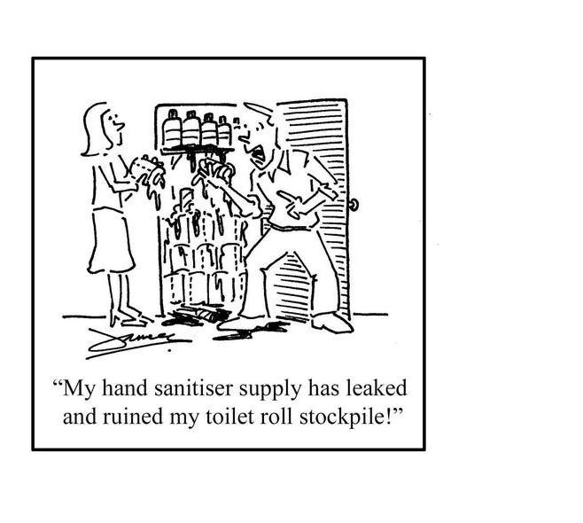
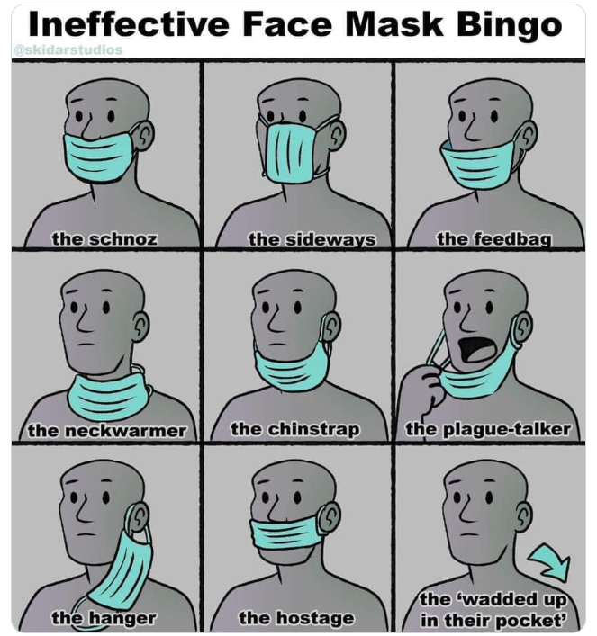

Slide 37

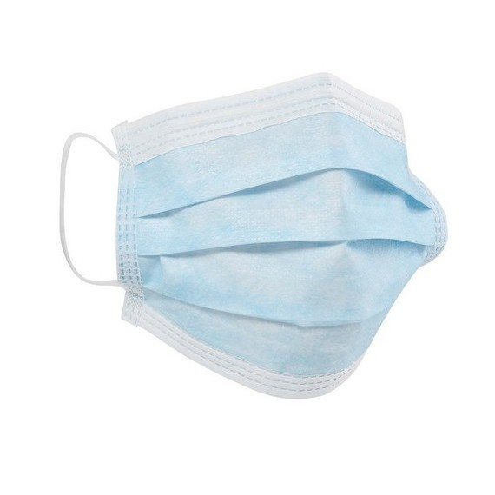
PPE and hand hygiene improvements nudged by COVID-19
Overuse and misuse of PPE results in increased risk to the wearer (through self-inoculation) and increased risk of cross-transmission.^{1, 2}
  Under-appreciated risks related to PPE doffing and disposal.
  Overuse and misuse of gloves/gowns makes hand hygiene harder and results in more cross-transmission.
The pandemic has raised important questions about respiratory protection, especially for AGPs.
  Emerging evidence suggests that mask wearing has reduced all respiratory diseases in inpatients.³
On-the-ground support has proved vital to improving PPE practice and reduce PPE-related anxiety.⁴
[1] Verbeek et al. Cochrane Reviews 2020. [2] Loveday et al. J Hosp Infect 2014; 86 Suppl 1: S1-S70. [3] Chou et al. Annals Intern Med 2020; 173: 542-55.[4] Castro-Sánchez et al. J Hosp Infect 2021; 109: 68-77.
Dynamic PPE risk-assessments will never be the same again!
We understand better how to support staff towards PPE best-practice.

Slide 38
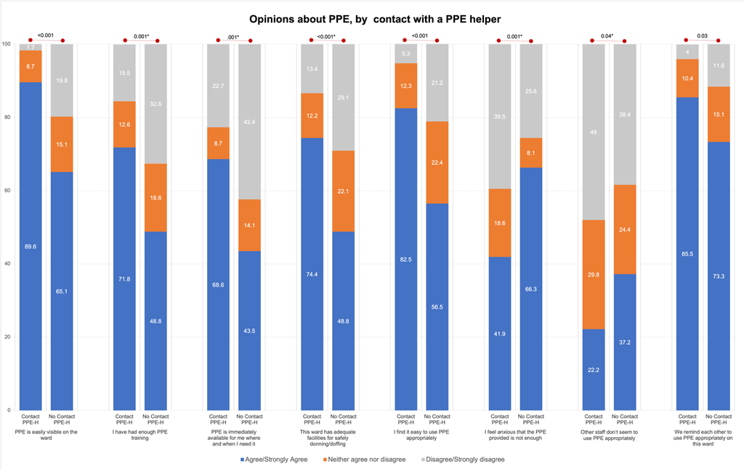
PPE Helper Programme
Staff perceptions around PPE, stratified by contact with a PPE helper (statistically significant findings only).
Castro-Sanchez et al. J Hosp Infect 2021.

Slide 39


Slide 40

Example of how gloves are misused
Same gloves: more than one task
Emptied catheter bag
Gave patient mouth care
Checked patients blood sugar
Central IV line flush and disconnection
Equipment trolley
Central line flush
IV monitor
Central line
IV infusion lines
Central line flush
IV pump
IV lines discarded into waste bin
Bed controls
IV pump
Same gloves: more than one task
NG feed flush
Urine catheter
ET suctioning
IV drugs
Prepare IV fluids in drug room
Press button to open door
Push door open
Carry drug to bedside
Slide reproduced with permission from Prof Jennie Wilson.

Slide 41
What’s wrong with gloves?
Glove use provides a false sense of security to staff, who feel protected and don’t then do hand hygiene when the gloves are removed
Gloves tend to be worn for too long, way beyond the duration of the immediate task for which they were selected (Wilson, Loveday, 2017)
Patients often feel uncomfortable with inappropriate use of gloves for personal tasks (Wilson, Bak et al, 2017).
Gloves add mountains to hospital plastic waste
Gloves cost money
Gloves cause and exacerbate skin issues for staff
epic 3 (published 2014) or a review of the evidence (published 2016) undertaken by NHS Scotland to inform the development of the Scottish national IPC manual

Slide 42
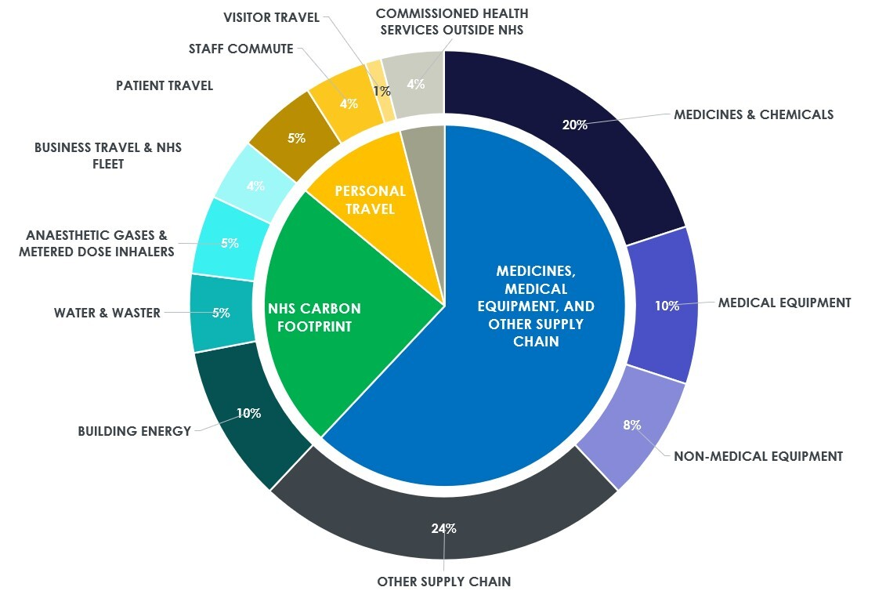
Getting to net zero (NHS)
Delivering a net zero NHS.

Slide 43
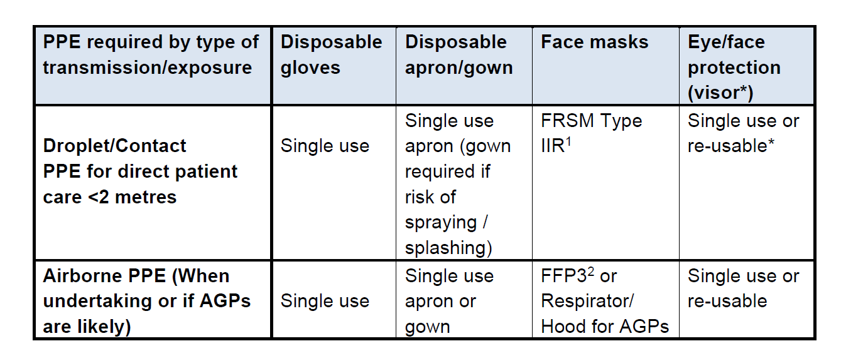
PPE and COVID-19
PHE COVID-19 infection prevention and control guidelines, January 2021.

Slide 44
Trends in PPE usage
PPE item | 2019 (1 Jan to 31 Dec 2019) | Full year total (25 Feb 2020 to 24 Feb 2021) | Cumulative total (25 Feb 2020 to 31 Mar 2022)
Aprons | 161,632,000 | 1,225,366,000 | 2,472,919,000
Eye protectors | 482,000 | 102,556,000 | 183,603,000
Face mask FFP3 | 2,810,000 | 82,507,000 | 163,599,000
Face mask IIR | 18,532,000 | 1,249,970,000 | 3,098,746,000
Gloves | 1,763,164,000 | 5,492,770,000 | 12,765,607,000
Gowns | 749,000 | 36,593,000 | 81,075,000
DHSC. Personal protective equipment distributed for use by health and social care services in England

Slide 45
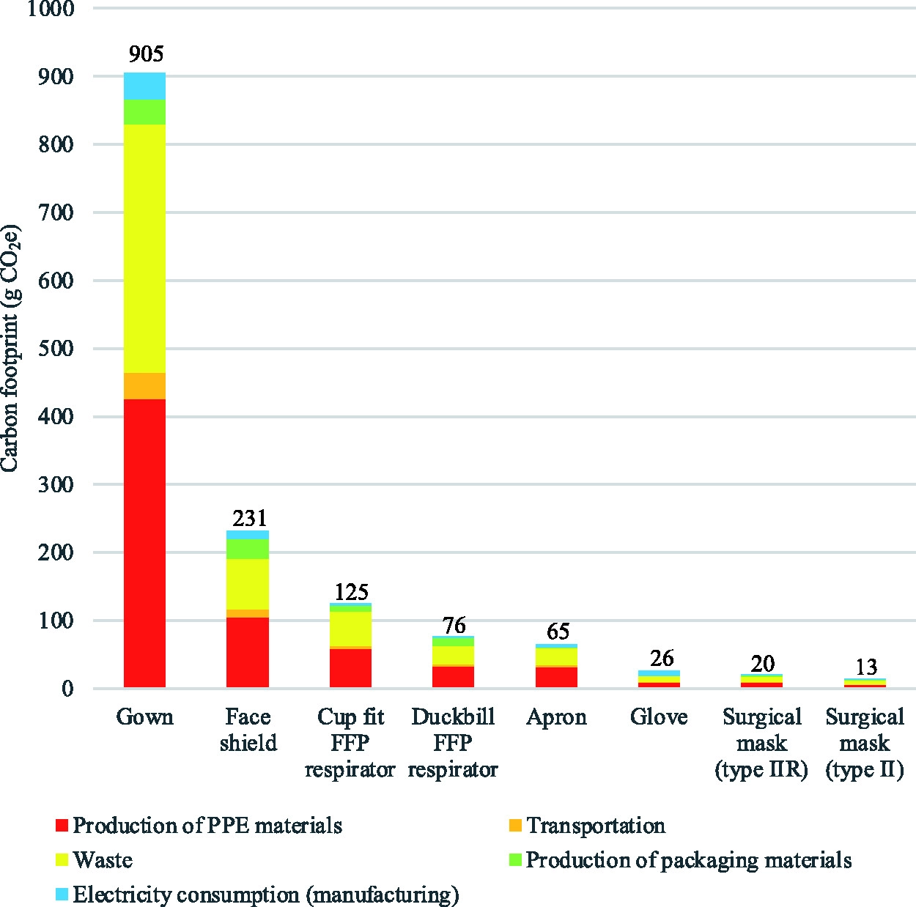
PPE: sustainability and waste
“The estimated damage to human health was 239 DALYs (disability-adjusted life years), impact on ecosystems was 0.47 species.year (loss of local species per year), and impact on resource depletion was costed at US $12.7m (GBP £9.3m)”
Rizan et al. J Royal Soc Med 2021;114:

Slide 46
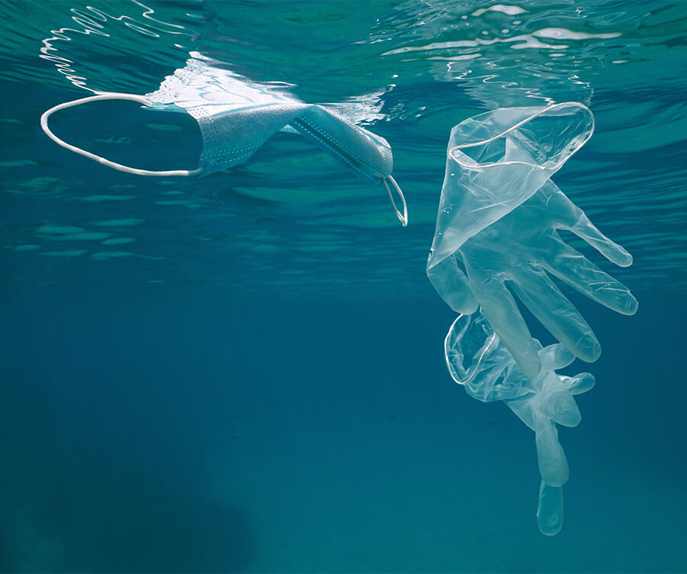
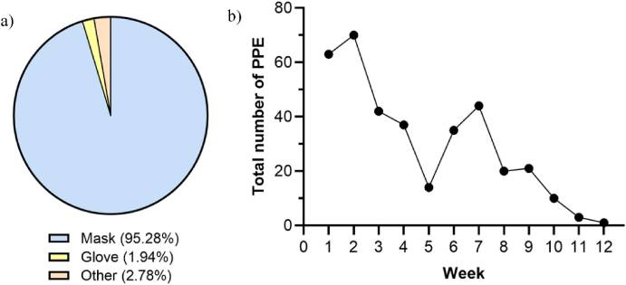
Where does all that PPE go?
A 12 week survey of PPE waste identified in the Caspian sea.
Hatami et al. Sci Total Environ. 2022 Jun 10; 824: 153771

Slide 47
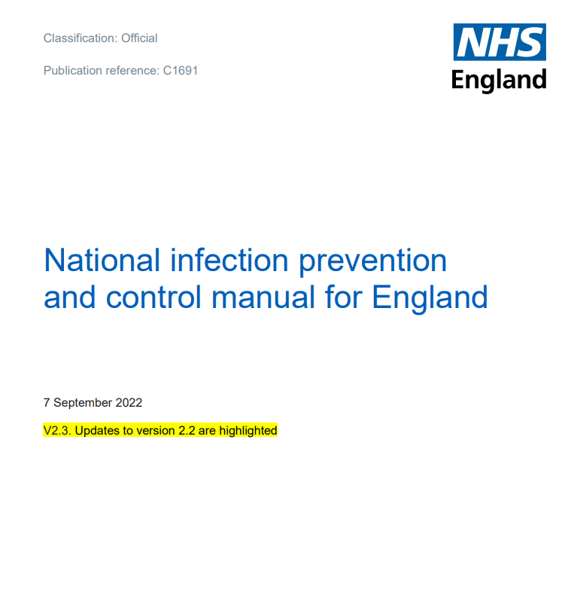
Do you really need to wear those gloves?
The IPC indications for glove use are:
When contact with body fluids is anticipated e.g. contact with blood, non-intact skin, or mucous membranes; this includes when handling patient waste and contaminated devices
Some sterile procedures

Slide 48
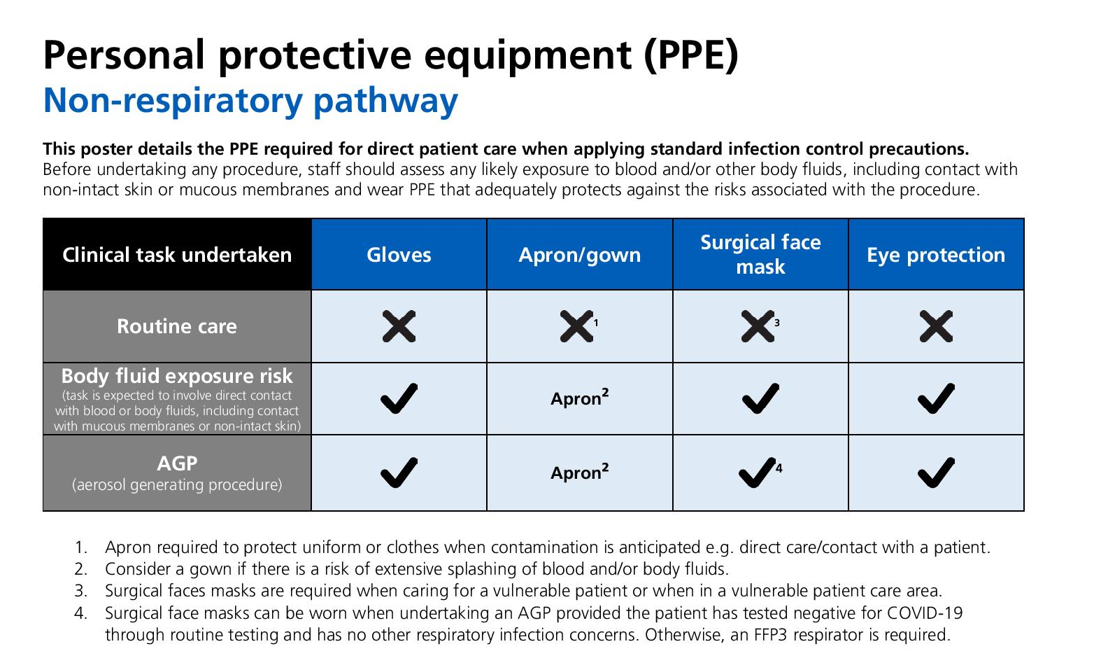
Moving away from universal gloves

Slide 49
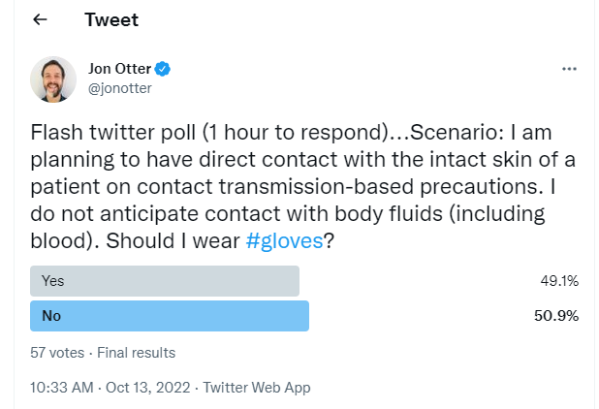
Do you even need gloves for contact precautions?

Slide 50

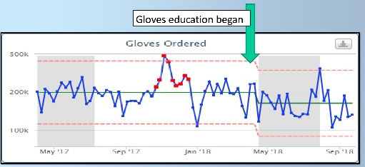
Gloves off…
Reduction in staff attendances to occupational health for hand or skin related problems.
GOSH “Gloves off” campaign; Dunn et al. HIS poster.

Slide 51



The Trust bought 20.4 million Pairs of non-sterile gloves or 40.8 million individual non-sterile gloves!
The total lifecycle of all these gloves would produce 1061 tons of CO₂
Equivalent to 56 flights from London to Paris!
Equivalent in weight to 112 tons or
X 9

Slide 52
Transpoosion
COVID/PPE
The environment
AMR

Slide 53


Slide 54

Transfer of a surrogate marker in a NICU
Oelberg et al. Pediatrics 2000;105:311-315.

Slide 55

Transfer over time: inoculated pod

Slide 56

Transfer of a surrogate marker in a NICU

Slide 57

Your hospital room can make you sick!
Mitchell et al. J Hosp Infect 2015;91:211-217.

Slide 58
Hydrogen peroxide vapour: clinical impact
30-month prospective cohort intervention study performed on 6 high-risk units (5 ICUs) including 8813 patients at Johns Hopkins Hospital.
64% reduction in the rate of MDRO acquisition
Standard cleaning / disinfection
HPV decontamination
Passaretti et al. Clin Infect Dis 2013;56:27-35.

Slide 59
Infection risks from water
Patient wash-water harbouring micro-organisms
Contaminated cleaning materials
Sinks and drains as reservoirs for infection
Hospital water systems contaminated with Pseudomonas and/or Legionella
Contamination during medical device reprocessing
Contaminated drinking water

Slide 60
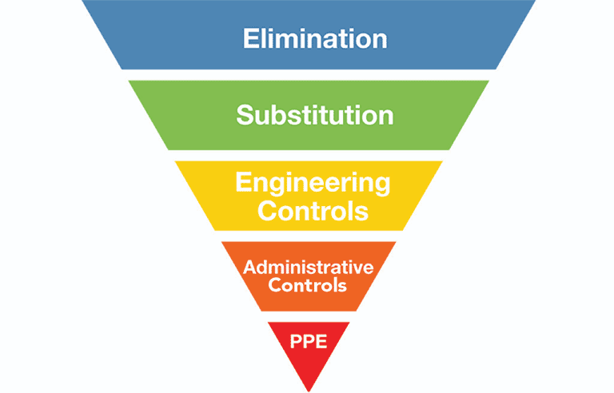
Hierarchy of controls

Slide 61
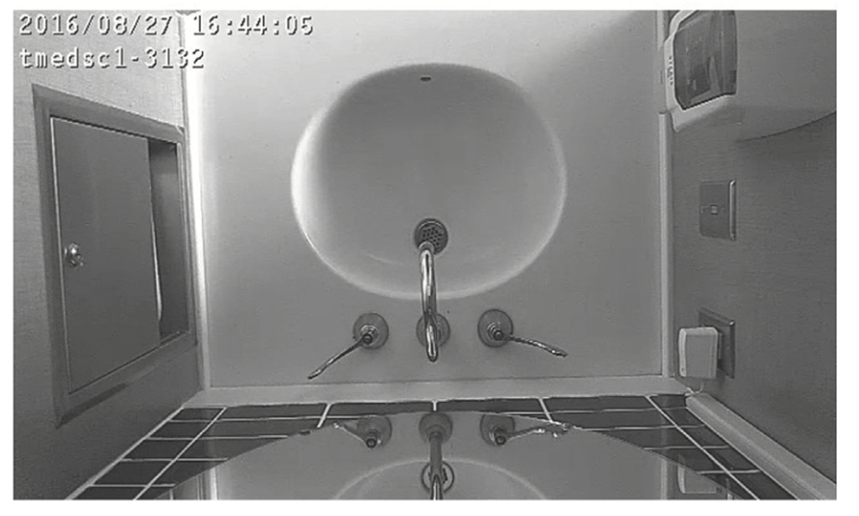
How often are sinks used for hand hygiene?
Analysis of activity from 2973 sink videos from 60 days in patient rooms and adjoining bathrooms
Handwashing was 4.38% of observed behaviours
But there were 56 activities where a variety of nutrients, which could promote microbial growth, were disposed of in the sink
Grabowski et al. J Hosp Infect 2018;100:e115-e122.

Slide 62
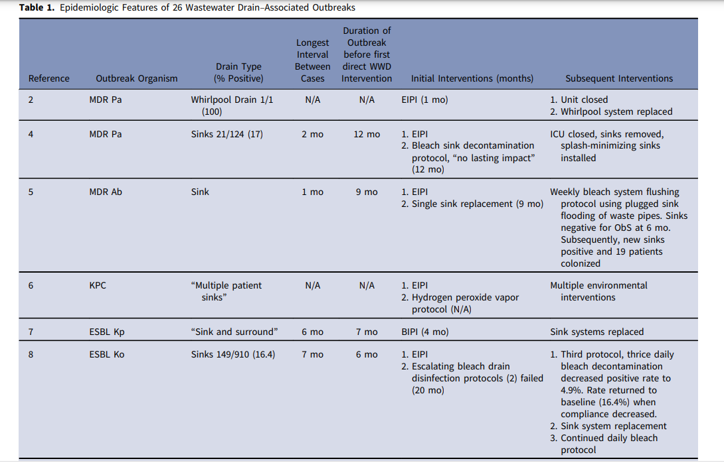
Outbreaks associated with sink/drain contamination
Carling PC. Infect Control Hosp Epidemiol 2018;39:972-979.

Slide 63
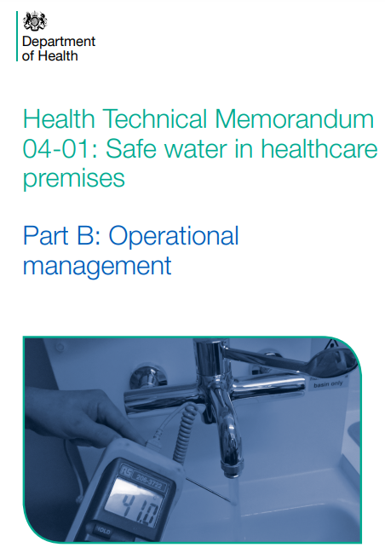
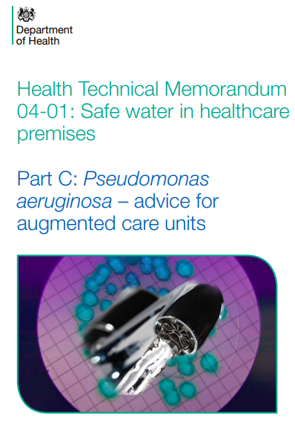

Slide 64
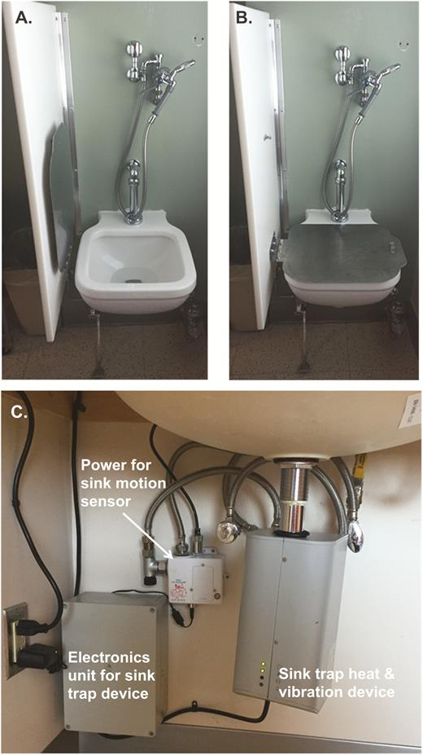
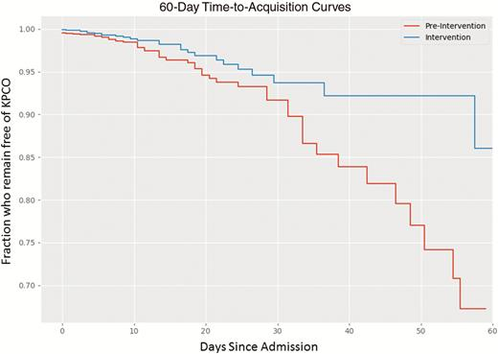
Addressing drain contamination
CPE (K. pneumoniae) acquisition and clinical infection halved through improved management of sinks (OR = 0.51 for acquisitons, and 0.29 for clinical cultures) (n=~7,500 pts).
Mathers et al. Clin Infect Dis 2018;67:171-178.

Slide 65
Water free critical care
Pre-post study in 5 ICUs in the Netherlands; rates of Gram-negative rod infection/colonisation compared before and after sink removal and the introduction of ‘water-free’ care.
Patient care-related action | New method with ‘water-free’ working
Hand washing after visual contamination | ‘Quick & Clean’, (Alpheios B.V., Heerlen, The Netherlands) wipes to remove extensive contamination from hands. Followed by disinfection with alcohol-based hand rub
Medication preparation | Dissolving of medication in bottled water (SPA reine, Spa, Belgium)
Drinks | Bottled water (SPA reine, Spa, Belgium)
Canula care | Disposable materials
Hair washing | Rinse-free shampoo cap (Comfort Personal cleansing products, USA)
Washing | Moistened disposable wash gloves, (D-care,Houten, The Netherlands)
Dental care | Bottled (SPA reine, Spa, Belgium)
Shaving | Electric shaving, or with warm bottled water (SPA reine, Spa, Belgium)
Hopman et al. Antimicrobial Resistance & Infection Control 2017;6:59

Slide 66
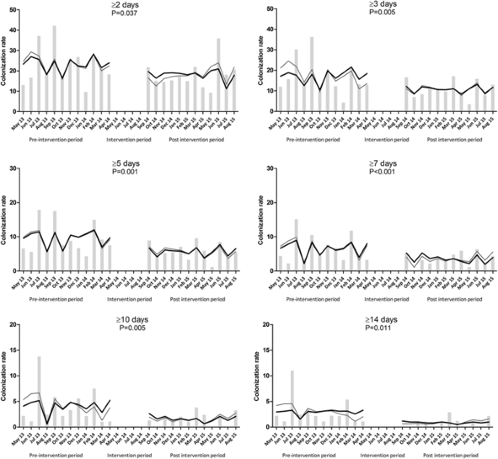
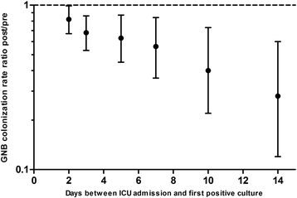
Water free critical care
Overall rate of Gram-negative rod colonisation rate: were 26.3 GNB/1000 ICU admission days pre-intervention and 21.6 during the intervention (rate ratio 0.82; 95%CI 0.67–0.99; P = 0.02).
Hopman et al. Antimicrobial Resistance & Infection Control 2017;6:59

Slide 67
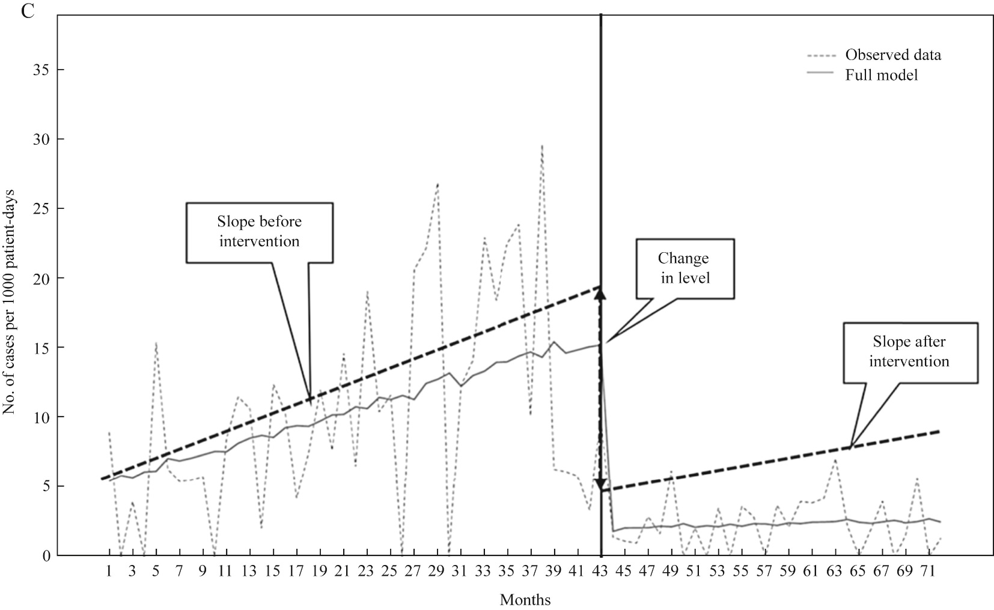
Water free critical care
Pre-post study in 2 ICUs in Spain; rates of multidrug-resistant Gram-negative rod infection/colonisation compared before and after sink removal and the introduction of ‘water-free’ care.
Overall rate of Gram-negative rod colonisation rate: 9.15 per 1000 patient-days before the intervention and 2.20 during. This yielded an RR between both periods of 0.24 (95% CI: 0.17–0.34).
Shaw et al. J Hosp Infect 2018;98:275-281

Slide 68
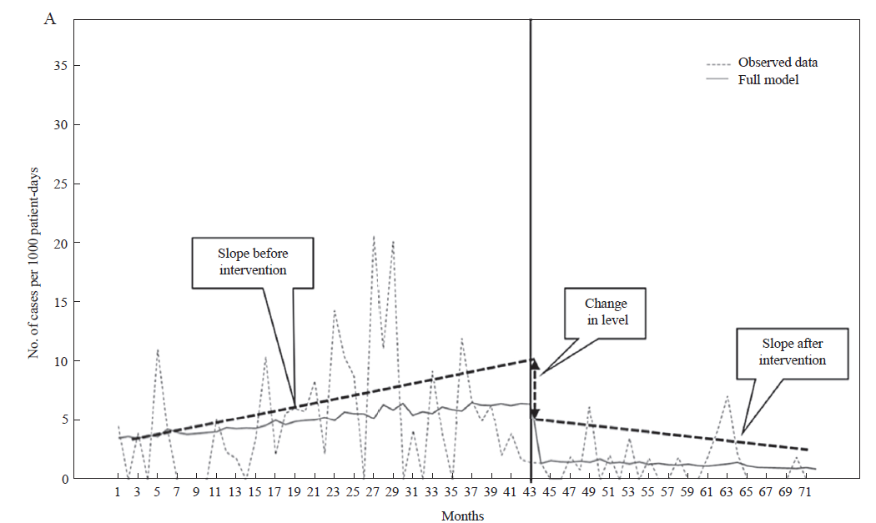
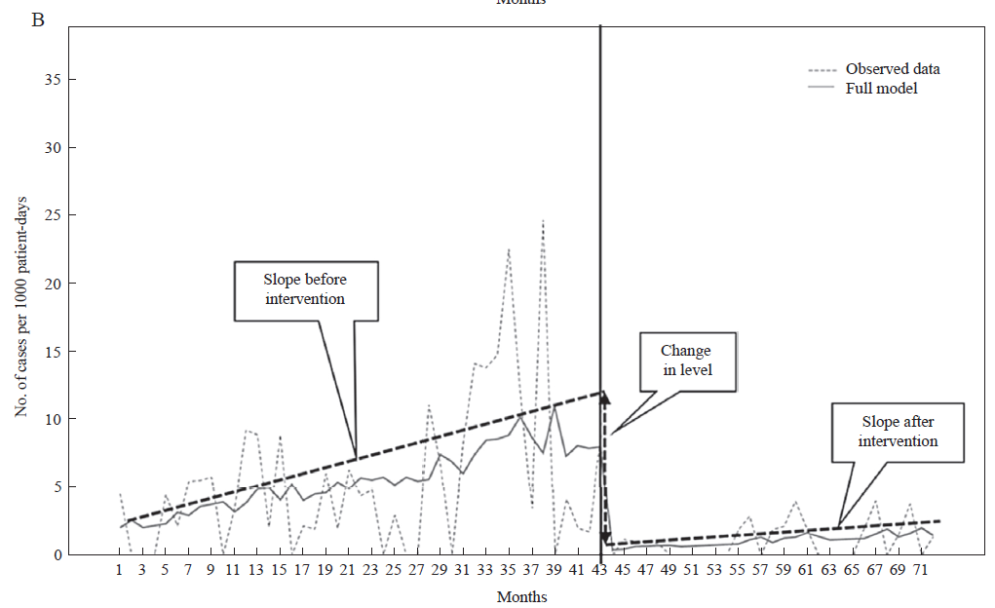
Water free critical care
Pre-post study in 2 ICUs in Spain; rates of multidrug-resistant Gram-negative rod infection/colonisation compared before and after sink removal and the introduction of ‘water-free’ care.
MDR K. pneumoniae
MDR P. aeruginosa
Shaw et al. J Hosp Infect 2018;98:275-281

Slide 69
Creative infection prevention and control issues
Jon Otter PhD FRCPath
Director of Infection Prevention and Control & Consultant Clinical Scientist
Guy’s and St Thomas’ NHS Foundation Trust
@jonotter
jon.otter@gstt.nhs.uk
Blog: www.reflectionsIPC.com
Slides: www.jonotter.net

