Slide 1


How to write a conference abstract…and beyond!
Jon Otter PhD
Research Fellow, Guy’s and St. Thomas’ NHS Foundation Trust & King’s College London

Slide 2
Disclosures
I work part-time for Bioquell.
I have received payment for producing educational material for 3M and ACIPC.
Research funding from Pfizer and the Guy’s & St Thomas’ Charity.

Slide 3
Overview
Plan and do the work
Prepare abstract
Present poster / oral presentation at ACIPC 2014
(Finish the work)
Write the paper
1
2
3

Slide 4
Why publish your work?
It is important to:
Prevent the re-invention of the wheel.
Share and stimulate changes in practice.
Challenge the status quo.
Disseminate your research or quality improvement initiatives.
Develop your professional skills.
Requirement of your clinical or academic role.

Slide 5
Publication process
Plan and do the work
Prepare abstract
Present poster / oral presentation at ACIPC 2014
(Finish the work)
Write the paper

Slide 6
What to publish?
Consider publishing information that is:
Important to practice or service delivery.
Something new.
Innovative.
Transferable.
Relevant and accessible to the audience.

Slide 7
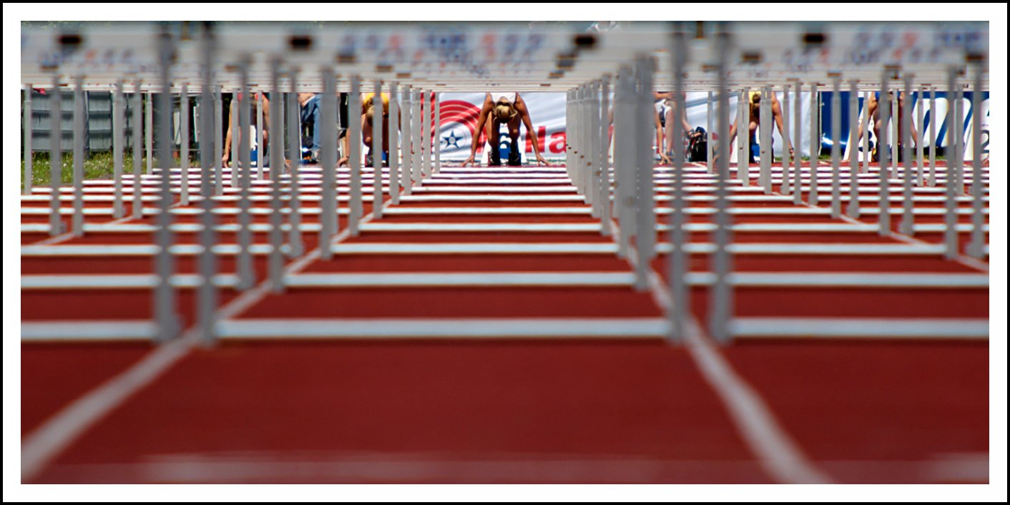
Ethics, conflicts of interest, authorship, formatting, structure, content
‘Hurdles start’ by Robert Voors, creative commons licence.

Slide 8
Hurdles: ethics
“Guidelines on good publication practice” from
the Committee on Publication Ethics (COPE)
Available free at www.publicationethics.org.uk

Slide 9
Hurdles: conflict of interest
A conflict of interest exists when a person has an affiliation that is not transparent to the reader or editor but which may affect his or her impartiality.
Always declare a conflict of interest.
If the work has links to industry, that’s fine provided the work was performed impartially and the link is declared.
If you’re not sure whether you have a conflict or interest or not, seek advice from the conference before submission. Transparency is better than embarrassment.

Slide 10
Hurdles: authorship
Authorship should be based only on a substantial
contribution to:
Conception and design or analysis and interpretation of data and;
Drafting the article or revising it critically for important intellectual content and;
Final approval of the version to be published.
(International Committee of Medical Journal Editors)

Slide 11
Hurdles: formatting
Structure (IMRD or other)
Word count
House style (e.g. fonts, spacing)
Referencing system
Knowing what is expected could save you a lot of time later
Large conferences will reject your abstract if you don’t meet their formatting requirements

Slide 12
Hurdles: the title (the hook)
Keep it short and to the point (10 to 15 word max)
Use the key words in the title
Be interesting and creative…
…but don’t be too obscure.

Slide 13
Draw in the reader…
Good | Not so good

Slide 14
Hurdles: structure
Spend time selecting the appropriate structure for the content and the reader:
  Scientific (IMRaD)
  Quality Improvement
  Systematic Review
Good structure is like a good Sat Nav – effortlessly leads you through the paper
Requires planning, discipline, patience and experience.

Slide 15
Hurdles: introduction
Background and context
  Setting
  Literature, policy and other key studies
  Rationale and hypothesis
Keep it short and succinct

Slide 16
Hurdles: methods
How you went about your study, outbreak investigation or review
  Describe how participants were selected and excluded
  Intervention
  Data collection tools
  Laboratory tests
  Measurement techniques
  Statistical methods
  Ethics, approval and consent

Slide 17
Hurdles: results
Relevance is key
Descriptive and statistical data
Themes and categories
Use a balance of text, tables and figures
Don’t use text to describe numbers or graphical data
Remember pictures and graphs can “paint 1000 words”

Slide 18
Hurdles: discussion
Findings – don’t overegg the outcomes
Strengths and weaknesses, remember nothing is perfect
How might the design or execution be improved?
Relationship of your study to other studies
Particularly any differences in outcomes
Negative findings are important
What are the implications for practitioners, managers or policymakers, if any?
Further research priorities

Slide 19
DOs and DON’Ts
DO
Have an interesting, creative title. (The title is the ‘hook’.)
Have good spelling and grammar.
Use short words, sentences and paragraphs.
Use plain English.
Run the draft by some colleagues that have not been involved in the project. If they don’t understand it, nobody else will.
DON’T
Have an obscure title.
Use jargon.
Use too many abbreviations.
Use slang and cliché.
Use poor spelling and grammar.

Slide 20
Abstract peer-review
Submitted abstracts will undergo peer review to assess their content and presentation.
A small proportion of abstracts will be selected to be presented as oral presentations. The majority of abstracts will be presented as posters.
Some abstracts will be rejected. We will give you some feedback as to why the abstract was rejected.

Slide 21
Abstract assessment
 | Rationale | Originality | Methods | Data analysis / synthesis | Results / conclusions
Outstanding | Crystal clear | Original | Rigorous | Spot on | Practice changing
Good | Clear and concise | Important | Strong | Valid and appropriate | Clear and applicable
Average | Lacks clarity | Lacks novelty | Weak | Could be better | Incomplete
Poor | Flawed | Old hat | Very weak | Inappropriate | Confusing

Slide 22
Publication process
Plan and do the work
Prepare abstract
Present poster / oral presentation at ACIPC 2014
(Finish the work)
Write the paper

Slide 23
What makes a good poster?
A good poster:
Eye catching – draws the viewer in
Graphical, not text based
Not cluttered
Good use of colour
Clear ‘flow’ from one section to the next
Key findings communicated clearly
  Use of arrows / boxes to highlight clear areas
Contains more detailed information for those that want it
Correct size for the board (check the guidelines!)
Not an essay / epic; it’s designed to stimulate discussion
No intricate fonts that are difficult to read
Watch out for fuzzy low-res graphics
You can’t include all your data – be selective

Slide 24
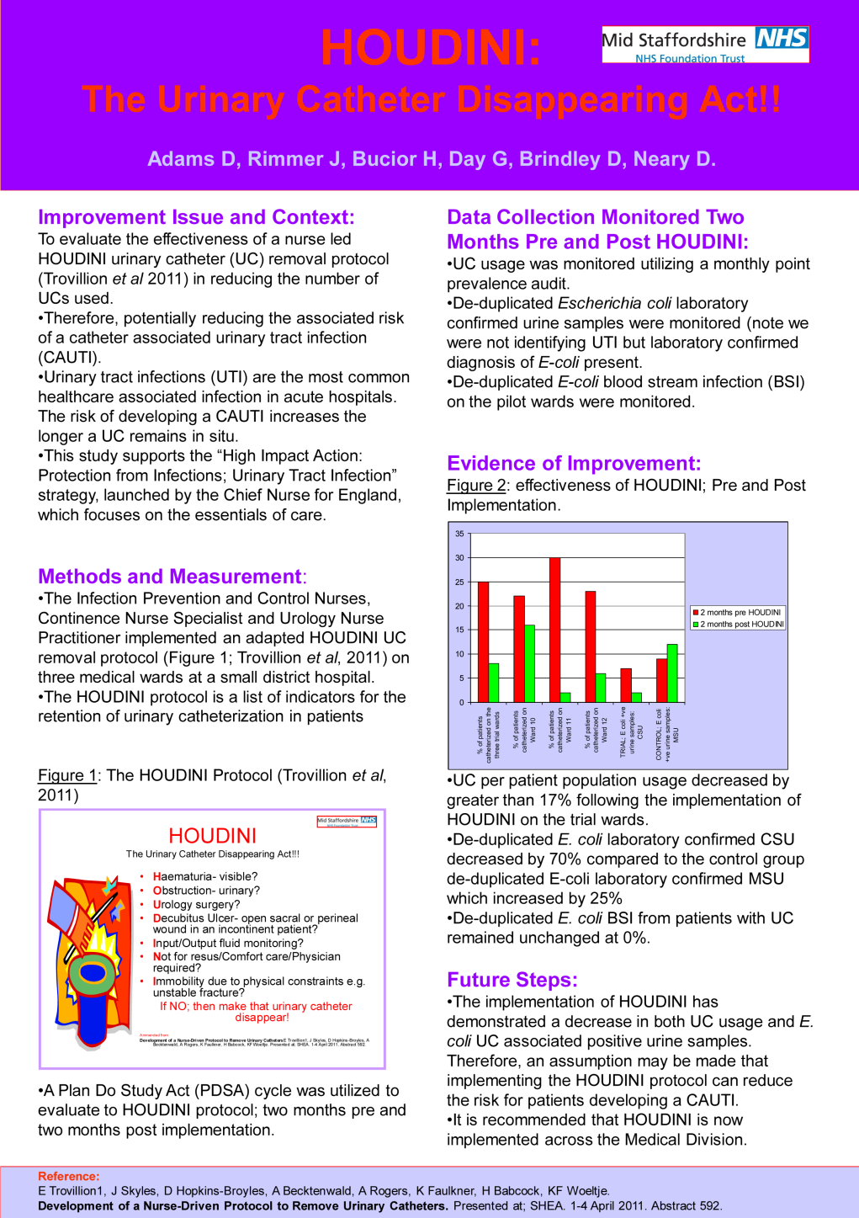
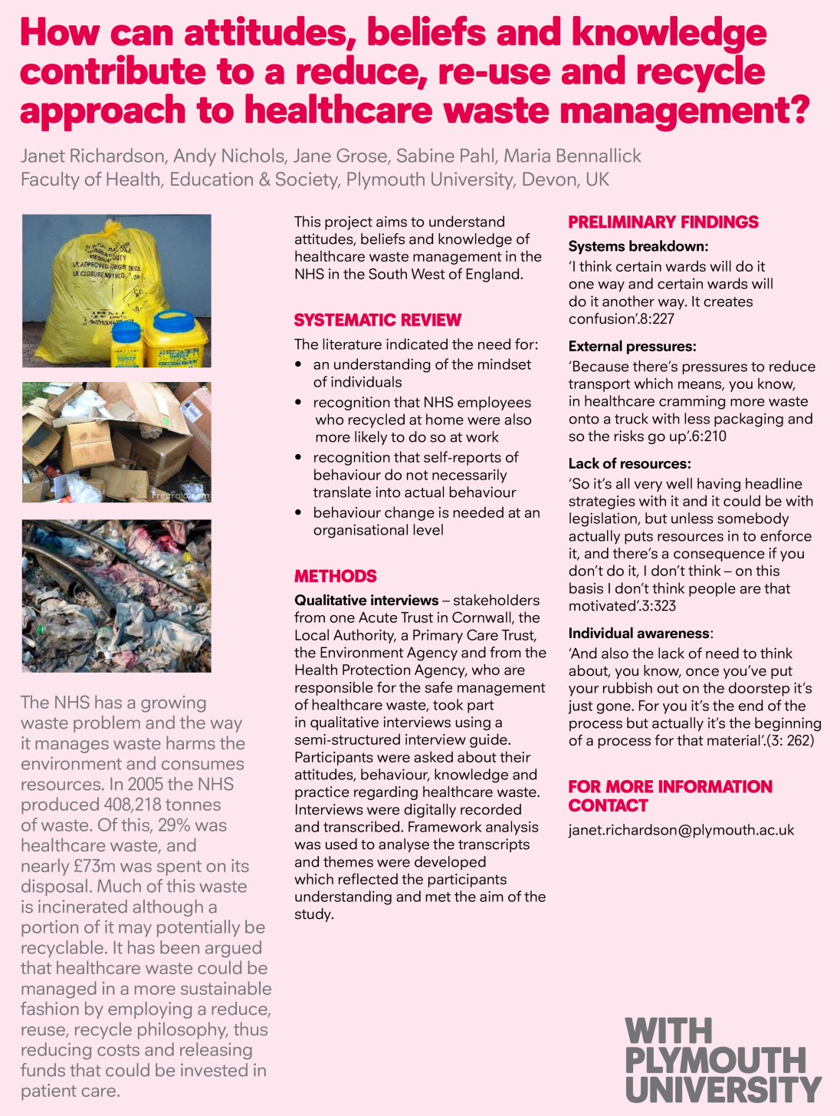

Slide 25
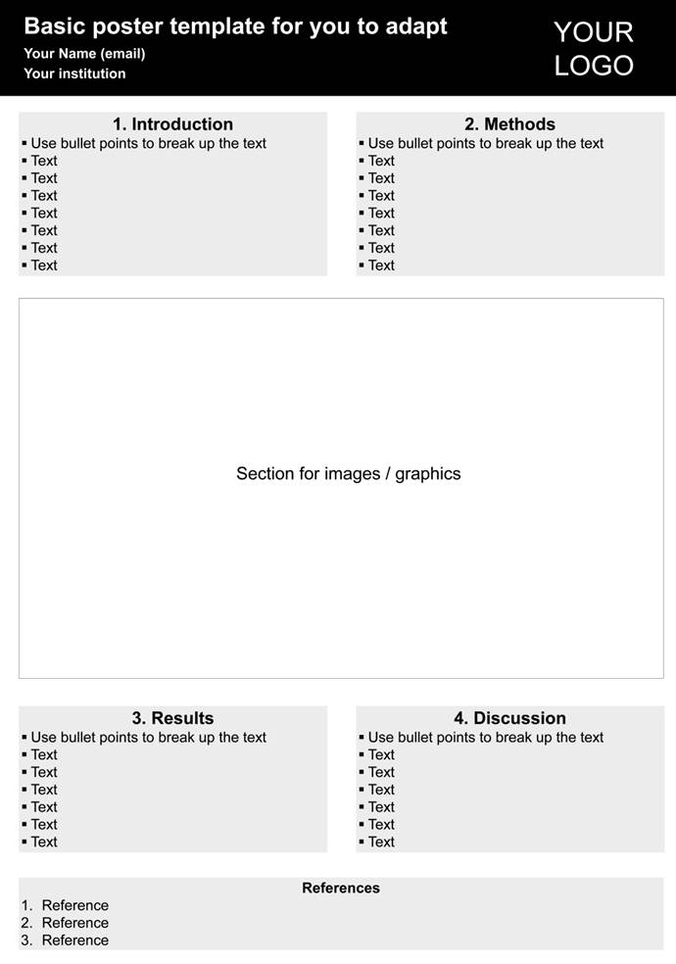
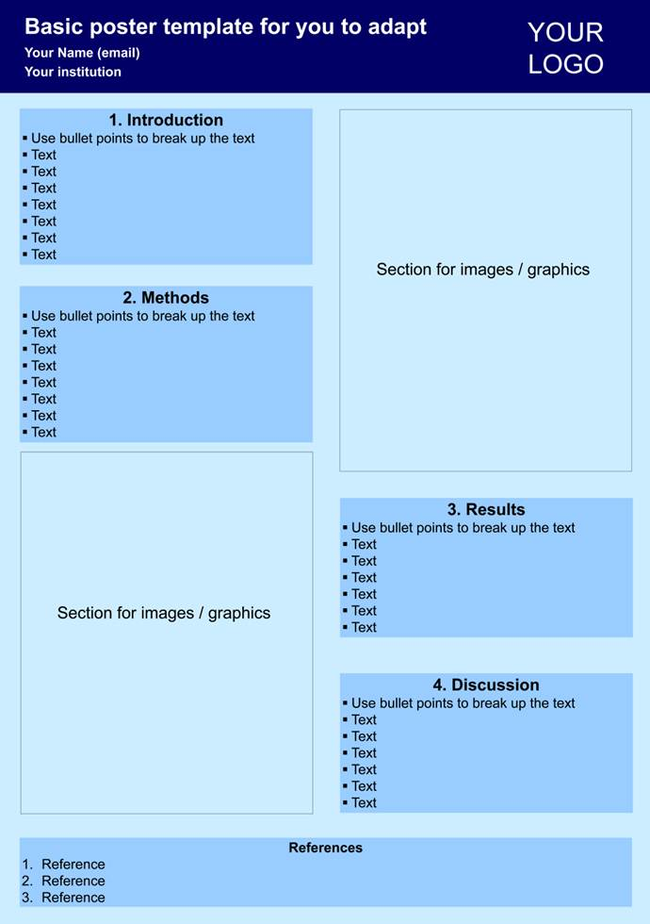
http://www.ips.uk.net/education-events/annual-conference/abstracts/poster-presentations/

Slide 26
What makes good slides?
Good slides:
Eye catching – draws the viewer in
Graphical, not text based
Not cluttered
Good use of colour
No intricate fonts that are difficult to read
No death by powerpoint – not too many slides with the same format

Slide 27
Tips for oral presentations
Good presenters:
Have enough notes so that you’re comfortable, but try to speak, rather than read, to the audience
Make sure you have a copy of the slides in case there are AV issues
Visit the room that you will be presenting in before your talk so that you’re familiar with where you will be speaking from
Practice to colleagues / family / pets / the mirror…but not too much
Leave some time for questions from the audience
If you get some questions, have a pen and paper to hand so that you can note them down as they’re asked – it’s embarrassing if you forget what was asked!
Remember, you’re the expert and know your stuff
You will be nervous, but try to channel the nervous energy!

Slide 28
Publication process
Plan and do the work
Prepare abstract
Present poster / oral presentation at ACIPC 2014
(Finish the work)
Write the paper

Slide 29
Selecting a journal
Check out information for authors
Focus on scope of the Journal
Word count / scope of your work
If you are not sure, contact the Editor to discuss your idea

Slide 30
Relevant Journals
Healthcare Infection
Journal of Infection Prevention
Journal of Hospital Infection
Infection Control and Hospital Epidemiology
American Journal of Infection Control

Slide 31
Peer review
Manuscripts sent to 2-3 independent reviewers
Provide perspective on the quality of the paper
  Objective
  Subjective
Reviewers and editors will improve what is submitted, but they won’t re-write a poor paper

Slide 32
Publication process
Plan and do the work
Prepare abstract
Present poster / oral presentation at IPS 2012
(Finish the work)
Write the paper
“Post-publication peer-review”: how does the professional community receive your paper?

Slide 33
Further information
ACIPC abstract submission site
Infection Prevention Society (IPS) resources for abstracts, posters and oral presentations

Slide 34
Acknowledgements
I used some slides courtesy of Prof Heather Loveday.

Slide 35
How to write an abstract…and beyond!
Jon Otter PhD
Research Fellow, Guy’s and St. Thomas’ NHS Foundation Trust & King’s College London

