Slide 1
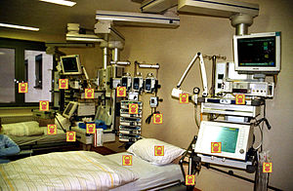


Surface disinfectants in healthcare: when to use them, how to choose them, and their contribution to AMR
Jon Otter PhD FRCPath
Director of Infection Prevention and Control & Consultant Clinical Scientist
Guy’s and St Thomas’ NHS Foundation Trust / Imperial College London
@jonotter
j.otter@imperial.ac.uk
Blog: www.reflectionsIPC.com
Slides: www.jonotter.net

Slide 2
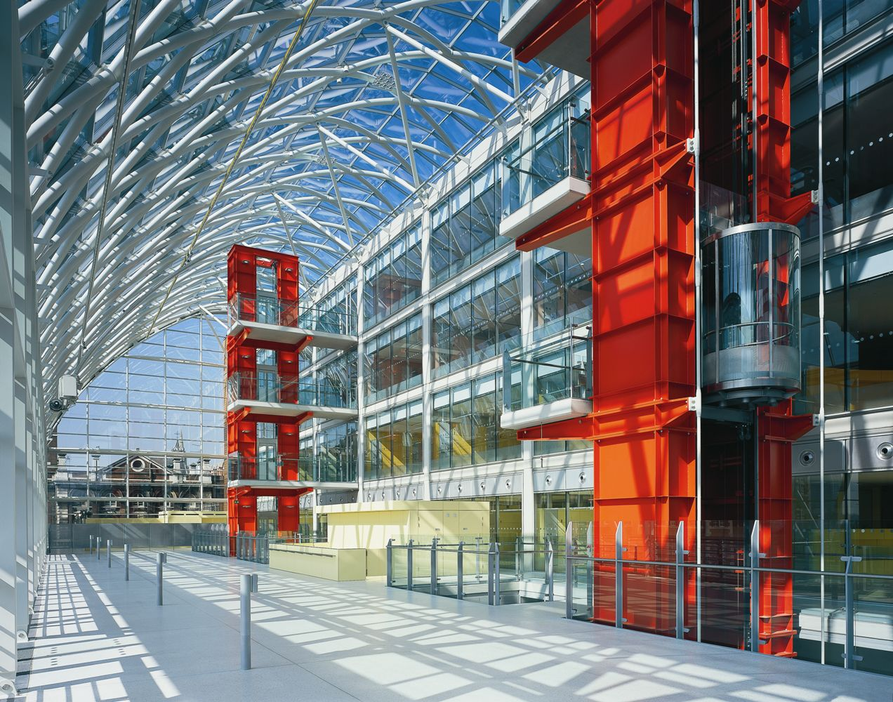




Slide 3


Slide 4

Transfer of a surrogate marker in a NICU
Oelberg et al. Pediatrics 2000;105:311-315.

Slide 5

Transfer over time: inoculated pod

Slide 6

Contamination over time by location

Slide 7
Importance of surface contamination for HCAI and AMR
Current approaches to cleaning and disinfection
Surface disinfectant overview
Possible contribution of surface disinfectants to AMR

Slide 8
Importance of surface contamination for HCAI and AMR
Current approaches to cleaning and disinfection
Surface disinfectant overview
Possible contribution of surface disinfectants to AMR

Slide 9

Transmission routes
Otter et al. Infect Control Hosp Epidemiol 2011;32:687-699.

Slide 10
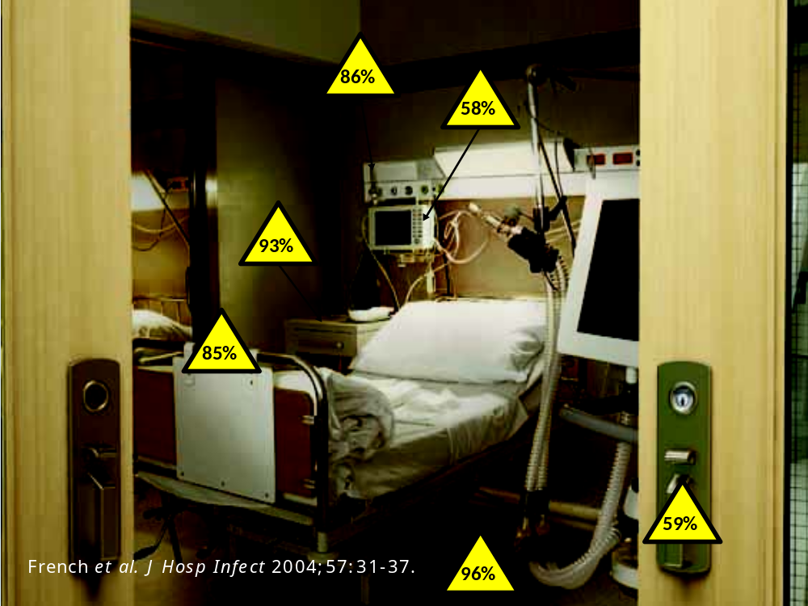

Slide 11



Surface <> Hand <> Patient
Pathogens can be transferred from surfaces to HCW hands without direct patient contact¹⁻²
52% of 23 HCW acquired VRE on their hands³ | Contact with patient or surface = ~10% risk of acquiring VRE³
45% of 50 HCW acquired MRSA on their hands⁴ | 40% of 50 HCW acquired MRSA on their hands⁴
50% of 30 HCW acquired C. difficile on their hands⁵ | 50% of 30 HCW acquired C. difficile on their hands⁵
Compliance with hand hygiene: 50%⁶ | Compliance with hand hygiene: 80%⁶
Boyce et al. Infect Control Hosp Epidemiol 1997;18:622-627.
Bhalla et al. Infect Cont Hosp Epidemiol 2004;25:164-167.
Hayden et al. Infect Control Hosp Epidemiol 2008;29:149-154.
Stiefel et al. Infect Control Hosp Epidemiol 2011;32:185-187.
Guerrero et al. Am J Infect Control 2012;40:556-558.
Randle et al. J Hosp Infect 2010;76:252-255.

Slide 12
Surface survival
Organism | Survival time
Clostridium difficile (spores) | 5 months
Acinetobacter spp. | 3 days to 5 months
Enterococcus spp. including VRE | 5 days – 4 years (!)¹
Pseudomonas aeruginosa | 6 hours – 16 months
Klebsiella spp. | 2 hours to > 30 months
Staphylococcus aureus, inc. MRSA | 7 days – 7 months
Norovirus (and feline calicivirus) | 8 hours to > 2 weeks²
SARS Coronavirus | 72 hours to >28 days³
Influenza | Hours to several days⁴
Adapted from Kramer et al. BMC Infect Dis 2006;6:130.
Wagenvoort et al. J Hosp Infect 2011;77:282-283.
Doultree et al. J Hosp Infect 1999;41:51-57.
Rabenau et al. Med Microbiol Immunol 2005;194:1-6.
Bean et al. J Infect Dis 1982;146:47-51.

Slide 13
Conventional terminal decontamination
Notes:
Studies that have evaluated the effectiveness of terminal cleaning and disinfection have consistently demonstrated that conventional methods fail to eliminate reliably contamination with pathogens.

Slide 14
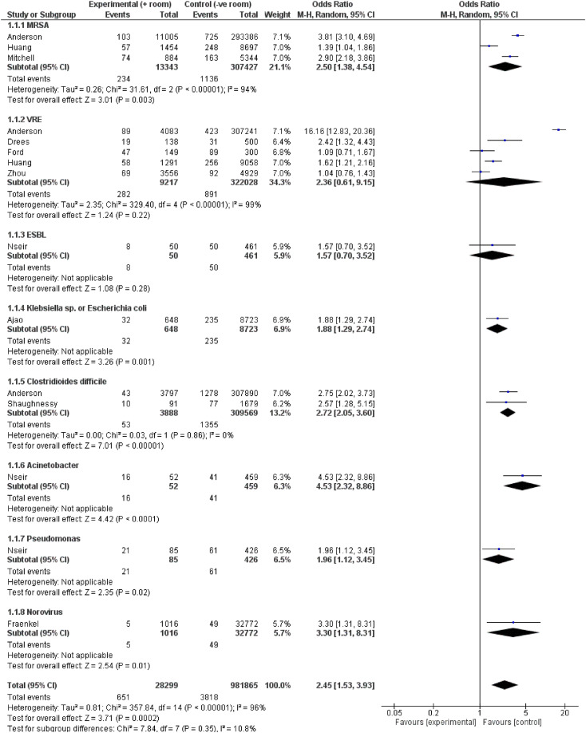
The MDRO status of the prior room occupant influences acquisition risk
Meta-analysis of studies evaluating the risk of MDRO acquisition for the incoming occupant based on the status of the prior room occupant.
 | OR | 95% CI
Acinetobacter | 4.5 | 2.3-8.9
Norovirus | 3.3 | 1.3-8.3
C. difficile | 2.7 | 2.0-3.6
MRSA | 2.5 | 1.4-4.5
VRE | 2.4 | 0.6-9.1
Pseudomonas | 2.0 | 1.1-3.4
Klebsiella or E. coli | 1.9 | 1.3-2.7
ESBL | 1.6 | 0.7-3.5
Total | 2.5 | 1.5-3.9
Mitchell et al. Infect Dis Health 2023.

Slide 15
Hydrogen peroxide vapour: clinical impact
30-month prospective cohort intervention study performed on 6 high-risk units (5 ICUs) including 8813 patients at Johns Hopkins Hospital.
64% reduction in the rate of MDRO acquisition
Standard cleaning / disinfection
HPV decontamination
Passaretti et al. Clin Infect Dis 2013;56:27-35.

Slide 16
Hospital cleaning and disinfection works
Key studies illustrating the impact of improved cleaning and disinfection
Author/year | Design | Result
Dancer et al. 2009 | Cross-over study of extra ward cleaner | 27% reduction in MRSA infection
Datta et al. 2011 | Cohort intervention study of enhanced disinfection | Significant reduction in VRE acquisition from the prior room occupant
Anderson et al. 2017 | Cluster RCT of UVC room disinfection | Significant reduction in MDRO acquisition from the prior room occupant
Mitchell et al. 2019 | Cluster RCT of cleaning bundle | Improved rate of cleaning high touch items and reduced incidence of VRE
Dadon et al. 2023 | Cross-over study of switching from chlorine “bucket” method to disinfectant wipes | Significant reduction in surface contamination, MDRO acquisition, and in-hospital mortality

Slide 17
Importance of surface contamination for HCAI and AMR
Current approaches to cleaning and disinfection
Surface disinfectant overview
Possible contribution of surface disinfectants to AMR

Slide 18
Detergent
Disinfectant
PRODUCT
“Bucket method”
Wipes
Automated
PROCEDURE

Slide 19
What is the protocol for surface cleaning and disinfection in your hospital?
Combined cleaner/disinfectant for all cleaning and disinfection
Routine detergent cleaning; cleaner/disinfectant when known infection risks
Detergent cleaning only

Slide 20
English cleaning / disinfection recommendations
Under Standard Infection Control Precautions, routine disinfection of the environment is not routinely recommended in the manual, aside from routine disinfection of sanitary fittings using chlorine.
Under Transmission Based Precautions, disinfection of hospital surfaces during the stay of the patient and at the time of their transfer or discharge is recommended.
  The manual makes a specific recommendation that chlorine should be used for daily and discharge surface disinfection.
National Infection Control Policy Manual

Slide 21
Limitations of a “detergent only” approach
  Patients with unidentified infection risks
  Challenges of cleaning complex and intricate environment
  Dry surface biofilms
  Limited reduction in pre-post studies
  Evidence that they spread contamination around
  Emerging evidence of detergent-related surface damage
  Evidence that moving to routine disinfection reduces transmission risk
Kiernan et al. J Hosp Infect 2024 (accepted)

Slide 22
Limitations of a chlorine-based disinfectants
    Many are not sporicidal when tested correctly
    Inactivation when exposed to soiling
    Poor environmental profile
    Material compatibility
    Staff exposure
    Majority of patients on TBPs don’t require chlorine
Kiernan et al. J Hosp Infect 2024 (accepted)

Slide 23
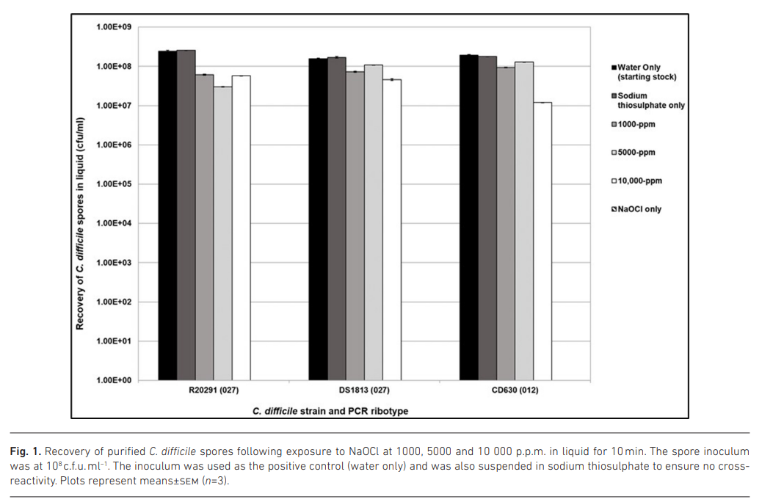
Chlorine may not be as effective as you think…
Ahmed & Joshi. Microbiology 2023.

Slide 24
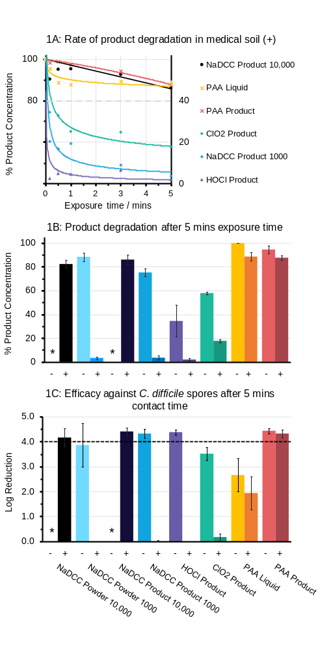
Impact of soiling
Brown et al. J Hosp Infect 2024 (accepted)
* = not tested

Slide 25
Importance of surface contamination for HCAI and AMR
Current approaches to cleaning and disinfection
Surface disinfectant overview
Possible contribution of surface disinfectants to AMR

Slide 26
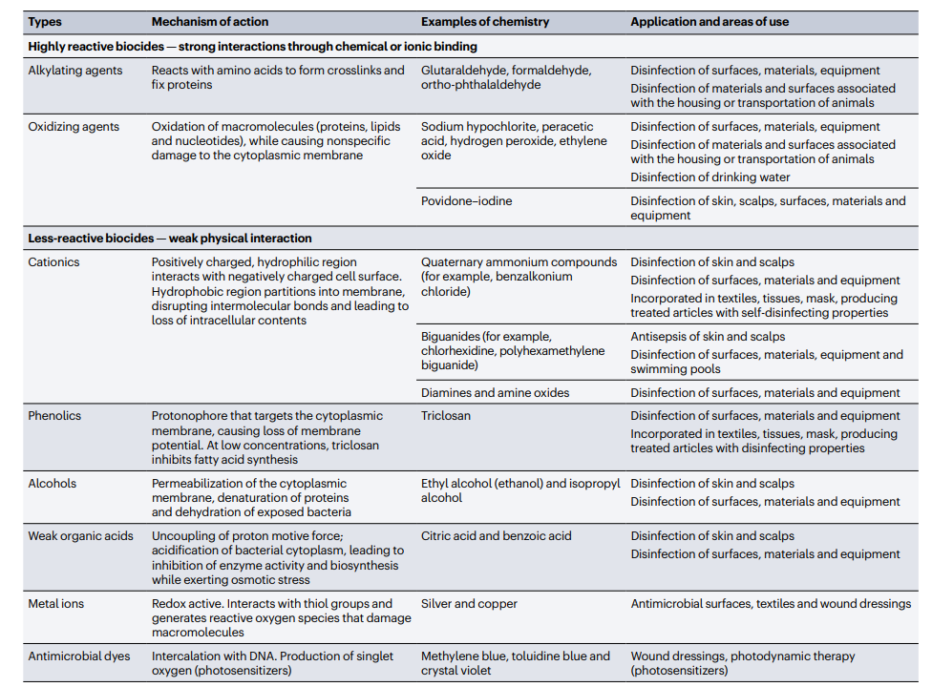
Maillard & Pascoe. Nature Rev Microbiol 2024.

Slide 27
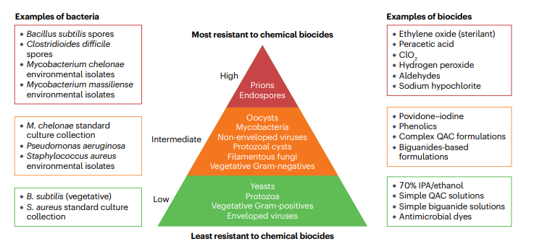
Maillard & Pascoe. Nature Rev Microbiol 2024.

Slide 28
Importance of surface contamination for HCAI and AMR
Current approaches to cleaning and disinfection
Surface disinfectant overview
Possible contribution of surface disinfectants to AMR

Slide 29
Biocide
Therapeutic antimicrobial
Antibacterial (antibiotic)
Disinfectant (surfaces)
Antiseptic (skin)
Antiviral
Antifungal

Slide 30
Biocides vs. therapeutic antimicrobials
Feature | Biocide | Therapeutic antimicrobial
Mechanism of action | Multiple cellular targets | Single process or structure
“Resistance” | Tolerance or reduced susceptibility | Resistance halts therapy
Measurement of “resistance” | No agreed methodology or breakpoints | Defined methodology and breakpoints
Mechanism of “resistance” | Intrinsic or acquired | Intrinsic or acquired

Slide 31
Factors affecting biocide effectiveness
Biocide
Type / mechanism of action
Concentration
Application
Dilution
Delivery method
Microbe
Structure (e.g. spores)
Reduced susceptibility
Formulation
Contact time
Soiling
Metabolic state (e.g. VNC)
Community (e.g. biofilm)
Surface type
Interactions
Maillard & Pascoe. Nature Rev Microbiol 2024.

Slide 32
The importance of formulation
Maillard & Pascoe. Nature Rev Microbiol 2024.

Slide 33
Importance of formulation
Brown et al. J Hosp Infect 2024 (accepted)
* = not tested

Slide 34
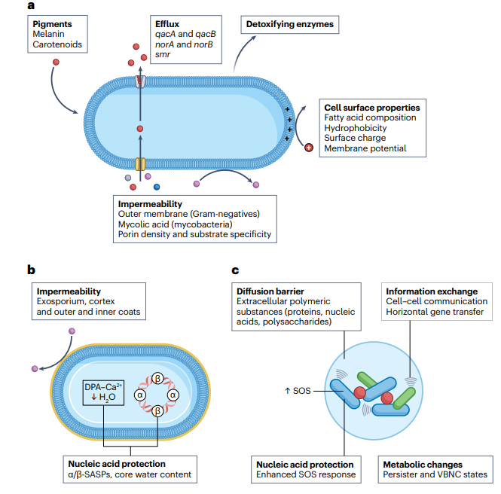
Intrinsic reduced susceptibility to biocides
Maillard & Pascoe. Nature Rev Microbiol 2024.

Slide 35
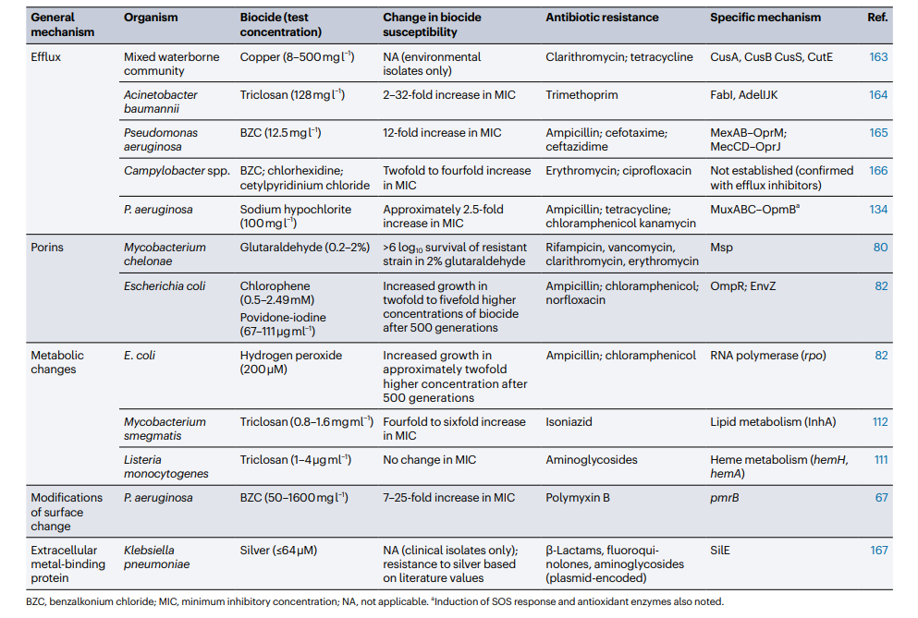
Acquired reduced susceptibility to biocides
Maillard & Pascoe. Nature Rev Microbiol 2024.

Slide 36
Biocide and therapeutic antimicrobial cross-resistance
    Direct – shared mechanism for reduced susceptibility to biocides and resistance to therapeutic antimicrobials
    Indirect
      Exposure to biocides can “switch on” AMR
      Co-selection of resistance genes on the same mobile genetic element
    Cross-resistance to other biocides can occur
    Risk of cross-resistance varies by biocide
      Oxidising agents less prone to cross-resistance
    Limited evidence of “real world” impact

Slide 37
Why I’m not too worried about reduced susceptibility to biocides
Biocide reduced susceptibility | Therapeutic antimicrobial resistance (AMR)
Subtle and difficult to measure | Barn door
Few examples of clinically significant issues | We are running out
Have been using for decades without “failures” | New therapeutic antimicrobials don’t last long
We can “formulate our way out” | Formulation isn’t a way out

Slide 38
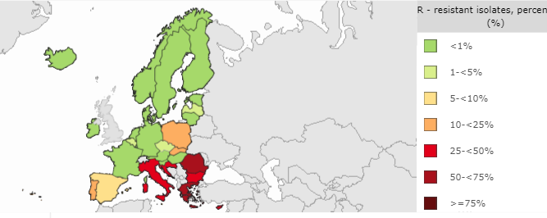
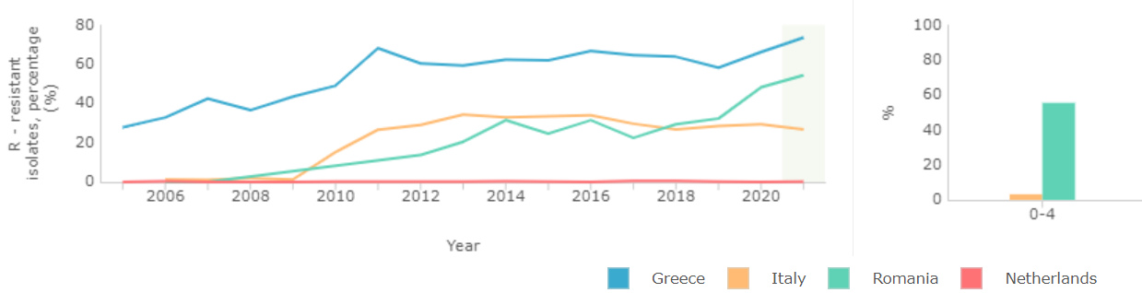
Why I’m really worried about resistance to therapeutic antimicrobials (aka AMR)
% invasive K. pneumoniae isolates resistant to carbapenems (CRE)
ECDC 2023.

Slide 39
Surface disinfectants in healthcare: when to use them, how to choose them, and their contribution to AMR
Jon Otter PhD FRCPath
Director of Infection Prevention and Control & Consultant Clinical Scientist
Guy’s and St Thomas’ NHS Foundation Trust / Imperial College London
@jonotter
j.otter@imperial.ac.uk
Blog: www.reflectionsIPC.com
Slides: www.jonotter.net

