Slide 1



What’s next for IPC? Winter 2024 and beyond
What’s next for IPC? Winter 2024 and beyond: setting priorities and scanning the horizon
Jon Otter PhD FRCPath
Director of Infection Prevention and Control & Consultant Clinical Scientist
Guy’s and St Thomas’ NHS Foundation Trust / Imperial College London
@jonotter
j.otter@imperial.ac.uk
Blog: www.reflectionsIPC.com
Slides: www.jonotter.net

Slide 2
Priorities
What’s hot in IPC

Slide 3
Promoting antimicrobial stewardship
Embedding digital systems to enhance our clinical services
Preventing SSI
Preventing the transmission of SARS-CoV-2 in our hospitals
Preventing Gram-negative bloodstream infection

Slide 4
Promoting antimicrobial stewardship
Embedding digital systems to enhance our clinical services
Preventing SSI
Preventing the transmission of SARS-CoV-2 in our hospitals
Preventing Gram-negative bloodstream infection

Slide 5
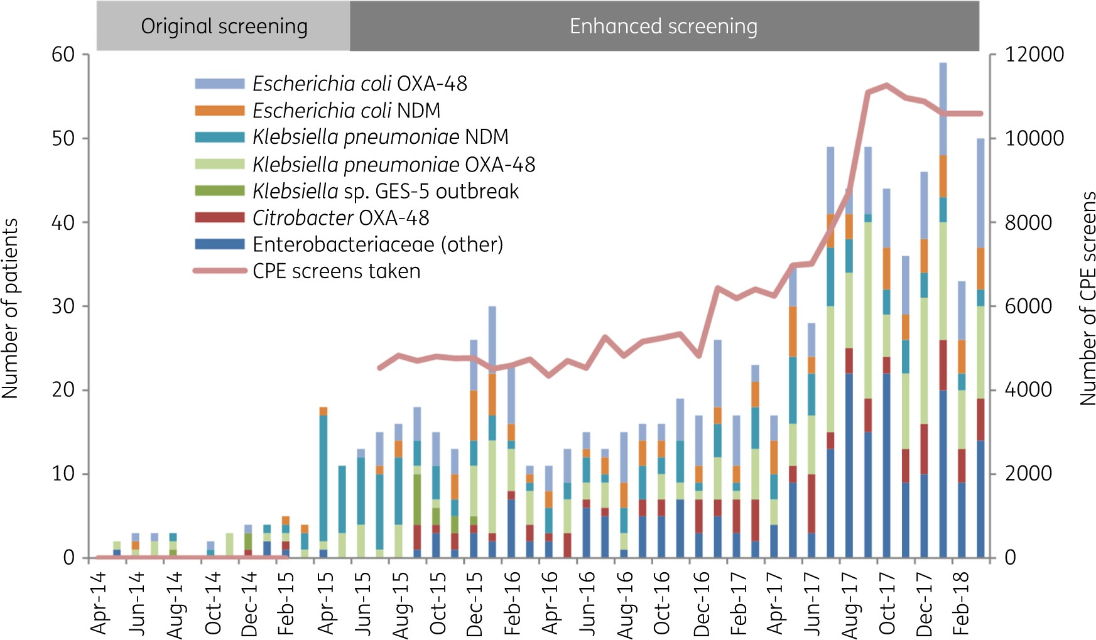
CPE: seek and ye shall find?
Overall trend in CPE detected at Imperial, by bacterial species and mechanisms, deduplicated by patient
Otter et al. J Antimicrob Chemother 2020.

Slide 6
Promoting antimicrobial stewardship
Embedding digital systems to enhance our clinical services
Preventing SSI
Preventing the transmission of SARS-CoV-2 in our hospitals
Preventing Gram-negative bloodstream infection

Slide 7
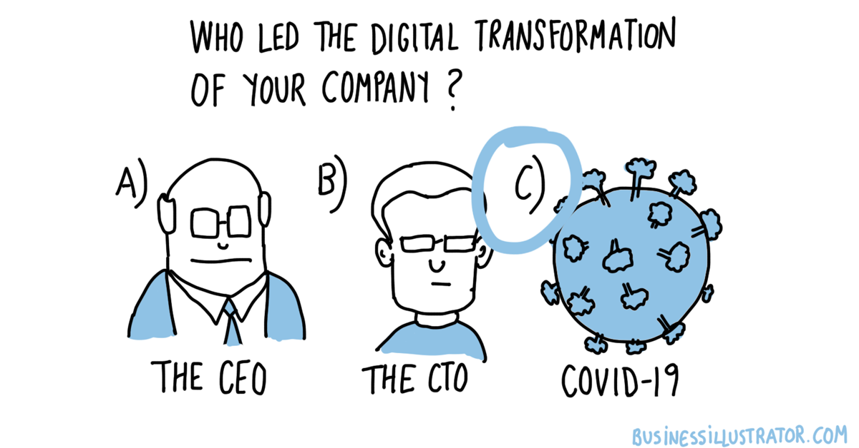

Slide 8
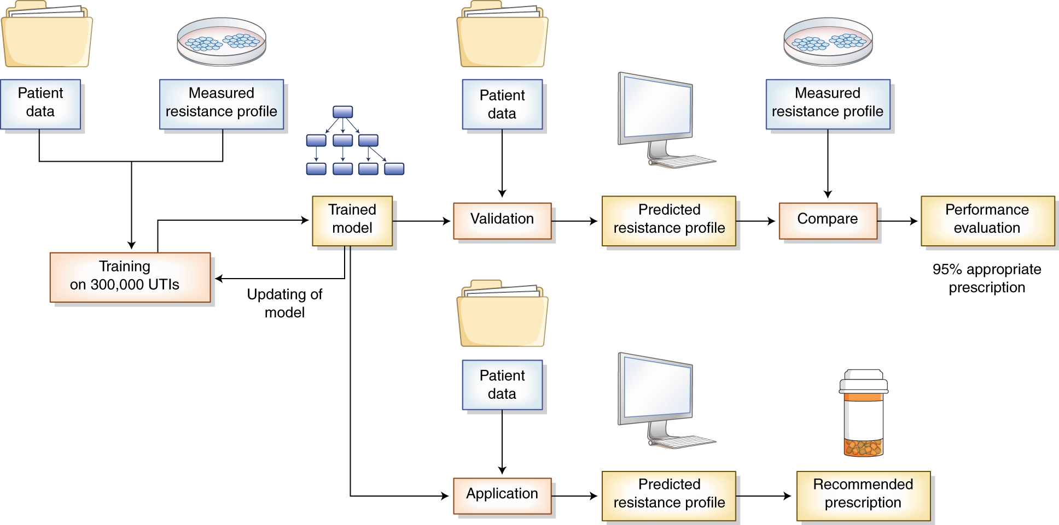
Machine learning / AI: antimicrobial prescribing decision support
Didelot et al. Nature Medicine 2019.

Slide 9
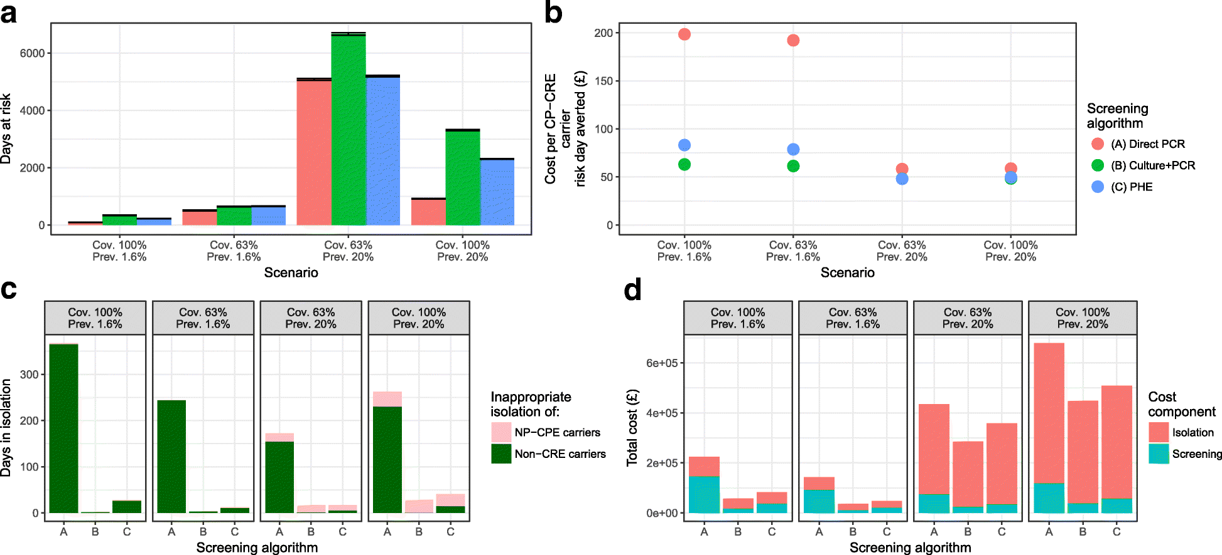
Modelling
Fast and expensive (PCR) or cheap and slow (culture)? A mathematical modelling study to explore screening for carbapenem resistance in UK hospitals
Knight BMC Medicine 2018.

Slide 10
Promoting antimicrobial stewardship
Embedding digital systems to enhance our clinical services
Preventing SSI
Preventing the transmission of SARS-CoV-2 in our hospitals
Preventing Gram-negative bloodstream infection

Slide 11
Drivers of Gram-negative BSI
Lab testing
Patient sampling
Deprivation
Seasonal variation
Acquisition
Sources
Humans
Transmission routes
Hands
Environment
Animals
Food
Soil
Patient factors
Devices
AMR
Surgery & wounds
High risk patients
Hydration & UTI

Slide 12
Promoting antimicrobial stewardship
Embedding digital systems to enhance our clinical services
Preventing SSI
Preventing the transmission of SARS-CoV-2 in our hospitals
Preventing Gram-negative bloodstream infection

Slide 13
Patient experience
17 patients who had suffered an SSI were enrolled into a semi-structured interview
‘I was crying, I was just not well at all. I couldn’t keep a drink down. The GP came and said what do you expect, you’ve had major surgery. I started to think I was going mad, perhaps you are supposed to feel like this. My husband was at his wits end, he didn’t know what to do. He called the NHS helpline and they said to buy some anti-sickness tablets from the chemist but they didn’t work. He rang the hospital and they weren’t very helpful, he rang the ward and they said she has been discharged so there is nothing we can do. Then after three or four days I was getting terrific pains in my stomach and I felt like I had wet myself, there was a lot of blood just gushing out of me.’
Tanner et al. J Infect Prevent 2012

Slide 14
SSI prevention: a success story
SSI surveillance at GSTT began to be enhanced in January 2009. The Trust now performs SSI surveillance in 12 surgical specialties. Assuming that the latest and lowest rate of SSI was achievable from the start of the programme, the reductions achieved suggest that 774 SSIs have been prevented. Assuming each SSI costs £5,239, this has resulted in savings of £4,056,443 over 6 years.
Unpublished data, with permission from GSTT.

Slide 15
Promoting antimicrobial stewardship
Embedding digital systems to enhance our clinical services
Preventing SSI
Preventing the transmission of SARS-CoV-2 in our hospitals
Preventing Gram-negative bloodstream infection

Slide 16


Slide 17
PPE
Transmission routes
Vaccination
Organizational transformation
Regulatory framework
Outbreaks
Non-COVID pathogens
Antimicrobial stewardship
Digital transformation
Applied research
Guidelines and policy development
Testing and laboratory factors

Slide 18
Promoting antimicrobial stewardship
Embedding digital systems to enhance our clinical services
Preventing SSI
Preventing the transmission of SARS-CoV-2 in our hospitals
Preventing Gram-negative bloodstream infection

Slide 19
Priorities
What’s hot in IPC

Slide 20
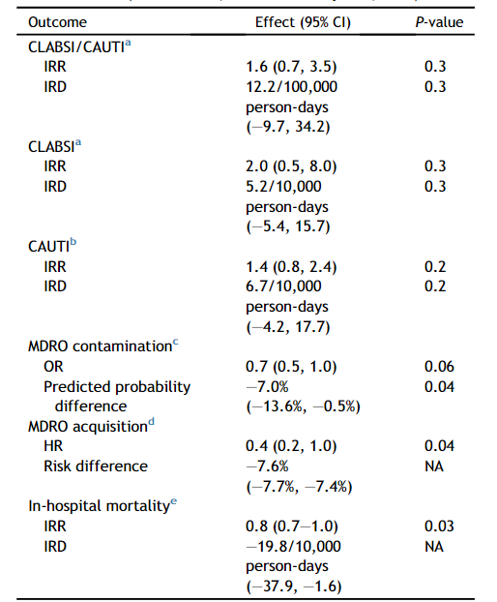
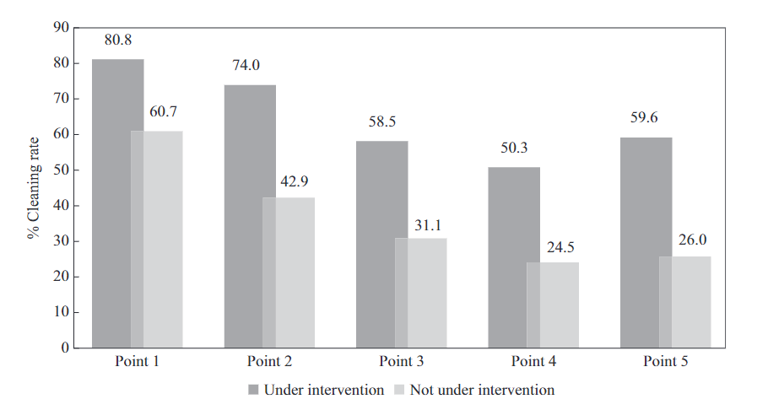
More effective surface disinfection improves patient outcomes
Prospective intervention cluster cross-over study in Israel.
Performed over 15 months, including 7,725 patients.
Intervention was a switch from “bucket-based” chlorine disinfection to routine use of QAC-based wipes.
Dadon et al. J Hosp Infect 2023.

Slide 21
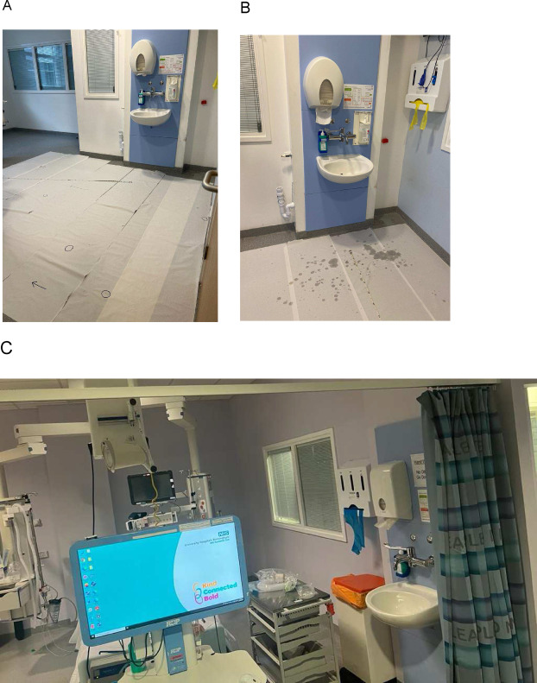
“Gonna take you right in to the sink splash zone”
(duh duh duh)
Category | Examples | Prevalence
A | Vascular access equipment | 65%
Bi | Ventilator equipment | 18%
Bii | Respiratory equipment | 27%
C | Haemofiltration / dialysis | 12%
D | Personal care items | 68%
E | Nutrition / enteral care | 33%
F | Alcohol gel / PPE | 57%
G | Housekeeping / cleaning | 5%
H | Patient skin contact items | 43%
I | Medicines / infusion pumps | 32%
J | Negatinve pressure wound care | 5%
K | Patients with IV devices | 12%
L | Patinets with urinary catheters | 18%
M | Invasive monitoring equipment | 5%
N | Patinet admission packs | 5%
O | Computers on wheels | 48%
The sink splash zone. Panel A: after running the tap. Panel B: after hand hygiene. Panel C: equipment in the sink splash zone.
Garvey et al. Infect Prevent Practice 2023.

Slide 22
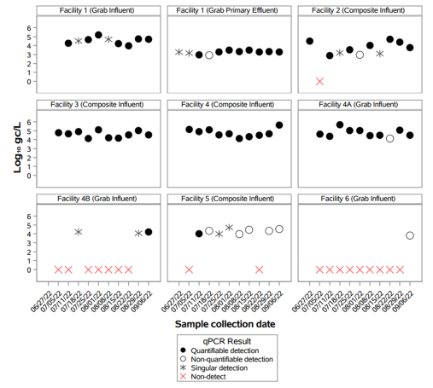
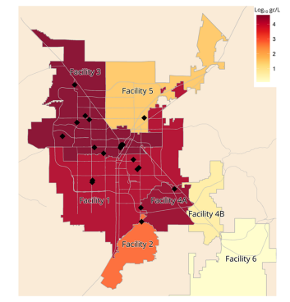
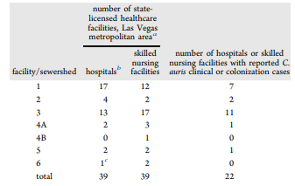
Candida auris: coming to a hospital near you…(& wastewater surveillance is pretty cool)
Positive detection 72 of 91 samples (79%); higher detection frequencies in sewersheds serving healthcare facilities involved in the outbreak (94 vs 20% sample positivity)
Barber et al. Env Sci Tech 2023.

Slide 23
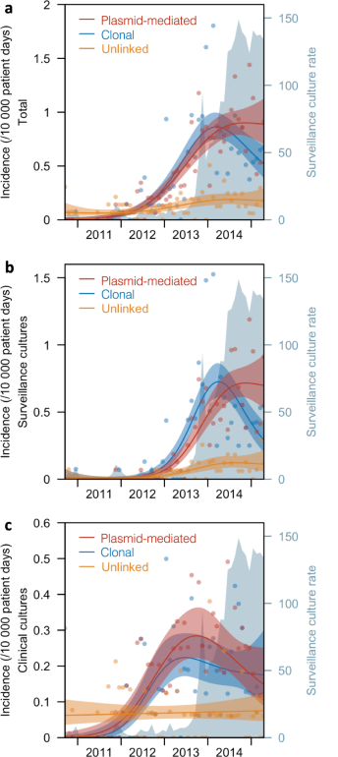
Horizontal plasmid transfer is a key driver of CPE transmission
Genomic analysis of 1312 CPEs submitted to government ref lab in Singapore between 2010 and 2015.
Significant risk factors for clonal spread of CPE:
direct or indirect ward-level contact;
direct or indirect hospital-level contact;
bacterial species (Klebsiella and Enterobacter a higher risk of spread than E. coli;
carbapenemase type (NDM and OXA-type a higher risk of spread than KPC)
Significant risk factors for plasmid-mediated spread of CPE:
none
Marimuthu et al. Nat Comm 2022.

Slide 24
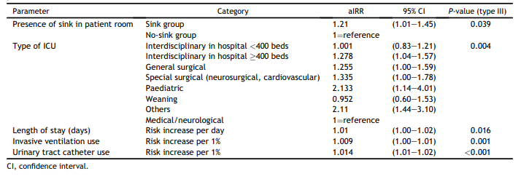
Water-free care demands our attention
Retrospective cohort study including 552 German ICUs, comparing HCAI prevalence in patients cared for in rooms with or without sinks.
Multivariable analyses identified sinks as a risk factor for BSIs and UTIs
Fucini et al. J Hosp Infect 2023.

Slide 25
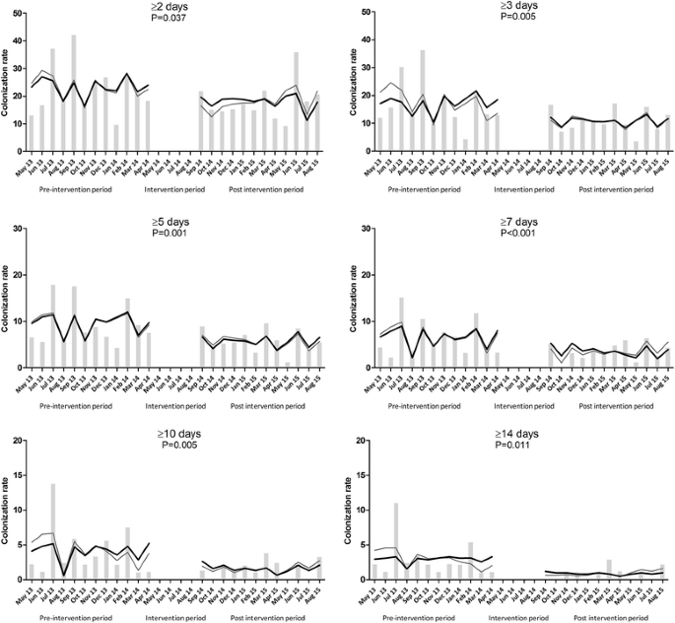
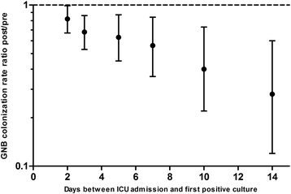
Water free critical care
Overall rate of Gram-negative rod colonisation rate: were 26.3 GNB/1000 ICU admission days pre-intervention and 21.6 during the intervention (rate ratio 0.82; 95%CI 0.67–0.99; P = 0.02).
Hopman et al. Antimicrobial Resistance & Infection Control 2017;6:59

Slide 26
What’s next for IPC? Winter 2024 and beyond: setting priorities and scanning the horizon
Jon Otter PhD FRCPath
Director of Infection Prevention and Control & Consultant Clinical Scientist
Guy’s and St Thomas’ NHS Foundation Trust / Imperial College London
@jonotter
j.otter@imperial.ac.uk
Blog: www.reflectionsIPC.com
Slides: www.jonotter.net

