Slide 1




Vascular access service development - and making the case for investment
Jon Otter PhD FRCPath,
Director of Infection Prevention and Control & Consultant Clinical Scientist
Guy’s and St Thomas’ NHS Foundation Trust
@jonotter
jon.otter@gstt.nhs.uk

Slide 2
The cost of failure
The evidence
The business case
Implementation and service redesign
The challenge

Slide 3
The cost of failure
The evidence
The business case
Implementation and service redesign
The challenge

Slide 4
The challenge
You already have a nurse-led vascular access service in an acute care setting, but you can’t keep up with referrals. Also, to complicate matters, Trust has merged with another, and the new part of the Trust doesn’t have a nurse-led vascular access service. Your mission is to write a business case to convince the Trust board to invest in expanding the existing service to meet current demand and cover the whole Trust…

Slide 5


Slide 6
The cost of failure
The evidence
The business case
Implementation and service redesign
The challenge

Slide 7
The cost of failure
Patient experience (e.g multiple attempts)
Treatment delays
Additional use of IR / theatres equipment and personnel
HCAI, especially line-related infections
Litigation / reputation damage
Sharps injuries for staff
Clinical complications

Slide 8
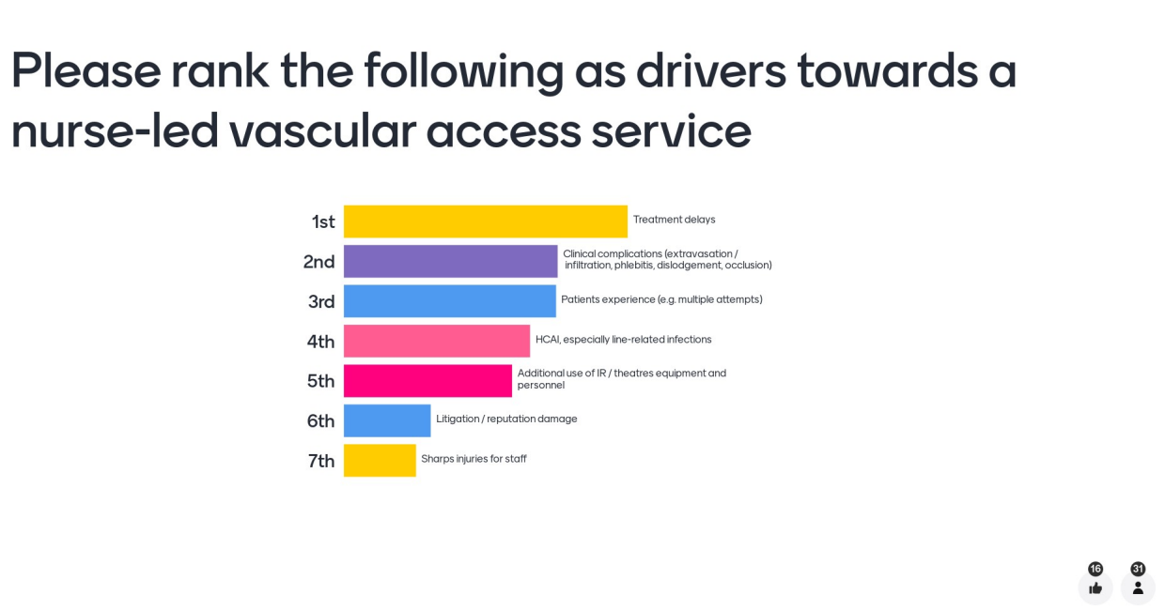

Slide 9
Patient experience
Medical notes from an end of life cancer patient referred for a PICC:
“A key source of distress for ****** is the pain and anxiety associated with multiple unsuccessful attempts to take bloods/ cannulate. She recognises the reasons for trying and has complied to her best ability but the pain and distress levels are now becoming overwhelming. She is aware of the plan for a PICC line this week and we are hopeful this will allow access to investigations and medications as needed without her having to undergo further distressing attempts.”

Slide 10

The cost of expensive HCAI
Cassini et al. Plos Med 2016.

Slide 11
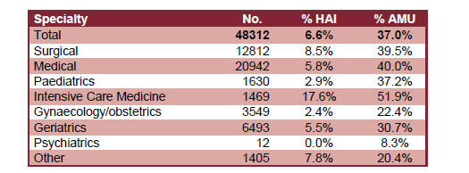
Prevalence of HCAI
The 2016 national PPS was a huge undertaking that included 48,312 patients from 88 NHS Trusts and 6 private hospitals.
7% of patients had an HCAI and 33% were on an antimicrobial.
Pneumonia was the most common HCAI (29%) followed by UTI (17%) then SSI (15); BSI (6.6%).
Prevalence of peripheral vascular cannula (43%), central venous catheters (7%), urinary catheters (20%), and intubation (2%).
37% of ICU BSI episodes were catheter-related. European CDC, 2017
HCAI and antimicrobial use by speciality.
ESPAUR Report 2017.

Slide 12
Risk factors for CVC-associated BSI in the ICU
Modifiable factors:
duration of catheterization (≥ 5d) (OR: 2.07, 95%CI: 1.41–3.03),
duration of catheterization (≥ 7d) (OR: 3.62, 95%CI: 2.65–4.97),
duration of catheterization (≥ 14d)(OR: 4.85, 95%CI: 3.35–7.01),
total parenteral nutrition (OR: 2.27,95%CI: 1.56–3.29),
use of multiple-lumen catheters(OR: 3.41, 95%CI: 2.27–5.11),
times of tube indwelling (OR: 3.50, 95%CI: 2.93–4.17),
length of ICU stay (OR: 4.05, 95%CI: 2.41–6.80),
the position of indwelling(OR: 2.41, 95%CI: 2.03–2.85);
Unmodifiable factors:
APACHEII scores (OR: 1.84, 95%CI: 1.54–2.20),
Age≥ 60 years old (OR: 2.19, 95%CI: 1.76–2.73),
the extensive use of antibiotic (OR: 3.54, 95%CI: 1.65–7.61),
Diabetes mellitus (OR: 3.06, 95%CI: 2.56–3.66),
Immunosuppression (OR: 2.87, 95%CI: 2.08–3.95).
Huang et al. Plos One 2024.

Slide 13
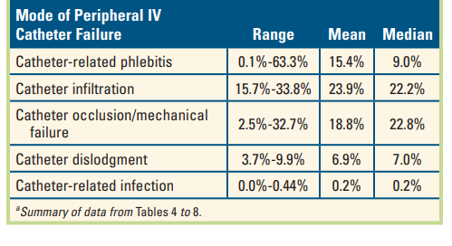
Clinical complications
Review and meta-analysis of peripheral IV failures.
Helm et al. Infusion Nursing Society 2015.

Slide 14
Clinical complications
Observational study of 1,428 peripheral intravenous cannula insertion among 368 adult patients hospitalised at the tertiary healthcare clinics, Serbia.
Significant risks associated with infiltration included:
20‐gauge catheter
two or more attempts at cannulation
administration of a high‐risk solutions during the first day
Simin et al. J Clin Nursing 2019.

Slide 15
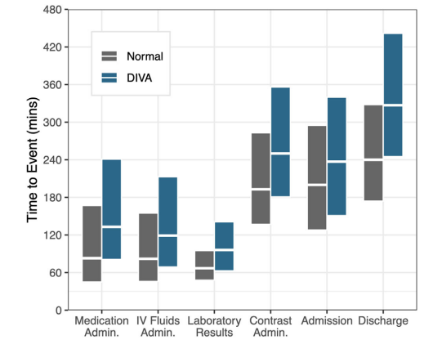
Care delays and increased length of stay
Comparison of patients with difficult intravenous access (DIVA*) with “normal” patients; n = 108,256 patients.
* DIVA was defined as patients requiring ultrasound-guided intravenous access placed by physicians or advanced practice providers (APPs) as opposed to landmark-based intravenous placement by nurse
Shokoohi et al. JACEP Open 2020

Slide 16
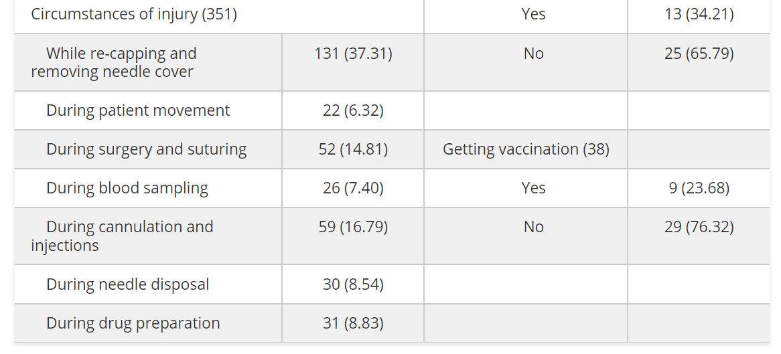
Sharps injuries
“46% of nurses reported at least one exposure per month during IV insertion.” Jagger et al. Nursing 2011.
A survey of 151 nurses working in Taiz city, Yemen.
Abdo Almoliky et al. Sage Open Medicine 2024.

Slide 17

Legal costs of vascular access failures
NHS Resolution report, “Did you know? Extravasation”, Mar 2022
“From 1 April 2010 until 1 December 2021 NHS Resolution received 467 claims relating to extravasation injuries. Of those 467 claims, 214 have settled with damages and 112 have closed with nil damages. This has cost the National Health Service (NHS) 16 million pounds. This includes payment for claimant legal costs, NHS legal costs and damages.”

Slide 18
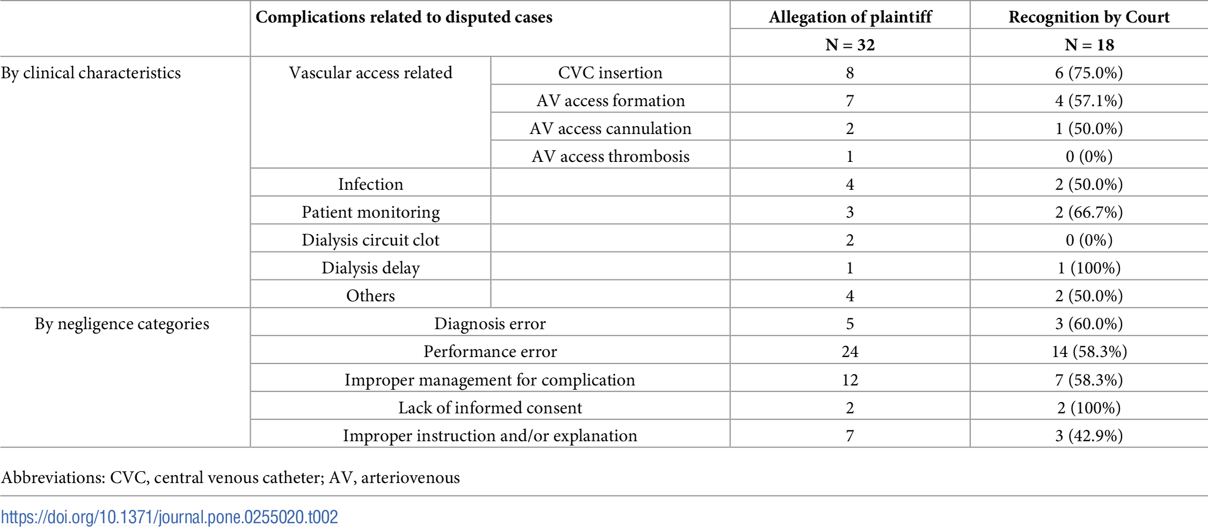
Legal costs of vascular access failures
Kim et al. Plos One 2021.

Slide 19
The cost of failure
The evidence
The business case
Implementation and service redesign
The challenge

Slide 20
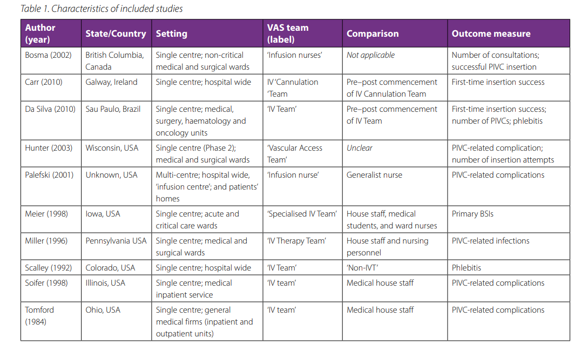
How to measure the impact of a vascular access team?
Marsh et al. Vascular access 2020.

Slide 21
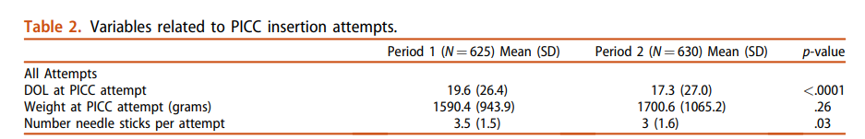

Impact of a nurse-led vascular access team in NICU
Five nurses were trained in central line insertion and maintenance practices and replaced a team primarily comprised of neonatal-perinatal medicine fellows in a US NICU setting. Six hundred and twenty peripherally inserted central catheters were attempted preintervention (period 1) in 325 infants, and 630 were attempted in 406 infants postintervention (period 2).
Levit et al. J Maternal-fetal & Neonatal Medicine 2020.

Slide 22
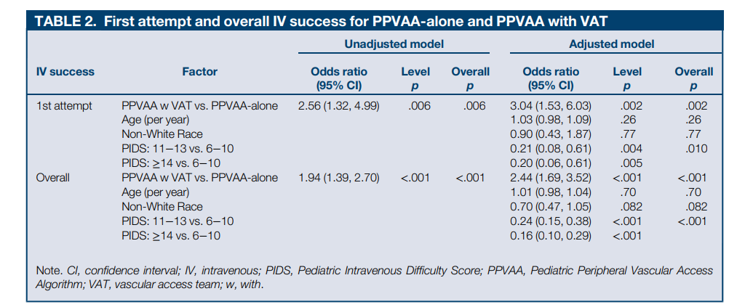
Impact of a nurse-led vascular access team
Impact of a vascular access team in a 120 bed children’s hospital. n = 596 insertions for both periods combined.
Hartman et al. Journal of Pediatric Health Care 2019.

Slide 23
Qualitative assessment of vascular access teams
Multi-methods analysis of vascular access teams in the USA. Online survey of 62 hospitals, and interviews with 74 clinicians.
More than 77% (n = 48) of hospitals had an on‐site vascular access team (VAT).
  The average team size was seven nurses; their primary function was device insertion.
Interview findings revealed that teams varied in characteristics and functions.
  Interviewees described the broad role that teams play in device insertion, care and removal, and in educating/training hospital staff.
  However, we found that teams' role in decision making, particularly related to appropriate device selection, was limited and, in some cases, met with physician resistance
Quinn et al. J Hosp Med 2023.

Slide 24
The cost of failure
The evidence
The business case
Implementation and service redesign
The challenge

Slide 25
The RCN guidelines states that:
“All NHS acute service providers should consider the establishment of a Vascular Access Service (VAS) to enable health care providers to meet the requirements of national standards of care associated with VAD.” (Royal College of Nursing (2016) Infusion Therapy Standards, 4 th Edn. London, Royal College of Nursing.)
The 2022 NIVAS-White-paper states that:
“There is overwhelming evidence to prove that a VAST is well aligned to enable acute Trusts to meet the following points found within the NHS Long Term Plan:

Slide 26
Key components of a vascular access service
PICC insertion
Difficult cannulation
Troubleshooting
Audit & surveillance
Education
Procurement
Governance & guidance
Incident reviews
Applied research
Reduce risk of sharps injury
Adoption of innovation

Slide 27
Considerations when building a vascular access team
Team
Investment
Culture
Stakeholders*
Scope, scale, structure, banding, training, recruitment, retention, leadership and organisation location
People, technology, and space.
Resistance to change
Reducing the practice of using IR and anaesthetists to insert lines.
Prioritisation of nurse-led services
Who are they and how can you engage them?
* Specialist vascular access nurses, IPC / microbiology, Hospital executives, Clinical directors / Directors of Nursing, Occupational Health, Health and Safety, Bed managers / site directors, Key clinical specialities (oncology, IR, anaesthetics), Procurement
NIVAS white paper, 2022.

Slide 28
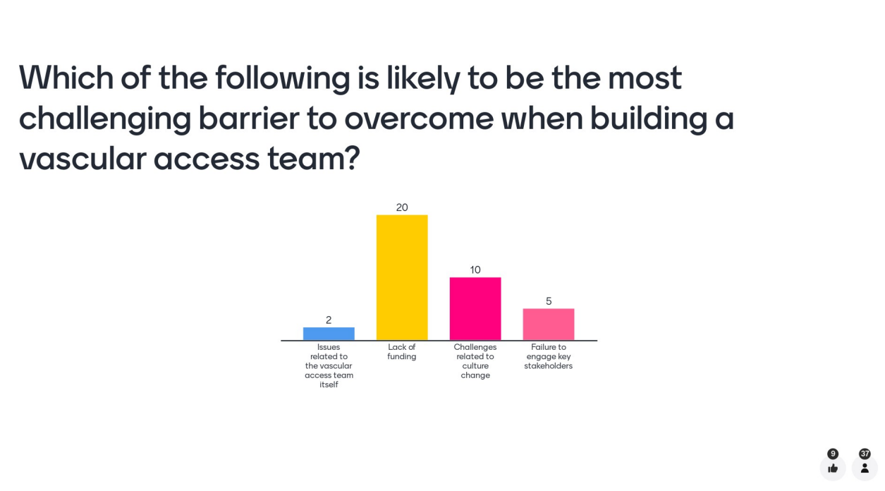

Slide 29
Writing a compelling business case
Step 1: Frame the problem and the solution
Step 2: Discuss the case in principle with key stakeholders
Step 3: Determine the cost of your solution
Step 4: Determine the benefits of your solution (financial and otherwise)
Step 5: Make the case for your case!
Step 6: Monitor progress of your case once funded
Adapted from Perencevich et al. Infect Control Hosp Epidemiol 2007;28.

Slide 30
Tips for making a compelling case
Concise evidence summary
Capture value (not just cost)
Patient stories
Understand the approval process
Do your pre-committee homework!
Guidelines / peer comparisons

Slide 31
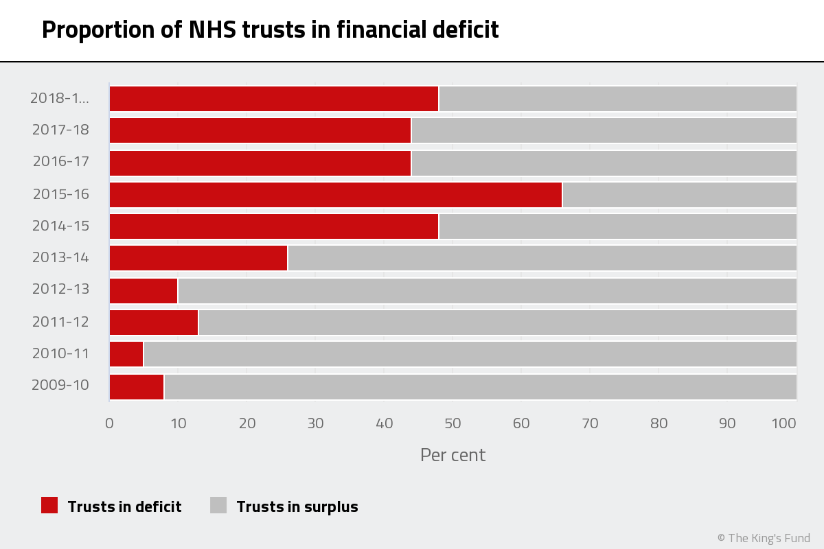
The King’s Fund. Trusts in deficit.

Slide 32
Talking the same language
Know your audience
Develop a concise message
Consult with stakeholders
Be part of a convincing brand
Be quietly tenacious

Slide 33
The cost of failure
The evidence
The business case
Implementation and service redesign
The challenge

Slide 34
So, you have the money…now what?
Guiding principles for service redesign¹ | Our new (or expanded) vascular access team
Follow the patient’s journey | Where will the team make the most impact?
Be clinically led | Ensure clinicians are leading discussions around deployment model
Involve all stakeholders | Clinical teams, Executives, OH, H&S, IPC, microbiology
Promote effective team working | How will the new team fit into the existing management structure?
Focus on improving patient & outcomes | How will outcomes be monitored (e.g. # lines inserted, complications)?
1. Adapted from NHS Employers guide for service redesign.

Slide 35

Mission impossible?
You already have a nurse-led vascular access service in an acute care setting, but you can’t keep up with referrals. Also, to complicate matters, Trust has merged with another, and the new part of the Trust doesn’t have a nurse-led vascular access service. Your mission is to write a business case to convince the Trust board to invest in expanding the existing service to meet current demand and cover the whole Trust…

Slide 36
Summary
Vascular access failures have enormous financial and non-financial impact and cost.
You need to make the best of the evidence that you have for your intervention (which may not be great).
Perspectives on the cost and value will vary with different groups (i.e. CEO vs. CFO vs. clinical staff vs. patient).
Business cases are vital; you need to know your audience and consult widely.
An investment that is poorly implemented and monitored will probably be the last investment that you secure!

Slide 37
Business case writing: resources
Building a business case. Library and Knowledge Healthcare Services, Health Education England.
Building Your Business Case. Johnson et al. Am J Infect Control 2011;39:E126.
Raising Standards While Watching the Bottom Line: Making a Business Case for Infection Control. Perencevich et al. Infect Control Hosp Epidemiol 2007;28.
Making the business case for infection control: Pitfalls and opportunities. Dunagan et al. Am J Infect Control 2002;30:86-92.

Slide 38
Vascular access service development - and making the case for investment
Jon Otter PhD FRCPath,
Director of Infection Prevention and Control & Consultant Clinical Scientist
Guy’s and St Thomas’ NHS Foundation Trust
@jonotter
jon.otter@gstt.nhs.uk

Slide 39
Implementation and evaluation
Plan
define scope, set objectives, set terms of reference, build team, develop comms
Don’t reinvent the wheel
map existing pathways, analyse current processes, identify best practice, define unmet needs
Create
Pilot
design new process, define infrastructural changes
develop implementation plan, consult widely on new processes, review the pilot and respond to feedback
Implement & evaluate
roll out new processes, provide support, monitor benefits and provide feedback
Adapted from NHS Employers guide for service redesign.

