Slide 1
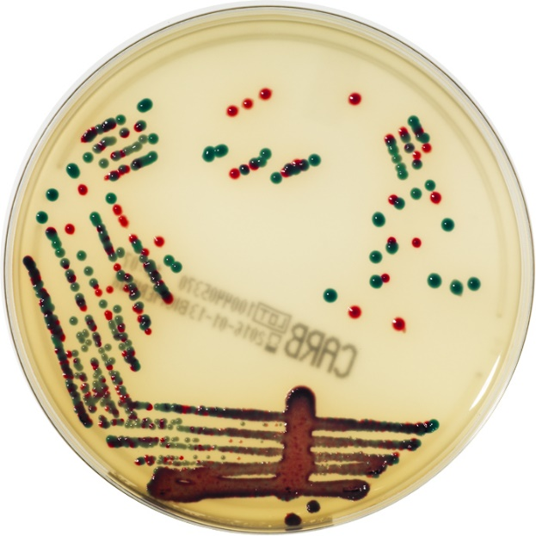



Which approach would you support for screening patients for CPE in hospitals in the UK?
Targeted screening of inpatients based on risk factors
Jon Otter PhD FRCPath
Director of Infection Prevention and Control & Consultant Clinical Scientist
Guy’s and St Thomas’ NHS Foundation Trust
Honorary Senior Lecturer in HCAI and AMR, Imperial College London
@jonotter
jon.otter@gstt.nhs.uk
Blog: www.reflectionsIPC.com
Slides: www.jonotter.net

Slide 2
Preamble
Universal admission screening
Targeted screening
Universal vs. targeted

Slide 3
Preamble
Universal admission screening
Targeted screening
Universal vs. targeted

Slide 4
CRE (carbapenem-resistant Enterobacerales)
CP-CRE (carbapenemase-producing Enterobacterales) aka CPE
NCP-CRE (non-carbapenemase-producing Enterobacterales)

Slide 5
What do we mean by universal vs. targeted screening?
Universal screening = screening all inpatient admissions
Targeted screening = screening patients based on individual or speciality-level risk factors

Slide 6
Why bother with CPE screening? – Clinical outcomes
Meta-analyses of subsequent infection in patients first identified as colonised with CPE/VRE.
 |  | Any infection |  |  | Bloodstream infection
 |  | N studies | N infected / N colonised | Cumulative incidence (95% CI), % | N studies | N infected / N colonised | Cumulative incidence (95% CI), %
MDR-GNB |  | 32 | 845/9034 | 0·14 (0·10–0·18) | 23 | 434/8307 | 0·07 (0·04–0·11)
CRE or CPE |  | 19 | 602/4547 | 0·19 (0·15–0·25) | 14 | 347/4142 | 0·10 (0·07–0·15)
ESBL-E or 3GCR-E |  | 14 | 235/4461 | 0·08 (0·05–0·13) | 9 | 70/4087 | 0·04 (0·02–0·07)
 | E. coli | 7 | 133/3098 | 0·08 (0·04–0·14) | 6 | 46/3042 | 0·04 (0·01–0·10)
 | K. pneumoniae | 4 | 59/741 | 0·09 (0·06–0·13) | 3 | 14/730 | 0·02 (0·01–0·05)
VRE |  | 16 | 329/5015 | 0·07 (0·04–0·12) | 10 | 163/1840 | 0·10 (0·06–0·16)
Incidence for CP-CRE was 26% (95% CI 19–35)
Willems et al. Lancet Infect Dis 2023.

Slide 7


Slide 8
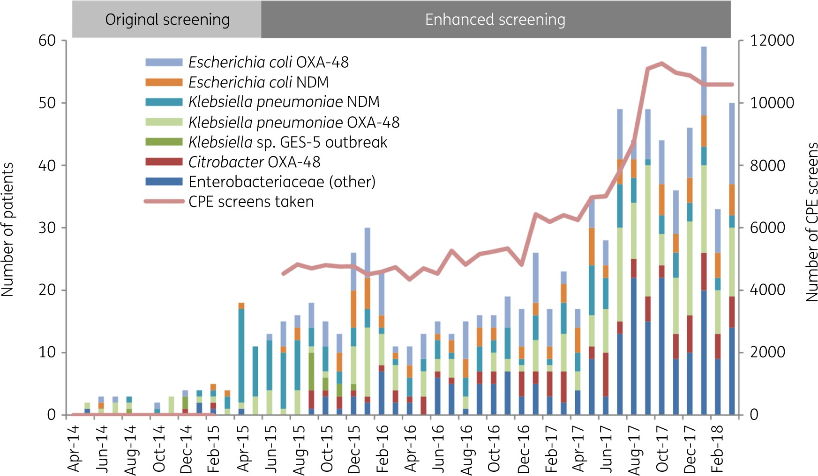
Why bother with CPE screening? – the iceberg…
Overall trend in CPE detected at the Trust, by bacterial species and mechanisms, deduplicated by patient
Otter et al. J Antimicrob Chemother 2020.

Slide 9
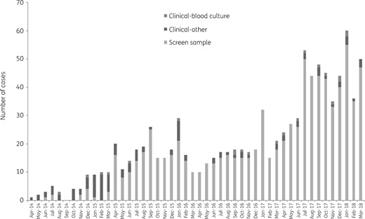
Screen vs. clinical culture
Otter et al. J Antimicrob Chemother 2020.

Slide 10
Preamble
Universal admission screening
Targeted screening
Universal vs. targeted

Slide 11
£££
GSTT 196,230 admissions = £2.5m (culture) or £7.8m (PCR)
National 16,399,596 = £2bn (culture) or £6.4bn (PCR)
Admissions from NHS; costs from Moloney et al. Diagn Progn Res 2019.

Slide 12
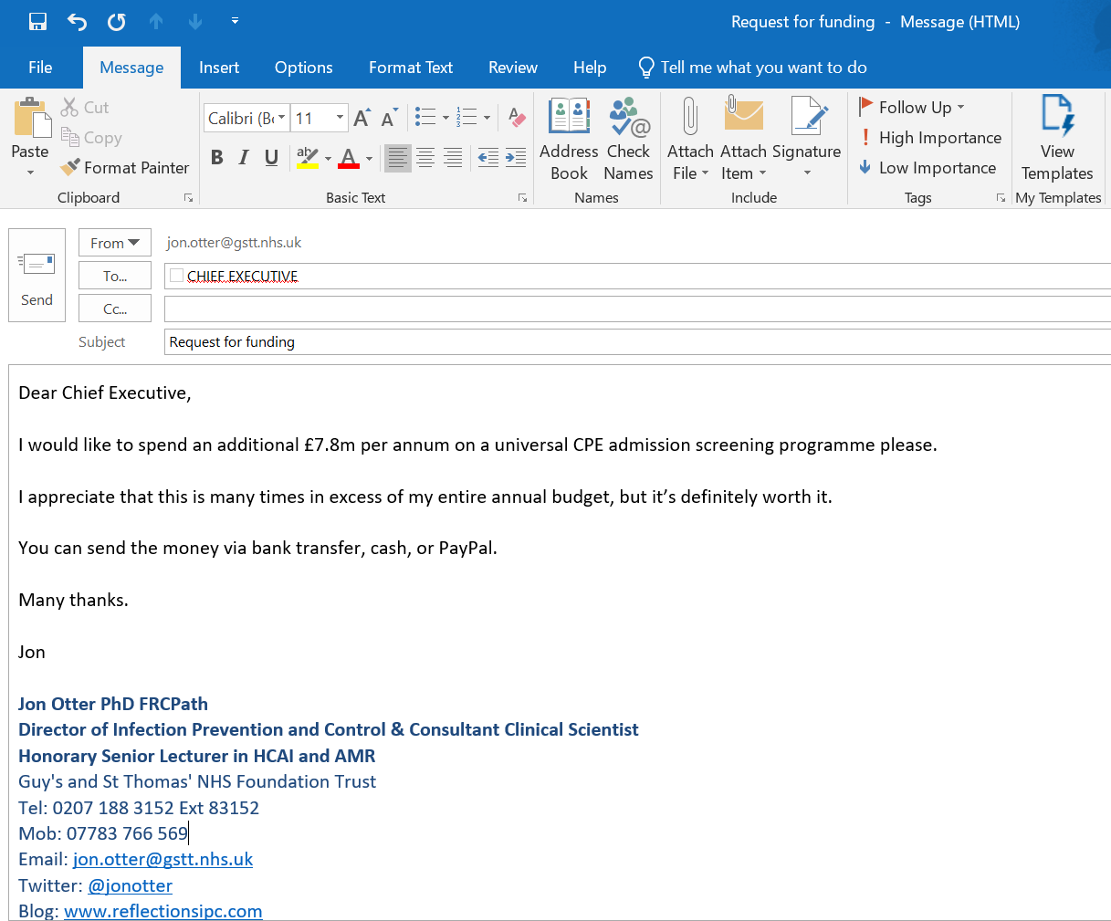
£10m

Slide 13
Time
15 minutes per sample
GSTT (196,230 admissions)
  49,000 hours
  1308 weeks
  25 full time jobs!
  Nationally = 2,100 full time jobs!
Otter et al. Clin Microbiol Infect 2015.

Slide 14

£10m

Slide 15
Acceptability
Cross sectional survey of healthcare professionals and the public on the acceptability of CPE screening.
1/3 nursing staff did not agree that CPE screening is acceptable
However, there were high levels of agreement amongst the public that they would find CPE screening acceptable
For staff:
  ‘intentions to screen’; ‘environmental context and resources’; ‘knowledge’; ‘social influences’; ‘beliefs about the severity of consequences of CPE’; and, ‘emotion’ (embarrassment for patients in being asked for rectal swab).
For pubic
  experience of health care employment, the acceptability of being cared for in isolation and the TDF domains of ‘knowledge’; ‘social influences’; and ‘beliefs about the severity of consequences of CPE’.
Currie et al. Antimicrob Res Infect Control 2018.

Slide 16
Can I swab your rectum please?
Prospective study of asymptomatic antibiotic-resistant Gram-negative bacteria colonisation in 4006 patients on admission to a London hospital group.
Original description (weeks 1-4)
“Bug”-focussed message
Detailed scientific language
Modified description (weeks 5-14)
Patient-focussed message
“Why is it important to be screened?”
“Benefits for you and those close to you!”
“If you get an infection, we can put you on the right antibiotics straight away.”
Change in description of the study
The change in study description results in a significant reduction in decline rate, from 31.9% of 869 patients to 7.6% of 3690 patients (p <0.001)
Dyakova et al. Clin Microbiol Infect. 2017;23:577.e1-577.e3.

Slide 17
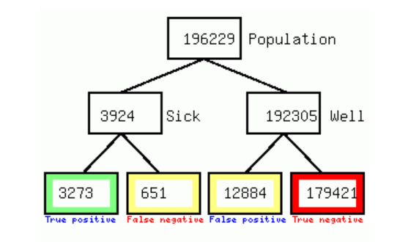
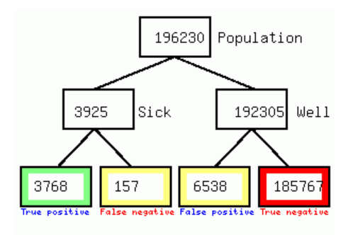
Accuracy
Culture
Sensitivity = 0.834, Specify = 0.933, Prevalence = 2%, Sample size = 196,230
PCR
Sensitivity = 0.960, Specify = 0.966, Prevalence = 2%, Sample size = 196,230
Moloney et al. Diagn Progn Res 2019.

Slide 18
Preamble
Universal admission screening
Targeted screening
Universal vs. targeted

Slide 19
Risk factors for CPE
Known contact with CPE
History of CPE
Hospitalisation
  Overseas? Duration? Local prevalence?
Invasive procedures / devices
Co-morbidities
Antimicrobial therapy
Travel
Ilan & Kjerulf. J Hosp Infect 2023.

Slide 20
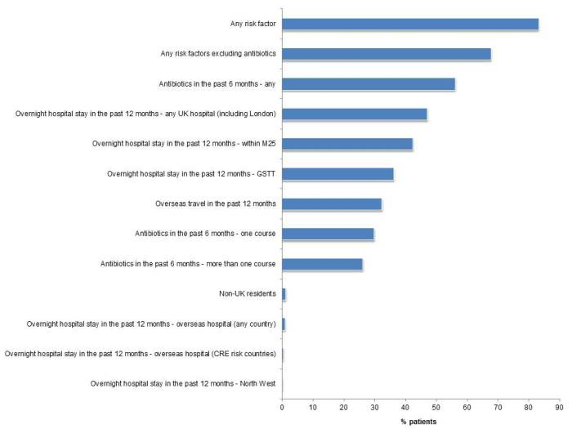
Prevalence of risk factors
Otter et al. J Antimicrob Chemother 2016.

Slide 21
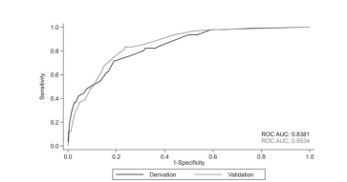
Effective risk scores are possible
Development and assessment of a risk score for CPE admission screening in an endemic setting (Greece), based on screening 2,303 patients over 6 months in 2015/16.
Using the cut-off point of ≥27 in the patients of the validation dataset would result in performing approximately 88 screening tests per 1000 admitted patients and would identify 48.9% of colonized patients (44/90).
Using a lower cut-off of e.g. ≥20 would result in 216 screening tests per 1000 admitted patients and identification of 81% of CPE colonized patients (73/90).
Papafotiou et al. J Antimicrob Chemother 2022.

Slide 22
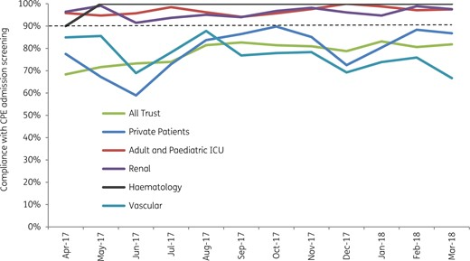
Can we implement targeted screening?
Adoption of the enhanced CPE admission screening recommendations, April 2017 to March 2018. Universal screening in ICU, renal, haematology, and vascular.
Otter et al. J Antimicrob Chemother 2020.

Slide 23
Preamble
Universal admission screening
Targeted screening
Universal vs. targeted

Slide 24
Prevalence of CPE in England
Universal admission screening of 4006 admissions in central London found only 6 CPE were cultured from 5 (0.1%) of 4006 patients in 2015 (1).
The incidence of CPE estimated by a laboratory analysis of carbapenem-non-susceptible Enterobacterales was 0.007 per 1000 patient-days (95% CI = 0.005-0.010) (2).
Models use a variety of estimates, e.g. 0.01-10% (3,4).
Otter et al. J Antimicrob Chemother 2017.
Trepanier et al. J Antimicrob Chemother 2017.
Lapointe-Shaw et al. E J Clin Microbiol Infect Dis 2017.
Manoukian et al. Eur J Health Econ 2022.

Slide 25
“Carbapenemase-producing organism (CPO) colonisation at a district general hospital: universal screening may help reduce transmission”
Universal screening of all ICU admissions and targeted screening of all other admissions!
Overall CPO prevalence was 2.1% of 3,553 patients sampled.
  This includes admission prevalence and acquisition.
Incidence was highest where universal screening strategy was applied (3.9 per 1000 patient-days, 95% CI: 2.4-5.91).
  But this was ICU vs. general wards, so it’s apples and pears!
Phee et al. Infect Prevention Practice 2021.

Slide 26
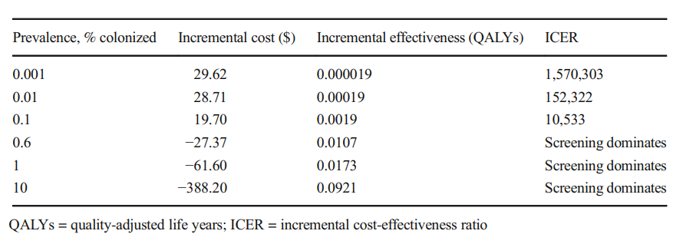
Universal screening may be cost effective
Modelling study to evaluate the cost-effectiveness of hospital admission screening strategies for CPE based on US data.
Lapointe-Shaw et al. E J Clin Microbiol Infect Dis 2017.

Slide 27
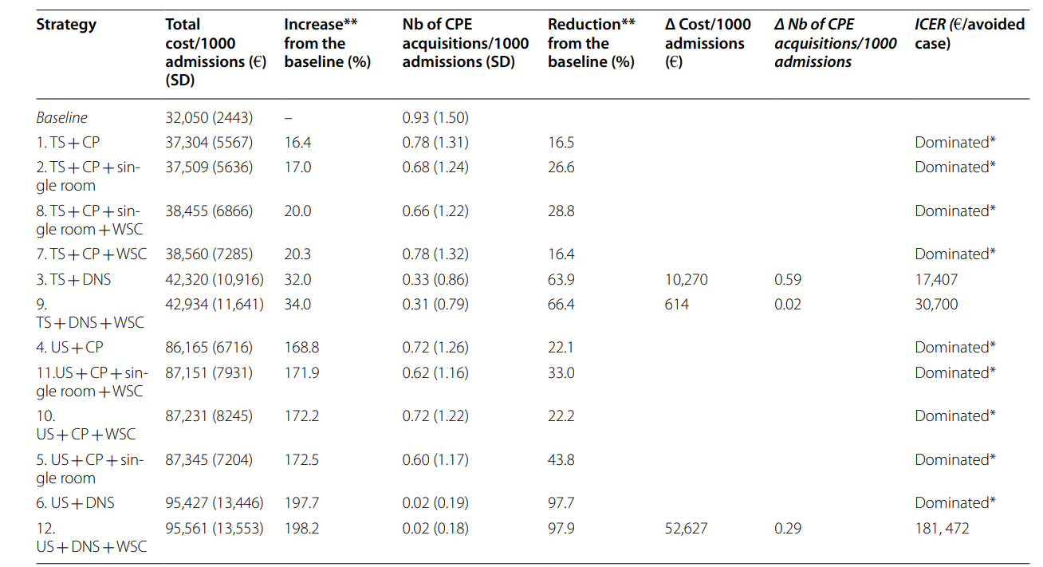
Cost effectiveness of screening approaches (2)
Modelling study to evaluate the cost-effectiveness of hospital admission screening strategies for CPE in a general ward setting.
Kardaś‑Słoma et al. ARIC 2022.

Slide 28
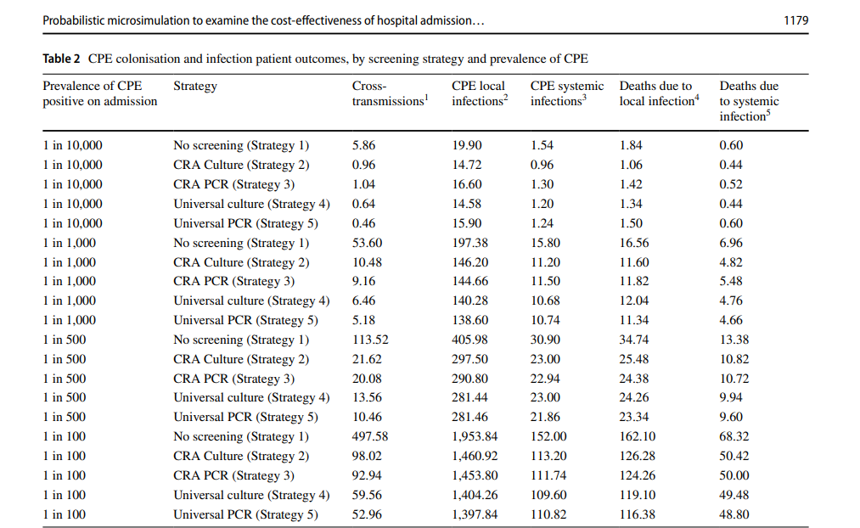
Cost effectiveness of screening approaches
Modelling study to evaluate the cost-effectiveness of hospital admission screening strategies for CPE in the UK.
Manoukian et al. Eur J Health Econ 2022.

Slide 29
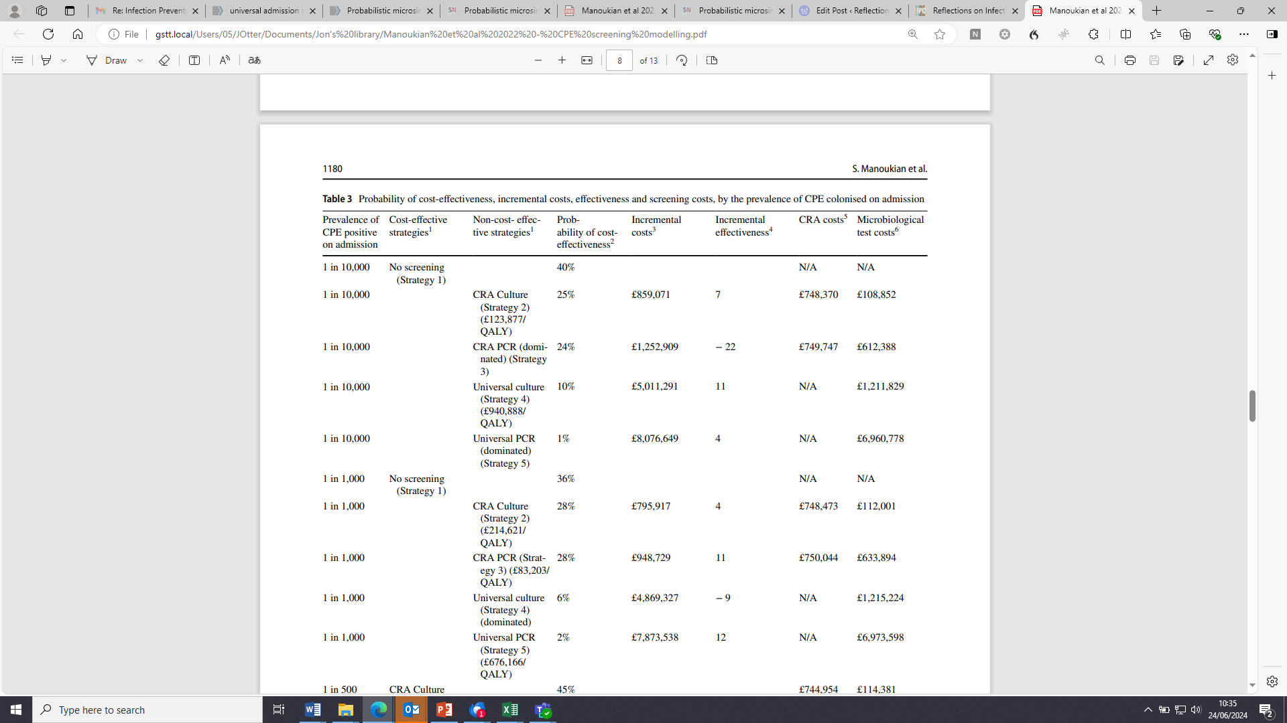
Cost effectiveness of screening approaches
Modelling study to evaluate the cost-effectiveness of hospital admission screening strategies for CPE in the UK.
Manoukian et al. Eur J Health Econ 2022.

Slide 30
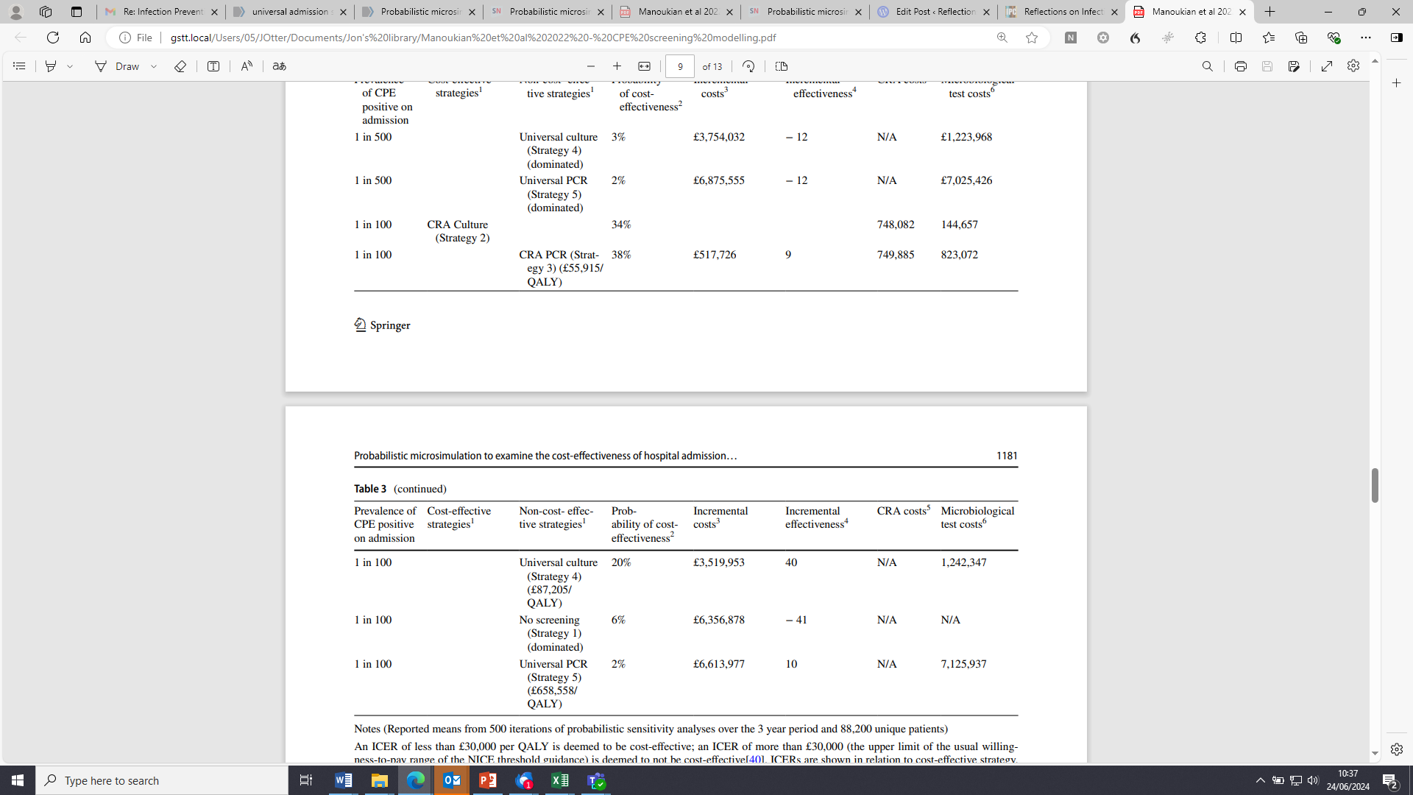
Cost effectiveness of screening approaches
Modelling study to evaluate the cost-effectiveness of hospital admission screening strategies for CPE in the UK.
Manoukian et al. Eur J Health Econ 2022.

Slide 31
Summary
We need to get CPE screening right!
Universal screening is limited by cost, resource consumption, acceptability, and accuracy
Targeted screening is limited by limited understanding of risk factors, and challenges with implementation
Comparative evaluation via modelling suggests that universal screening is can be cost effective in some scenarios, but targeted screening is a better choice in every scenario!

