Slide 1
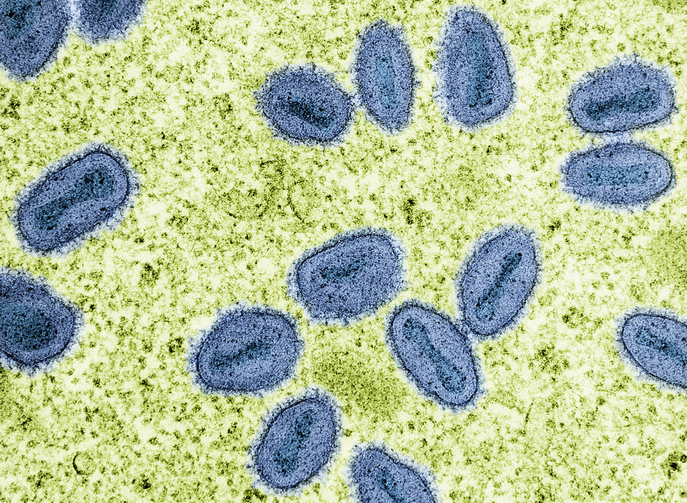




Mpox: situation update and IPC implications
Jon Otter PhD FRCPath
Director of Infection Prevention and Control & Consultant Clinical Scientist
Guy’s and St Thomas’ NHS Foundation Trust
Honorary Senior Lecture in HCAI & AMR, Imperial College London
@jonotter
j.otter@imperial.ac.uk

Slide 2
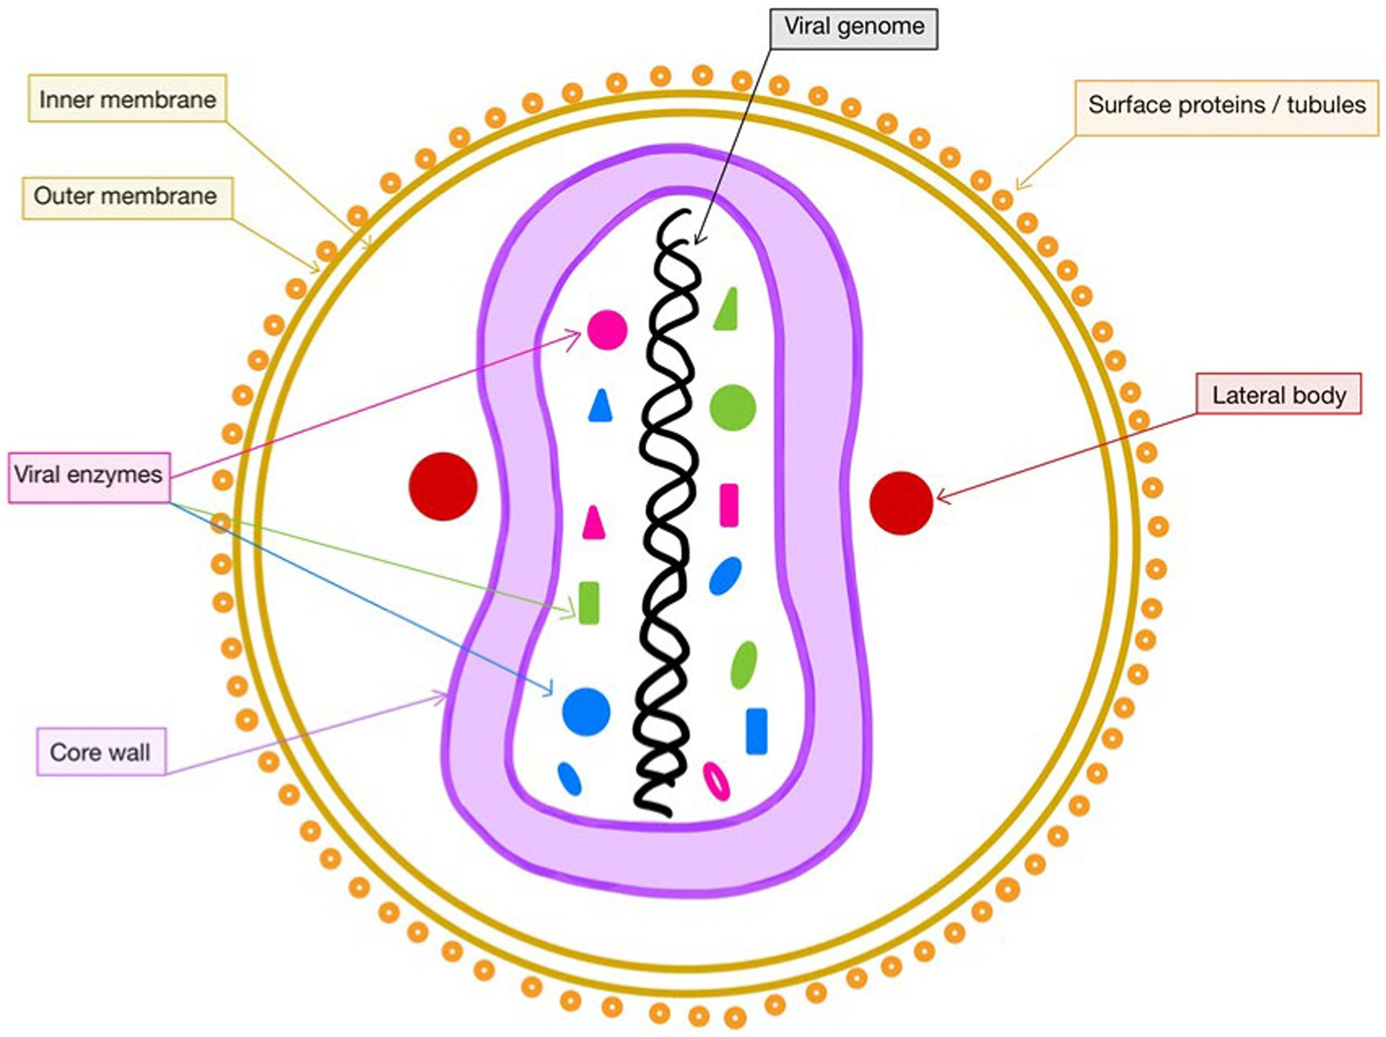
Microbiology / history
First reported in 1958 as a disease in monkeys.
First human infections reported in the 1970s in DRC.
Prior to 2022, most cases in humans reported from DRC and Nigeria.
MPXV is a type of enveloped Orthopoxvirus in the Poxviridae family (same genus as variola / smallpox).

Slide 3
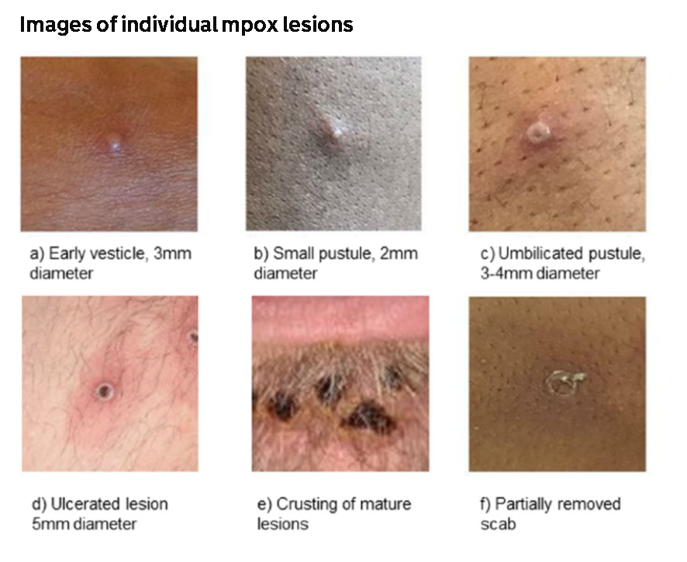
Clinical features of mpox
Incubation: 5-21 days
Usually self-limiting; most recover within weeks.
Severe illness can occur.
Symptoms
  Initially fever, headache, muscle aches, backache, swollen lymph nodes, chills, exhaustion, joint pain
  1-5 days after appearance of fever, characteristic rash; often starts on the face; blisters / vesicles, scabs or ulcers
  Contagious until all the scabs have fallen off and there is intact skin underneath
UKHSA

Slide 4
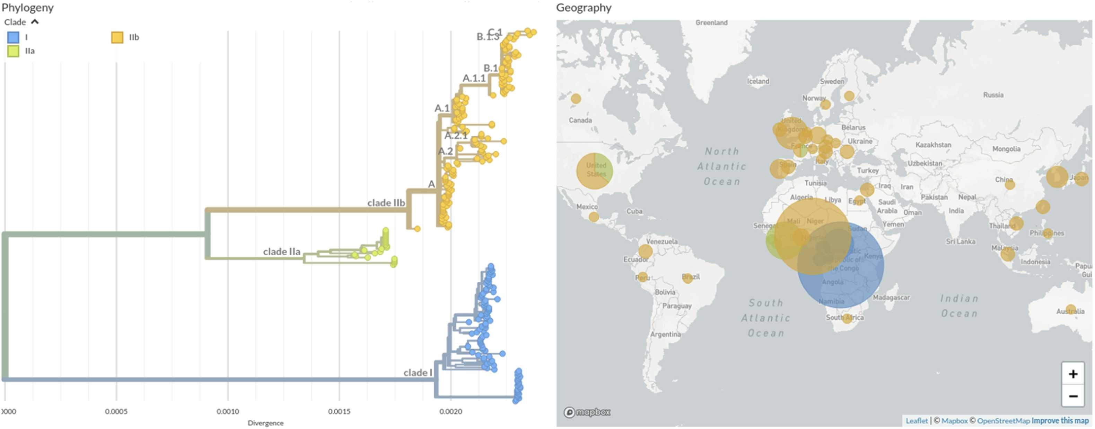
Clades
Duarte et al 2024. The Microbe

Slide 5
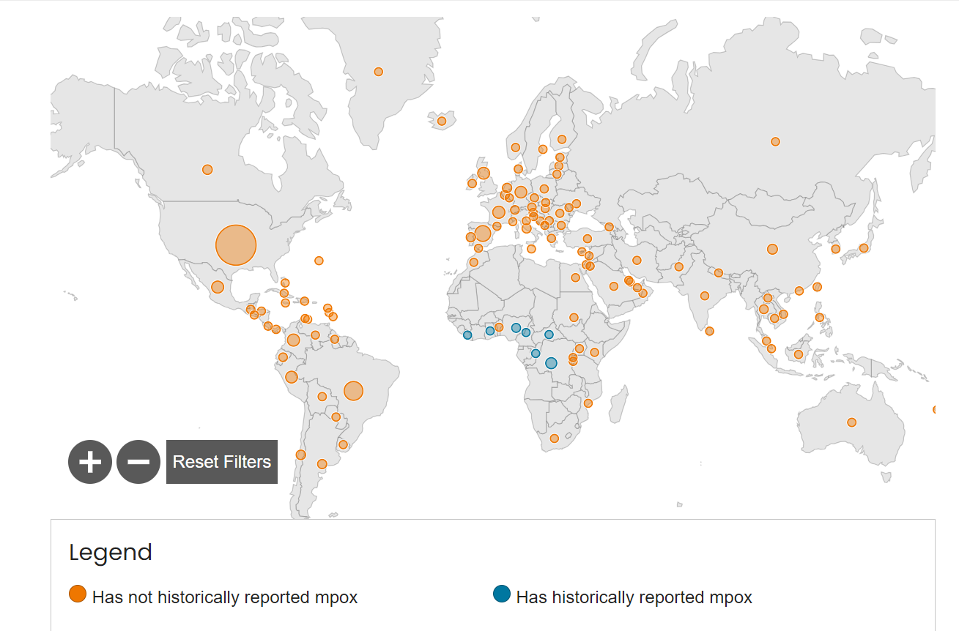
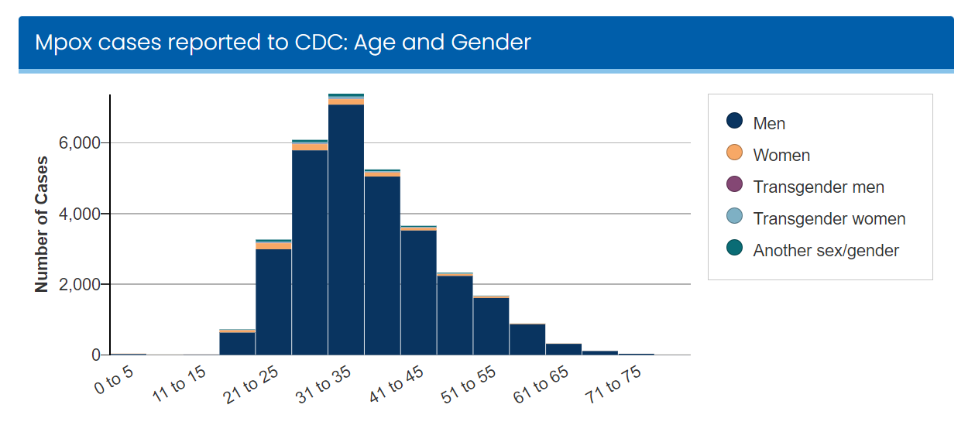
2022 outbreak of Clade IIb Mpx
~10,000 cases worldwide
Close association with gay, bisexual, and other MSM populations
CDC

Slide 6
Clade Ib outbreak
WHO declared a public health emergency of international concern because of the rapid spread of Clade I mpx in DRC and potential to spread further across countries in Africa and outside the continent
  Low numbers of confirmed Clade I cases historically
Jan – June 2024 – upswing in cases (1000 in 2022, 3000 in 2023) 15,000 cases with 500 deaths.
  Broader geographical area
  Equal split between men and women (contrast the Clade II outbreak!)
  Genomic diversity within the ‘outbreak’
  Frequent involvement of sex workers
Clade Ib mpx cases reported in Sweden and Thailand in August 2024, both of whom had travel links to affected African countries.
No Clade I cases in the UK, and UKHSA assess the overall risk to the public to be low.

Slide 7
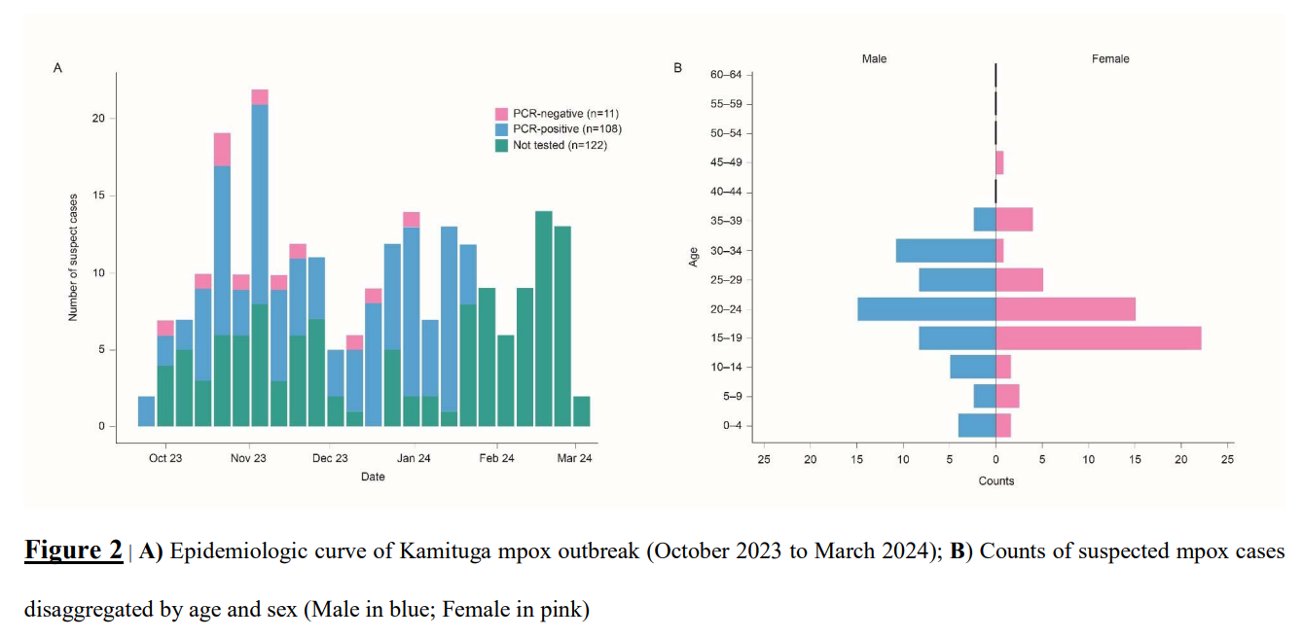
Clade Ib outbreak in DRC
Outbreak report for the first 241 suspected and 108 confirmed Clade Ib cases in DRC. 29% in sex workers.
Vakaniaki et al. Medrxiv 2024.

Slide 8
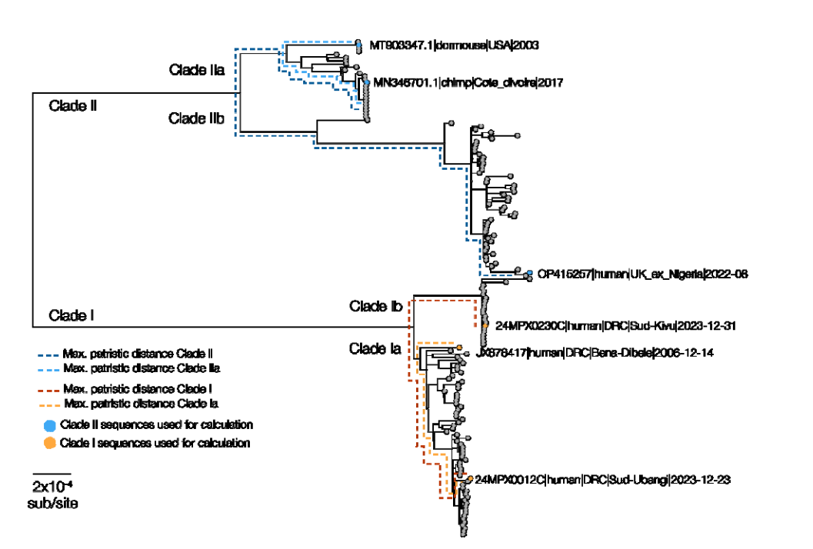
Clade Ib outbreak in DRC
Genomic diversity of mpx in DRC.
Vakaniaki et al. Medrxiv 2024.

Slide 9
Case fatality rate
Clade | Case Fatality Rate
Clade I (prior to 2022) | 10.6%
Clade II (prior to 2022) | 3.6%
Clade II (2022 outbreak) | <1%*
Clade I (2024 outbreak) | ~3%**
* Improved surveillance, treatment, vaccination, improved supportive care.
** Based on 15,000 cases and 500 deaths.
Bungle et al. Plos Neg Trop Med 2022.

Slide 10
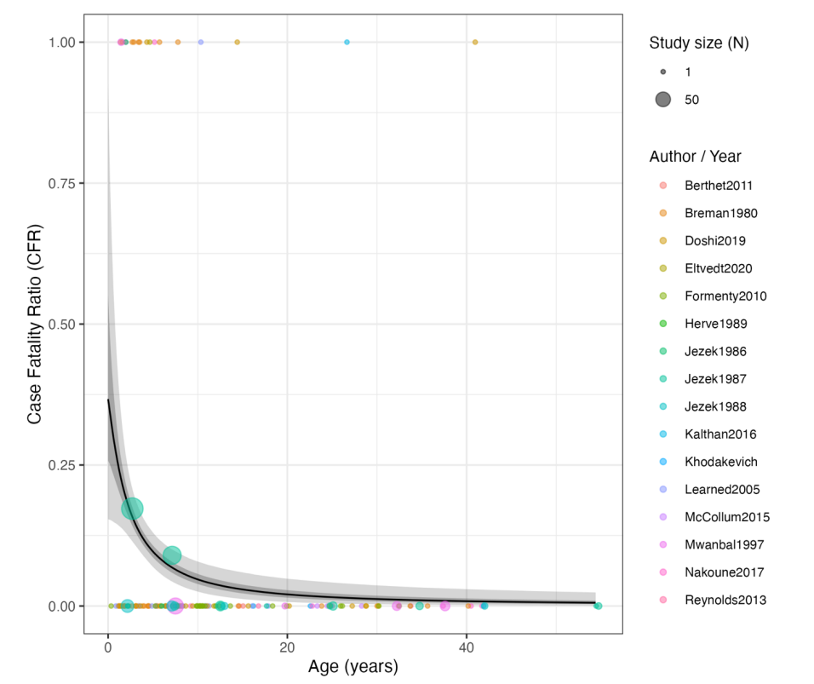
Age and CFR in Clade I mpx
Modelled the relationship between CFR and age based on historic mpx Clade I data.
Whittles et al. Medrxiv 2024.

Slide 11
Treatment
Mainly supportive.
Antiviral drugs such as cidofovir and tecovirimat can be used to treat mpox patients with severe disease or those who are at high risk of severe disease.
UKHSA

Slide 12
Vaccination
No specific mpox vaccine.
Smallpox vaccine can be used to support the control of outbreaks of mpox.
People vaccinated against smallpox in childhood may experience a milder disease.
Some healthcare workers, gay, bisexual and other MSM, some close contacts of a confirmed case eligible for vaccination
Mpox vaccines are being developed (using RNA tech)
UKHSA

Slide 13
Transmission routes
Contact with skin or mucous membranes or Through The Air
Mpox does not spread easily between people unless there is very close contact.
Person-to-person spread may occur through:
  direct contact with skin lesions or scabs (including during sexual contact, kissing, cuddling or other skin-to-skin contact)
  coughing or sneezing of someone who has mpox when they’re close to you
  contact with clothing or linens (such as bedding or towels) used by someone with mpox
Spread of mpox may also occur when a person comes into close contact with an infected animal
UKHSA

Slide 14
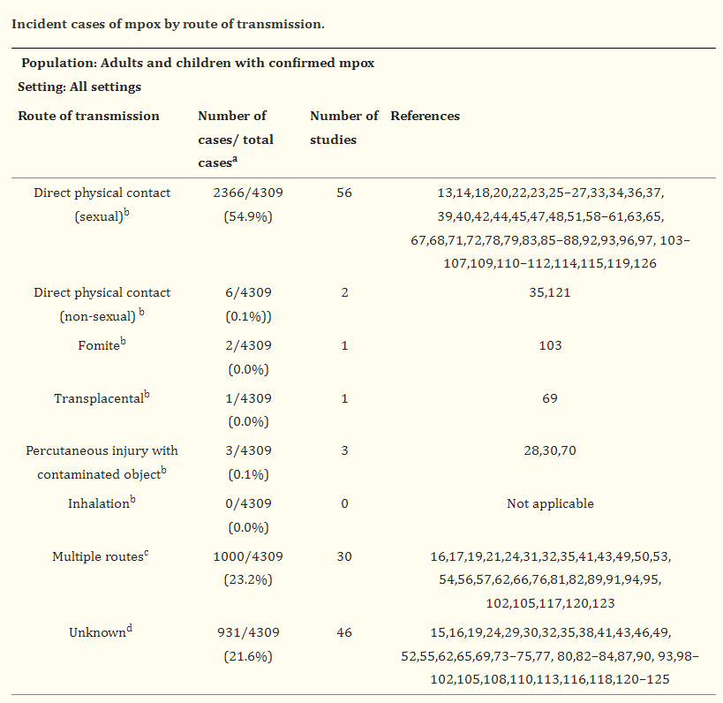
Transmission routes
Systematic review of studies of transmission routes of mpox.
Kuehn et al. Plos Glob Pub Health 2024.

Slide 15
Measuring ‘transmissibility’
R0 = a figure expressing the average number of cases of an infectious disease arising by transmission from a single infected individual, in a population that has not previously encountered the disease
Secondary attack rate (SAR) = the probability that an infection occurs among susceptible people within a specific group (ie, household or close contacts)

Slide 16
R0 of mpox
Clade | R0
Clade I | <1¹
Clade IIb (2022 onwards) | 2.5 (range 1.5-3.5)²
Measles | 1.4-770³
Chickenpox (VZV) | 1.2-16.9³
1. Beer & Bhargavi Rao. Plos Neg Trop Med 2019.
2. Branda et al. J Molec Virol 2023.
3. Leung et al. Nature Rev Microbiol 2021.

Slide 17
Secondary attack rate (SAR) of mpox
Clade | SAR
Combined | 0-10%¹
Measles | 52-85%²
Chickenpox (VZV) | 61-78%²
1. Alakunle et al. Frontiers Cell Infect Microbiol 2024.
2. Leung et al. Nature Rev Microbiol 2021.

Slide 18
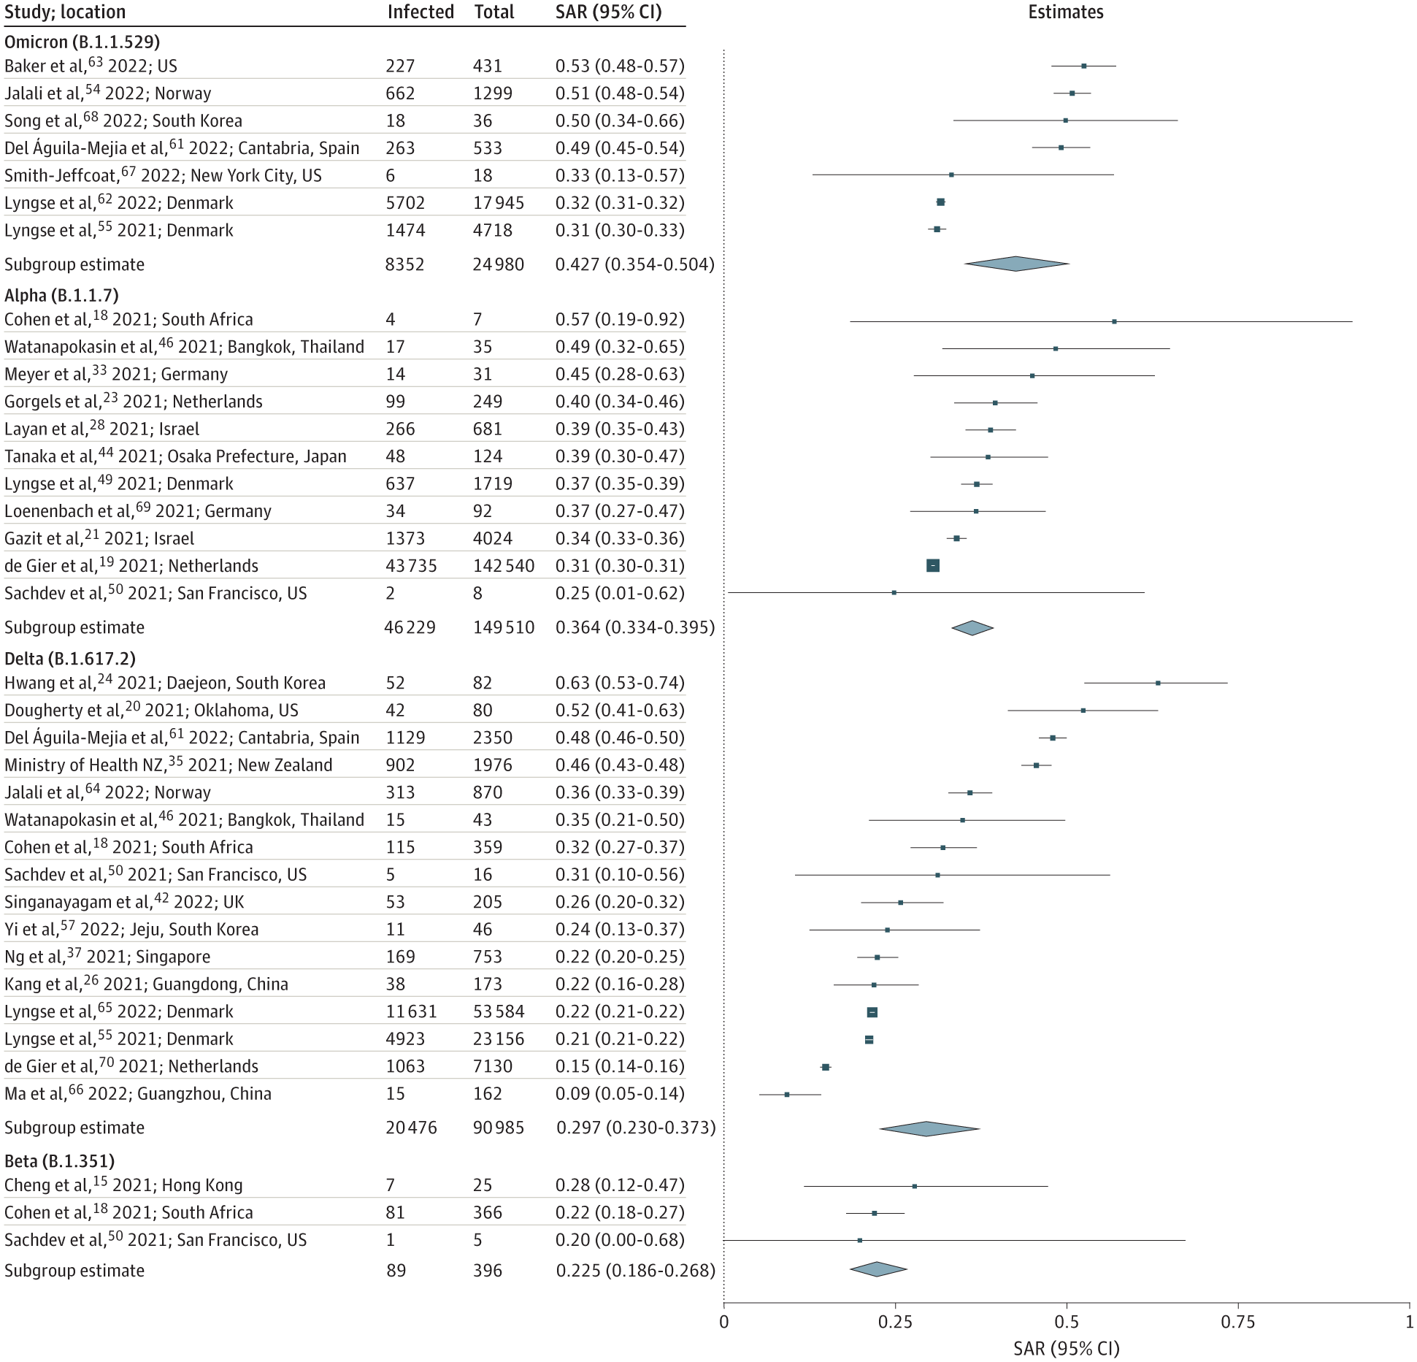
Secondary attack rate for SARS-CoV-2 (household)
Systematic review and meta-analysis.
SAR 42.7% for Omicron, 36.4% for Alpha, 29.7% for Delta, and 22.5% for Beta.
SAR lower when either index case or contacts were vaccinated.
Madewell et al. JAMA 2022.

Slide 19
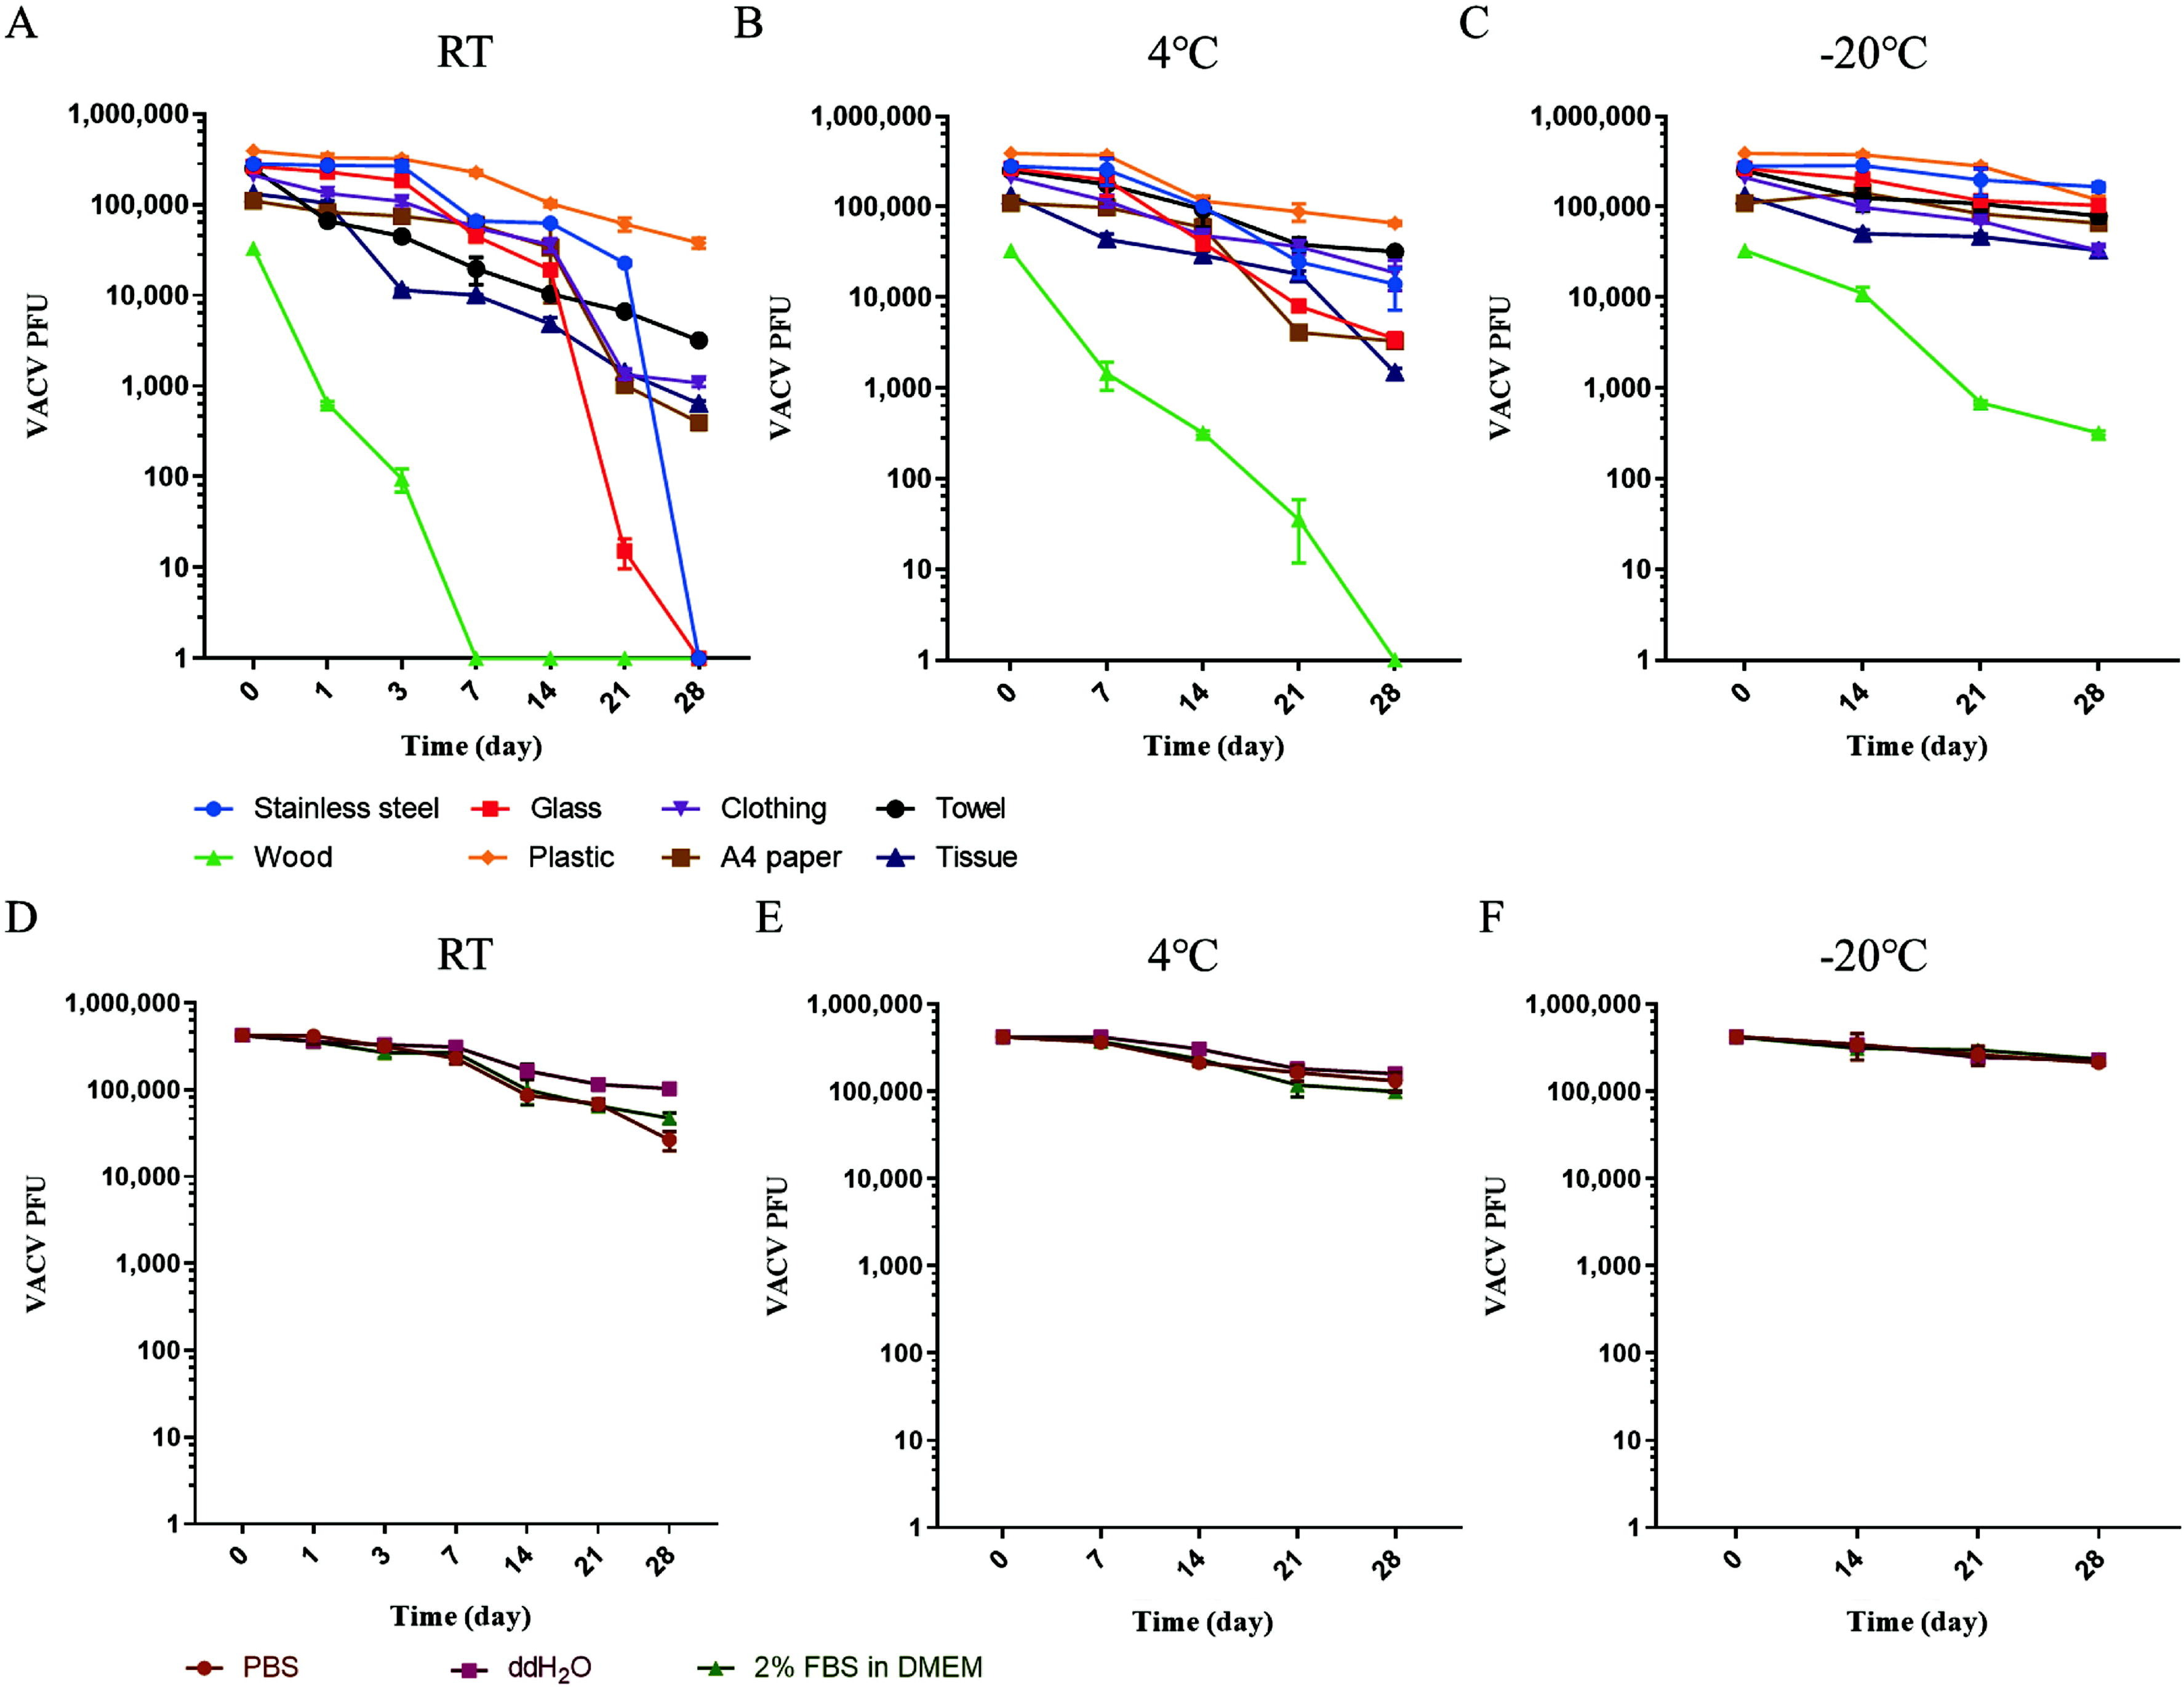
Surface survival – vaccinia virus
Persistence of vaccinia virus on surface of different materials or in different media at room temperature (RT), 4 °C and −20 °C.
Mei et al. Biosafety and Health 2024.

Slide 20
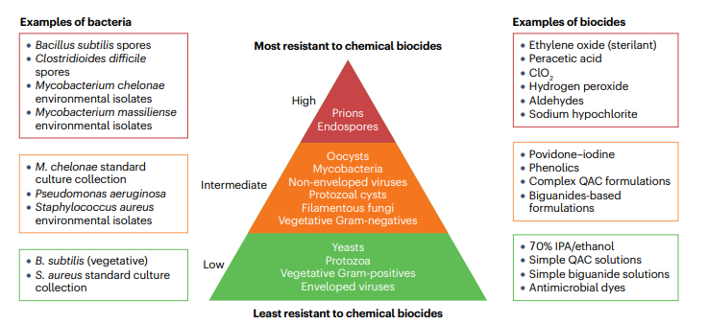
Relative resistance of microbes to biocides
Maillard & Pascoe. Nature Rev Microbiol 2024.

Slide 21
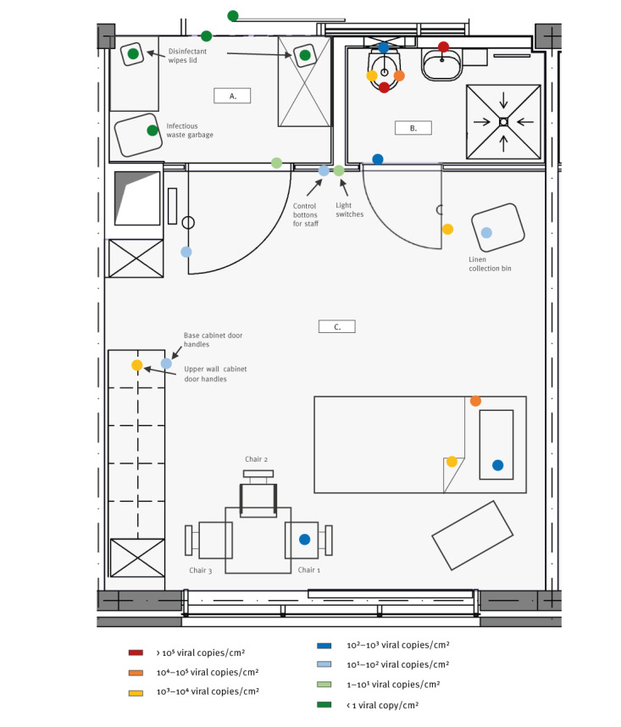
Environmental contamination
Environmental contamination of 2 hospital rooms occupied by patients with mpox.
MPXV DNA detected on 36 different surfaces.
MPXV cultured from 3 surfaces.
Outline map of the (A) anteroom (B) bathroom and (C) room of a hospitalised patient infected with monkeypox virus, with various sampled-surface locations and measured monkeypox virus contamination levels
Nörz et al. Eurosurveill 2022.

Slide 22
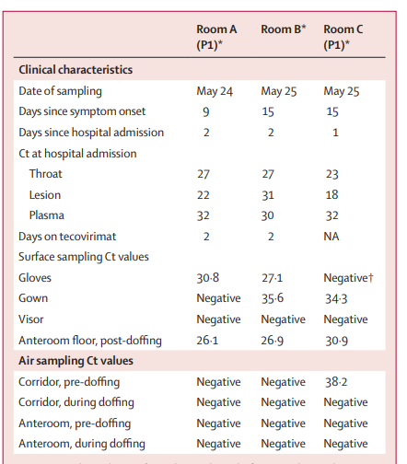
Environmental contamination
Surface samples from 5 patient rooms.
Samples of PPE in doffing areas of 3 rooms.
Air samples during bed changes in 5 patient rooms.
56 (93%) of 60 samples positive for MPXV DNA.
Virus cultured from 2/4 samples tested (including air samples)
Sampling of PPE and PPE doffing areas
Gould et al. Lancet Microbe 2022.

Slide 23
Testing
Viral swabs should be collected from vesicles by rubbing the swab over the lesion.
  Throat swabs should be taken if phrangeal lesions are present.
Throat swabs can be taken from patients who are contacts or probable cases with systemic symptoms but without a rash or lesions to sample.
  A negative throat swab doesn’t rule out mpx!
Lab testing via PCR, either locally or at UKHSA.
UKHSA

Slide 24
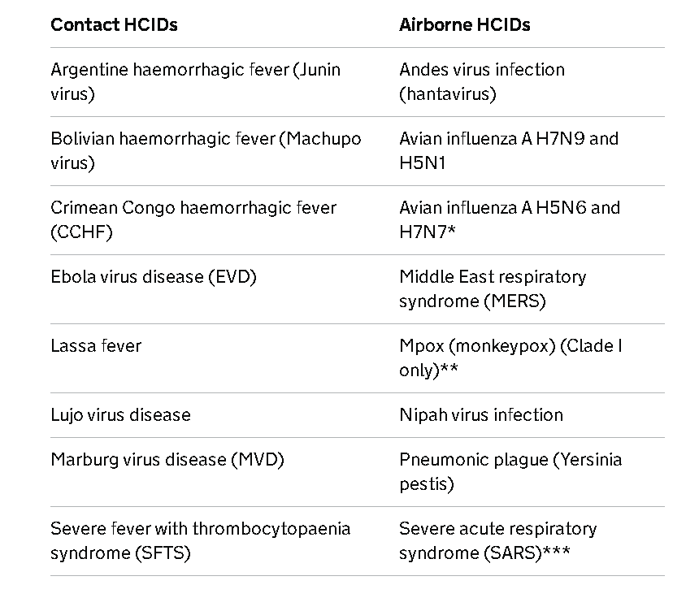
IPC precautions
Depends on the clade / origin of the case
HCID mpox = Clade I (or cases imported from Africa)
Non-HCID mpox = Clade II

Slide 25
Case definitions – HCID mpox (Clade I)
Patients with confirmed or clinically suspected mpox but clade not yet known should be managed as a HCID mpox case whilst further information is pending, if either (or both):
  there is a travel history to the Democratic Republic of the Congo (DRC) or specified countries where there may be a risk of Clade I exposure, or a link to a suspected case from those countries*, within 21 days of symptom onset
  there is an epidemiological link to a case of Clade I mpox within 21 days of symptom onset
* DRC, Republic of the Congo, Central African Republic, Burundi, Rwanda, Uganda, Kenya, Cameroon, Gabon, Angola, South Sudan, Tanzania, Zambia
UKHSA – operational mpox HCID definition

Slide 26
Case definitions – non-HCID mpox (Clade II)
Possible case | Probable case
A possible case is defined as anyone who fits one or more of the following criteria: a febrile prodrome† compatible with mpox infection, where there is known prior contact with a confirmed case in the 21 days before symptom onset an illness where the clinician has a suspicion of mpox, such as unexplained lesions, including but not limited to: genital, ano-genital or oral lesion(s) – for example, ulcers, nodules proctitis – for example anorectal pain, bleeding | A probable case is defined as anyone with an unexplained rash or lesion(s) on any part of their body (including genital/perianal, oral), or proctitis (for example anorectal pain, bleeding) and who: has an epidemiological link to a confirmed, probable or highly probable case of mpox in the 21 days before symptom onset or identifies as a gay, bisexual or other man who has sex with men (GBMSM) or has had one or more new sexual partners in the 21 days before symptom onset
†Febrile prodrome consists of fever ≥ 38°C, chills, headache, exhaustion, muscle aches (myalgia), joint pain (arthralgia), backache, and swollen lymph nodes (lymphadenopathy)
UKHSA – mpox case definitions

Slide 27
Core IPC precautions – all mpx clades
Hand hygiene using soap and water (if soiled) or alcohol-based hand hygiene products
Environmental hygiene
  Cleaning and disinfection required
  Since MPXV is an enveloped virus, the usual hospital disinfectants (e.g. quaternary ammonium compounds, chlorine, peracetic acid, hydrogen peroxide etc) will be effective
Contact tracing may (or may not) be required
Airborne isolation room (confirmed cases)
Waste: usual wastesteam for TBPs (i.e. Category B)

Slide 28
IPC precautions – non-HCID mpox (Clade II)
Transmission-based precautions (TBP) (see NICPM)
PPE (possible / probable):
  FRSM (upgrade to FFP3 respirator?)
  Gloves / apron
  Eye protection (if splash or droplet risk)
PPE (confirmed / highly probable):
  FFP3 respirator
  Gloves / gown
  Eye protection
Principles for control of non-HCID mpox in the UK: 4 nations consensus statement

Slide 29
IPC precautions – HCID mpox (Clade I)
HCID PPE for suspected and confirmed HCID mpox*
  filtering face piece 3 (FFP3) respirator
  hood
  longer-length visor
  long rear-fastening fluid-resistant surgical gown tied to the side
  medium thickness apron
  inner / middle / outer gloves
  wellington boots
* Judgement required based on case definition and presentation for suspected cases!
NICPM: HCID addendum

Slide 30
Mpox: situation update and IPC implications
Jon Otter PhD FRCPath
Director of Infection Prevention and Control & Consultant Clinical Scientist
Guy’s and St Thomas’ NHS Foundation Trust
Honorary Senior Lecture in HCAI & AMR, Imperial College London
@jonotter
j.otter@imperial.ac.uk

