Slide 1
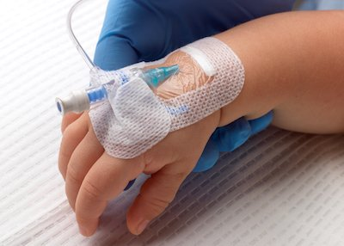




Vascular access and infection prevention: making peripheral lines a central focus
Jon Otter PhD FRCPath,
Director of Infection Prevention and Control & Consultant Clinical Scientist
Guy’s and St Thomas’ NHS Foundation Trust
Honorary Senior Lecture in HCAI & AMR, Imperial College London
@jonotter
jon.otter@gstt.nhs.uk

Slide 2
Importance of safe vascular access
Why focus on PVC?
Timed removal or clinical indication?
Hub disinfection
Preventing PVC complications

Slide 3
Glossary
PVC = peripheral venous catheter
CVC = central venous catheter
CR-BSI = catheter-related BSI
PVCR-BSI = PVC-related BSI (aka “PLABSI”)
CVCR-BSI = CVC-related BSI (aka “CLABSI”)

Slide 4
Importance of safe vascular access
Why focus on PVC?
Timed removal or clinical indication?
Hub disinfection
Preventing PVC complications

Slide 5
The importance of safe vascular access
Patient experience (e.g multiple attempts)
Treatment delays
Additional use of IR / theatres equipment and personnel
HCAI, especially line-related infections
Litigation / reputation damage
Sharps injuries for staff
Clinical complications

Slide 6
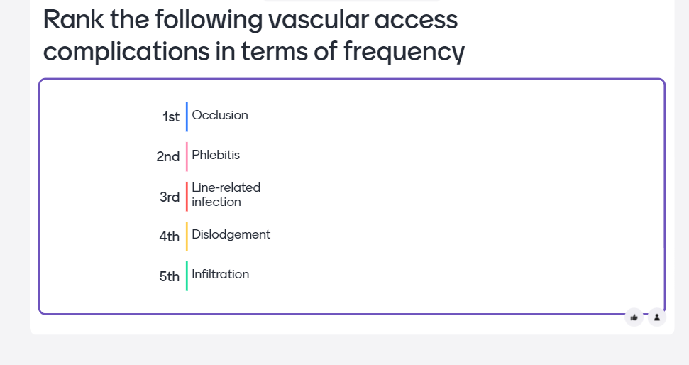

Slide 7
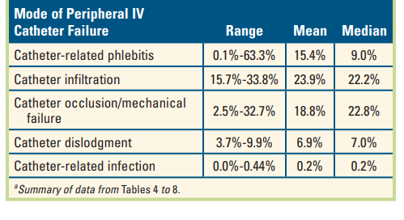
Clinical complications
Review and meta-analysis of PVC failures.
Helm et al. J Infusion Nursing 2015.

Slide 8
Importance of safe vascular access
Why focus on PVC?
Timed removal or clinical indication?
Hub disinfection
Preventing PVC complications

Slide 9
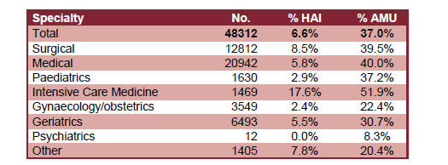
Prevalence of HCAI
The 2016 national PPS was a huge undertaking that included 48,312 patients from 88 NHS Trusts and 6 private hospitals.
7% of patients had an HCAI and 33% were on an antimicrobial.
Pneumonia was the most common HCAI (29%) followed by UTI (17%) then SSI (15); BSI (6.6%).
Prevalence of peripheral vascular cannula (43%), central venous catheters (7%), urinary catheters (20%), and intubation (2%).
37% of ICU BSI episodes were catheter-related. European CDC, 2017
HCAI and antimicrobial use by speciality.
ESPAUR Report 2017.

Slide 10
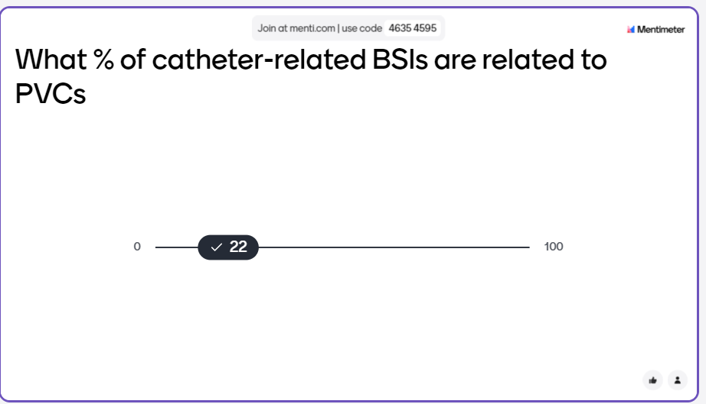

Slide 11
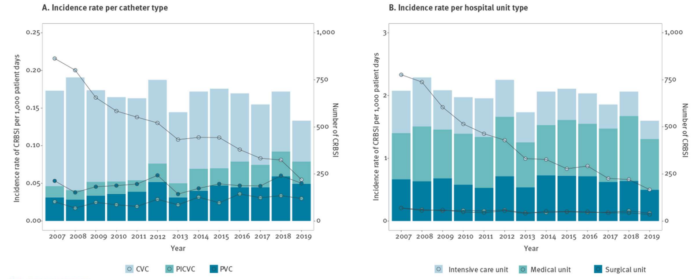
Relative proportion of CR-BSIs is changing
Trends in the epidemiology of CR-BSI in a Spanish hospital
Badia-Cebada et al. Eurosurveillance 2022.

Slide 12
Prevalence of PVCs and complication rates
Around 30-50% of inpatients will have a PIVC, and these typically account for 80-90% of vascular lines¹
It is estimated that around 70% of inpatients will require a PVC at some stage in their stay²
Prevalence of PVCR-BSI around 0.2% or 0.5/1000 catheter days¹
Around 46-59% of PVCs will fail³
Mermel L. Clin Infect Dis 2017.
Zingg & Pittet. Int J Antimicrob Agents. 2009.
Helm et al. J Infusion Nursing 2015.

Slide 13
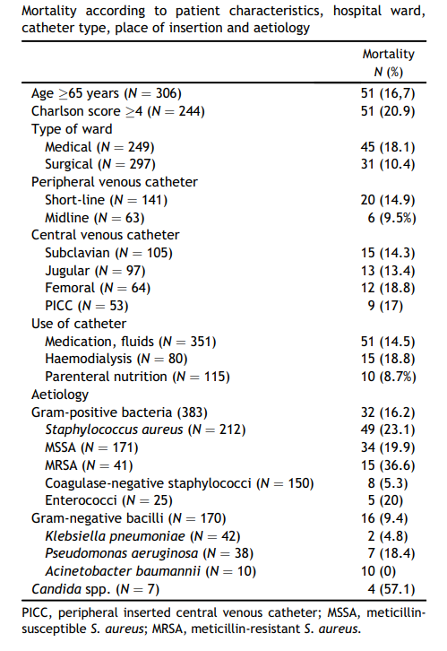
Mortality associated with PVCR-BSI
Mortality risk factors among non-ICU patients with nosocomial vascular catheter-related bloodstream infections: a prospective cohort study in Spain
PVCs accounted for 41% (n=204) of CR-BSIs
Independent risk factors for mortality were Charlston score, S. aureus, or Candida sp. BSI
38% of S. aureus CR-BSIs were associated with PVCs (Mermel et al. Clin Infect Dis 2017)
Saliba et al. J Hosp Infect 2018.

Slide 14
We use a lot of PVCs…
16.4m NHS admissions each year
70% will required a PVC
~50% will fail
That’s 5.7m failed PVCs each year
Each PVC costs £10¹ to insert = £57m per annum
Each PVC costs carbon impact = 7.4m kgCO2e
1. van Loon et al. J Vasc Access 2020.

Slide 15
Importance of safe vascular access
Why focus on PVC?
Timed removal or clinical indication?
Hub disinfection
Preventing PVC complications

Slide 16
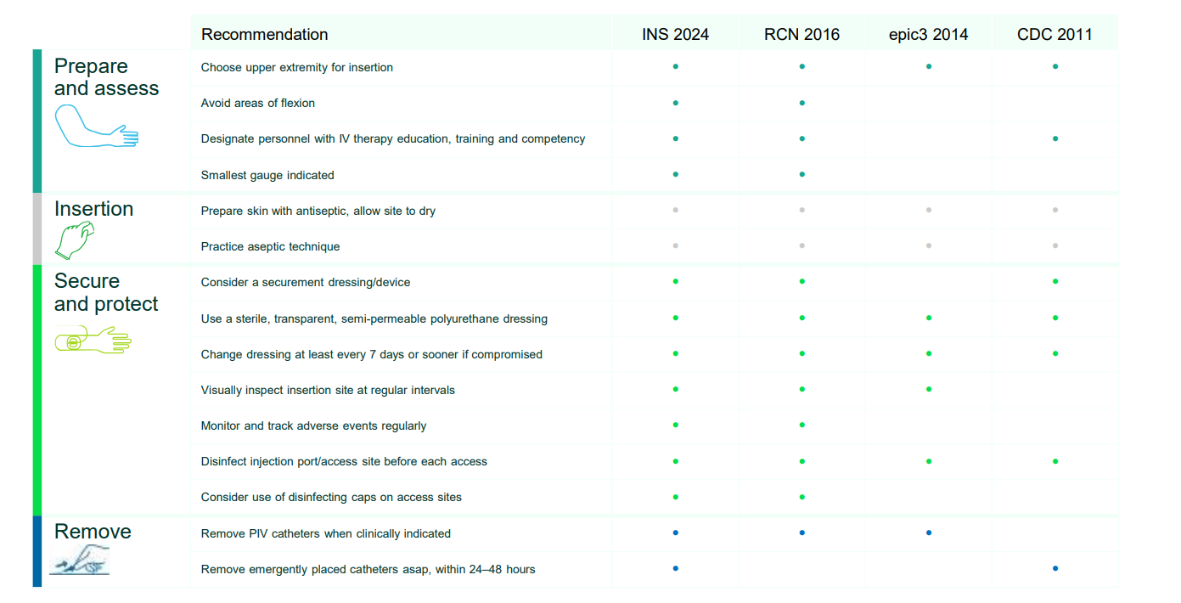
Preventing complications in PVCs
Courtesy of Solventum.

Slide 17
Strategic improvements
Put in fewer Take better care Remove sooner
Patient safety Save money Sustainability

Slide 18
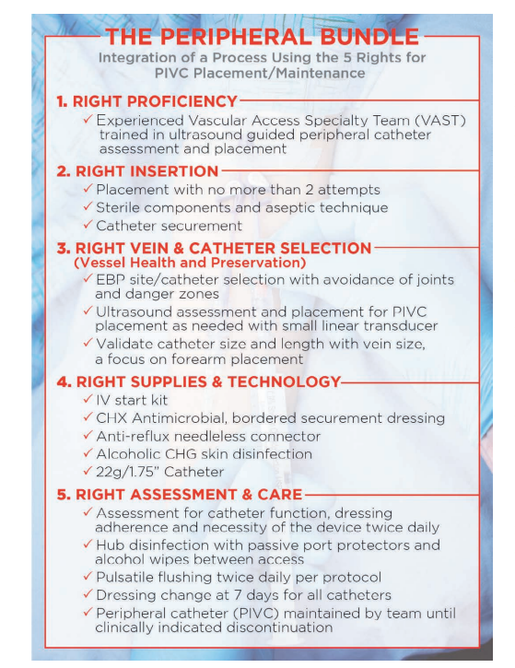
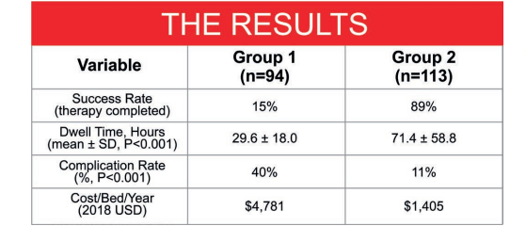
Strategic improvements: 1 PVC per patient
Bundled intervention evaluated as a cohort study to reduce the number of PVCs per patient on a medical unit in a US hospital; n=207 catheters in 114 patients across the 2 groups
Steere et al. J Assoc Vasc Access 2020.

Slide 19
Importance of safe vascular access
Why focus on PVC?
Timed removal or clinical indication?
Hub disinfection
Preventing PVC complications

Slide 20


Slide 21
Routine or clinically indicated replacement?
Systematic review and meta-analysis of randomised controlled trials.
9 RCTs, 10,973 patients.
  Routine replacement every 72-96 hours
Significantly higher in clinically indicated group:
  Phlebitis (RR, 1.20; 95% CI, 1.01–1.44)
  Occlusion (RR, 1.45; 95% CI, 1.08–1.95)
  Infiltration (RR, 1.27; 95% CI, 1.06–1.53)
Not significantly different between routine / clinically indicated groups:
  Local infection (RR, 1.75; 95% CI, 0.38–8.16)
  PVCR-BSI (RR, 0.61; 95% CI, 0.08–4.68)
Chen et al. Front Med 2022.

Slide 22
Routine or clinically indicated replacement?
Cochrane review of randomised controlled trials.
No clear difference in rates of CRBSI, thrombophlebitis, all‐cause BSI, mortality and pain.
We are uncertain if local infection is reduced or increased when catheters are changed when clinically indicated.
There is moderate‐certainty evidence that infiltration and catheter blockage is probably lower when PIVC are changed routinely; and moderate‐certainty evidence that clinically indicated removal probably reduces device‐related costs.
Webster et al. Cochrane Reviews 2019.

Slide 23
Importance of safe vascular access
Why focus on PVC?
Timed removal or clinical indication?
Hub disinfection
Preventing PVC complications

Slide 24


Slide 25
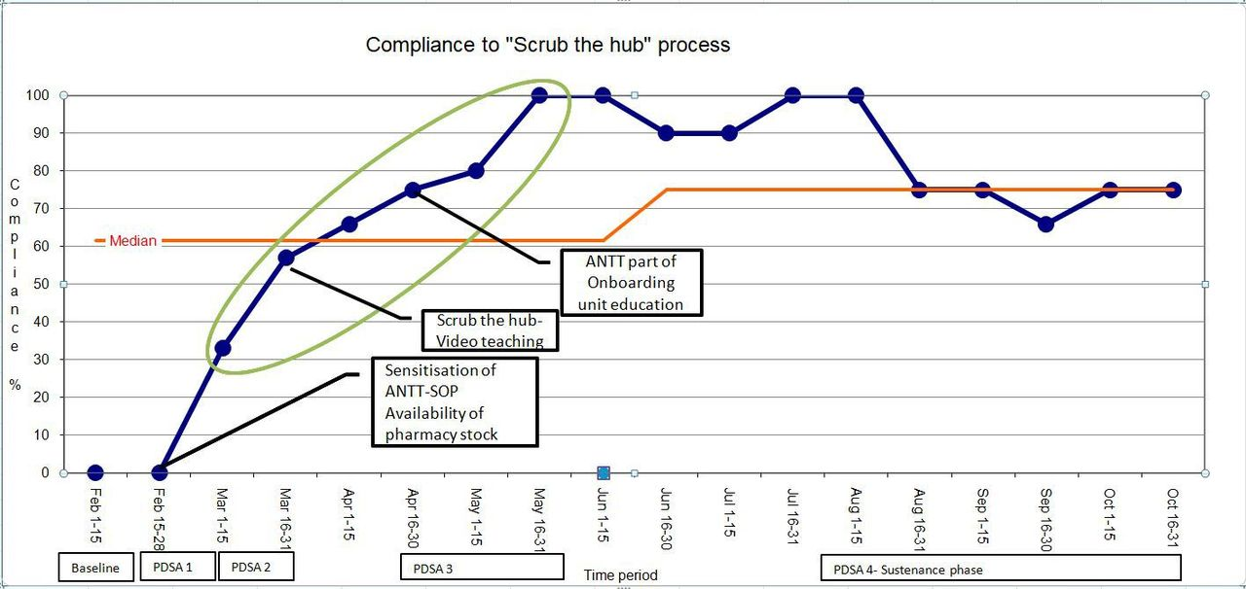
Are we scrubbing the hub?
Quality improvement project to improve vascular line maintenance in a NICU, India.
Shettigar et al. BMJ Open Quality 2021.

Slide 26
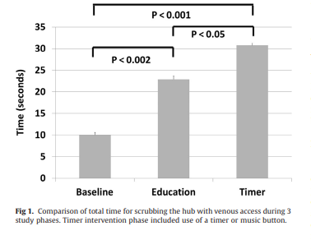
Are we scrubbing the hub for long enough?
An exploration of the role of human factors in active hub disinfection.
Caspari et al. Am J Infect Control 2017.

Slide 27
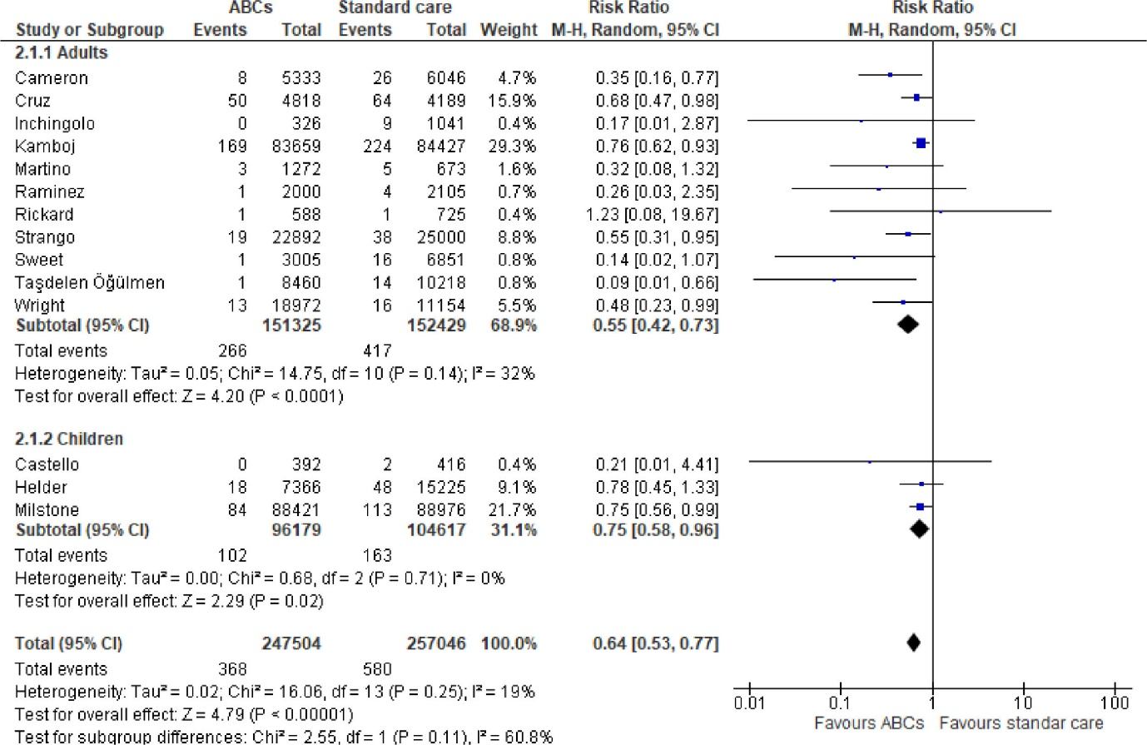
Active or passive disinfection?
Systematic review and meta-analysis of active disinfection vs. standard of care to prevent CVC-BSI.
Gillis et al. Am J Infect Control 2023.

Slide 28
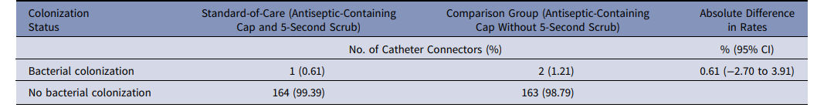
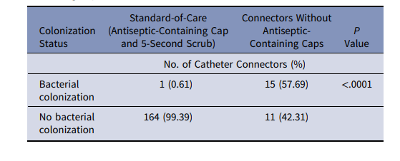

Do we need both passive and active disinfection?
Cohort microbiological study of passive or active disinfection of catheter connectors. 356 catheter connectors were cultured: 165 in the standard-of-care group (active + passive), 165 in disinfecting cap group (active only), and 26 controls without an antiseptic-containing cap (i.e. sampled before active disinfection)
Fillman et al. Infect Control Hosp Epidemiol 2024.

Slide 29
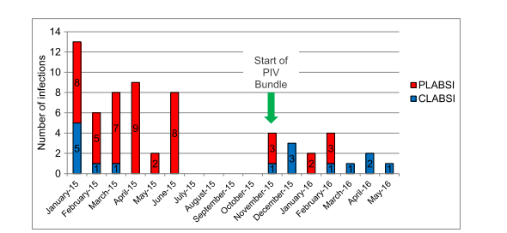
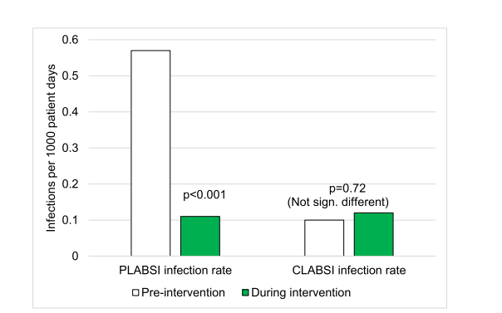
Preventing PVC-BSI
Evaluation of a hospital wide intervention bundle to prevent PVC-BSI in a US hospital.
The bundle included:
Assessment of PIV sites and removing IV catheters when there is an indication of phlebitis;
Assessing the dressing;
Alcohol-impregnated disinfecting caps on all needleless connectors;
Minimizing IV tubing disconnections;
Alcohol impregnated disinfecting tip protectors on all disconnected IV tubing
Duncan et al. J Assoc Vasc Access 2018.

Slide 30
Summary
Vascular access failures have enormous financial and non-financial impact and cost.
Much discussion and improvement effort is focussed on CVCs, but PVCs are important too!
PVCs account for ~22% of CR-BSIs, and around 70% of inpatients will require a PVC during an inpatient stay.
Reducing the number of PVCs we use, taking better care of them, and removing them sooner will improve patient safety, save money, and bring sustainability benefits.
Guidelines recommend clinically indicated (rather than routine) replacement of PVCs.

Slide 31
Vascular access and infection prevention: making peripheral lines a central focus
Jon Otter PhD FRCPath,
Director of Infection Prevention and Control & Consultant Clinical Scientist
Guy’s and St Thomas’ NHS Foundation Trust
Honorary Senior Lecture in HCAI & AMR, Imperial College London
@jonotter
jon.otter@gstt.nhs.uk

